Slide 1
Higher nervous activity, its typical features and research methods. Functional systems (P.K.Anokhin). Innate and acquired forms of behavior. The first and second signaling systems. Remember, sleep. Physiology of adaptation processes
PhD Onufryenko Oksana

Slide 2
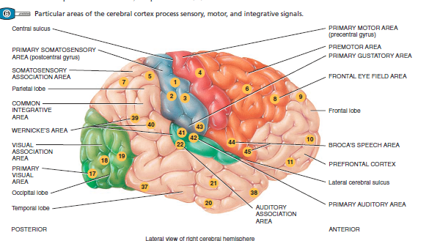

Slide 3
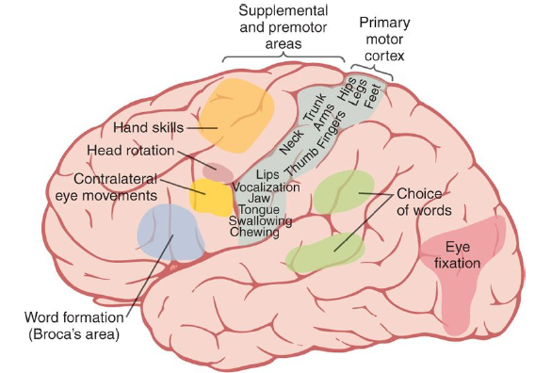

Slide 4
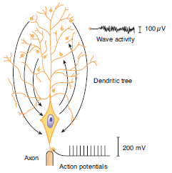
Diagrammatic comparison of the electrical responses of the axon and the dendrites of a large cortical

Slide 5
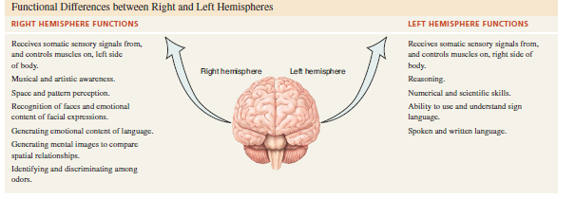

Slide 6
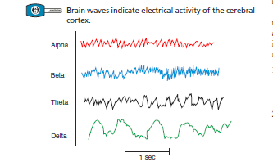
Types waves

Slide 7
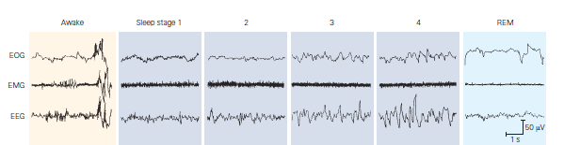

Slide 8
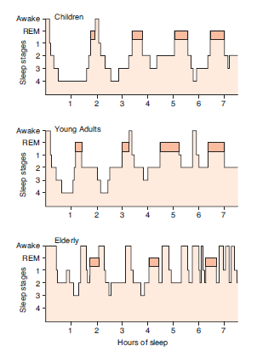

Slide 9
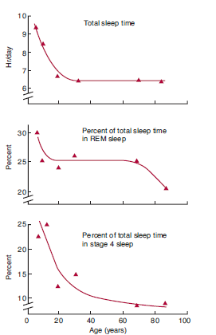

Slide 10
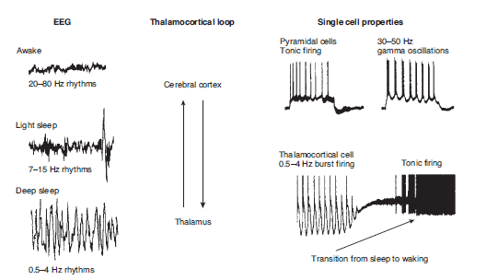

Slide 11
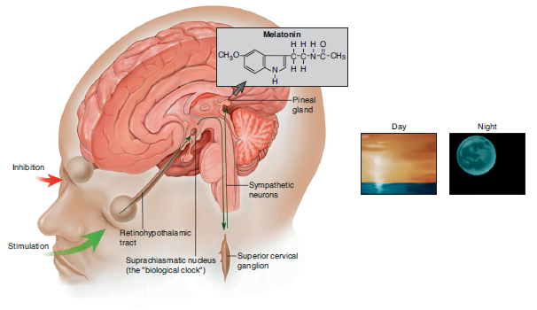

Slide 12
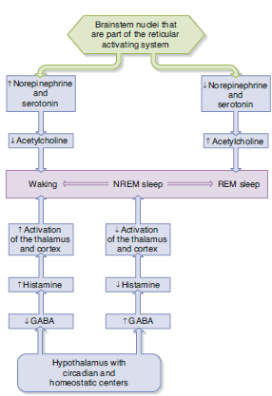
A model of how alternating activity of brain step and hypothalamic neurons may influence the differ states of consciousness

Slide 13
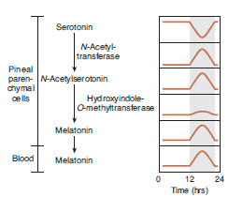
Diurnal rhythms of compound involved in melatonin synthesis in the pineal

Slide 14
Thank you for your attention!

