Slide 1
LECTURE
General principles and methods of tuberculosis treatment.

Slide 2
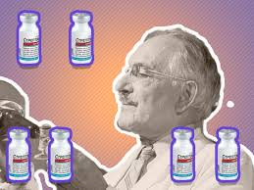
HISTORY
Streptomycin discovered in 1943 p. Schatz, Bougie, and Waxman of
1952 Waxman got the Nobel Prize
This is a "revolution" in medicine

Slide 3
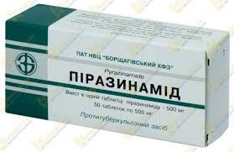
HISTORY
In subsequent years, all anti-mycobacterial drugs (AMBP) were discovered

Slide 4
GENERAL PRINCIPLES OF TREATMENT
1.complexity - to combined specific and nonspecific treatment, as well as surgical methods of treatment, this is etiotropic (antimycobacterial drugs) -AMT
non-specific treatment
Hygiene and dietary regimen support
To use of pathogenetic drugs that increase the effectiveness of AMT. Its purpose mobilization of the body's defense reactions and promotes the healing of cavities, stimulates regeneration processes, reduces fibrotic changes, and normalizes impaired body functions

Slide 5
GENERAL PRINCIPLES OF TREATMENT
Hygiene-dietary regimen - rational nutrition in years. In our times has lost its relevance, because appetite and tissue trophism are quickly will restor after AMBT (detoxification)
Pathogenetic drugs - affect the mechanism of pathogenesis
Symptomatic therapy - prescribed, for example, antipyretic drugs, stimulants of reparative processes and healing of cavities, expectorant drugs, psychotherapy, surgical treatment

Slide 6
GENERAL PRINCIPLES OF TREATMENT
combination - the use of at least 4 drugs.
Prevents MBT resistance.
Enhances the effect of AMP.
In addition, different drugs act on different structures of the mycobacterial cell.
The combination of etiotropic drugs improves reparative processes

Slide 7
GENERAL PRINCIPLES OF TREATMENT
4. Duration and continuity - about 6-8 months.
Obliteration of vessels, or their destruction, is observes in caseous-necrotic masses, cavities, where MBT are
Therefore, AMBT in sufficient concentrations does not reach the main site of the pathogen accumulation.
involution and reparations are a long process
5. Continuity of treatment reduces the risk of MBT resistance

Slide 8
GENERAL PRINCIPLES OF TREATMENT
Treatment regimen for chemosensitive tuberculosis
2HRZE (S) + 4HR
At the end of the course we do smear control
Phase I - at least 2 months, during this time the patient should receive at least 60 daily doses - if missed, treatment continues until all 60 doses are received
The whole set of daily doses of AMBP – course dose

Slide 9
PALLIATIVE TREATMENT IN TREATMENT FAILURE IN PATIENTS WITH MRTB
Palliative care consists of the following:
Pain relief and reduction of symptoms of the disease. Paracetamol or codeine with paracetamol relieves moderate pain, reduces cough
DN treatment - oxygen therapy
Nutrition: frequent, small portions
symptomatic treatment of nausea
Regular medical visits
Continuation of taking pathogenetic drugs
Hospitalization in a hospice or at home with proper organization of IC (infection control)

Slide 10
INDICATIONS FOR SURGICAL DIAGNOSTICS
1) dissemination of unknown etiology
2) rounded shadow to the lungs;
3) pleurisy of unknown etiology
4) hyperplasia of the intrathoracic lymph nodes of unknown etiology

Slide 11
Types of operations for TB of the respiratory organs, with the use of thoracotomy, videothoracoscopic surgery
1) resection of the lung of different volumes: wedge-shaped resection; segmentectomy; lobectomy and bilobectomy; combined resection (lobectomy combined with economical resection) pneumonectomy or pleuropneumonectomy; lung resection with correction of hemithorax volume;
2) extrapleural thoracoplasty;
3) extrapleural pneumolysis;
4) pleurectomy and decortication of the lungs;
5) operations on the bronchi: occlusion;
6) resection; bronchoplasty; stump processing;
7) thoracocentesis;
8) thoracostomy;
9) artificial pneumothorax and pneumoperitoneum

Slide 12
AMBD CLASSIFICATION
in 1975 on the basis of the totality of the properties of the International Anti-Tuberculosis Union, it was proposed to classify anti-tuberculosis drugs into three groups
Group A - the most effective drugs; isoniazid, rifampicin
Group B - drugs of average effectiveness: ethambutol, pyrazinamide, morfazinamide, streptomycin, prothionamide, ethionamide, cycloserine, kanamycin, florimycin, ofloxacin, capreomycin.
Group C - drugs of the slightest effectiveness: sodium PASK, thioacetazone.

Slide 13
AMBD CLASSIFICATION
row I - H-isoniazid
R - rifampicin
Z - pyrazinamide
E - ethambutol
S - strepnomycin
II row - fluoroquinolones, aminoglycosides, ethionamide, prothionamide, PASK
To write schemes, use an abbreviation formed from the initial names
The number is the duration

Slide 14
CHARACTERISTICS OF AMBD
Isoniazid (isonicotinic acid hydrazide). Synonyms: GINK, tubazid, rimiphone, nikazid, neoteben, etc. White crystalline powder, easily soluble in water. Release form: powder and tablets, 0.1 each; 0.2; 0.3 g, in ampoules - 10% solution of 5 ml.
Pharmacological features: isoniazid has a pronounced, strictly specific bactericidal effect on mycobacterium tuberculosis (MBT), it does not work on other microorganisms. Under the influence of isoniazid, the synthesis of endogenous catalase in the MBT decreases and hydrogen peroxide accumulates, which leads to the termination of the growth and reproduction of mycobacteria. It enhances phagocytosis in the focus of specific inflammation, which contributes to its resorption. After oral administration, it is rapidly and completely absorbed from the gastrointestinal tract and enters all organs and tissues, creating a high concentration in areas of inflammation of an exudative nature. In caseous encapsulated foci, into the wall of the cavity and its contents, it penetrates in small quantities. It is inactivated by acetylation in the liver and excreted by the kidneys after 2 - 4 hours, depending on the degree of inactivation. Strong inactivators are considered patients in whom the content of the active fraction of isoniazid in daily urine is 10% or less of the accepted test dose. At a level of more than 10%, patients are classified as weak inactivators.Under the influence of isoniazid, peripheral and coronary vessels expand, blood pressure decreases, the secretory function of the stomach increases, appetite improves, bile secretion and bile formation increase.
Dosage 5 - 10 mg per 1 kg of body weight

Slide 15
CHARACTERISTICS OF AMBD
Pyrazinamide (tizamide, Pi-coke, zinamide, etc.).
Release form: tablets of 0.5 g.
Pyrazinamide is a synthetic analogue of nicotinamide. Has a strong sterilizing effect on mycobacteria of the human species, especially on slowly multiplying and persistent in macrophages, creating acidosis zones around phagocytosed individuals. Where the drug easily penetratesIts maximum effect is established in acidic environments: in foci of caseosis, tuberculomas, caseous-pneumonic processes,.
It is taken orally after meals. The daily dose for adults is 1.5 - 2 g. Children are prescribed at the rate of 20 - 30 mg / kg per day, but not more than 1.5 g.
In the course of treatment, it is necessary to monitor the condition of patients with diabetes mellitus, because it increases blood glucose levels.

Slide 16
CHARACTERISTICS OF AMBD
Rifampicin (synonyms: rifadin, benemicin, rimactan, etc.)
Semisynthetic broad-spectrum antibiotic, rifamycin derivative. It inhibits the synthesis of ribonucleic acid by microorganisms. It has a bactericidal and strong sterilizing effect on mycobacterium tuberculosis in their intracellular and extracellular arrangement, as well as a pronounced bacteriostatic effect on persistent forms of MBT and certain types of atypical mycobacteria. When it is taken, peaks of bacteriostatic concentration are created within 2 - 4 hours in the blood serum and for a longer time in areas of lung tissue damage.
In patients who resume rifampicin after a long interruption in treatment, serious immunological disorders may occur, leading to impaired renal function, hemolysis or thrombocytopenia. In such rare cases, you must immediately stop taking rifampicin.
Rifampicin increases the level of liver enzymes, which may be associated with the need to increase the dosage of those drugs taken by the patient that are metabolized in the liver. These drugs include corticosteroids, steroid contraceptives, oral antidiabetic drugs, oral anticoagulants, cimetidine, cyclosporine, cardiac glycosides.

Slide 17
CHARACTERISTICS OF AMBD
Streptomycin.
In recent years, mainly streptomycin sulfate has been used (synonyms: ustrep, diplostrep, stricin, strizolin, etc.). Available in bottles of 0.25; 0.5 and 1.0 g.
Streptomycin is a broad-spectrum antibiotic. It is active against mycobacterium tuberculosis of the human and bovine species, the MBT of the bird species are less sensitive to it. The most active against rapidly multiplying MBT populations, has little effect on slowly multiplying and phagocytosed MBT. Its action is sharply weakened in an acidic environment (foci of caseosis), in the cavity it is rapidly inactivated by the products of tissue decay.
Streptomycin is administered intramuscularly to adults, 1 g per day, once, every other day or 2 times a week. With poor tolerance for patients over 60 years old and patients weighing less than 50 kg, the daily dose is 0.5 - 0.75 g. Streptomycin is not recommended for children.
Streptomycin is also used in aerosols, in the form of instillations into the pleural and abdominal cavities, cavity, bronchi, fistulas, etc.
It is strictly forbidden to simultaneously prescribe it with the same type of antibiotics (kanamycin, florimycin, monomycin, etc.).
Streptomycin is prescribed at the rate of 0.015 g / kg of body weight per day.

Slide 18
CHARACTERISTICS OF AMBD
Ethambutol - (synonyms: combutol, ambutol, tubetol, ethambin, etc.). Available in tablets of 0.1; 0.2; 0.4 g
It has only bacteriostatic activity on the MBT of the human and bovine species, to a lesser extent of the bird species. The predominant effect on the rapidly multiplying MBT populations, located both intracellularly and extracellularly. To him there is no cross-resistance of MBT, which are resistant to other anti-tuberculosis drugs. The activity of the drug is higher in an alkaline medium, lower in an acidic one.
Peak concentrations occur 2-4 hours after ingestion, accumulates in erythrocytes, where its depot is created.
Ethambutol is taken orally once after breakfast. The optimal daily dose for adults is 25 mg / kg in one dose. Children are prescribed at the rate of 15 mg / kg per day, but not more than 1 g.
With intermittent treatment (2-3 times a week), ethambutol is given to adults at 30 mg / kg per day once

Slide 19
SIDE EFFECTS AND CONTRAINDICATIONS OF AMBT
H - Adverse reactions are due to a violation of the metabolism of vitamin B6 and PP, which can provoke epileptiform seizures
R -Adverse reactions and complications: hyperthermia, rhinitis, flu-like syndrome, myalgia, arthralgia, abdominal pain, nausea, vomiting, loss of appetite, obstructive respiratory disorders, skin rashes, hematological disorders (thrombocytopenia, hemorrhage, anemia), anaphylactic reactions, hepatitis , staining of contact lenses.
In patients who resume rifampicin after a long interruption in treatment, serious immunological disorders may occur, leading to impaired renal function, hemolysis or thrombocytopenia. In such rare cases, you must immediately stop taking rifampicin.

Slide 20
SIDE EFFECTS AND CONTRAINDICATIONS OF AMBT
Z - Contraindications: increased individual sensitivity to the drug, liver disease with impaired function, gout. In the course of treatment, it is necessary to monitor the condition of patients with concomitant diabetes mellitus, because it increases blood glucose levels.
E-Contraindications: increased individual sensitivity, optic neuritis, impaired renal excretory function, pregnancy, preschool children.
Adverse reactions: retrobulbar neuritis with decreased visual acuity and narrowing of the visual field to red and green light, peripheral neuritis.

Slide 21
GROUPS OF DRUGS RECOMMENDED FOR USE IN INDIVIDUAL LONG-TERM SCHEMES OF CHEMI-RESISTANT TB
Group A Inclusion of all three drugs levofloxacin or Lfx, moxifloxacin Mfx bedaquiline Bdq linezolid Lzd
Group B Addition of one or both drugs clofazimine Cfz cycloserine or Cs terizidone Trd
Group C Add to complete the composition of the scheme and if it is impossible to use drugs of groups A and B ethambutol E delamanid Dlm pyrazinamide Z imipenem-cilastatin or Ipm-CIn meropenem Mpm amikacin Am (or streptomycin) (S) ethionamide or Eto protionamide Pto paraaminosalicylic acid PAS

Slide 22
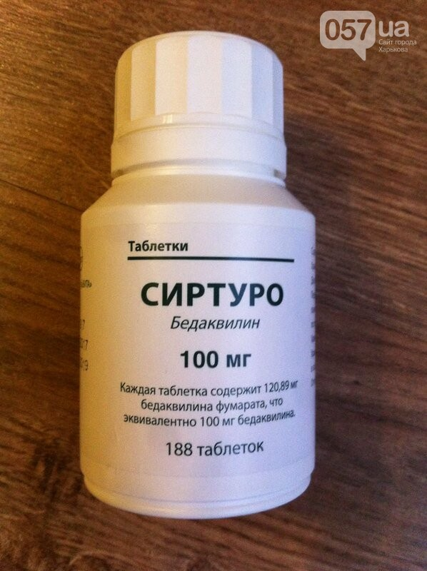
NEW DRUGS FOR TB TREATMENT
Its use should be regulated in accordance with current international guidelines. To organize a high-quality treatment process for tuberculosis patients using bedaquiline, a laboratory system for rapid diagnosis of anti-tuberculosis drug resistance determination, an appropriate system of active monitoring and drug safety management, the appointment of adequate treatment regimens, compliance with infection control measures, and a patient-centered approach will be established.
Bedaquiline - a drug synthesized exclusively for the treatment of tuberculosis, has a bactericidal and sterilizing effect, that is, it destroys active and inactive forms of mycobacterium tuberculosis. There are tablets that are prescribed for patients over 14 years old. It has cross-resistance with clofazimine, therefore it is used in patients who have previously taken clofazimine in ineffective treatment regimens.

Slide 23
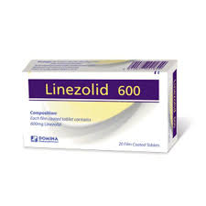
NEW DRUGS FOR TB TREATMENT
Basic physical and chemical properties: white or almost white, oval, with beveled edges, biconvex film-coated tablets, with a notch, with the inscription "H" on one side and the inscriptions "L" and "8", separated by a line, with the back of the tablet. Antibacterial agent for systemic use. ATX code J01X X08. Linezolid is active in vitro against aerobic gram-positive bacteria and anaerobic microorganisms. The distribution of MIC of linezolid for clinical isolates of wild-type Mycobacterium tuberculosis has been reported to be 0.125 to 0.5 mg / ml, with the recommended epidemiological cut-off point (ECOFF) of 0.5 mg / ml.
There are limited data on the efficacy and safety of linezolid in the treatment of multidrug-resistant tuberculosis (MR-TB).

