Slide 1
PREVENTION OF TUBERCULOSIS
Lecture for 5th year students medical faculty of ONMedU

Slide 2
Tuberculosis is an infectious disease.
In its origin, development, spread, all links of the epidemiological chain can be traced: the pathogen, the source of infection, the ways of its transmission and the susceptible organism. Modern tuberculosis prevention is based on all parts of the epidemiological process. Tuberculosis prevention is divided into:
- non-specific (social, sanitary, infection control), - specific (BCG vaccination),
- preventive chemotherapy (chemoprophylaxis).

Slide 3
An essential element of social prevention of tuberculosis is health education, which is aimed at mass promotion of knowledge about tuberculosis among the population:
-ways of spreading tuberculosis;
- the importance of following hygienic rules to prevent disease;
- the importance of preventive vaccinations;
- the importance of preventive examinations;
- causes that contribute to the development of tuberculosis.

Slide 4
Sanitary prevention
This is a preventive measure aimed at protecting healthy people from infection and tuberculosis.
The main goals: a) active detection of tuberculosis in the early stages at the level of primary care among persons with risk factors for tuberculosis by questionnaires and preventive tuberculin testing among children from 1 year and annual FG examination of adults (from 15 years); b) preventive measures aimed at the source of the disease and should prevent the spread of tuberculosis infection

Slide 5
Sanitary prevention measures should be carried out primarily in places where infection with Mycobacterium tuberculosis is most likely, ie in foci of tuberculosis infection.

Slide 6
Risk groups for tuberculosis
Risk groups by social factors: homeless, migrants, prisoners and persons released from cities of imprisonment, unemployed, low-income;
Risk groups by contact factors: family contacts, professional contacts, nosocomial contacts;
Risk groups by medical factors: HIV-infected and AIDS patients, diabetics, patients with occupational lung diseases, patients who have long taken and are taking corticosteroids and immunosuppressive drugs, alcoholics, drug addicts, patients with COPD.

Slide 7
Infectious control of tuberculosis is a system of organizational, anti-epidemic and preventive measures aimed at preventing and reducing the likelihood of transmission of Mycobacterium tuberculosis to healthy individuals.

Slide 8
The main factor in the transmission of tuberculosis infection is indoor air with an infectious aerosol.
The virulence of the Office in the aerosol persists for 6 hours.
The risk of tuberculosis infection depends on: the duration of contact with the patient who secretes the Office's virulence of the concentration of infectious aerosol in the air of the state of the body's defenses.

Slide 9
The basis of infection control is administrative measures that prevent air infection:
- differentiation of flows of infectious and non-infectious patients; - organization of rapid diagnosis of tuberculosis;
- immediate isolation and immediate treatment of the patient;
- reducing the time of contact with the source of infection;
- etiquette of cough and the use of surgical masks for the patient;
Administrative
measures
prevent air infection

Slide 10
Infection control is also aimed at reducing the concentration of infectious aerosol in the air and its disinfection, which is carried out by engineering control measures:
- natural and mechanical ventilation;
- use of ultraviolet lamps;
- natural insolation of premises.
reducing the concentration
of infectious aerosol in the
air and its disinfection
Engineering
control

Slide 11
Infection control includes individual protection of the respiratory organs from inhalation of contaminated air and the principles of personal hygiene during respiratory acts:
- the use of medical staff and other persons who communicate with patients with infectious forms of respiratory tuberculosis;
- patients with infectious forms of tuberculosis in contact with medical staff, family members and others are required to use surgical gauze disposable masks;
personal hygiene
during respiratory acts
individual protection
of the respiratory organs

Slide 12
Characteristics of tuberculosis infection place
The tuberculosis infection place is the location of the source of Mycobacterium tuberculosis together with the people around it. The spatial boundaries of the outbreak include the patient's home, place of work, education, upbringing, treatment, closed institutions, as well as teams and groups of people who communicate temporarily or permanently.

Slide 13
Persons (adults and children) who come into contact with a person or animal with tuberculosis are called "contact persons".
Contacts are divided into:
- family (family members of the patient); - apartment (persons living in a communal apartment or dormitory room);
-profecional(persons who work directly with people or animals with tuberculosis).
Persons who are in family contact or living with the patient in the same room (dormitory) are most at risk of contracting the Office.

Slide 14
The degree of epidemic danger of the outbreak is not the same and depends on:
- the massive excretion of Mycobacterium tuberculosis in patients
- the presence in the outbreak of children, adolescents, pregnant women and others with increased susceptibility to tuberculosis infection;
- housing conditions (which determine the possibility of isolation of the patient, close communication with contacts, their number, as well as the level of sanitary and communal improvement of housing);
- compliance with the anti-epidemic regime in the center of tuberculosis infection

Slide 15
The tuberculosis infection place of the first category - outbreaks with the greatest epidemic danger.
Category 1 includes an outbreak in which a patient with tuberculosis lives, with massive bacterial excretion. In this category of outbreaks there are all or the vast majority of adverse factors: children and adolescents, pregnant women, difficult living conditions, patients violated the anti-epidemic regime.
Such conditions are most common in dormitories, communal apartments, closed institutions, in which it is impossible to allocate a separate room for the patient.

Slide 16
tuberculosis infection place of the second category - outbreaks with relative epidemic danger.
These are the centers in which patients with tuberculosis of respiratory organs live, with insignificant allocation of mycobacteria of tuberculosis, in separate apartments without children and teenagers and where the patient adheres to a sanitary and hygienic mode.
These are relatively prosperous hearths.

Slide 17
tuberculosis infection place of the third category - outbreaks with potential epidemic danger.
These are place where there are patients with tuberculosis, as a result of whose treatment the allocation of the Office (formal) has stopped, who live without children and adolescents and have no aggravating factors.

Slide 18
Anti-epidemic measures in tuberculosis outbreaks
- hospitalization and treatment of the patient or isolation of the bacterium within the outbreak if it is impossible to hospitalize him;
- order and organization of final disinfection;
- the organization of current disinfection, training of the patient and contact persons in a technique of its carrying out;
- examination of contact persons (X-ray examination, tuberculin test - Mantoux reaction with 2 TO PPD-L, bacterioscopic examination, general clinical tests).
- Chemoprophylaxis of tuberculosis is carried out at the first established contact.

Slide 19
Organization and implementation of disinfection measures in tuberculosis foci
In the prevention of tuberculosis, disinfection measures aimed at breaking the mechanism of transmission of the pathogen play an important role.
Current and final disinfection is carried out in tuberculosis foci. The task of disinfection is to destroy the pathogen of tuberculosis in the environment.

Slide 20
The main methods of disinfection during the final disinfection are:
- use of high temperature on the spot (boiling of linen, dressings, utensils, toys, care items, cleaning material and incineration of garbage and low-value items);
- use of chamber disinfection (bed linen, outer and wearable clothes of the patient, blankets, carpets, paths, bedding, books, etc.);
- use of chemical disinfectants (for disinfection of sputum, linen, utensils, premises, household items and furniture).
Current disinfection is carried out from the moment of detection of a bactericidal agent and systematically during all period of treatment.

Slide 21
Chemoprophylaxis
Chemoprophylaxis of tuberculosis is carried out at the first established contact. Children, adolescents and adults in contact with a TB patient, regardless of the presence of bacterial excretion, are subject to initial examination and, subsequently (if they are healthy), supervision with periodic examinations and a course of preventive chemotherapy - one of the most active TB drug
Isoniazid is prescribed at a dose of 5 mg per kg of body weight for 6 months.
Chemoprophylaxis is not prescribed for contact with MRI sites.

Slide 22
Annual screening fluorographic examination is performed among the adult population (from 15 years) among persons with:
- high risk groups;
- mandatory contingents of the population (students, military, public transport workers, prisoners, etc. Also categories of the population whose work requires a sanitary book)

Slide 23
TUBERCULIN DIAGNOSIS - A METHOD OF EARLY DETECTION OF TUBERCULOSIS IN CHILDREN AND ADOLESCENTS
Mantoux tuberculin test in children and adolescents is used for:
- early detection of initial and local forms of tuberculosis in children and adolescents;
- to study the infection of the population (children and adolescents);
- before vaccination of children aged 2 months and older who have not been vaccinated in the maternity hospital.

Slide 24
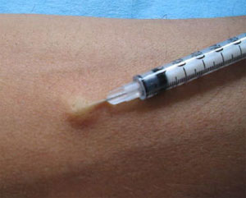
TUBERCULIN DIAGNOSIS - A METHOD OF EARLY DETECTION OF TUBERCULOSIS IN CHILDREN AND ADOLESCENTS
Mantoux tuberculin test in children and adolescents is used for:
- early detection of initial and local forms of tuberculosis in children and adolescents;
- to study the infection of the population (children and adolescents);
- before vaccination of children aged 2 months and older who have not been vaccinated in the maternity hospital.

Slide 25
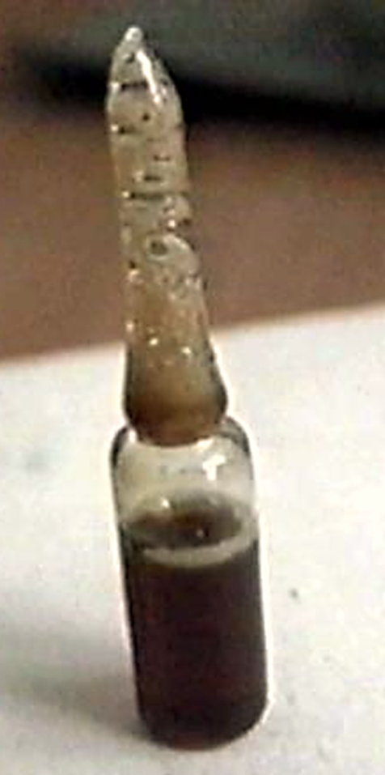
Tuberculin diagnosis is based on the determination of the body's allergy to tuberculin, which is the hapten of
Mycobacterium tuberculosis.
For the first time, tuberculin was isolated from the products of mycobacterial tuberculosis R. Koch in 1890 Tuberculin - a liquid allergen, is a solution of tuberculin in 0.85% sodium chloride solution, with phosphate buffer, with tween-80 as a stabilizer and phenol as a preservative.

Slide 26
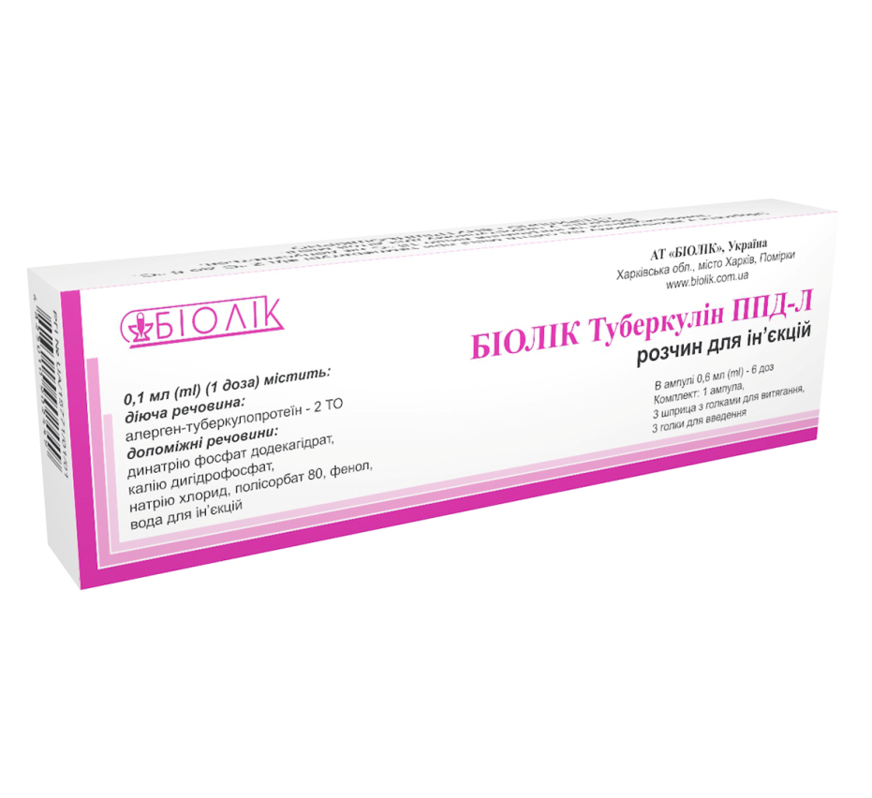
For routine tuberculin testing
as a single tuberculin test is used
Mantoux test 2 TO standard purified tuberculin
PPD-L, ready to use.
The drug is available in ampoules with a solution of 3 ml,
in 0.1 ml which contains 2 TO, and has the form of a colorless transparent liquid.

Slide 27
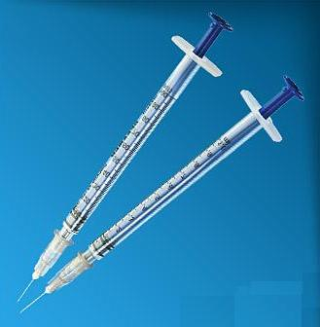
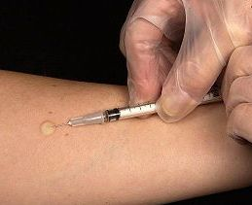
Mantoux test technique Only single-use disposable syringes are used for the Mantoux test. The ampoule with the drug, before opening, wipe with gauze soaked in 70 ° ethyl alcohol. Gain 0.2 ml (two doses), release the solution to the mark of 0.1 ml. The ampoule after opening is stored in aseptic conditions for no more than 2 hours. On the inner surface of the middle third of the forearm, the skin area is treated with 70 ° ethyl alcohol. A thin needle cut upwards is injected intradermally. With proper technique, a papule 7-8 mm in diameter is formed in the skin.

Slide 28
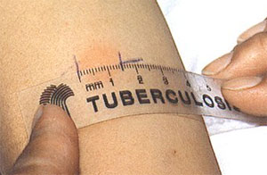
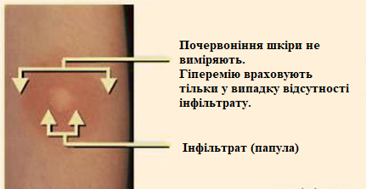
The Mantoux test is performed on the prescription of a doctor (pediatrician, family doctor, therapist) by a specially appointed nurse who has a document - admission to tuberculin testing.
The test results are evaluated
after 72 hours by measuring
the infiltrate
in millimeters,
and in its absence - redness.

Slide 29
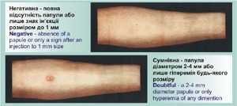
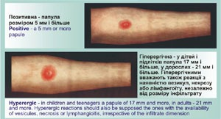
According to the results of the Mantoux test with 2 TO distinguish:
- negative reaction - no infiltrate (redness),
or the presence of a prick reaction (1 mm);
- doubtful reaction - infiltrate (papule) size 2-4 mm
or only hyperemia of any size without infiltration;
- positive reaction - infiltrate of 5 mm or more;
- hyperergic reaction - infiltration in children and adolescents
size of 17 mm and more, as well as if available
vesicular-necrotic reaction or lymphangitis,
regardless of the size of the infiltrate.

Slide 30
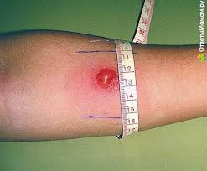
The initial period of tuberculosis infection is defined as a "turn" of tuberculin reactions and qualifies as the first positive tuberculin reaction in a virtually healthy child (without symptoms of intoxication and local changes).

Slide 31
Children with a "convertion" ("twist") of the tuberculin test or to address the etiology of allergies (post-vaccination or infectious) are referred to a TB doctor with documentation stating the date of BCG vaccination, dates and results of all previous tuberculin tests, test results (general blood test, review radiography).
Children and adolescents with a "twist" of tuberculin reactions must be examined and monitored at a TB clinic, because the appearance of sensitivity to tuberculin may be the first signs of tuberculosis.

Slide 32
Contraindications to tuberculin testing:
- skin diseases in the period of exacerbation;
- acute and chronic infectious diseases in the period of exacerbation, including convalescence (at least 1 month after the disappearance of all clinical symptoms);
- allergic respiratory or skin diseases in acute and subacute stages;
- rheumatism in acute and subacute stages;
- exacerbation of other chronic somatic diseases;
- quarantine due to children's infections in children's groups

Slide 33
SPECIFIC PREVENTION
The purpose of TB vaccination is to create a vaccine immune system. Currently, TB vaccination is used in most countries (more than 120) as a recognized method of active specific prevention of tuberculosis with BCG vaccine.

Slide 34
BCG vaccine is a preparation of live weakly virulent M. bovis BCG vaccine strain, lyophilized in 1.5% sodium glutamate solution. One ampoule contains 20 doses of BCG vaccine of 0.05 mg.
BCG vaccine is a prlyophilized in 1.5% sodium glutamate solution. One ampoule contains 20 doses of BCG vaccine of 0.05 mg.eparation of live weakly virulent M. bovis BCG vaccine strain,

Slide 35
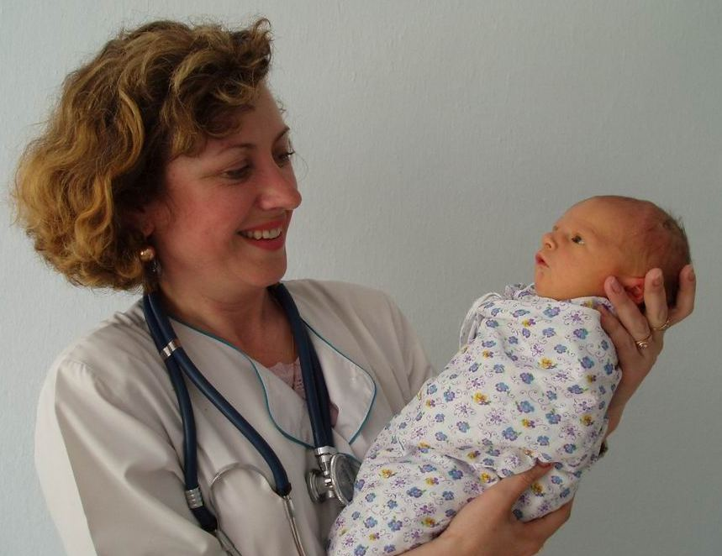
The BCG vaccine is administered intradermally in a volume of 0.1 ml. Primary BCG vaccination is carried out with healthy full-term
newborns weighing at least 2500 g
for 3-5 days of life.
Vaccination of infants is carried out in the morning directly in the ward after examination of children by a pediatrician.
Vaccination should be carried out by specially trained medical staff of treatment and prevention facilities.

Slide 36
.
Contraindications to vaccination
-absolute:
-generalized BCG infection, BCG-ostitis, found in other children in the family.
-relative:
- premature babies weighing less than 2500 g;
- intrauterine infection;
- purulent-septic diseases;
- hemolytic disease of infants
- birth injuries with neurological symptoms;
- generalized skin lesions;
- acute diseases;
- HIV-infected mother.

Slide 37
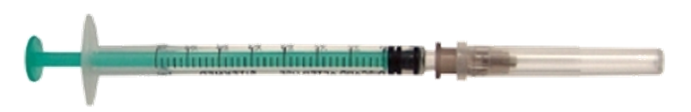
Disposable syringes with a volume of 1 ml with thin needles with a short cut are used for vaccination.
The dry vaccine is diluted with 2 ml of isotonic sodium chloride solution added to the vaccine. Diluted vaccine gives a uniform suspension for 1 minute, and then has the form of a clear liquid
without inclusions, sediment. It must be protected from sunlight and daylight and used immediately after breeding. The maximum shelf life of the diluted vaccine is 2 hours, with strict adherence to sterility and protection from sunlight and daylight. Unused vaccine is destroyed by boiling or immersion in a disinfectant solution.

Slide 38
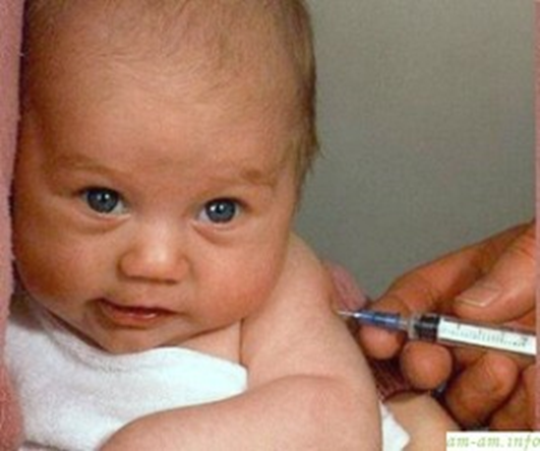
For one vaccination, 0.2 ml (2 doses) of diluted vaccine is drawn into a syringe, then a portion of the vaccine is released through a needle to expel air and bring the volume of vaccine to the desired 0.1 ml.
The vaccine must be mixed before each set.
The BCG vaccine is administered strictly intradermally at the border of the upper and middle third of the outer surface of the left shoulder.

Slide 39
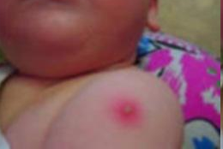
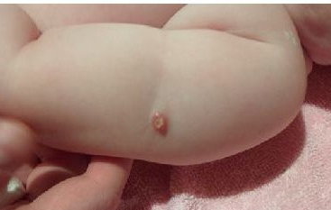
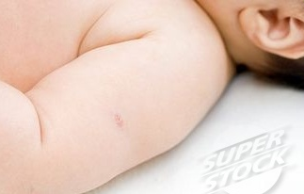
As a rule, at the site of intradermal administration of BCG vaccine develops a specific reaction in the form of an infiltrate, 5-10 mm in diameter with a small nodule in the center. Later pustulation is often noted. Then in most cases in the center of an infiltrate there is a small necrosis with insignificant serous allocations. After 2-4 months, a crust is formed at the injection site, and then a scar from 2 to 8 mm.
.
post-vaccination infiltrate
.
post-vaccination necrosis
with ulcer
.
post-vaccination scar

Slide 40
Complications Complications after BCG vaccination are usually local and relatively rare (in 0.02% of cases).
Complications are:
- subcutaneous cold abscesses;
- ulcers of 10 mm or more in diameter at the site of intradermal administration of BCG vaccine;
- lymphadenitis of regional lymph nodes (axillary, cervical, supra- and subclavian) with an increase in the node to 1.5 mm or more in the phase of infiltration, abscessing and calcification;
- keloid scars with a size of 10 mm or more in diameter at the injection site;
- generalized BCG infection.

Slide 41

Post-vaccination regional lymph node lymphadenitis usually occurs in primary vaccinated children. Appear 2-3 months after vaccination in the presence of a normal local reaction, in some cases may be combined with a cold subcutaneous abscess. For pstvactional lymphadenitis is characterized by asymptomatic onset, enlargement of regional lymph nodes. Clinical manifestations of post-vaccination lymphadenitis depend on the phase of the process (infiltration, abscessing or calcification). After self-emptying of lymphadenitis, healing occurs. If self-healing does not occur - is treated with isoniazid for 3-6 months.
Echogram
of the lymphatic
nodes

