Slide 1
ODESA NATIONAL MEDICAL UNIVERSITY
Microbiology, virology and immunology
Stomatological faculty
Lecture 2
The importance of medical microbiology for the practical activity of the doctor. History of microbiology. Morphology and structure of microorganisms. Evolution and classification of microorganisms. Genetics of bacteria and viruses.
Odesa

Slide 2
Bacterial physiology studies physical, chemical and biological processes in bacterial cell, and also physical, chemical and biological changes, caused by bacteria in environment.
Vital activity of bacteria is provided by cell structures such as cytoplasm, membranes, nuclear apparatus, organelles and appropriate chemical composition.
Chemical composition of bacteria:
water (75 - 85 % in vegetative cells, 40 - 50 % in spores), may be present in bacterial cells as independent substance (free water вода), or in joint condition with cellular components (fixed water);
dry rest contains mineral substances (2 - 14 %), organic part, on 50 - 75 % consisting from proteins, on 10 - 30% from nucleic acids (DNA and RNA), on 12 - 28 % from carbohydrates, including polysaccharides, on 10 - 40 % - from lipids.
Organogenesis: С, Н, О, N, P, S, К, Са, Mg, Fe; Microelements: Mn, Mo, Zn, Сu, Со, Ni, Va, В, Сl, Na, Se, Si, Wo

Slide 3
Classification of bacteria according type of nutrition
AUTOTROPHES
use as single source of carbon СО₂.
HETEROTROPHES
use carbon, which is present in complex organic compounds.
Pathogenic bacteria - paratrophes and metatrophes
For vital activity of bacteria (their growth and multiplication) are necessary appropriate nutrient substances in form easy for assimilation, also water, vitamins, growth factors, mineral compounds,microelements.
In diagnostic cultivation of bacteria we divide them on:
METATROPHES (SAPROPHYTES) Require relatively simple organic compounds and use dead nutrient material | PARATROPHES (PARASITES) use complex compounds, frequently present only in alive organisms.
NON EXACTING Grow on simple, universal nutrient media | EXACTING Grow on special nutrient media

Slide 4

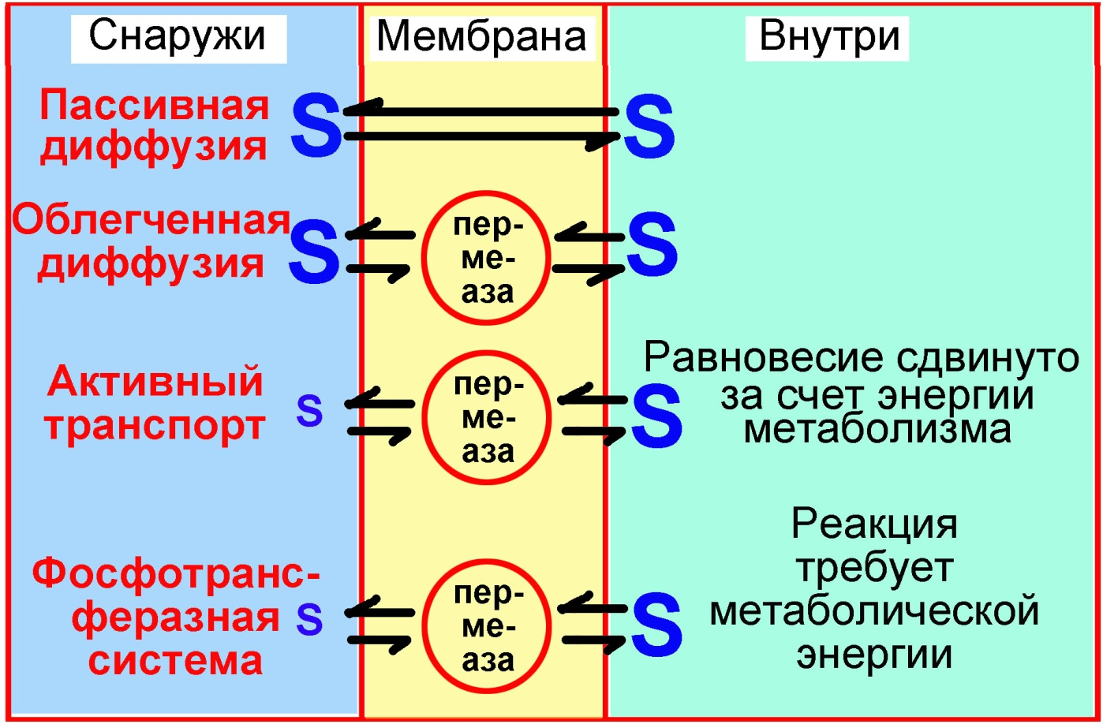
BACTERIAL TRANSPORT SYSTEMS
OUTSIDE
MEMBRANE
INSIDE
PASSIVE DIFFUSION
Permease
FACILITATED DIFFUSION
Permease
Balance moved due to metabolic energy
ACTIVE TRANSPORT
PHOSPHO
TRANSFERASE
SYSTEM
Permease
Reaction requires metabolic energy

Slide 5
CULTIVATION OF BACTERIA
FOR CULTIVATION OF EACH SPECIES OF BACTERIA APPROPRIATE CONDITIONS ARE NECESSARY:
NUTRIENT MEDIUM. REQUIREMENTS: presence of needed nutrient compounds in forms, easy for assimilation, certain рН (in majority of cases - 7,2 - 7,6), necessary consistency (liquid, semi-solid, solid media), sterility, if possible - transparency, convenient packing, efficiency.
TYPE OF AERATION depending on type of respiration.
TEMPERATURE created in thermostat. Majority of pathogenic bacteria - mesophilic (37°С).
ABSENCE OF HARMFULL INFLUENCES.

Slide 6
CLASSIFICATION OF NUTRIENT MEDIA
Types | Purpose | Examples
Simple (basic) | For cultivation of non- exacting bacteria | Meat-peptone broth, meat-peptone agar
Special | For cultivation of exacting bacteria | Glucose broth, serum broth, blood agar, Kitt-Tarozzi
Differential | For differentiation of microorganisms according to biochemical qualities | Endo, Levin, Hiss, Mac Conkey’s media
Selective | For the primary accumulation of certain microorganisms when the growth of the rest is suppressed | Basic peptonic water, media of Loeffler, Rue, Ploskyrev, Mueller
Transport | For preservation of viability of microorganisms at the time of transporting to the laboratory | Glycerin mixture

Slide 7
BACTERIAL ENZYMES
OXYREDUCTASES – catalyze reduction-oxydation reaction.
TRANSFERING ENZYMES – catalyze transferring of different groups from donor to acceptor.
HYDROLYSES – catalyze bond rupture in substrates with attachment of molecules of water.
LYASES - catalyze bond rupture in substrates without attachment of molecules of water or oxidation.
ISOMERASES – catalyze transformation in the range of one molecule (intermolecular rearrangement).
LYGASES (SYNTETASES) – catalyze attachment of 2 molecules with use of phosphate bonds energy.
ENDOENZYMES. EXOENZYMES
CONSTITUTIVE ENZYMES. INDUCIBLE

Slide 8
CLASSIFICATION OF BACTERIA ACCORDING SUBSTRATE SPECIFICITY
PROTEOLYTIC,
GLYCOLYTIC,
LIPOLYTIC,
NUCLEASES,
OXIDO-REDUCTASES
ENZYMATIC ACTIVITY OF BACTERIA
can be studied by inoculation on differential nutrient media.

Slide 9
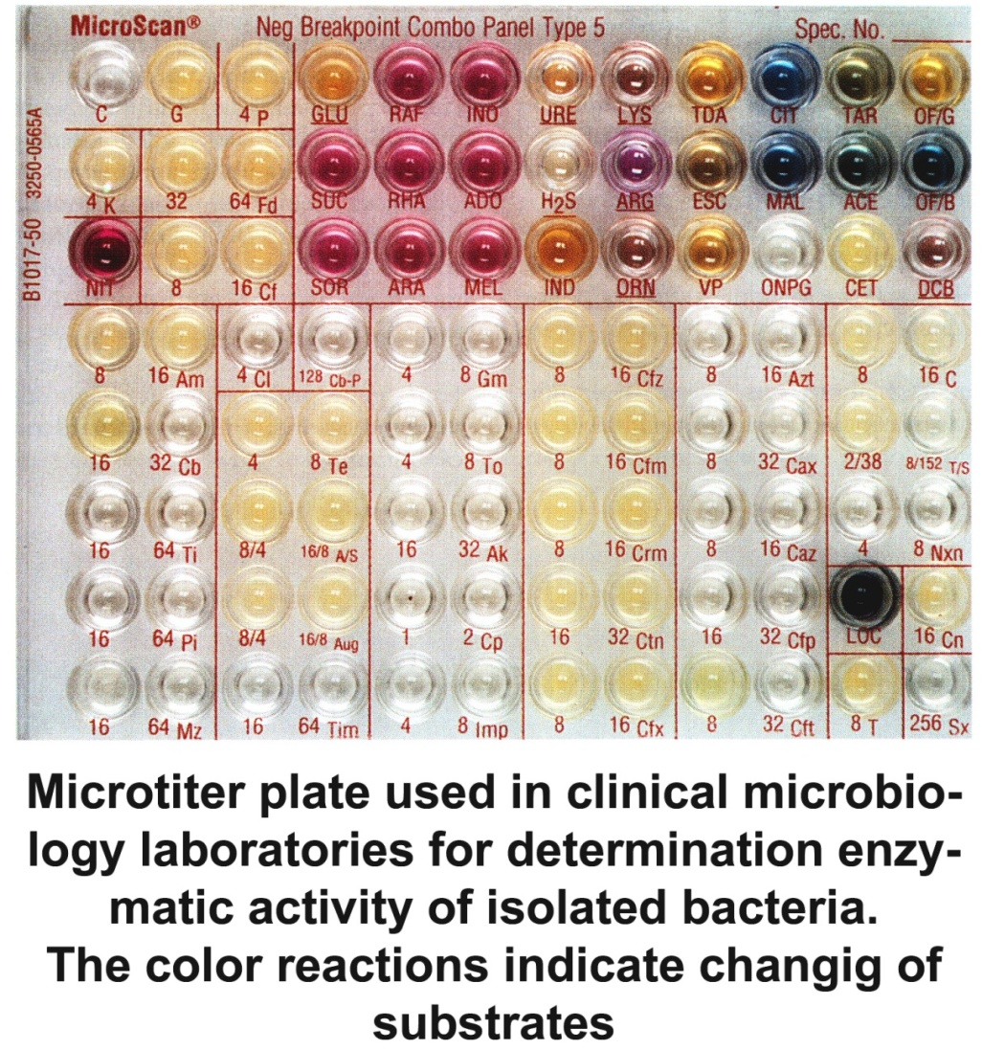
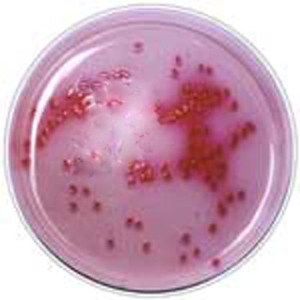
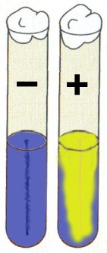
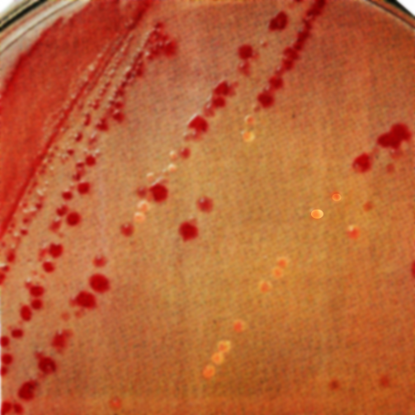
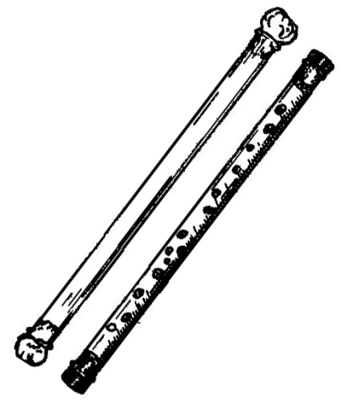
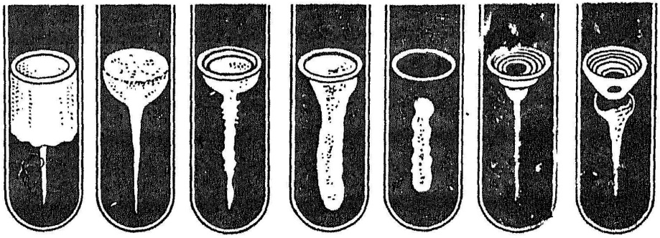
Study of biochemical properties of bacteria.
Principle content of differential media :
Nutrient base
Substrate
Indicator
Сахароза
Глюкоза
Growth of E.coli on Endo medium
Среды Гисса
Colonies of E. coli and S. typhi on McConkey medium
Burri tubes
Variants of liquefaction of gelatin

Slide 10
TYPES OF RESPIRATION OF MICROORGANISMS
Type of respiration | Conditions of aeration | Examples | Cultivation
Obligate aerobes | Wide access of oxygen. | Vibrio cholerae | Thermostat
Micro aerophils | Lowered content of free oxygen, increased content of CO₂ | Brucella abortus, Campylobacter, Helicobacter, | Thermostat
Facultative anaerobes | Can change type of respiration to aerobic and vice versa | Majority of pathogenic bacteria | Anaerobic culture apparatus, Kitt-Tarocci medium
Obligate anaerobes | Absence of oxygen | Clostridia, nonsporing anaerobes: Bacteroides, Veilonella, Peptococcus, Peptostreptococcus and al.

Slide 11
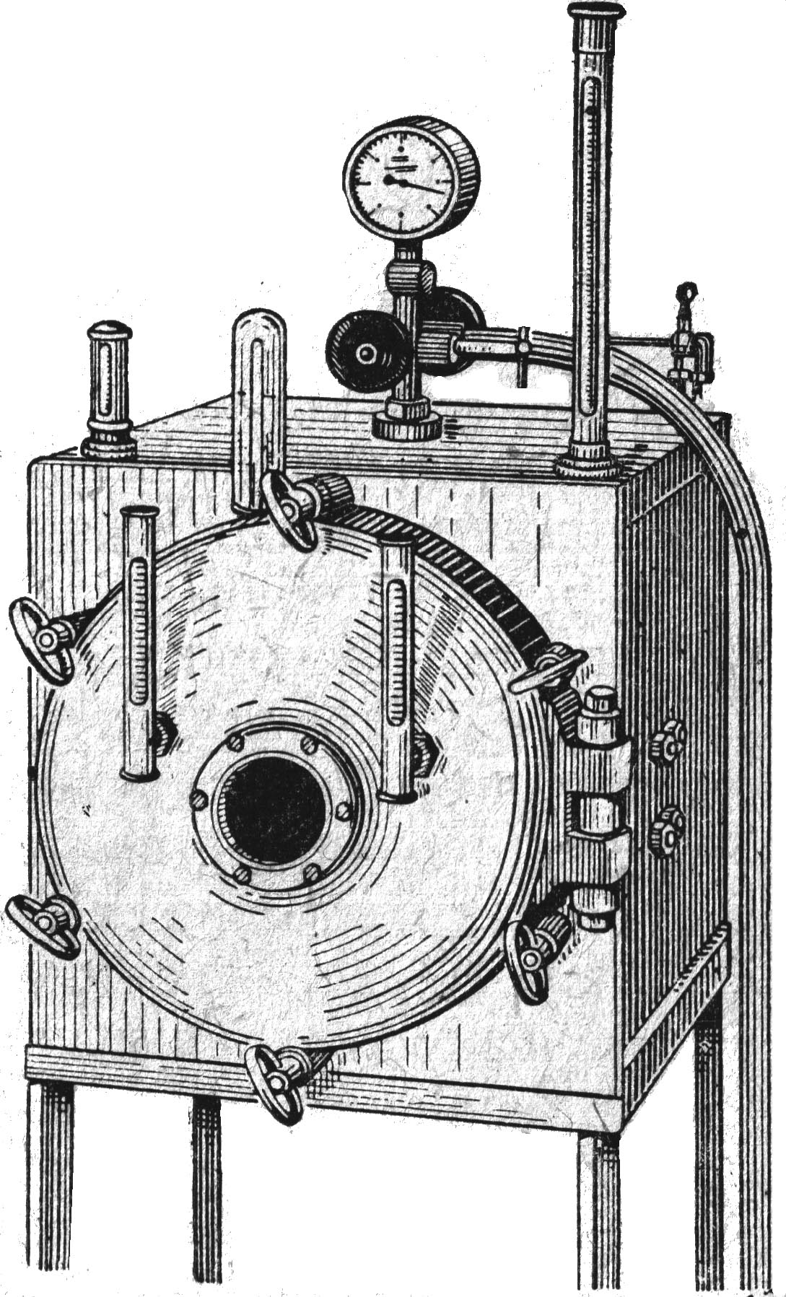
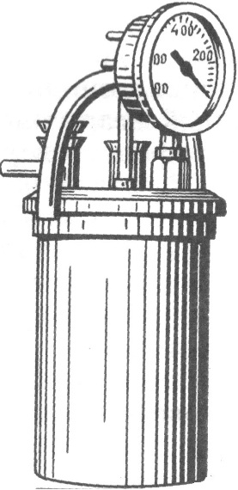
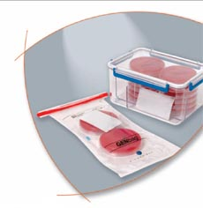
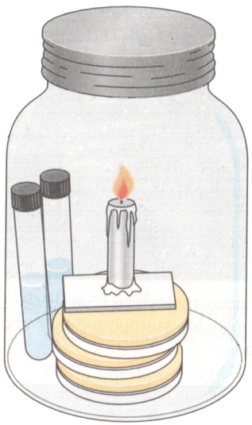

CREATION OF ANAEROBIC CONDITIONS
Microanaerostat
Burri tubes
Stationary anaerostat
By the way of burning of О₂

Slide 12
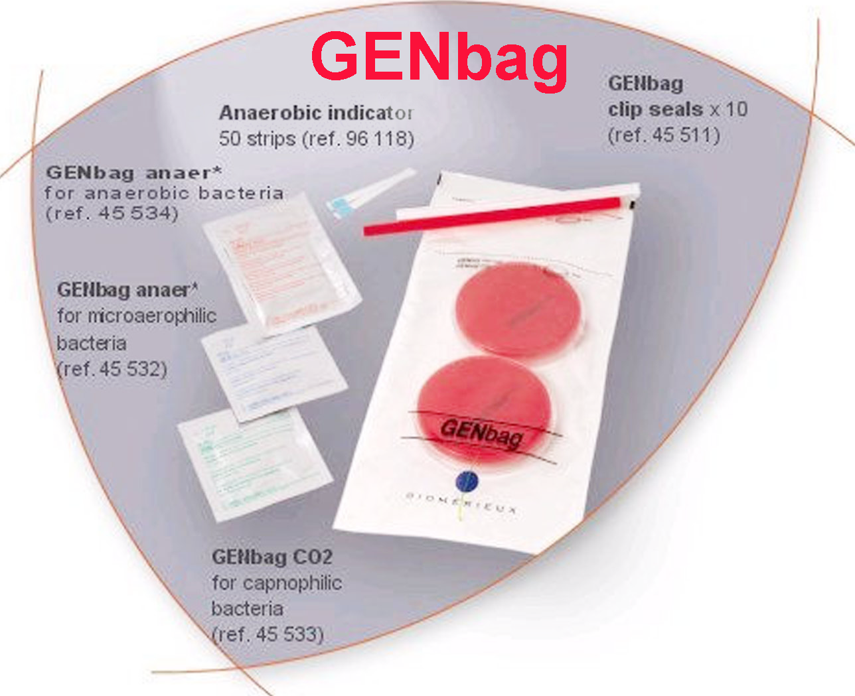
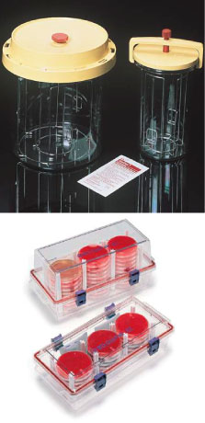
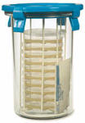
KIT FOR CULTIVATION IN ANAEROBIC CONDITIONS

Slide 13
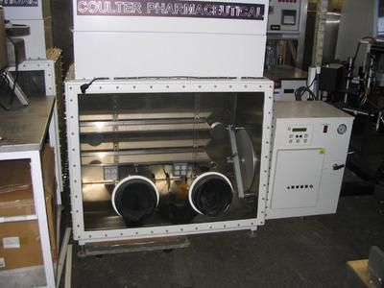
Modern type of anaerostat

Slide 14
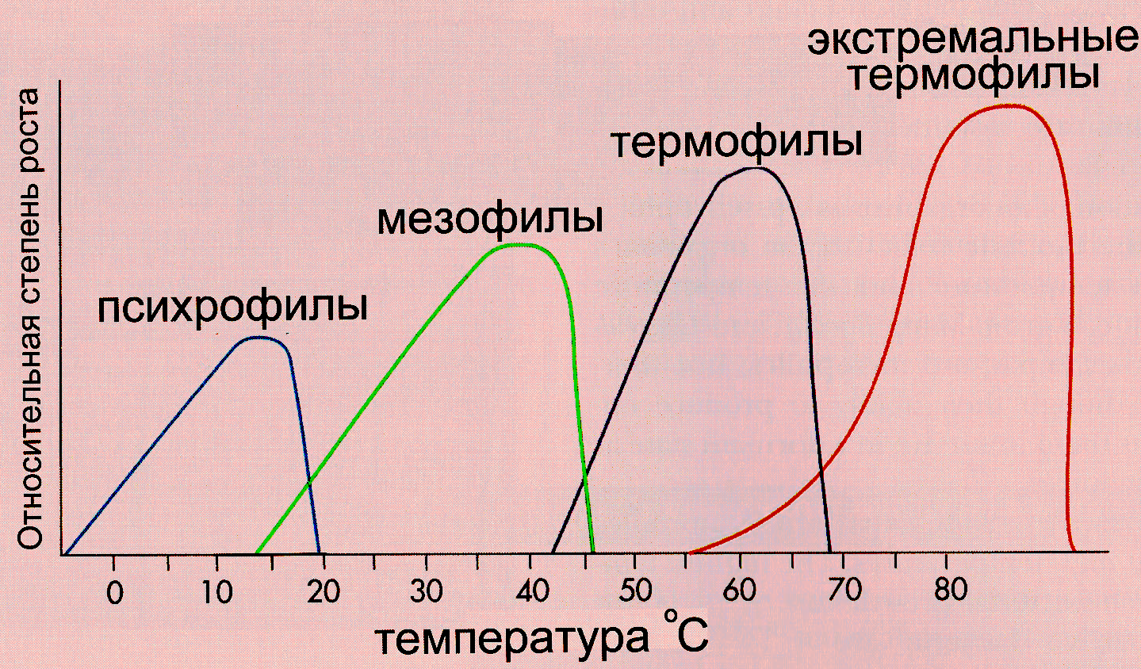
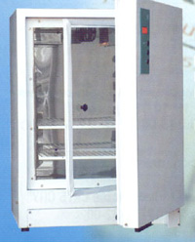
CLASSIFICATION OF BACTERIA ON TEMPERATURE OPTIMUM
Exteme thermophilic
Thermophilic
Mesophilic
Pshycrophilic
TERMOSTAT ТС-1/80
Temperature º C

Slide 15
Culture of microorganisms – there are microorganisms, which multiplied on nutrient media in the laboratory.
Population of microorganisms – this is group of alive microorganisms, independently from type of receiving - in the laboratory or in natural condition in the host organism or outside from the organism.
PURE CULTURE – culture of microorganisms of one species.
Clone – microbial population, received by the way of vegetative multiplication of one cell.
Strain – culture of microorganisms, isolated from particular source.
Some strains, having useful properties are the objects of patenting.

Slide 16
CULTURAL PROPERTIES OF BACTRERIA
Type of nutrition (requirements to nutrient media)
Type of respiration,
Temperature optimum,
Morphology of growth on liquid nutrient media
Morphology of growth on solid nutrient media
Morphology of colonies

Slide 17
CHARACTER OF BACTERIAL GROWTH
On liquid nutrient media | On slant agar
Diffuse turbidity and sediment | Dense or poor film
On the bottom and on the walls | Colonies without fusion
Pellicle like | Wet or dry film
Sediment like cotton wool | Mucous film
Absence of visible changing | Pigmented film

Slide 18
COLONY - result of multiplication of ONE bacterial cell on SOLID nutrient medium.
ISOLATED COLONY – colony, separated from other colonies by sterile nutrient medium.
SUSPICIOUS COLONY - COLONY, which МОRPHOLOGICALLY and MICROSCOPICALLY SIMILAR on colony of pathogenic (isolated) microorganism.

Slide 19
COLONY MORPHOLOGY:
shape,
size,
surface,
character of edges,
structure,
consistency,
color,
microscopic content.

Slide 20
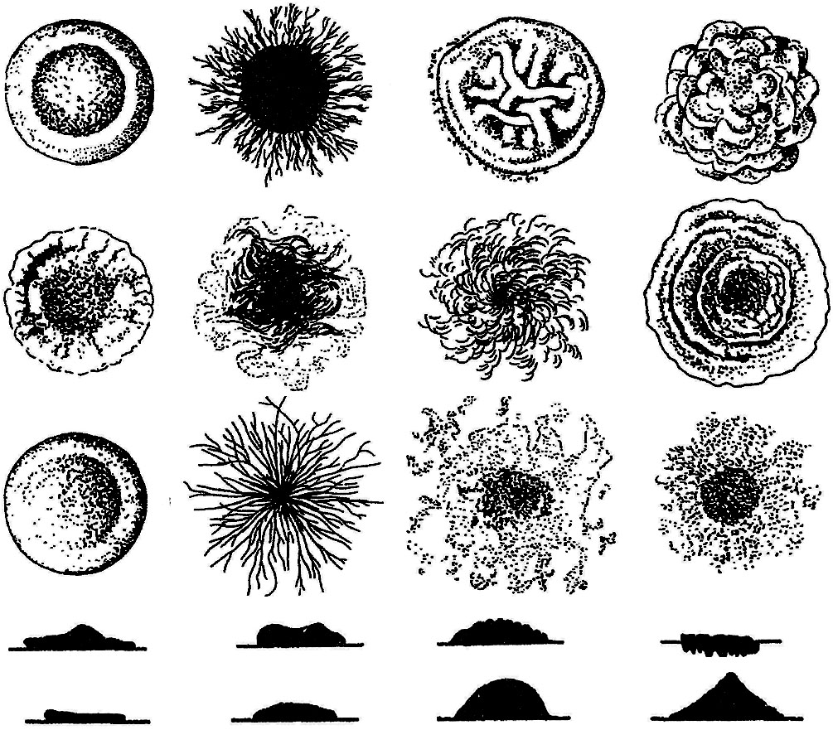
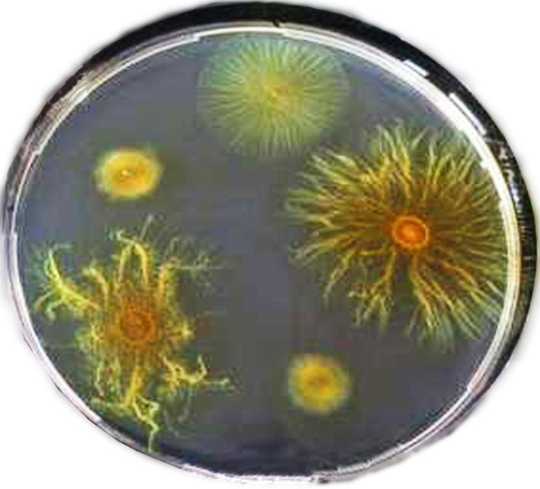
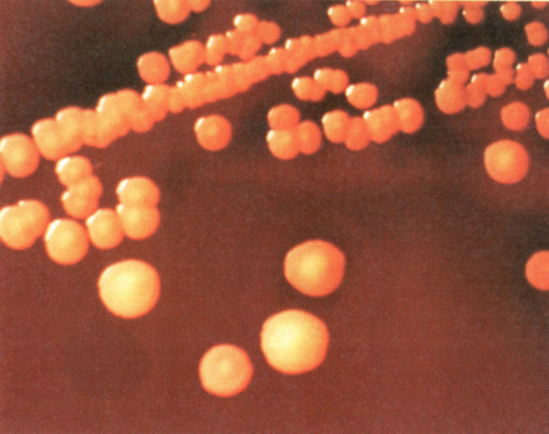
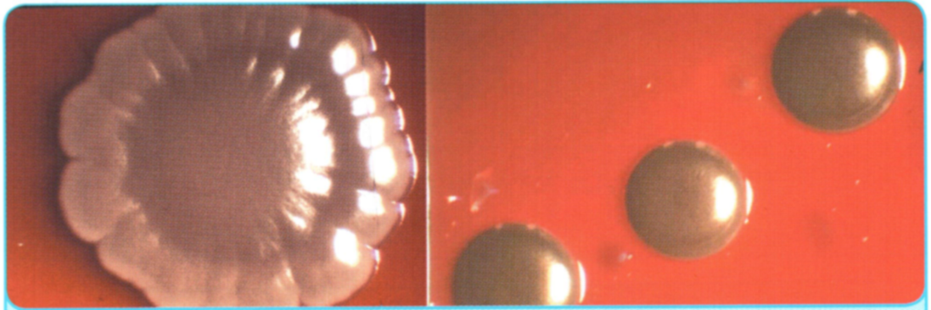
COLONIES MORPHOLOGY
Goldish pigment of
S. aureus
Corynebacterium diphtheriae

Slide 21
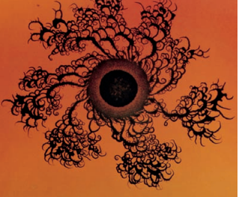
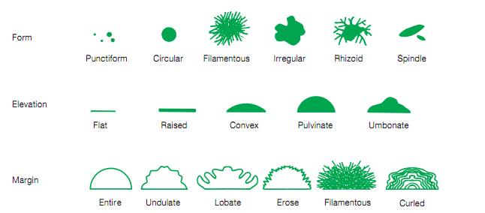
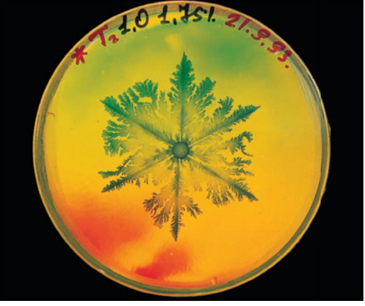
COLONIES MORPHOLOGY
Bacillus subtilis on nutrient poor agar

Slide 22
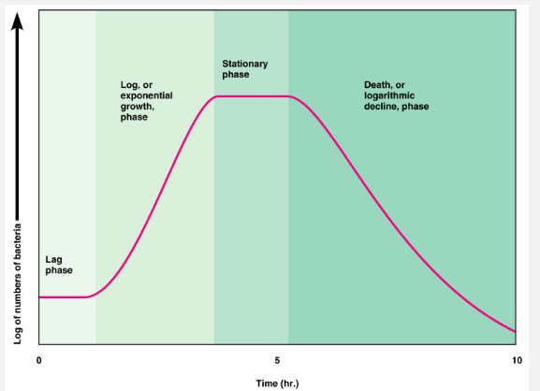
STAGES OF BACTERIAL GROWTH

Slide 23
REASONS OF BACTERIAL DEATH
Depletion of nutrient medium on limiting components
Self-poisoning of medium by bacterial methabolic products
Consumption of oxygen, diluted in the medium
Natural «aging» of bacteria
Self-regulation of bacterial population

