Slide 1
ODESA NATIONAL MEDICAL UNIVERSITY
Microbiology, virology and immunology department
Stomatological faculty
Lecture 6
Introduction to special microbiology. Pyogenic cocci.
Odesa

Slide 2
SPECIAL MICROBIOLOGY
studies etiology and pathogenesis of diseases, properties of pathogens, questions of epidemiology, clinical course, principles of prophylaxis, treatment and
microbiological diagnostics
of infectious diseases

Slide 3
PLAN OF STUDY IN SPECIAL MICROBIOLOGY
Full name of causative agent with indication of
Family: Micrococcaceae
Genus: Staphylococcus
Species: S.aureus, S.epidermidis, S.saprophyticus

Slide 4
Properties of causative agent :
Morphological: size, shape, additional structure, arrangement into smear.
Tinctorial: relation to staining – main Gram stain, or special: Zhiehl-Neelsen, Loffler, Neisser, Gins-Burri, Ozeshko
Cultural: media, type of respiration, temperature, character of growth on liquid and solid media (description of colonies)

Slide 5
Biochemical: presence of enzymes
- proteolytic,
- glycolytic,
- lipolytic,
- nucleases, etc.
Serological (antigenic properties)-serotypes,
Phage sensitivity (phagotypes),
Biological (pathogenicity for laboratory animals, pathogenicity for humans)

Slide 6
Production of virulence factors
Adhesins
Invasive enzymes
Capsule
Toxins

Slide 7
            Pathogenesis of disease in humans:
- source of infection,
- mechanism of transmission,
- susceptibility of humans;
- entrance gates,
- pathways of dissemination and localization in the organism;
- main virulence factors, action of toxins;
- ways of elimination of pathogen from the organism;
- immune changes – immunity, infectious allergy,
- main clinical presentations and outcomes;

Slide 8
PRINCIPLES OF THERAPY:
SYMPTOMATIC (PALLIATIVE) THERAPY directed on pain or other symptoms relief without action on main cause of disease and mechanisms of development, for example, use of analgesics in pain, antipyretic in hyperthermia. Symptomatic therapy is used before determination of diagnosis and in addition to other types of therapy.
PATHOGENETIC THERAPY directed on normalization of affected physiological functions of organism. In some cases correct pathogenetic therapy can be basic – like rehydration therapy in cholera, anticonvulsant therapy in tetanus, intubation in diphtheric croup.

Slide 9
ETIOTROPIC THERAPY directed on removal of cause of disease, for example, in infection - on elimination of pathogen from the organism.
- nonspecific etiotropic therapy – use of antibiotics, chemotherapy and antiviral preparations.
- specific etiotropic therapy - serotherapy (by immune serums and immunoglobulins), vaccine therapy, phage therapy.

Slide 10
PROPHYLAXIS OF INFECTIOUS DISEASES
achieved by measures directed on break of epidemiological chain :
source of infection
mechanism of transmission
susceptible population
with the help of methods of specific and nonspecific prophylaxis.
Action on first link of chain - SOURCE OF INFECTION:
early detection, isolation and treatment of ill persons and carriers.
Action on second link of chain - MECHANISM AND FACTORS OF TRANSMISSION can be different, depending on pathway of transmission.

Slide 11
FAECAL-ORAL PATHWAY sanitary control of potable and sewage water in housing estates, sanitary control in catering, production of food, prevention of fly pollution, etc. Final desinfection is also very important.
AIR-DROPLET PATHWAY – can be broken by isolation of population, use of masks, use of ultraviolet irradiation in rooms and others.
TRANSMISSIVE PATHWAY can be broken by disinsection of blood sucking arthropods (for example in malaria), or in rickettsial diseases.
CONTACT PATHWAY can be broken by following of personal hygiene, use of preservatives for prophylaxis of sexual transmitted diseases and others.
TRANSPLACENTAL PATHWAY can be broken by screening of pregnant women on some infections (HIV, HCV, lues, TORCH-group),which can be transmitted from mother to child.

Slide 12
Third link of epidemiological chain - SUSSEPTIBLE POPULATION
Protection mainly provided by information about unfavorable situation, sanitary information, etc.
In some cases can be provided immediate medicamental prophylaxis (by antibiotics, chemopreparations, for example, antimalarial), which is basically preventive against possible infection.
This is NONSPECIFIC PROPYLAXIS, where is used complex of measures, similar for prevention of all infectious diseases with similar pathway of transmisson.
But we can use also specific measures of prophylaxis.

Slide 13
SPECIFIC PROPHYLAXIS
Use of preparations, which develop immunity only to particular pathogen: vaccines, serums, phages.
VACCINE PROPHYLAXIS based on creation of ARTIFICIAL ACTIVE IMMUNITY and up to nowadays is MAIN METHOD OF CONTROL on infectious diseases.
Vaccine prophylaxis can be scheduled and according to epidemiological situation.
SCHEDULED VACCINE PROPYLAXIS is done in accordance with calendar of vaccination.
VACCINE PROPYLAXIS ACCORDING TO EPIDEMIOLOGICAL SITUATION for all population in cases of possible epidemia- influenza, plaque, cholera, anthrax, tularemia, leptospirosis, etc.), for risk groups (against HBV for doctors), for persons in some area – yellow fever, TBE, etc.

Slide 14
SEROPROPHYLAXIS - serums or immunoglobulins for creation of passive immunity (1—4 weeks).
- contact with ill persons (measles, HAV, pertussis)
- traumas (tetanus, gas gangrene)
- biting by animals (rabies)
- biting by ticks (TBE).
PHAGE PROPYLAXIS - specific prophylaxis of infectious diseases with the help of specific bacteriophages:
against E.Coli, Shigella zonne, Salmonella typhi.
PROPYLAXIS SHOULD BE COMPLEX !!!

Slide 15
MAIN TASK OF MICROBIOLOGIST –
MICROBIOLOGICAL DIAGNOSIS
DIAGNOSIS – TASK FOR DOCTOR-CLINICIAN, NOT FOR LABORATORY!
DIANOSTICS OF INFECTIOUS DISEASES IS COMPLEX:
ANAMNESIS
OBJECTIVE EXAMINATION
(visual examination, palpation, percussion, auscultation)
INSTRUMENTAL EXAMINATION
(termometria, endoscopy, X-ray examination, US, ECG and others),
CLINICAL-LABORATORY EXAMINATION
(analysis of blood, urine, feces, biochemical, cytological etc.)
EPIDEMIOLOGICAL SITUATION
All methods help us in probable diagnosis, prescription of primary therapy and antiepidemic regime.

Slide 16
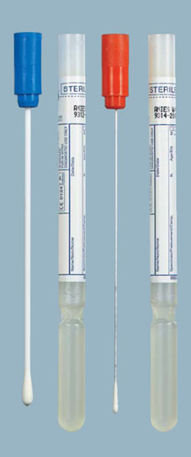
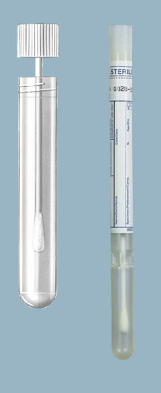
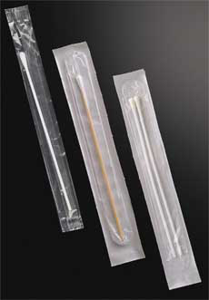
MICROBIOLOGICAL DIAGNOSIS is based on determination of: PATHOGEN: BY DIRECT METHODS: MICROSCOPIC EARLY DIAGNOSTIC BACTERIOLOGIC (microscopic can be BIOLOGICAL EXPRESS) BY DETECTION OF ANTIGENS OR GENES OF PATHOGEN: IFT,ELISA, PT, EXPRESS NT, IIHAT,PCR, MH BY DETECTION OF SPECIFIC CHANGES, CAUSED BY PRESEBCE OF PATHOGEN INTO ORGANISM: SEROLOGICAL LATE, sometimes - ALLERGIC RETROSPECTIVE

Slide 17
MICROSCOPIC METHOD – identification on morphological and tinctorial properties.
BACTERIOLOGICAL (CULTURAL) METHOD – isolation and identification of pure culture.
BIOLOGICAL METHOD (BIOTEST) – infection of laboratory animals, development of diseases, action of toxin, sometimes with biological neutralization.
SEROLOGICAL METHOD – determination of antibodies against pathogen (infectious immunity).
ALLERGIC METHOD – determination of infectious allergy.

Slide 18
USE OF SEROLOGICAL TESTS IN DIAGNOSTICS
SEROLOGICAL INDICATION – determination of pathogen and its antigens for express diagnostics
SEROLOGICAL IDENTIFICATION – determination of species and serotypes of pathogen in reactions with diagnostic serums .
SEROLOGICAL DIAGNOSTICS – diagnostics of diseases by the way of determination in patient’s serum antibodies to pathogen.
CRITERIA IF SEROLOGICAL DIAGNOSIS :
Determination of specific IgM antibodies.
Determination of IgG antibodies in diagnostic titres;
3) Determination of diagnostic increasing of IgG titres (not less than
4 times, for example, in first serum 1:20, in second serum after
10-14 days – 1:80)
DIAGNOSTIC TITRE - titre of specific antibodies, which is usually registered in ill persons and is not registered in healthy individuals.

Slide 19
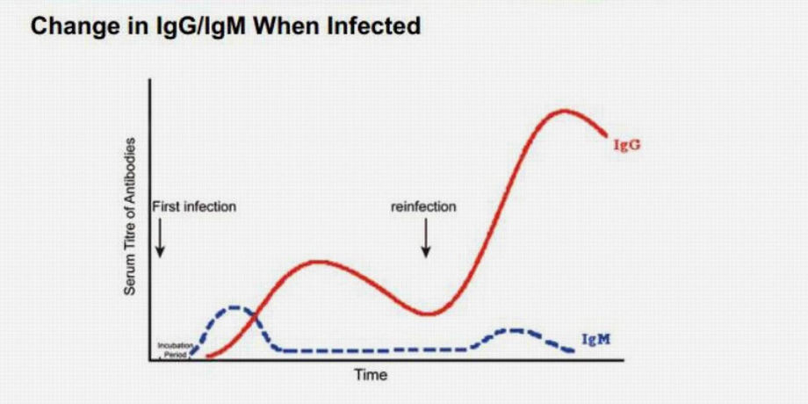
Diagnostic
titre

Slide 20
ODESSA NATIONAL MEDICAL UNIVERSITY
Microbiology, virology and immunology
Lecture
PYOGENI COCCI
Odessa - 2021

Slide 21
PYOGENIC COCCI
Gram-positive
Gram-negative
Family
Micrococcaceae
Family
Streptococcaceae
Family
Neisseriaceae
Genus
Staphylococcus
Genus
Streptococcus
Genus
Neisseria
S. aureus
S. epidermidis
S.saprophyticus
S. pyogenes
S. pneumoniae
S. mutans
N. meningitidis
N. gonorrhoeae

Slide 22
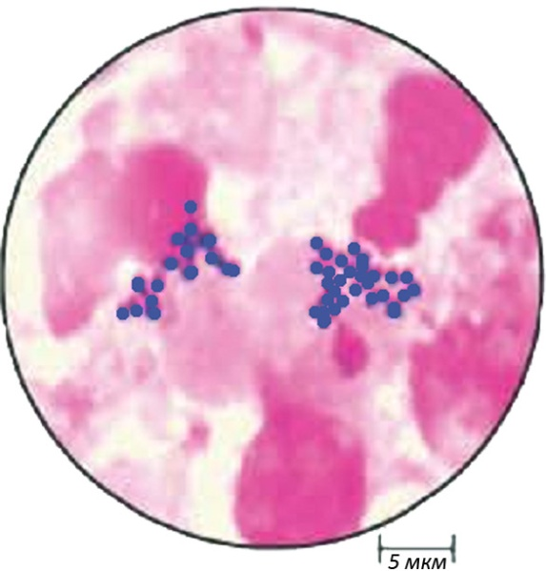
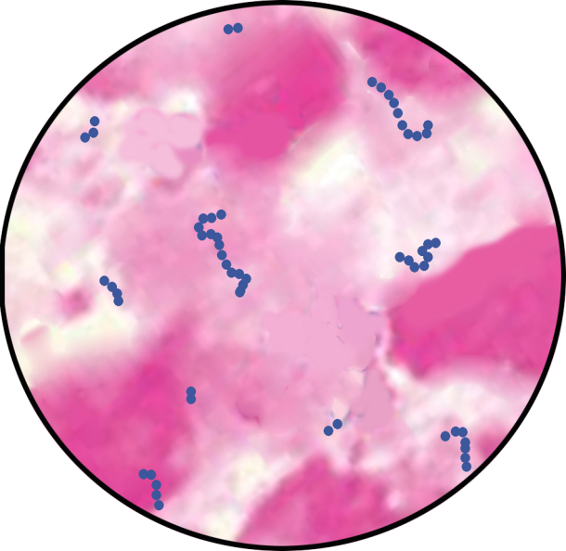
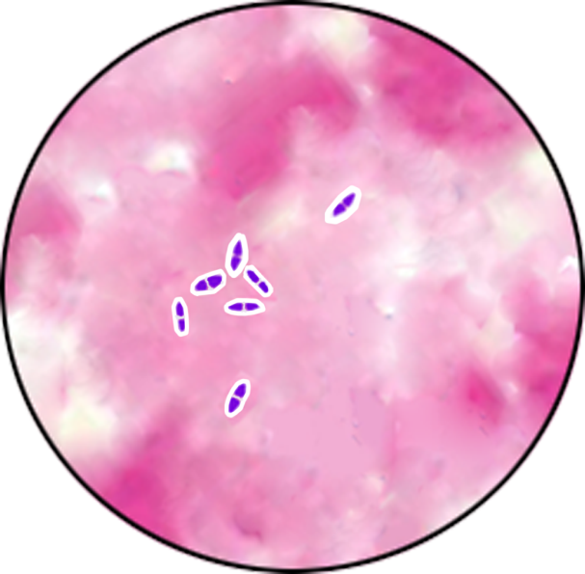
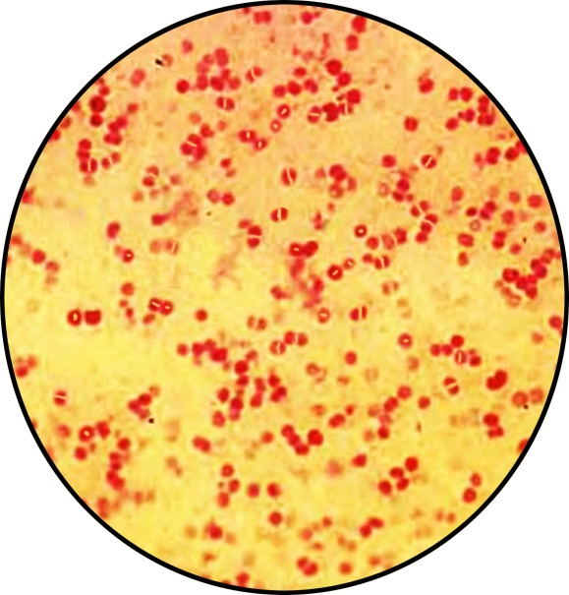
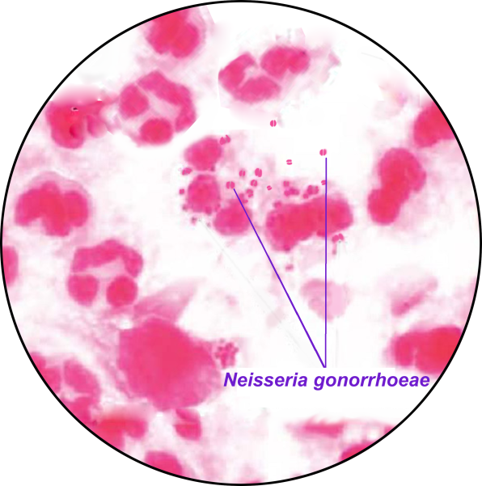
MAIN PYOGENIC COCCI
Staphylococcus aureus
Streptococcus pyogenes
Streptococcus pneumoniae
In this row increases: exactingness to nutrient media, level of parasitism and organ tropism;
decreases:
fermentative activity
Neisseria meningitidis
Neisseria gonorrhoeae

Slide 23
General characteristics of pyogenic cocci
Properties | Staphylococci | Streptococci | Pneumococci | Meningococci | Gonococci
Shape | Spherical | Oval | Lancet-shaped | Bean-shaped (coffee-beans)
Arrangement | Bunch of grape | Chains | By pairs | By pairs
Capsule | Microcapsule |  | Capsule | Microcapsule
Staining | Gram-positive |  |  | Gram-negative
Grows | Simple media | Sugar media | Serum, blood | Highly exacting, serum, blood
Respiration | Phacultative anaerobes |  |  | Aerobes
Hemolysis | β – | α –, β –, γ - | α - | Absent
Proteolytic | +++ | ++ | + | - | -
Saccharolyt. | +++ | ++ | + | Glucose maltose | Glucose
Toxigenicity | EXOtoxins |  |  | ENDOtoxins
Pathogenicity for humans | Conventionally-pathogenic |  | Pathogenic | Pathogenic, possible carrier state | Obligatory pathogenic

Slide 24
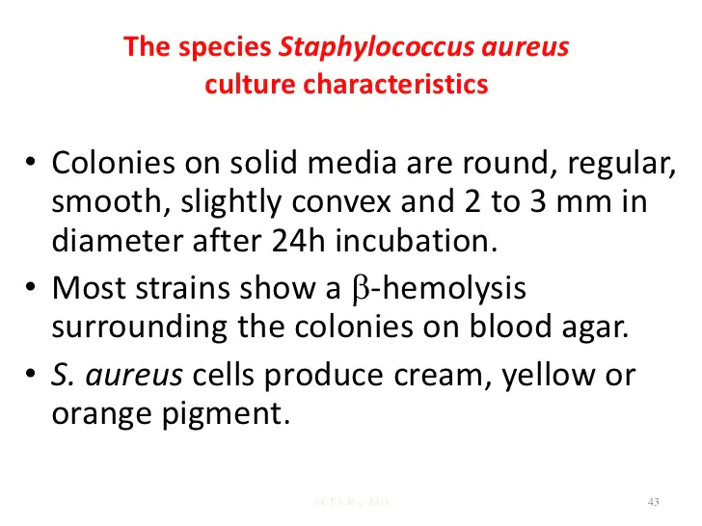

Slide 25
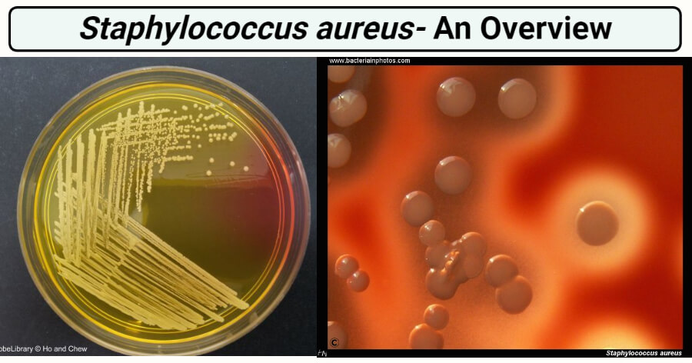

Slide 26
VIRULENCE FACTORS OF STAPHYLOCOCCUS
FACTORS |  | ACTION
Cellular | Microcapsule | Protect against phagocytosis
 | Protein А | fix Fc-fragment IgG, antiphagocytic effect
 | Peptigoglycan fibrinonectin- binding protein | Stimulate production of endogenic pyrogens, fixation with mucous cells, chemoattraction (abscessis)
Exo-toxins | α -, β-, γ-, δ –hemolysins | membranotoxins, affect erythrocytes, leucocytes, macrophages, fibroblasts
 | Leucocidine (δ-toxin) | leucotoxin, activates formation of cAMP, caused staphylococcal diarrhea
 | Exfoliatins А, В | Scalded skin syndrome, superantigen
 | Toxic shock synd-rome toxin - TSST | neurotropic, vasotropic effects, superantigen
 | Enterotoxins A-F | Action on enterocytes (food poisonning), neurotropic, effect, superantigen
Enzy-mes | Plasmocoagulase Hyaloronidase Lecithinase Fibrinolysin DNA-ase Protease Catalase Β-lactamase | Fibrinogen to fibrin, protection against phagocytosis Destruction of connective tissue Hydrolysis of lecithin, adhesion and penetration in tissue Destruction of clots, spreading into tissue Liquefying of pus Destruction of intercellular connection, penetration Protection against microbicidic action of phagocytes Resistance to penicillin

Slide 27
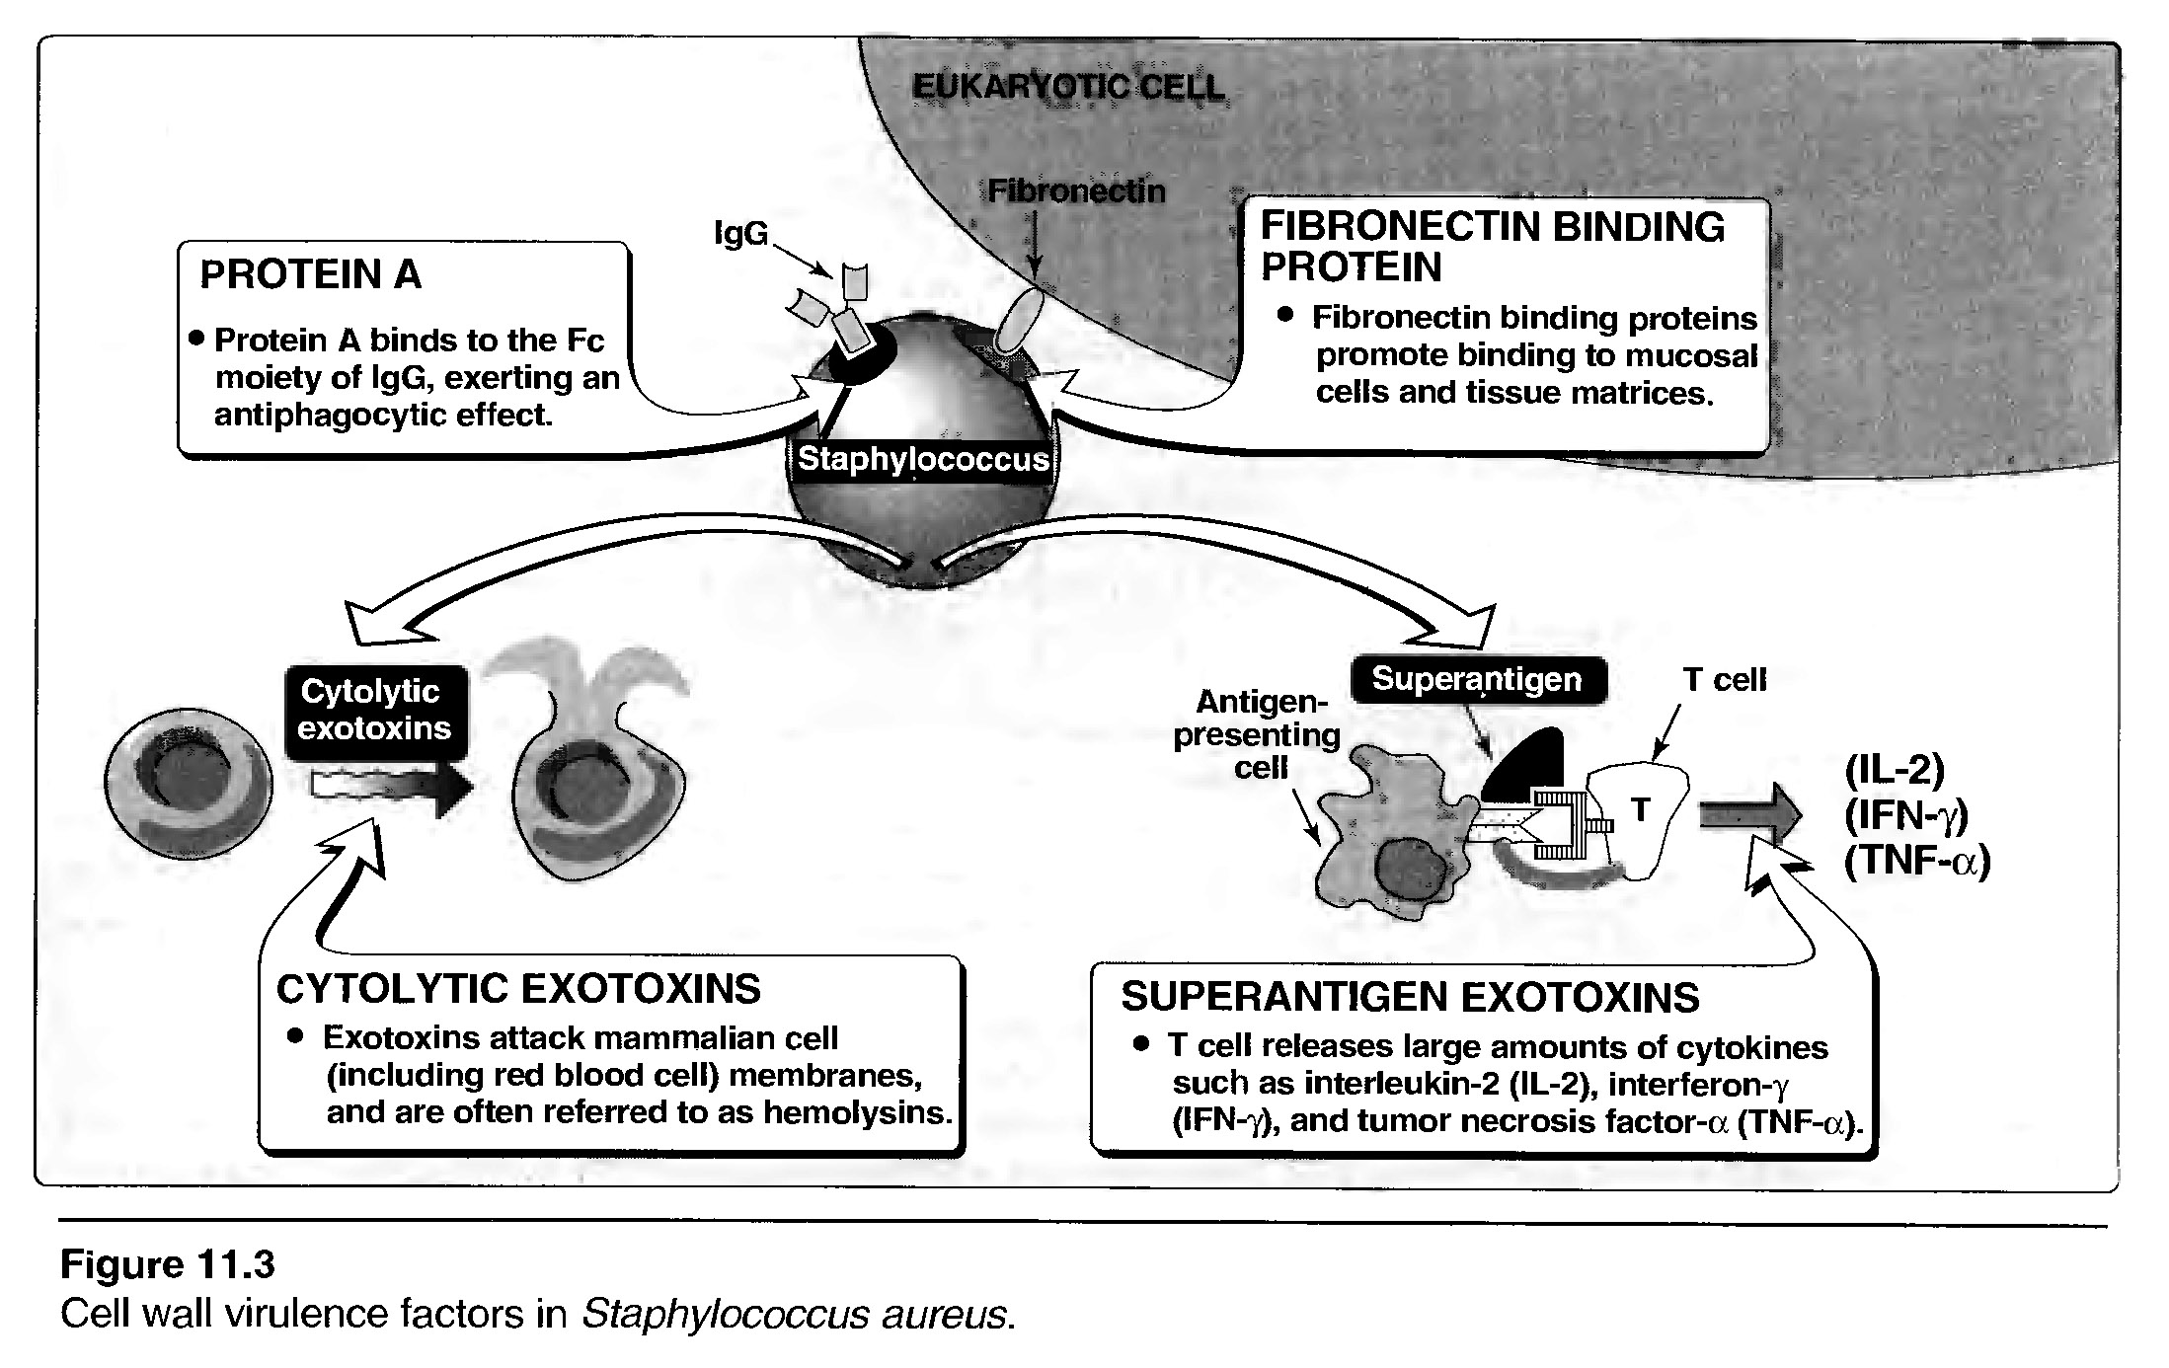
Cell wall virulence factor in S.aureus
EUCARYOTIC CELL
Fibronectin

Slide 28
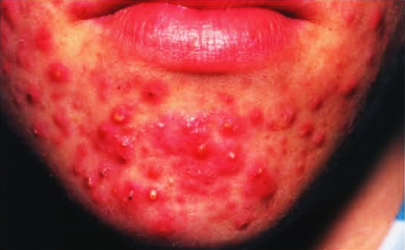
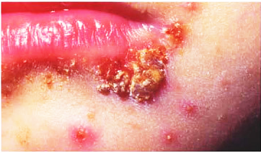
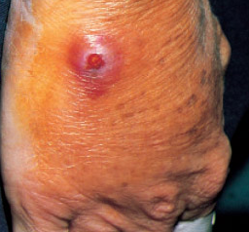
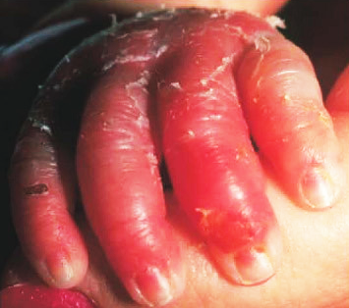
SKIN STAPHYLOCOCCAL INFECTIONS
Severe acne
Impetigo pholliculitis
Furuncle
Scalded skin syndrome

Slide 29
DIFFERENTIATING FEATURES OF DIFFERENT COCCI
Species | Staphylococcus aureus ** | Staphylococcus epidermidis** | Staphylococcus saprophyticus*
Frequency of infections | often | often | rarely
Coagulase | + | - | -
Hemolysis | + | - | -
Mannitol fermentation | + | - | -
Protein А | + | - | -
Golden pigment | + (-) | - | variable
DNase | + (-) | - | -
Resistance to the novobiocin | - | - | +
* - human only pathogen; ** - human and animal pathogen

Slide 30
VIRULENCE FACTORS OF STREPTOCOCCI
Factors | Biological effects
Capsule | Antiphagocytic activity
М-protein | Antiphagocytic effect, destroys complement (СЗb)
М-like proteins | Binds IgM, IgG и α₂- macroglobulin (proteinase inhibitor)
F-protein | Adherence of streptococci to epithelial cells
Pyrogenic exotoxin (eryhtrogenic toxin) | Pyrogenic effect, enhance delayed hypersensitivity and sensitivity to endotoxin; B-lymphocytes suppressive effect, erythematous rush
Streptolysin S (S —stable) | Stable to oxygen. Destroys leukocytes, plates, RBC; stimulates releasing of lyzosomal enzymes; not immunogenic
Streptolysin О (Oxygen-labile) | Sensitive to oxygen. Destroys leukocytes, plates, RBC; stimulates release of lyzosomal enzymes; immunogenic
Strepokinase (fibrinolysin) | Cause lyses of fibrin clothes, facilitate spread of dacteria in tissue
DNA-ase | Depolymerisation of extracellular DNA in pus
С5а-peptidase | Cause break down of С5а, inactivate it.

Slide 31
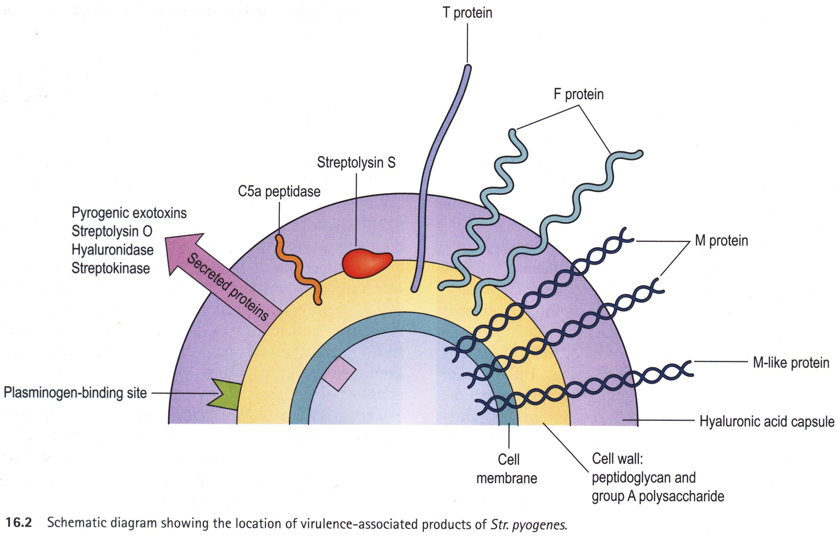
Factors of virulence of Streptococci

Slide 32
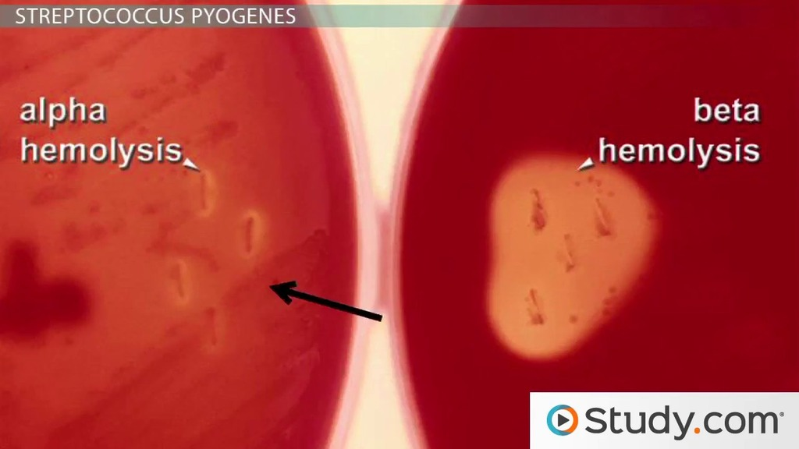
Cultural properties of Streptococci

Slide 33
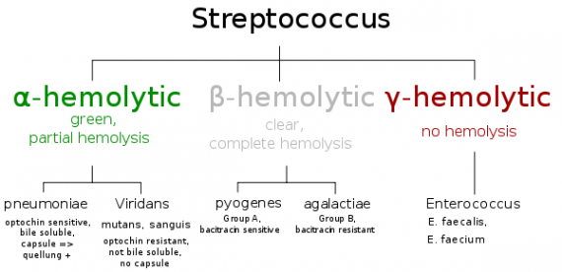
Classification on the base of hemolytic properties

Slide 34
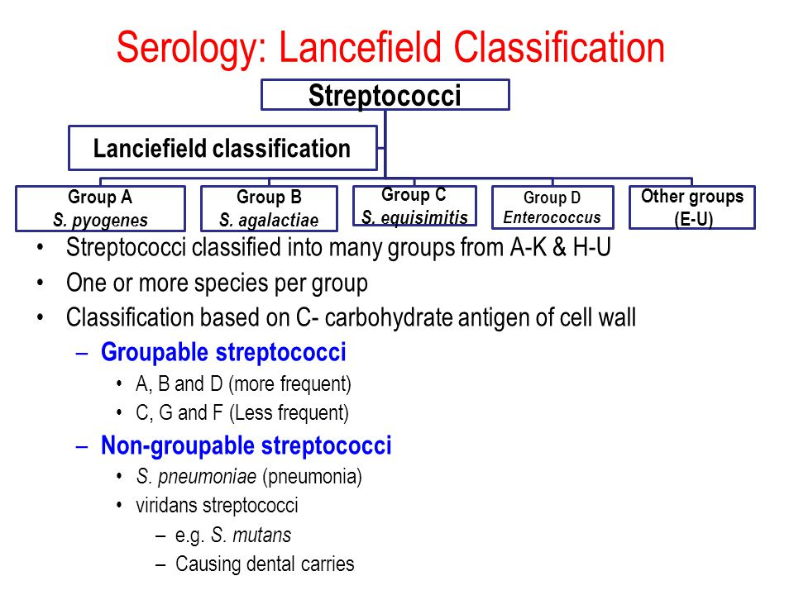

Slide 35
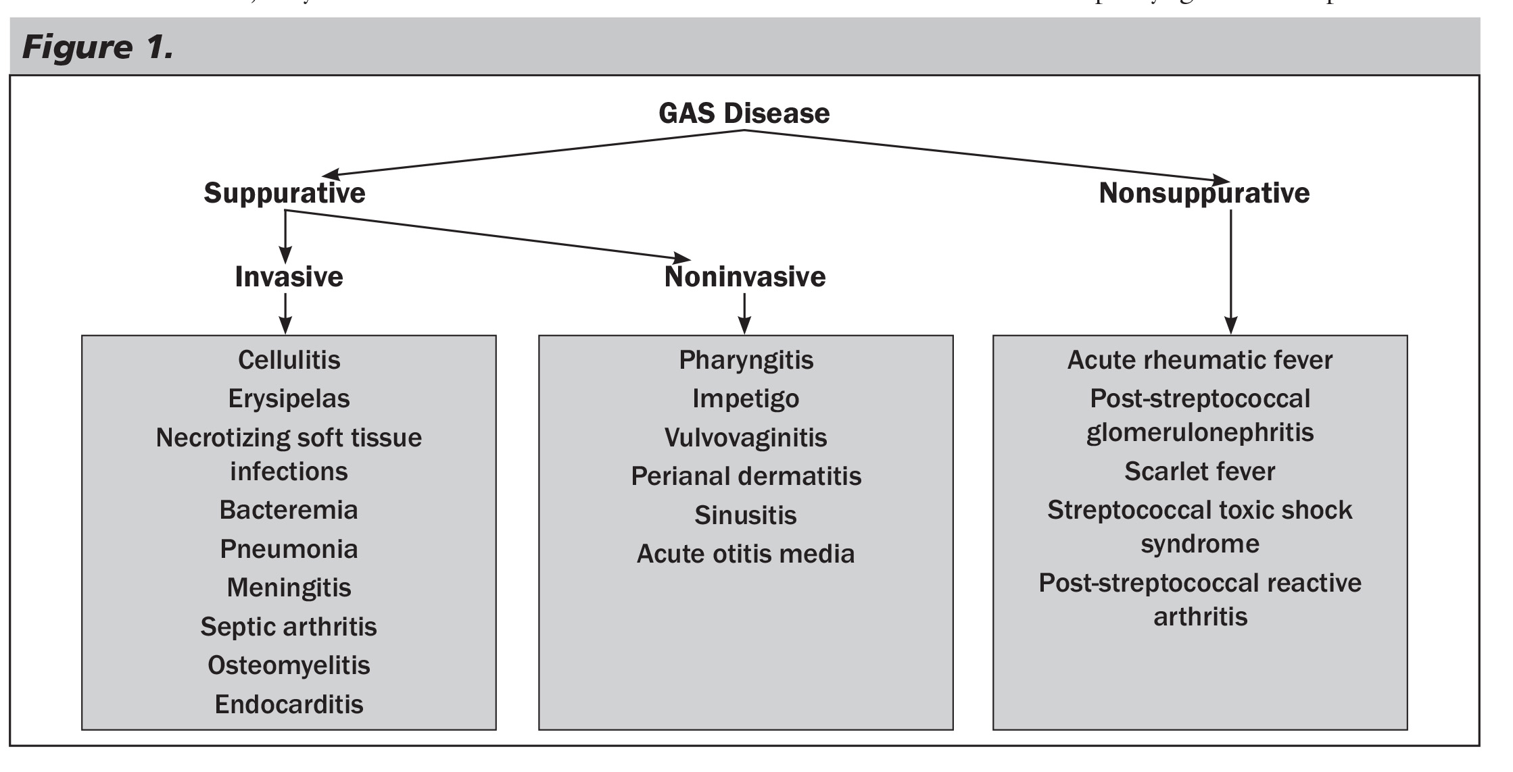
Diseases caused by Streptococci

Slide 36
Neisseria meningitidis
Family: Neisseriaceae
Genus: Neisseria
Species: Neisseria meningitidis
Neisseria gonorrheae

Slide 37
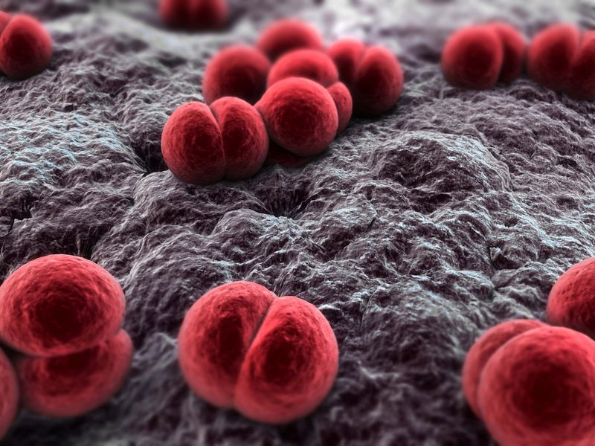
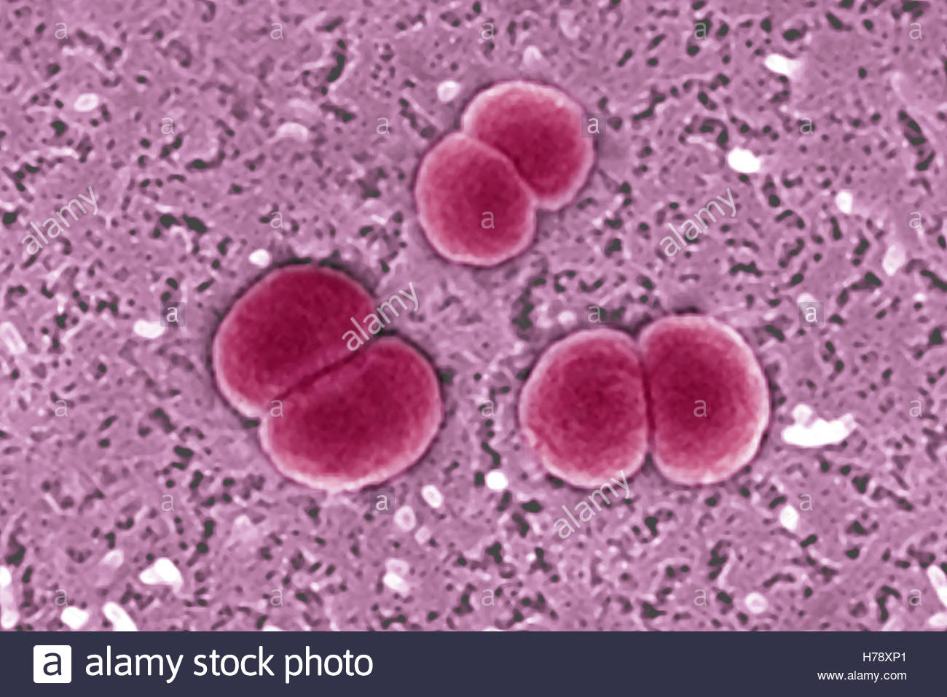
Neisseria meningitidis
Morphology
Gram negative diplococcus (paired)
Size: 0.6-0.8 μm
Bean shaped
Non-motile
Aerobe
Encapsulated
Scanning electron microscope image of Neisseria meningitidis. From: Bioquell.com

Slide 38
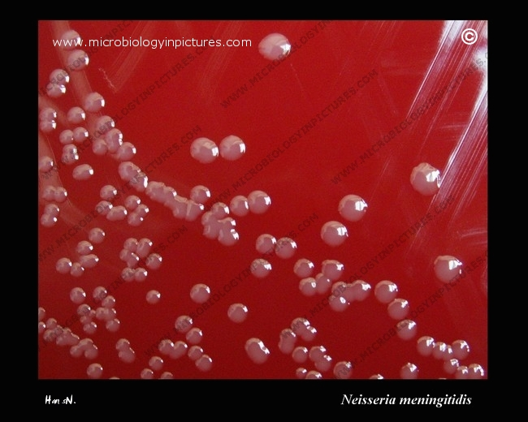
Neisseria meningitidis
Colony characterisitics
Color: Bluish grey
Shape: Round
Size: About 1mm
Surface: Smooth
Elevation: Convex
Opacity: Transluscent
Consistency: Butyrous

Slide 39
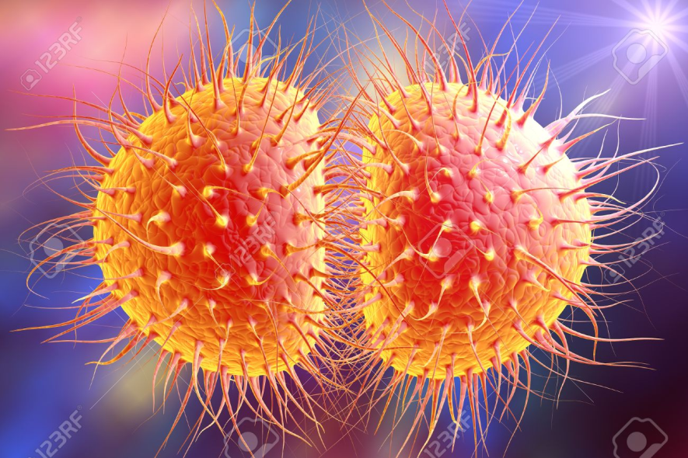
Neisseria meningitidis
Neisseria meningitidis
Virulence Factors
Adhesion factors :
Pili for adhesion to mucosa of oropharynx and meningeal tissue
Capsule : Antiphagocytic
Lipopolysaccharide : Endotoxin
IgA proteases : cleaves IgA protecting organism from effects of secretory IgA

Slide 40

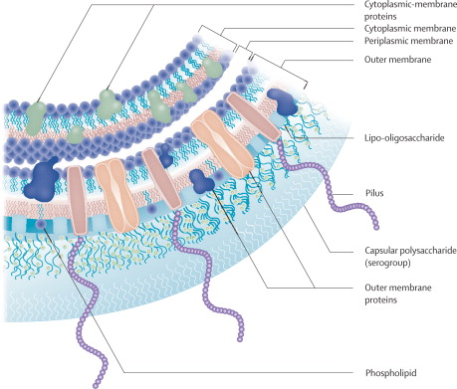
Serogroups
N. Meningitidis -13 serogroups on
the basis of specificity of capsular
polysaccharide antigens.
These are A,B,C,D,X,Y,Z,W 135,
29E,H,I,K and L.
Serogroups A,B,C,X,Y,W 135
are most commonly associated
with meningococcal disease.

Slide 41
Neisseria meningitidis
Biochemical Properties:
Oxidase positive
Catalase positive
Ferments glucose and maltose with acid production
Doesn’t ferment lactose, sucrose and fructose
Production of Deoxyribonuclease (DNAse)
Nitrate negative
Colistin resistant

Slide 42
Neisseria meningitidis
Epidemiology
Natural habitat and reservoir :
Mucosal surfaces of the human nasopharynx,
urogenital tract and anal canal
Nasopharyngeal carriers :
approximately 5-10% adults are asymptomatic carriers
(may reach 90% in close communities)
Modes of infection: Direct contact or respiratory droplets from the nose and throat of infected people

Slide 43
Neisseria meningitidis
Pathogenesis (Steps)
Inhalation of contaminated droplets
Adherence of organism to nasopharyngeal mucosa
Local invasion and spread from nasopharynx to meninges through blood stream, in meninges, organisms are internalised into phagocytic cells
They replicate and migrate to subepithelial spaces
Incubation period : 3-4 days

Slide 44
Neisseria meningitidis
Clinical Features
Febrile illness : Mild and self limiting
Pyogenic meningitis : High fever, stiff neck, Kernig’s sign, severe headache, vomiting, photophobia, chills
Meningococcal septicemia : acute fever with chills, malaise, prostation, Waterhouse-frederichsen syndrome, DIC
Other Syndrome : Pneumonia, arthritis, urethritis, respiratory tract infection

Slide 45
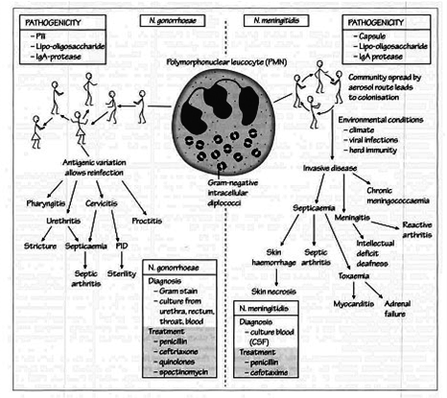

Slide 46
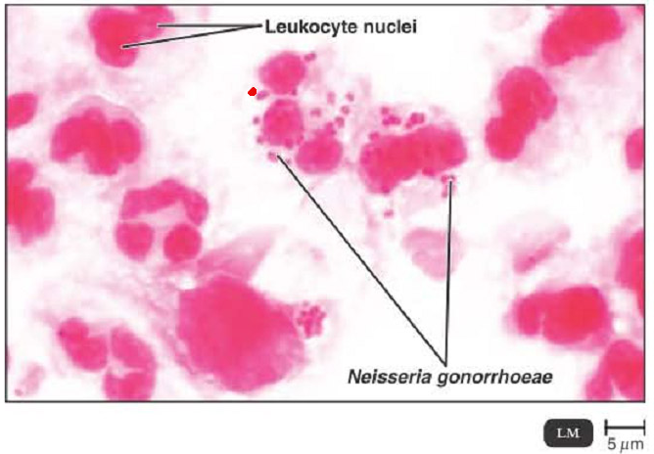

Slide 47
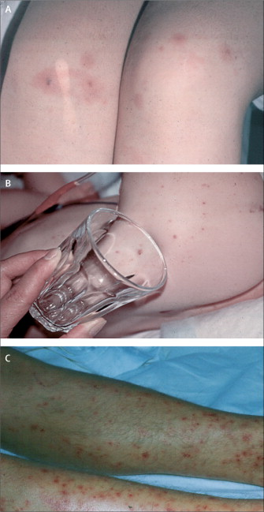
and non-blanching petechial (B and C)
Rashes in meningococcal
disease
Macular (A)

Slide 48
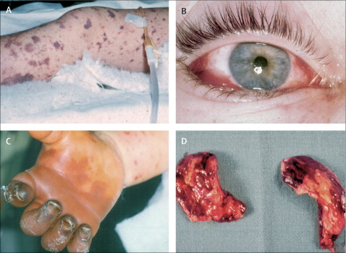
Fulminant meningococcal septicaemia
A=fulminant meningococcal septicaemia with ecchymoses.
B=eye with intraocular haemorrhage during fulminant meningococcal septicaemia.
C=thrombosis and gangrene of the fingers in a child surviving fulminant meningococcal septicaemia.
D=haemorrhagic adrenals in fulminant meningococcal septicaemia.

Slide 49
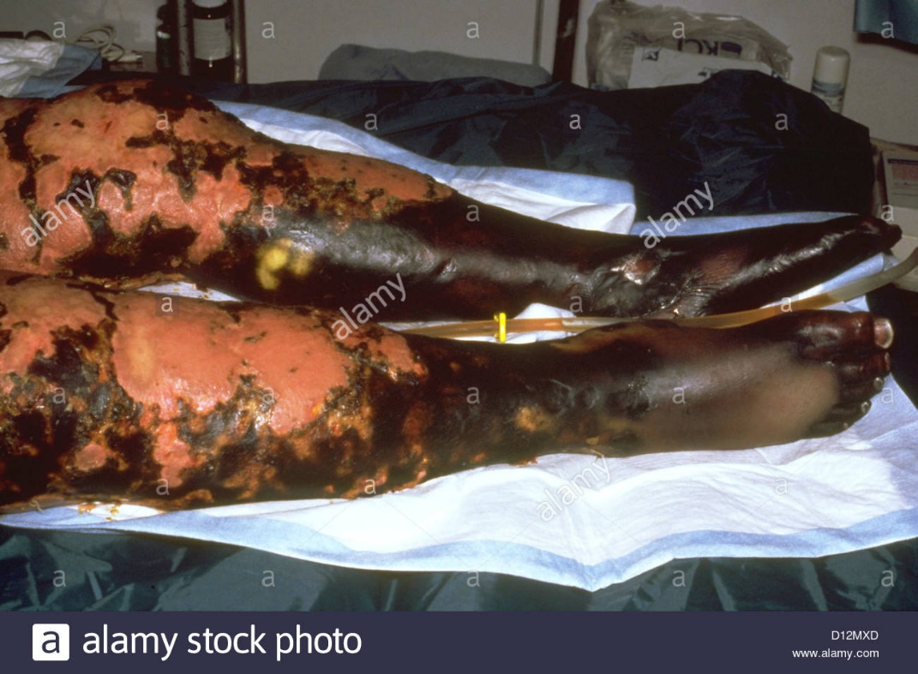
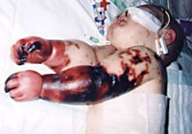
Complications of meningococcal diseases
Charlotte Cleverley-Bisman, one of the youngest survivors of the disease. The infected arms had to be amputated later.

Slide 50
Polysaccharide Vaccines
A meningococcal polysaccharide (MPS) vaccine, containing antigens of serogroups A, C, Y, and W135, (MPSV4) has been used since the past 20 years.

Slide 51
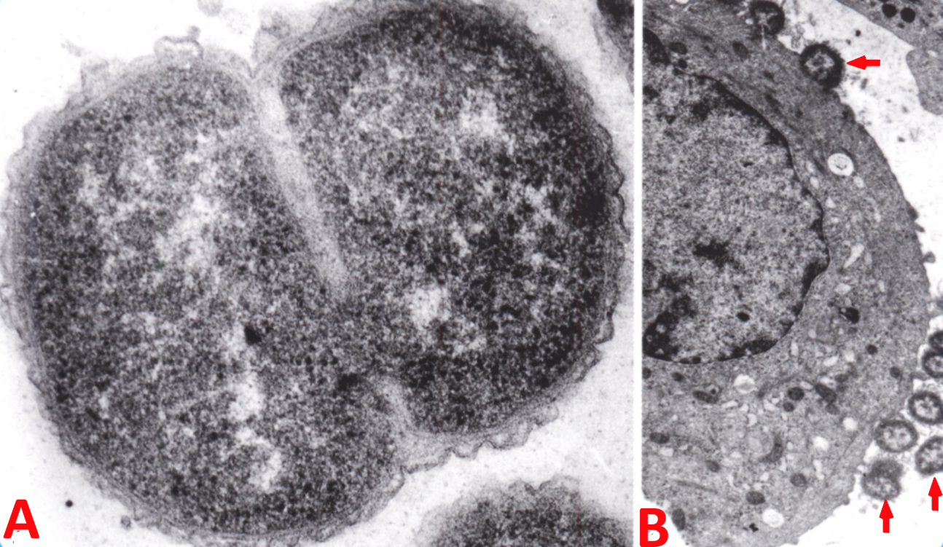
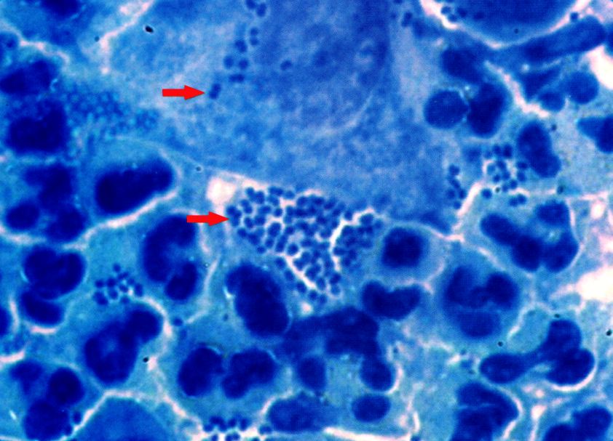
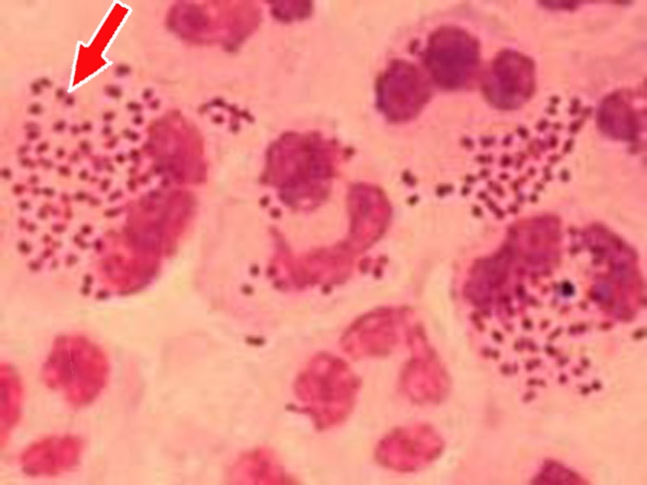
N. gonorrhoeae.
Smear from urethral pus.
Methylene blue staining
ELECTRON MICROSCOPY OF ULTRATHIN SECTIONS OF GONOCOCCI
А – extra membrane and fision of gonococcus;
В – excretion from urethra. Gonococcus on epithelial cell
Gram -staining

Slide 52
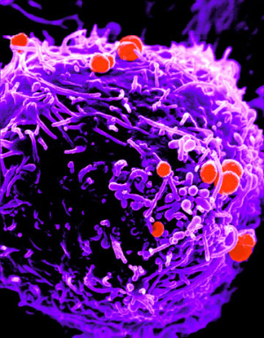
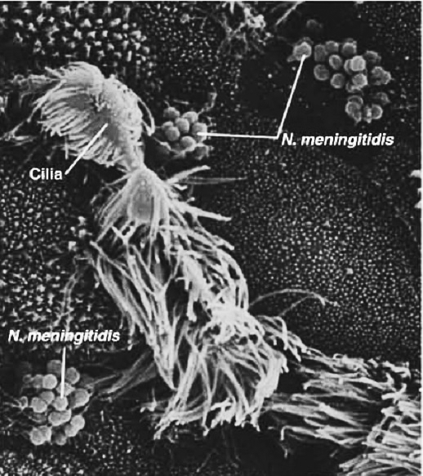
Gonococci on the surface of the lymphocyte
Scanning electronic microscopy
Meningococci on mucous membrane of pharynx
Electronic microscopy

Slide 53
