Slide 1

Bronchial asthma in children

Slide 2
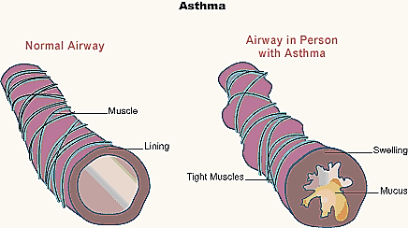
Bronchial asthma
- chronic allergic inflammation of bronchi, with is conditioned by excess of cells and inflammatory mediators.

Slide 3
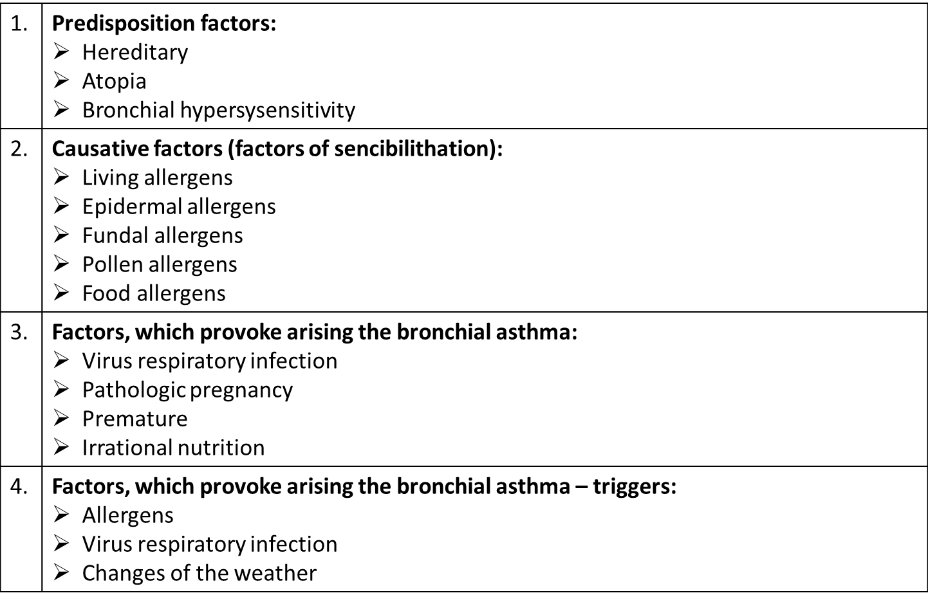
Risk factors of BA

Slide 4
PATHOPHYSIOLOGY
  Asthma pathophysiology is quite difficult and insufficiently studied. Undoubtedly, in most cases the disease is based on 1 type hypersensitivity reaction.
  The genesis of any allergic reaction may be divided into immune, pathochemical and pathophysiologic phases.

Slide 5
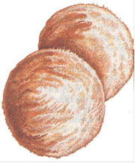
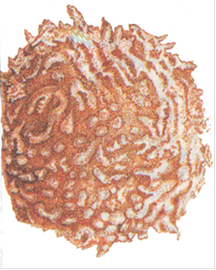

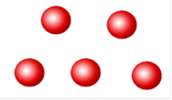
Immune phase
Allergen-specific
IgE
Allergens
B-cell
T-cell
After involving into the airways allergens activate immunocompetent cells. As a result B-lymphocytes produce antibodies of Ig E class. In case of asthma T-lymphocytes are inhibited, so the activation of B-lympocytes and Ig E production are excessive, exceeding normal needs.

Slide 6
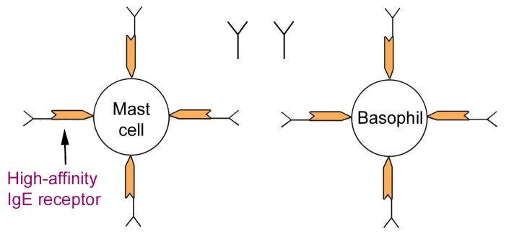
Further these antibodies bind to the surface of mast cells, basophils and eosinophils of bronchial mucous. When a new portion of allergen involves the respiratory system, it interacts with IgE-antibodies.
This is a first,
immune phase
of allergic reaction.

Slide 7
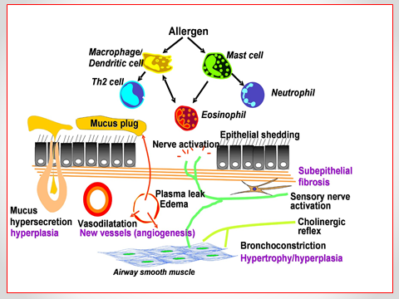
Pathochemical phase
As a result of antigen-antibody reaction the peculiar “explosion” occurs. The membranes of mast cells, basophils and eosinophils of bronchial mucous wreck with output of biologically active substances (histamine, serotonin, chemotaxis factors, heparin, proteases, thromboxane, leukotrienes, prostaglandins), which induce hyperergic inflammation,
mucous edema, spasm of
smooth myocytes,
glands hypersecretion,
viscous exudate formation
in bronchial lumen.

Slide 8
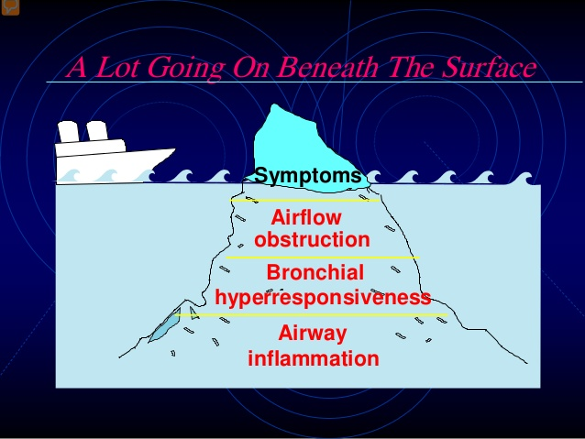
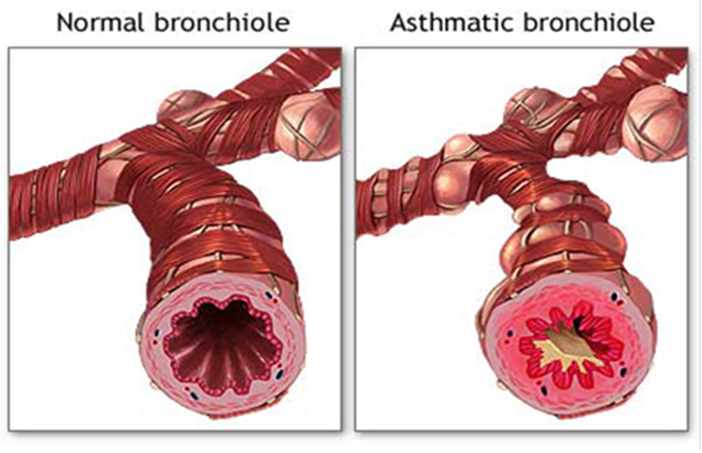
Pathophysiology phas

Slide 9
CLASSIFICATION OF BA
Forms | Immune (atopic) Nonimmune (aspirin, dysgormonal, exercise induced)
Period of the disease | Exacerbation Remission Control
Severity | Intermittent | 2. Persistent: Mild Moderate Sever
Complications | Pulmonary heart Emphysema Atelectasis Pneumothorax Neurological and endocrine disturbances

Slide 10
EVOLUTION OF THE BA SEVERITY
Intermittent |  | Short-term symptoms 1 per week Short attack Night symptoms < 2 per months The symptoms are absent in remission PEF > 80% Deviation of PEF < 20%
Persistent | Mild | Short-term symptoms 1-2 per week Night symptoms > 2 per months Disorders of physical activity and sleeping PEF > 80% Deviation of PEF – 20-30%
 | Moderate | Daily symptoms – every day Night symptoms > 1 per week Disorders of physical activity and sleeping PEF - 60 - 80% Deviation of PEF > 30% Requirement in every day using β2 –agonists of short action
 | Severe | Frequently exacerbation Permanent presence of the symptoms Frequently night attacks Limitation of physical activity PEF < 60 % Deviation of PEF > 30%

Slide 11
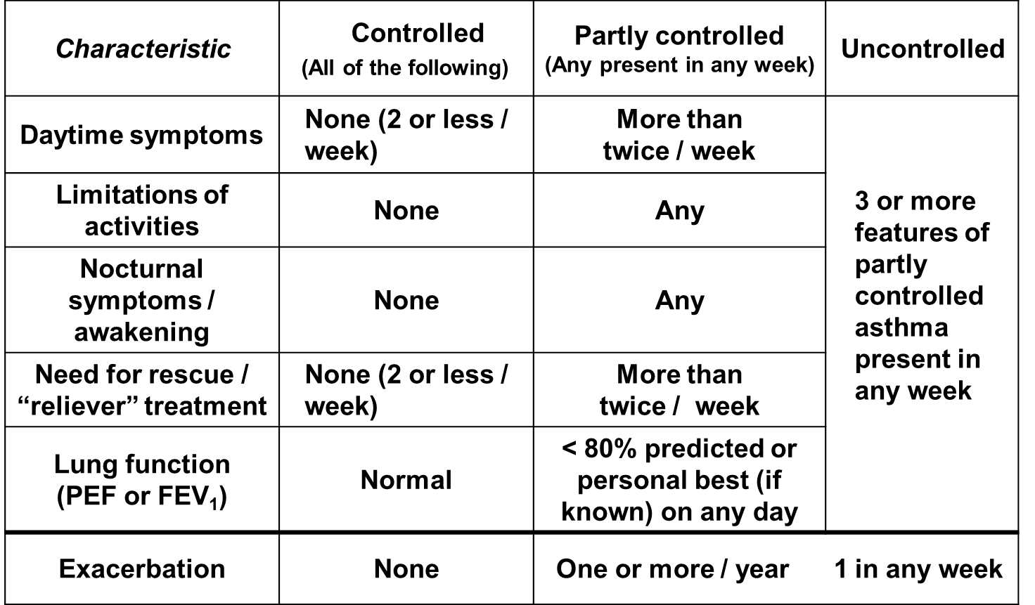
Levels of Asthma Control

Slide 12
Clinical manifestations
  attacks of expiratory dyspnea
  shortness of breath
  cough
  chest tightness
  wheezing (high-pitched whistling sounds when breathing out)
  sibilant rales

Slide 13
Evaluation of anamnesis data
Premorbid condition (premature, irrational nutrition, atopic diseases, frequently ARVI)
Hereditary allergic anamnesis
Atopic diseases (urticary, atopic dermatitis, allergic rhinitis)
Connection diseases with causative allergens
Ecology, tobacco smoking
Season character of the diseases
Night attack
Recurring episodes of bronchoobstruction (>3 times during the year)
And effectiveness of broncholitic therapy

Slide 14
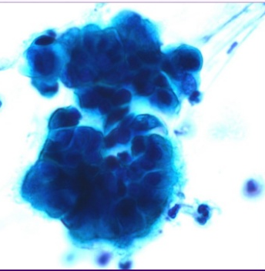
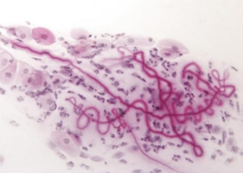
Investigations
Lab Data
Eosinophilia, moderate leukocytosis in blood count as well as increased serum level of Ig E can be found in patients with asthma, especially at asthma exacerbations.
Inflammatory cells, Curschmann's spirals (viscous mucus which copies small bronchi) and Charcot-Leyden crystals (crystallized enzymes of eosinophils and mast cells) can be observed in sputum.

Slide 15
Immunological investigation
Evaluation of the immunological system condition (cells, humoral and macrophage immunity)
Level of IgE

Slide 16
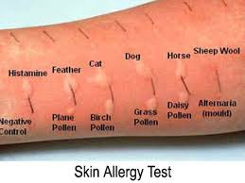
Allergy Testing
Methods in vitro (LEA)
Methods in vivo (scarification skin tests)

Slide 17
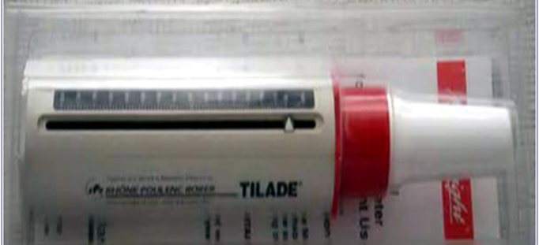
Diagnostic Testing
Spirography (FEV1, FVC, FEV1/FVC)
Spirography with medicamental and tests with physical exercises
Peakflowmetry (PEF)
X-ray Chest

Slide 18
Management
  includes:
  1. Avoiding the contact with allergen. If it is impossible, the specific hypo sensitization with standard allergens should be performed. It is rather effective in case of mono allergy, in intermittent and mild persistent asthma, in remission phase.
  2. Elimination of trigger factors (rational job placement, changing the residence, psychological and physical adaptation, careful drug using) is the second condition for successful asthma treatment.
3. Optimally selected medical care is the base of asthma management.

Slide 19
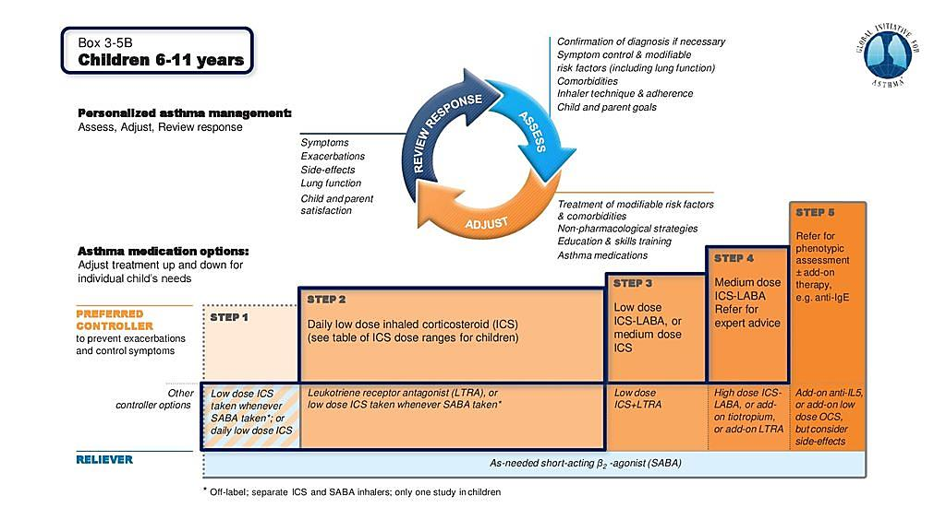

Slide 20
