Slide 1
Congenital heart defect (CHD) or congenital heart anomaly is a defect in the structure of the heart and great vessels that is present at birth.
Heart defects are among the most common birth defects and are the leading cause of birth defect-related deaths.
The defects can range in severity from simple problems, such as “holes” between chambers of the heart, to very severe malformations, such as complete absence of one or more chambers or valves.
Etiology of CHD
Environmental factors existing during first trimester of pregnancy:
Maternal Infections viral infections Rubella, cytomegalovirus, herpes virus, coxsackievirus...
Maternal Drugs
Fetal alcohol syndrome
Maternal exposure of radiation
Maternal metabolic diseases
Genetic factors
Chromosomal abnormalities - Down's, Edward's, Patau's, Turner's syndrome…
Epidemiology
CHD occurs in 8 per 1000 infants .
About 1 in 10 stillborn infants have a cardiac anomaly.
About 10-15% have complex lesions with more than 1 cardiac abnormality.
About 10-15 % also have non-cardiac abnormality.
CHD’s are the №1 cause of DEATH from a birth defect, killing twice as many children as cancer every year.

Slide 2
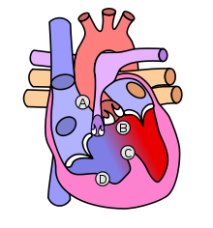
Classification
CHD
Acyanotic
Cyanotic
Teralogy of Fallot
Transposition of the great arteries
Atrioventricular septal defect
Left-to-right shunts
With no shunt - acyanotic obstructive (outflow obstruction)
- Ventricular Septal Defect (VSD)
- Pаtent Ductus Arteriosus (PDA)
- Atrial Septal Defect (ASD)
- Pulmonary Stenosis
- Aortic Stenosis
- Coarctation of aorta
This is 9 common lesions, which account for 85 percent of all cases CHD

Slide 3
Features of CHD
Complications of CHD
Abnormal Heart Murmurs
Congestive Heart Failure:
- rapid and labored breathing
- pallor with peripheral cyanosis
- tachycardia and excessive sweating
Recurrent Respiratory Tract Infections
Central cyanosis
Growth Failure, hypercyanotic spells
Diminished or nonpalpable pulses
Left to right shunt
Recurrent respiratory infections (pneumonia)
Infective endocarditis
Congestive heart failure
Right to left shunt
Cerebral infarction
Brain abscess
Diagnostic Techniques for CHD
Treatment of CHD
History taking, physical examination
Radiography
Electrocardiography (ECG)
Echocardiography (UCG)
Sometimes cardiac MRI or CT angiography, cardiac catheterization with angiocardiography
Control infection
Control heart failure
Control hypoxemic spells
Surgical treatment

Slide 4
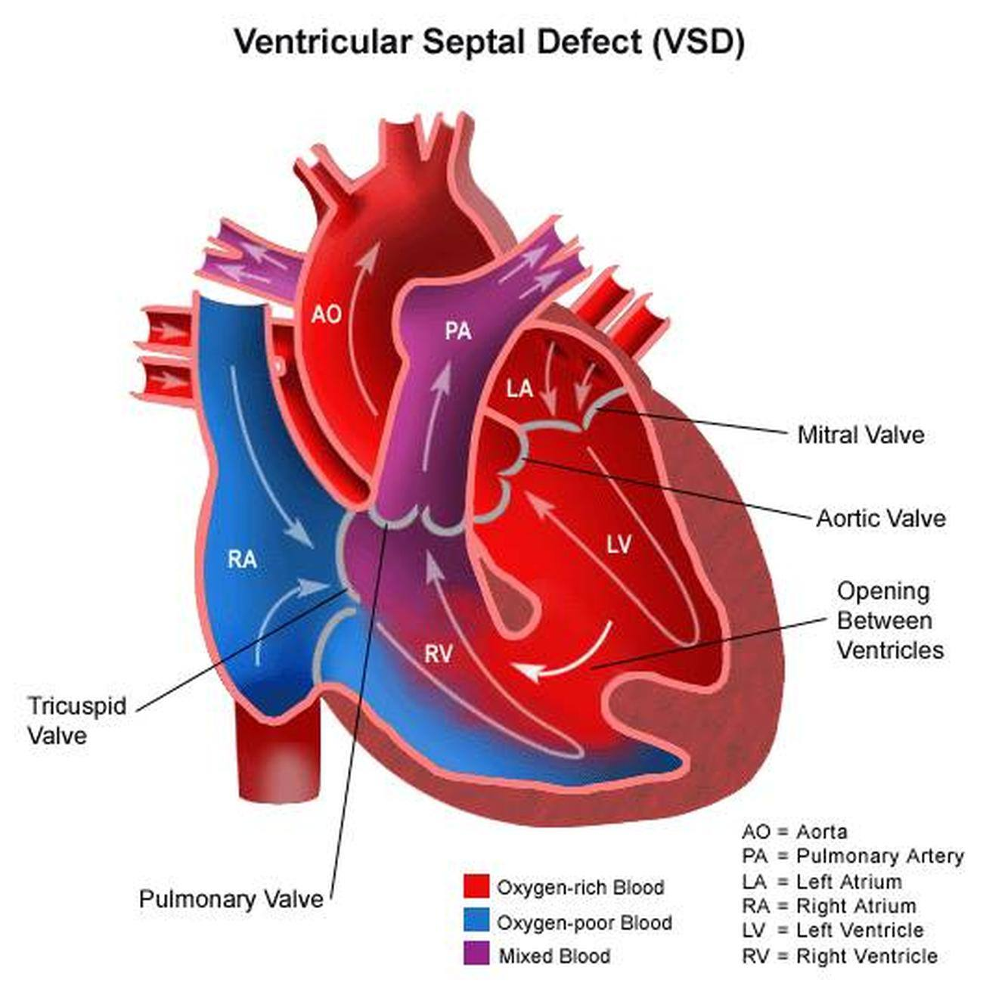
There are four basic types of VSD:
Membranous VSD. An opening in a particular area of the upper section of the ventricular septum (an area called the membranous septum), near the valves. This type of VSD is the most commonly operated on since most membranous VSDs do not usually close spontaneously.
Muscular VSD. An opening in the muscular portion of the lower section of the ventricular septum. This is the most common type of VSD. A large number of these muscular VSDs close spontaneously and do not require surgery.
Atrioventricular canal type VSD.
A VSD associated with atrioventricular canal defect. The VSD is located underneath the tricuspid and mitral valves.
Conal septal VSD. The rarest of VSDs which occur in the ventricular septum just below the pulmonary valve.
The size of the ventricular septal opening will affect the type of symptoms noted, the severity of symptoms, and the age at which they first occur. Symptoms may include: Fatigue, sweating, rapid breathing, heavy breathing, congested breathing, disinterest in feeding, or tiring while feeding, poor weight gain.
VSD permits a left-to-right shunt to occur at the ventricular level with 3 adverse hemodynamic consequences:
1) left ventricular (LV) volume overload, 2) increased pulmonary blood flow, 3) compromise of systemic cardiac output.
In time, as PVR increases, irreversible histologic changes may occur within the pulmonary vascular bed.
Untreated, a reversal of the flow occurs, leading to a right-to-left shunt with the development of increasing cyanosis (Eisenmenger complex)

Slide 5
Small VSDs
Smaller than the aortic valve in diameter (3mm).
Clinical features
Symptoms
  Asymptomatic
Physical signs
  Thrills at lower sternal edge
  Loud pansystolic murmur at lower left sternal edge
  Quiet pulmonary second sound (P2)
Investigations
  Chest X-ray - normal
  ECG - normal
  Echocardiography
  Demonstrates the precise anatomy of the defect. Assessment of haemodynamic effect using Doppler echocardiography
Management
  - Most will close spontaneously. Ensure by the disappearance of the murmur, normal ECG on follow up, normal echocardiogram.
  While the VSD is present, for prevention of bacterial endocarditis :
    - Maintain good dental hygiene
    - Antibiotic prophylaxis before dental extraction or any operation where there’ll be bleeding
  - Surgical closure may not be required
Large VSDs
Defects are the same size or bigger than the aortic valve.
Clinical features
Symptoms
  Heart failure with breathlessness and failure to thrive after 1 week old
  Recurrent chest infections
Physical signs
  Prominence of the left precordium
  Soft pansystolic murmur
  Apical mid-diastolic murmur at the apex
  Loud pulmonary second sound (P2)
  Tachypnoea, tachycardia and enlarged liver from heart failure.
Investigations
Chest X-ray
  Cardiomegaly
  Enlarged pulmonary arteries
  Pulmonary vascular markings
  Pulmonary oedema
ECG
  Biventricular hypertrophy by 2 months of age and signs of pulmonary HPT → right ventricular enlargement and hypertrophy
Echocardiography
  Demonstrates the anatomy defect, haemodynamic effects and severity of pulmonary HPT.

Slide 6
MANAGEMENT
Initial treatment – diuretics and digoxin/captopril.
Continued poor growth or pulmonary HPT requires closure of the defect.
Most VSDs are by surgery. But muscular defects by devices placed at cardiac catheterization.
Surgery is usually done at 3-6 months of age for :
Managing heart failure and failure to thrive.
Prevent permanent lung damage from pulmonary HPT and high blood flow.
KEY POINTS
- An atrioventricular (AV) septal defect may be complete, transitional, or partial; the majority of patients with the complete form have Down syndrome.
- A complete AV septal defect involves a large ostium primum atrial septal defect (ASD), a ventricular septal defect (VSD), and a common AV valve (often with significant regurgitation), all resulting in a large left-to-right shunt at both atrial and ventricular levels and enlargement of all 4 cardiac chambers.
- A partial AV septal defect also involves an ASD, but the common AV valve is partitioned into 2 separate AV orifices and there is no VSD, resulting in enlargement of the right heart chambers because of a large atrial shunt but no ventricular shunt.
- A transitional AV septal defect involves an ostium primum ASD, a common AV valve, and a small- or moderate-size VSD.
- Complete AV septal defect with a large left-to-right shunt causes signs of heart failure by age 4 to 6 weeks.
- Symptoms in partial AV septal defects vary with the degree of mitral regurgitation; if mild or absent, symptoms may develop during adolescence or early adulthood, but infants with moderate or severe mitral regurgitation often have manifestations of heart failure.
- Symptoms in transitional AV septal defect fall on a spectrum, depending on the size of the VSD.
- Defects are repaired surgically between age 2 to 4 months or 1 to 3 years, depending on the specific defect and severity of symptoms.

Slide 7
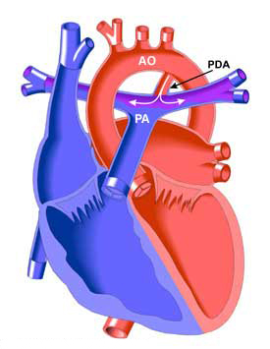
PATENT DUCTUS ARTERIOSUS (PDA)
Patent ductus arteriosus (PDA) is a persistence of the fetal connection (ductus arteriosus) between the aorta and pulmonary artery after birth. In the absence of other structural heart abnormalities or elevated pulmonary vascular resistance, shunting in the PDA will be left to right (from aorta to pulmonary artery).
Symptoms may include failure to thrive, poor feeding, tachycardia, and tachypnea. A continuous murmur at the upper left sternal border and bounding pulses are common. Diagnosis is by echocardiography. Administration of a cyclo-oxygenase inhibitor (ibuprofen lysine or indomethacin) with or without fluid restriction may be tried in premature infants with a significant shunt, but this therapy is not effective in term infants or older children with PDA. If the connection persists, surgical or catheter-based correction is indicated.
DIAGNOSIS
Chest x-ray and ECG
Echocardiography
  Diagnosis is suggested by clinical examination, supported by chest x-ray and ECG, and established by 2-dimensional echocardiography with color flow and Doppler studies.
  Chest x-ray and ECG are typically normal if the patent ductus arteriosus is small. If the shunt is significant, chest x-ray shows prominence of the left atrium, left ventricle, and ascending aorta and increased pulmonary vascular markings; ECG may show left ventricular hypertrophy.
  Echocardiography provides important information about the hemodynamic significance of a PDA by assessing a number of parameters, including the
Size of the PDA (often compared to the left pulmonary artery size)
Flow velocity in the PDA
Presence of left heart enlargement
Presence of diastolic reversal of flow in the descending aorta
Presence of diastolic antegrade flow in the left pulmonary artery
  Cardiac catheterization is not necessary unless used for therapy.

Slide 8
SYMPTOMS
-Depend on size of PDA
- Small – asymptomatic
Moderate to larger shunts – symptoms of CHF or even pulmonary HPT
PHYSICAL FINDINGS
- Continuous machinery murmur beneath the left clavicle
- Widened pulse pressure → collapsing or bounding pulse
-Larger shunts → mid-diastolic murmur at the apex
TREATMENT
Supportive medical therapy
In symptomatic premature infants, cyclo-oxygenase (COX) inhibitor therapy (eg, indomethacin, ibuprofen lysine)
Sometimes transcatheter closure or surgical repair
Typical medical management of patent ductus arteriosus includes fluid restriction, a diuretic (usually a thiazide), maintenance of hematocrit ≥ 35 %, providing a neutral thermal environment, and, for ventilated patients, use of positive end-expiratory pressure (PEEP) to improve gas exchange.
Treatment differs depending on whether the infant is premature or full term
KEY POINTS
Patent ductus arteriosus (PDA) is a persistence after birth of the normal fetal connection (ductus arteriosus) between the aorta and pulmonary artery, resulting in a left-to-right shunt.
Manifestations depend on the size of the PDA and the age of the child, but a continuous murmur is characteristic and, if loud, has a “machinery sounding” quality.
Premature infants may have respiratory distress or other serious complications (eg, necrotizing enterocolitis).
Over time, a large shunt causes left heart enlargement, pulmonary artery hypertension, and elevated pulmonary vascular resistance, ultimately leading to Eisenmenger syndrome if untreated.
For premature infants with hemodynamically significant PDA, give a cyclo-oxygenase (COX) inhibitor (eg, ibuprofen lysine or indomethacin). Surgical closure may benefit patients with a hemodynamically significant PDA in whom medical therapy has failed.
For full-term infants and older children, COX inhibitors are usually ineffective, but a catheter-delivered occlusion device or surgery typically provides long-term correction of this anomaly.

Slide 9
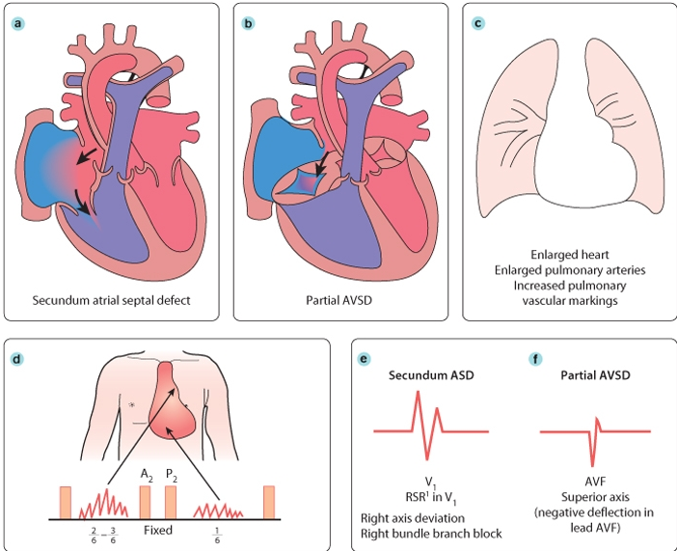
Atrial Septal Defects (ASD)
Atrioventricular (AV) septal defect consists of an ostium primum type atrial septal defect and a common AV valve, with or without an associated inlet (AV septal type) ventricular septal defect (VSD). These defects result from maldevelopment of the endocardial cushions.
Patients with no VSD component or a small VSD and good AV valve function may be asymptomatic.
If there is a large VSD component or significant AV valve regurgitation, patients often have signs of heart failure, including dyspnea with feeding, poor growth, tachypnea, and diaphoresis. Heart murmurs, tachypnea, tachycardia, and hepatomegaly are common.
Diagnosis is by echocardiography. Treatment is surgical repair for all but the smallest defects.
An AV septal defect may be
Complete, with a large (nonrestrictive) inlet ventricular septal defect
Transitional, with a small or moderate-sized (restrictive) ventricular septal defect
Partial, with no ventricular septal defect

Slide 10
Complete AV septal defect
A complete atrioventricular septal defect consists of a large ostium primum atrial septal defect (ASD) in the anteroinferior aspect of the septum, a nonrestrictive inlet ventricular septal defect, and a common AV valve orifice. This defect is also called a complete common AV canal defect. A left-to-right shunt occurs at the atrial and ventricular levels and is often large; AV valve regurgitation may be significant, sometimes causing a direct left ventricle-to-right atrial shunt. These abnormalities result in enlargement of all 4 cardiac chambers. Hemodynamic findings are similar to those of a large ventricular septal defect (VSD).
If a complete AV septal defect is unrepaired, over time, the increase in pulmonary blood flow, pulmonary artery pressure, and pulmonary vascular resistance may lead to reversal of shunt direction with cyanosis and Eisenmenger syndrome.
Transitional AV septal defect
A transitional atrioventricular septal defect consists of an ostium primum atrial septal defect; a restrictive inlet ventricular septal defect, which may be small or moderate in size; and a common AV valve, which may or may not be partitioned into a left and right orifice. This defect is also called transitional AV canal defect. The shunt at the atrial level is usually large. The shunt at the ventricular level is smaller than in complete AV septal defect, and right ventricular pressure is lower than left ventricular pressure. The hemodynamics depend largely on the size of the VSD and whether there is significant AV valve regurgitation.
Partial AV septal defect
A partial AV septal defect consists of an ostium primum atrial septal defect and partitioning of the common AV valve into 2 separate AV orifices, resulting in a so-called cleft in the mitral valve (left AV orifice). The ventricular septum is intact. Hemodynamic abnormalities are similar to those of ostium secundum ASD (eg, left-to-right shunt at the atrial level, enlarged right heart chambers, increased pulmonary blood flow) with the additional finding of variable degrees of AV valve regurgitation.
Unbalanced AV septal defect
In a subset of patients, the common AV valve is positioned more over one ventricle than the other. This condition, referred to as unbalanced AV septal defect, results in one ventricle receiving more blood flow and the other ventricle being underdeveloped.

Slide 11
Symptoms and Signs
Complete atrioventricular septal defect with a large left-to-right shunt causes signs of heart failure (eg, tachypnea, dyspnea during feeding, poor weight gain, diaphoresis) by age 4 to 6 weeks. Pulmonary vascular obstructive disease (Eisenmenger syndrome) is usually a late complication but may occur earlier, especially in children with Down syndrome.
Partial AV septal defects do not usually cause symptoms during childhood if left AV valve regurgitation is mild or absent. However, symptoms (eg, exercise intolerance, fatigue, palpitations) may develop during adolescence or early adulthood. Infants with moderate or severe left AV valve regurgitation often have signs of heart failure. Patients with transitional AV septal defects may have signs of heart failure if the ventricular septal defect is moderately restrictive with high flow or may be asymptomatic if the ventricular septal defect is highly restrictive (small).
Physical examination in children with complete AV septal defects shows an active precordium due to volume and pressure overload of the right ventricle; a single, loud 2nd heart sound (S2) due to pulmonary hypertension; a grade 2 to 3/6 systolic murmur; and sometimes a diastolic murmur at the apex and low left sternal. In patients with persistent elevation of pulmonary vascular resistance, especially those with Down syndrome, there may be no murmur, but a loud single S2 will be present.
Diagnosis
Chest x-ray and ECG
Echocardiography
Diagnosis of atrioventricular septal defects is suggested by clinical examination, supported by chest x-ray and ECG, and established by 2-dimensional echocardiography with color flow and Doppler studies.
Chest x-ray shows cardiomegaly with right atrial enlargement, biventricular enlargement, a prominent main pulmonary artery segment, and increased pulmonary vascular markings.
ECG shows a superiorly directed QRS axis (eg, left axis deviation or northwest axis), frequent 1st-degree AV block, left or right ventricular hypertrophy or both, and occasional right atrial enlargement and right bundle branch block.
Two-dimensional echocardiography with color flow and Doppler studies establishes the diagnosis and can provide important anatomic and hemodynamic information. Cardiac catheterization is not usually necessary unless hemodynamics must be further characterized before surgical repair (for example, to assess pulmonary vascular resistance in a patient presenting at an older age).

Slide 12
TREATMENT
Surgical repair
For heart failure, medical therapy (eg, diuretics, digoxin, angiotensin-converting enzyme inhibitors) before surgery
Complete atrioventricular septal defect should be repaired by age 2 to 4 months because most infants have heart failure and failure to thrive. Even if infants are growing well without significant symptoms, repair should be done before 6 months to prevent development of pulmonary vascular disease, especially in infants with Down syndrome.
Pulmonary artery banding may be used as a palliative procedure to delay the timing of open heart repair, particularly in premature infants or those with associated abnormalities that make complete repair at an early age or low body weight higher risk.
For asymptomatic patients with a partial defect, elective surgery is done at age 1 to 3 years. Surgical mortality rate should be very low.
For patients with large shunts and heart failure, diuretics, digoxin, and angiotensin-converting enzyme (ACE) inhibitors may help to manage symptoms before surgery.
Endocarditis prophylaxis is not needed preoperatively and is required only for the first 6 months after repair or if there is a residual defect adjacent to a surgical patch.
KEY POINTS
An atrioventricular (AV) septal defect may be complete, transitional, or partial; the majority of patients with the complete form have Down syndrome.
A complete AV septal defect involves a large ostium primum atrial septal defect (ASD), a ventricular septal defect (VSD), and a common AV valve (often with significant regurgitation), all resulting in a large left-to-right shunt at both atrial and ventricular levels and enlargement of all 4 cardiac chambers.
A partial AV septal defect also involves an ASD, but the common AV valve is partitioned into 2 separate AV orifices and there is no VSD, resulting in enlargement of the right heart chambers because of a large atrial shunt but no ventricular shunt.
A transitional AV septal defect involves an ostium primum ASD, a common AV valve, and a small- or moderate-size VSD.
Complete AV septal defect with a large left-to-right shunt causes signs of heart failure by age 4 to 6 weeks.
Symptoms in partial AV septal defects vary with the degree of mitral regurgitation; if mild or absent, symptoms may develop during adolescence or early adulthood, but infants with moderate or severe mitral regurgitation often have manifestations of heart failure.
Symptoms in transitional AV septal defect fall on a spectrum, depending on the size of the VSD.
Defects are repaired surgically between age 2 to 4 months or 1 to 3 years, depending on the specific defect and severity of symptoms.

Slide 13
Eisenmenger syndrome is a complication of uncorrected large intracardiac or aortic to pulmonary artery left-to-right shunts. Increased pulmonary resistance may develop over time, eventually leading to severe pulmonary hypertension, bidirectional shunting with progressively increasing right-to-left shunting. Cyanosis and hypoxia inevitably lead to multiple complications.
Symptoms of Eisenmenger syndrome develop at different ages depending on the cause.
Symptoms include cyanosis, syncope, dyspnea during exertion, fatigue, chest pain, and palpitations. Some patients die suddenly.
Hemoptysis is a late symptom. Manifestations of cerebral emboli, brain abscess, or endocarditis may develop.
Secondary polycythemia commonly causes symptoms (eg, transient ischemic attacks with slurred speech or other neurologic symptoms, visual problems, headaches, increased fatigue, signs of thromboembolism). Abdominal pain may result from cholelithiasis. Painful gouty arthritis may result from hyperuricemia.
Physical examination detects central cyanosis and digital clubbing. Signs of right ventricular failure (eg, hepatomegaly, peripheral edema, jugular venous distention) may be present. Palpation may reveal a right ventricular heave. A holosystolic murmur of tricuspid regurgitation may be present at the lower left sternal border. An early diastolic, decrescendo, high-pitched murmur of pulmonic regurgitation may be audible along the left sternal border. A loud, single 2nd heart sound (S2) is a constant finding; a pulmonary ejection click is common.
Diagnosis
Chest x-ray and ECG
Echocardiography or cardiac catheterization
Chest x-ray usually shows prominent central pulmonary arteries, peripheral pulmonary vessel pruning, and right heart enlargement.
ECG shows right ventricular hypertrophy, right axis deviation, and, occasionally, right atrial enlargement.
Treatment
  Drugs to treat pulmonary arterial hypertension (eg, prostacyclin analogs, endothelin antagonists, phosphodiesterase-5 inhibitors)
  "Treat and repair" approach
  Supportive care
  Heart and lung transplantation
Ideally, corrective operations should have been done earlier to prevent Eisenmenger syndrome. There is no specific treatment once the syndrome develops, other than heart and lung transplantation, but drugs that may lower pulmonary artery pressure have been shown to have at least a modest beneficial effect on survival
Prostacyclin analogs (eg, treprostinil, epoprostenol), endothelin antagonists (eg, bosentan), and phosphodiesterase-5 inhibitors (eg, sildenafil, tadalafil).
Symptomatic polycythemia can be treated by cautious phlebotomy to lower hematocrit to 55 to 65% plus simultaneous volume replacement with normal saline. Hyperuricemia can be treated with allopurinol.
Anticoagulation therapy is controversial because the risk of pulmonary artery thrombosis and other thromboembolic phenomena must be balanced with the risk of pulmonary hemorrhage. Warfarin therapy is potentially harmful due to the risk of pulmonary hemorrhage, so anticoagulant use should be individualized . Although there is no clear evidence, low-dose aspirin
Life expectancy depends on type and severity of the underlying congenital anomaly and ranges from 20 to 50 years. In untreated patients, low exercise tolerance and secondary complications severely limit quality of life. Use of advanced pulmonary vasodilator therapies has been shown to improve functional capacity and appears to improve survival.
All patients should be given endocarditis prophylaxis before dental or surgical procedures that are likely to cause bacteremia.

Slide 14
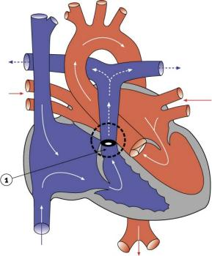
PULMONARY STENOSIS
Pulmonic stenosis (PS) is narrowing of the pulmonary outflow tract causing obstruction of blood flow from the right ventricle to the pulmonary artery during systole.
In children, these problems can include:
  A valve that has leaflets that are partially fused together.
  A valve that has thick leaflets that do not open all the way.
  The area above or below the pulmonary valve is narrowed.
There are four different types of pulmonary stenosis:
Valvar pulmonary stenosis. The valve leaflets are thickened and/or narrowed.
Supravalvar pulmonary stenosis. The pulmonary artery just above the pulmonary valve is narrowed.
Subvalvar (infundibular) pulmonary stenosis. The muscle under the valve area is thickened, narrowing the outflow tract from the right ventricle.
Branch peripheral pulmonic stenosis. The right or left pulmonary artery is narrowed, or both may be narrowed.
Pulmonary stenosis may be present in varying degrees, classified according to how much obstruction to blood flow is present. A child with severe pulmonary stenosis could be quite ill, with major symptoms noted early in life. A child with mild pulmonary stenosis may have few or no symptoms, or perhaps none until later in adulthood. A moderate or severe degree of obstruction can become worse with time.
Pulmonary stenosis is a component of half of all complex congenital heart defects.
SYMPTOMS AND SIGNS
Many children with pulmonic stenosis remain asymptomatic for years and do not present to a physician until adulthood. Even then many patients remain asymptomatic. When symptoms of pulmonic stenosis develop, they resemble those of aortic stenosis (syncope, angina, dyspnea).
Visible and palpable signs reflect the effects of right ventricular (RV) hypertrophy and include a prominent jugular venous a wave (due to forceful atrial contraction against a hypertrophied RV), an RV precordial lift or heave, and a left parasternal systolic thrill at the 2nd intercostal space.
AUSCULTATION
Widened 2nd heart sound (S2) and delayed pulmonic component of S2 (P2)
Harsh crescendo-decrescendo ejection murmur

Slide 15
- On auscultation, the 1st heart sound (S1) is normal and the normal splitting of the S2 is widened because of prolonged pulmonic ejection (P2 is delayed). In RV failure and hypertrophy, the 3rd and 4th heart sounds (S3 and S4) are rarely audible at the left parasternal 4th intercostal space. A click in congenital PS is thought to result from abnormal ventricular wall tension. The click occurs early in systole (very near S2) and is not affected by hemodynamic changes. A harsh crescendo-decrescendo ejection murmur is audible and is heard best at the left parasternal 2nd (valvular stenosis) or 4th (infundibular stenosis) intercostal space with the diaphragm of the stethoscope when the patient leans forward.
Unlike the aortic stenosis murmur, a pulmonic stenosis murmur does not radiate, and the crescendo component lengthens as stenosis progresses. The murmur grows louder immediately with Valsalva release and with inspiration; the patient may need to be standing for this effect to be heard.
DIAGNOSIS
Echocardiography
Diagnosis of pulmonic stenosis is confirmed by Doppler echocardiography, which can characterize the severity as
  Mild: Peak gradient < 36 mm Hg
  Moderate: Peak gradient 36 to 64 mm Hg
  Severe: Peak gradient > 64 mm Hg
ECG may be normal or show RV hypertrophy or right bundle branch block.
Right heart catheterization is indicated only when 2 levels of obstruction are suspected (valvular and infundibular), when clinical and echocardiographic findings differ, or before intervention is done.
TREATMENT
Sometimes balloon valvuloplasty.
Prognosis of pulmonic stenosis without treatment is generally good and improves with appropriate intervention.
Treatment of pulmonic stenosis is balloon valvuloplasty.
Percutaneous valve replacement may be offered at highly selected congenital heart centers, especially for younger patients or those with multiple previous procedures, in order to reduce the number of open heart procedures.
KEY POINTS
Pulmonic stenosis is usually congenital, but symptoms (eg, syncope, angina, dyspnea) usually do not appear until adulthood.
Heart sounds include increased splitting of S2 and a harsh crescendo-decrescendo ejection murmur heard best at the left parasternal 2nd or 4th intercostal space when the patient leans forward; the murmur grows louder immediately with Valsalva release and with inspiration.
Balloon valvuloplasty is done for symptomatic patients and asymptomatic patients with normal systolic function and a peak gradient > 40 to 50 mm Hg.

Slide 16
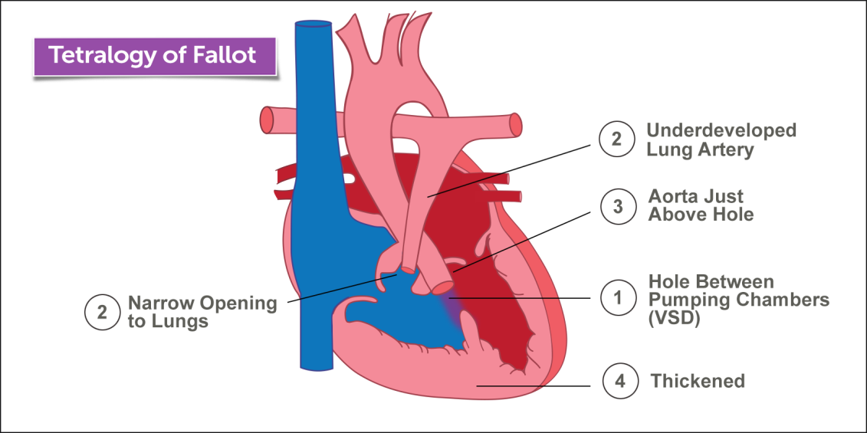
TETRALOGY OF FALLOT consists of 4 features: a large ventricular septal defect, right ventricular outflow tract obstruction and pulmonic valve stenosis, right ventricular hypertrophy, and over-riding of the aorta. Symptoms include cyanosis, dyspnea with feeding, poor growth, and hypercyanotic "tet" spells (sudden, potentially lethal episodes of severe cyanosis). A harsh systolic murmur at the left upper sternal border with a single 2nd heart sound (S2) is common. Diagnosis is by echocardiography. Definitive treatment is surgical repair.
HYPERCYANOTIC SPELLS
In some children with unrepaired tetralogy of Fallot, most often those several months up to 2 years of age, sudden episodes of profound cyanosis and hypoxia (hypercyanotic or "tet" spells) may occur, which may be lethal. A spell may be triggered by any event that slightly decreases oxygen saturation (eg, crying, defecating) or that suddenly decreases systemic vascular resistance (eg, playing, kicking legs when awakening) or by sudden onset of tachycardia or hypovolemia.
The mechanism of a hypercyanotic spell based on an increase in right-to-left shunting and a fall in arterial saturation. Factors include an increase in right ventricular outflow tract obstruction, an increase in pulmonary vascular resistance, and/or a decrease in systemic resistance—a vicious circle caused by the initial fall in arterial PO2, which stimulates the respiratory center and causes hyperpnea and increased adrenergic tone. The increased circulating catecholamines then stimulate increased contractility, which increases outflow tract obstruction.
A severe spell may lead to limpness, seizures, and occasionally death. During play, some toddlers may intermittently squat, a position that increases systemic vascular resistance and aortic pressure, which decreases right-to-left ventricular shunting and thus raises arterial oxygen saturation.
Auscultation detects a harsh grade 3 to 5/6 systolic ejection murmur at the left mid and upper sternal border. The murmur in tetralogy is due to the pulmonic stenosis; the ventricular septal defect is usually silent because it is large and has no pressure gradient. The 2nd heart sound (S2) is usually single because the pulmonary component is markedly reduced. A prominent right ventricular impulse and a systolic thrill may be present.
PATHOPHYSIOLOGY
The ventricular septal defect in tetralogy of Fallot is often described as a malalignment type, since the conal septum is displaced anteriorly. This displaced septum protrudes into the pulmonary outflow tract, often resulting in obstruction and hypoplasia of the downstream structures, including the pulmonary valve, main pulmonary artery, and branch pulmonary arteries.
The ventricular septal defect is typically large; thus, systolic pressures in the right and left ventricles (and in the aorta) are the same. Pathophysiology depends on the degree of right ventricular outflow obstruction.
A mild obstruction may result in a net left-to-right shunt through the VSD; a severe obstruction causes a right-to-left shunt, resulting in low systemic arterial saturation (cyanosis) that is unresponsive to supplemental oxygen.

Slide 17
DIAGNOSIS
Chest x-ray ; ECG; Echocardiography, Anamnesis
Diagnosis of tetralogy of Fallot is suggested by history and clinical examination, supported by chest x-ray and ECG, and established by 2-dimensional echocardiography with color flow and Doppler studies.
Chest x-ray shows a boot-shaped heart with a concave main pulmonary artery segment and diminished pulmonary vascular markings. A right aortic arch is present in 25%.
ECG shows right ventricular hypertrophy and may also show right atrial hypertrophy.
Anamnesis: Manifestations depend on the degree of right ventricle outflow obstruction; severely affected neonates have marked cyanosis, dyspnea with feeding, poor weight gain, and a harsh grade 3 to 5/6 systolic ejection murmur. The murmur comes from the pulmonary stenosis; the VSD shunt is silent.
TREATMENT
  For symptomatic neonates, prostaglandin E1 infusion
  For hypercyanotic spells, knee-chest positioning, calming, oxygen, IV fluids, and sometimes drugs
  Surgical repair
Neonates with severe cyanosis may be palliated with an infusion of prostaglandin E1 to open the ductus arteriosus and thereby increase pulmonary blood flow.
Hypercyanotic spells
Hypercyanotic spells require immediate intervention. The first steps are to
  Place infants in a knee-chest position (older children usually squat spontaneously and do not develop hypercyanotic spells)
  Establish a calm environment
  Give supplemental oxygen
  Give IV fluids for volume expansion
If the spell persists, standard medical therapy includes morphine, phenylephrine, and beta-blockers (propranolol )
Ultimately, if positioning and drugs do not relieve the spell or if the infant is rapidly deteriorating, tracheal intubation with muscle paralysis and general anesthesia, extracorporeal membrane oxygenation (ECMO), or urgent surgical intervention may be necessary.
Propranolol 0.25 to 1 mg/kg orally every 6 hours (given until surgical repair) may prevent recurrences. Most experts think that even one significant spell indicates the need for expeditious surgical repair.
DEFINITIVE MANAGEMENT
Complete repair of tetralogy of Fallot consists of patch closure of the ventricular septal defect, widening of the right ventricular outflow tract with muscle resection, pulmonic valvuloplasty and, when warranted, patch augmentation of the main pulmonary artery. If there is significant hypoplasia of the pulmonic valve annulus, a transannular patch is placed. Surgery is usually done electively at age 2 to 6 months but can be done at any time if symptoms are present or right ventricular outflow tract obstruction is severe.

Slide 18
COARCTATION OF THE AORTA is a localized narrowing of the aortic lumen that results in upper-extremity hypertension, left ventricular hypertrophy, and malperfusion of the abdominal organs and lower extremities. Symptoms vary with the anomaly’s severity and range from headache, chest pain, cold extremities, fatigue, and leg claudication to fulminant heart failure and shock. A soft bruit may be heard over the coarctation site. Diagnosis is by echocardiography or by CT or MR angiography. Treatment is balloon angioplasty with stent placement, or surgical correction.
PATHOPHYSIOLOGY
Coarctation of the aorta usually occurs at the proximal thoracic aorta just beyond the left subclavian artery and just across from the opening of the ductus arteriosus. Coarctation rarely involves the abdominal aorta.
Physiologic consequences involve 2 phenomena:
Pressure overload in the arterial circulation proximal to the coarctation
Hypoperfusion distal to the coarctation
Pressure overload causes left ventricular hypertrophy and hypertension in the upper part of the body, including the brain.
Hypoperfusion affects the abdominal organs and lower extremities. Malperfusion of the intestine increases the risk of sepsis due to enteric organisms.
Ultimately, the pressure gradient increases collateral circulation to the abdomen and lower extremities via intercostal, internal mammary, scapular, and other arteries.
Untreated coarctation may result in left ventricular hypertrophy, heart failure, collateral vessel formation, bacterial endocarditis, intracranial hemorrhage, hypertensive encephalopathy, and hypertensive cardiovascular disease during adulthood. Patients with untreated coarctation are at increased risk of aortic dissection or rupture later in life or in association with pregnancy. The ascending aorta is the area most frequently involved in dissection or rupture. Current data suggest that this risk is less likely a direct consequence of the coarctation and more likely related to a bicuspid aortic valve and associated aortopathy.
SYMPTOMS AND SIGNS
If coarctation is significant, circulatory shock with renal insufficiency (oliguria or anuria) and metabolic acidosis may develop in the first 7 to 10 days of life and may mimic findings of other systemic disorders such as sepsis. Infants with critical (severe) coarctation are likely to become acutely ill as soon as the ductus arteriosus constricts or closes.
Less severe coarctation may be asymptomatic during infancy. Subtle symptoms (eg, headache, chest pain, fatigue, and leg claudication during physical activities) may be present as children age. Upper-extremity hypertension is often present, but heart failure rarely develops after the neonatal period. Rarely, in adulthood, intracerebral aneurysms rupture, resulting in subarachnoid or intracerebral hemorrhage.
Typical physical examination findings include strong pulses and hypertension in the upper extremities, diminished or delayed femoral pulses, and a blood pressure (BP) gradient, with low or unobtainable arterial BP in the lower extremities.
A grade 2 to 3/6 ejection systolic murmur is often present at the upper left sternal border, left axilla, and sometimes most prominently in the left interscapular area (see table Heart Murmur Intensity). An apical systolic ejection click may be present if a bicuspid aortic valve is also present. Dilated intercostal collateral arteries may cause a continuous murmur in the intercostal spaces.

Slide 19
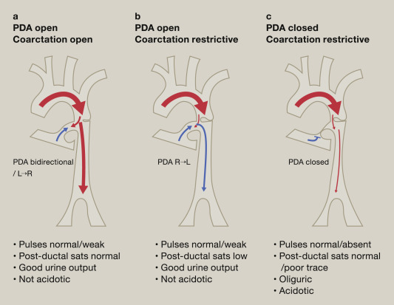
COARCTATION OF THE AORTA is a localized narrowing of the aortic lumen that results in upper-extremity hypertension, left ventricular hypertrophy, and malperfusion of the abdominal organs and lower extremities. Symptoms vary with the anomaly’s severity and range from headache, chest pain, cold extremities, fatigue, and leg claudication to fulminant heart failure and shock. A soft bruit may be heard over the coarctation site. Diagnosis is by echocardiography or by CT or MR angiography. Treatment is balloon angioplasty with stent placement, or surgical correction.
PATHOPHYSIOLOGY
Coarctation of the aorta usually occurs at the proximal thoracic aorta just beyond the left subclavian artery and just across from the opening of the ductus arteriosus. Coarctation rarely involves the abdominal aorta.
Physiologic consequences involve 2 phenomena:
Pressure overload in the arterial circulation proximal to the coarctation
Hypoperfusion distal to the coarctation
Pressure overload causes left ventricular hypertrophy and hypertension in the upper part of the body, including the brain.
Hypoperfusion affects the abdominal organs and lower extremities. Malperfusion of the intestine increases the risk of sepsis due to enteric organisms.
Ultimately, the pressure gradient increases collateral circulation to the abdomen and lower extremities via intercostal, internal mammary, scapular, and other arteries.
Untreated coarctation may result in left ventricular hypertrophy, heart failure, collateral vessel formation, bacterial endocarditis, intracranial hemorrhage, hypertensive encephalopathy, and hypertensive cardiovascular disease during adulthood. Patients with untreated coarctation are at increased risk of aortic dissection or rupture later in life or in association with pregnancy. The ascending aorta is the area most frequently involved in dissection or rupture. Current data suggest that this risk is less likely a direct consequence of the coarctation and more likely related to a bicuspid aortic valve and associated aortopathy.
SYMPTOMS AND SIGNS
If coarctation is significant, circulatory shock with renal insufficiency (oliguria or anuria) and metabolic acidosis may develop in the first 7 to 10 days of life and may mimic findings of other systemic disorders such as sepsis. Infants with critical (severe) coarctation are likely to become acutely ill as soon as the ductus arteriosus constricts or closes.
Less severe coarctation may be asymptomatic during infancy. Subtle symptoms (eg, headache, chest pain, fatigue, and leg claudication during physical activities) may be present as children age. Upper-extremity hypertension is often present, but heart failure rarely develops after the neonatal period. Rarely, in adulthood, intracerebral aneurysms rupture, resulting in subarachnoid or intracerebral hemorrhage.
Typical physical examination findings include strong pulses and hypertension in the upper extremities, diminished or delayed femoral pulses, and a blood pressure (BP) gradient, with low or unobtainable arterial BP in the lower extremities.
A grade 2 to 3/6 ejection systolic murmur is often present at the upper left sternal border, left axilla, and sometimes most prominently in the left interscapular area (see table Heart Murmur Intensity). An apical systolic ejection click may be present if a bicuspid aortic valve is also present. Dilated intercostal collateral arteries may cause a continuous murmur in the intercostal spaces.

Slide 20
DIAGNOSIS
Chest x-ray and ECG
Echocardiography or CT or MR angiography
Diagnosis is suggested by clinical examination (including BP measurement in all 4 extremities and palpation of femoral pulses), supported by chest x-ray and ECG, and established by 2-dimensional echocardiography with color flow and Doppler studies or, in older patients with a suboptimal echocardiographic window, with CT or MR angiography.
Chest x-ray shows coarctation as a “3” sign in the upper left mediastinal shadow. Heart size is normal unless heart failure supervenes. Dilated intercostal collateral arteries may erode the 3rd to 8th ribs, causing rib notching, but rib notching is seldom seen before age 5 years.
ECG usually shows left ventricular hypertrophy but findings may be normal. Because the presence of a coarctation alters fetal circulation by shifting a higher proportion of flow through the right ventricle, neonates and infants with severe coarctation usually have right ventricular hypertrophy rather than left ventricular hypertrophy.
There is typically a blood pressure gradient between upper and lower extremities, an easily distinguished amplitude differential between the upper and lower extremity pulses, and a grade 2 to 3/6 ejection systolic murmur, sometimes most prominent in the left interscapular area.
TREATMENT
For symptomatic neonates, prostaglandin E1 infusion
For hypertension, beta-blockers
Surgical correction for neonates, infants, and small children
Sometimes balloon angioplasty (sometimes with stent placement) in older children
Symptomatic neonates are treated promptly. In infants with very mild coarctation and no signs of lower body hypoperfusion, the condition is monitored until definitive repair is done.
Medical management of coarctation
Symptomatic neonates require cardiopulmonary stabilization with infusion of prostaglandin E1 to reopen the constricted ductus arteriosus. Opening the ductus and its aortic ampulla provides some relief of the aortic obstruction. It also allows pulmonary artery blood to bypass the aortic obstruction via right-to-left shunting across the ductus and increases perfusion of the descending aorta, improving systemic perfusion and reversing metabolic acidosis.
Diuretics can help treat heart failure symptoms. IV milrinone can be useful in select circumstances (eg, infants with heart failure and significant left ventricle dysfunction).
In nonemergent situations, patients with hypertension may be treated with beta-blockers; angiotensin-converting enzyme (ACE) inhibitors may adversely affect renal function. After repair of the coarctation, hypertension may persist or develop years after repair and can be treated with beta-blockers, ACE inhibitors, angiotensin II receptor blockers, or calcium channel blockers.
Supplemental oxygen should be used with caution in neonates because the resulting decrease in pulmonary vascular resistance may increase pulmonary blood flow at the expense of systemic blood flow.
Surgical management
Surgical options include resection and end-to-end anastomosis, patch aortoplasty, and left subclavian flap aortoplasty. In severe coarctation manifesting early in life, the transverse aorta and isthmus are often hypoplastic, and this region of the aorta may need to be surgically enlarged.

Slide 21
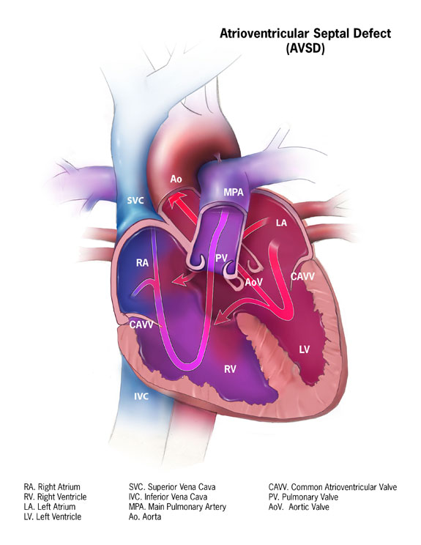
An atrioventricular septal defect (AVSD) is a heart defect in which there are holes between the chambers of the right and left sides of the heart, and the valves that control the flow of blood between these chambers may not be formed correctly. This condition is also called atrioventricular canal (AV canal) defect or endocardial cushion defect. In AVSD, blood flows where it normally should not go. The blood may also have a lower than normal amount of oxygen, and extra blood can flow to the lungs. This extra blood being pumped into the lungs forces the heart and lungs to work hard and may lead to congestive heart failure.
An AV septal defect may be
Complete, with a large (nonrestrictive) inlet ventricular septal defect
Transitional, with a small or moderate-sized (restrictive) ventricular septal defect
Partial, with no ventricular septal defect
1. Complete AVSD . . .
A complete AVSD occurs when there is a large hole in the center of the heart which allows blood to flow between all four chambers of the heart. This hole occurs where the septa (walls) separating the two top chambers (atria) and two bottom chambers (ventricles) normally meet. There is also one common atrioventricular valve in the
center of the heart instead of two separate valves – the tricuspid valve on the right side of the heart and the mitral valve on the left side of the heart. This common valve often has leaflets (flaps) that may not be formed correctly or do not close tightly. A complete AVSD arises during pregnancy when the common valve fails to separate into the two distinct valves (tricuspid and mitral valves) and when the septa (walls) that split the upper and lower chambers of the heart do not grow all the way to meet in the center of the heart.
2. Transitional AV septal defect
A transitional atrioventricular septal defect consists of an ostium primum atrial septal defect; a restrictive inlet ventricular septal defect, which may be small or moderate in size; and a common AV valve, which may or may not be partitioned into a left and right orifice. This defect is also called transitional AV canal defect. The shunt at the atrial level is usually large. The shunt at the ventricular level is smaller than in complete AV septal defect, and right ventricular pressure is lower than left ventricular pressure. The hemodynamics depend largely on the size of the VSD and whether there is significant AV valve regurgitation.
3. Partial or Incomplete AVSD .
A partial or incomplete AVSD occurs when the heart has some, but not all of the defects of a complete AVSD. There is usually a hole in the atrial wall or in the ventricular wall near the center of the heart. A partial AVSD usually has both mitral and tricuspid valves, but one of the valves (usually mitral) may not close completely, allowing blood to leak backward from the left ventricle into the left atrium.

Slide 22
Unbalanced AV septal defect
In a subset of patients, the common AV valve is positioned more over one ventricle than the other. This condition, referred to as unbalanced AV septal defect, results in one ventricle receiving more blood flow and the other ventricle being underdeveloped.
Symptoms and Signs
Complete atrioventricular septal defect with a large left-to-right shunt causes signs of heart failure (eg, tachypnea, dyspnea during feeding, poor weight gain, diaphoresis) by age 4 to 6 weeks. Pulmonary vascular obstructive disease (Eisenmenger syndrome) is usually a late complication but may occur earlier, especially in children with Down syndrome.
Partial AV septal defects do not usually cause symptoms during childhood if left AV valve regurgitation is mild or absent. However, symptoms (eg, exercise intolerance, fatigue, palpitations) may develop during adolescence or early adulthood. Infants with moderate or severe left AV valve regurgitation often have signs of heart failure. Patients with transitional AV septal defects may have signs of heart failure if the ventricular septal defect is moderately restrictive with high flow or may be asymptomatic if the ventricular septal defect is highly restrictive (small).
Physical examination in children with complete AV septal defects shows an active precordium due to volume and pressure overload of the right ventricle; a single, loud 2nd heart sound (S2) due to pulmonary hypertension; a grade 2 to 3/6 systolic murmur; and sometimes a diastolic murmur at the apex and low left sternal border. In patients with persistent elevation of pulmonary vascular resistance, especially those with Down syndrome, there may be no murmur, but a loud single S2 will be present.
Most children with a partial defect have examination findings similar to patients with a secundum ASD, wide splitting of the S2 and a midsystolic (eg, ejection systolic) murmur audible at the upper left sternal border. A mid-diastolic murmur may be present at the lower left sternal border when the atrial shunt is large. A cleft in the left AV valve results in a blowing apical systolic murmur of mitral regurgitation.
Diagnosis
Chest x-ray and ECG
Echocardiography
Diagnosis of atrioventricular septal defects is suggested by clinical examination, supported by chest x-ray and ECG, and established by 2-dimensional echocardiography with color flow and Doppler studies.
Chest x-ray shows cardiomegaly with right atrial enlargement, biventricular enlargement, a prominent main pulmonary artery segment, and increased pulmonary vascular markings.
ECG shows a superiorly directed QRS axis (eg, left axis deviation or northwest axis), frequent 1st-degree AV block, left or right ventricular hypertrophy or both, and occasional right atrial enlargement and right bundle branch block.
Two-dimensional echocardiography with color flow and Doppler studies establishes the diagnosis and can provide important anatomic and hemodynamic information. Cardiac catheterization is not usually necessary unless hemodynamics must be further characterized before surgical repair (for example, to assess pulmonary vascular resistance in a patient presenting at an older age).
Treatment
- Surgical repair. For heart failure, medical therapy (eg, diuretics, digoxin, angiotensin-converting enzyme inhibitors) before surgery
Complete atrioventricular septal defect should be repaired by age 2 to 4 months because most infants have heart failure and failure to thrive. Even if infants are growing well without significant symptoms, repair should be done before 6 months to prevent development of pulmonary vascular disease, especially in infants with Down syndrome.

