Slide 1

Functional Gastrointestinal Disorders in children

Slide 2
History
Rome I: In 1994, Rome I was published as The Functional Gastrointestinal Disorders: Diagnosis, Pathophysiology, and Treatment—A Multinational Consensus.
Rome II: By the mid-1999s, the concept of FGID classification and the use of diagnostic criteria was promoted. In Rome II, the pediatric population of FGIDs was added.
Rome III: It differed from Rome I and II by the use of more evidence-based rather than consensus-based data in 2006.
Rome IV: It was published in 2016 and tried to address the limitations of a symptom-based criteria.

Slide 3
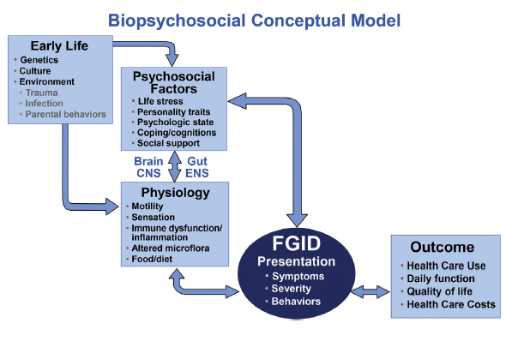

Slide 4
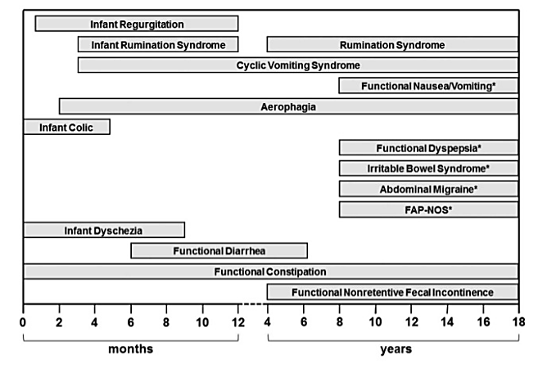

Slide 5
G - Functional Gastrointestinal Disorders Neonates and toddlers
G1. Infant regurgitation
G2. Rumination syndrome
G3. Cyclic vomiting syndrome (CVS)
G4. Infant colic
G5. Functional diarrhea
G6. Infant dyschezia
G7. Functional constipation

Slide 6
G1. Infant Regurgitation
Must include both of the following in otherwise healthy infants 3 weeks to 12 months of age:
Regurgitation 2 or more times per day for 3 or more weeks
No retching, hematemesis, aspiration, apnea, failure to thrive, feeding or swallowing difficulties, or abnormal posturing

Slide 7
G4. Infant Colic
For clinical purposes, must include all of the following:
An infant who is <5 months of age when the symptoms start and stop
Recurrent and prolonged periods of infant crying, fussing, or irritability reported by caregivers that occur without obvious cause and cannot be prevented or resolved by caregivers
No evidence of infant failure to thrive, fever, or illness in infants from birth to 4 months of age
“Fussing” refers to intermittent distressed vocalization and has been defined as “[behavior] that is not quite crying but not awake and content either.” Infants often fluctuate between crying and fussing, so that the two symptoms are difficult to distinguish in practice.

Slide 8
For clinical research, a diagnosis of infant colic must meet the preceding diagnostic criteria and also include both of the following:
Caregiver reports infant has cried or fussed for 3 or more hours/day during 3 or more days in 7 days in a telephone or face-to-face screening interview with a researcher or clinician;
Total 24-hour crying plus fussing in the selected group of infants is confirmed to be 3 hours or more when measured by at least one, prospectively kept, 24-hour behavior diary.

Slide 9
G7. Functional constipation
Diagnostic criteria Must include one month of at least two of the following in infants up to 4 years of age:
Two or fewer defecations per week
History of excessive stool retention
History of painful or hard bowel movements
History of large diameter stools
Presence of a large fecal mass in the rectum
In toilet trained children, the following additional criteria may be used:
At least one episode/week of incontinence after the acquisition of toileting skills
History of large diameter stools which may obstruct the toilet

Slide 10
H. Childhood Functional GI Disorders: Child/Adolescent
H1. Functional nausea and vomiting disorders
H1a. Cyclic vomiting syndrome (CVS)
H1b. Functional nausea and functional vomiting
H1c. Rumination syndrome
H1d. Aerophagia
H2. Functional abdominal pain disorders
H2a. Functional dyspepsia
H2a1. Postprandial distress syndrome
H2a2. Epigastric pain syndrome
H2b. Irritable bowel syndrome (IBS)
H2c. Abdominal migraine
H2d. Functional abdominal pain − not otherwise specified
H3. Functional defecation disorders
H3a. Functional constipation
H3b. Non-retentive fecal incontinence

Slide 11
H1a. Cyclic Vomiting Syndrome
Prevalence
Cyclic vomiting syndrome (CVS) occurs from infancy to middle-age adulthood, with a peak prevalence between 2 and 7 years. Based on maternal reports, the prevalence of CVS in the US was 0.0% in infants <1 year, and 3.4% in toddlers. The population-based survey study from Colombia found the prevalence of CVS to be 3.8% in infants <1 year and 6.1% in children from 1-4 years of age.
Presentation
CVS is presented as stereotypic, recurrent episodes of vomiting which last hours to days with symptom-free interval periods which last weeks to months. Vomiting attacks may occur sporadically or at regular intervals, and they are characterized by onset at the same time of day, most often late at night or early in the morning.

Slide 12
Diagnostic criteria, must include all of the following:
Two or more periods of intense, unremitting nausea and paroxysmal vomiting, lasting hours to days within a 6-month period
Episodes are stereotypical in each patient
Episodes are separated by weeks to months with return to baseline health between episodes
After appropriate evaluation, the symptoms cannot be attributed to another medical condition
Treatment
Treatment focusses on two aspects of the CVS attacks. One aspect is the prevention of episodes in children who suffer from frequent, severe and prolonged attacks. Daily treatment with cyproheptadine, pizotifen, amitriptyline, propranolol or erythromycin can diminish the frequency of episodes or can even prevent them entirely. The other aspect is to reduce the severity of the attacks. Oral acid-inhibiting drugs for the protection of esophageal mucosa and lorazepam for antiemetic, anxiolytic and sedative purposes can be considered.

Slide 13
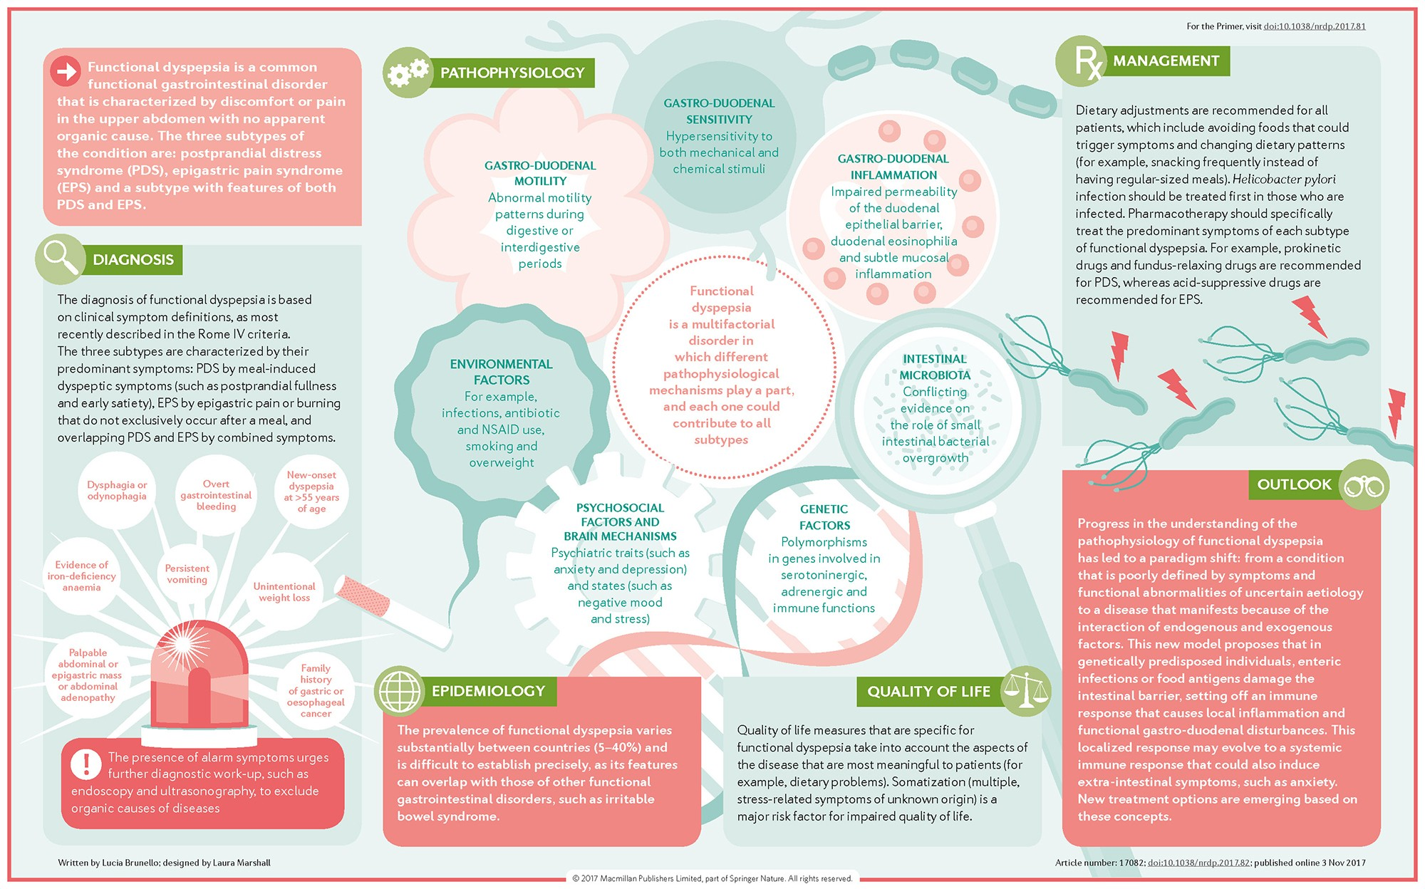
H2a. Functional Dyspepsia

Slide 14
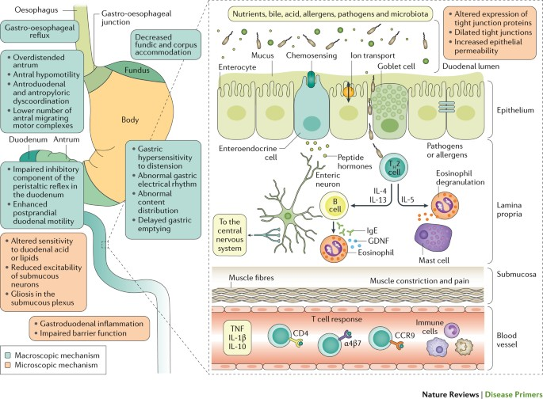
PATHOGENESIS

Slide 15
H2a. Functional Dyspepsia
Diagnostic criteria must include one or more of the following bothersome symptoms at least 4 times a month for at least 2 months prior to diagnosis:
Postprandial fullness
Early satiation
Epigastric pain or burning not associated with defecation
After appropriate evaluation, the symptoms cannot be fully explained by another medical condition

Slide 16
H2a1. Postprandial distress syndrome includes bothersome postprandial fullness or early satiation which prevents finishing a regular meal. Supportive features include upper abdominal bloating, postprandial nausea, or excessive belching.
H2a2. Epigastric pain syndrome which includes all of the following: bothersome (severe enough to interfere with normal activities)
pain or burning localized to the epigastrium. The pain is not generalized or localized to other abdominal or chest regions and is
not relieved by defecation or passage of flatus. Supportive criteria can include (a) burning quality of the pain but without a retrosternal component, (b) commonly induced or relieved by ingestion of a meal but may occur while fasting.

Slide 17
H2b. Irritable Bowel Syndrome
Diagnostic criteria* must include all of the following:
Abdominal pain at least 4 days per month over at least 2 months associated with one or more of the following:
Related to defecation
A change in frequency of stool
A change in form (appearance) of stool
In children with abdominal pain and constipation, the pain does not resolve with resolution of the constipation (children in whom the pain resolves have functional constipation, not IBS)
After appropriate evaluation, the symptoms cannot be fully explained by another medical condition
*Criteria fulfilled for at least 2 months prior to diagnosis

Slide 18
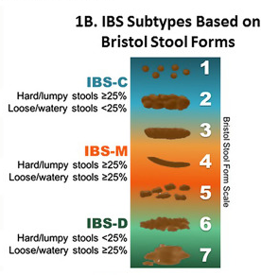
IBS Subtypes
Classifying patients with IBS into specific subtypes based on predominant bowel habits is useful as it helps focus treatment on the predominant, and often, the most bothersome symptom. IBS is classified into four subtypes:
IBS with predominant constipation (IBS-C),
IBS with predominant diarrhea (IBS-D),
with mixed bowel habits (IBS-M) or
IBS, unsubtyped.

Slide 19
MANAGEMENT
Management of irritable bowel syndrome (IBS) is typically based on most bothersome symptoms, predominant bowel habit pattern, and severity of symptoms. Treatment may include:
Dietary modifications (e.g. low FODMAP diet)
Peppermint oil, soluble fiber, anti-spasmodics (e.g. hyoscyamine)
For IBS-C: PEG-3350, linaclotide, lubiprostone, plecanatide, tegaserod, tenapanor
For IBS-D: Eluxadoline, rifaximin, alosetron
Neuromodulators (e.g. tricyclic antidepressants, serotonin norepinephrine reuptake inhibitors)
Psychological therapies (e.g. cognitive behavioral therapy, hypnotherapy)
The choice of therapy is outside the scope of this calculator and will depend on clinical context.

