Slide 1
PNEUMONIA IN CHILDREN

Slide 2
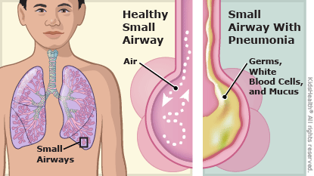
PNEUMONIA IN CHILDREN
- acute infectious inflammatory disease of a pulmonary parenchyma with various etiology and intra – alveolar inflammatory exudation.

Slide 3
Classification
Morphologic forms of pneumonias | Groups (by etiology & a place of occurrence) | Duration of pneumonias | Complications of pneumonias
Focal | Out of hospital pneumonias | Acute (<6 weeks) Prolonged (from 6 weeks to 8 months) | Pulmonary Extra-pulmonary
Segmental (mono- or poly-) | Hospital pneumonias ( is pneumonia acquired during or after hospitalization for another illness or procedure with onset at least 48-72 hrs after admission)
Lobar | Perinatal pneumonias
Interstitial | with immunodeficit condition
 | Ventilation
 | Aspiration

Slide 4
The causative agents of pneumonias
Out of hospital pneumonias | Hospital pneumonias | Perinatal pneumonias | With immunodefi- ciency condition
Pneumococci H. Influenzae Staphylococci Mycoplazma Chl. Pneumon. Legionella Viruses | Staphylococci E. Coli H. Influenzae Pseudomonas Protei Branchamella Seracia Virusis | Chlamidia Pneumocista Ureaplazma CMV Branchamella Virusis | Different bacteria Pneumocista Fungus Cytomegalovirus Mycobacterium Virusis

Slide 5
Patogenesis
Absorption of metabolism product of the microorganism, their toxins lead to intoxication (infective toxicosis)
Respiratory insufficiency is disturbance of function of external respiration (restrictive ventilation insufficiency, obstructive, combined insufficiency).
Water-electrolyte disturbances (wheezing-water loss with expiration – water-deficit exicosis).
Metabolic disturbances (anabolic and aerobic metabolism).
Acid-based condition (respiratory alkalosis, metabolic acidosis.
Activation of lipid peroxidation.
Destruction of cells membrane.
Microcirculation and coagulation disturbances.

Slide 6
Diagnostic criteria of bacterial pneumonia
Bacterial intoxication symptoms
Clinical:
Fever more than 3 days
Intoxication syndrome
Acute beginning
Cough
Lab data:
Neutrophyl leukocytosis
Elevated ESR
Functional respiratory disturbancies
Increased respiratory rate more than 20% from age norma
Accessory musculature involving in respiration
Cough or its equivalents
Cyanosis ( perioral, periorbital, diffuse)
Local symptoms in pneumonia:
Percussion sound shortening ( dullness)
Breathing sound conductivity changes (attenuation, rales)
Radiologic confirmation

Slide 7
Plan of examination
Blood analysis
Biochemical blood test (Increased inflammatory markers - C-reactive protein)
Bacteriological examination
X-ray of the chest
Pulse oximeter
Ultrasound of the lungs

Slide 8
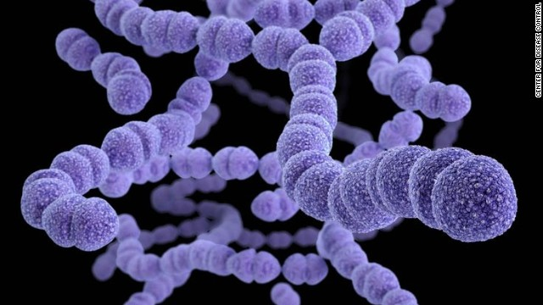
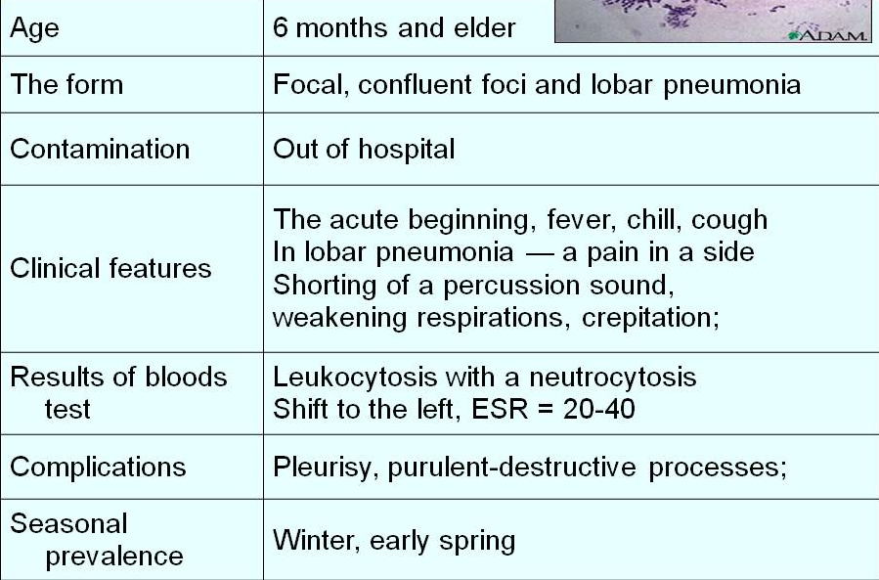
Pneumococcal Pneumonia

Slide 9
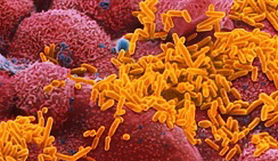
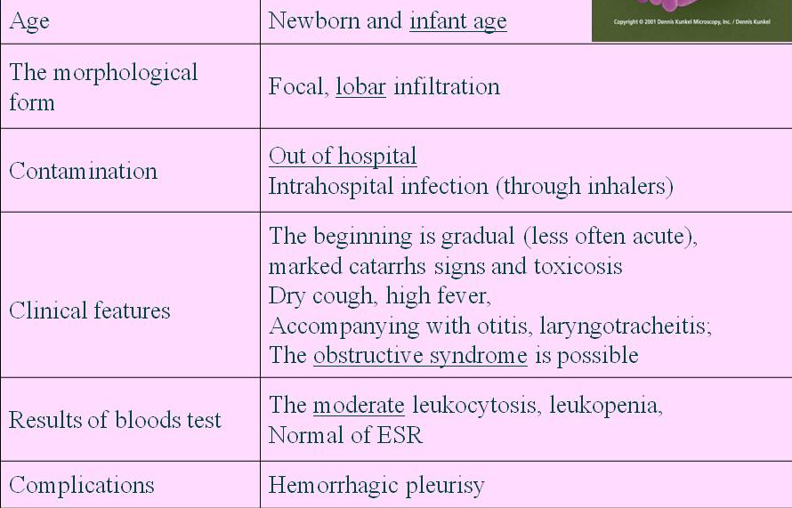
H. Influenzae type b

Slide 10
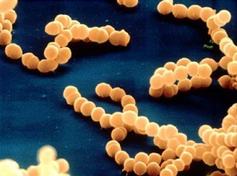
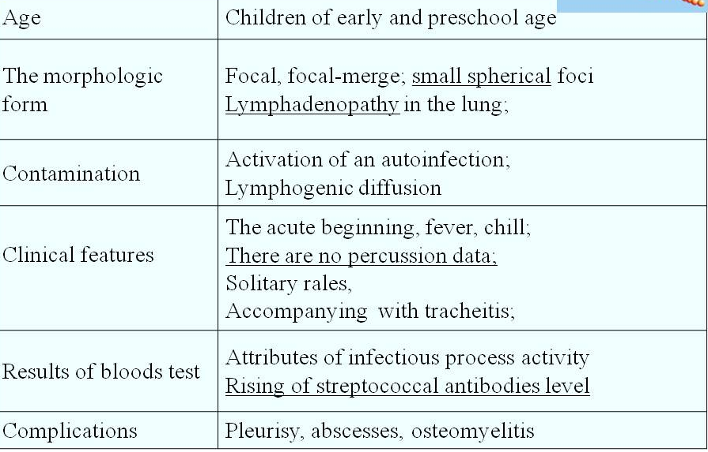
Streptococcus gr. A

Slide 11
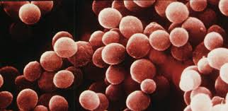
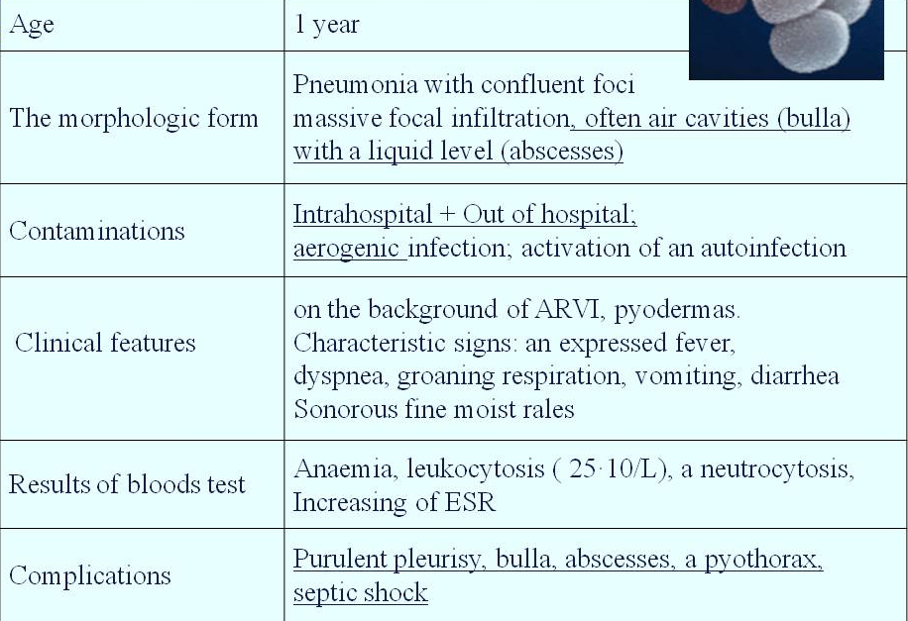
Staphylococcus aureus

Slide 12
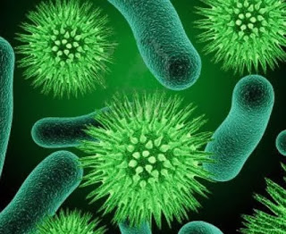
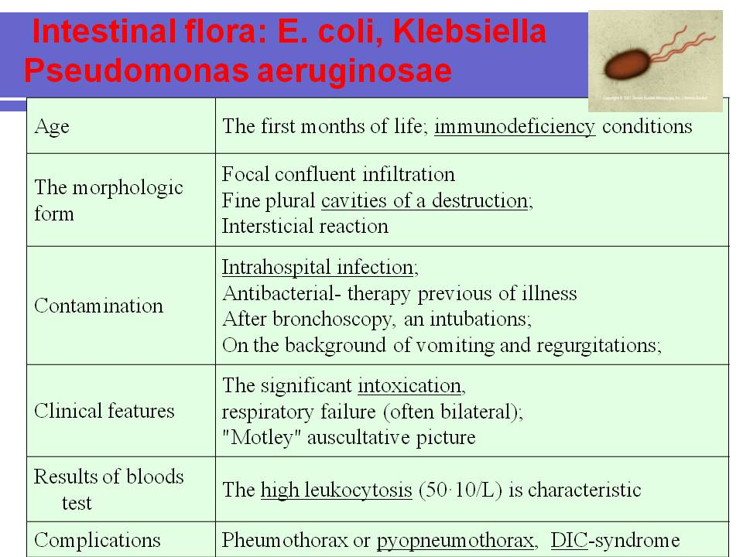
Intestinal flora: E. coli, Klebsiella, Pseudomonas aeruginosae

Slide 13
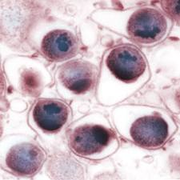
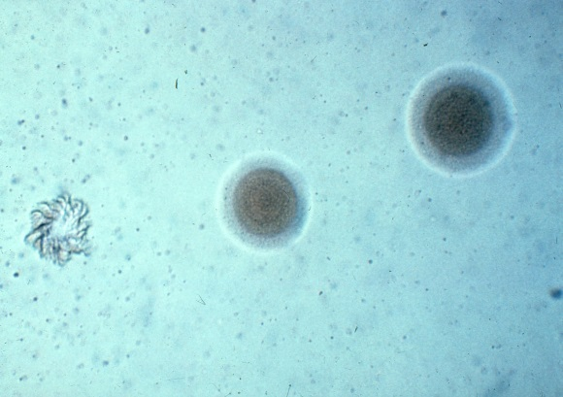
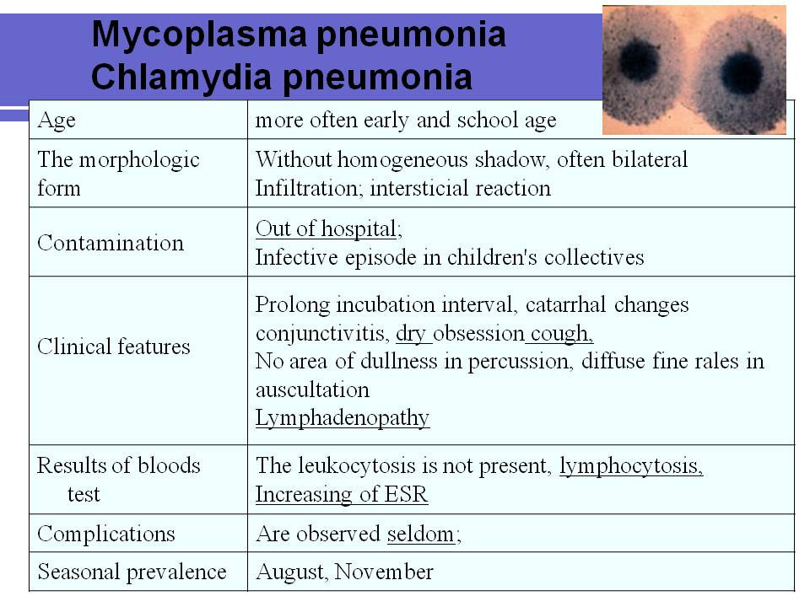
Mycoplasma pneumoniae
Chlamydia pneumoniae

Slide 14

TREATMENT
Bed rest should last for the whole fever period. The temperature normalizing, the regime becomes less strict during 2–3 days, and in 3–4 days the child can go for a walk, gradually increasing its length (from 20 minutes).

Slide 15

THE DIET
Must correspond to the child’s age. When the disease is in acute period, the food should be mechanically and chemically light. The liquid amount is increased by 20% in comparison with the age norms (fruit drinks, juices, tea with lemon etc.).

Slide 16
The etiotropic therapy
For the empiric (starting therapy) it is recommended to use “protected” penicillin, cephalosporin of the 2nd generation, more rarely (in case of hospital-acquired acute pneumonia of newborns) – cephalosporin of the 3rd generation, new macrolides; the latter are chosen to treat atypical pneumonias.

Slide 17
Complete effect:
the temperature falls under 38°C in 24–48 hours in case of non-complicated pneumonia and in 3–4 days in case of complicated pneumonia on the background of general condition and appetite improvement, decrease of dyspnea.

Slide 18
Partial effect:
the temperature remains on febrile level after the aforementioned period with toxicosis and dyspnea degree decreasing, appetite improvement and the negative roentgenological dynamics (destructive pneumonia, metapneumonic pleurisy) being absent.

Slide 19
No effect:
the temperature remains on febrile level, with the general condition aggravating and (or) pathological changes in the lungs and pleura increasing.

Slide 20
Pathogenetic therapy :
1) supporting free conductivity of the respiratory tract, oxygen therapy with moistened oxygen;
3) treatment of the toxicosis.
Symptomatic therapy:
anti-inflammatory drugs
mucolytic

