Slide 1
Fundamental properties of ionising radiation. Biological effect of ionising radiation. Radioactivity and dose. Ionising radiation dosimetry..
ODESSA NATIONAL MEDICAL UNIVERSITY
Department of Radiation Diagnostics, Therapy , Radiation medicine
and Oncology
Dr. Inna Krupnik,
teaching assistant
2022

Slide 2
What is radiation?
Notes:
Radiation is energy travelling as waves or particles. Ionising radiation has enough energy to ionise (remove an electron from an atom) which can change the chemical composition of the material. Non-ionising radiation has less energy but can still excite molecules and atoms causing them to vibrate faster.
X-ray and gamma ray radiation, which are at the upper end of electromagnetic spectrum, have very high frequencies (in the range of 100 billion billion hertz) and very short wavelengths (1 million millionth of a metre). Radiation in this range has high energy. It has enough energy to strip electrons from an atom or, in the case of very high-energy radiation, break up the nucleus of the atom.

Slide 3
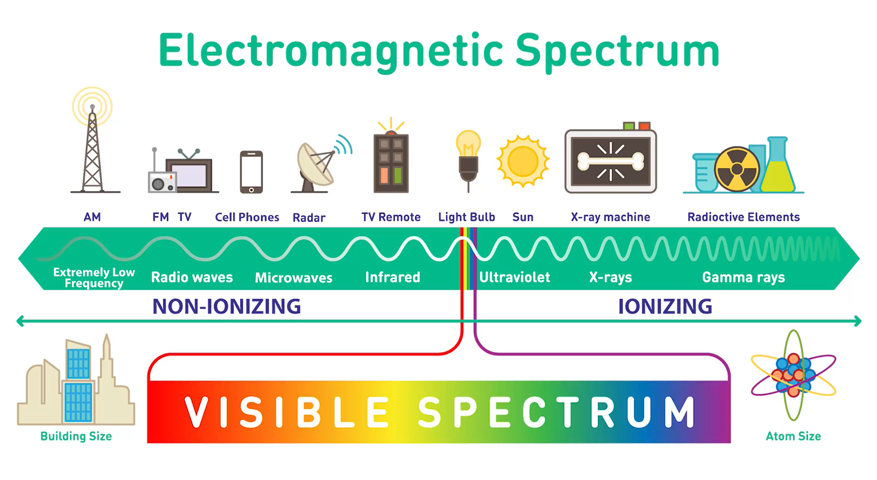
Notes:
Radiation is energy travelling as waves or particles. Ionising radiation has enough energy to ionise (remove an electron from an atom) which can change the chemical composition of the material. Non-ionising radiation has less energy but can still excite molecules and atoms causing them to vibrate faster.
X-ray and gamma ray radiation, which are at the upper end of electromagnetic spectrum, have very high frequencies (in the range of 100 billion billion hertz) and very short wavelengths (1 million millionth of a metre). Radiation in this range has high energy. It has enough energy to strip electrons from an atom or, in the case of very high-energy radiation, break up the nucleus of the atom.

Slide 4
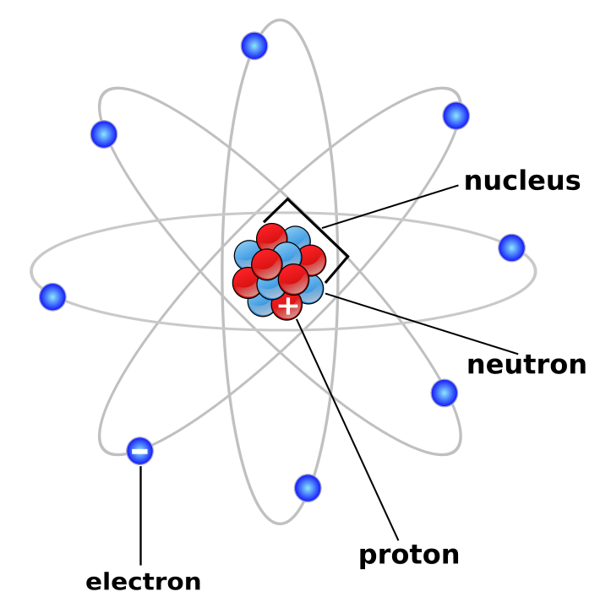
Atomic structure
Notes:
The mass of atom is concentrated in the central nucleus that contains a number of nucleouns (protons and neutrons) they make up a mass number (A)
Charge of atom depends on number of protons it is also called an atomic number

Slide 5
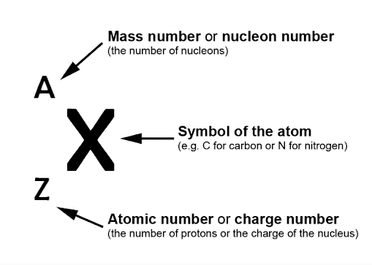
Atomic symbols
Notes:
A - protons + neutrons
Z - protons
A-Z - neutrons

Slide 6
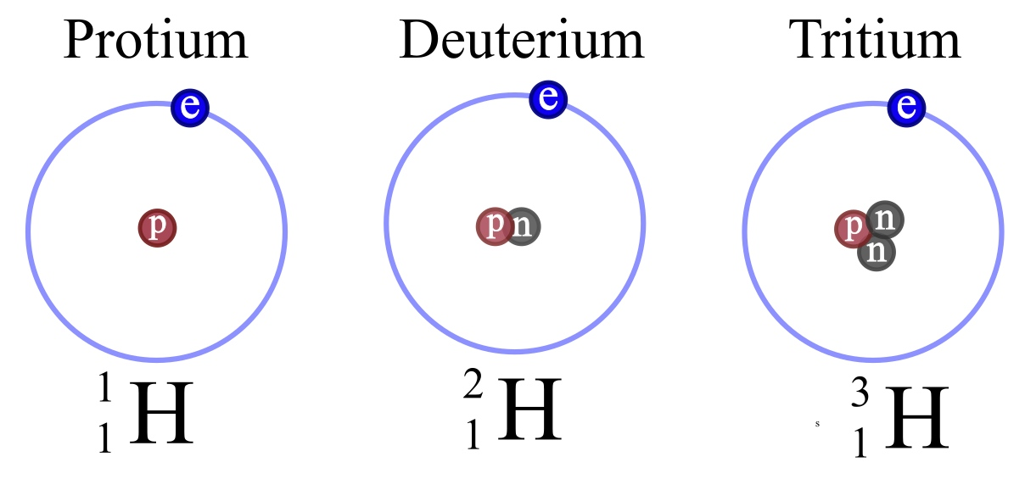
Isotopes
Notes:
Isotopes are variants of a particular chemical element which differ in neutron number, and consequently in nucleon number. All isotopes of a given element have the same number of protons but different numbers of neutrons in each atom.

Slide 7
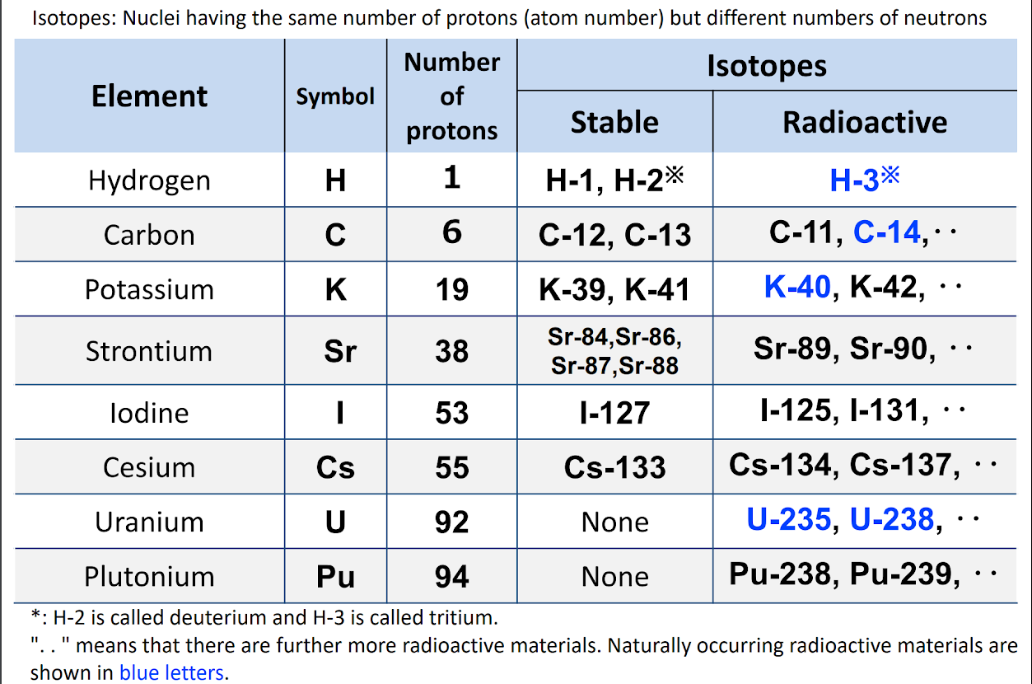
Isotopes
Notes:
Isotopes are variants of a particular chemical element which differ in neutron number, and consequently in nucleon number. All isotopes of a given element have the same number of protons but different numbers of neutrons in each atom.

Slide 8
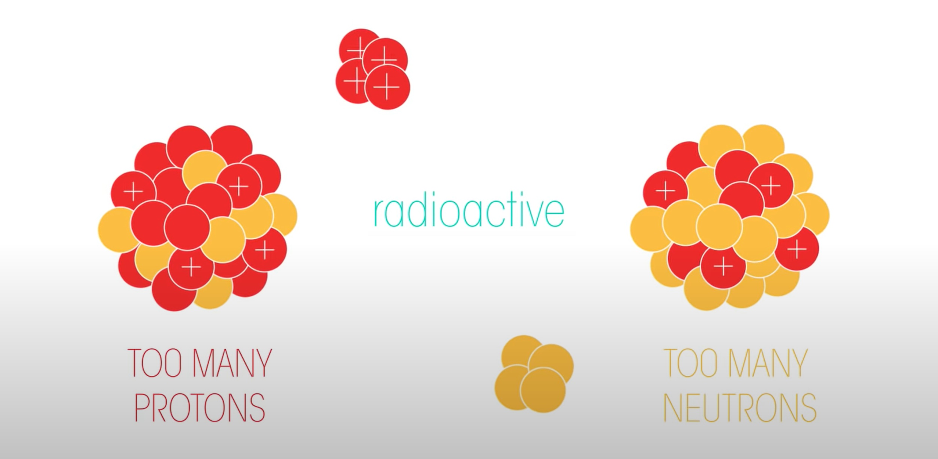
Radioisotope (radionuclide)
has excess nuclear energy making it unstable
Radioactive decay
is the process by which an unstable atomic nucleus loses energy by radiation
Notes:
A radioactive atom will attempt to reach stability by ejecting nucleons (protons or neutrons), as well as other particles, or by releasing energy in other forms.
This radiation is emitted when the nucleus undergoes radioactive decay and is converted into a different isotope which may, according to its number of neutrons and protons, be either radioactive (unstable) or non-radioactive (stable). This “daughter” nucleus will usually be of a different chemical element to the original isotope. This process is called radioactive decay. It will continue until the forces in the nucleus are balanced.

Slide 9
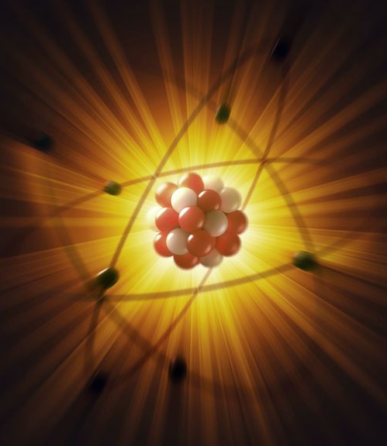
Radiation
is the energy or particles that are released during radioactive decay
Notes:
There are three main kinds of ionising radiation:
alpha particles, which include two protons and two neutrons
beta particles, which are essentially electrons
gamma rays and x-rays, which are pure energy (photons).
Alpha particles and beta particles are not part of the electromagnetic spectrum; they are energetic particles as opposed to pure energy bundles (photons).
https://www.arpansa.gov.au/understanding-radiation/what-is-radiation/ionising-radiation

Slide 10
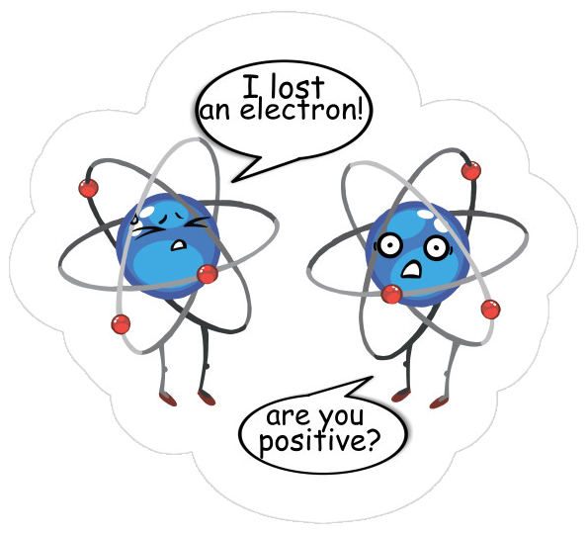
Ion
an atom which has lost at list one of its electrons and becomes positively charged

Slide 11
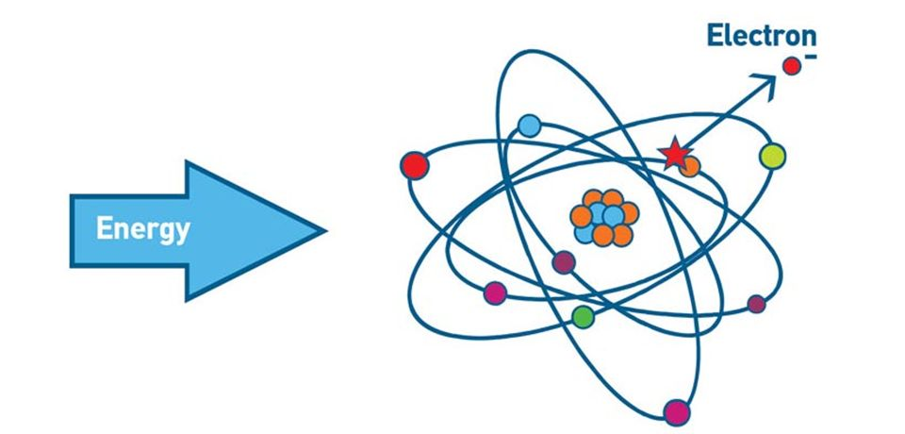
Ionisation
is a process in which an electron is given enough energy to break away from an atom creating an ion

Slide 12
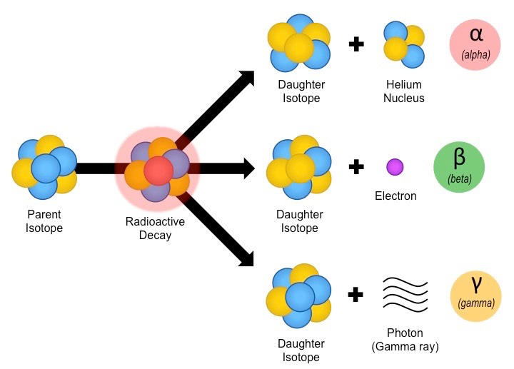
Types of radioactive decay
Notes:
There are three main kinds of ionising radiation:
alpha particles, which include two protons and two neutrons
beta particles, which are essentially electrons
gamma rays and x-rays, which are pure energy (photons).
Alpha particles and beta particles are not part of the electromagnetic spectrum; they are energetic particles as opposed to pure energy bundles (photons).
Other types of decay: https://www.arpansa.gov.au/understanding-radiation/what-is-radiation/ionising-radiation/radiation-decay

Slide 13
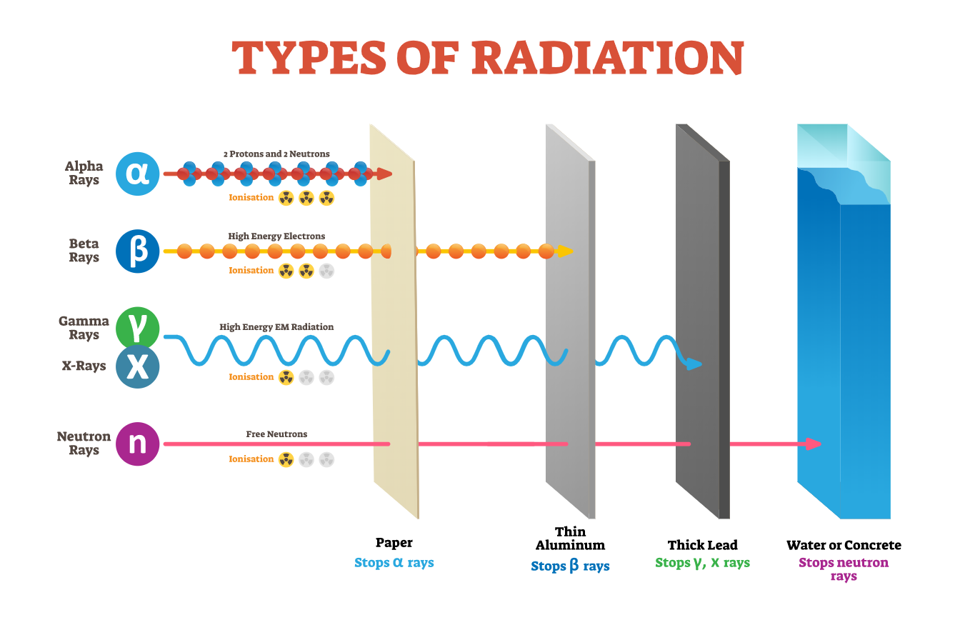

Slide 14
Types of ionizing radiation
X-rays - penetrating electromagnetic radiations produced by X-ray tube
Gamma rays - penetrating electromagnetic radiations produced by nuclear transformations
Beta particles (electrons), positrons
Alpha particles, protons, neutrons, heavy nuclei
Particles are not used for the imaging purposes because they are just get absorbed on the body surface and they don’t penetrate it, therefore we can not get any imaging signal

Slide 15
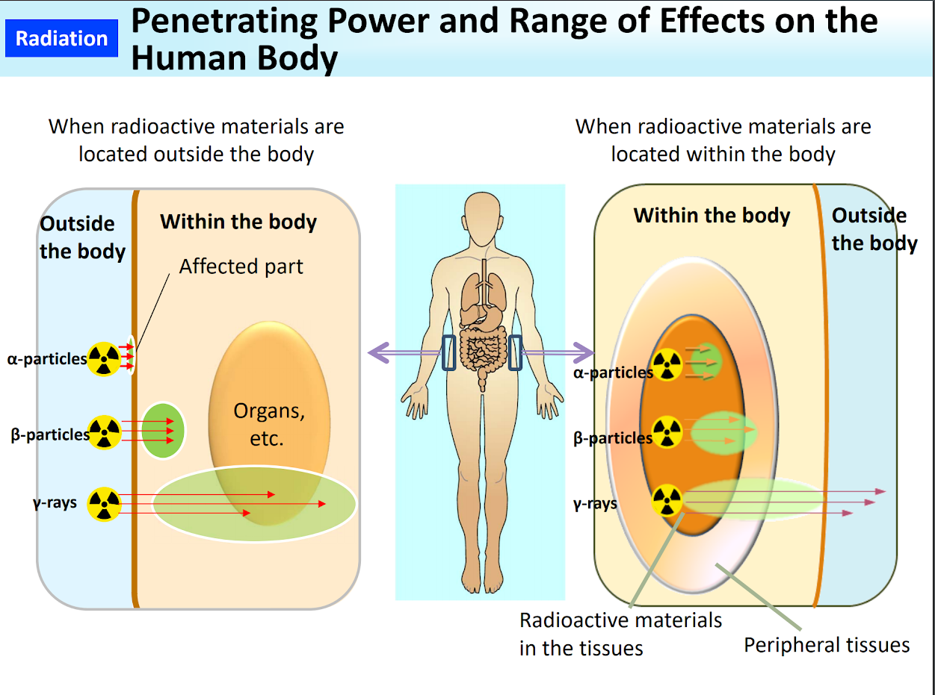
Notes:
Internal exposure could occur after:
ingestion, inhalation, percutaneous absorption, wound contamination

Slide 16

Half life, t1⁄2
the time taken for the radioactivity of a specified isotope to fall to half its original value
Notes:
Radioactive decay is a stochastic (or random) process at the level of single atoms. According to quantum theory, it is impossible to predict when a particular atom will decay, regardless of how long the atom has existed. However, for a significant number of identical atoms, the overall decay rate can be expressed as a decay constant or as half-life. The half-lives of radioactive atoms have a huge range; from nearly instantaneous to far longer than the age of the universe.
Lambda symbol

Slide 17
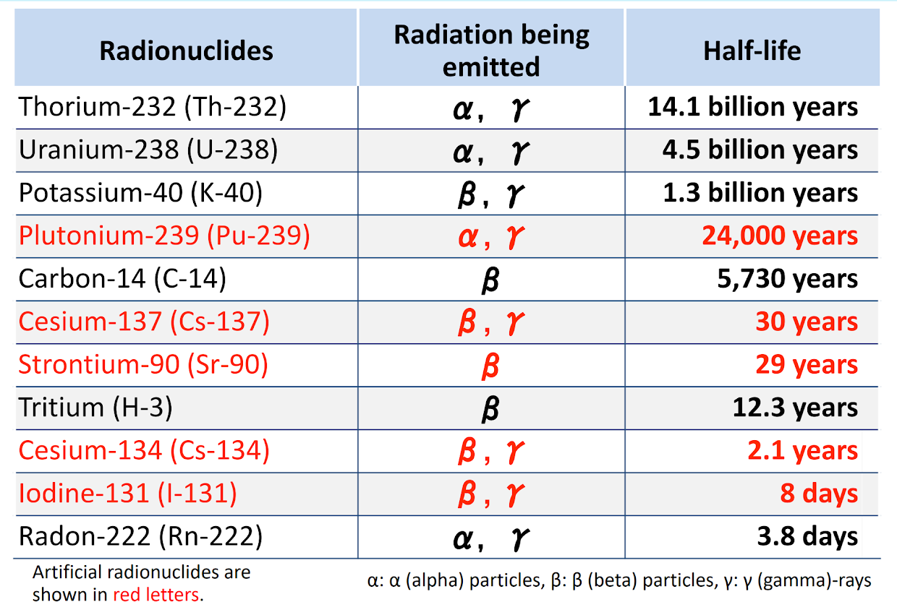
Half life, t1⁄2
Notes:
Radioactive decay is a stochastic (or random) process at the level of single atoms. According to quantum theory, it is impossible to predict when a particular atom will decay, regardless of how long the atom has existed. However, for a significant number of identical atoms, the overall decay rate can be expressed as a decay constant or as half-life. The half-lives of radioactive atoms have a huge range; from nearly instantaneous to far longer than the age of the universe.
Lambda symbol

Slide 18
Measuring the Radiation
Notes:
Radiation is energy travelling as waves or particles. Ionising radiation has enough energy to ionise (remove an electron from an atom) which can change the chemical composition of the material. Non-ionising radiation has less energy but can still excite molecules and atoms causing them to vibrate faster.
X-ray and gamma ray radiation, which are at the upper end of electromagnetic spectrum, have very high frequencies (in the range of 100 billion billion hertz) and very short wavelengths (1 million millionth of a metre). Radiation in this range has high energy. It has enough energy to strip electrons from an atom or, in the case of very high-energy radiation, break up the nucleus of the atom.

Slide 19
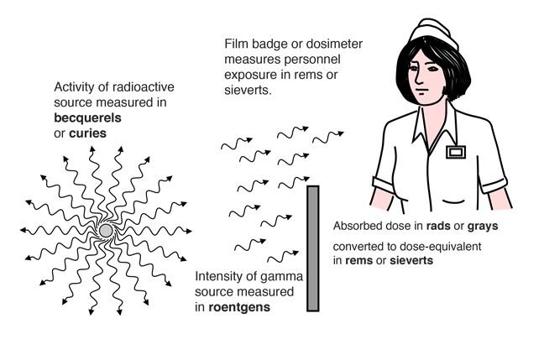
Activity & Exposure
Notes:
We measure two general phenomena when we discuss radiation. We measure "activity" and "exposure". Activity is basically just how much radiation is coming out of something, whether it's particles or waves. Exposure measures the effect of radiation on substances that absorb it.

Slide 20
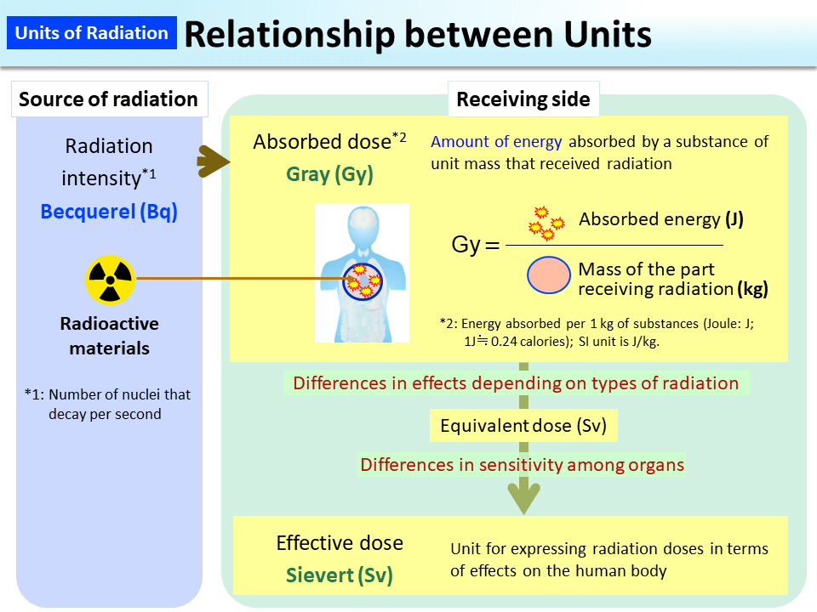
Notes:
https://www.env.go.jp/en/chemi/rhm/basic-info/1st/02-03-03.html

Slide 21
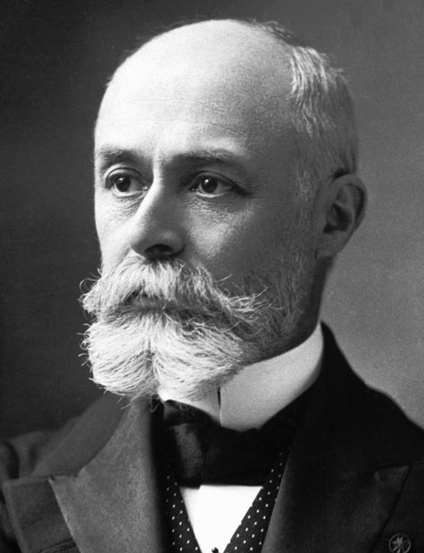
Radiation Activity (R)
SI: becquerel, Bq
non-SI: curie, Ci
It is the rate of decay expressed in decays per unit time
1 Bq = 1 decay/sec
The activity of a source depends on two things: the amount of the radioactive substance present and its half-life
Henri Becquerel
physicist discovered radioactivity, 1852-1908
Notes:
Becquerel was a French engineer, physicist, Nobel laureate, and the first person to discover evidence of radioactivity.
Intuitively, you would expect the activity of a source to depend on two things: the amount of the radioactive substance present, and its half-life. The greater the number of radioactive nuclei present in the sample, the more will decay per unit of time. The shorter the half-life, the more decays per unit time, for a given number of nuclei. So activity R should be proportional to the number of radioactive nuclei, N, and inversely proportional to their half-life, t_{1/2}. In fact, your intuition is correct.

Slide 22
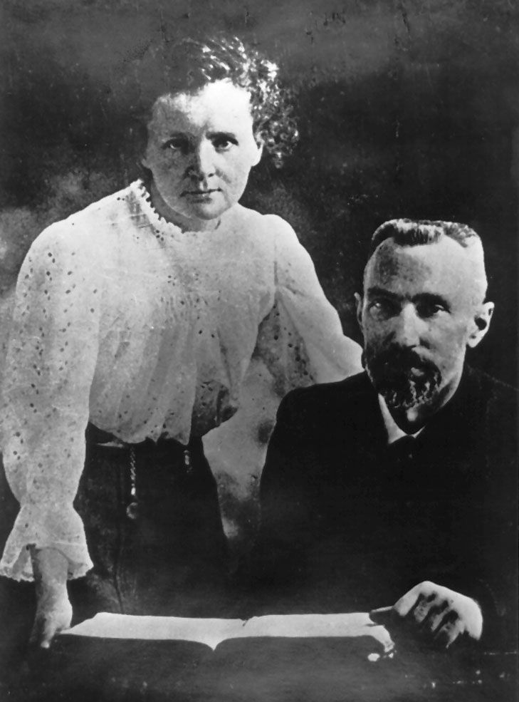
Radiation Activity (R)
SI: becquerel, Bq
non-SI: curie, Ci
One curie was defined as the radioactivity of one gram of pure radium-226. This is equivalent to
10
3.7 x 10 decays per second
10
1 Ci = 3.7×10 Bq = 37 GBq
Pierre and Marie Curie
physicists studied radioactivity,
1859-1906, 1867-1934
Notes:
Becquerel was a French engineer, physicist, Nobel laureate, and the first person to discover evidence of radioactivity.
Intuitively, you would expect the activity of a source to depend on two things: the amount of the radioactive substance present, and its half-life. The greater the number of radioactive nuclei present in the sample, the more will decay per unit of time. The shorter the half-life, the more decays per unit time, for a given number of nuclei. So activity R should be proportional to the number of radioactive nuclei, N, and inversely proportional to their half-life, t_{1/2}. In fact, your intuition is correct.

Slide 23
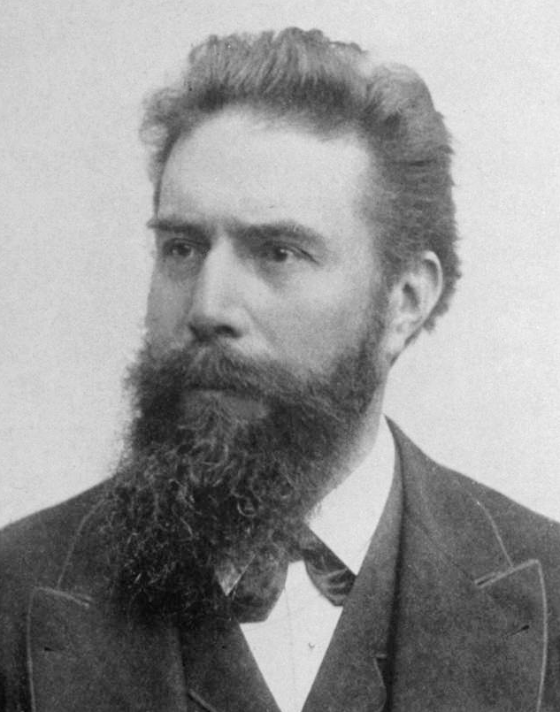
Radiation Exposure
SI: coulomb/kg, C/kg
non-SI: röntgen, R
Is a measure of the ionization of air by photons (gamma rays and X-rays).
It is defined as the electric charge freed by such radiation in a specified volume of air divided by the mass of that air.
1 C/kg = 3876 R
1 R = 0, 000258 C/kg
Wilhelm Conrad Röntgen
physicist discovered X-rays, 1845-1923

Slide 24
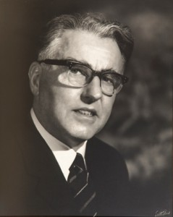
Absorbed dose (D)
SI: gray, Gy
non-Si: rad*
Measures the amount of energy (E) absorbed per unit of mass of a medium (M)
and so has the unit joules (J) per kilogram (kg), with the adopted name of gray (Gy)
D = E/M
1 Gy = 1 J/kg
1 rad = 0,01 Gy
Louis Harold Gray
physicist, 1905-1965
*rad - röntgen absorbed dose
Notes:
The absorbed dose is not a good indicator of the likely biological effect. 1 Gy of alpha radiation would be much more biologically damaging than 1 Gy of photon radiation for example. Appropriate weighting factors can be applied reflecting the different relative biological effects to find the equivalent dose.
Gray was an English physicist who worked mainly on the effects of radiation on biological systems.

Slide 25
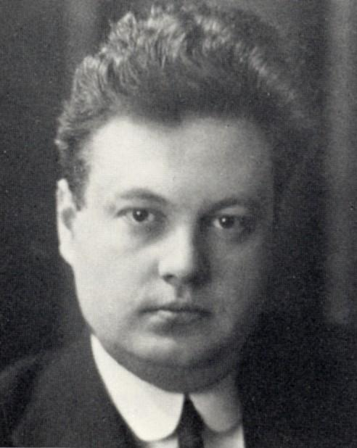
Equivalent dose (H)
sievert, Sv
non-Si: rem
Quantifies biological damage by different types of radiation.
It is the absorbed dose multiplied by radiation weighting factor (WR)
H = D x WR
1 Sv (H) = 1 J/kg x WR
*rem - röntgen equivalent man
Rolf Maximilian Sievert
physicist, 1896-1966
Notes:
Metric prefix

Slide 26
Effective dose (E)
sievert, Sv
non-Si: rem
It takes into account the equivalent dose to all exposed organs, as well as each organs relative radiosensitivity.
It is the equivalent dose multiplied by the tissue weighting factor WT
E = Dx WR x WT
1 Sv (E) = 1 J/kg x WR x WT
1 rem = 0,01 Sv
*rem - röntgen equivalent man

Slide 27
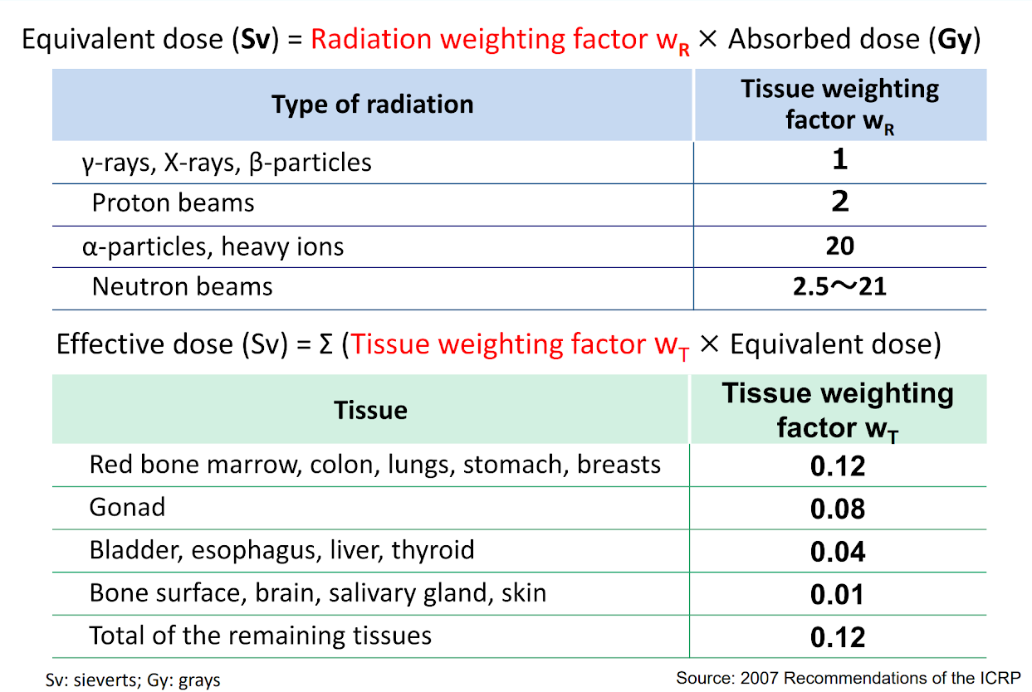
Notes:
Susceptible organs: Rapidly proliferating cells (e.g. bone marrow stem cells) are the most sensitive
Highly differentiated and/or nonproliferating cells (e.g. neurons) are least sensitive

Slide 28
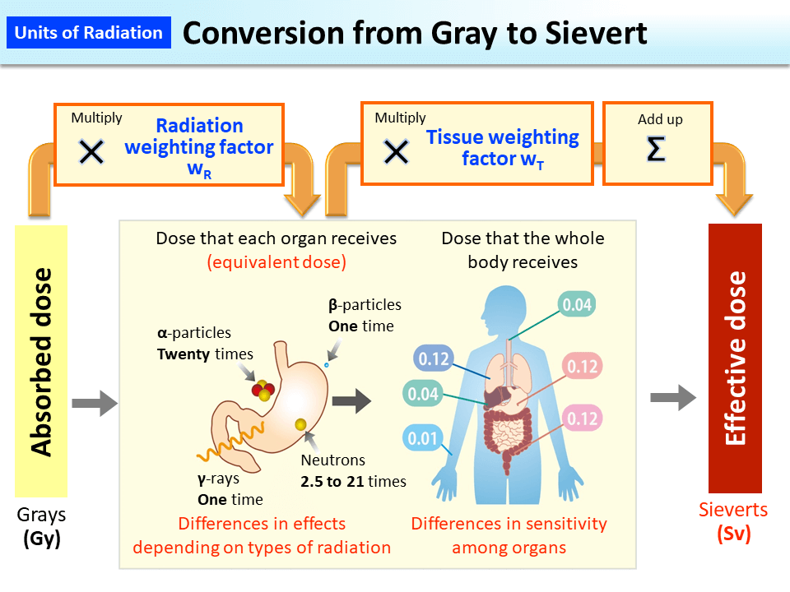
Notes:
https://www.env.go.jp/en/chemi/rhm/basic-info/1st/02.html

Slide 29
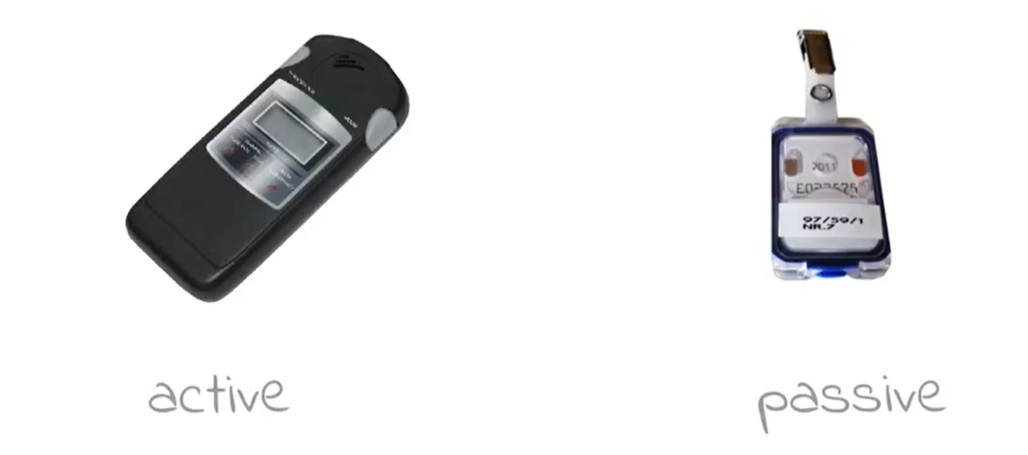
Dosimeters
Dosimeter is an effective dose measuring instrument which are worn by people who are exposed to ionizing radiation.
indicates to the user the actual dose value straight away and can warn if the predetermined value is attained
measures all the doses taken in the certain period of time (month, quartal) and adds them together. Result is obtained after evaluation
Notes:
Dosimeter is an effective dose measuring instrument which are worn by people who are exposed to ionizing radiation. The are measuring the effective dose
Geiger counter indicates the known radiation intensity but no the sum of all previously received radiation

Slide 30
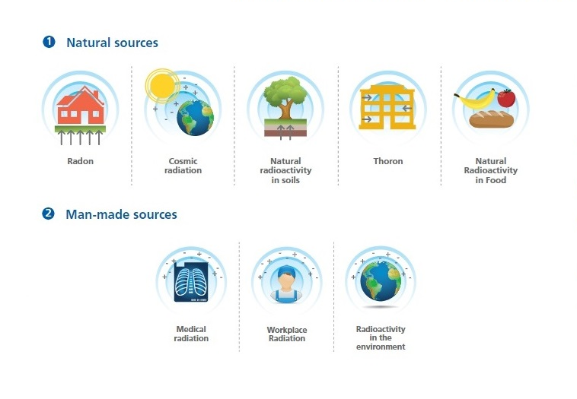
Sources of ionizing radiation

Slide 31
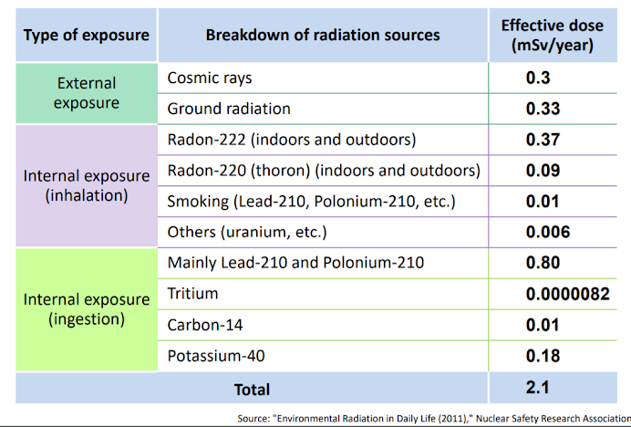
Breakdown of natural exposure doses

Slide 32
Metric prefixes for sieverts
-3
1 millisievert (mSv) = one thousandth of 1 Sv = 1 x 10 Sv
-6
1 microsievert (μSv) = one millionth of 1 Sv = 1 x 10 Sv

Slide 33


Dose limits
Annual exposure | Public | Occupational
General | 1 mSv | 20 mSv (50 mSv*)
Lens of the eye | 15 mSv | 20 mSv (50 mSv*)
Hands and feet (skin) | 50 mSv | 500 mSv
Pregnant or breastfeeding women | 1 mSv | 1 mSv**
*20 mSv per year averages over 5 consecutive years (100 mSv in 5 years) and of 50 mSv in any single year
** employer shall adapt the working conditions in respect of exposure so they could correspond the public dose limits
Notes:
https://radiopaedia.org/articles/equivalent-dose?lang=gb#expandableQuestionsContainer
Occupational - an effective dose of 20 mSv per year averaged over 5 consecutive years (100 mSv in 5 years) and of 50 mSv in any single year

Slide 34

Natural background radiation
(worldwide average)
Artificial radiation exposure
(worldwide average)
UNSCEAR 2008 Report Vol. I
2,4 mSv per year
0,006 mSv per day
0,6 mSv per year

Slide 35
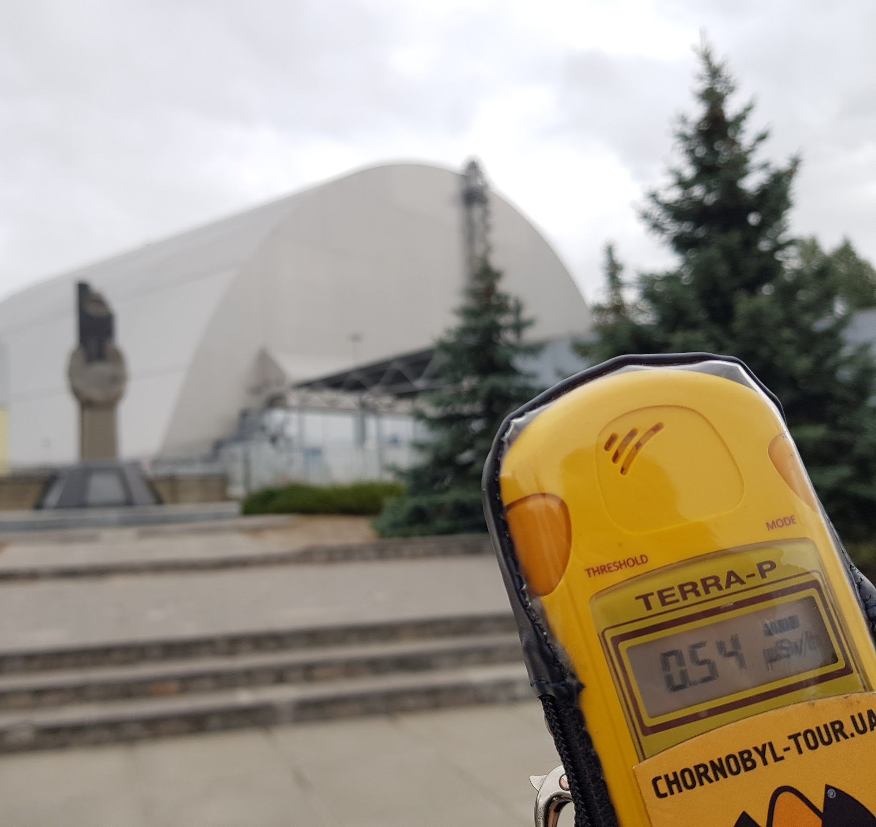
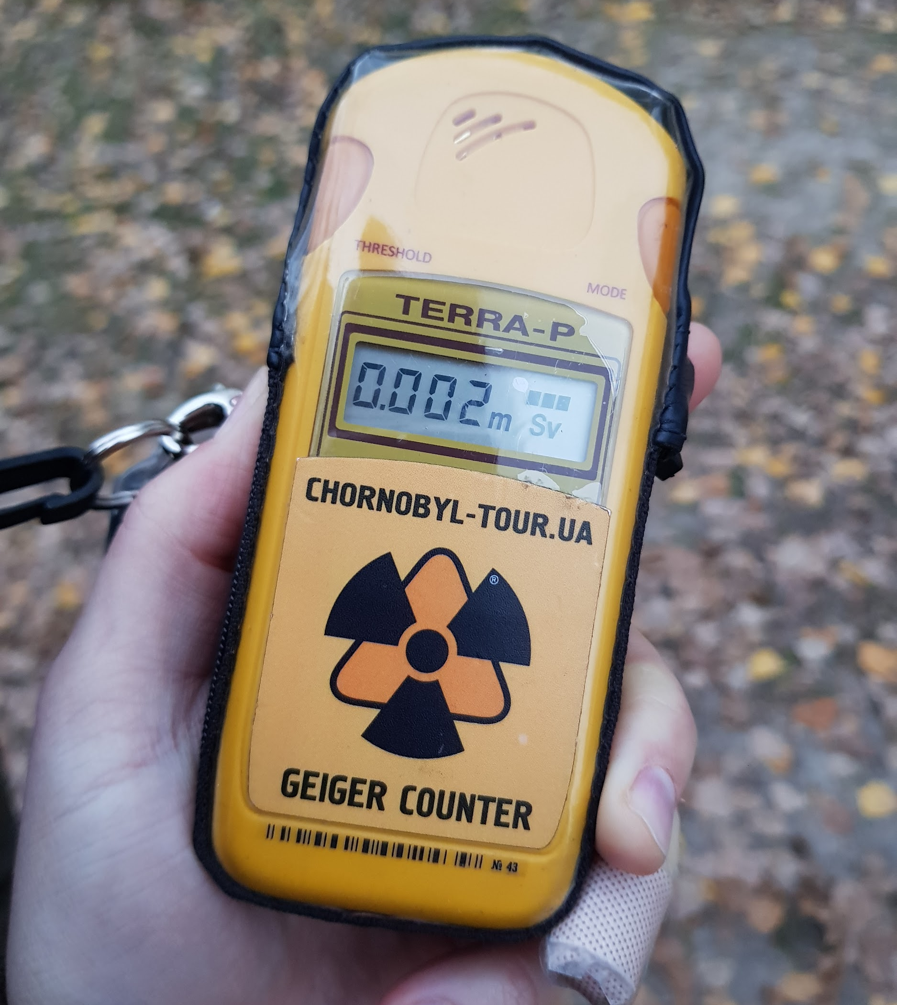
Average natural background radiation
0,1-0,3 μSv/hour = 0,002-0,006 mSv/day
In front of the sarcophagus of the 4th reactor of the Chernobyl nuclear power plant
0,54 μSv/hour = 0,013 mSv/day (2 times more)
Daily exposure in the Exclusion Zone
0,002 mSv (normal)

Slide 36
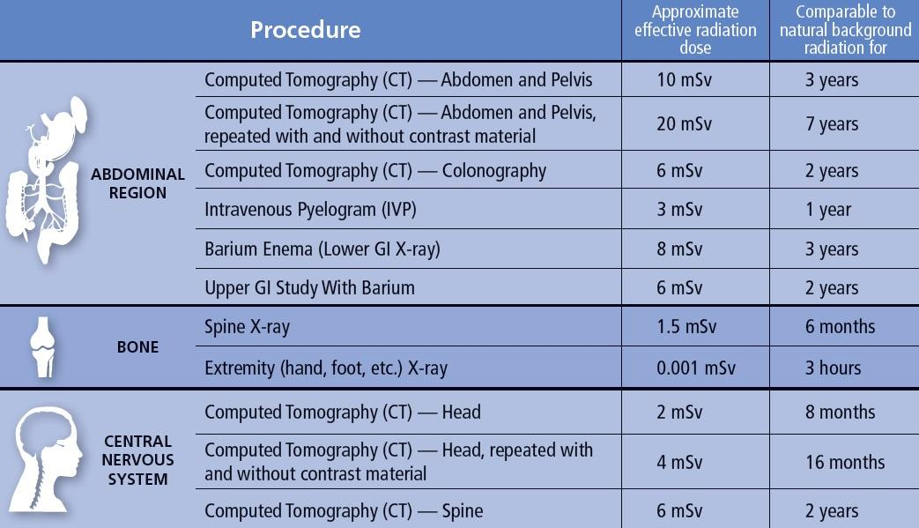
Radiation dose to adults from common imaging examinations

Slide 37
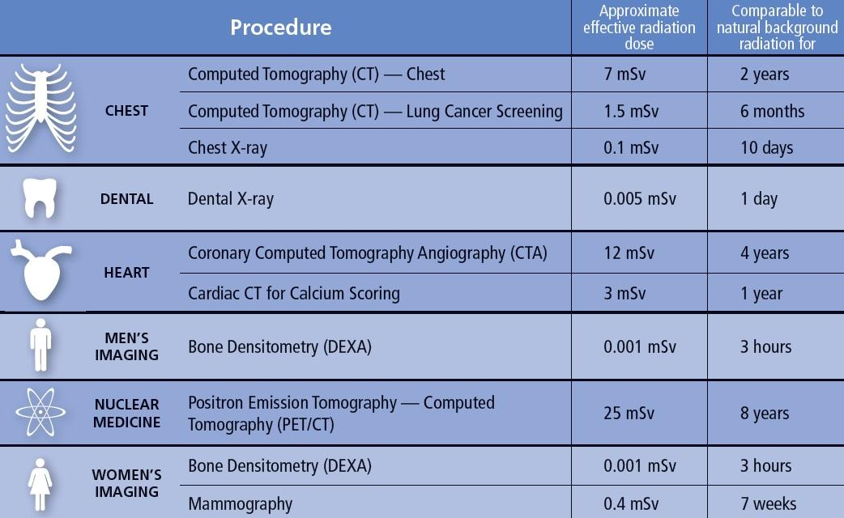
Radiation dose to adults from common imaging examinations

Slide 38
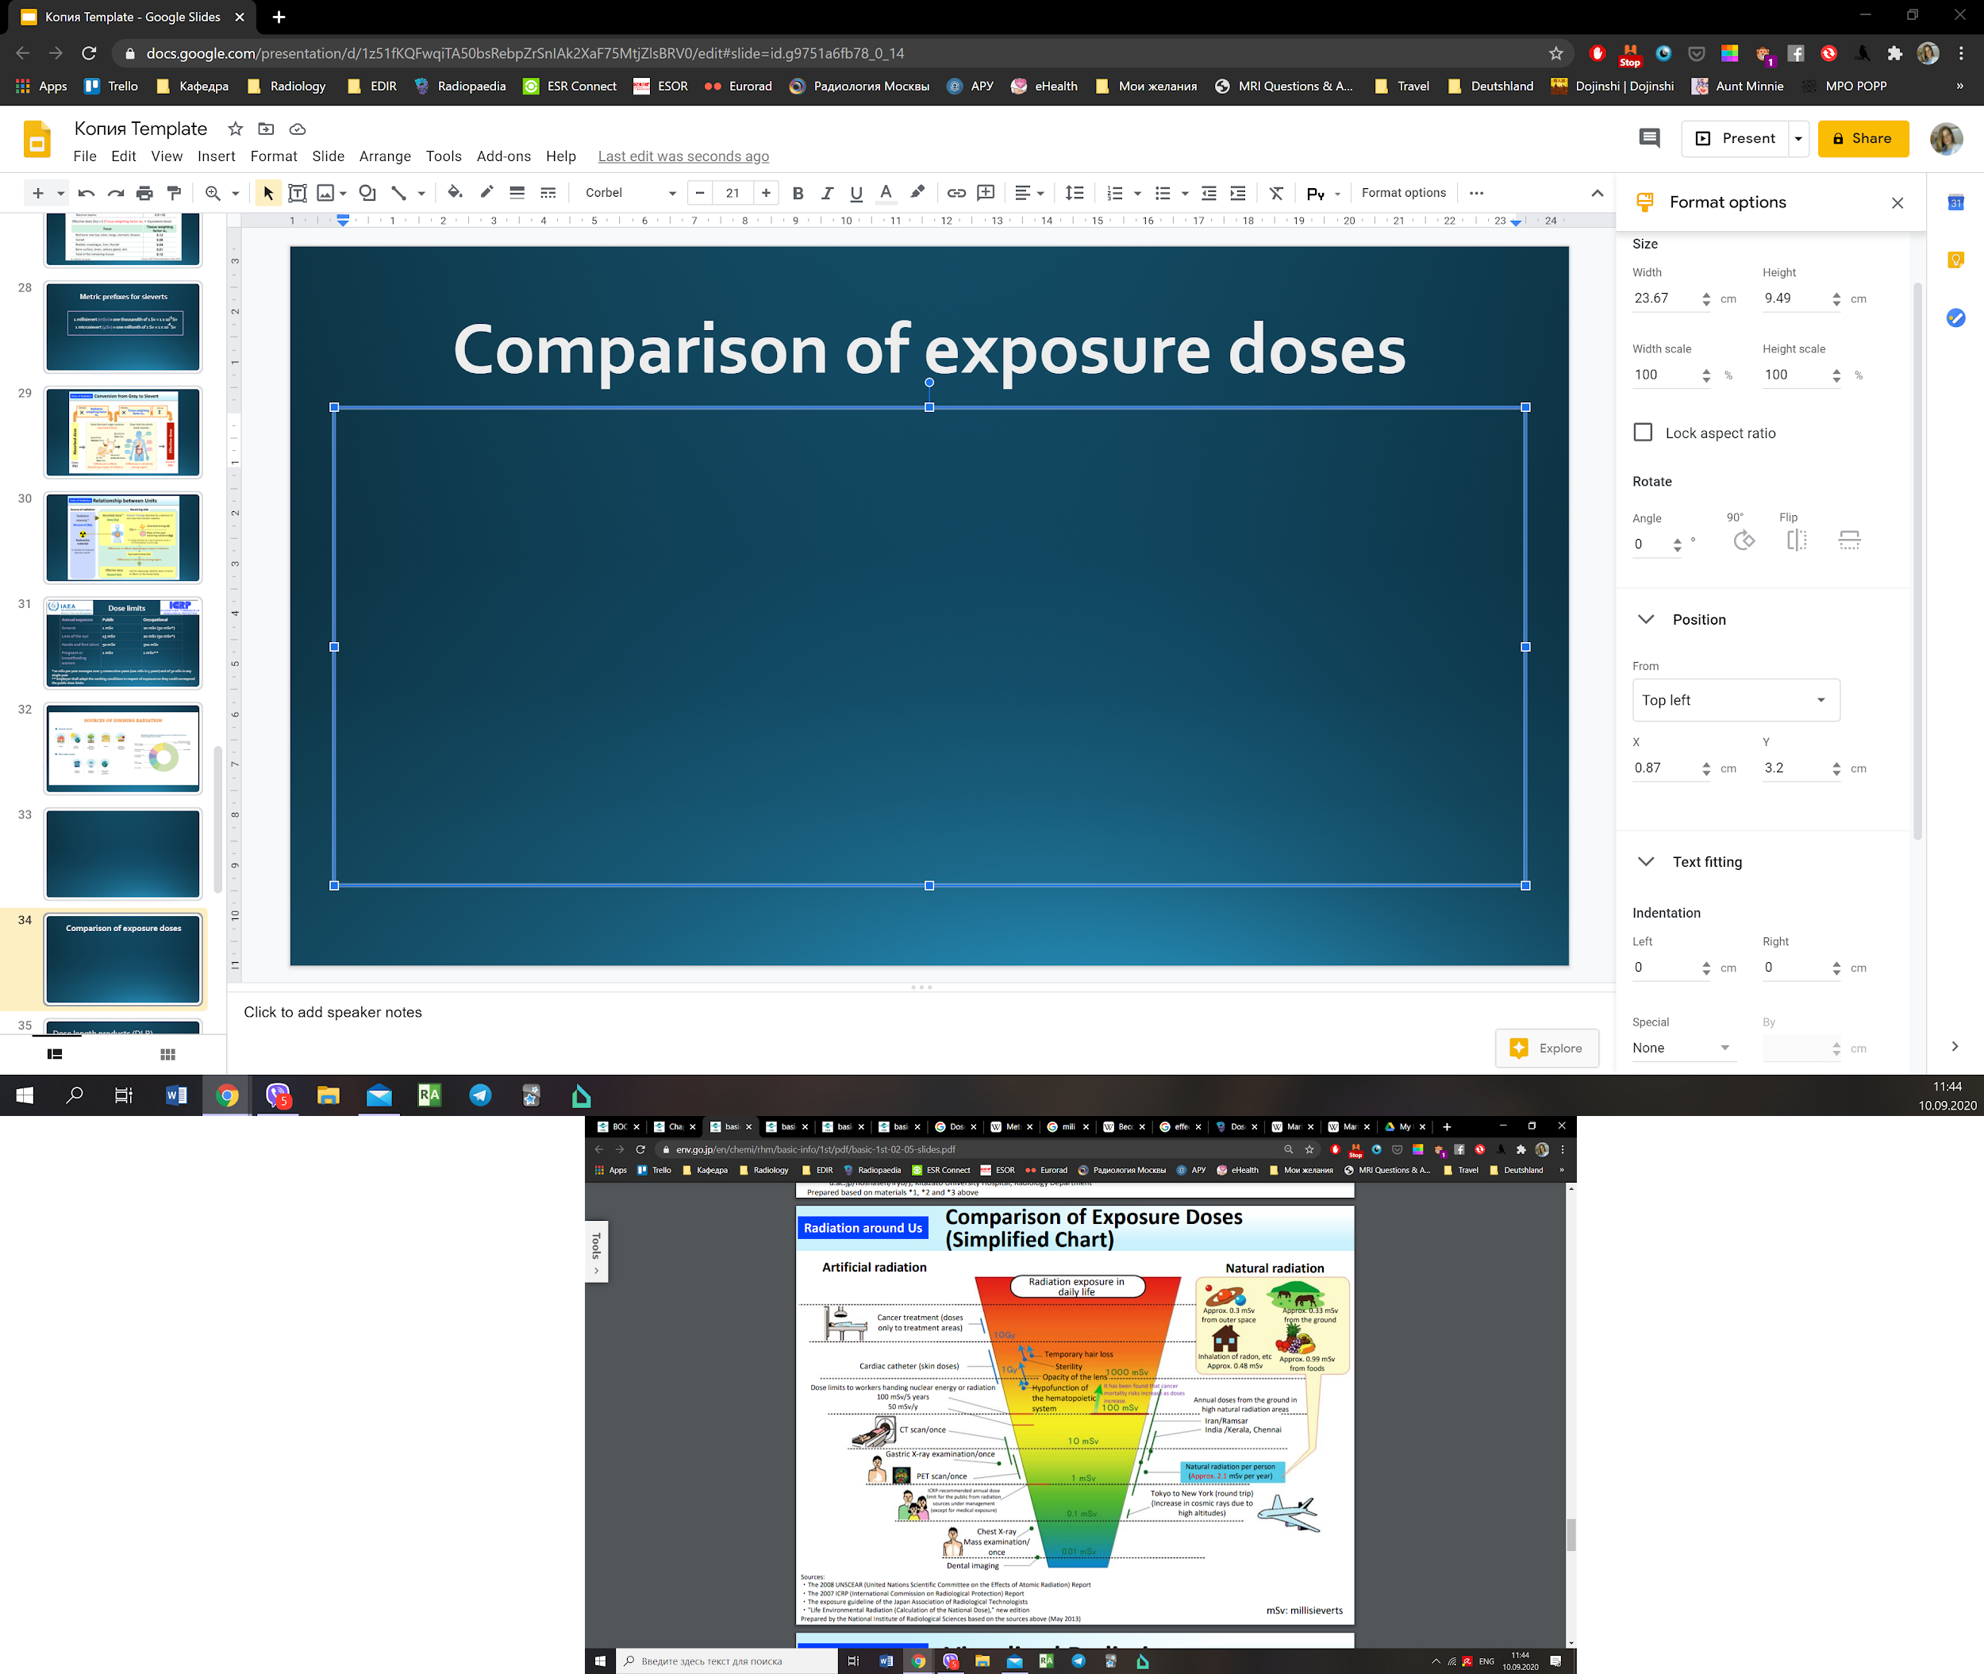
Comparison of exposure doses

Slide 39
Effects of Radiation
Notes:
Radiation is energy travelling as waves or particles. Ionising radiation has enough energy to ionise (remove an electron from an atom) which can change the chemical composition of the material. Non-ionising radiation has less energy but can still excite molecules and atoms causing them to vibrate faster.
X-ray and gamma ray radiation, which are at the upper end of electromagnetic spectrum, have very high frequencies (in the range of 100 billion billion hertz) and very short wavelengths (1 million millionth of a metre). Radiation in this range has high energy. It has enough energy to strip electrons from an atom or, in the case of very high-energy radiation, break up the nucleus of the atom.

Slide 40
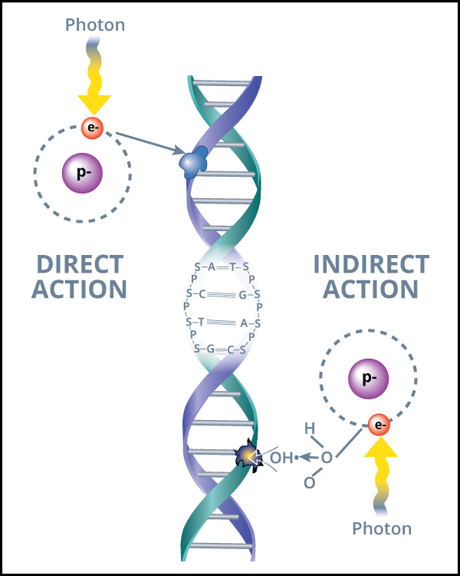
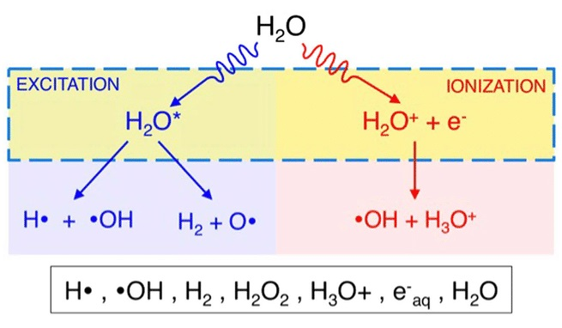
Biological action of radiation
Radiation can damage DNA directly by causing DNA breaks or indirectly by causing water radiolysis with radical generation in such as H2O2 and hydroxyl radicals.
DNA damage, if not repaired, will likely cause cell death or mutations.

Slide 41
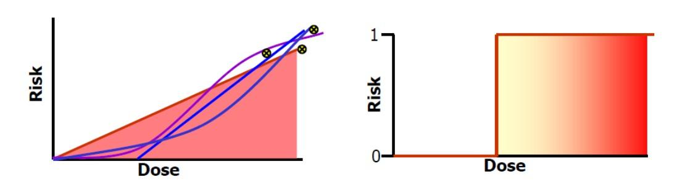
Biological effects of radiation
Stochastic effects
(delayed)
Deterministic effects
occur by chance
have no threshold
risk increases with dose
cancer, hereditary effects
directly caused by radiation
have threshold
severity increases with dose
skin damage, epilation, etc
Notes:
Stochastic effects occur by chance, there is no threshold point and the risk increases in proportionally with dose.
Cancer induction and radiation induced hereditary effects are the two main examples of stochastic effects. Although the risk increases with dose, the severity of the effects do not; the patient will either develop cancer or they will not.
Deterministic effects describe a cause and effect relationship between ionising radiation and certain side-effects. They have a threshold below which the effect does not occur. However, once the threshold has been exceeded, the severity of an effect increases with dose.

Slide 42
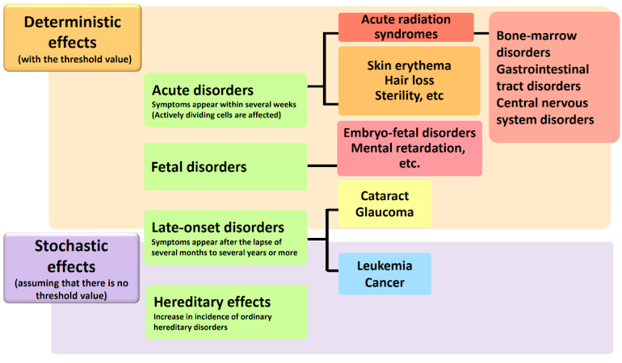
Biological effects of radiation

Slide 43
Deterministic effects
skin erythema: 2-5 Gy
irreversible skin damage: 20-40 Gy
hair loss: 2-5 Gy
sterility: 2-3 Gy
cataracts: 0.5 Gy
lethality (whole body): 3-5 Gy
fetal abnormality: 0.1-0.5 Gy

Slide 44
Diagnostic imaging procedures utilizing radiation
Radiography
Fluoroscopy
Computed tomography
Nuclear medicine procedures

Slide 45
Principles of radiation protection
Justification
Optimization
Doze limitation

Slide 46
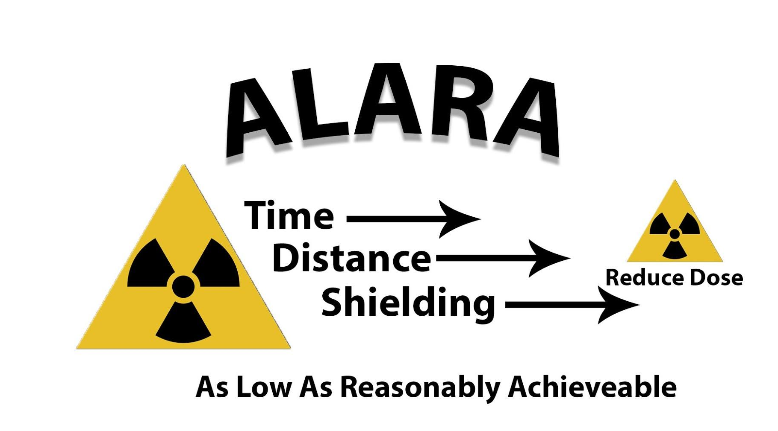

Slide 47
