Slide 1
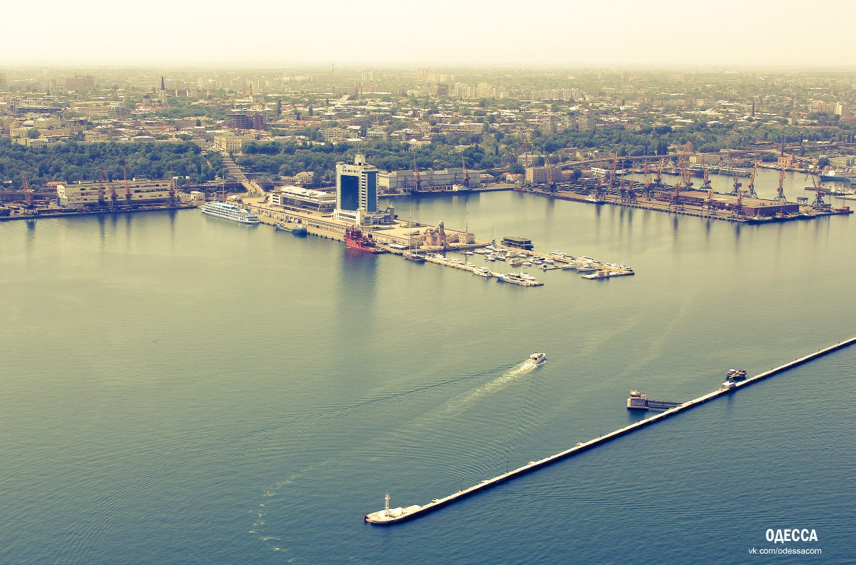
DEPARTMENT OF PHYSIOLOGY
Odessa National Medical University

Slide 2
GENERAL PRINCIPLES OF BIOLOGICAL REGULATION. REFLEX PRINCIPLE OF CNS. EXCITATION AND INHIBITION IN THE CNS. PRINCIPLES OF COORDINATION OF REFLEX ACTIVITY.
Lecture № 2
as. DENYSENKO Oksana

Slide 3
Biological regulation
Any organism is an open system that self-regulates and self-renews itself.
All cells, tissues, organs, systems are in close interconnection. The adaptation of the organism to the rapidly changing conditions of the external and internal environment is realized due to the presence of regulatory systems and mechanisms.

Slide 4
Biological regulation
There are two types of biological regulation: visceral and behavioural.
Visceral regulation is divided into intracellular, intercellular and organismic.
The contours of biological regulation are nervous and humoral by mechanisms. Nervous mechanisms are basic.

Slide 5
The structure of the contours of the nervous and humoral regulation is fundamentally the same, and the differences are associated with a different set of morphological components.

Slide 6
The deviation regulation requires a communication channel between the output of the regulation system and its central control unit and even between the output and the input of the regulation system. This communication channel was called the feedback mechanism.
Based on the final effect of regulation, the feedback mechanism can be positive and negative.

Slide 7
The nervous system can be divided into two main parts:
Somatic (skeletal muscles)
Autonomic (visceral organs and vessels)
Both somatic and autonomic nervous systems have two divisions:
• Sensory division (for collecting information)
• Motor division (for executing the action)

Slide 8
The main function of the nervous system is integration of the activity of all systems, organs and tissues.
It provide:
1. Regulation of movement
2. Maintenance of homeostasis
3. Individual adaptation of the organism to the external environment
4. Intellectual and mental activity

Slide 9
The principal and specific manifestation of the activity of the central nervous system is THE REFLEX.
A REFLEX - is a regular reaction of the organism to a change in it’s external or internal environment, effected through the CNS in response to the stimulation of receptors.

Slide 10
The basis of the study of reflex activity
of an organism was incorporated
by the French scientist
R. Descartes (1596-1650).
The term "reflex"
was entered significantly later
- after the works of Т. Wіllіs (1672)
and .J. Ргосhaskа (1780).

Slide 11
Reflectory
arch
is a neuron circuit from the peripheral
receptor through the CNS to the
peripheral effector (working body).

Slide 12
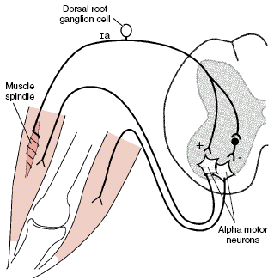
Components of the reflectory arch
1. Receptors
2. Afferent pathways
3. Neuronal centre
(central neurons)
4. Efferent pathways
5. Effector

Slide 13
Neuronal
center
… is one neuron or group of neurons
which are functioning together to
provide concrete reflectory reaction

Slide 14
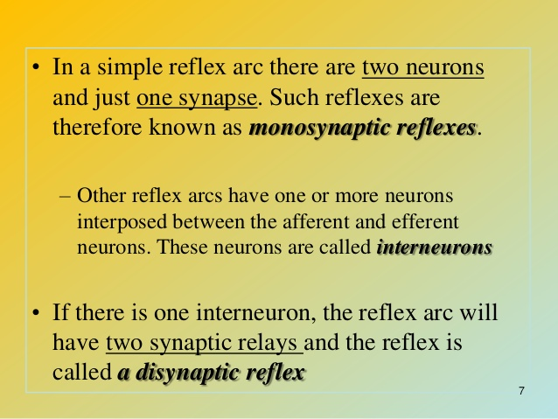

Slide 15
PRINCIPLES OF COORDINATION IN CNS
Coordination – harmonization of the activity of nervous centers
Coordination is an association of all actions of organism in a single whole, association neurons in the uniform functional ensemble deciding specific target.
Allocate the following principles of coordination:
divergence and convergences
reverberation
feedback connection
irradiation excitation
Induction
reciprocal innervation
Dominants
plasticity of the nervous centers
subordinations
common final way

Slide 16
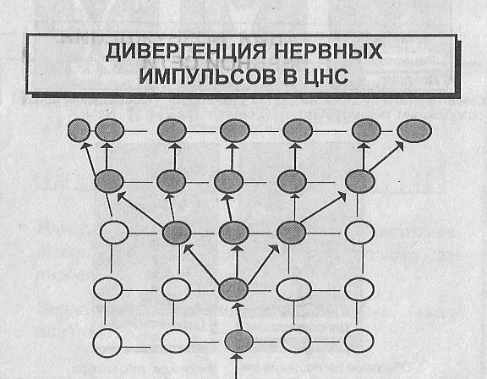
Neuronal impulses divergence within CNS
neuron cell establish numerous synaptic contracts with different nerve cells; this phenomena known as divergence

Slide 17
Divergence of signal
neuron cell establish numerous synaptic contracts with different nerve cells; this phenomena known as divergence

Slide 18
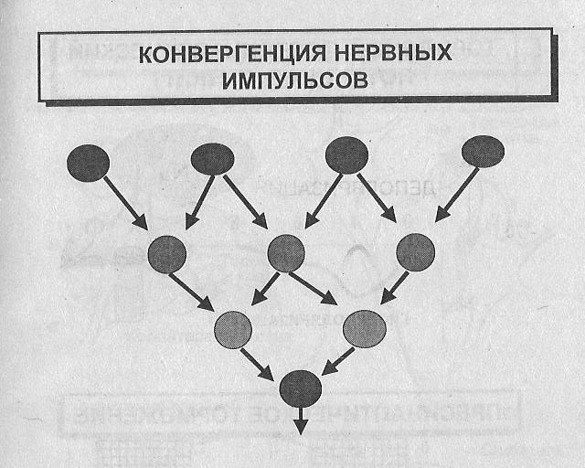
Neuronal impulses convergence within CNS
from different source
from same source
impulses reaching the CNS, along different afferent fibers that may convert upon the same intermediate or effectors neuron

Slide 19
Convergence of signal
from different source
from same source
impulses reaching the CNS, along different afferent fibers that may convert upon the same intermediate or effectors neuron

Slide 20
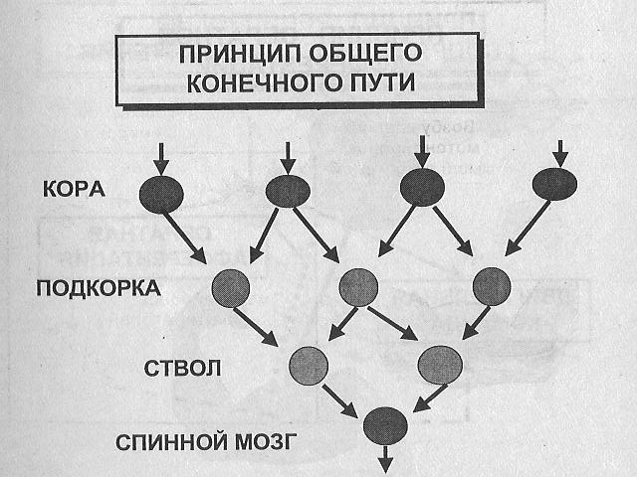
Principle of the general final way
Brain
cortex
Subcortical
structures
Brainstem
Spinal cord

Slide 21
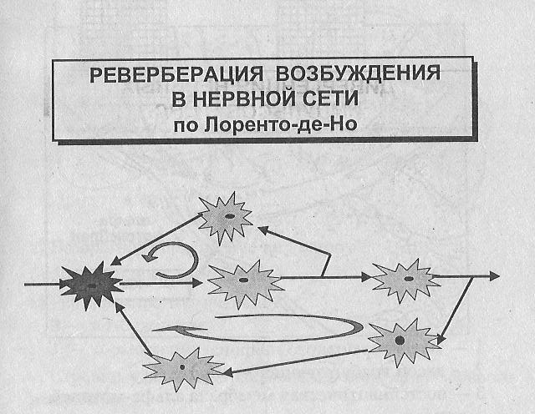
Reverberation of Excitation
according to Lorento-de-No

Slide 22
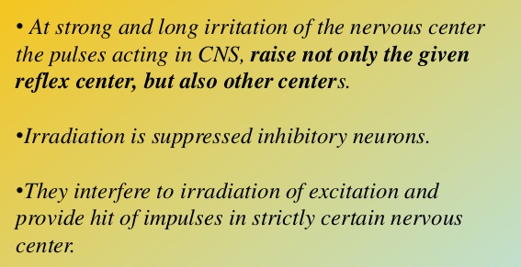
Irradiation of excitation
Spread of excitation through the CNS is known irradiation

Slide 23
The principle of feedback
Afferent impulsation generated within the organism by the activity of its organ & tissues can be called secondary in contrast to these first elicited & reflex reaction
Secondary affrentation send impulsations in the CNS about state of motor apparatus, about state of excitatory gland.

Slide 24
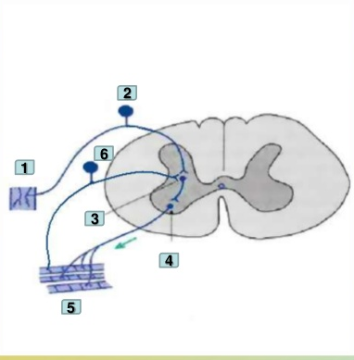
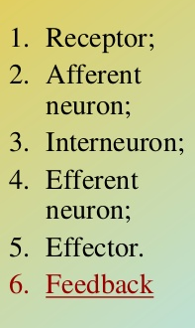
Feedback

Slide 25
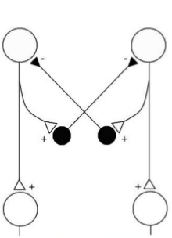
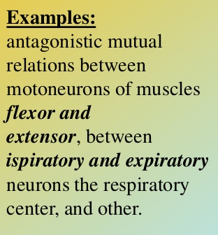
Reciprocal innervation

Slide 26
Sucessive and simultaneous induction
Negative consecutive (successive) induction + → -
Positive consecutive (successive) induction -→ +
These are contrast changes of excitability of the nervous center. If in the nervous center inhibition develops after excitation is a negative consecutive induction. If excitation develops after inhibition cause a positive consecutive induction
Negative simultaneous == + --
Positive simultaneous ++=++

Slide 27
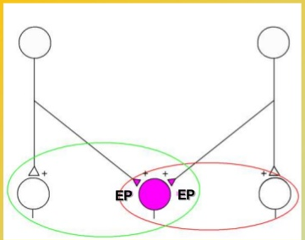
Occlusion
consist simultaneously stimulation of 2 groups of afferent fibers, discharge zone, producing an effect whose magnitude is less than arimethical sum of reflexes taken separately

Slide 28
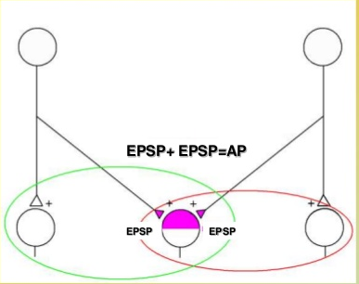
Facilitation
consist in simultaneous stimulation of 2 groups of afferent fibers at facilitated zone, producing an effect whose magnitude is bigger than the arthmyatical sum of those reflexes taken separately

Slide 29
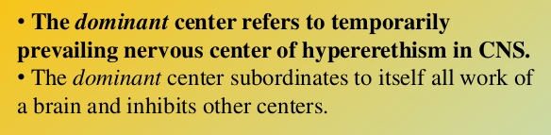
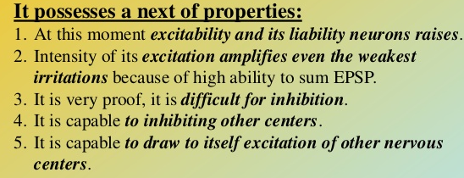
Principle of a dominant

Slide 30
DOMINANTA
- the prevailing excitation
within CNS, which
change and
"subordinate" to itself,
at present, the activity
of other centres.
O.O. Ukhtomsky
1. Neurones hyperexcitability
2. Stability of excitation
3. Ability of excitation summation
4. Ability to inhibit other nervous centres
and reflectory systems
5. Ability to keep the excitation till the end
of stimulation – this is ‘dominant’s’ inertia

Slide 31
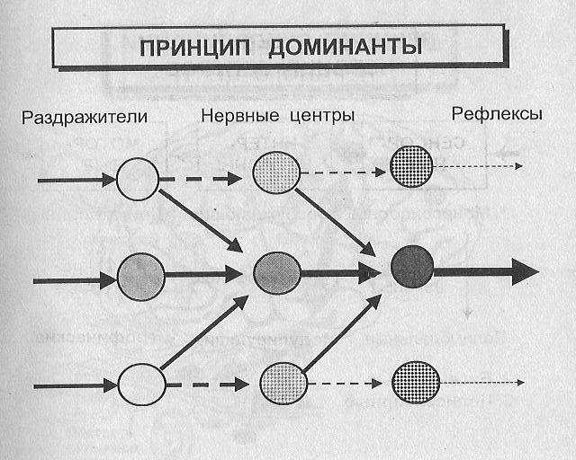
Principle of dominant relations
Stimuli
Neuronal centers
Reflexes

Slide 32
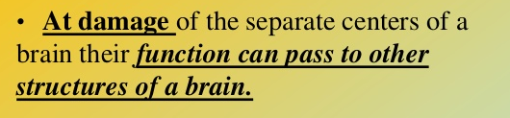
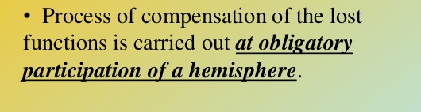
Principle of plasticity of the nervous centers

Slide 33
Principle of subordination (cephalisation)
In CNS hierarchical mutual relations take place: the underlaying department submits to instructions of an overlying department.
Evolution of nervous system has consisted in moving function of regulation from underlaying in again educated overlying departments of CNS.
It is refers to cephalisation.

Slide 34
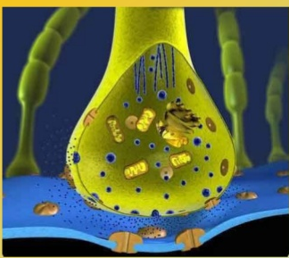
Properties of excitation propagation in the neural centres
1. One way conduction. Opposite to the nervous fiber, capable of conducting excitation in both directions, central synapses distribute only in one: from the receptor through inserted neurons to the effectors. It is caused by the mediator, released by the presynaptic ending, entering the synapse clefts, operating on the receptors of the postsynaptic membranes, causing EPSP there, and then AP in the postsynaptic structure, i.e. the synapse functions as a valve

Slide 35
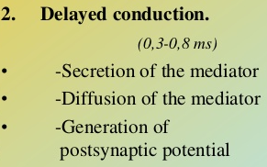
Properties of excitation propagation in the neural centres
2. Synaptic delay. In the synapses of the CNS, excitation is conducted slower than in nervous fibers. It is explained by the features of synaptic transfers (so-called synaptic decremention), namely diffusion of the mediator to the postsynaptic membrane, occurrence EPSP, its increase to critical size, generation of AP. Exact measurements have allowed the establishment, that for the conducting of excitation through one synapse elapsed time is 2-3 milliseconds. Proceeding from this, it is possible to determine the quantity of synapses in neuron grid by which a pulse in CNS passes.

Slide 36
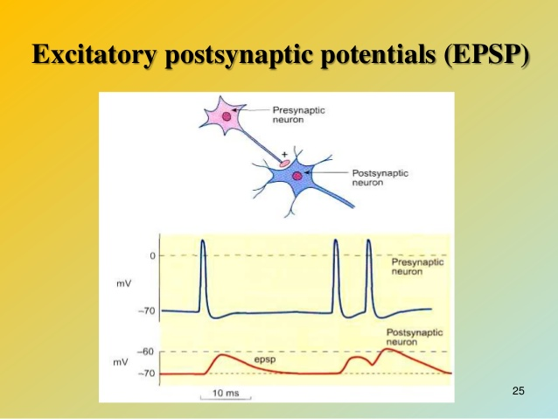
EPSP: Excitatory postsynaptic potential, this moves the MP toward the threshold level by allowing positive ions to enter in the cell as result of opening the ligand ions channels. The larger the EPSP the more like the action potention is to fire

Slide 37
Properties of excitation propagation in the neural centres
4. Summation of excitation. Summation of excitation on the body of a neuron is understood as the summation of EPSP as local potential. Addition – the process of adding two or more identical reactions, in which the resulting reaction will be greater in size, than any of its compounds.

Slide 38
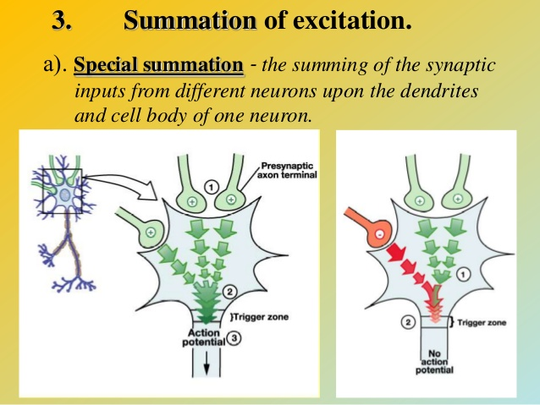

Slide 39
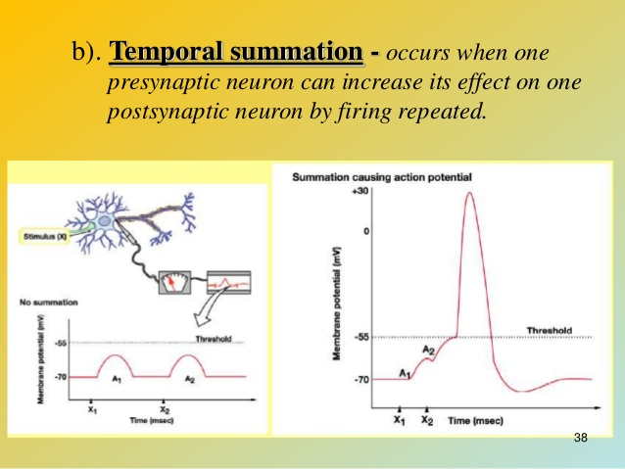

Slide 40
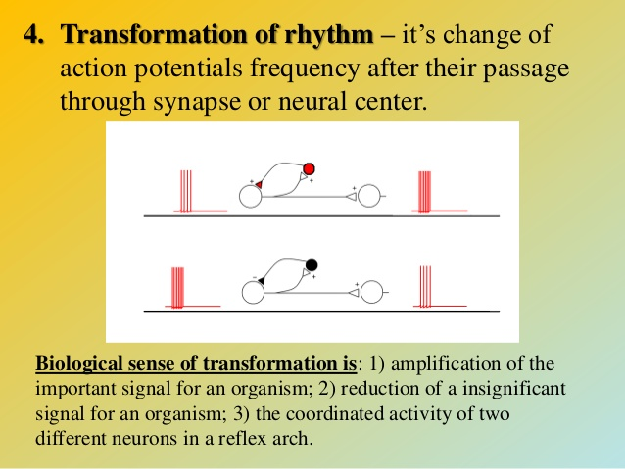

Slide 41
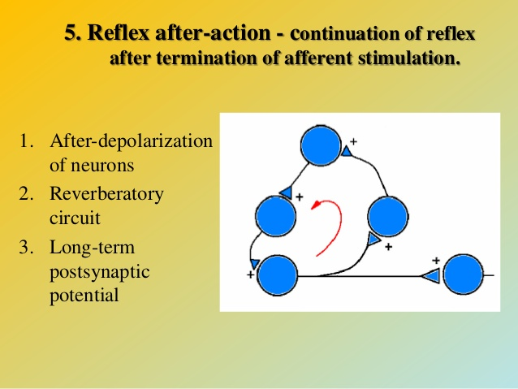

Slide 42
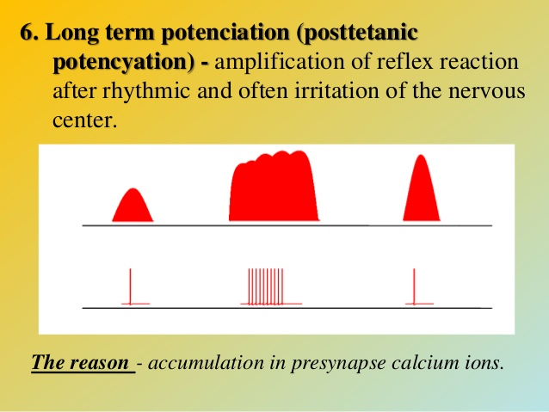

Slide 43

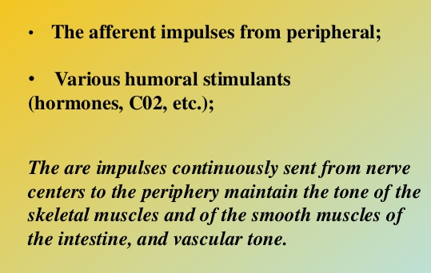

Slide 44

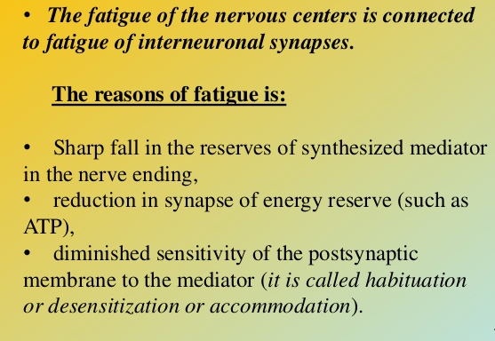

Slide 45

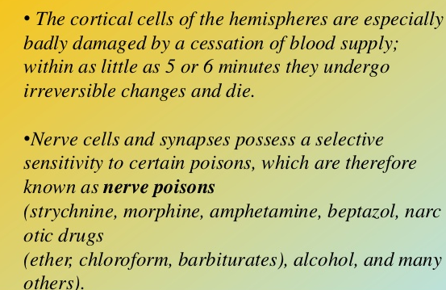

Slide 46
Definition of Inhibition
Inhibition in a general definition is a Indendent nerve process which is caused by exitation & manifested by the suppression of another exitation.
Inhibition means to slow down the excitation effect of the CNS.
Inhibition is the process where by nerves can retard or prevent the functioning of an organ or part; "the inhibition of the heart by the vagus nerve".
Inhibition is the reduction of a reflex or other activity as the result of an antagonistic stimulation.
Inhibition is a state created at synapses making them less excitable by other sources of stimulation.

Slide 47
Role of inhibition
Protection (as antaganism protection)
Coordination ( Inhibition of nervous process in the CNS that ensures the harmonious activity)

Slide 48
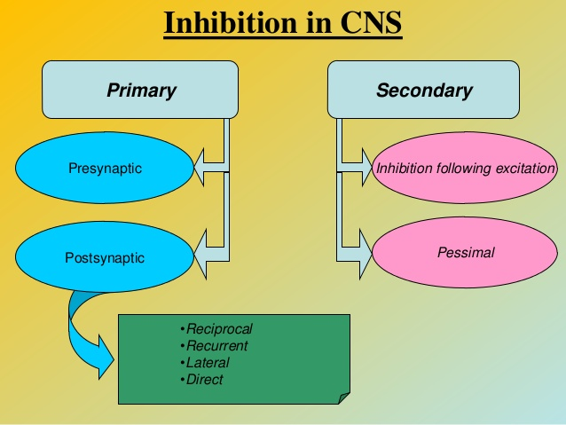

Slide 49
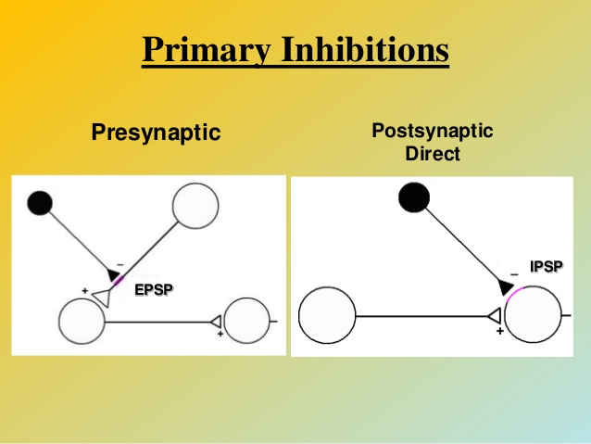

Slide 50
IPSP
IPSP: Inhibitory postsynaptic potential. It moves the cell away from the threshold level due to the movement of negative ions into the cell or positive ions out of the cell.

Slide 51
Mechanism and Properties of the inhibitory postsynaptic potential
Increase in negativity beyond normal resting potential level.
The inhibitory mainly open to Cl ions -70 mvolt . more –ve than -65 mvolt that present inside resting neuronal membrane.
Opening Cl channel allow negatively charge Cl ion to move from extracellular fluid -interior --> will make interior membrane potential more negative than normal
Opening of K channel allow positively charge K ion to move from interior > extracellular --> - also will make interior membrane potential more negative
Both Cl influx and K influx increase the degree of intracellular negativity – hyperpolarization.
It inhibit neuron because : membrane potential father away from -45 mv threshold for excitation.
IPSP > - 5 mv.

Slide 52
Inhibitory transmitters
GABA : is used at the great majority of fast inhibitory synapses in virtually every part of the brain. Many sedative/tranquilizing drugs act by enhancing the effects of GABA.
Glycine is Correspondingly as GABA, but is the inhibitory transmitter in the spinal cord
Dopamine: has a number of important functions in the brain. It plays a critical role in the reward system, but dysfunction of the dopamine system is also implicated in Parkinsons disease and schizophrenia.

Slide 53
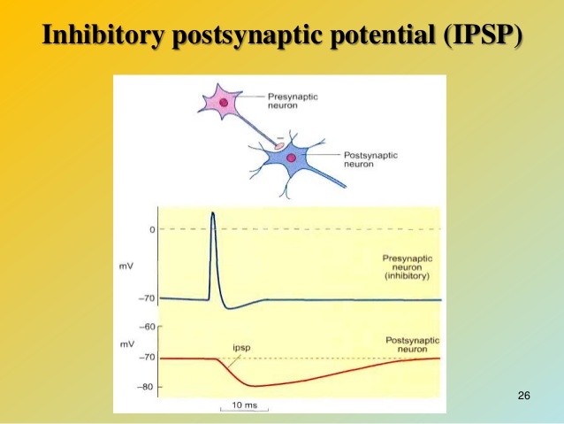

Slide 54
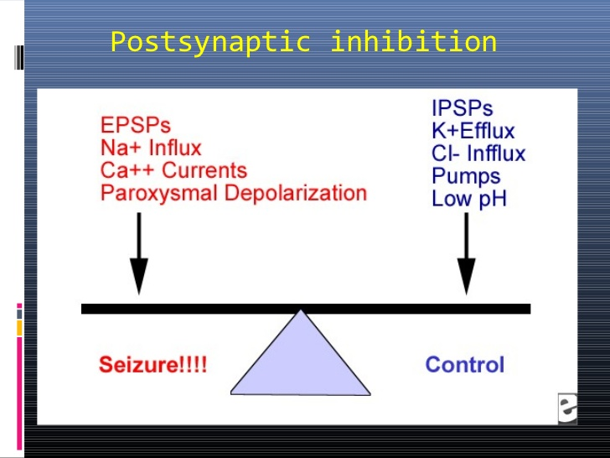

Slide 55
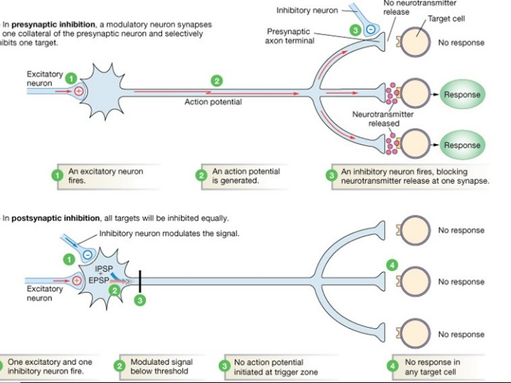

Slide 56
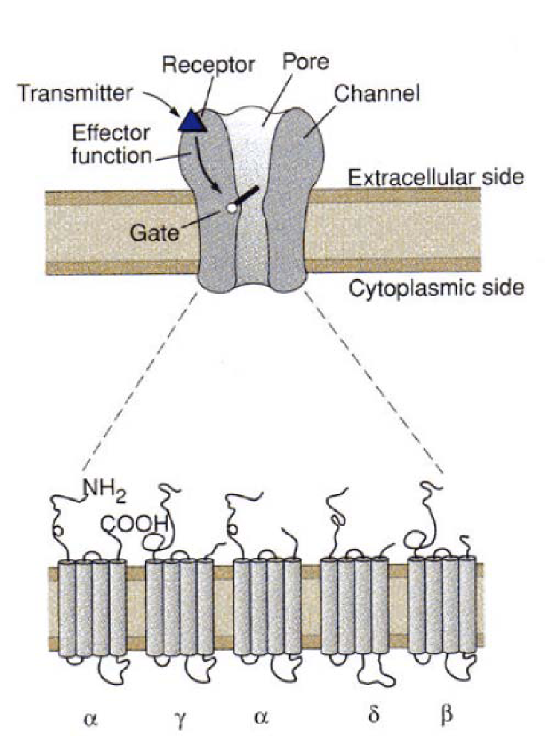
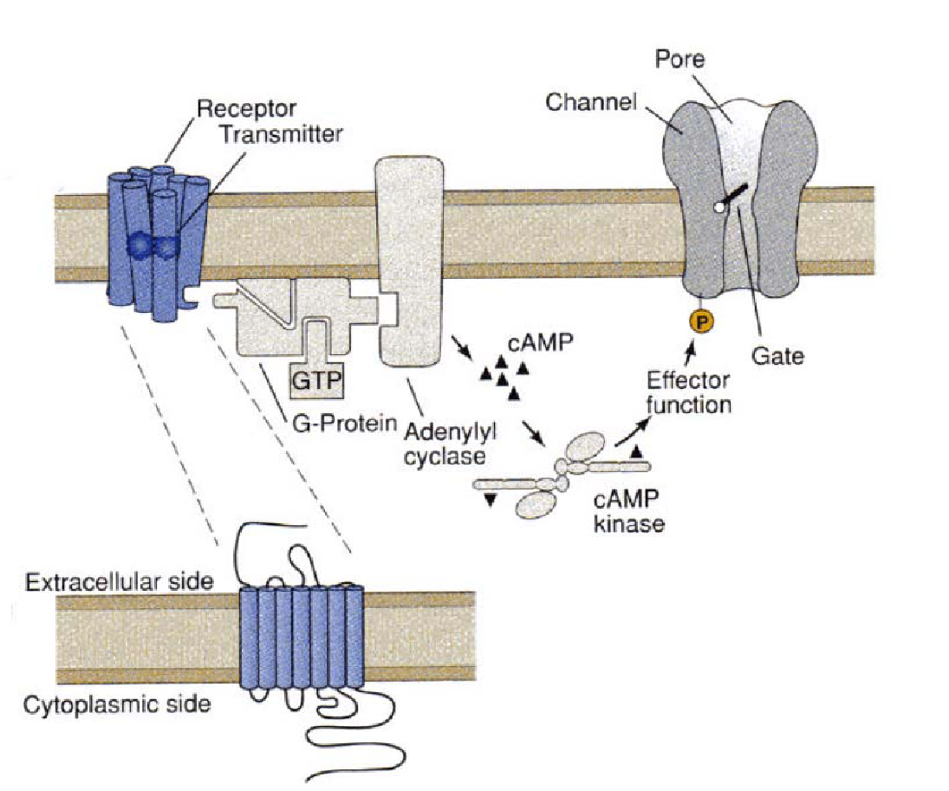
Ionotropic and metabotropic receptors

Slide 57
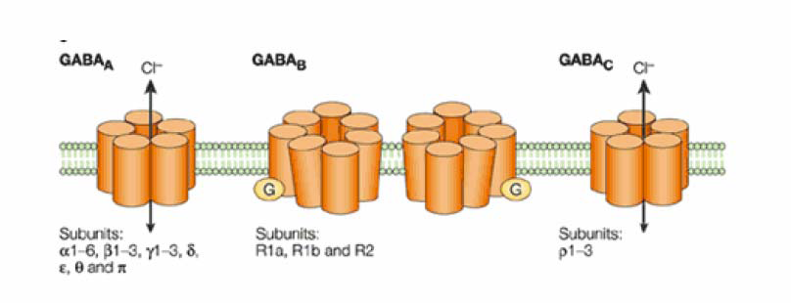
GABA receptors
GABA_{A} and GABA_{C} - ionotropic GABA receptors.
GABA_{B} - metabotropic GABA receptors.
As a rule, GABAA and GABAC receptors hyperpolarized the MP,
depolarized in the case that the MP of the postsynaptic neuron is more negative than the reversal potential for Cl⁻ in cell.

Slide 58
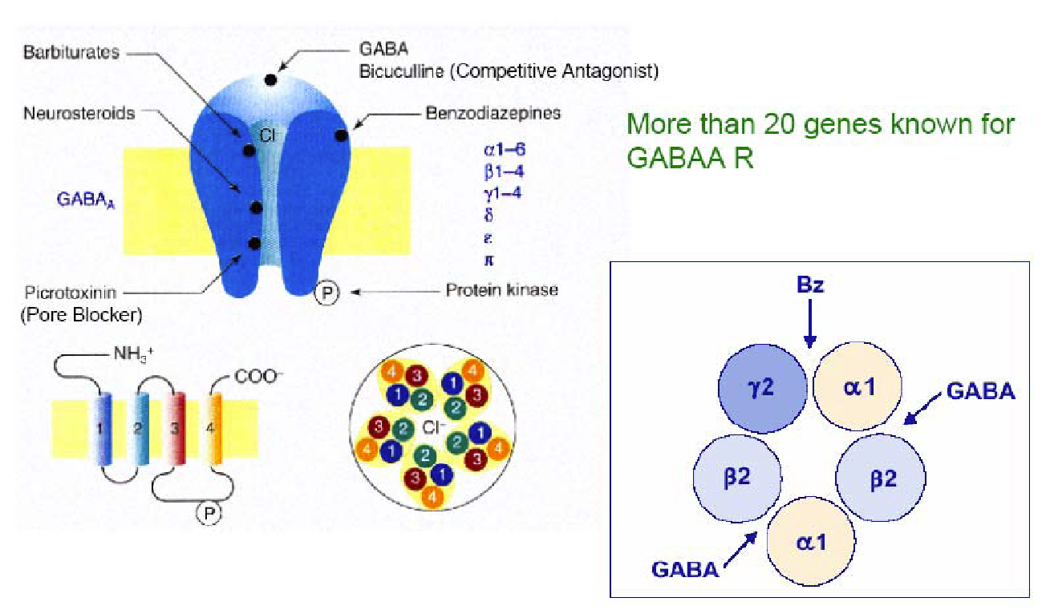
GABA_{A} receptors consist of 5 subunits

Slide 59
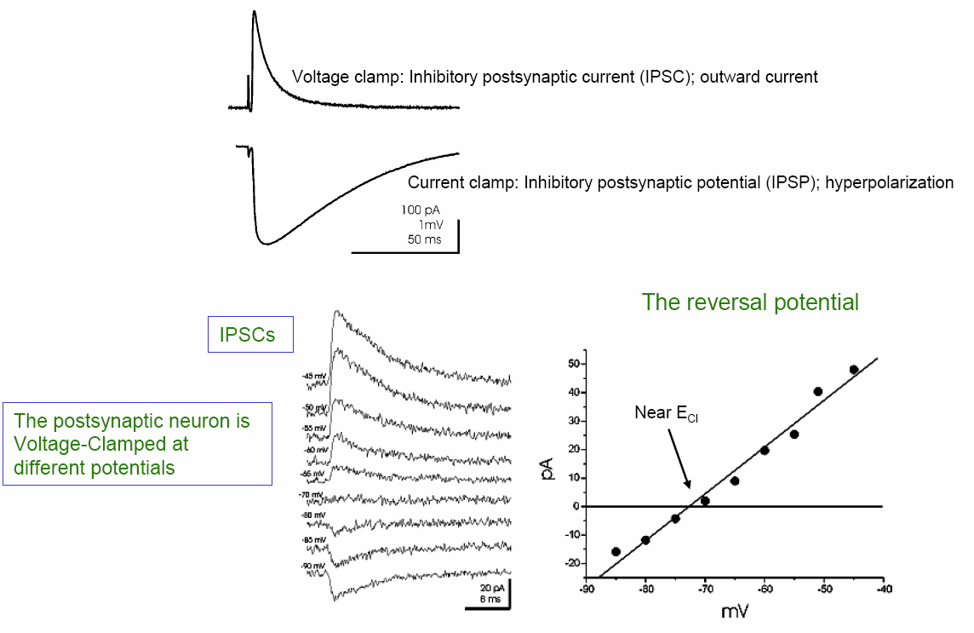
Fast IPSP is determinates by chloride conductivity

Slide 60
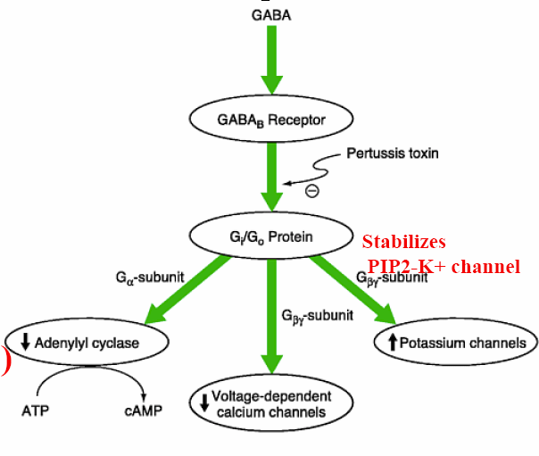
Metabotropic GABA receptors
Presynaptic function: reduced release of the neurotransmitter
Post-synaptic function: Slow K⁺ current (hyperpolarizing)
Since activation of cascades of GPSR is required: Large delay (20-50 msec), slow-wave phase and attenuation phase (400-13000 msec)

Slide 61
Mechanism of presynaptic inhibition
Occur at presynaptic terminal before the signal ever reach the synapse. Presynaptic inhibition is realize only at axon-axonal synapses.
The GABA secreted in these inhibitory synapses depolarize the membrane of terminals and bring them in a state similar to Werigo`s cathodal depression which results in Na potential-gated channels inactivation with partial or complete block of conduction of APs to the nerve endings.

Slide 62

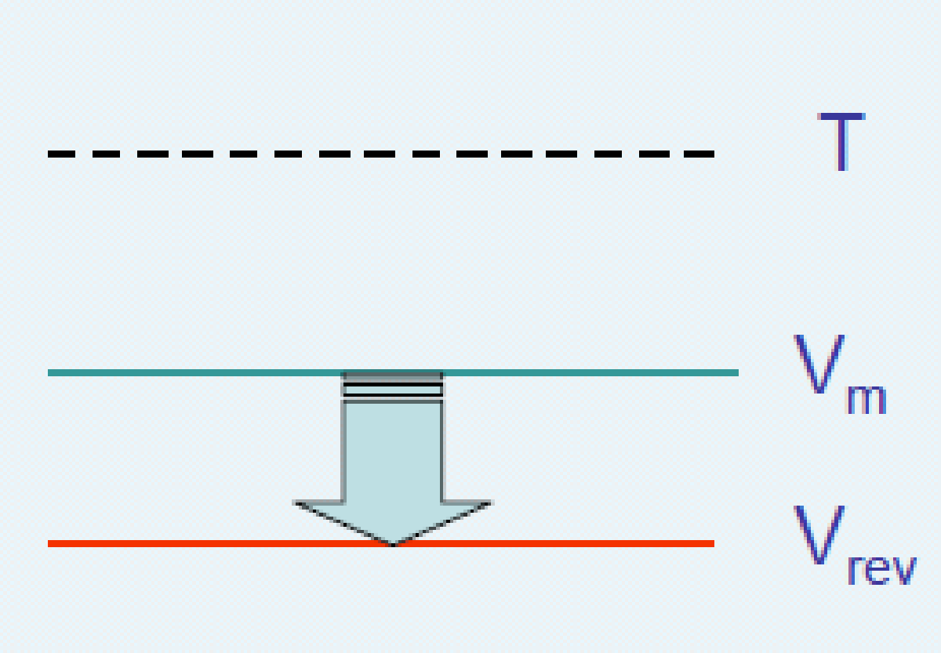

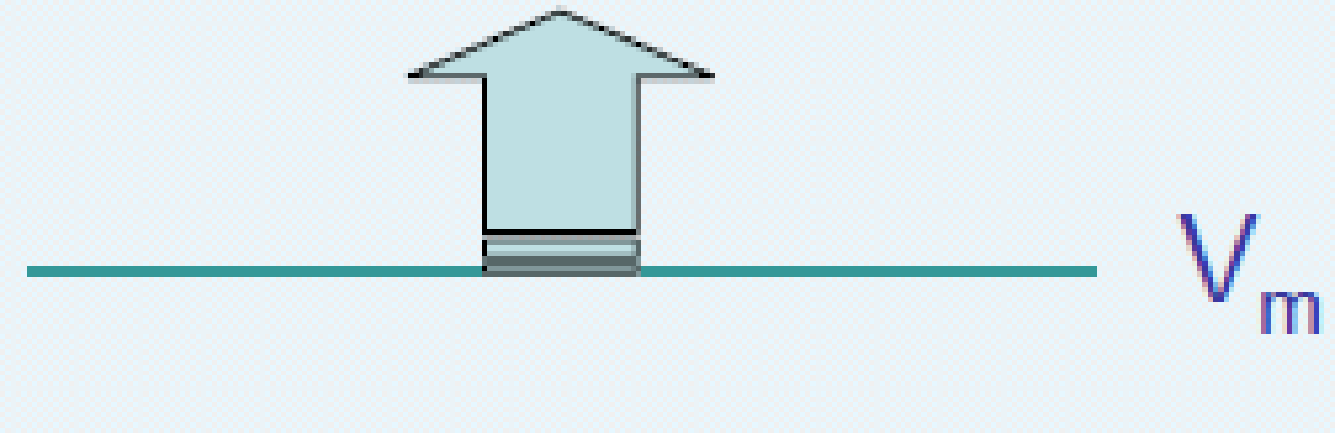
Chloride current direction
-80mV
-60 mV
-80mV
-90mV

Slide 63
The reversion potential depends on the ionic conductivity
The Nernst equation Eirev = (RT / zF) ln ([ion] out / [ion] in)
where R = gas constant
T = absolute temperature
z = valence of ion
F = Faraday constant
For 37 ^{о}С we get E i rev = 68 log ([ion] out / [ion] in)
For 20 °С we get E i rev = 58 log ([ion] out / [ion] in)
E irev for Na⁺ at 20 ° C = 58 log [140 mM] / [7 mM] = + 75 mV
Since the RMP is negative (-60 mV), the Na⁺ current
will be depolarizing
E irev for Cl⁻ ~ -80 mV
RMP of nerves (axons) is more negative (-90 mV), than RMP of dendrites and
Cl⁻ moves from the axon.

Slide 64
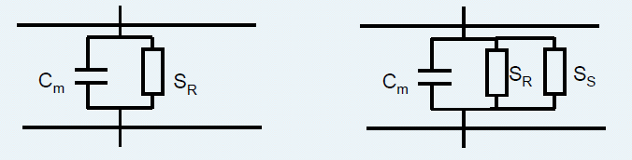
Chloride current shunt the positive Na current influx
S_{R} = 1 / R_{R}-membrane conductivity at rest Sm = SR
Shunt response S_{S} increases membrane conductivity
If shunt conductivity is added, according to Ohm's law
depolarization of the membrane will be less in response to the exciting
synaptic current Vsyn = Isyn / Sm
Thus, the shunting response is inhibitory

Slide 65
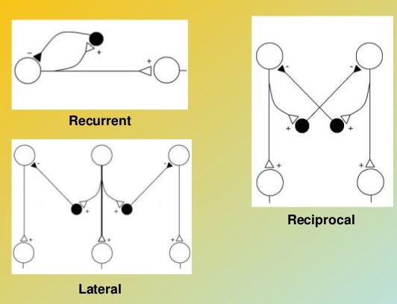
Types of postynaptic inhibition

Slide 66
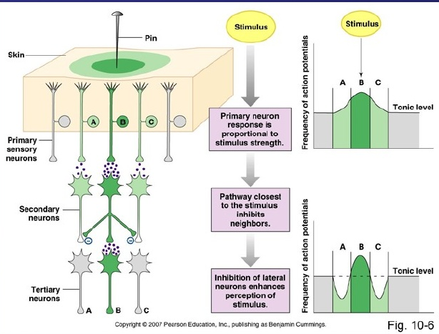
Lateral inhibition

Slide 67
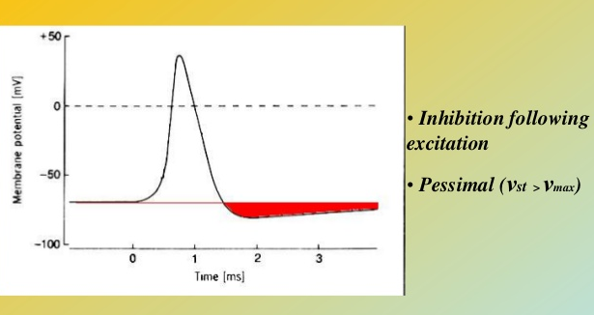
Secondary inhibition

Slide 68
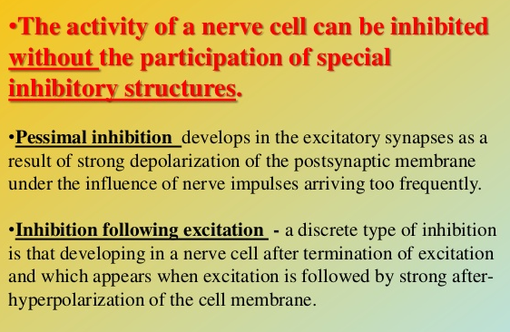
Secondary inhibition

Slide 69
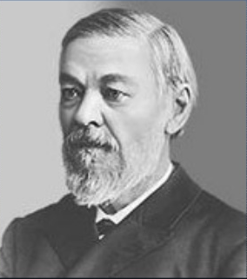
Central inhibition (Sechenovs inhibition)
The phenomenon of central inhibition was discovered by Sechenov in 1862.

Slide 70
Central inhibition (Sechenovs inhibition)
Sechenovs fundamental experiment was as follows:
a frog brain as incised at the level of the thalamus, and the cerebral hemispheres removed. Then the reflex time for withdrawing the hind legs from a solution of sulphuric acid was measured (Turcks method). The reflex was performed by the spinal centers and its time indicated their excitability.

Slide 71
Central inhibition (Sechenovs inhibition)
Sechenov found that application of a crystal of common salt or a weak electrical stimulus to the section of the thalamus markedly prolonged the reflex time. From this experiment he concluded that there were nerve centers in the thalamic region of the frog brain producing an inhibitory influence on spinal reflexes.
Sechenov correctly evaluated the great importance of the phenomenon of central inhibition he had discovered, and used it in his theoretical work to explain the physiological mechanisms of mans behaviour.

Slide 72
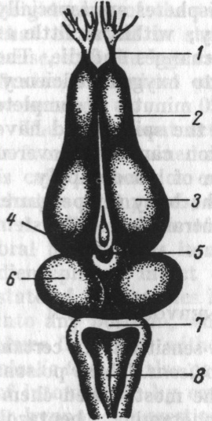
Central inhibition (Sechenovs inhibition)
A frog brain showing the line of section in Sechenov`s expiriment
1 - olfactory nerve;
2 – olfactory lobe;
3 – cerebral hemispheres;
4 – thalamus;
5 – line of brain section;
6 – corpora bigemina;
7 – cerebellum;
8 – medulla oblongata and fossa
rhomboidea`

Slide 73

Central inhibition (Sechenovs inhibition)
Notes:
‹#›

Slide 74


Slide 75

THANKS FOR
ATTENTION !

