Slide 1
№ 5
STUDY OF THE ROLE OF THE
SPINAL CORD, POSTERIOR BRAIN, MIDBRAIN AND RETICULAR FORMATION IN THE REGULATION OF BODY FUNCTIONS.
as. DENYSENKO Oksana

Slide 2
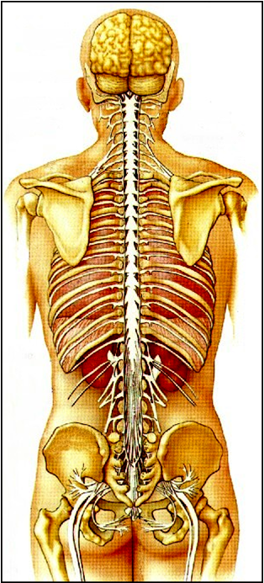
SPINAL CORD
The caudal part of the central nervous system, located in vertebral canal.
The length is about 45 cm, the thickness is about 1 cm.

Slide 3
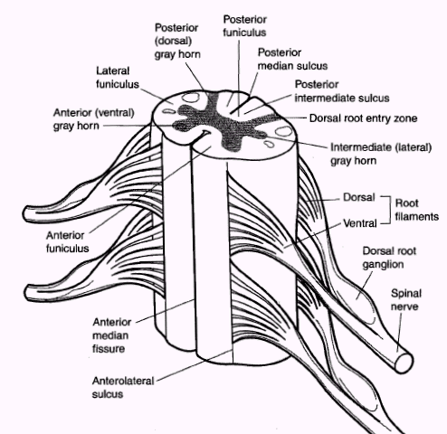
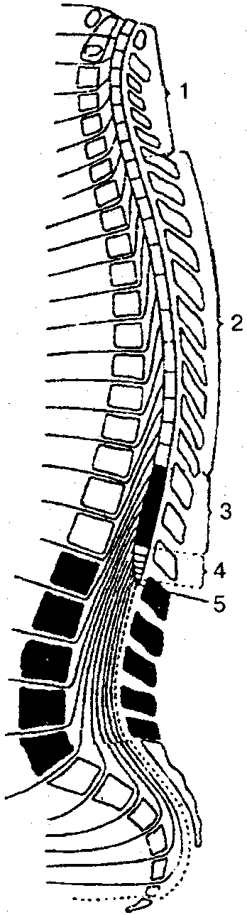
The segment is a transverse fragment of the spinal cord that has a radix apparatus. There are 31-33 segments in total:
8 cervical - CI-CVIII,
12 thoracic (thoracic) - ThI-ThXII,
5 lumbar (lumbar) - LI-LV,
5 sacral (sacral) - SI-SV,
1-3 coccygeal - C1-3.
In the spinal canal, the spinal cord is shifted upward, therefore, at the level of LII and below, the spinal canal is filled with spinal nerves that form the cauda equina (until the 3rd month of fetal life, the spinal cord fills the entire vertebral canal, then the bone grows faster and the canal is empty) .

Slide 4
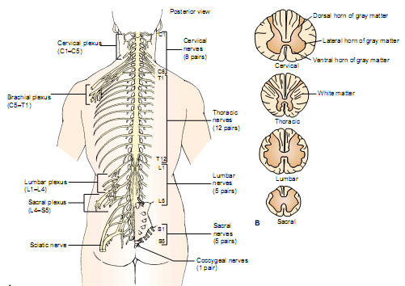

Slide 5
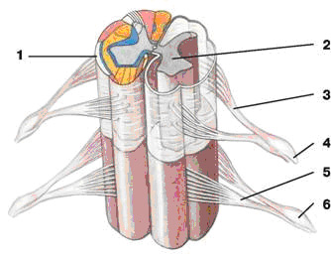
SPINAL CORD COMPOSITION
According to the structure in the segment, the following substances are distinguished: - gray matter - formed by demyelinated elements of neurons and neuroglia, white matter - mainly myelinated nerve fibers. Radix apparatus: - radix dorsalis - axons of afferent neurons of spinal ganglia, the radix ventralis are the axons of efferent and vegetative neurons.
1 Shells of the spinal cord
2 Gray matter
3 radix dorsalis
4 nervus spinal e
5 radix ventralis
6 ganglion spinale

Slide 6
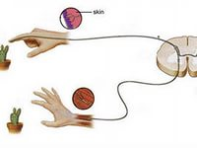
The law of Bell - Mazhandi
Charles Bell (1811), F. Mazhandi (1822). The Bell-Mazhadi law: the posterior roots are sensitive, afferent, sensory; anterior - motor, efferent.
cutting of the posterior roots of the spinal cord leads to loss of sensitivity;
cutting of the anterior roots of the spinal cord leads to loss of motor function (to paralysis);

Slide 7
Rear sensitive roots. According to the works of C. Sherrington, the distribution of sensitive innervation:
each metamer of the body sends afferentation to 3 consecutive segments of the spinal cord;
each segment of the spinal cord innervating 3 different metamer of the body.
A metamer is a body site (skin and muscle mass under it) that have a common innervation.

Slide 8
Spinal Cord Neurones
Reksed described the layered topography of the gray matter of the spinal cord. It consists of 10 plates. The neurons of each plate differ in structure and function. In gray matter, the posterior, the anterior horns are distinguished, and the lateral horns in the Th and L segments.
According to the functions posterior horns include:
interneurons - small associative neurons (within the given half of the segment) and commissural (between neurons of different halves of the segment),
Clarke's motor nucleus (nucleus dorsalis) - the second neuron of the tractus spinocerebralis dorsalis (Flexing tractus).
Lateral horns:
neurons of the medial nucleus - the 2nd neuron of tractus spinocerebralis ventralis (Hovers tractus),
neurons of the lateral nucleus - sympathetic vegetative neurons Th and L.
Anterior horns:
effector neurons α- and γ-motoneurons (their only 3% of all neurons of the spinal cord)
Sensitive neurons
are located in the spinal cord
ganglia

Slide 9
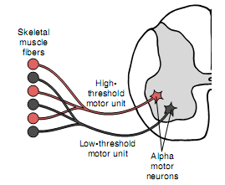

Slide 10
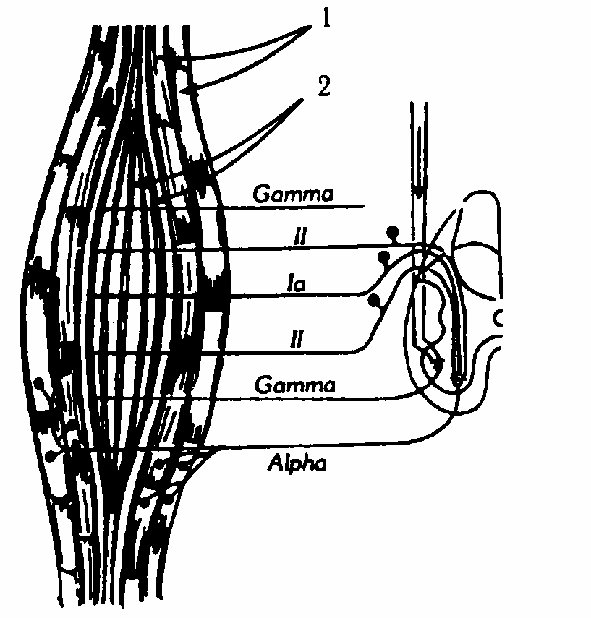
α-Motoneurons - the largest, have up to 10-20 thousand synapses on their bodies.

Slide 11
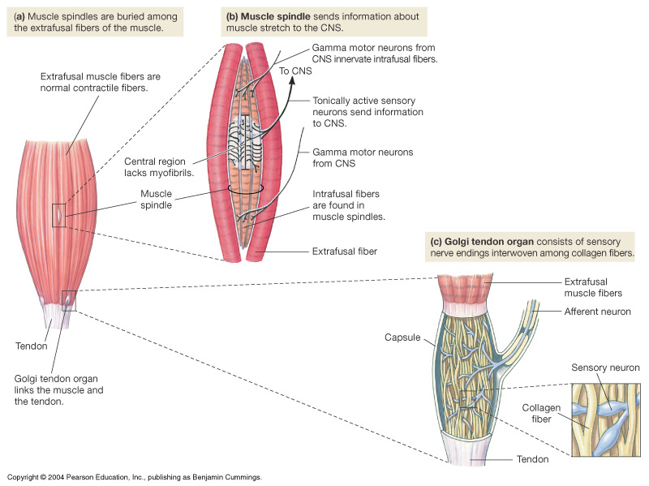
Muscle Spindle & Golgi Tendon Organ

Slide 12
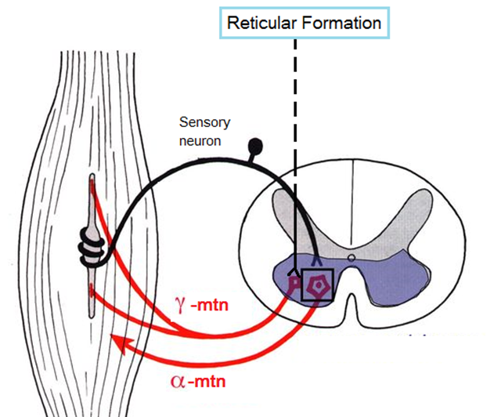
γ-motoneurons innervate the intramuscular muscle fibers of the muscle spindles. The smaller. The speed is 10-40 m / s. Direct synapses with afferent nerve fibers do not have, but have monosynaptic activation from descending pathways (reticulospinal, pyramidal) - the possibility of conjugate activation of α- and γ-motoneurons via the γ-loop

Slide 13
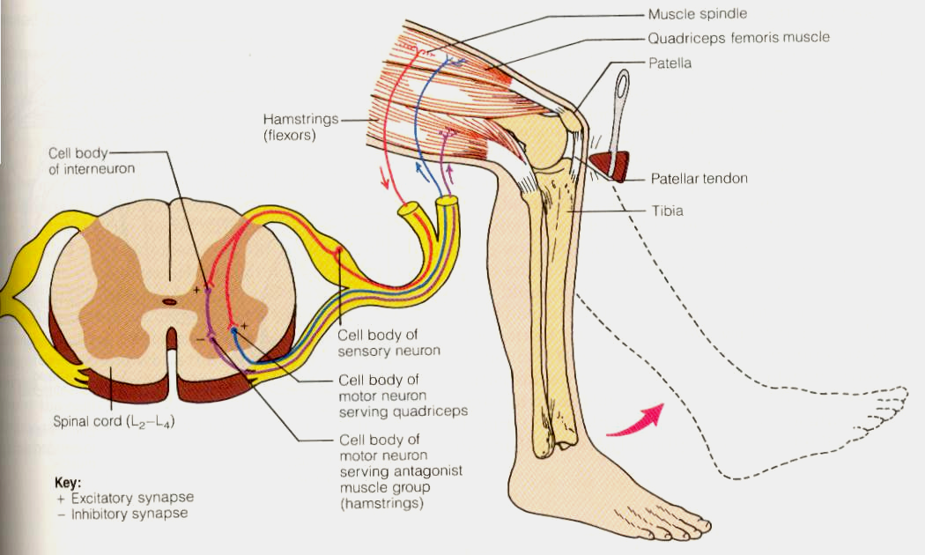
Functions of the spinal cord:
1. Reflex.
2. Conductor
3. Trophic.
Reflexes of the spinal cord is an innate response to internal or external irritation.
All reflexes in complexity of reflex arcs are divided into monosynaptic and polysynaptic.

Slide 14
Spinal Cord Reflexes
1. Stretch reflex (phasic)
2. Withdrawal reflex (tonic)
3. Reflex of muscle-antagonists
4. Viscero-motor reflexes
5. Vegetative reflexes.

Slide 15
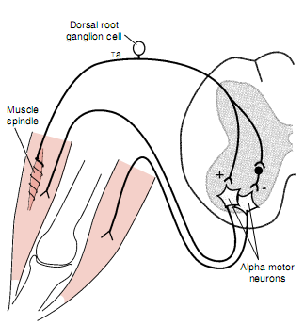
Stretch reflex (knee reflex) scheme

Slide 16
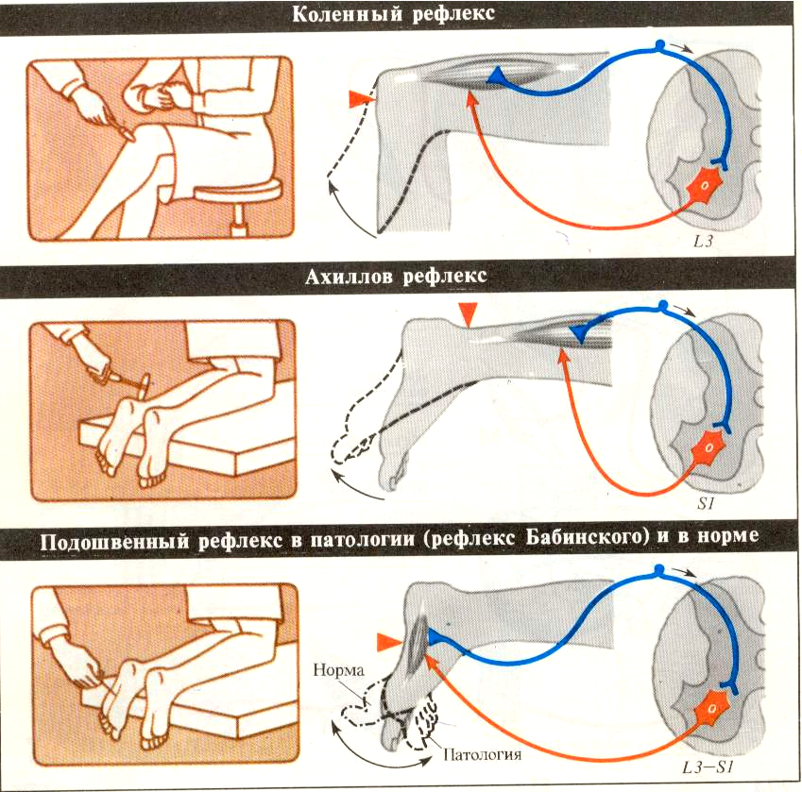
Spinal Cord Reflexes
……………………………………………………………………………………………………….
…………………………………………………………………………………………………………….

Slide 17
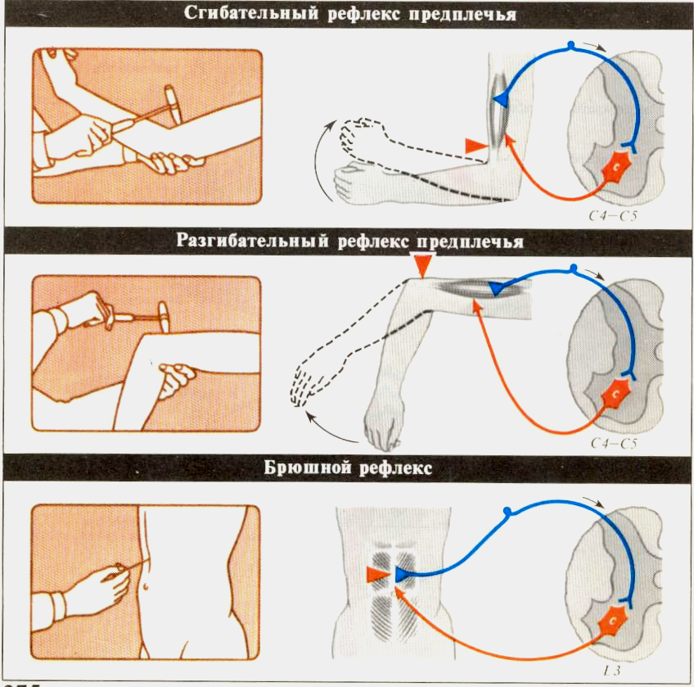
Spinal Cord Reflexes
………………………………………………………………………………………………
.………………………………………………………………………….

Slide 18
Tendon reflexes (stretching reflexes) in a clinic can be determined:
1. At what level of the spinal cord is the pathological process localized
2. The level of excitation of the nerve centers.
3. The side of the spinal cord lesion.

Slide 19
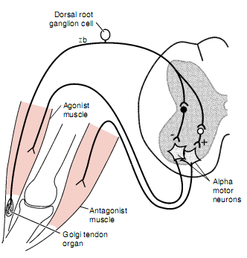
Withdrawal reflex scheme

Slide 20
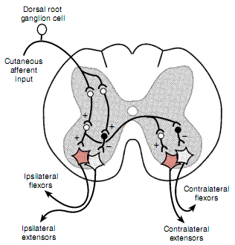
Muscle – antagonists reflex scheme

Slide 21
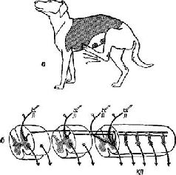
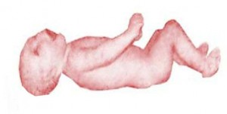
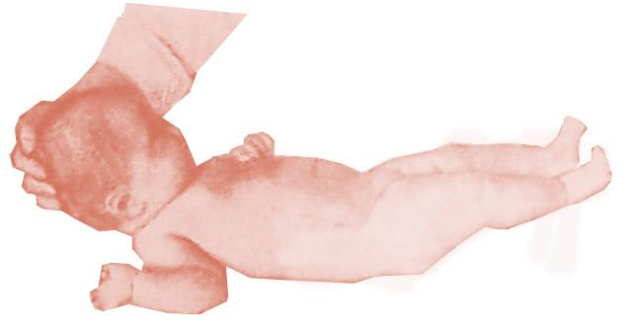
Complex / polisinapticheskie spinal cord reflexes
Rhythmic (walking, carding reflex of animals)
Pose poses (maintaining posture)
Neck / Tonic
When the head is bent, the hands are reflexively flexed and the legs are extended.
When the head is extended, the arms are extended, and the legs are flexed.

Slide 22
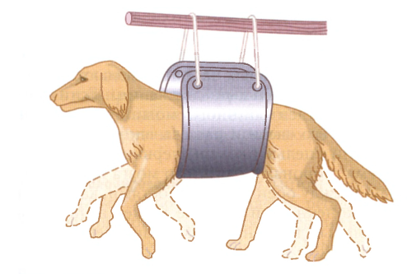
Spinal Locomotion (Automatism)
The main characteristics of locomotion, i.e. movement of a person or animal in the environment using coordinated movements of the limbs, programmed at the level of the spinal cord.
Pain irritation of any limb of the spinal animal causes reflex movements of all four limbs; if such stimulation continues, rhythmic flexor and extensor movements of non-irritated limbs may occur.
If a spinal animal is put on a treadmill, it will make coordinated walking movements that are very similar to natural ones.

Slide 23
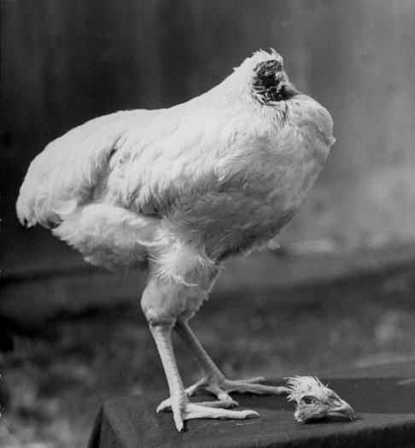
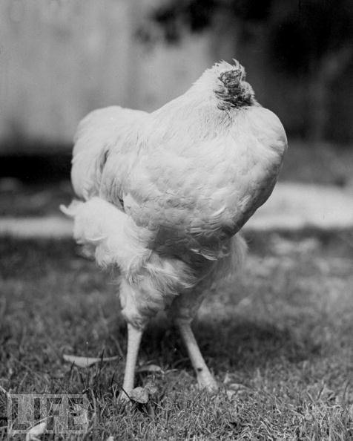
The activity of the centers is coordinated by propriospinal systems and tracts crossing the spinal cord within some segments.
In more primitive animals, spinal locomotion can manifest itself - in running without a head.

Slide 24
An assumption that a human also has spinal locomotor centers.
Apparently, their activation during skin irritation manifests itself in the form of a pacing reflex of the newborn (lasts up to 2 months).
However, as the central nervous system matures, the supraspinal regions subordinate such centers to themselves, and in an adult they lose the ability for independent activity.

Slide 25
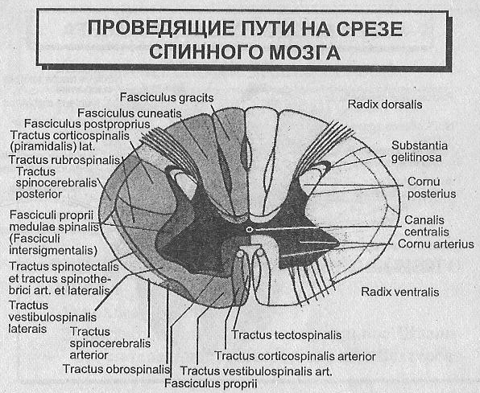
Spinal Cord Cross-Section.
The view of the conductive pathways.

Slide 26
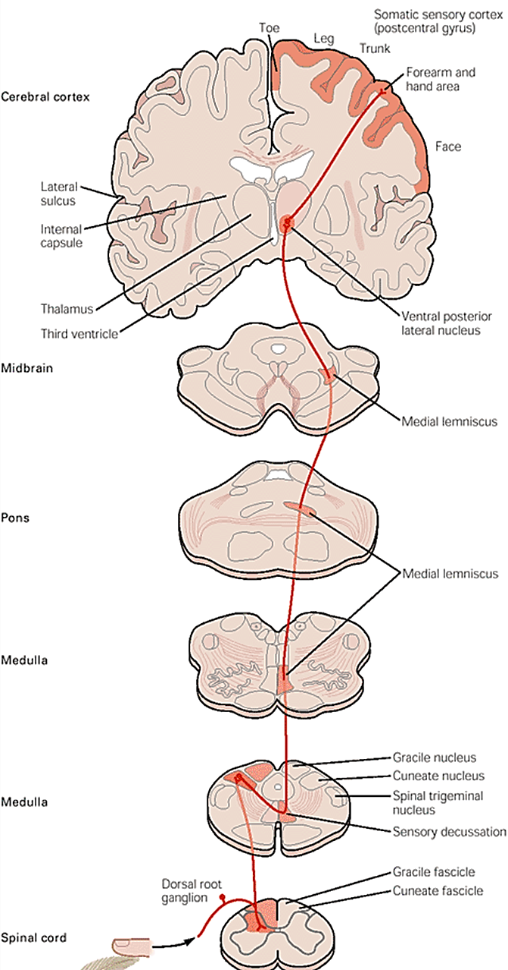
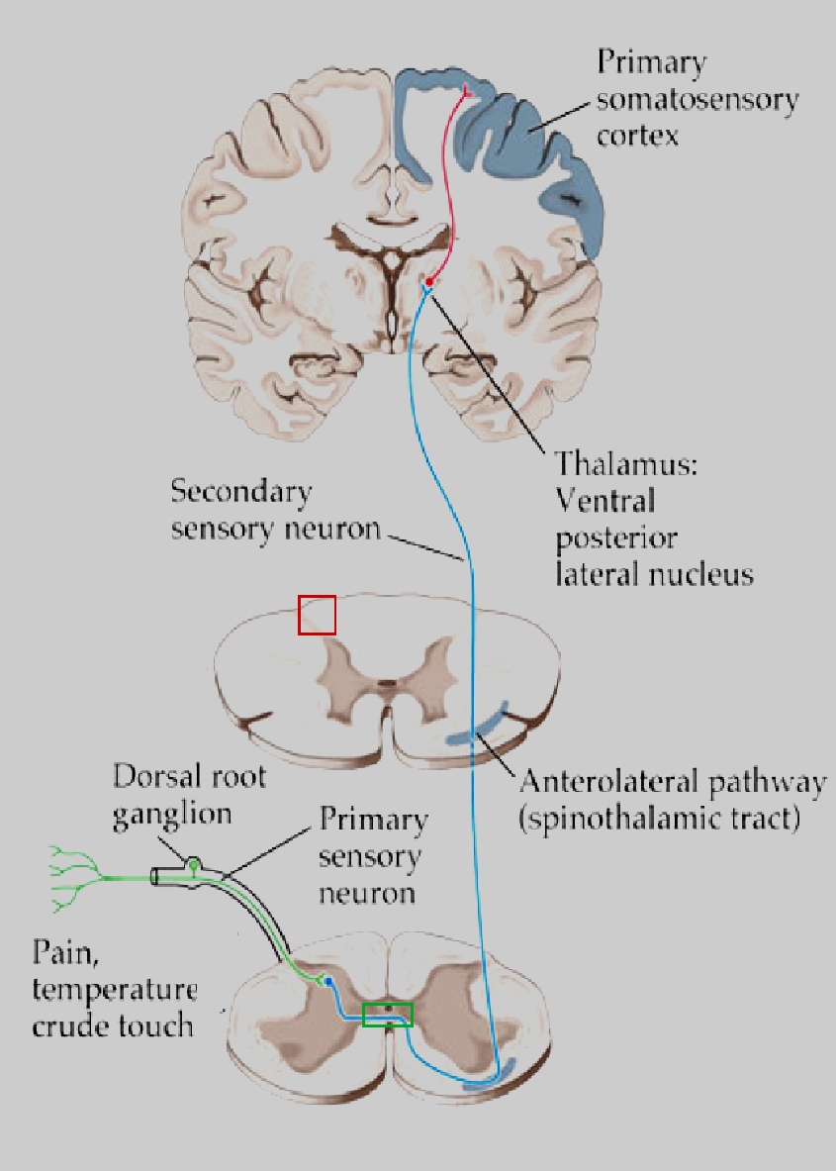
The uscendent pathways of the spinal cord

Slide 27
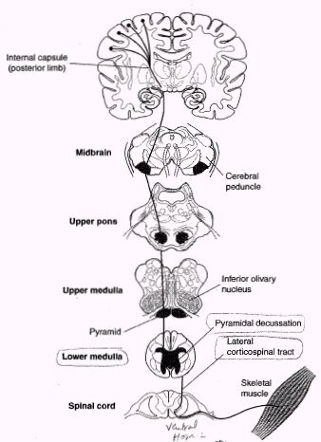
Tractus corticospinalis

Slide 28
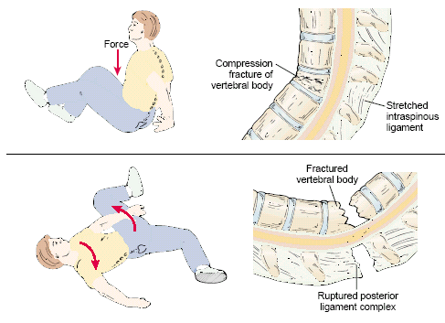
Descending motor tracts lesions
SPINAL SHOCK
- temporary pathologic condition characterizes by spinal cord connections rupture with upper brain after trauma or surgical intersection that follows by the lower spinal reflexes dissappearing.

Slide 29
Functions of the medulla oblongata
Reflectory
Conductive
Tonic

Slide 30
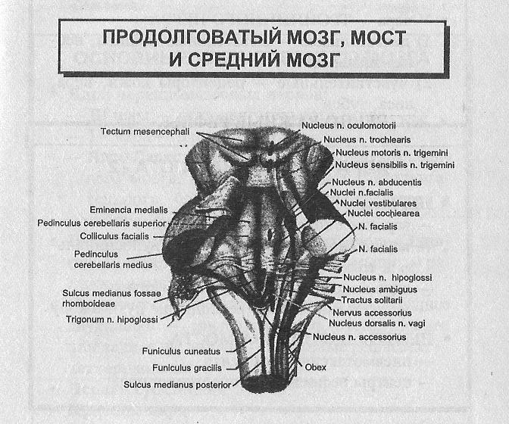
FOSSA RHOMBOIDALIS

Slide 31
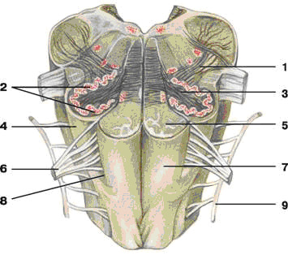
Medulla oblongata. Structural and functional organization.
1 - tractus olivocerebellaris;
2 – nucleus olivaris;
3 - hilus nuclei olivaris;
4 - oliva;
5 - tractus pyramidales;
6 – n. hypoglossus;
7 - pyramis;
8 –sulcus lateralis anyerior;
9 – n. accessorius,

Slide 32
Nucleus of the medulla oblongata
1. Nuclei of cranial nerves
XII pair - n. hypoglossus - motor nuclei
XI pair - n. accessorius - motor nuclei
X pair - n. vagus:
1) vegetative nucleus
2) the sensitive nucleus - nucleus tractus solitarii
3) nucleus ambiguus - regulation of motor functions of pharynx and larynx

Slide 33
IX pair – n. glossopharyngeus:
1) motor nucleus - mouth and pharynx
2) sensitive nucleus - taste of the back third of the tongue
3) vegetative nucleus - salivary glands
On the border with the pons:
YIII pair – n. vestibulocochlearis
1) cochlear nuclei
2) vestibular nuclei - medial Schwalbe ,
lateral Deiters, superior, inferior

Slide 34
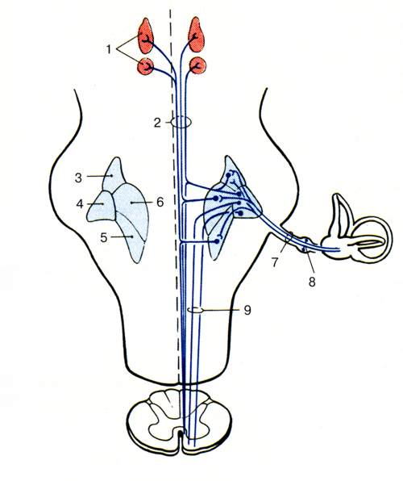
medial Schwalbe ,
lateral Deiters,
superior,
Inferior Roller

Slide 35
Nucleus of the medulla oblongata (2)
СONDUCTIVE NUCLEUS:
- nucleus gracillis and nucleus cuneatus - to the thalamus
- Reticular formation - from the cortex and subcortical ganglia to the spinal cord
- nuclei olivaris - from the cortex, subcortical nuclei and the cerebellum to the spinal cord and from the spinal cord to the cerebellum, thalamus and cortex; from the cochlear nuclei to the midbrain and tectum mesencephali

Slide 36
Reflexes of the medulla oblongata
Vital
Protective reflexes
Reflexes maintaining posture
Vegetative reflexes
Vestibulo-vegetative reflexes

Slide 37
Centers of the medulla oblongata
LIVING
Respiratory
Cardiovascular
3) Digestion
Salivation
Sucking
Chewing
Swallowing
PROTECTIVE:
1) lacrimation
2) sneezing
3) cough
4) flashing
5) gagging

Slide 38
Postural reflexes (maintaining posture)
1. Static (maintaining posture alone) :
position reflexes
straightening reflexes
labyrinth reflexes
neck reflex
2. Statokinetic (maintaining posture when changing the speed of movement):
nystagmus
lift reflexes

Slide 39
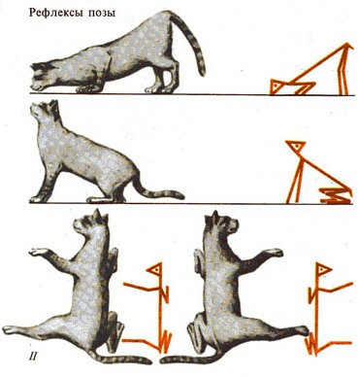
Postural (static) reflexes (R. Magnus):
-..........................
1. neck tonic - activated when proprioreceptors of the neck muscles are excited:
head down - hypertonus of the extensors of the hind limbs,
head back - hypertonus of the extensors of the forelimbs,
head to the right - hypertonus of the extensors of the right limbs,
head to the left - hypertonus of the extensors of the left limbs,
Any deviation of the head causes the movement of the eyeballs in the opposite direction.
(in its pure form in the destruction of the vestibular apparatus, which gives additional information about the position of the head)

Slide 40
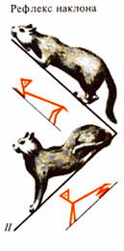
vestibular tonic reflexes associated with the excitation of receptors of the vestibule of the labyrinth, is inextricably connected with neck tonic reflexes.
They do not depend on the position of the head relative to the body, but depend on the position of the head in space (without bending in the neck).
Subdivided into:
- vestibulo-neck reflexes are responsible for the vertical position of the head.
- vestibulospinal reflexes adjust the position of the limbs to the position of the head.
………………………….
(in its pure form when the head is fixed in relation to the body or when the proprioreceptors of the neck muscles are turned off by the novocain).

Slide 41
PONS
In the pons are located nuclei of cranium nerves :
V pair – n. trigeminus,
VI pair – n. abducens,
VII pair – n. facialis,
VIII pair – n. vestibulocochlearis.

Slide 42
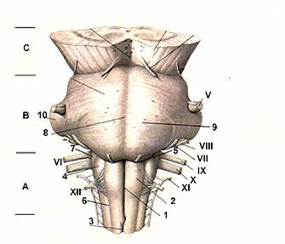
VIII pair – n. vestibulocochlearis
VII pair – n. facialis
Is mixed:
Afferent fibers transmit signals from the taste receptors of the front of the tongue.
Efferent fibers innervate the facial muscles of the face
VI pair – n. abducens
Is motor
Innervates the rectus lateral muscle, abductor eyeball out.
V pair – n. trigeminus
Is mixed:
Afferent fibers transmit signals from receptors of the face skin, the mucous of the nose and mouth, teeth, and tongue.
The efferent fibers innervate the chewing muscles, the muscles of the palatine curtain and the muscle straining the eardrum.

Slide 43
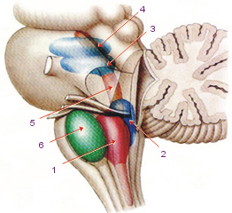
Reflex functions of the pons:
Localized centers that regulate the work of the respiratory system and gastrointestinal tract;
The centers of protective reflexes are located: sneezing, coughing, tearing, corneal reflex;
The centers of complexly coordinated reflexes are located: chewing, swallowing, sucking;
Reflexes associated with maintaining posture, straightening and body changes in space during human movement.

Slide 44
Sensory function of the pons
The following types of sensitivity are analyzed in the sensory nuclei of the pons:
Primary skin sensitivity (the nucleus of the trigeminal nerve);
Primary reception of sound signals (nucleus of the cochlear nerve);
Primary reception of vestibular irritations (superior vestibular nucleus).

Slide 45
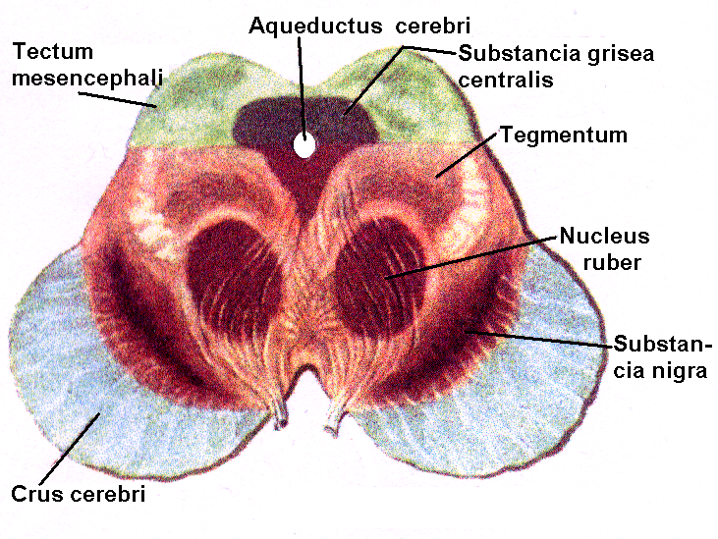
The midbrain. Structural and functional organization.

Slide 46
In the midbrain are located:
cranial nerve nuclei (III and IV pairs);
Lamina quadrigemina;
red nucleus;
substantia nigra;
blue nucleus;
reticular formation;
various ascending pathways to the thalamus, cerebellum, and descending pathways pass through the midbrain.

Slide 47
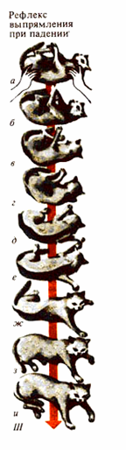
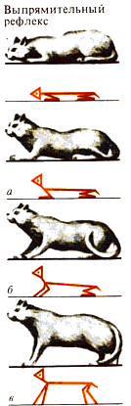
The midbrain motor reflexes:
STATIC - from vestibule receptors - straightening reflexes (setting)
the transition of an animal from an unnatural posture to its usual position.
When falling -
- first, due to the vestibular rectifying reflex, the normal position of the head is restored - face down.
- then the repositioning of the head excites the proprioceptors of the neck muscles and they trigger the neck rectifier reflex, as a result of which, following the head, the body also returns to its normal position.

Slide 48
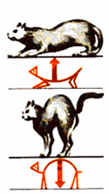
STATOKINETIC -
from the semicircular canal receptors
- reflexes of rectilinear acceleration
- angular acceleration reflexes

Slide 49
Lamina quadrigemina of the midbrain
Colliculus superior
Colliculus inferior
Visual subcortical
centers
Audial subcortical
centers
The function:
organization of start-reflexes
on sudden, unrecognized visual and sound signals
participation in the organization of voluntary movements

Slide 50
Starts the extrapyramidal motor
pathway - Tr. rubrospinalis
N. Ruber of the
midbrain
Receives motor inputs from
motor cortex, cerebellar nuclei,
substantia nigra.
FUNCTIONS:
Skeletal muscles tone regulation.
Unconsciousness instinctive and
precise consciousness movements.

Slide 51
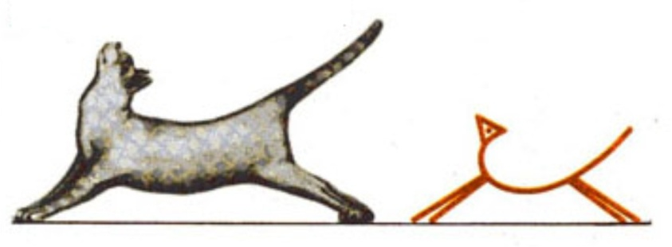
DECEREBRATIVE RIGIDITY
- pathological conditions induced in experiment after brain tissue section with red nucleus connections to vestibular nuclei complete dissection (Ch. Sherringtone experiment).
This condition characterizes by extreme extensor tone prevailing on the flexor tone of the muscles.

Slide 52
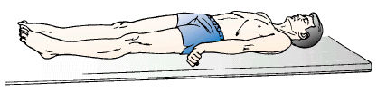
DECEREBRATIVE RIGIDITY
chaws are clenched;
neck muscles are extended ;
the arms are adducted;
and stiffly extended at the elbows with the forearms pronated;
wrists and fingers are flexed.
Notes:
‹#›
‹#›

Slide 53
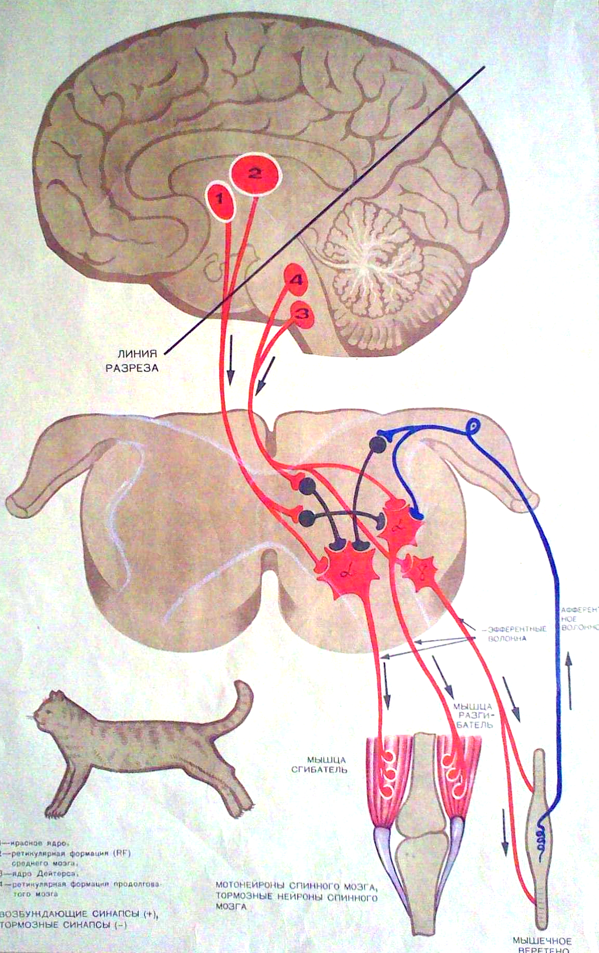
Mechanism:
Lateral Deiters nucleus is under the inhibitory effect of the red nucleus.
After transection below the red nucleus, the inhibitory effect ceases, which leads to hypertonicity of the extensors - decerebration rigidity
The cerebellum also has a braking effect on the nucleus of Deiters; therefore, the removal of the cerebellum leads to increased decerebration
………….
……
……
____
_________________________________________________________________________________

Slide 54
Substantia nigra
unpigmented neurons and neurons containing melanin pigment.
Closely related to quadrigemina, red nucleus, reticular formation of the brain stem, thalamus and striopallidarnoy system.
Participates in the maintenance of plastic tone. Responsible for emotional behavior, precise movements, especially of the fingers; regulate acts of chewing and swallowing (pathology - parkinsonism)
The black pigment appears in the cells by the age of 2–3 years; its chemical structure is dopamine, which is transported along axons to the basal ganglia.
Mediators of the substantia nigra:
Dopamine (pigmented neurons)
Ach and GABA (non-pigmented neurons)

Slide 55
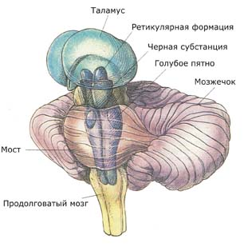
The locus ceruleus (blue nucleus) is a dense cluster neurons whose processes form divergent network with one entrance.
Its ascending fibers are projected to the structures of the cortex, diencephalon and cerebellum, the descending projections go into the spinal cord to the sympathetic centers and motoneurons.
The mediator is norepinephrine.
Responsible for the physiological response of stress and anxiety.

Slide 56
ONE OF THE VERY IMPORTANT
MIDBRAIN FUNCTION ! ! ! ! !
eyeballs movement regulation
Notes:
‹#›
‹#›

Slide 57
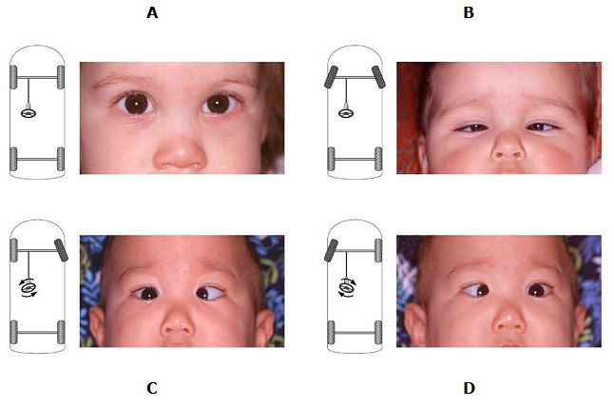
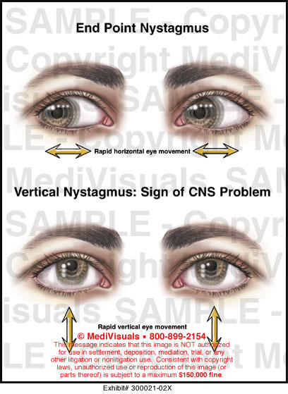

Slide 58
The midbrain aqueduct surrounds the central gray matter belonging to the reticular formation. Its functions include participation in the regulation of sleep and wakefulness.

Slide 59
RETICULAR FORMATION
Phylogenetically ancient brain core - occupies the mediocentral region of the medulla oblongata, the pons and the midbrain.
It consists of a multitude of network structures forming complexes (for example, adrenergic, serotonergic, and noradrenergic neural systems).
In the reticular formation are areas associated with the regulation of heart rhythm, blood pressure, respiration and other functions.
Some of its descending paths block the transmission of impulses in the sensory conductors of the spinal cord and affect the system of stretching reflexes.

Slide 60
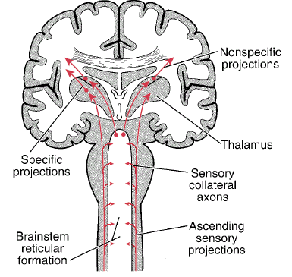
RETICULAR FORMATION
OF BRAINSTEM

Slide 61
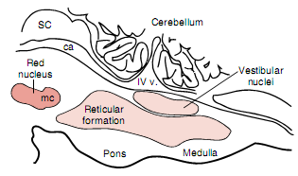
Brain sagittal cross-section
on the level of BRAINSTEM

Slide 62
Nonspecificity of the system
The reticular formation is a complex of polysynaptic pathways. Axons enter it not only from the ascending sensory tracts, but also from the systems of the trigeminal, auditory, and optic nerves. The complexity of neural networks and the degree of convergence of signals led to a violation of modal specificity.
Therefore, most of the neurons of the reticular system are activated with the same degree of lightness by various sensory stimuli, in this respect the reticular formation is nonspecific.

Slide 63
Functions of reticular formation
1. Respiration regulation (1885, Mislavsky).
2. Heart and vessel activity regulation
(1871, Ovsyannikov).
3. Brain cortex activation via thalamus.
Reaction of desynchronization.
4. Spinal reflexes activation.
N. Reticularis lateralis.
5. Spinal reflexes inhibition.
1862, Sechenov. Reticular giant nucleus.

Slide 64
Projections of the ascending reticular activating system
The scheme shows the general system of control of brain activity.
The central component of this system is located in the reticular formation of the pons, midbrain; this is the bulboreticular facilitating area.
The excitatory signals from this area come primarily to the thalamus, where they excite a new system of neurons.

Slide 65
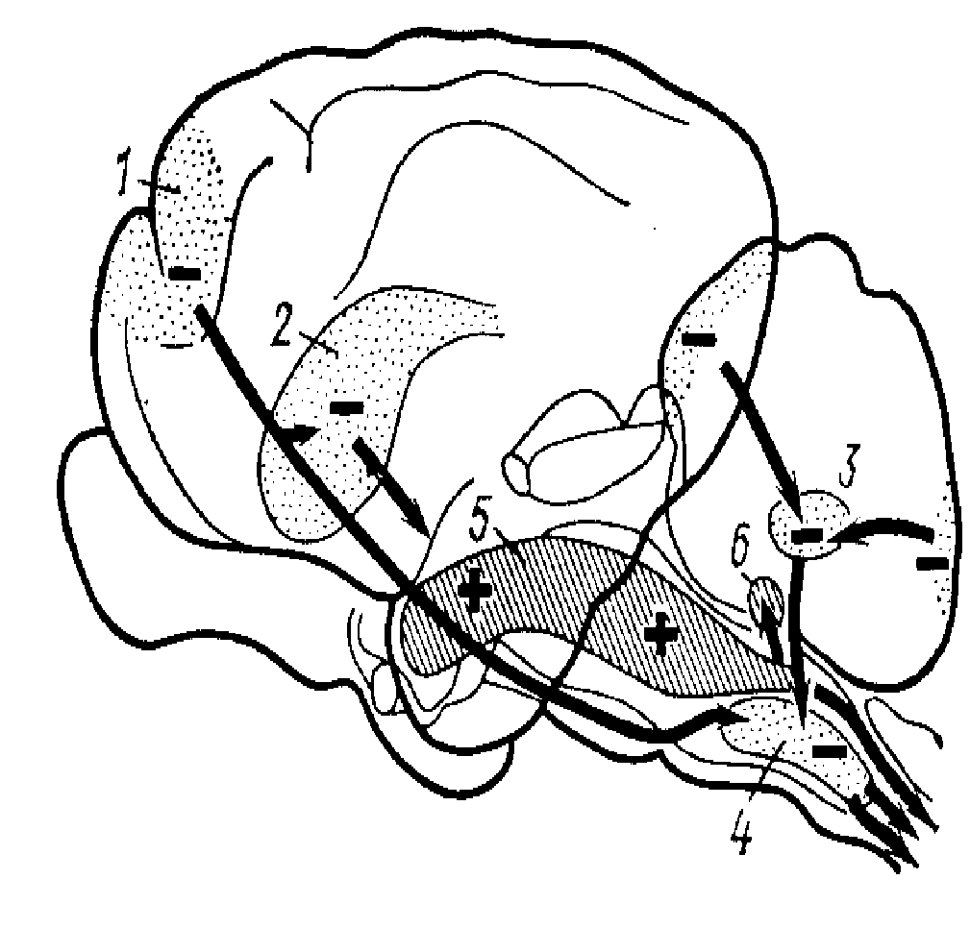
The reticular formation is a complex of polymorphic neurons of various sizes associated with all CNS structures, between which there are close contacts in the form of chemical and electrical synapses, located from the spinal cord to the thalamus nuclei
RF neurons are highly sensitive to chemical effects;
Neurons of the RF are polysensory, i.e. stimulate stimulation from various receptors.

Slide 66
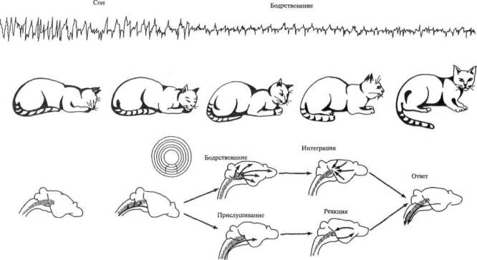
Thanks to the works of G. Megun and J. Moruzzi, along with the nonspecific descending effects of the reticular formation of the brainstem, its ascending, activating effects on the cerebral cortex were discovered.
If through the implanted electrodes to irritate the central parts of the reticular formation of the brainstem, the cat, which is in a sleepy state, awakens. This behavioral awakening response is accompanied by characteristic changes in the frequency spectrum of the electroencephalogram, a transition from regular, high-voltage oscillations of the α-rhythm to low-voltage oscillations (β-rhythm).
This electroencephalographic reaction is called desynchronization reaction.

Slide 67
The level of activity of the reticular formation and, therefore, the level of activity of the large brain is largely determined by the number and nature of sensory signals entering the brain from the periphery.
Thus, pain signals excite extremely strongly the reticular formation of the brain stem, increasing the reactions of attention and anxiety.
The importance of sensory signals for maintaining the active state of the reticular formation of the brain stem is demonstrated by the intersection of the brain stem above the entry point into the brain of the V pair of cranial nerves. These nerves enter the upper sections of the brain stem and transmit a significant amount of somatosensory signals to the brain.
Stopping the flow of signals into the reticular formation of the brain stem dramatically reduces its activity, which leads the body to a state of coma (coma is a severe unconscious state). When the brain stem is crossed below the entry point of the V pair of cranial nerves, coma does not occur.

Slide 68
Blue nucleus and noradrenaline system. Nerve fibers from this region spread to the basal ganglia, olfactory region, cerebellum, brain stem, and cerebral cortex. The endings of fibers secrete norepinephrine, as a rule, stimulating the brain and increasing its activity.
Substance nigra and dopaminergic system. Nerve fibers go to the caudate nucleus and the shell and release dopamine. Part of the fiber is directed to the hypothalamus and the limbic system. Black pigment (DOPA) appears in cells by 2-3 years. The destruction of dopaminergic neurons of the black substance leads to the development of Parkinson's disease.

Slide 69
Raphe neurons and serotonergic system.
Nerve fibers travel to the midbrain, cortex and spinal cord.
Serotonin is involved in the functioning of the antinociceptive system, sleep mechanisms and the development of a number of neuropsychiatric disorders.
Giant cell neurons of the reticular formation of the brain stem and cholinergic system.
Nerve fibers go up (to the diencephalon and cortex) and down (to the spinal cord).
Acetylcholine is excreted in the terminal axon ramifications, providing excitatory effects.

Slide 70
Basic reticular formation systems
AFFERENT SYSTEMS:
from the spinal cord, from the cerebellum, from the quadrilateral, from the cortex,
from sensitive nuclei of cranial nerves
EFFECTIVE SYSTEMS:
Ascending activating system - non-specific toning through the synapses on the dendrites of neurons in the I and II layers of the cortex
Descending reticulospinal systems:
- facilitating
- braking

Slide 71
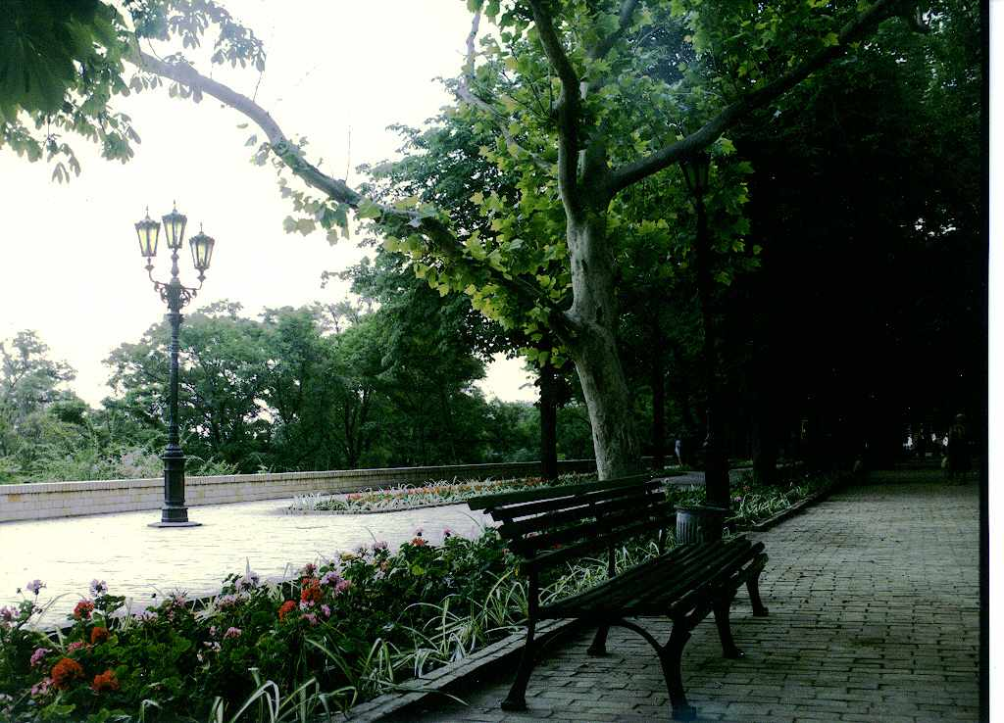
THANKS for attention!

