Slide 1
№ 8
STRUCTURAL AND FUNCTIONAL ORGANISATION OF THE AUTONOMIC NERVOUS SYSTEM, ITS ROLE IN THE REGULATION OF VISCERAL FUNCTIONS.
As. DENYSENKO Oksana
Notes:
‹#›

Slide 2
Autonomic nervous system
АNS functions fall into three major categories:
¨ 1. Maintaining homeostatic conditions within the body;
¨ 2. Coordinating the body’s responses to exercise and stress;
¨ 3. Assisting the endocrine system to regulate reproduction.

Slide 3
AUTONOMIC NERVOUS SYSTEM
A part of the nervous system - complex of central and peripheral cellular structures - that regulates key involuntary functions of the body, including the activity of the heart muscle; the smooth muscles, including the muscles of the intestinal tract; and the glands.

Slide 4
ClASSIFICATION OF ANS
Vegetative,
autonomic,
visceral,
ganglionic,
involuntary
Sympathetic,
thoracolumbar,
adrenergic
Parasympathetic,
craniosacral,
cholinergic
Metasympathetic,
enteric,
intramural

Slide 5
General plan of ANS composition
Central segmented neurons – preganglionic neurons, spinal cord, medulla oblongata, midbrain. Hypothalamus, RF, cerebellum, BG, cortex – supersegmentary centers
Axons of segmented neurons – preganglionic fibers
Vegetative ganglies – paravertebral and prevertebral - sympathetic, intramural – para- and metasympathetic
Posganglionic fibers – go to organs

Slide 6
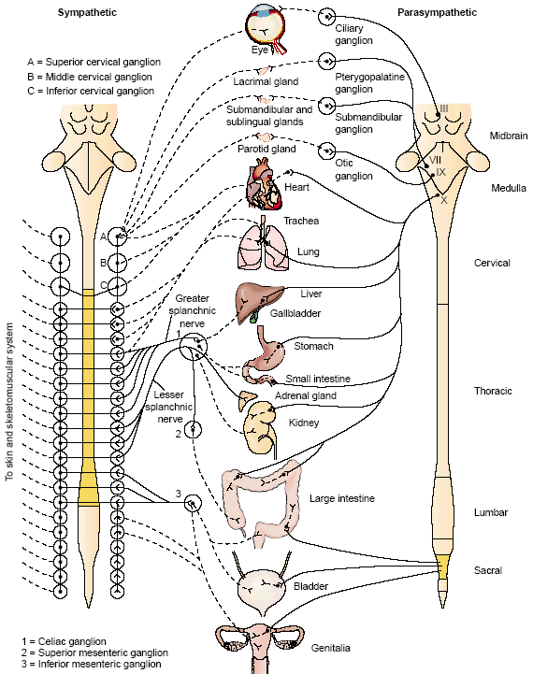

Slide 7
Main differences between somatic and autonomic nervous system
Indices
Somatic NS
ANS
Control
voluntary
involuntary
Action
Innervates skeletal muscles
Innervates internal organs
Main functions
Sensory, motor
Energy, nutrition
Spreading
strongly segments
All body
Fibers type
Mostly А
В, С

Slide 8
Main function of ANS
Maintenance of homeostasis
Mechanisms of adaptation
Metabolism regulation
Efferental innervation of all SMsc. of internal organs, vessels, sweat glands
Trophic innervation of skeletal muscles (SNS), receptors and CNS

Slide 9
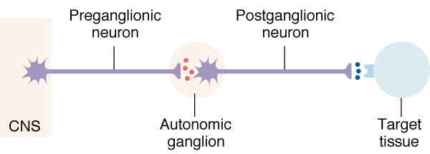
Autonomic pathway: Two Efferent Neurons in Series
Preganglionic neuron cell body in CNS
Synapse in autonomic ganglion outside CNS (often divergence!)
Postganglionic neurons
target cells
N1
N2

Slide 10
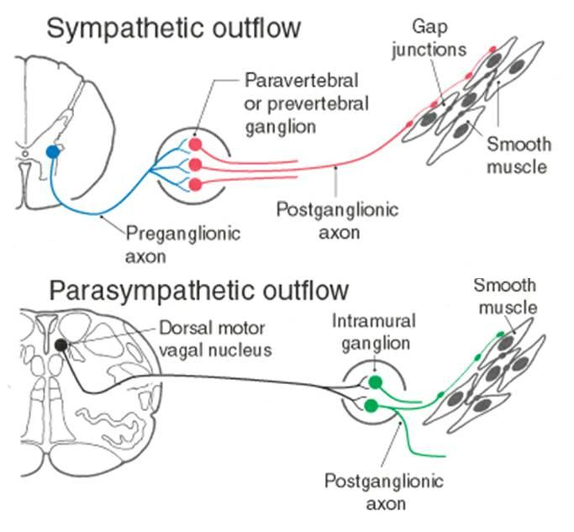

Slide 11
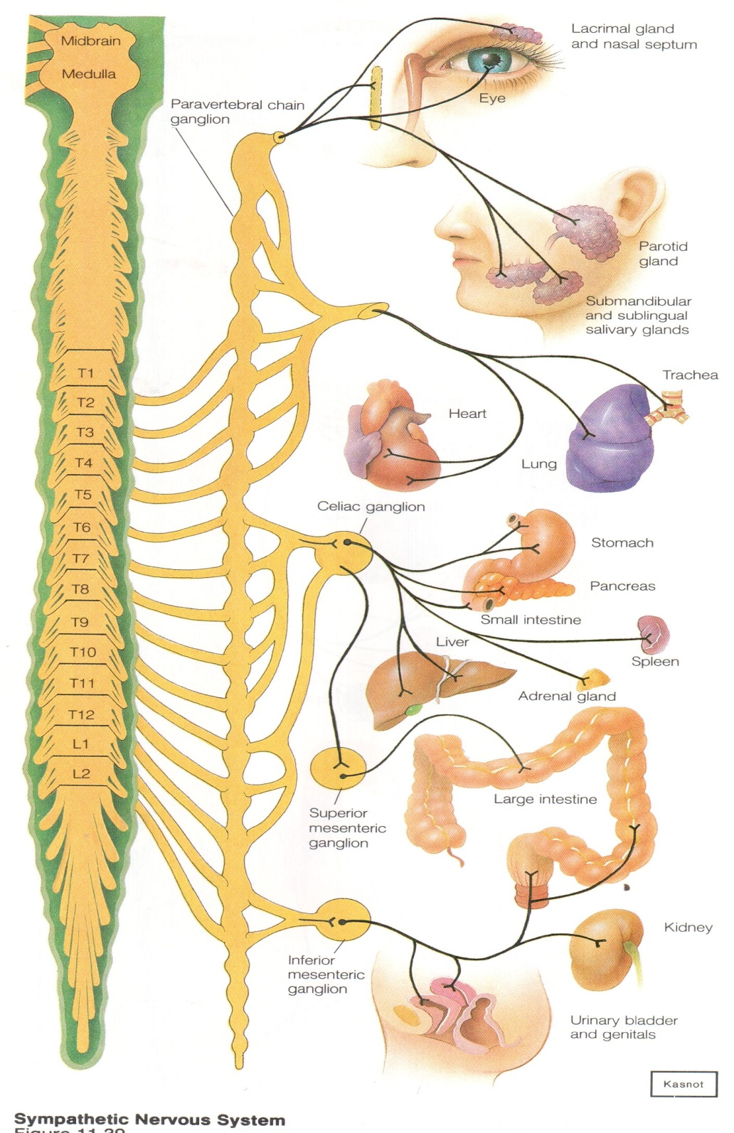
Sympathetic nervous system innervates all organs and tissues

Slide 12
Sympathetic nervous system
Preganglionic central (1-st ) neurons – lateral horns of spinal cord С8-L2 :
- С8-Th2 – spinociliary centre – midriasis, exophthalmos
- T1-T5 – heart, lungs
- T1- L2 – vessels tonus, sweat glands

Slide 13
Sympathetic nervous system
Main preganglionic fibers leave the spinal cord with the ventral roots of spinal nerves end in pаravertebral ganglia (sympathetic trunk (vertebral chain)).
Other part of these fibers – ends in prevertebral ganglia. These ganglia form different nervous plexus: celiac, superior mesenteric, inferior mesenteric, aorticorenal and renal.
Neurotransmitter of preganglionic neuron – Ach.
It acts to N – cholinereceptors. These receptors are blocked by gangliablockers, but not curare like substances as in receptors of skeletal muscles
- postganglionics axons go as self-contained fibers or contained of somatic fibers (rami communicantes grisei)

Slide 14
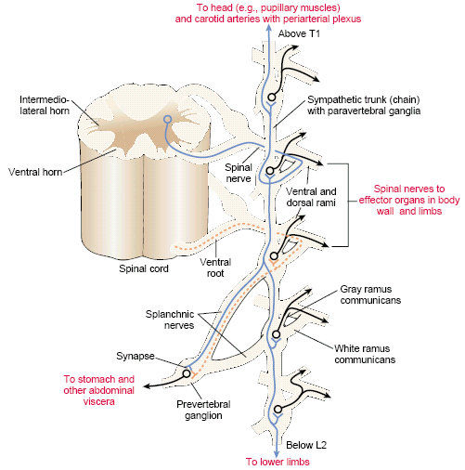
Sympathetic pathways
Sympathetic chain ganglia (paravertebral ganglia) – preganglionic fibers of the sympathetic NS that carry motor impulses to the body wall or thoracic cavity synapses in chain ganglia
Collateral ganglia (prevertebral ganglia) – group of second order neurons that innervate organs in the abdominopelvic region
Located on both sides of the vertebral column
Linked by short nerves into sympathetic trunks
Joined to ventral rami by white and gray rami communicantes
Right and left sympathetic trunks extend from the base of the skull to the region of the coccyx; at their distal ends, the right and left trunks are fused.

Slide 15
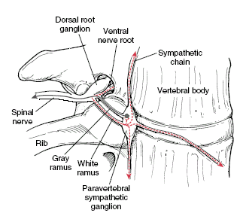
Sympathetic pathways

Slide 16
Abdominopelvic viscera
Celiac ganglion
  Innervates stomach, liver, gall bladder, pancreas, spleen
Superior mesenteric ganglion
  Innervates small intestine and initial portion of large intestine
Inferior mesenteric ganglion
  Innervates kidney, urinary bladder, sex organs, and final portion of large intestine

Slide 17
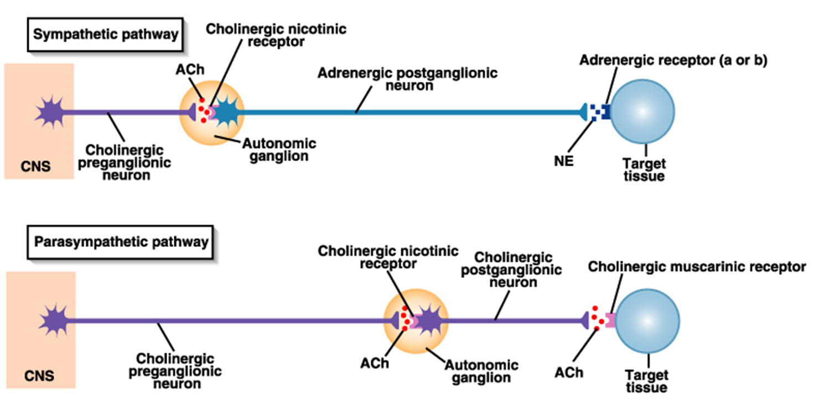
Other important considerations:
ganglion cells are usually located at some distance from the effectors. Accordingly, postganglionic sympathetic fibers are usually long fibers.
Acetylcholine (Ach) - pre-ganglionic ganglionic Neurotransmitter
Norepinephrine (NE) - post-ganglionic ganglionic Neurotransmitter

Slide 18
Sympathetic Division
A single sympathetic preganglionic fiber has many axon collaterals and may synapse with 20 or more postganglionic neurons.
The postganglionic axons typically terminate in several visceral effectors and therefore the effects of sympathetic stimulation are more widespread than the effects of parasympathetic stimulation.

Slide 19
Sympathetic nervous system
Endings of postganglionic sympathetic fibers secrete NА.
NA contacts to a1, a2 and ß1, ß2, ß3 АR. Kind of resulting potential depends on different amount of receptor on postsynaptic membrane.
For example, if NA interacts to ß1-АR in myocardium, depolarization starts - > HR increases.
if NA interacts to ß2-АR in uterus, hyperpolarization starts - > activity of uterus decreases.

Slide 20
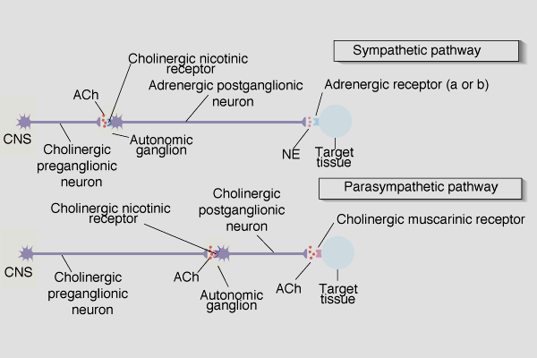
Adrenergic
Receptors
Found in neuroeffector junctions of sympathetic branch
G protein linked, with various 2nd mess. Mech
NT is NE
α- and β- Receptors

Slide 21
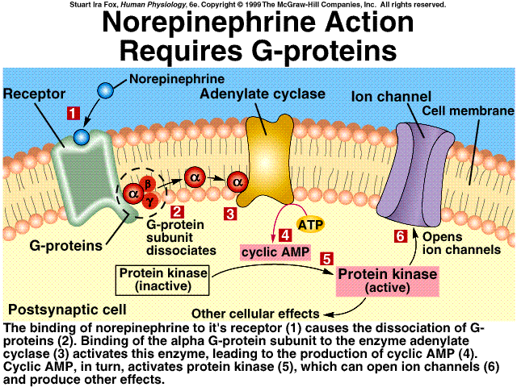
NE Action

Slide 22
Sympathetic Receptors
α Receptors:
NT is NE
(most common) α 1 Receptors ⇒Gq ⇒phospholypase C ⇒ Excitation [Ca2+] In↑ ⇒ muscle contraction or secretion by exocytosis.
α 2 Receptors ⇒Gi ⇒ adenylatecyclase⭣ ⇒ cAMP⭣ ⇒ [Ca2+] In ⭣ ⇒ Inhibition of GI tract and pancreas
Notes:
‹#›
Toprol-XL, metoprolol succinate, is a beta1-selective (cardioselective) adrenoceptor blocking agent, for oral administration, available as extended release tablets.

Slide 23
 − Receptors Clinically more important
  ₁ ⇒ Excitation heart ([E] = [NE])
    “ - blockers” = Antagonists (e.g.: Propranolol)
  ₂ usually with inhibitory effects: smooth muscle relaxation of some blood vessels and bronchioles ([E] > [NE])
  ₃ Adipose; [NE]>[E]
  “ -blockers” = Antagonists (e.g.: Propranolol)

Slide 24
Sympathetic nervous system
PECULIARITY
Postganglionic sympathetical fibers of sweat glands secrete Аch.
Ach interacts to М – ChR in this case, sweat glands increase their activity.
So these fiber’s name is sympathetic cholinergic.

Slide 25
Effects of Sympathetic Division
cardiac output increases
SA node: heart rate (chronotropic) β₁, : ↑cardiac muscle: contractility (inotropic) β₁ ↑conduction at AV node β₁ : increases
vascular smooth muscle: α1 = contracts; β₂ = relaxes
smooth muscles of bronchioles β₂: relaxes;
pupil of eye α₁: relaxes
ciliary muscle β₂ : relaxes
smooth muscles of GI tract α_{2,} β₂: relaxes
sphincters of GI tract α₁: contracts
glands of GI tract inhibits

Slide 26
MAIN SYMPATHETIC INFLUENCE ON ORGANS AND TISSUES
Energy action :
- ability to work increases,
- organism`s life reserve increases
- ⇑ glycogenolysis, glyconeogenesis, lipolysis
- ⇑ lungs ventilation
- blood volume increases in skeletal muscles
Digestive activity and urinary bladder tonus is decreased

Slide 27
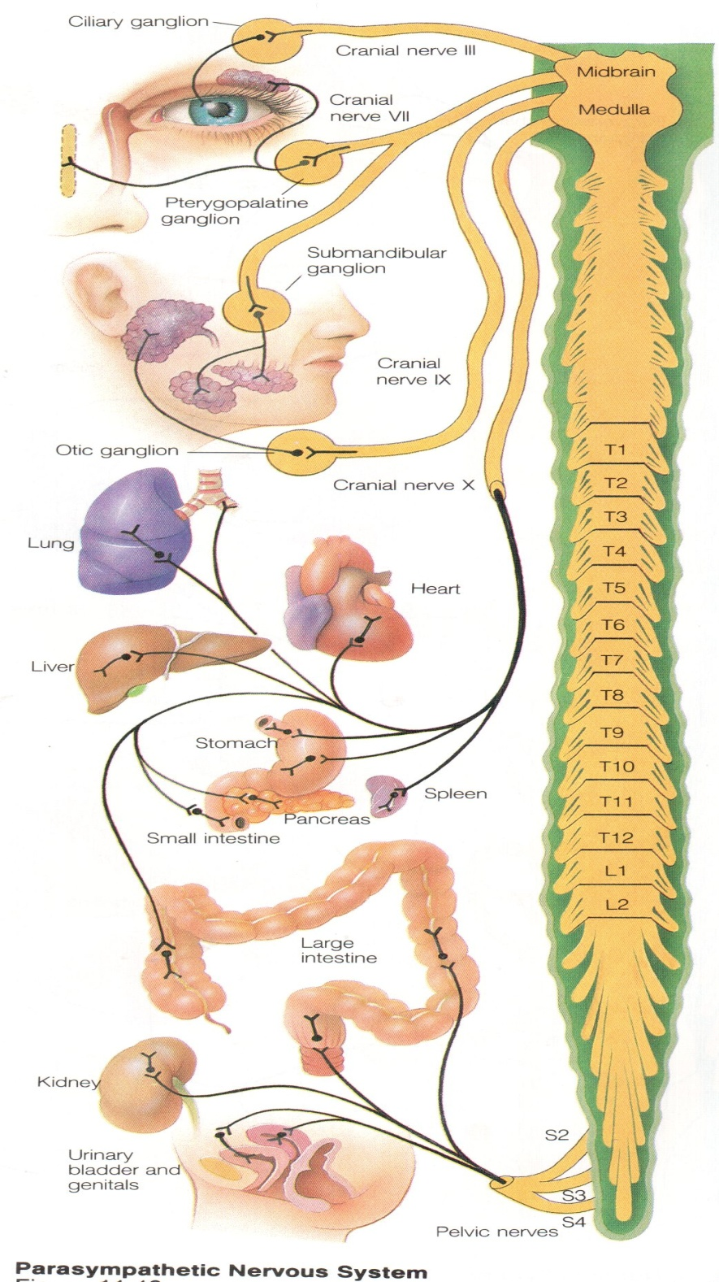
PARASYMPATHETIC NERVOUS SYSTEM doesn’t innervate: skeletal muscles, CNS and bigger part of blood vessels

Slide 28
PARASYMPATHETIC NERVOUS SYSTEM
Preganglionic (central) – 1-st neurons :
- in mesencephalon part – midbrain – n. oculomotorius (III)
- in medulla oblongata – nucleus VII, IX, X n.
- in sacral part – level of S II-IV
The fibers of cells in the midbrain and brainstem are in the oculomotor (III), facial (VII), glossopharyngeal (IX), and vagus (X) nerves. They innervate smooth muscles of the eye (III), lacrimal and salivary glands (VII and IX), and smooth muscles of the thoracic and abdominal viscera (X).

Slide 29
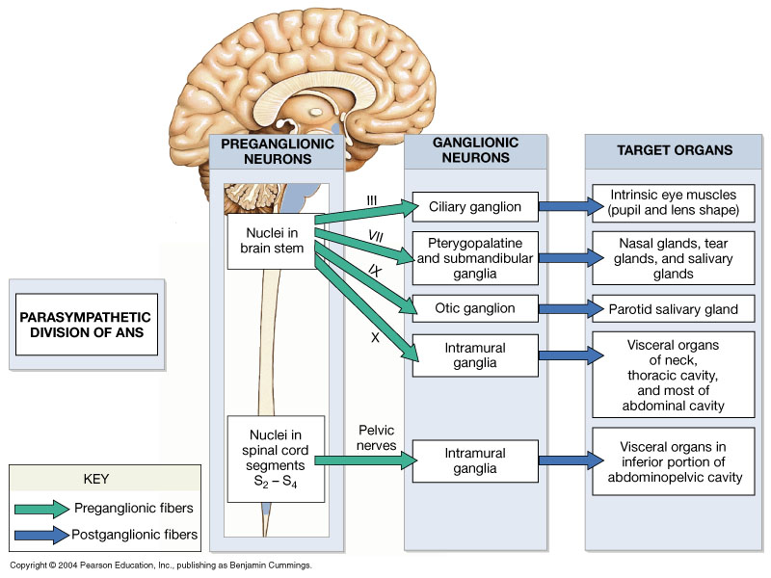
The Organization of the Parasympathetic Division of the ANS

Slide 30
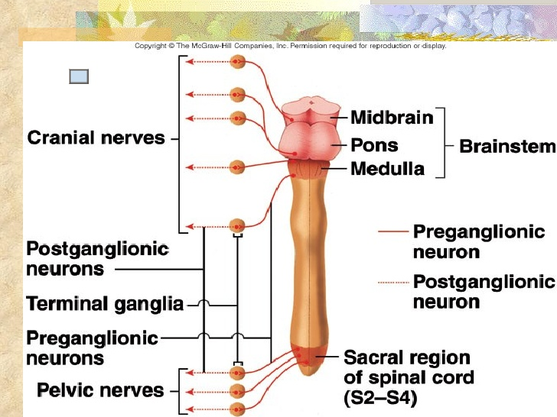

Slide 32
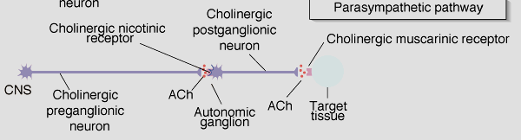
Summary: Pre- & Postganglionic Parasympathetic Neurons Release ACh
N1
N2
nicotinic
muscarinic
Receptors

Slide 33
PARASYMPATHETIC NERVOUS SYSTEM
Main part of рreganglionic fibers end in intramural ganglia
Neurotransmitter of preganglionic neuron is – Ach. Ach interacts to N-cholinereceptors.
Endings of postganglionic parasympathetic fibers secrete Ach too.
Ach interact to М-cholinereceptors.
М-ChR blocks by atropine like substances.

Slide 34
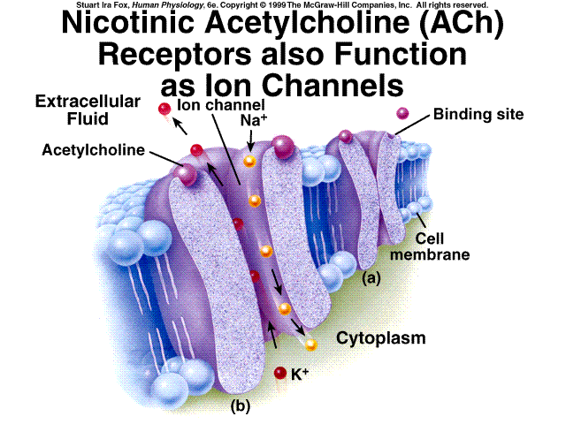
Two Types of Cholinergic Receptors: Nicotinic and Muscarinic
1) Nicotinic cholinergic receptor
Nicotine = agonist
In autonomic ganglia & somatic NS
Directly opens a Na⁺ & K⁺ channel: ⇒ ?
Curare = antagonist

Slide 35
When the neurotransmitter, acetylcholine, attaches to the portion of the nicotinic receptor outside of the cell wall, it induces a conformational change that selectively opens up the channel to sodium ions. The resulting influx of positively charged sodium then triggers membrane depolarization.

Slide 36
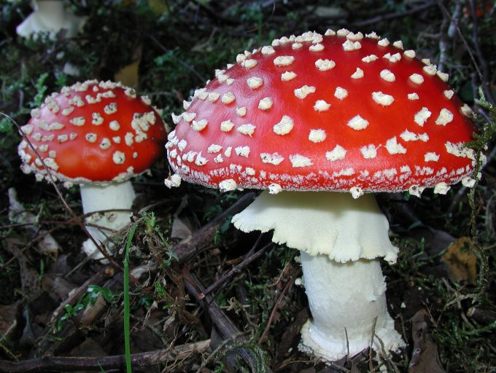
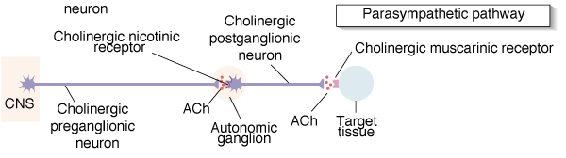
2) Muscarinic cholinergic receptor
Muscarine = agonist
Found in neuro-effector junctions of parasympathetic branch
G-protein coupled mechanisms
Atropine = antagonist
Amanita muscarina
N1
N2

Slide 37
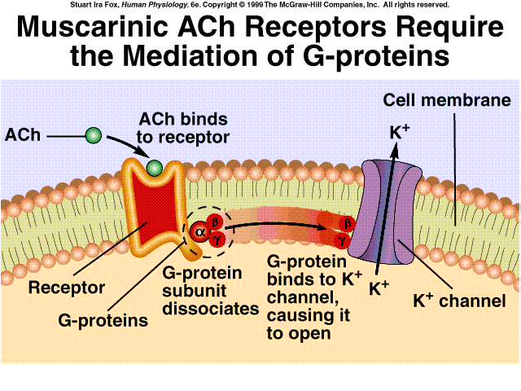
Muscarinic ACh are G-protein Mediated Receptor Mechanism of Sweat Glands:
Also some 2nd messenger mechanisms

Slide 38
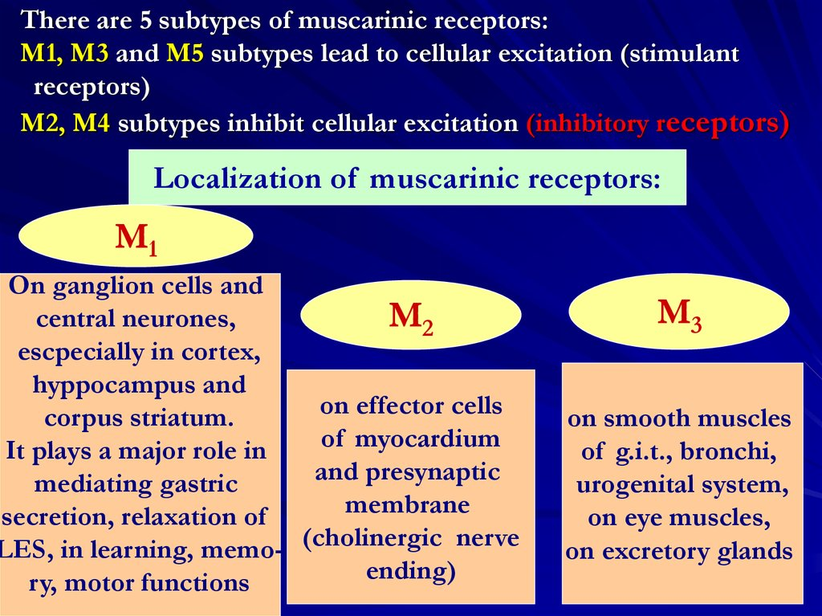

Slide 39
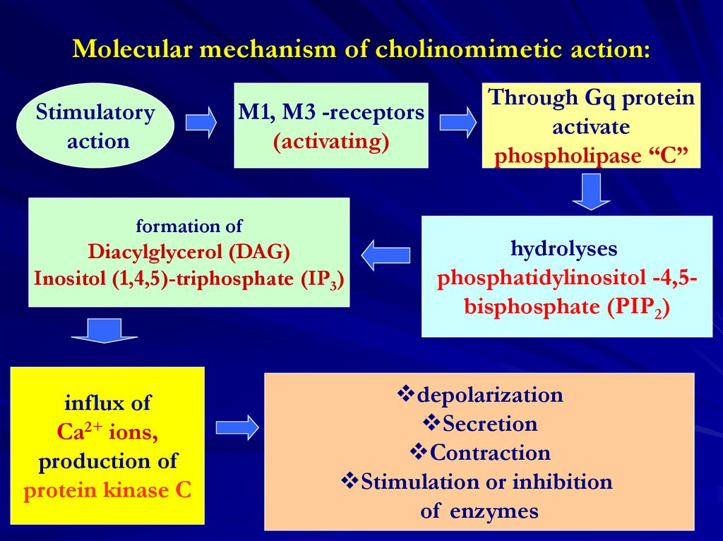

Slide 40
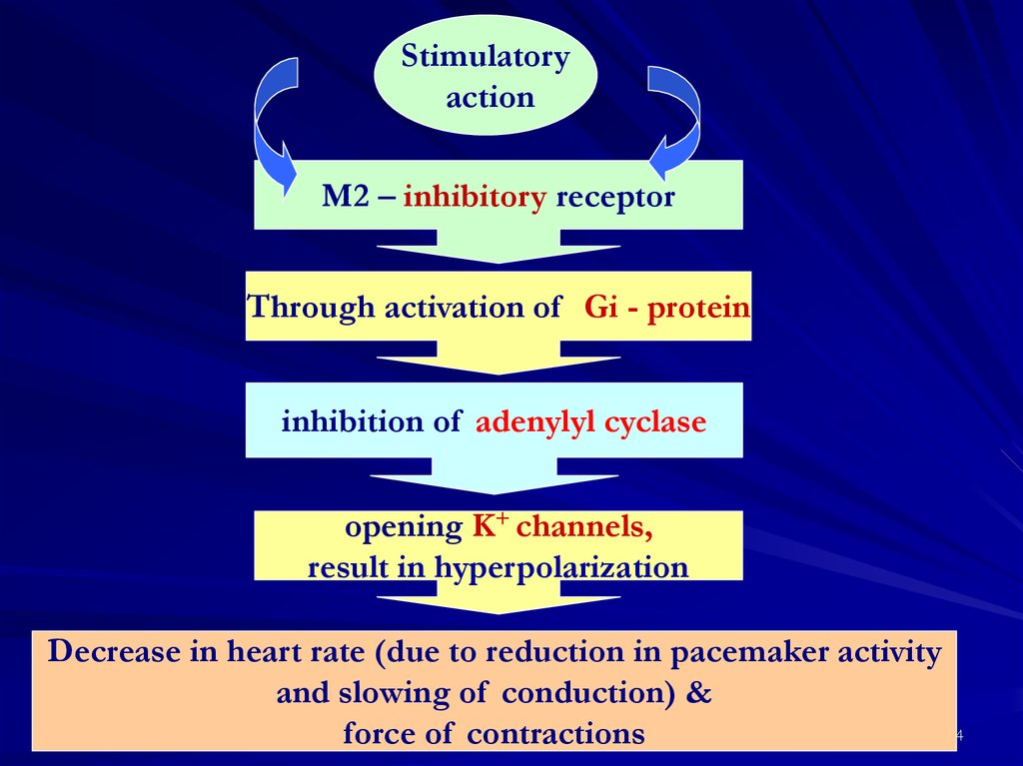

Slide 41
Parasympathetic (muscarinic)
cardiac output M2: decreases
SA node: heart rate (chronotropic) M2: decreases
cardiac muscle: contractility (inotropic) M2: decreases (atria only)
conduction at AV node M2: decreases
smooth muscles of bronchioles M3: contracts
pupil of eye M3: contracts
ciliary muscle M3: contracts
salivary glands: secretions stimulates watery secretions
GI tract motility M1, M3: increases
smooth muscles of GI tract M3: contracts
sphincters of GI tract M3: relaxes
glands of GI tract M3: secretes

Slide 42
The ganglion cells of the parasympathetic system are located in or on the wall of the organs supplied or in specific ganglia located near the organs supplied. Hence the postganglionic fibers are short.
Except for the vagus nerves, the area of distribution of parasympathetic nerves is somewhat limited. The number of synaptic connections is smaller than in the sympathetic division. Accordingly, the effects of the parasympathetic division tend to be local rather than widespread.

Slide 43
MAIN PARASYMPATHETIC INFLUENCE ON ORGANS AND TISSUES
TROPHIC action :
- homeostasis restitution
- ⇑ anabolism level in tissues,
- ⇑ functional level of internal organs
- increase blood volume in internal organs vessels
Decrease of muscle tonus, AP, HR, RR

Slide 44
Parasympathetic activation
Effects produced by the parasympathetic division
  relaxation
  food processing
  energy absorption

Slide 45

Metasympathetic neural system forms neurals intramurals plexus in internals organs

Slide 46
Metasympathetic system
autonomic neural system of subserous, intramuscular and intramucous plexus of esophagus, stomach, intestine, myocardium and all.
MNS are composed of motors neurons (Dogel cells I), sensitives neurons (Dogel cells II) and associative neurons (Dogel cells III)
MNS reflexes have neuronal centers at local level - in intramurals ganglions

Slide 47
Metasympathetic system
Preganglionic (afferent) fibers terminate in intramurals ganglions.
P-cells are placed in ganglions of intramuscular and submucous plexus.
Synapses of intramurals ganglions are blocked by ganglioblockers, but not curare like substanses as neuro-muscular synapses of skeletal muscles
Endings of postganglionic (efferent) fibers secret АCh, NA, A, purin, serotonin, DOPA, histamine, GABA and all.

Slide 48
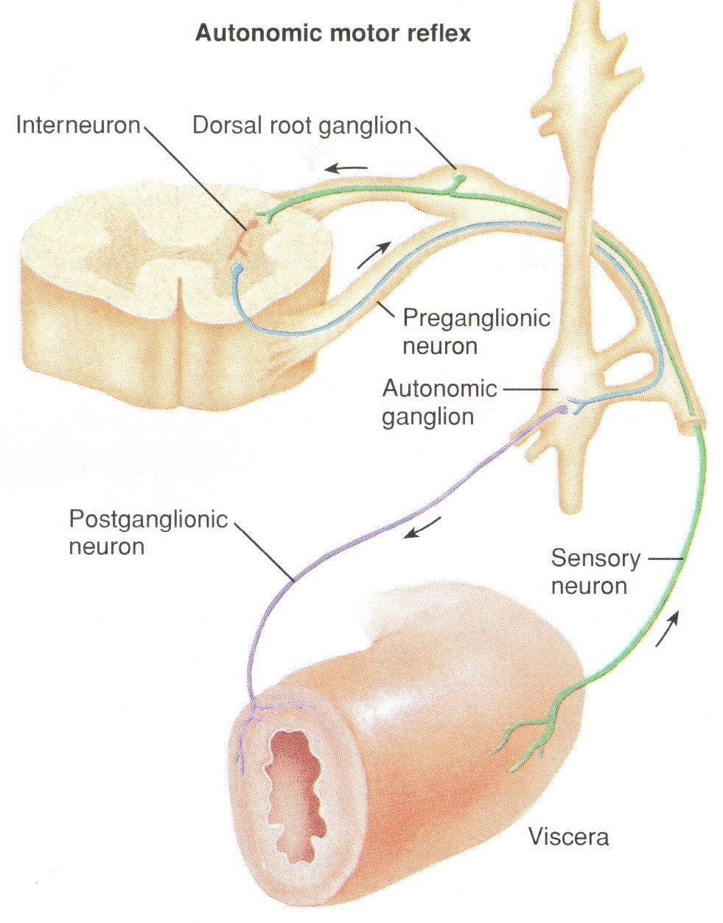
ANS reflexes

Slide 49
General plan of reflex arc composition :
- receptors
- afferent fibers
- central neurons
- efferent fibers
- working organ
Peculiarity of autonomic reflex arc:
- efferent fibers are situated in ganglia out of CNS

Slide 50
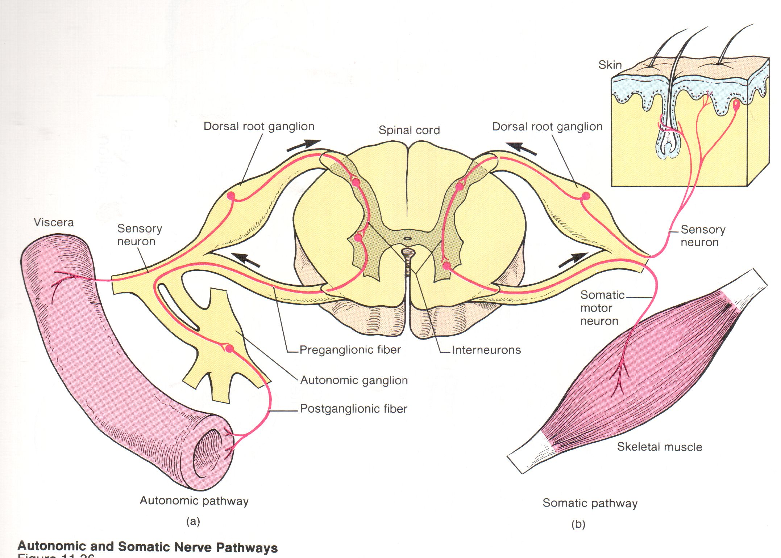
Main differences between somatic and autonomic reflex arcs

Slide 51
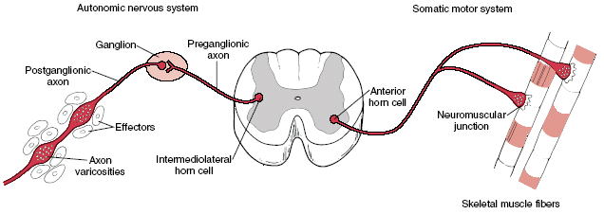
Schematic illustration of the ANS efferent pathway compared with the somatic motor system.

Slide 52
Classification of vegetative reflexes
viscero-dermal reflexes (reflecting zones of stenocardia)
Dermatovisceral reflexes (physio-, reflexotherapy)
Viscero-visceral reflex ( gastrocardial reflex)
Viscero-motor reflex (defence, special position of patient)
Motor – visceral reflexes (basis for treatment exercise use)
Local (autonomous) ganglional axon – reflexes :
- internal (centers are situated in intramural ganglions)
- prevertebral (centers are situated in prevertebral ganglions)
- paravertebral (centers are situated in paravertebral ganglions) Conditional, unconditional; extero-, interoreceptive

Slide 53
ANS NEURONS PECULIARITIES
Interactivity – unability to exciting under one stimulus action
High level of additional hyperpolarisation
Low frequency of impulses generation– no more10-15 / sec
Stimuli application more than 100 /sec cause full block of vegetative synapse working
Long duration of synaptic delay– 1.5 – 30.0 msec (in CNS 0.3 – 0.5 msec)
Long duration of EPSP

Slide 54
ANS FIBRE’S PECULIARITIES -
Low excitability, long refractority
Preganglionic fibres have long additional +ve potential
Postganglionic fibres have long additional –ve potential
All these fibers have long AP
All these fibers have big rheobase and chronaxie
All fibers have small diameter
Preganglionic fibers – B, postganglionic – C
Low velocity of impulses conduction
No segments composition
Efferent fibers have 2 neurons

Slide 55

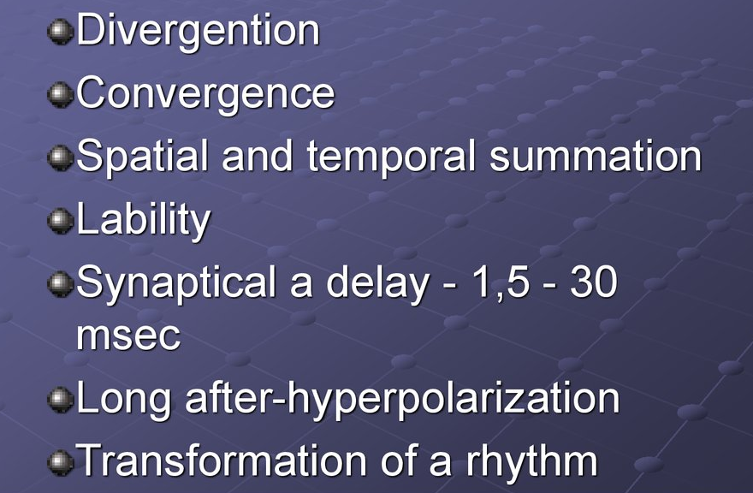

Slide 56
Age changing of ANS
Influence on organism of PSNS less than SNS during all ages.
Centers of SNS are activated early in newborn than PSNS. n.Vagus are activated in 2-3 months of life.
PECULIARITY – SNS are activated in digestive system of newborn after finishing of natural nutrition only.
Old people have low level SNS and PSNS both. It decrease level of metabolic processes and velocity of adaptation.

Slide 57
THE STRESS REACTION
A stressful situation activates three major communication systems in the brain that regulate bodily functions.
The first of these systems is the voluntary nervous system, which sends messages to muscles so that we may respond to sensory information.
The second communication system is the autonomic nervous system.
The brain’s third major communication process is the neuroendocrine system, which also maintains the body’s internal functioning.

Slide 58
THE STRESS REACTION
When stress occurs, the sympathetic nervous system is triggered. Norepinephrine is released by nerves; epinephrine and norepinephrine is secreted by the adrenal glands. By activating receptors in blood vessels and other structures, these substances ready the heart and working muscles for action.
Acetylcholine is released in the parasympathetic nervous system, producing calming effects. The digestive tract is stimulated to digest a meal, the heart rate slows, and the pupils of the eyes become smaller. The neuroendocrine system also maintains the body’s normal internal functioning.

Slide 59
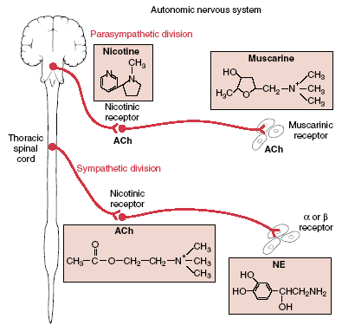

Slide 60
Sympathetic and parasympathetic divisions typically function in opposition to each other. But this opposition is better termed complementary in nature rather than antagonistic. For an analogy, one may think of the sympathetic division as the accelerator and the parasympathetic division as the brake.
The sympathetic division typically functions in actions requiring quick responses.
The parasympathetic division functions with actions that do not require immediate reaction. Consider sympathetic as "fight or flight" and parasympathetic as "rest and digest".

Slide 61
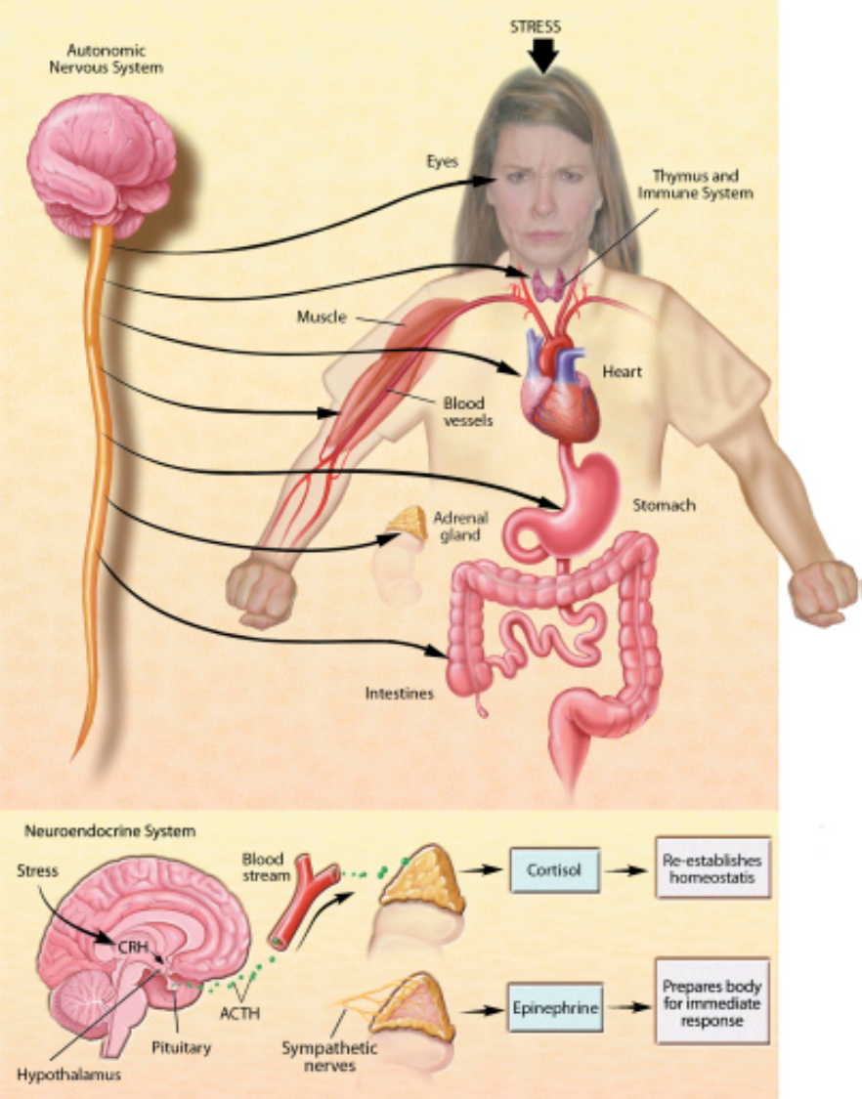

Slide 62
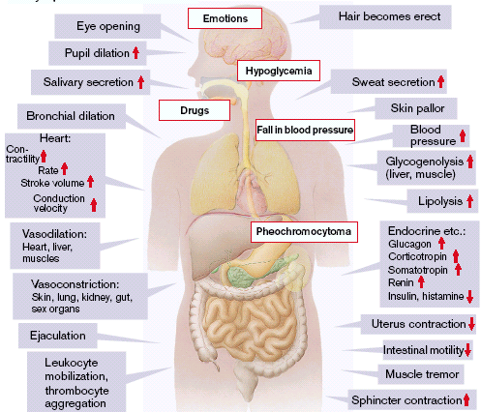
Schematic illustration of sympathetic nerves activation effects

Slide 63
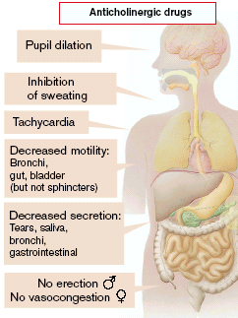
Schematic illustration of effects in case of parasympathetic stimulation loss

Slide 64
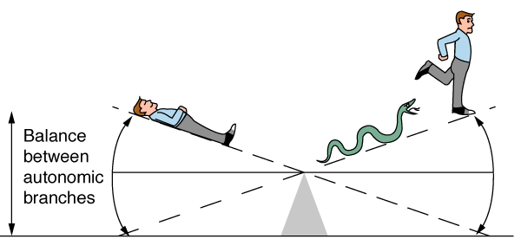
Homeostasis and the Autonomic Division
BP, HR, Resp., H₂O balance, Temp. . .
Mostly dual reciprocal innervation
  i.e., agonist/antagonist or excitatory/inhibitory
Sympathetic:
  AKA Thoracolumbar
  flight-or-fight
Parasympathetic:
  AKA Craniosacral
  rest and digest

Slide 65
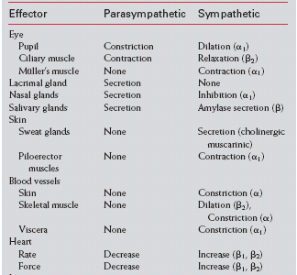
Responses of Effectors to Parasympathetic
and Sympathetic Stimulation

Slide 66
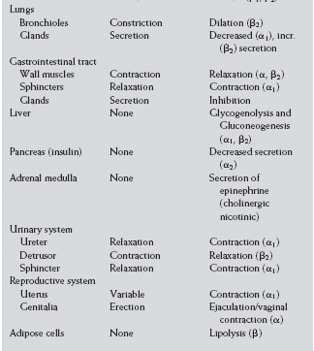
Responses of Effectors to Parasympathetic
and Sympathetic Stimulation

Slide 67
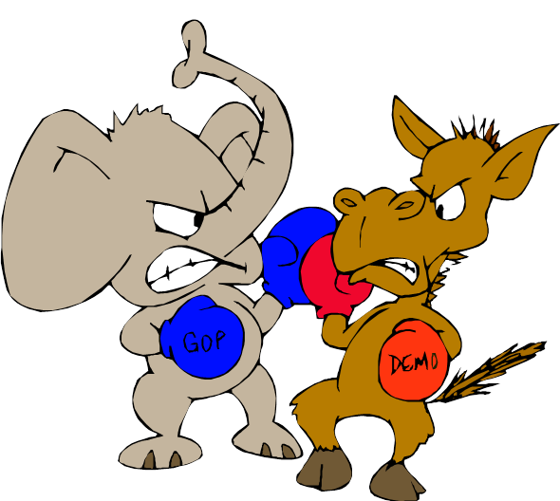

ANS
2 divisions:
Sympathetic
“Fight or flight”
“E” division
Exercise, excitement, emergency, and embarrassment
Parasympathetic
“Rest and digest”
“D” division
Digestion, defecation, and diuresis

Slide 68
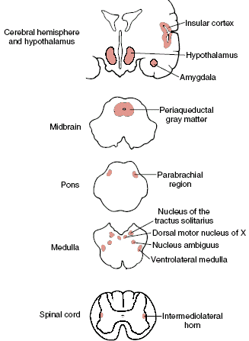
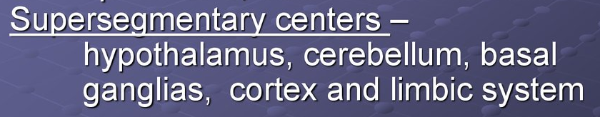
The central autonomic
network

Slide 69
Although “involuntary”, the autonomic nervous system is regulated by higher centers. The best known of these centers is the hypothalamus which has descending projections to cell bodies of the preganglionic neurons. Other areas of the central nervous system affect the activities of the hypothalamus.

Slide 70
Hypothalamus is the important
integrative center of vegetative, somatic
and endocrinal functions,
that is responsible for the complex
homeostatic reactions realization
and serves as the key structure within the
hierarchically organized brain system
that regulates visceral functions.

Slide 71
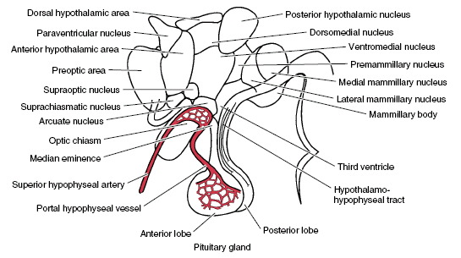
HYPOTHALAMUS and its main nuclei
Notes:
‹#›
‹#›

Slide 72
FUNCTIONS of hypothalamus N1
1. Water and electrolyte balance regulation
(supraoptic and paraventricular nuclei).
2. Secretion of hypothalamic releasing factors
(arcuate and periventricular nuclei and parvocellular cells of the
paraventricular nucleus).
3. Temperature regulation
(the anterior and posterior hypothalamic nuclei).
4. Activation of the sympathetic nervous system
and adrenal medullary hormone secretion
(the dorsal and posterior hypothalamus).

Slide 73
FUNCTIONS of hypothalamus N2
5. Thirst and drinking regulation
(lateral hypothalamus).
6. Hunger, satiety and the regulation of eating behavior
(the arcuate nucleus, ventromedial nucleus, and lateral hypothalamic area).
7. Regulation of sexual behavior
(the anterior and preoptic hypothalamic areas).
8. Regulation of circadian rhythms.
Sleep-wakefullness cycle
(the suprachiasmatic nucleus of hypothalamus).

Slide 74
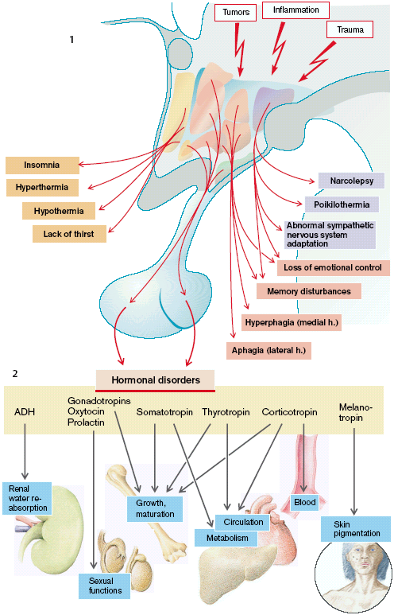

Slide 75
cc
Limbic system
anterior
nucleus
posterior
nucleus
hypothalamus
Craniosacral
Thoracolumbar

Slide 76
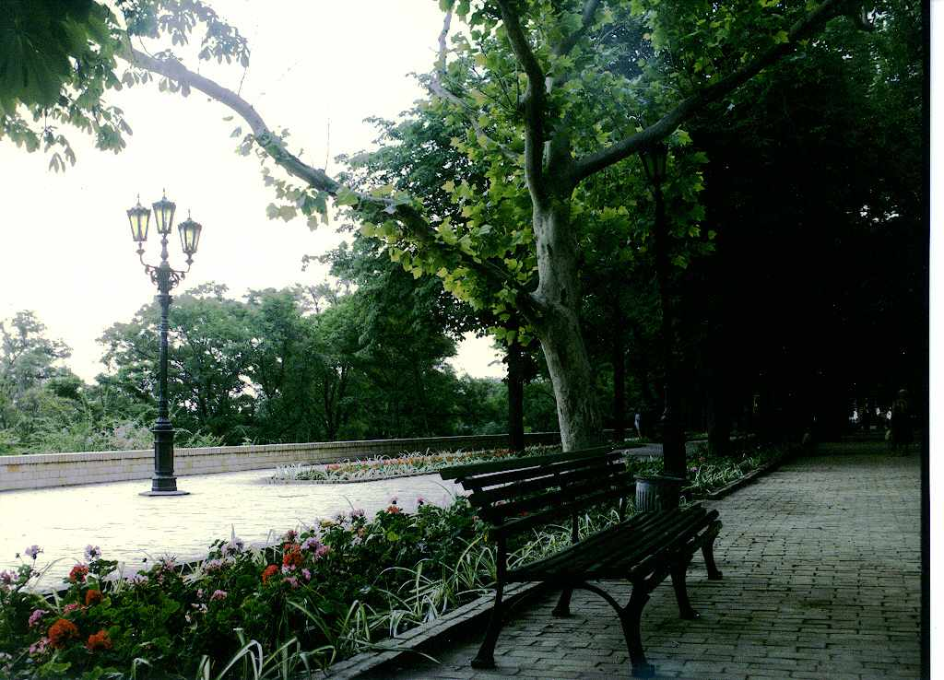
THANKS FOR
ATTENTION !
Notes:
‹#›
‹#›

