Slide 1
№ 6
THE ROLE OF FOREBRAIN, CEREBELLUM, LIMBIC SYSTEM AND CEREBRAL CORTEX IN THE FORMATION OF THE BODY'S SYSTEMIC ACTIVITY.
as. DENYSENKO Oksana

Slide 2
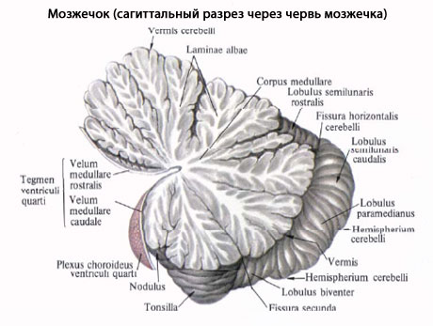
C E R E B E L L U M

Slide 3
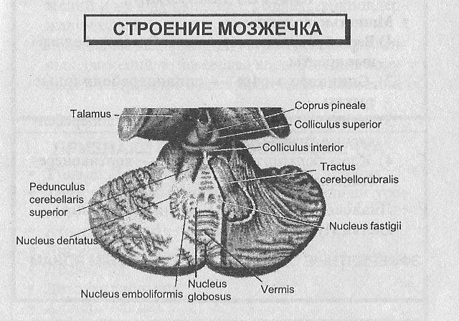
C E R E B E L L U M

Slide 4
The cerebellum ("small or diminutive brain")
consists of two cerebellar hemispheres
joined by a vermis.
Cerebellar cortex, only a few mm thick,
lies in the surface.
Deep to the cortex lies the white matter.
Within the white matter, masses of gray
matter, called cerebellar nuclei, are found.

Slide 5
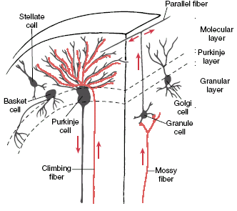
The layers of cerebellar cortex
Notes:
‹#›

Slide 6
Types of the cerebellar cortical cells
Basket cells
their projections terminate on the Purkinje cells bodies
Stellate cells
their projections terminate on the Purkinje cells
dendrites
Purkinje cels
their dendrites reach upward into the molecular layer
their axons go downward and make synapses with
cerebellar nuclei
some axons terminate on vestibular nuclei
Golgi cells
their dendrites reach upward into the molecular layer,
their axons go the the granular cells
Granular cells
their axons reach upward into the molecular layer and
make synapses with Purkinje, basket and stellate cells

Slide 7
Purkinje cells constantly generate IPSP
This is critically important for the cerebellar
nuclei activity inhibition because they are
constantly generate tonic activity
Purkinje cells excitation through
climbing and mossy fibers results in
IPSP generation increasing that lead
in turn more expressed cerebellar
nuclei activity inhibition.
Both stellate cells and basket
cells – induced Purkinje cells
activity inhibition results in their
activation that lead to cerebellar
nuclei activity increasing.

Slide 8
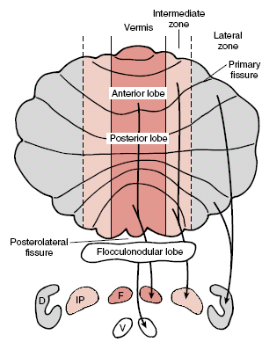
TOPOGRAPHIC CLASSIFICATION OF
CEREBELAR CORTEX AND NUCLEI
1. MEDIAL zone –
has projections on the fastigial n.
2. INTERMEDIATE zone –
has projections on the interposed n.
3. LATERAL zone –
has projections on the dentate n.
Notes:
‹#›

Slide 9
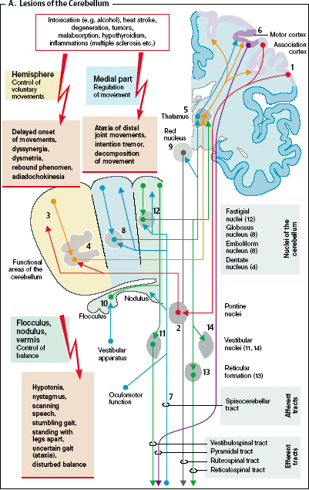
Cerebellar lesions
Notes:
‹#›

Slide 10
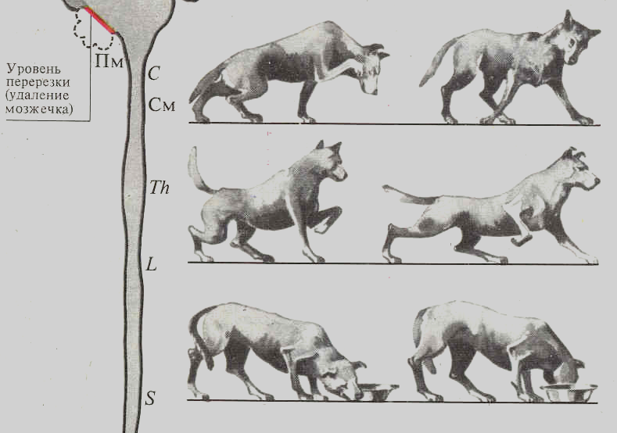
…………
…………. ………….

Slide 11
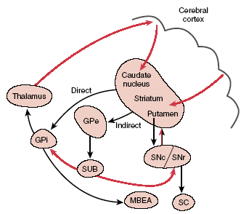
Basal gangles and circuitry

Slide 12
Classic
strio-pallidar system
Basal gangles
Nucleus subthalamicus
Substantia nigra
Basolateral amygdala
Nucleus ambiquus

Slide 13
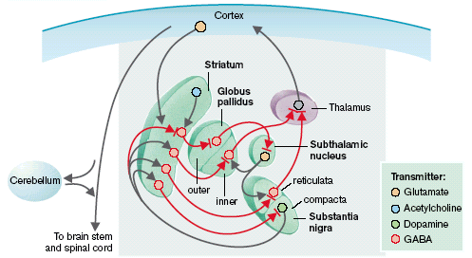
Basal gangles afferent and efferent connections
Striato- pallido-nigro-thalamo-cortical system of the brain cortex activity regulation
Notes:
‹#›
‹#›

Slide 14
Basal gangles FUNCTIONS
1. Movements regulation and their sensorimotor
coordination
2. Muscle tone control and voluntary movements regulation
3. Centers of complex unconditioned reflexes and instincts
4. Centers of aggressive reactions inhibition
5. Sleep-wakefulness cycle maintenance

Slide 15
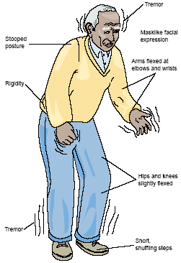
PARKINSONIAN
SYNDROME
Notes:
‹#›
‹#›

Slide 16
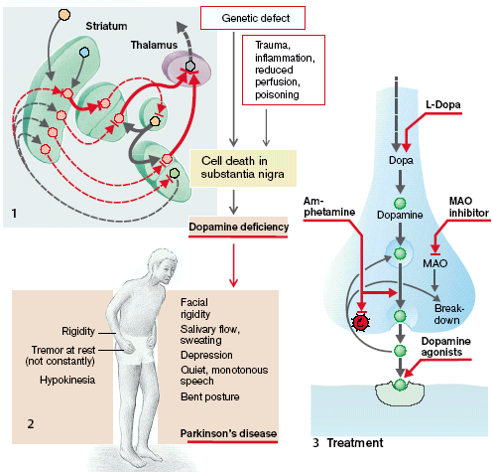
PARKINSONIAN
SYNDROME
Notes:
‹#›
‹#›

Slide 17
Strio-pallidar system failure
Athetosis
Chorea
- slow vermis-like forearms
and digits movements
- seizure-like mimic and skeletal muscles
contractions during the rest state

Slide 18
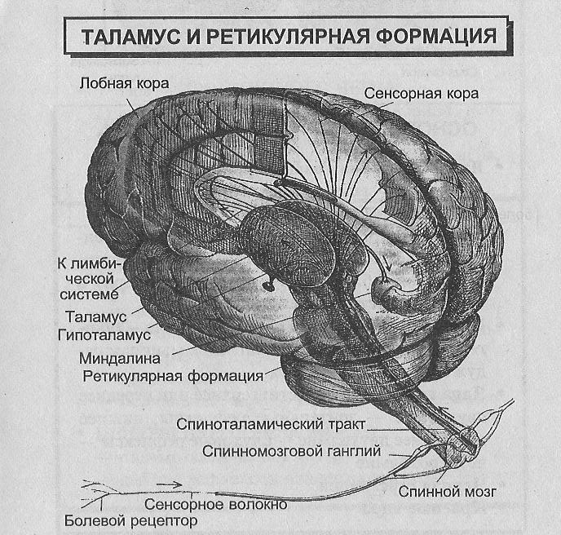
Thalamus and the reticular formation
Motor (frontal) cortex
Sensoric cortex
To the
limbic system
Thalamus
Hypothalamus
Amygdala
Reticular formation
Tractus Spinothalamicus
Ganglion spinalis
Spinal cord
Sensor fiber
Pain receptor

Slide 19
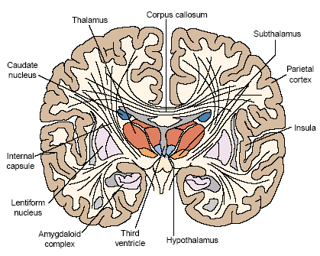
The main thalamic nuclei
Specific nuclei
Relying
Associative
Motor
Nonspecific nuclei
Notes:
‹#›

Slide 20
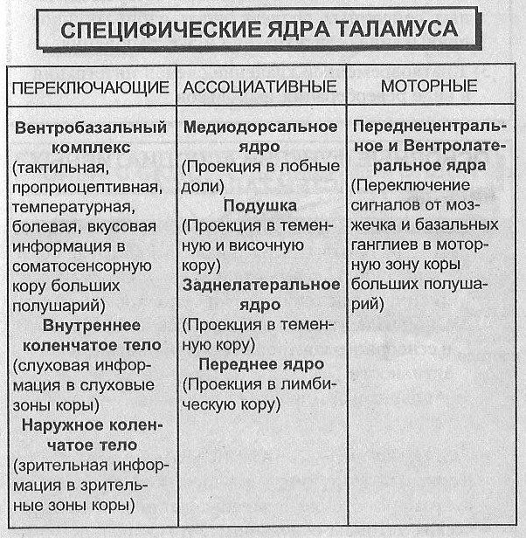
Specific thalamic nuclei
Relying
    Associative
Motor
Ventrobasal
complex
Mediodorsal
nucleus
N.N. frontolateral
and ventrolateral
Tactile,
proprioceptive,
temperature,
pain, gustatory
inputs to brain
somatosensory
cortex
Projections to
frontal lobes
Signals rely
from cerebellum
and basal
gangles to motor
cortex
Putamen
Projections to tempo-
ral and occipital lobes
Nucleus lateralis
dorsalis
N.geniculatum int.
Projections to
temporal lobe
Audial information in-
to brain audial centers
Nucleus frontalis
Projection to
limbic cortex
N.geniculatum ext.
Visual information in-
to brain visual centers

Slide 21
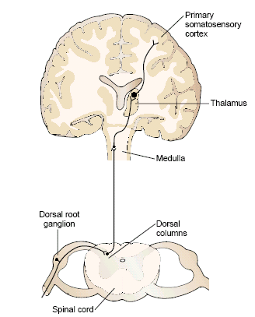
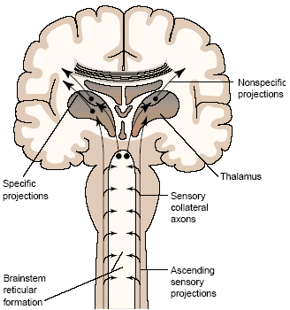
Thalamus
rely
function
Notes:
‹#›

Slide 22
All sensory pathways have direct
projections to thalamic nuclei, which
convey the information to restricted
areas of the sensory cortex.
Coordination and integration of peripheral
sensory stimuli occur in the thalamus

Slide 23
«… thalamus serves as the rely station,
where all the external stimuli,
coming together, change their expression
and go to subcortical and cortical centers».
А. К. Walker
Notes:
‹#›

Slide 24
Sensoric (visual, audial, tactile, etc.).
Functional zones
of the cortex
Мotor (primary, secondary, complex).
Аssociative (frontal, occipital,
temporal) – polysensoric,
plasticity, inertious.

Slide 25
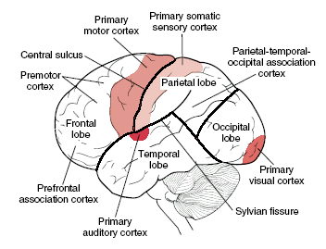

Slide 26
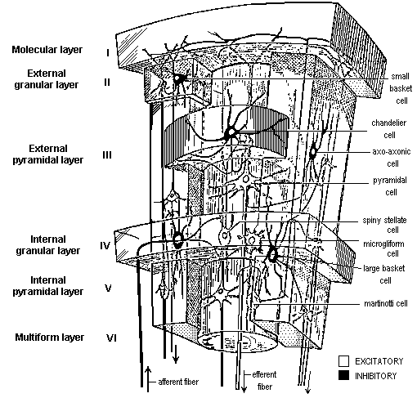
Brain cortex layers
Pyramidal cells sprouted apical
dendrites. + Аfferent thalamo-
cortical projections out of the
nonspecific thalamic nuclei
Numerous granular cells
+ Afferent thalamo-
cortical projections out of
the specific thalamic nuclei
Giant pyramidal cells
Веретёновидные клетки
Notes:
‹#›
‹#›

Slide 27
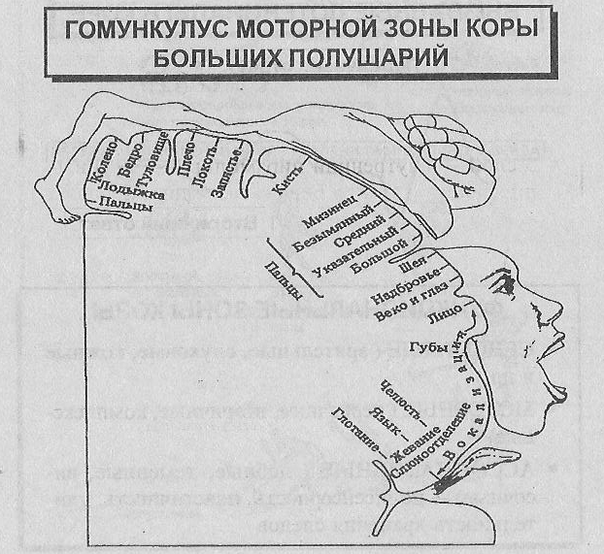
BRAIN CORTEX HOMUNNCULUS

Slide 28
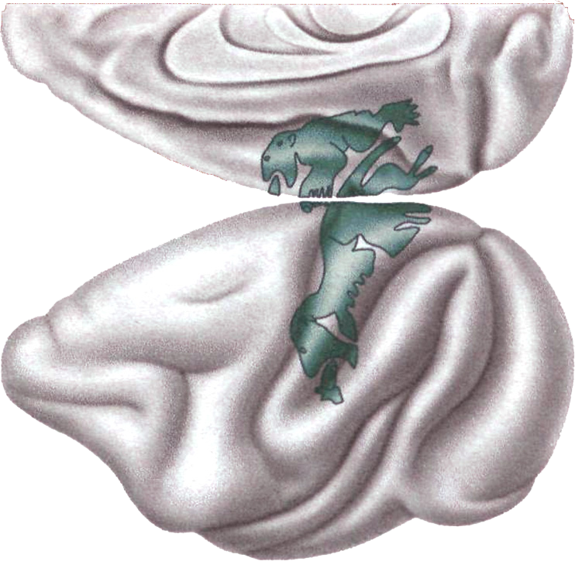
Lateral and mesial views of the cerebral cortex of the macaque monkey showing the primary (green area below) and the supplementary (green area above) motor areas according to Woolsey (adapted from Woolsey, 1958).
Both these areas contain a complete representation of body movements.
These representations were schematized in the form of two "homunculi,"
one located on the lateral cortical surface and the other on the mesial
one. The two homunculi became a dogma for clinical and
experimental neurology for almost 30 years.
Notes:
‹#›

Slide 29
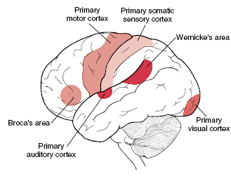

Slide 30
Frontal lobe FUNCTIONS
The major areas are:
(i) area 4 (motor area),
(ii) area 6 (premotor area),
(iii) frontal eye field (area 8),
(iv) supplementary motor area,
(v) prefrontal cortex
(areas 9, 10, 11, 12)
and Broca's area (area 44).
autonomic changes (e.g. BP, heartrate,
gastrointestinal secretion and
motility) can be elicited.
♦ The area is somehow related
to pain perception.
It is connected with limbic system
and thus associated with emotions.
The ability to judge with a situation
and make small plans are also
associated with this area.

Slide 31
Parietal lobe FUNCTIONS
The major areas are:
(i) primary sensory area (also
called somatic area I)
or Brodmann's area 3, 1, 2,
or the post central gyrus,
(ii) secondary somatic area
or somatic area II and
(iii) somesthetic association
area.
Sensory inputs integration, this integration
produces a motive and the motive in turn
can lead to an action.
Its presence is necessary for
maintenance of body image.
The parietal lobe also contains
angular gyrus. Destruction of angular
gyrus causes agraphia (=inability to
write), which is a form of aphasia .

Slide 32
Occipital lobe FUNCTIONS
Major areas of this lobe are:
(i) primary visual area (area 17),
(ii) visual association area (area 18), and
(iii) occipital eye field (area 19).

Slide 33
Temporal lobe FUNCTIONS
Major areas of this lobe are:
(i) Primary auditory area, in the gyrus of
Heschl (area 41) which is situated
in the floor of the lateral sulcus
plus a small part of the superior temporal gyrus.
(ii) In area '41' sound is 'heard' while
in the Wernicke's area the sound is 'interpreted'.
Notes:
‹#›

Slide 34
Symptoms assiciated with premotor cortex lesions:
Changes in Personality and Consciousness.
Judgments disturbances.
Loss of spontaneity in interacting with others (changes in social behavior).
Loss of flexibility in thinking. Difficulty with problem solving.
Inability to focus on task (Attending).
Mood changes (Emotionally Labile). Could based on relations of amygdaloid basolateral nucleus with cingulate and premotor cortex.
Motivation disturbance.
Inability to plan a sequence of complex movements needed to complete multi-stepped tasks, such as making coffee (Sequencing).
Persistence of a single thought (Perseveration).
Inability to express language (Broca's Aphasia).

Slide 35
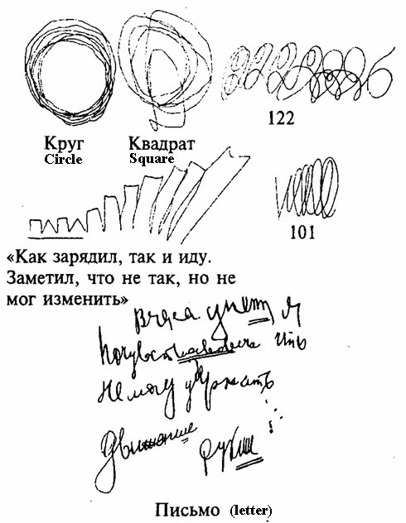
Motor perseveration in patient with premotor region injury
(by A.R.Luriya, 1973)
Notes:
‹#›

Slide 36
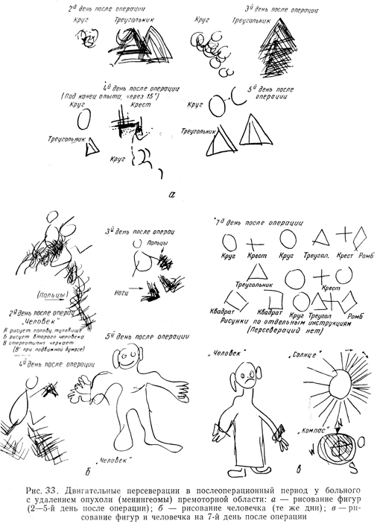
Elementary (simple) motor perseveration in the postoperative period after removal of meningeoma from premotor region

Slide 37
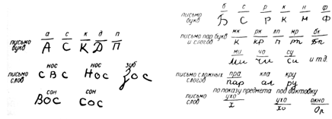
Writings of the patient with kinetic motor aphasia

Slide 38
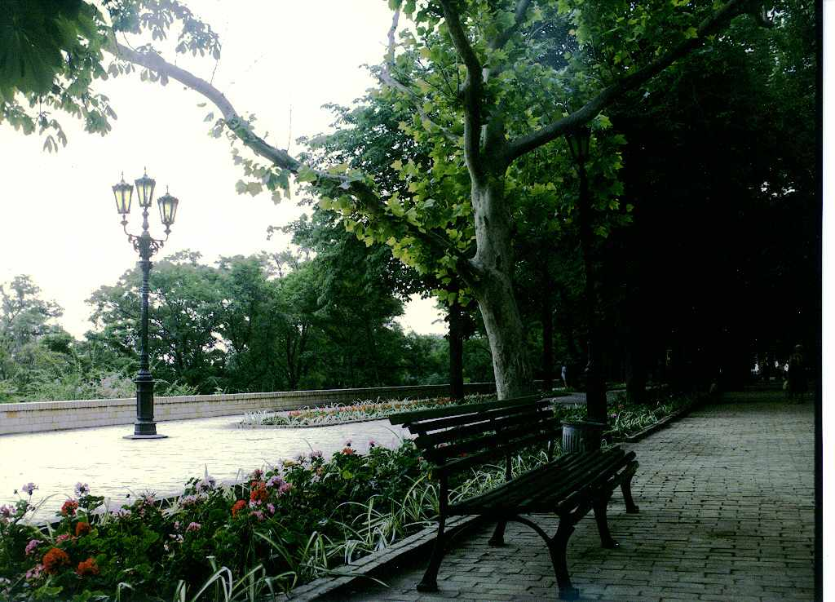
THANKS for attention!

