Slide 1
STUDY OF MUSCLE STRENGTH AND WORK. DYNAMOMETRY
PhD, Olha Kashchenko

Slide 2
The elementary functional unit of the muscle is motor, or locomotor, units (PO).
They are the final link in direct nervous control of the movements of the human or animal body.
For the first time, the term "motor unit" was introduced in the work of Liddell and Sherrington to define a structure that includes a group of muscle fibers that are innervated by axon terminals

Slide 3
The accumulation of knowledge about PO led to the identification of differences between them in certain structural and functional features, as well as connections with nerve structures.
According to the structure, small and large PO's are distinguished;
By function – slow (tonic) and fast (phase).

Slide 4
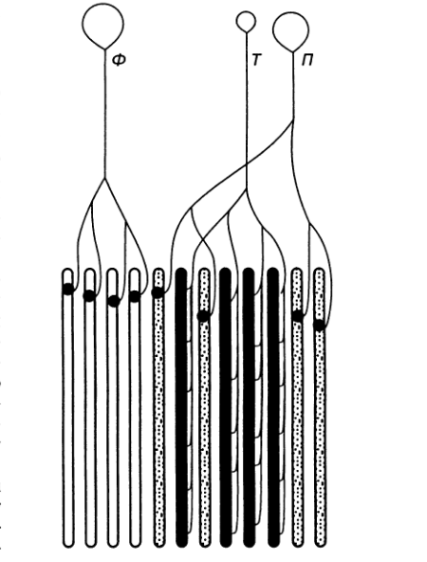
Neuromotor units of different types:
F – phase, T – tonic, P – transitional.

Slide 5
Comparative characteristics of slow and fast MF
Slow (tonic) MF | Fast (phase) MF
By the number of muscle fibers
Include several hundred or even thousands of muscle fibers | Include several muscle fibers.
According to the structure of muscle fibers
Contain many mitochondria. Sarcoplasmic reticulum is poorly developed. There are red due to the presence of myoglobin and cytochrome pigments. The glycogen content is small. Close contact with blood capillaries to speed up metabolism. | Contain few mitochondria. Sarcoplasmic reticulum is well developed. They are white – myoglobin and cytochrome pigments have little or no. Many glycogen granules.
By placement in the thickness of the muscle
У глибоких шарах м'язів кінцівок. | Ближче до поверхні м'язів.

Slide 6
By the nature of innervation
Slow motoneurons are small in size, characterized by high excitability, low threshold of excitation and inclusion in impulse activity, relatively low pulse frequency, narrow frequency range between the minimum and maximum pulse frequency, relatively low pulse speed along the axon (2-8 m/s), smaller axon diameter (5 microns), high endurance and tirelessness. They are capable of long-term (for tens of minutes) maintaining a stable low-frequency pulse without reducing the frequency. Several terminal plates are placed on one muscle fiber (multiple type of innervation). | Fast motoneurons are larger nerve cells with a thicker axon (10-20 microns in diameter). They are characterized by lower excitability, a high threshold for inclusion in impulse activity, a relatively high pulse frequency, a wide range between the minimum and maximum frequency, a relatively high speed of pulses along the axon (8-40 m / s). They are tired and short-lived. They cannot withstand high-frequency impulses: a high-frequency discharge is followed by a rapid drop in frequency. On one muscle fiber there is one, less often two terminal plates (a single type of innervation).

Slide 7
By excitability of the muscle fiber membrane
The membrane is characterized by moderate to low electrical excitability. Each electrical impulse results in the release of only a small amount of AH. In response to irritation within the terminal plate, local depolarization occurs. The measure of membrane depolarization depends on the frequency of stimuli. PD is not generated due to the lack of potential-dependent sodium channels on the fiber membrane. The local potential is capable of electrotonic propagation along the fiber. | The membrane is characterized by high electrical excitability. In response to irritation, PD is generated, spreading through the fiber. PD develops on the principle of "all or nothing."
According to the type of response of the muscle fiber
Slow graduation and slow relaxation. | Strong, fast contraction and rapid fatigue.

Slide 8
By the nature of the energy supply
The source of ATP is aerobic respiration. With a lack of oxygen, muscle fiber continues to work due to anaerobic glycolysis. | Source of ATP – anaerobic processes (glycolysis)
By function performed by
Provide long-term contraction of the muscle used to maintain posture. | They provide large-scale static and dynamic muscle contractions, as well as high-speed tensions with a high power gradient. Very important for locomotion.

Slide 9
Research methods of physiological and mechanical
characteristics of human movements

Slide 10
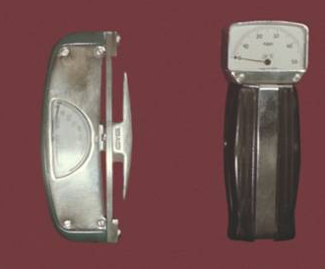
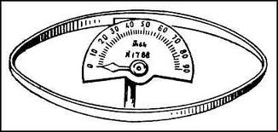
Dynamometry
Dynamometry as a method makes it possible to measure and register the force of contraction of certain muscle groups.
Different types of brush dynamometers

Slide 11
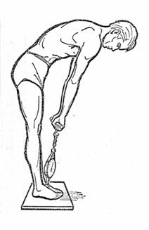
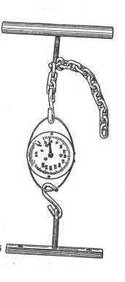
Standby dynamometer

Slide 12
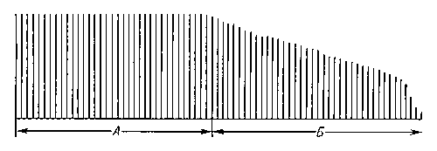
Ergography
Ergography allows you to get a record of angular or linear movement in time with simple movements such as flexion-extension.
Ergogram of muscle fatigue
A — phase of optimal performance;
B is the phase of fatigue development.

Slide 13
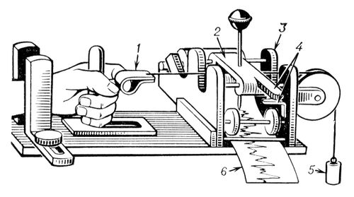
Mosso finger ergograph:
1 — motion sensor; 2 — recording device;
3 — salazki; 4 — parts of the mechanism for the movement of the tape; 5 — cargo; 6 — tape for recording an ergogram.

Slide 14
Ergometry is a set of quantitative methods for measuring a person's physical performance, which has an expression in ergometric indicators.
What are:
The intensity of the motor task performed: a) the speed of the athlete (m / s); b) power (for example, when pedaling on a bicycle ergometer; unit of measurement — watts); c) force (for example, with static cargo content; unit of measure — newtons).
The volume of the motor task performed: a) the path traveled (m); b) the work done (in physical content, for example, when the pedals of the bicycle ergometer are rotated; the unit of measurement is joules).
Execution time (unit of measure — seconds).

Slide 15
Cyclography
The cyclographic technique is corrected in the multiple photographing of the observed moving links of the body, as well as in the subsequent analysis of the record in the microintervals of time.

Slide 16
Other methods for studying the mechanical parameters of movements are the use of sensors that convert non-electrical quantities into electrical ones. With their help, continuous registration of changes in articular angles and forces in the process of natural motor acts can be carried out.

Slide 17
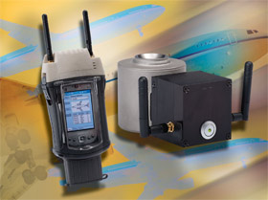
Electrotensodynamography
The method of electrotensodinography allows you to record and measure the effort that a person develops during interaction with the support and other environmental objects that have a certain mass.
Electric load cell

Slide 18
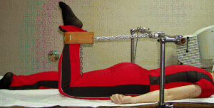
Universal electrotensodynamic measuring complex.
It has a torque table with a movable frame, on the transverse bar of which is fixed with the ability to move in different planes an electrotensodynamometer connected to the recording device, according to the invention, the complex additionally has a support platform connected to an electric tensodometer, fixed to the anti-resistance table and a neutralizing cuff fixed, for example, on the Balkan frame.

Slide 19
Stabilography
Nowadays, to assess the conditions of balance of the body, the coordination capabilities of a person, tolerance to static loads, the method of stabilography is widely used.
During the study, a person becomes on a stabilographic platform and performs a control test.

Slide 20
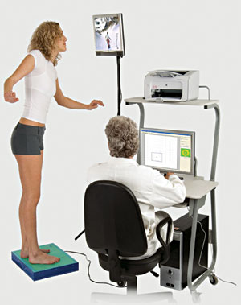
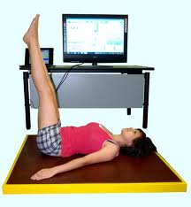
Stabilographic installation

Slide 21
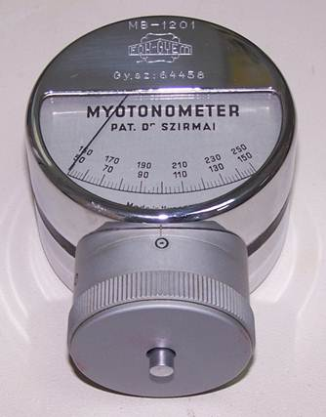
Myotonography
Myotonography is the registration and analysis of the biomechanical qualities of human skeletal muscles.
Information on the biomechanical state of the studied muscles is obtained in digital and graphic forms.
Myotonometer

Slide 22
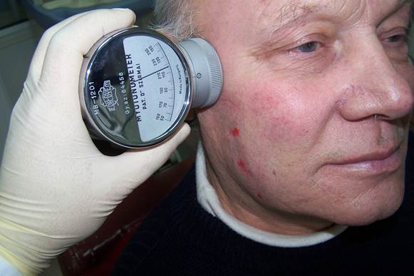
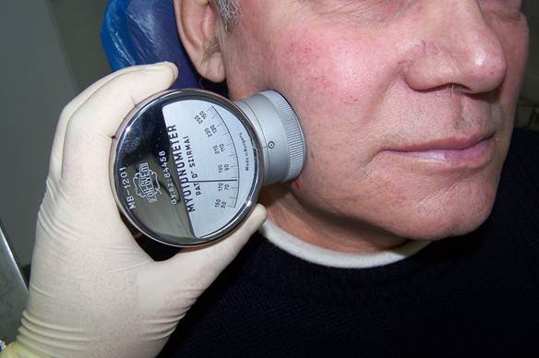
Measurement of the tone of the right masticatory muscle with a myotonometer.
Measurement of the tone of the right viscous muscle with a myotonometer.

Slide 23
Accelerometry
Acceleration is a technique that allows you to measure the acceleration of the human body and its individual biolinks when performing movements.
Acceleration measurement takes place in two stages: 1) mechanical measurement of acceleration;
2) conversion of the mechanical movement of the sensor into an electrical signal.

Slide 24
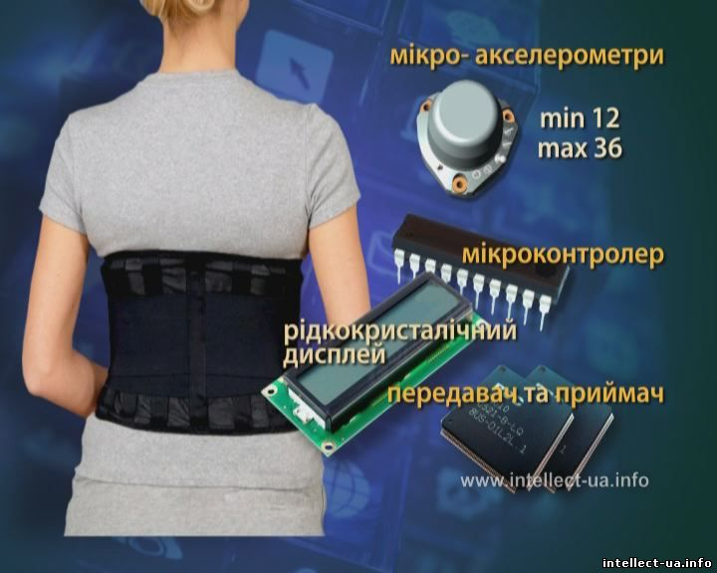
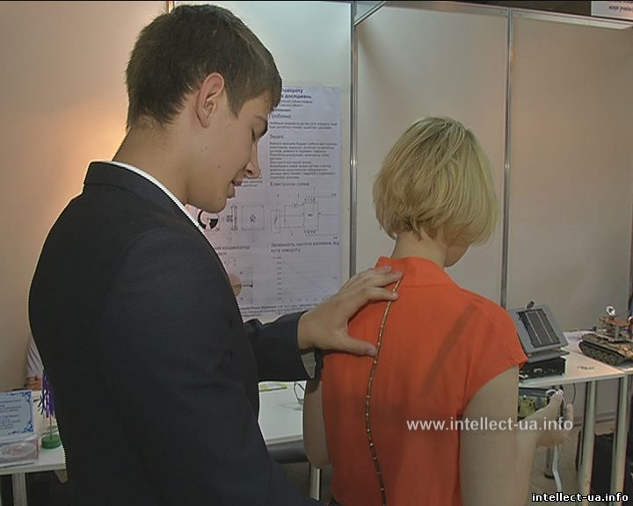
Accelerometer Is a flexible bandage in which microaxelrometers are located in the form of sequentially placed cells. Data from each of them is transmitted to the primary processing unit and further along the radio channel, or using a standard parallel PT port to a computer, where with the help of special software we see the state of the human spine in visual mode.

Slide 25
Goniometry
Goniometry is a method of registering angular movements in the joints. The magnitudes of the articular angles are important spatial characteristics of movements about:
determination of the mobility of combinations of body links;
flexibility assessments;
study of rational sports techniques.

Slide 26
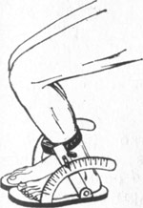
Goniometer

Slide 27
To measure the angular movements of the links of the human body, to assess the level of development of flexibility (amplitude of movements), methods such as:
radiographic,
optoelectric,
Mechanical
mechanoelectric.

Slide 28
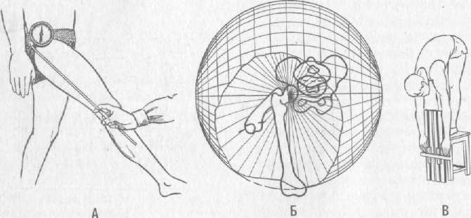
Ways to measure flexibility: A – goniometric; B – globographic;
B – in linear measures.

Slide 29
Electromyography
A method based on the registration and analysis of bioelectrical activity of muscle and peripheral nerve fibers.
In this case, we study:
1) spontaneous bioelectric activity, reflects the state of the neuromuscular system at rest and under muscle tension;
2) caused by bioelectrical activity caused by electrical stimulation of a nerve or muscle of varying intensity and frequency.

Slide 30
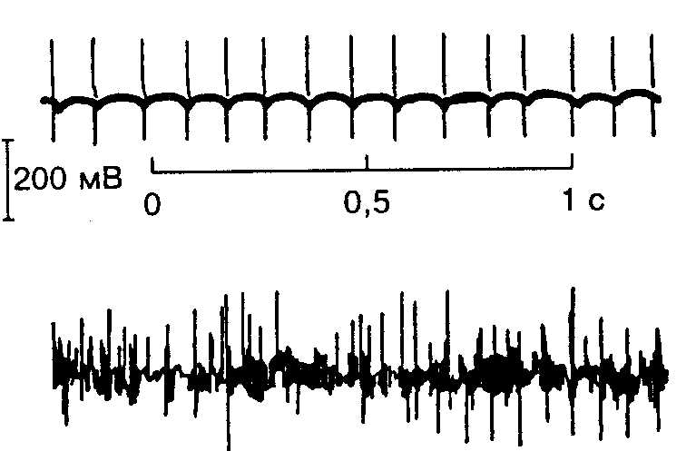
The electrical activity of a separate motor unit (a) and muscle (b) in humans

Slide 31
Stimulation methods in the diagnosis of the neuromuscular system solve the following tasks:
examine the direct excitability of the muscles,
examine neuromuscular transmission,
investigate the state of motoneurons and their axons,
examine the state of the sensitive fibers of peripheral nerves.

Slide 32
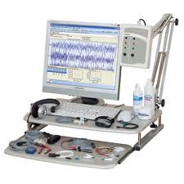
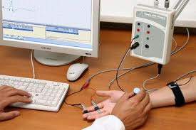
Electromyograph

Slide 33
Thank you for your attention!

