Slide 1
Role of taste and smell sensory systems in digestion

Slide 2
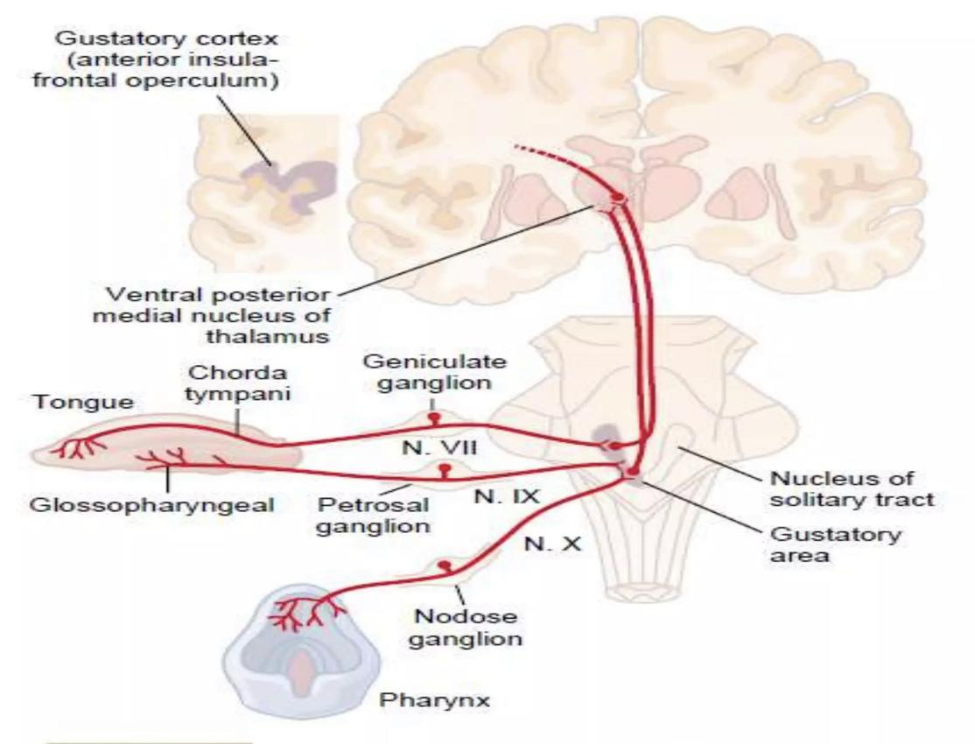
taste analyzer
The taste analyzer is found on chemoreception, it is necessary to determine the taste of food. This analyzer has the following departments:
Peripheral part (taste receptors/taste buds)
Conduction part (nerves Vll,lX,X)
Central section part(lower part of the gyrus postcentralis of the cerebral cortex)

Slide 3
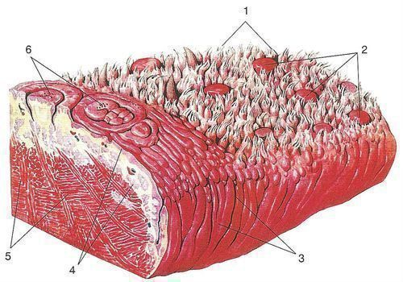
The peripheral part
taste papilla come in many forms: filiform, which do not have taste buds, mushroom-shaped containing taste buds, trough-shaped and leaf-shaped, mostly preserved in children. The each papilla of the tongue has taste buds, which contains 30-80 elongated cells on the sides. These cells are: sensory / gustatory (epithelial origin), supporting and basal cells. Each receptor cell has pores with microvilli, they participate in the development of cell excitation, perceive certain chemical substances adsorbed in the bulb canal. The same taste cell perceives several taste stimuli, for normal taste perception, the taste bud fluid is needed

Slide 4
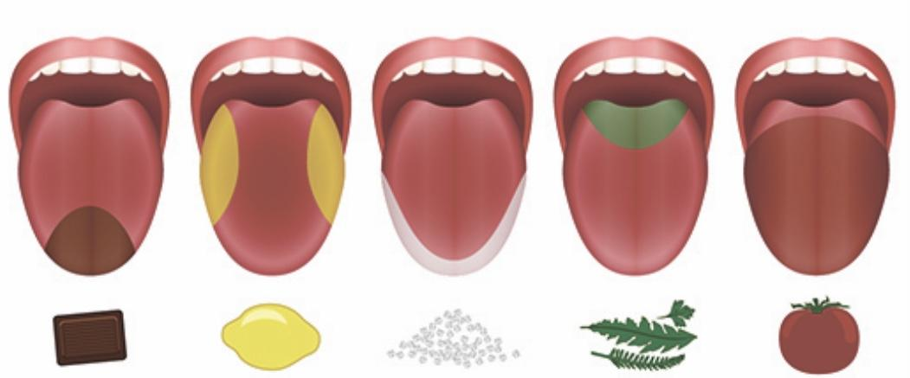
location of taste receptors and taste perception
in addition to the usual sweet, sour, salty, bitter tastes, there is umami, the essence of which is in the recognition of products (tomato, meat, banana ...) such receptors are sensitive to glutamate, to deceive these receptors, nutritional supplement manufacturers add monosodium glutamate

Slide 5
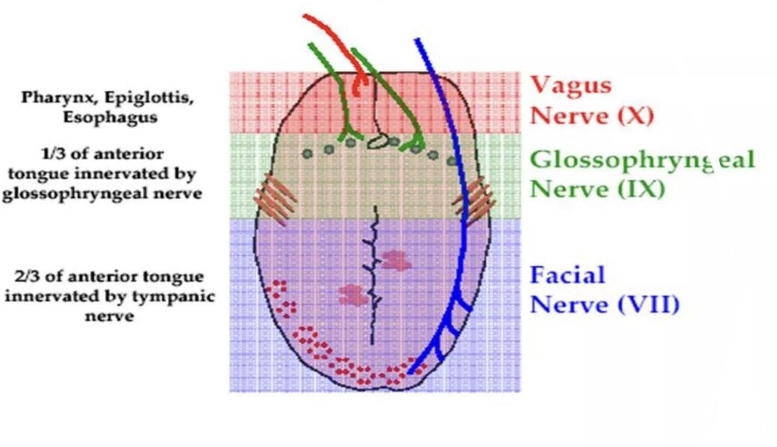
Conductor part
Conduction: nervus facialis, nervus glossopharyngeus, nervus vagus are represented, the facial nerve innervates the anterior part of the tongue, the bodies of neurons are located in the medulla, aff fibers carry information about taste, temperature, etc. The glossopharyngeal nerve carries information about the back of the tongue, the hard palate. The vagus nerve controls receptors in the throat.

Slide 6
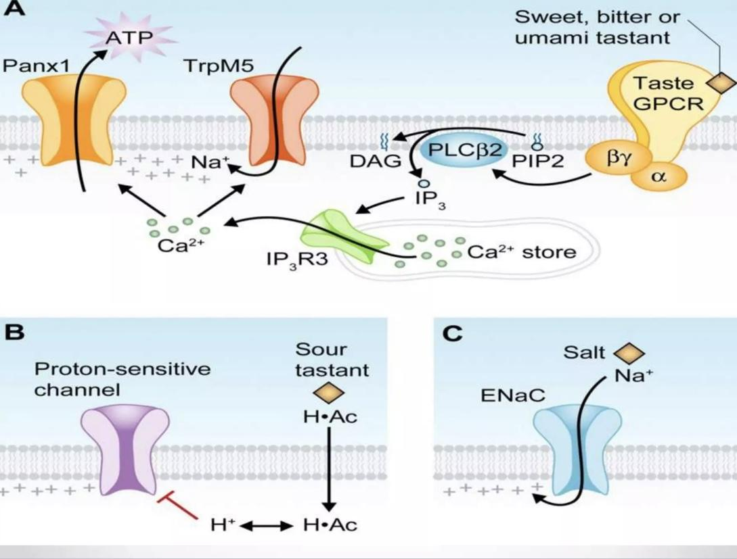
taste recognition mechanisms
А. chemosensory receptors bind to ligands -> G-protein activated -> phospholipase C active -> inositol-1,4,5-triphosphate produced -> open Na-tubules (taste-specific) -> Na enters the cell causing membrane depolarization —> opening of voltage-gated Ca+ channels —> Ca+ is released which causes the release of neurotransmitters;
В. sour taste is characterized by the H proton pathway. H+ enter the cell through amiloride-sensitive Na+ channels —> H+ blocks K+ channels —> membrane depolarization —> voltage-dependent Ca+ channels open —> neurotransmitter release
С. Na+ enters amiloride sensitive Na channels -> voltage-gated Na channels open -> membrane depolarization -> voltage-gated Ca channels open -> neurotransmitter release

Slide 7
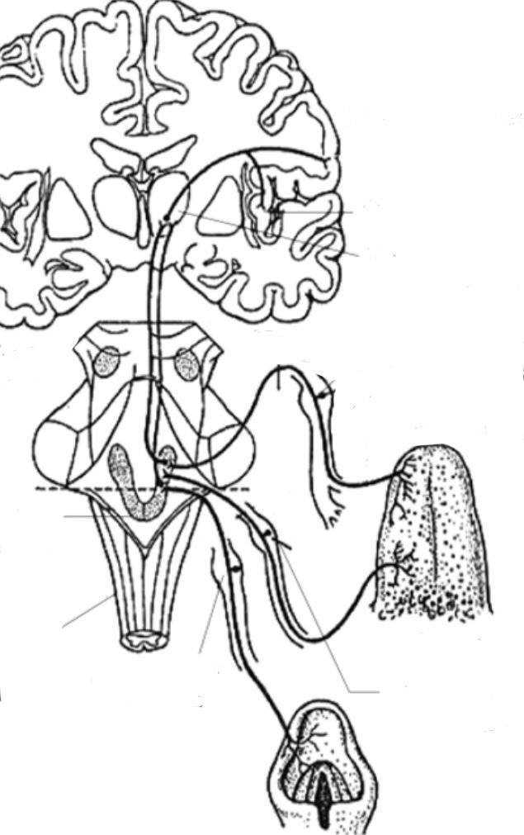
Central part
Central: The primary center of the taste analyzer in the nucleus tractus solitarii (the nucleus of the solitary pathway) here the first neuron ends and the second one begins, which goes to the thalamus. The third neuron starts from the thalamus and goes to the cerebral cortex to the gyrus postcentralis. The thalamocortical system provides taste discrimination, but the connection with the limbic structure provides a motivational characteristic of eating behavior. Cortical center in the gyrus postcentralis of the cerebral cortex. Its leading departments are represented in the lateral (hunger center or nutrition center) and ventromedial (satiation center) nuclei of the hypothalamus. With the destruction of the center of hunger, aphagia is observed, and with irritation - hyperphagia

Slide 8
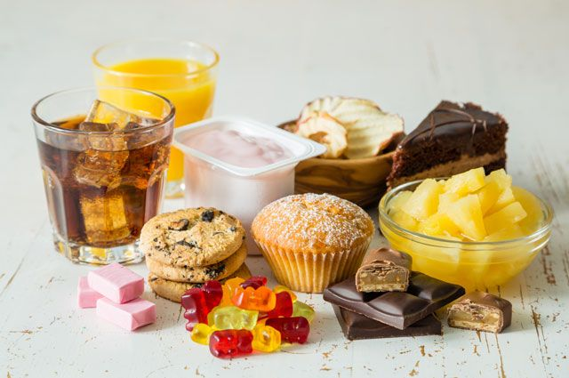
The taste adaptation
Over time, with prolonged action of flavoring substances, adaptation is observed, the taste sensation becomes less intense. We get used to sweet and salty very quickly and over time we begin to salt our food more and more, or add more spoons of sugar to tea. Cross-adaptation is a change in feelings for one taste under the influence of another. Adaptation to the sweet leads to an aggravation of the perception of salty, sour and bitter.When smoking and colds, we feel less taste because the sense of smell is weaker.

Slide 9
the activity of taste buds and what it can depend on
Taste perception depends on the functional state organism. So, in conditions of hunger or saturation, it is different: on an empty stomach, increased sensitivity to various tastes is noted substances and a high level of mobilization of taste receptor elements (taste buds), and after eating, taste sensitivity decreases and taste perception structures are demobilized. Taste perception changes under the influence of various types of social activities. Before the exam, the ability of students to perceive various flavoring substances is significantly reduced. With age, there is a decrease in taste sensitivity, and the ability to distinguish between individual flavoring substances also decreases. Taste perception is influenced by various pathological processes. They reduce the taste sensitivity of diseases of the oral cavity (stomatitis, glossitis), diseases of the gastrointestinal tract, respiratory organs, diseases of the blood and the central nervous system.

Slide 10
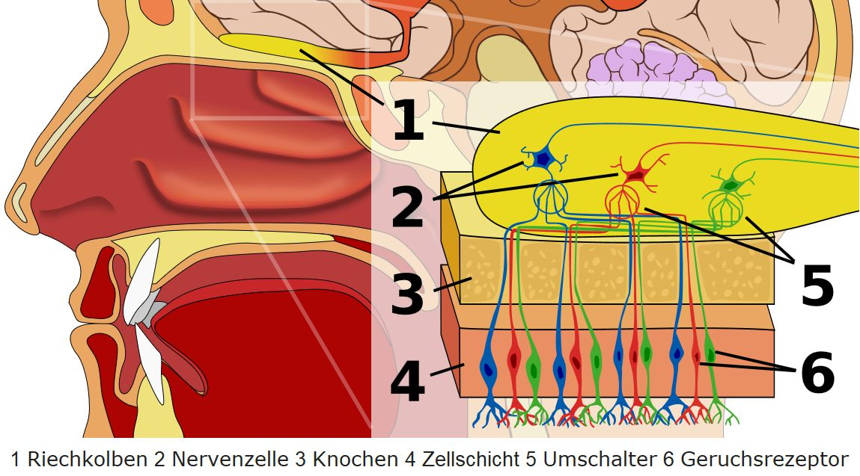
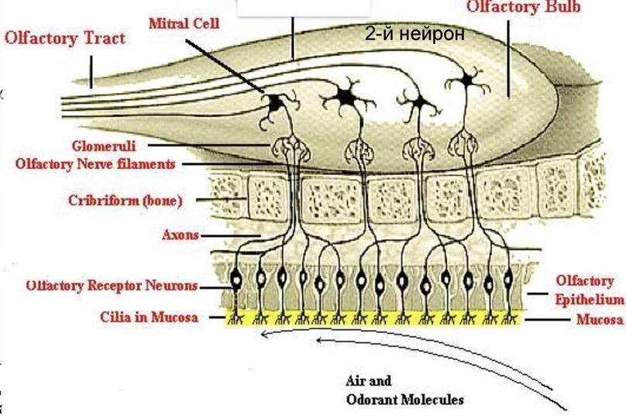
The olfactory system
The nasal cavity has three chambers: lower, middle and upper, where the main organ of smell is just the same, the remaining chambers are needed to warm and purify the air. The receptors are located in the upper nasal passage, the olfactory epithelium contains receptor, supporting and basal cells. Each olfactory cell (chemoreceptor cell, which is essentially a bipolar neuron) has an olfactory club with protruding hairs immersed in a liquid medium, the club is the cytochemical center of olfactory cells, it is capable of generating a receptor potential

Slide 11
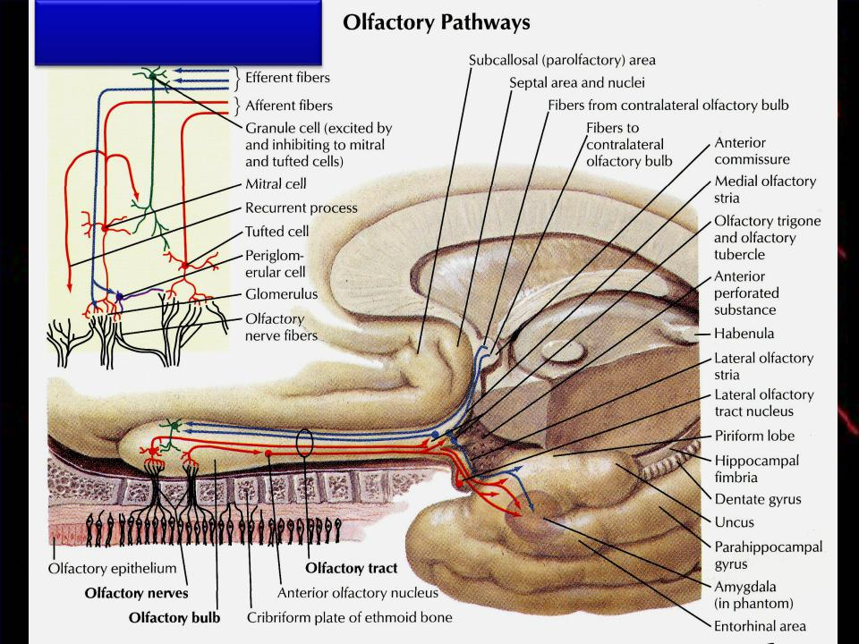
Parts of the olfactory system
The peripheral section is formed by receptors of the upper nasal passage of the mucous membrane of the nasal cavity. Olfactory receptors in the nasal mucosa terminate in olfactory cilia. Gaseous substances dissolve in the mucus surrounding the cilia, then a nerve impulse occurs.
Conduction department - olfactory nerve. Through the nerve fibers, impulses arrive at the olfactory bulb and then follow to the cortical olfactory center.
Central department - cortical olfactory center, located on the lower surface of the temporal and frontal lobes of the cerebral cortex. In the cortex, the smell is determined and an adequate reaction is formed.

Slide 12
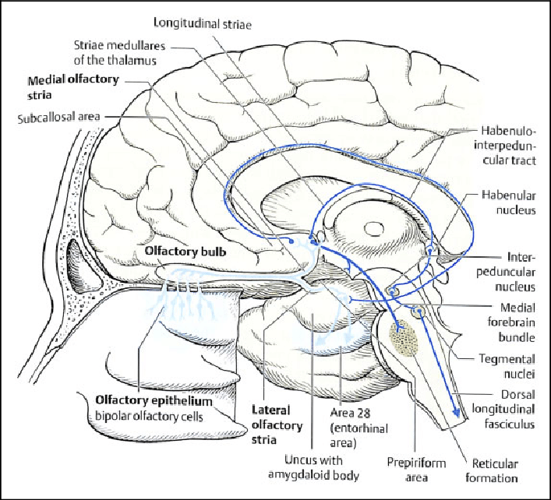
The mechanism of operation of the olfactory analysis of the feast in general
Reception mechanism: odorant particles come into contact with the olfactory mucosa. Receptor Active protein interacts with odor, protein conformation is detected, Na-channels on the plasmalemma open and sodium enters - as the depolarization of the Receptor Potential manifests itself. From the extremely flexible cilia on the olfactory bulb of a short process of chemoreceptors of cells capable of capturing aromatic molecules, the signal goes as it waits to the processes passing through the opening of the perforated plate of the ethmoid bone, the impulse goes to the bulb (primary processing), heading along the fibers of the olfactory nerve ( ophthalmic nerve) into the bulb, then to the Olfactory tract, found in the limbic system, bypassing the olfactory triangle, reaching the cortical section of the analyzer - the gyrus of the hippocampus, located in the temporal zone

Slide 13

Olfactory adaptation
We quickly adapt to many smells (our own smell, the smell of the room, the perfume that we applied and got used to), mainly there is a change in the cortical and not the peripheral section

Slide 14
disturbances in the activity of the olfactory and gustatory systems
Distinguish the following violations of smell:
anosmia - absence;
hyposmia - lowering;
hyperosmia - increased olfactory sensitivity;
parosmia - incorrect perception of smells;
violation of differentiation;
olfactory hallucinations, when there are olfactory sensations in the absence of odorous substances and
olfactory agnosia, when a person smells, but it is not finds out. With age, due to the predominance of involutive processes, there is mainly a decrease in olfactory sensitivity, as well as other types of functional disorders of smell.
There are such types of disorders:
ageusia - loss;
hypogeusia - lowering;
hypergeusia - increase;
parageusia - a perversion of taste sensitivity;
dysgeusia a disorder of fine analysis of taste substances;
gustatory hallucinations, as well as gustatory agnosia, when a person feels but does not recognize the taste of this substance.

Slide 15

Role in digestion
Destruction of the ventromedial nuclei (satiation) leads to hyperphagia, and irritation leads to aphagia. The centers of satiety and hunger are in reciprocal relationships (the activity of one of them inhibits the other) and are closely connected with other parts of the central nervous system, such as the limbic system (the structure of the "olfactory brain") and the reticular formation, the cortex, a violation of these structures leads to eating disorders. The state of the food center depends on the impulses coming from various peripheral and central receptors.

Slide 16
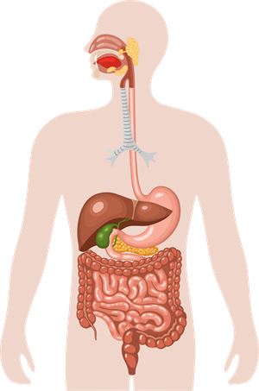
For normal digestion includes 5 processes: receptor, secretory, motor, absorption and excretion. the body needs to receive a signal that food is coming and it's time to start the digestion process. detection by taste buds of sweet foods containing glucose, promotes the launch of the processes of secretion of the corresponding enzymes, hormones, pancreatic juice, gastric juice and other biologically active substances. Smell is an important aspect in the appearance of appetite, provokes salivation, glonia and chewing reflexes

