Slide 1
The influence of Autonomic Nervous System on the functions of internal organs
Autonomic Nervous System
As. DENYSENKO Oksana

Slide 2
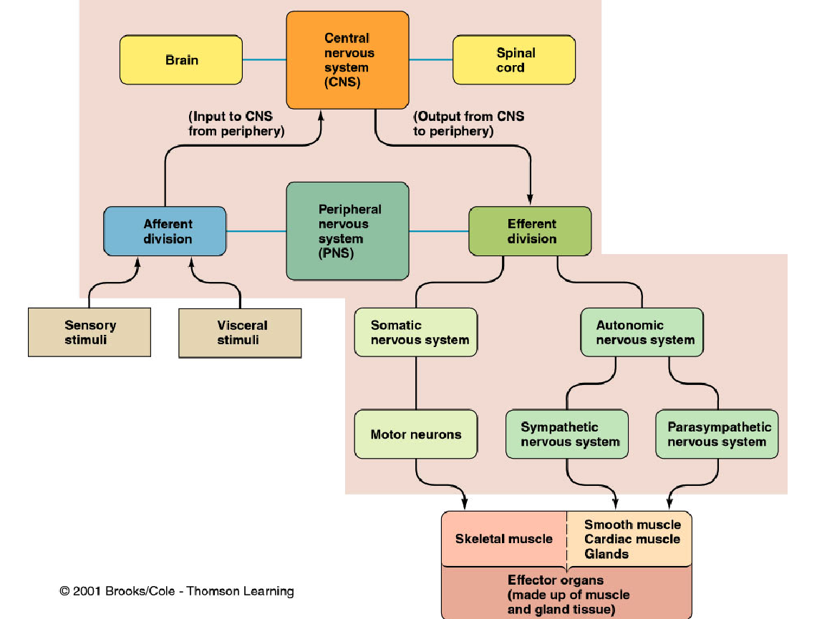

Slide 3
THE NERVOUS SYSTEM
INTRODUCTION
The nervous system monitors and controls almost every organ / system through a series of positive and negative feedback loops.
The Central Nervous System (CNS): Includes the brain and spinal cord.
The Peripheral Nervous System (PNS): Formed by neurons & their process present in all the regions of the body.
It consists of cranial nerves arises from the brain & spinal nerves arising from the spinal cord.
The peripheral NS is divided into
Somatic Nervous system
Autonomic nervous system
Notes:
‹#›

Slide 4
FUNCTIONAL ANATOMY OF THE AUTONOMIC NERVOUS SYSTEM

Slide 5
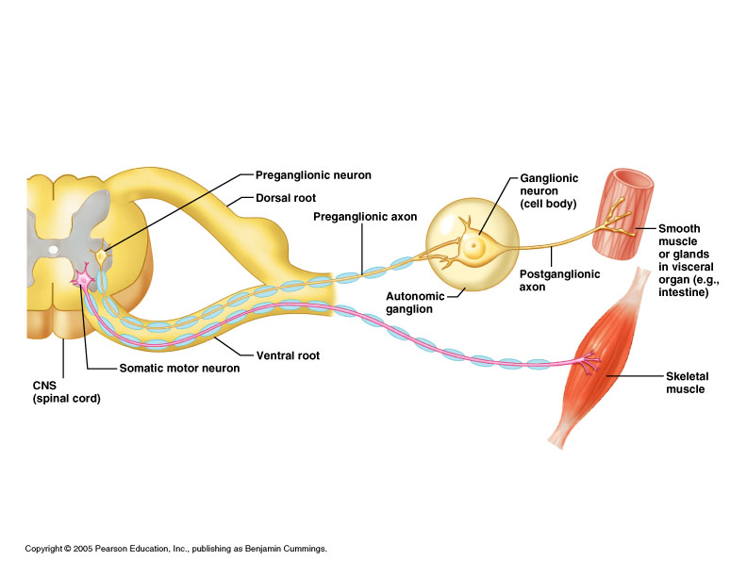
Basic anatomical difference between the motor pathways of the voluntary somatic nervous system (to skeletal muscles) and those of the autonomic nervous system

Slide 6
‹#›
Basic anatomical difference between the motor pathways of the voluntary somatic nervous system (to skeletal muscles) and those of the autonomic nervous system
Somatic division:
  Cell bodies of motor neurons reside in CNS (brain or spinal cord)
  Their axons (sheathed in spinal nerves) extend all the way to their skeletal muscles
Autonomic system: chains of two effector neurons
  1st = preganglionic neuron (in brain or cord)
  2nd = gangionic neuron (cell body in ganglion outside CNS)
  Slower because lightly or unmyelinated
Notes:
‹#›

Slide 7
‹#›
ANS is the subdivision of the peripheral nervous system that regulates body activities that are generally not under conscious control
Visceral innervates non-skeletal (non-somatic) muscles
Composed of a special group of neurons serving:
  Cardiac muscle (the heart)
  Smooth muscle (walls of viscera and blood vessels)
  Internal organs
  Skin

Slide 8
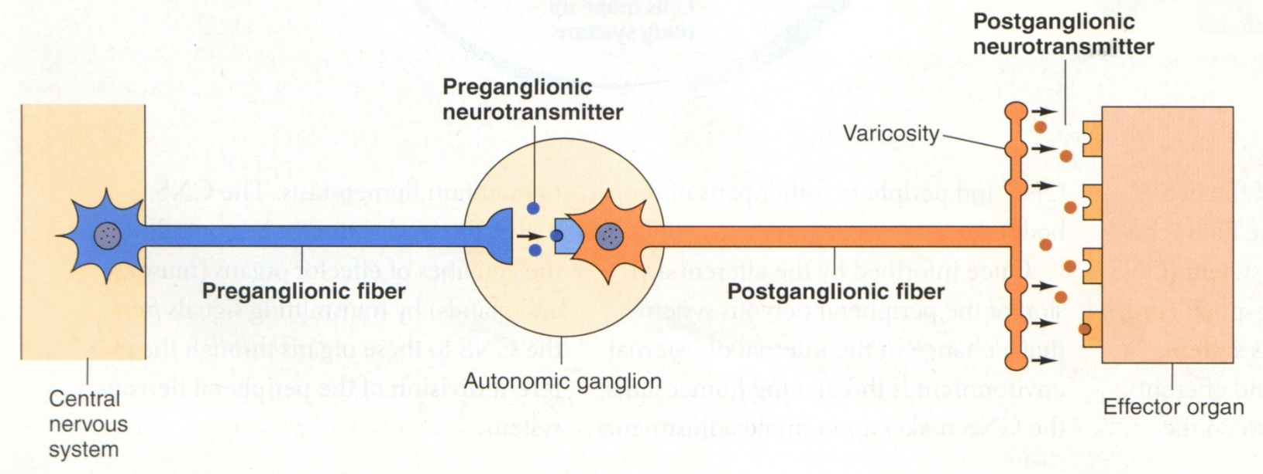
‹#›
Axon of 1st (preganglionic) neuron leaves CNS to synapse with the 2nd (ganglionic) neuron
Axon of 2nd (ganglionic) neuron extends to the organ it serves
this dorsal root ganglion is sensory

Slide 9
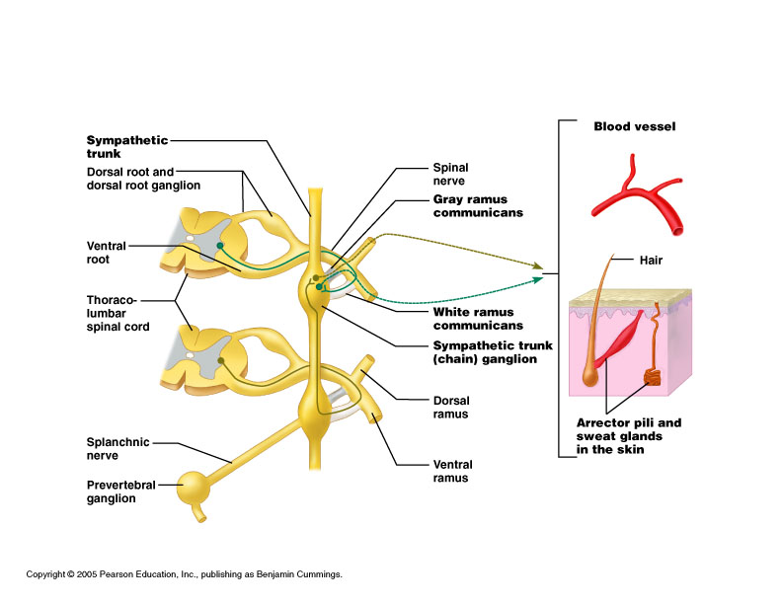
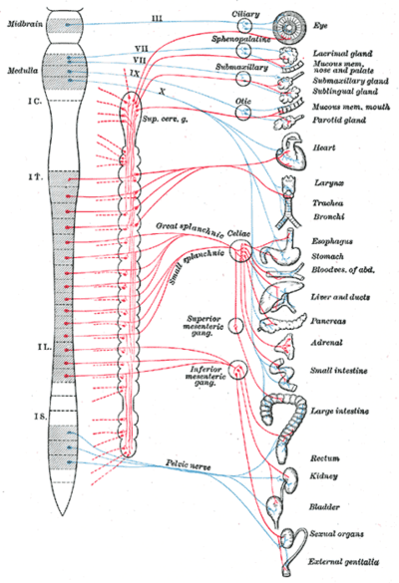
Overview of actions
LOCATIONS OF AUTONOMIC GANGLIA
Sympathetic Ganglia
Location
Trunk (chain) ganglia near vertebral bodies
Prevertebral ganglia near large blood vessel in gut :celiac
,superior mesenteric &
inferior mesenteric
Notes:
‹#›

Slide 10
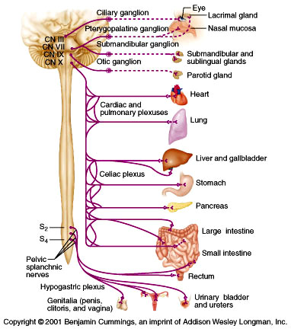
Parasympathetic Ganglia Location :
Terminal ganglia
in the wall of organ

Slide 11
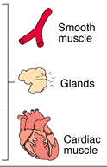
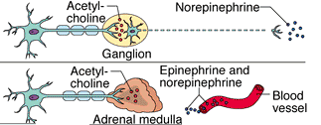
Sympathetic
Innervation of Visceral Targets
Short, lightly myelinated preganglionic neurons
Long, unmyelinated postganglionic neurons
Ganglia close to spinal cord
Spinal Cord
Notes:
‹#›
The target organs whose activities are regulated by the ANS are innervated by two neurons in tandem which synapse in ganglia * between the Central Nervous system and the target organ. The first ( preganglionic neuron) arises from the CNS * and carries information to the ganglion, * while the second carries information from the ganglion to the target organ (postganglionic neuron). *
The particular arrangement of these neurons that is characteristic of the Sympathetic division, includes a short, lightly myelinated preganglionic neuron and a much longer, unmyelinated postganglionic neuron which reaches from the ganglion to the target organ. Since the preganglionic neurons are short, the ganglia in which the sympathetic neurons synapse are located very close to the spinal cord itself. * Thus the innervation of visceral targets in the sympathetic division include a short preganglionic neuron, a ganglion that is close to the spinal cord and a much longer postganglionic neuron that reaches out to the target organ. *

Slide 12

Parasympathetic
Innervation of Visceral Targets
Ganglia close to or on target organs
Preganglionic neurons - long
Post ganglionic neurons - short
Notes:
‹#›
The Parasympathetic division of the ANS is characterized having the ganglia * very close to or on the target organs. * As a result, the preganglionic neurons * must be long to reach from the spinal cord to the ganglia. The postganglionic neurons * are relatively short, since they only must reach from the ganglia to the target organ the ganglia are already near or on. *

Slide 13
SYMPATHETIC & PARASYMPATHETIC NERVOUS SYSTEM ORIGIN
Blue= Para symp; Red symp
Notes:
‹#›

Slide 14
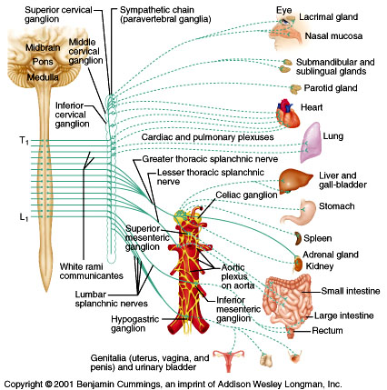
Sympathetic - Origin
Thoracolumbar lateral horns of the spinal segments T1-L2.
Nerve fibers originate between T1 & L2
Notes:
‹#›
The Sympathetic division of the ANS is sometimes referred to as the “thoracolumbar” branch * because its nerve fibers * arise from the central nervous system (spinal chord) between the first thoracic and the second lumbar vertebrae. * *

Slide 15
Parasympathetic - Origin
Craniosacral Cell bodies of the nuclei of the cranial nerves III, VII, IX and X in the brain stem
Second, third and fourth [S2-S4] sacral segments of the spinal cord
Nerve fibers emerge from brain &
sacrum cranio-sacral outflow
Notes:
‹#›
The Parasympathetic division of the ANS is sometimes referred to as the “craniosacral” division because its nerve fibers arise from the Central Nervous System directly from the brain in the cranium * and from spinal chord between the sacral vertebrae. *

Slide 16
PARASYMPATHETIC NERVOUS SYSTEM
The cranial nerves III, VII and IX affect the pupil and salivary gland secretion
Vagus nerve (X) carries fibres to the heart, lungs, stomach, upper intestine and ureter
The sacral fibres form pelvic plexuses which innervate the distal colon, rectum, bladder and reproductive organs.
Notes:
‹#›

Slide 17
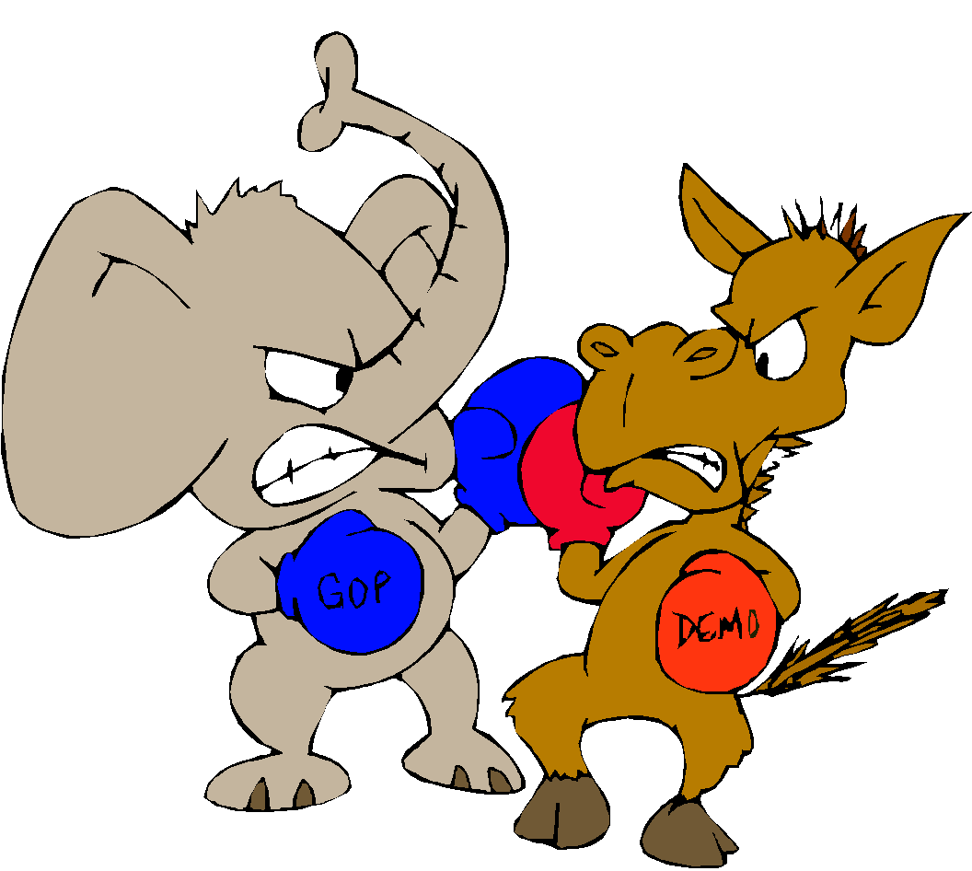

Autonomic Nervous System
2 divisions:
  Sympathetic
    “Fight or flight”
    “E” division
      Exercise, excitement, emergency, and embarrassment
  Parasympathetic
    “Rest and digest”
    “D” division
      Digestion, defecation, and diuresis

Slide 18
SYMPATHETIC NERVOUS SYSTEM FUNCTIONS
FEAR, FLIGHT OR FIGHT
The sympathetic system enables the body to be prepared for fear, flight or fight
Sympathetic responses include an increase in heart rate, blood pressure and cardiac output
Diversion of blood flow from the skin and splanchnic vessels to those supplying skeletal muscle
Increased pupil size, bronchiolar dilation, contraction of sphincters and metabolic changes such as the mobilisation of fat and glycogen.
Notes:
‹#›

Slide 19
FUNCTIONS OF SYMPATHETIC NERVOUS SYSTEM
Bronchioles dilate, which allows for greater alveolar oxygen exchange.
It increases heart rate and the contractility of cardiac cells (myocytes), thereby providing a mechanism for the enhanced blood flow to skeletal muscles.
Sympathetic nerves dilate the pupil and relax the lens, allowing more light to enter the eye.
Notes:
‹#›

Slide 20
PARASYMPATHETIC NERVOUS SYSTEM FUNCTIONS
The parasympathetic nervous system has "rest and digest" activity.
In physiological terms, the parasympathetic system is concerned with conservation and restoration of energy, as it causes a reduction in heart rate and blood pressure, and facilitates digestion and absorption of nutrients, and consequently the excretion of waste products
The chemical transmitter at both pre and postganglionic synapses in the parasympathetic system is Acetylcholine (Ach).
Notes:
‹#›

Slide 21
THE AUTONOMIC
NERVOUS SYSTEM
Subdivision | Nerves Employed | Location of Ganglia | Chemical Messenger | General Function
Sympathetic | Thoracolumbar | Alongside vertebral column | Norepinephrine | Fight or flight
Parasympathetic | Craniosacral | On or near an effector organ | Acetylcholine | Conservation of body energy
Notes:
‹#›

Slide 22
The Autonomic Nervous System
Structure | Sympathetic Stimulation | Parasympathetic Stimulation
Iris (eye muscle) | Pupil dilation | Pupil constriction
Salivary Glands | Saliva production reduced | Saliva production increased
Oral/Nasal Mucosa | Mucus production reduced | Mucus production increased
Heart | Heart rate and force increased | Heart rate and force decreased
Lung | Bronchial muscle relaxed | Bronchial muscle contracted
Notes:
‹#›

Slide 23
The Autonomic Nervous System
Structure | Sympathetic Stimulation | Parasympathetic Stimulation
Stomach | Peristalsis reduced | Gastric juice secreted; motility increased
Small Intes | Motility reduced | Digestion increased
Large Intes | Motility reduced | Secretions and motility increased
Liver | Increased conversion of glycogen to glucose
Kidney | Decreased urine secretion | Increased urine secretion
Adrenal medulla | Norepinephrine and epinephrine secreted
Bladder | Wall relaxed Sphincter closed | Wall contracted Sphincter relaxed
Notes:
‹#›

Slide 24
Sympathetic Neurotransmitters
Preganglionic neurons -
Cholinergic = ( release acetylcholine )
Postganglionic neurons:
  release norepinepherine at target organs
  ie. Adrenergic
Notes:
‹#›
As far as neurotransmitters are concerned, the preganglionic neurons of the Sympathetic division of the ANS release the neurotransmitter, acetylcholine (ACH). * Thus the preganglionic neurons are said to be “cholinergic”. *
An exception to the general rule that two neurons are necessary to innervate target organs is the adrenal gland. When stimulated, the preganglionic neuron carries information directly to the adrenal gland, and releases acetylcholine. * The ACH causes the adrenal gland to release its neurotransmitters epinepherine (adrenaline) & norepinepherine (noradrenaline) directly into the blood. When blood carrying these neurotransmitters reaches target organs with receptors for epinepherine & norepinepherine, the target organ responds to the stimulus. *

Slide 25
Parasympathetic Neurotransmitters
Pre & Postganglionic neurons release acetylcholine = Cholinergic
Notes:
‹#›
Postganglionic neurons * associated with the Parasympathetic division of the ANS also release the neurotransmitter acetylcholine. * Thus they are also considered to be cholinergic. One of the unique characteristics of the Parasympathetic division of the ANS is that both the preganglionic and the postganglionic neurons are cholinergic. *

Slide 26
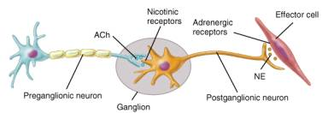
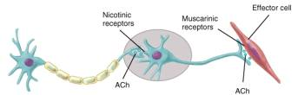
ANS Neurotransmitters: Classified as either cholinergic or adrenergic neurons based upon the neurotransmitter released
Adrenergic
Cholinergic
Notes:
‹#›

Slide 27
Chemical or neural transmitter
All preganglionic fibers release acetylcholin (Ach).
All parasympathetic postganglionic release Ach.
All sympathetic postganglionic release noradrenalin except sweat glands & bl vessels to skeletal muscles

Slide 28
Overview of actions
RECEPTORS
The parasympathetic nervous system uses only acetylcholine (ACh) as its neurotransmitter.
The ACh acts on two types of receptors, the muscarinic and nicotonic choloinergic receptors.
Most transmissions occur in two stages: When stimulated, the preganglionic nerve releases ACh at the ganglion, which acts on nicotinic receptors of the postganglionic nerve.
The postganglionic nerve then releases ACh to stimulate the muscarinic receptors of the target organ.
Notes:
‹#›

Slide 29
ANS Receptors : Classified as either parasympathetic or sympathetic
Adrenergic
Cholinergic
Notes:
‹#›

Slide 30
The Sympathetic NS Acts on two types of receptors : α and β.
What do the receptors do?
Activation of α receptors leads to smooth muscle contraction
Activation of β₂ receptors leads to smooth muscle relaxation
Activation of β₁ receptors leads to smooth muscle contraction (especially in heart)

Slide 31
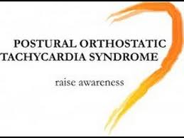
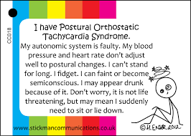

Slide 32
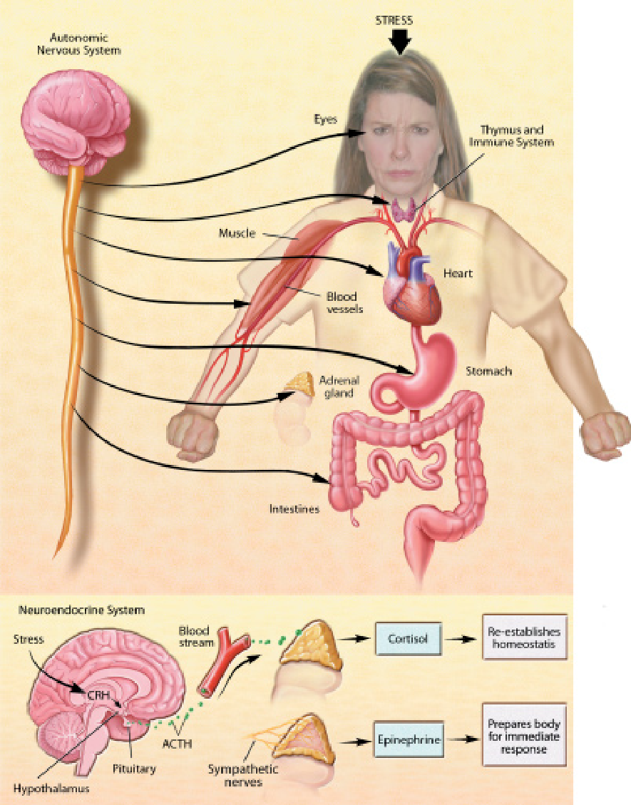
THE STRESS REACTION
When stress occurs, the sympathetic nervous system is triggered. Norepinephrine is released by nerves, and epinephrine is secreted by the adrenal glands. By activating receptors in blood vessels and other structures, these substances ready the heart and working muscles for action.
Acetylcholine is released in the parasympathetic nervous system, producing calming effects. The digestive tract is stimulated to digest a meal, the heart rate slows, and the pupils of the eyes become smaller. The neuroendocrine system also maintains the body’s normal internal functioning.

Slide 33
Chronic stress
When glucocorticoids or adrenaline are secreted in response to the prolonged psychological stress commonly encountered by humans, the results are not ideal. Normally, bodily systems gear up under stress and release hormones to improve memory, increase immune function, enhance muscular activity, and restore homeostasis. If you are not fighting or fleeing, but standing frustrated in a supermarket checkout line or sitting in a traffc jam, you are not engaging in muscular exercise.
Yet these systems continue to be stimulated, and when they are stimulated chronically, there are different consequences: Memory is impaired, immune function is suppressed, and energy is stored as fat.

Slide 34
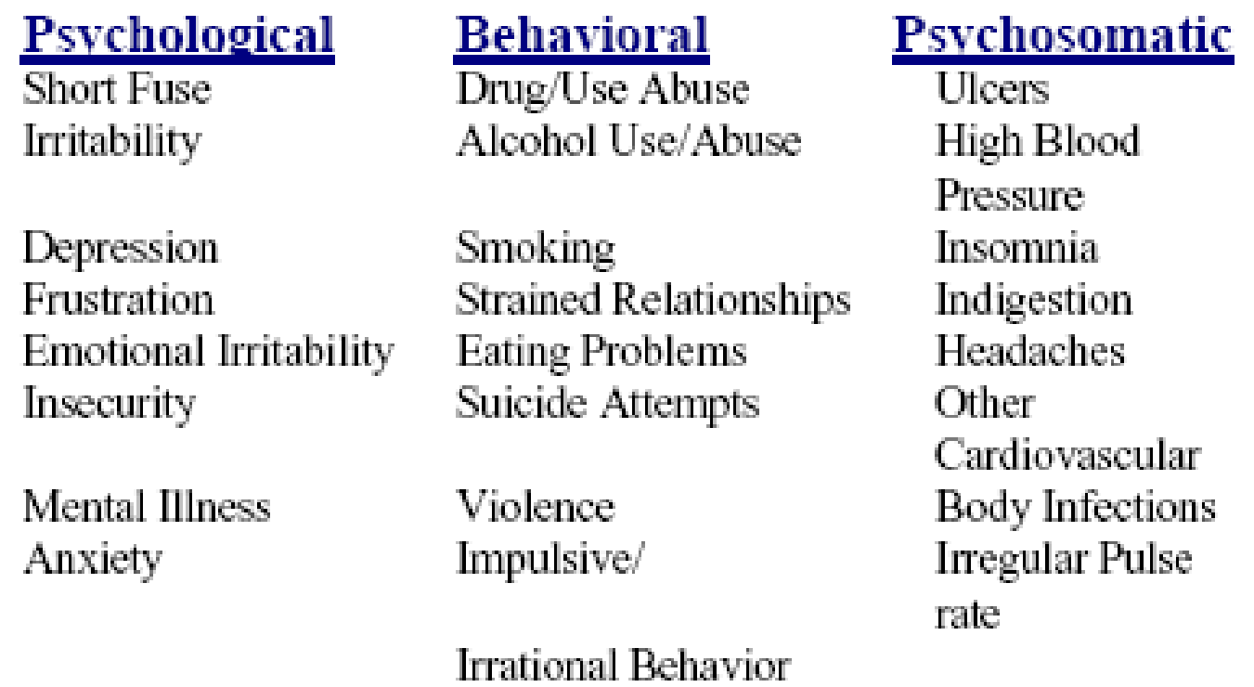
Response to stress

