Slide 1
Thyroid Disease

Slide 2
Objectives
To understand basic thyroid axis physiology
To know the common causes of hypo and hyperthyroidism
To recognise the signs and symptoms associated with hypo and hyperthyroidism
To understand TFT interpretation
To know the management for hypo and hyperthyroidism
Important complications associated with these
Thyroid cancers

Slide 3
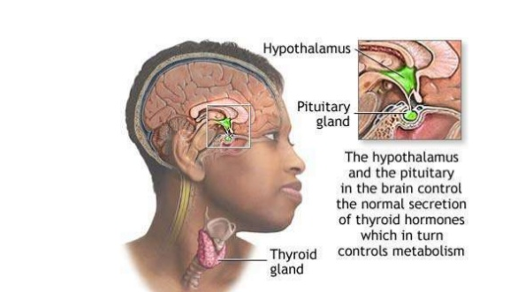
Thyroid Physiology
Notes:
Hypothalamus make TRH
Anterior pituitary makes TSH
Thyroid Gland makes T4 and T3

Slide 4
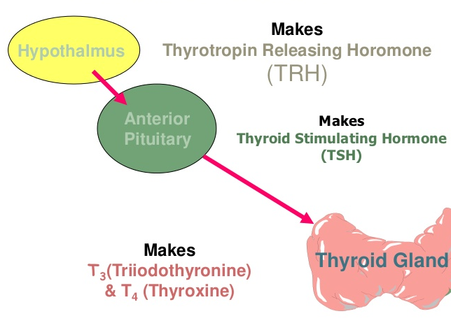
Hypothalamus-Pituitary-Thyroid Axis

Slide 5
Thyroid hormone synthesis, metabolism and action
Iodine enters thyroid gland and is used for T3 and T4 production
Hormones are released from the thyroid and vast majority are protein bound (TBG) and deposited in peripheral cells
T4 has 4 iodine atoms, removal of one produces T3
Total= Bound to TBG
Free= Unbound

Slide 6
T3 & T4
TSH
Facilitate normal growth and development
Increase metabolism
Increase catecholamine effects
Most useful marker of thyroid hormone function
Released in a pulsatile diurnal rhythm- highest at night

Slide 7
Hypothyroidism
Insufficient thyroid hormone
Primary: thyroid gland failure
Secondary: pituitary gland failure
Tertiary: hypothalamus failure

Slide 8
Hypothyroidism Causes
Primary hypothyroidism
  Iodine deficiency- most common cause worldwide
  Congenital
  Autoimmune mediated
    Hashimoto’s thyroiditis- B lymphocytes invade thyroid
  Iatrogenic- post-thyroidectomy or radio-iodine treatment
  Drug-induced – Anti-thyroid, lithium, amiodarone
  Severe infection
  Trauma to thyroid/pituitary/hypothalamus
  Pituitary tumour
Notes:
Hashimoto- anti thyroglobulin antibodies or anti- tpo antibodies

Slide 9
Hypothyroidism Symptoms

Slide 10
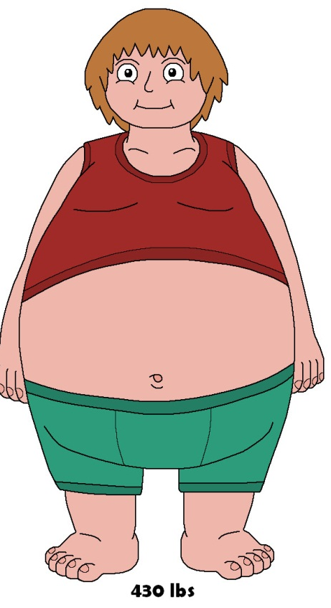

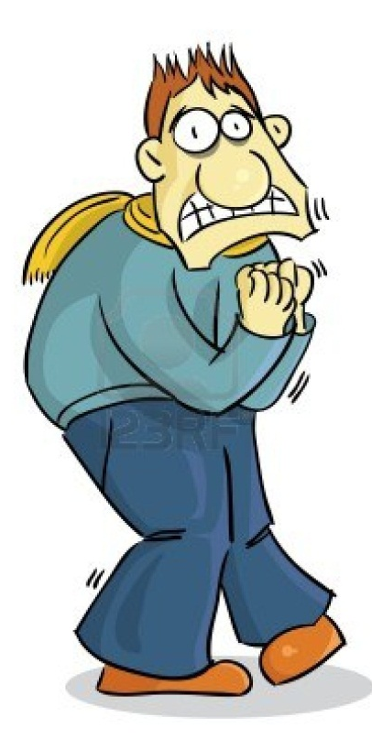
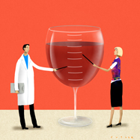
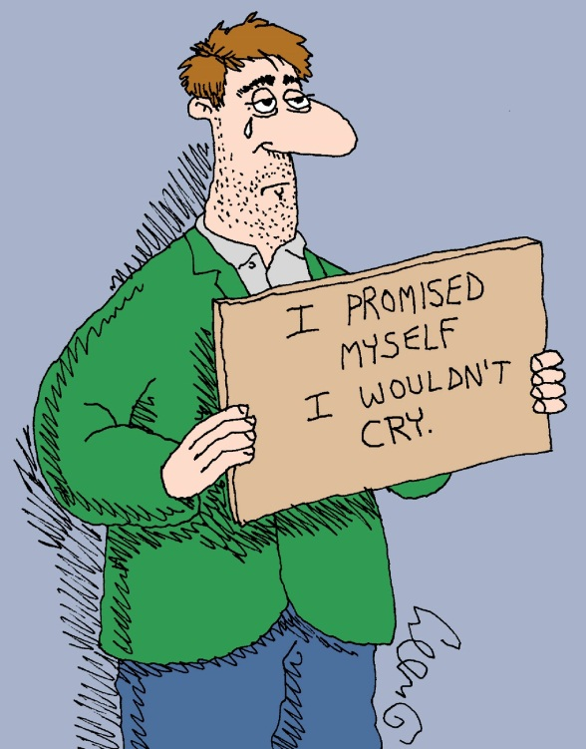
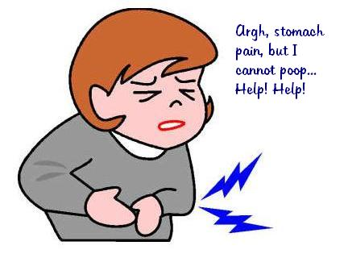
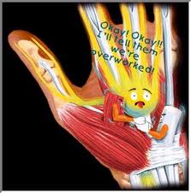

Slide 11
Hypothyroidism Signs

Slide 12
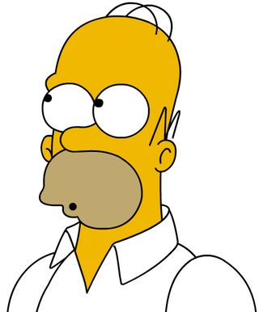
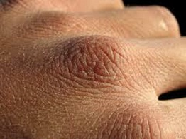
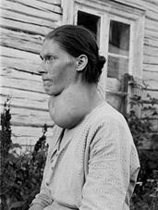
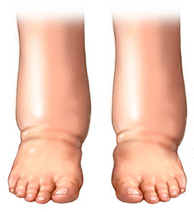
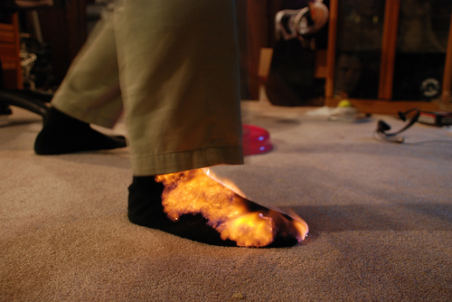
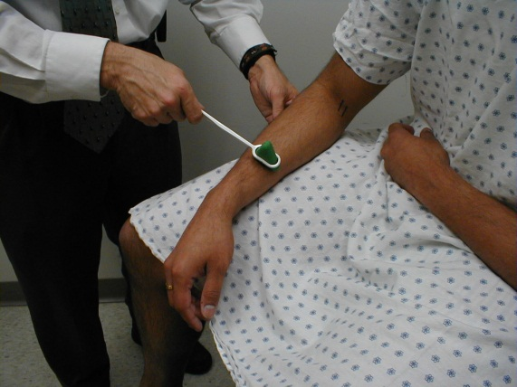
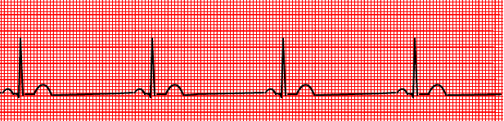
Notes:
underproduction of thyroid hormones slows metabolism, leading to fluid retention and swollen tissues that can exert pressure on peripheral nerves

Slide 13
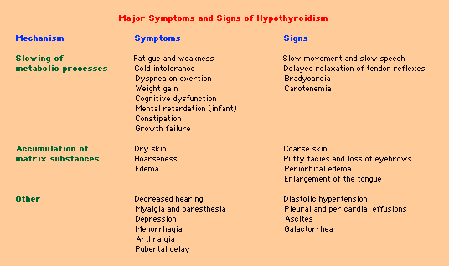

Slide 14
Hyperthyroidism Causes
Hyperthyroidism (thyrotoxicosis) is excess thyroid hormone
  Autoimmune
    Graves Disease (76%)
      F>M, age 20-40
      IgG auto antibodies bind TSH receptors T3 & T4
      Leads to gland hyper function
  Toxic adenoma and toxic multinodular goitre
  Viral Thyroiditis (de Quervain’s)
    Fever and ESR- self limiting
  Exogenous Iodine
  Neonatal thyrotoxicosis
  Drugs- Amiodarone
  TSH secreting pituitary adenoma (rare)
  HCG producing tumour

Slide 15
Hyperthyroid Symptoms

Slide 16
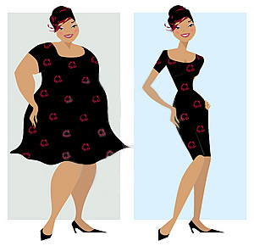
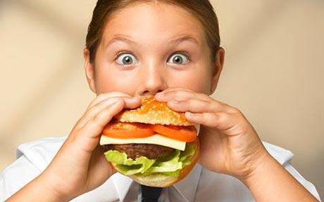
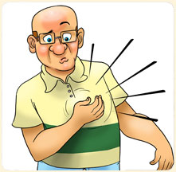
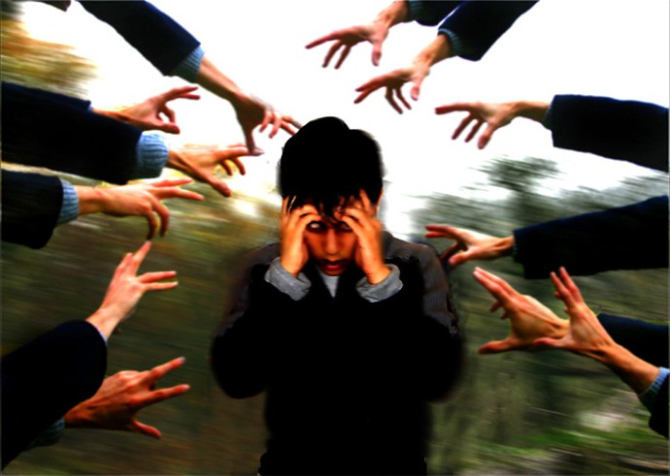
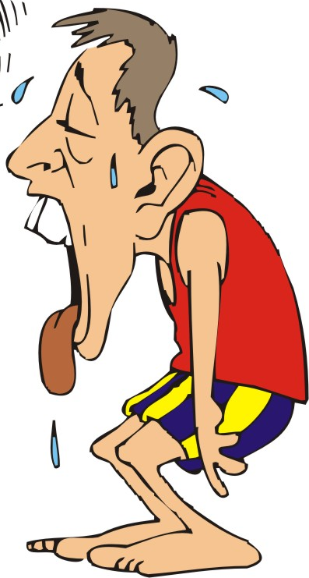
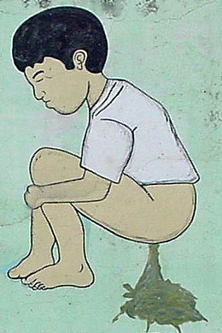
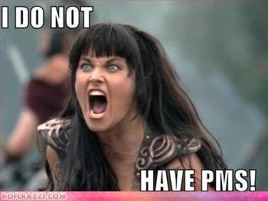

Slide 17
Hyperthyroid Signs

Slide 18
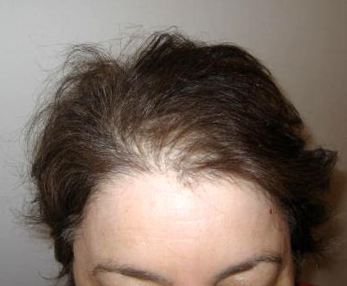
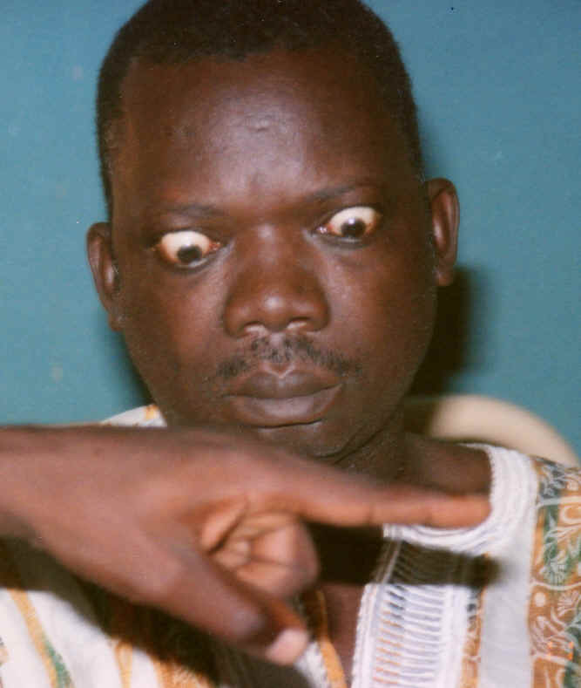
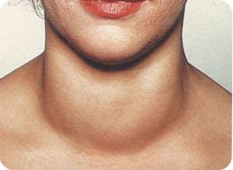
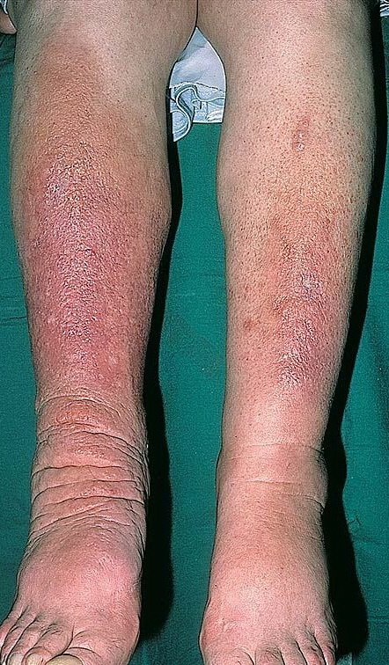
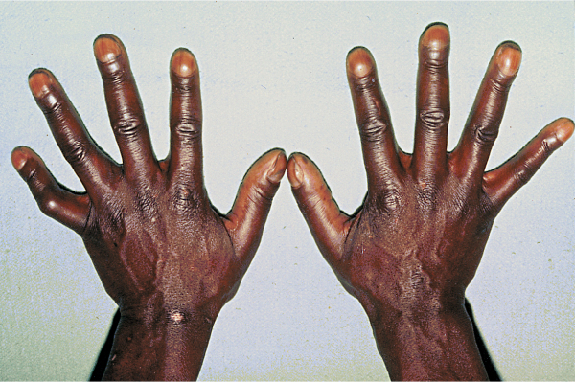
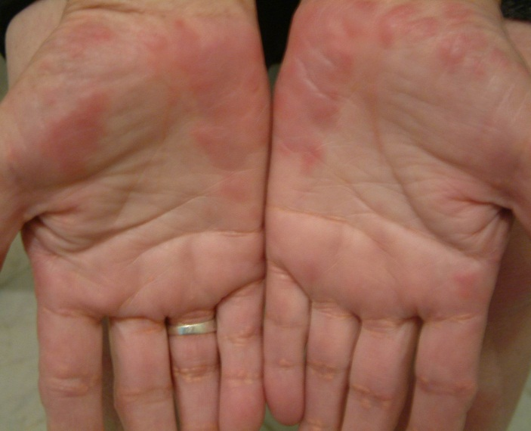
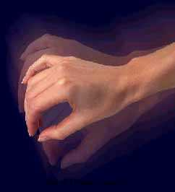
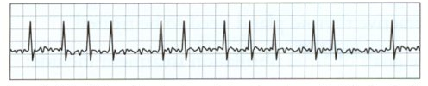
Notes:
Ptma- accumulation of hyaloronic acid in dermis- manifestation of graves

Slide 19
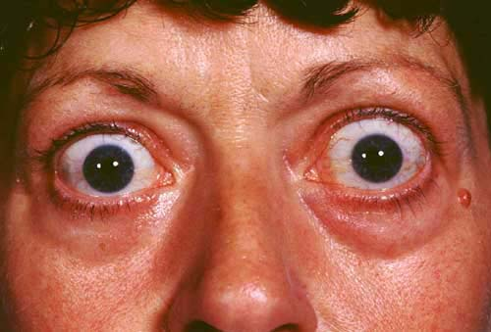
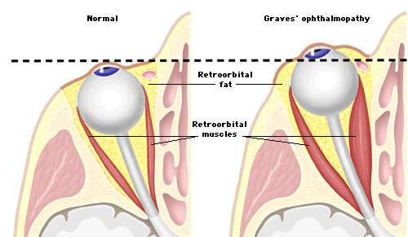
Hyperthyroidism – Eye Disease
Associated with Graves’ disease
  Inflammation of retro-orbital tissues
  Optic nerve compression→ atrophy
Symptoms
  Eye discomfort, grittiness
  Excess tear production
  Photophobia
  Diplopia
  Decreased acuity
Signs
  Exopthalmos- Graves
  Proptosis
  Opthalmoplegia
  Oedema

Slide 20
Investigating Thyroid Disease
TSH- first thing you assess
  Normal range 0.5-5 μU/ml
  Supressed= Hyperthyroid
  Elevated= Hypothyroid
  If TSH abnormal request Free T4
  Elevated= Hyperthyroid
  Suppressed= Hypothyroid

Slide 21
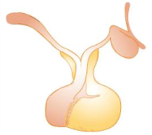
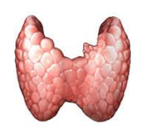
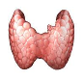
Investigations – TFTs
+
+
-
-
TSH
TSH
TSH
TSH
-
-
+
+
T3, T4
T3, T4
T3, T4
T3, T4
Hypothyroidism | Hyperthyroidism | Hypopituitarism | TSH secreting tumour
↑TSH; ↓T4,T3 | ↓TSH; ↑T4,T3 | ↓TSH; ↓T4,T3 | ↑TSH; ↑T4,T3

Slide 22
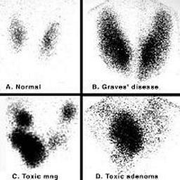
Investigations – Other tests
Bloods
  Thyroid auto-antibodies
  Anti thyroid peroxidase antibodies
  TSH receptor antibodies – Graves’ disease
USS Thyroid- can detect nodules >3mm
FNAC
Isotope scan
CXR- retrosternal expansion or tracheal compression

Slide 23
Hypothyroidism - Management
Conservative
  Lifestyle - smoking cessation, weight loss
Medical
  Levothyroxine (T4)
    Repeat TSH in 6/52
    Adjust dose according to clinical response and normalisation of TSH
    Caution in patients with IHD- risk of exacerbation of MI
    Clinical improvement may not begin for 2/52
    Symptom resolution 6/12→ if not consider +T3
Surgical
  Symptomatic – carpal tunnel decompression, thyroidectomy if compression of local structures

Slide 24
Hyperthyroidism - Management
Conservative
  Smoking cessation – especially with Graves’s ophthalmology, associated with worse prognosis
Medical
  Symptomatic – β-blockers
  Carbimazole, propylthiouracil (50% relapse)
    Risk of agranulocytosis
  Radio-iodine treatment –avoid contact with pregnant women and small children
    Long term likely to become hypothyroid

Slide 25
Hyperthyroidism - Management
Surgical
  Subtotal/total thyroidectomy
  Orbital decompression if thyroid eye disease causing compression of optic nerve
Complications of thyroid surgery
  Immediate
    Haemorrhage
  Short term
    Infection
  Long term
    Damage to laryngeal nerve
    Hypothyroidism
    Transient hypocalcaemia
    Hypoparathyroidism

Slide 26
Complications of Thyroid Disease

Slide 27
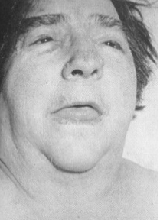
Myxoedema
Severe hypothyroidism (TSH T4 )
  Accumulation of mucopolysaccaride in subcutaneous tissues
  Presents with
    Hyponatraemia
    Hypoglycaemia
    Hypotension
    Hypothermia
    Coma
    Confusion
    HF
    Anaemia
    HIGH MORTALITY

Slide 28
Thyroid Storm
Life threatening emergency (rare) – 30% mortality even with early recognition and management
Exacerbation of thyrotoxicosis precipitated by stress i.e.
  Surgery
  Infection
  Trauma
Signs
  Fever
  Agitation and confusion
  Tachycardia +/- AF
Notes:
Management
IV fluids
Broad spectrum antibiotics
Propanolol, digoxin
Antithyroid drugs – sodium ipodate, Lugol’s solution, carbimozole

