Slide 1
Odessa National Medical University
Department of Surgery
Chest trauma
Odesa 2023

Slide 2
Objectives
Review annual injury and death rates for chest trauma victims.
Understand pathophysiologic changes that occur with chest trauma.
Discuss common signs and symptoms.
Identify current treatment modalities for the patient with chest trauma.
Notes:
Discuss the objectives.

Slide 3
Introduction
Chest injuries can be obvious and dramatic, or small and easy to miss.
Likewise, they may be critical injuries threatening life, or minor injuries of relative unimportance.
To identify the difference, the Advanced EMT must understand the physiology of the chest wall and its response to trauma.
Notes:
Discuss that most every major body system is represented in the thorax.
Injuries to this location can cause mild or significant injury, including death.

Slide 4
Epidemiology
20% to 25% of trauma deaths each year are due to thoracic trauma.
The most common mechanism is MVC.
Immediate deaths are due to myocardial or aorta rupture.
Early deaths are due to tension and open pneumothorax, tamponade, flail segments, and hemothorax.
Notes:
Relate epidemiology to the frequency with which the Advanced EMT will have patients with chest trauma.

Slide 5
Pathophysiology
Chest trauma distorts the normal thoracic anatomy.
Distortion injures body system and causes a change in physiology.
V/Q ratio disturbances, hypoxemia, hypercapnea ensue.
Ultimately, cellular death occurs.
Notes:
With chest trauma, the change in physiology is due to a structural change in the thoracic cavity.
Discuss how these changes ultimately produce changes in cellular integrity.

Slide 6
Pathophysiology (cont’d)
Tension pneumothorax
  Disruption of visceral pleura
  Accumulation of intrathoracic air
  Collapse of lung tissue
  Shifting of mediastinum
  Changes in hemodynamics
  Assessment
    Early findings
    Late findings
Notes:
Discuss the etiology, pathophysiology, and basic assessment findings for a tension pneumothorax.

Slide 7
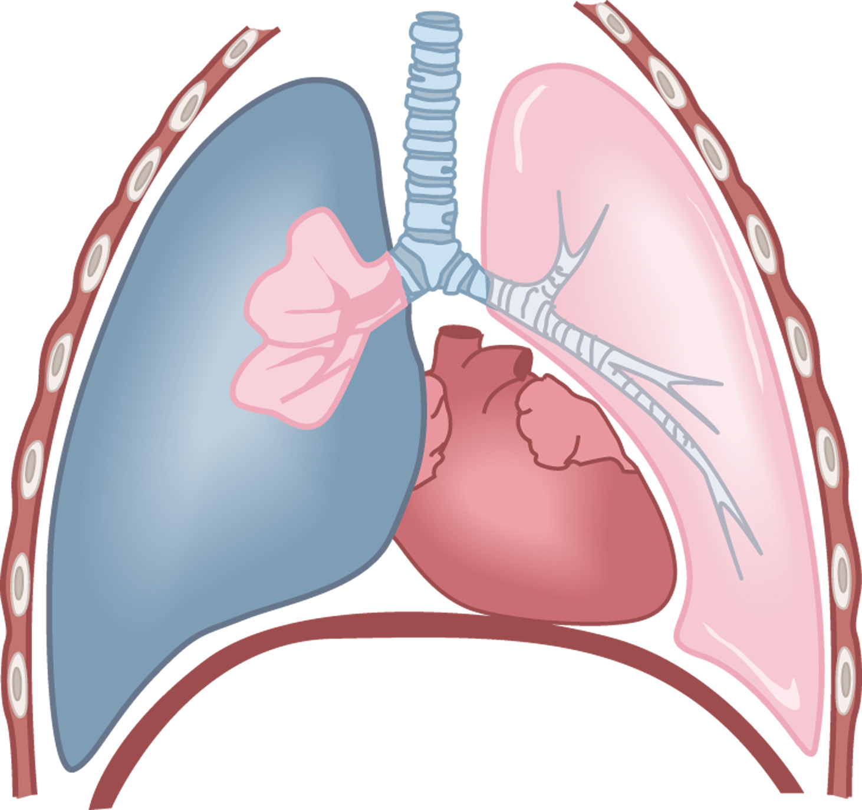
In a tension pneumothorax, air continuously fills the pleural space, the lung collapses, pressure rises, and the trapped air compresses the heart and the other lung.

Slide 8
Pathophysiology (cont’d)
Open pneumothorax
  Disruption of parietal pleura from hole in chest
  Accumulation of intrathoracic air
  Collapse of lung tissue
  Injury may turn into tension pneumothorax
  Assessment findings
Notes:
Discuss the etiology, pathophysiology, and basic assessment findings for an open pneumothorax.

Slide 9
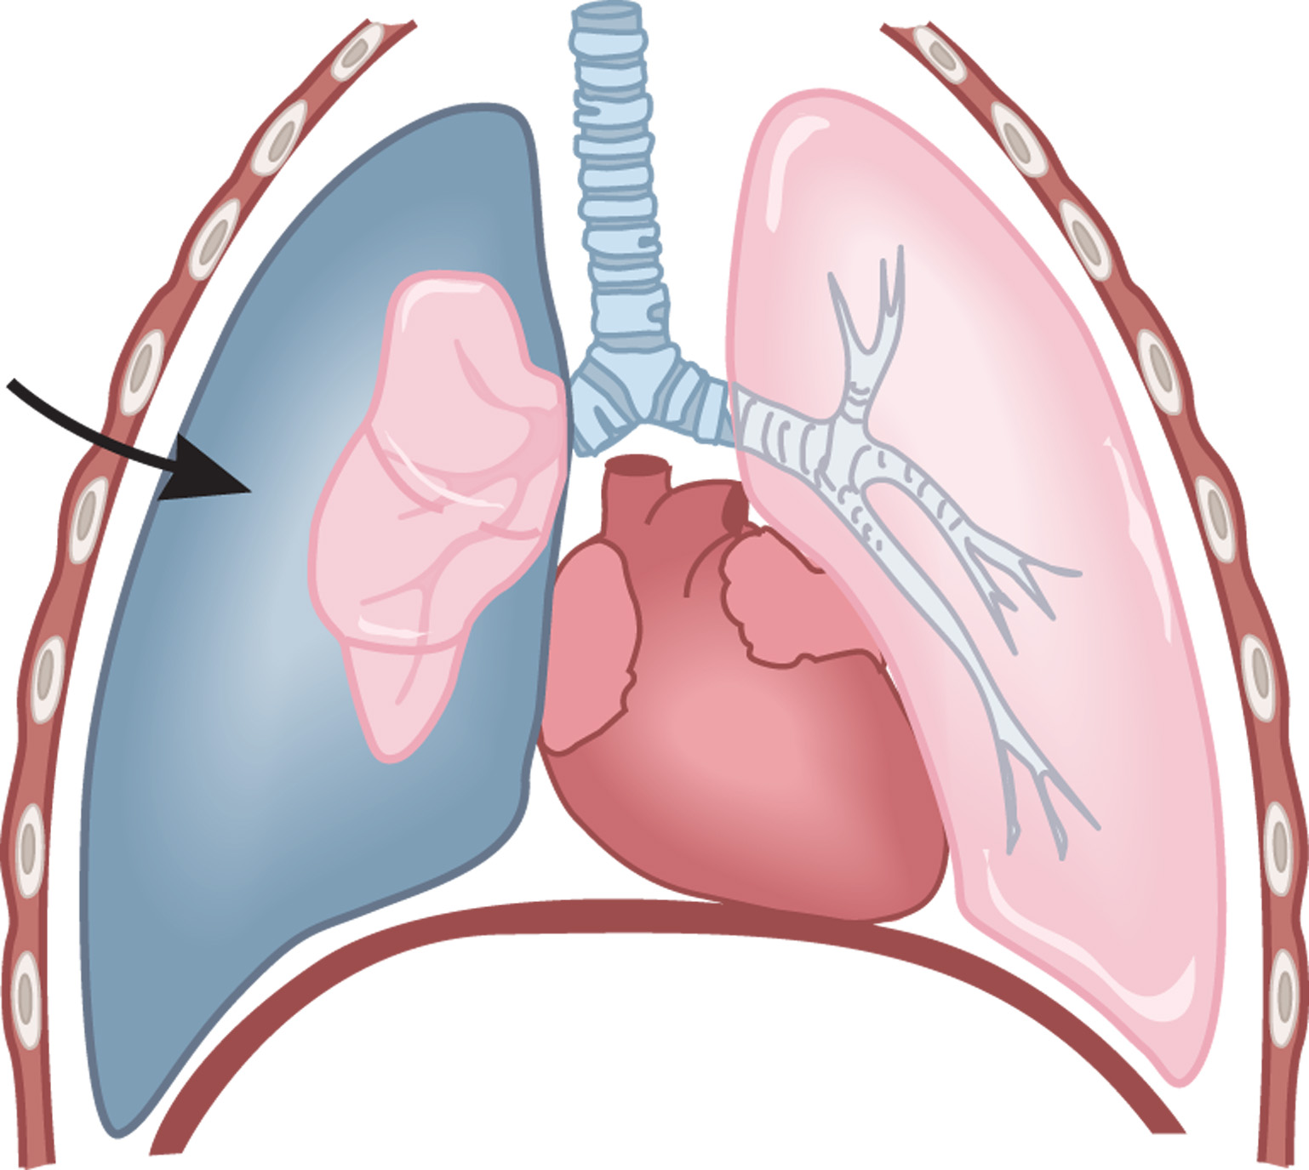
In an open pneumothorax, air enters the chest cavity through an open chest wound or leaks from a lacerated lung. The lung then cannot expand.

Slide 10
Pathophysiology (cont’d)
Flail chest
  Fractured ribs (2 or more in 2 places)
  Creates “free floating” segment of chest
  Paradoxical motion inhibits adequate ventilation
  Resulting pulmonary contusion
  Assessment findings
Notes:
Discuss the etiology, pathophysiology, and basic assessment findings for a flail chest.

Slide 11
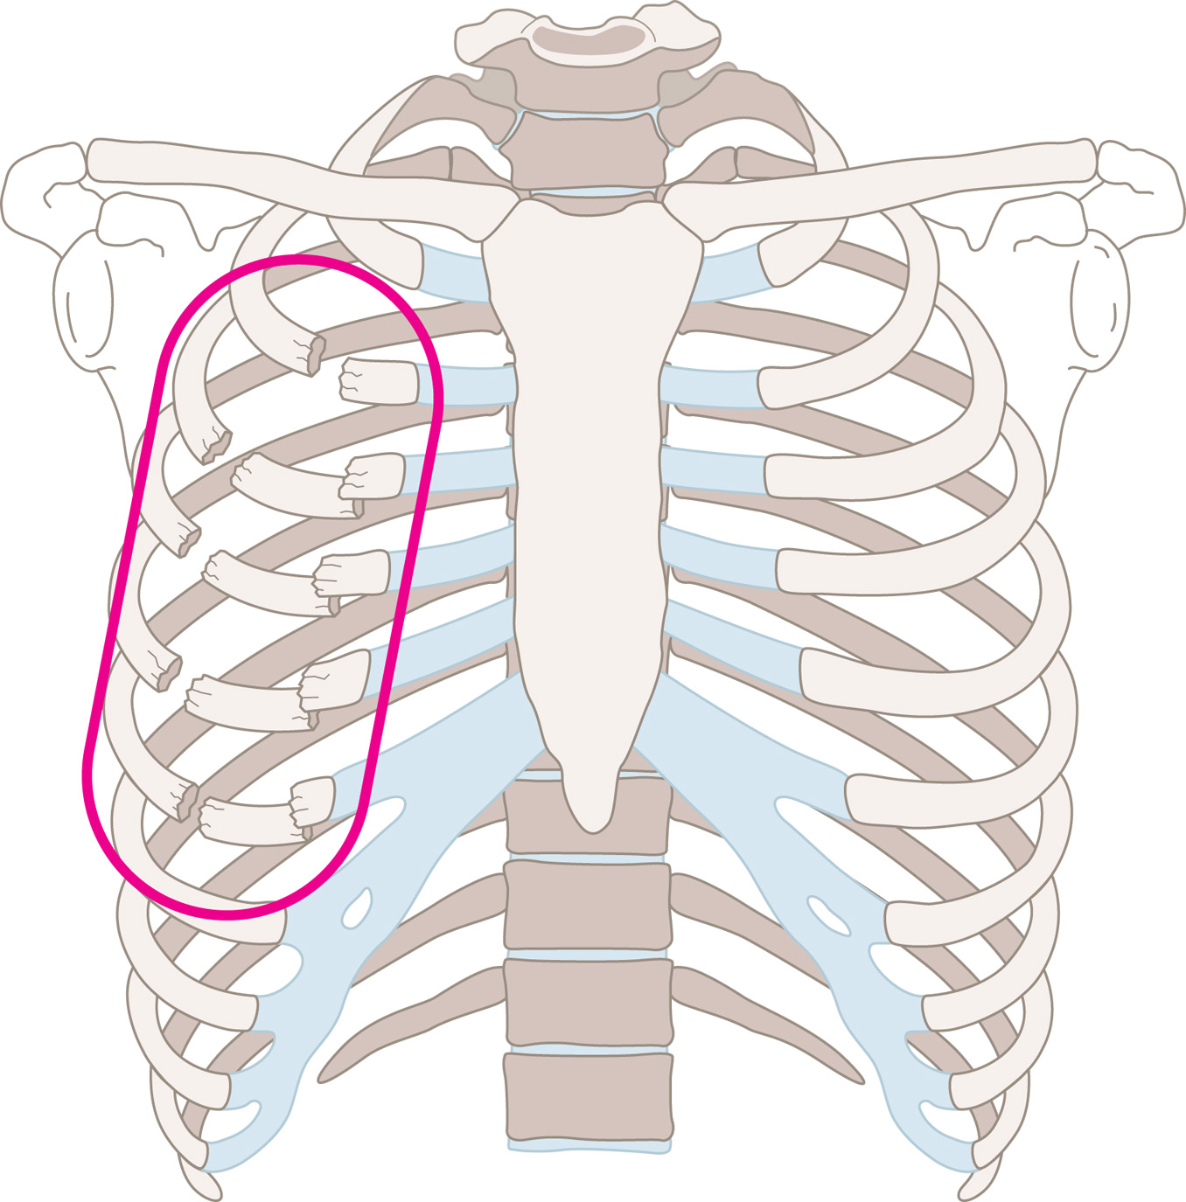
Flail chest occurs when blunt trauma causes the fracture of two or more ribs, each in two or more places.

Slide 12
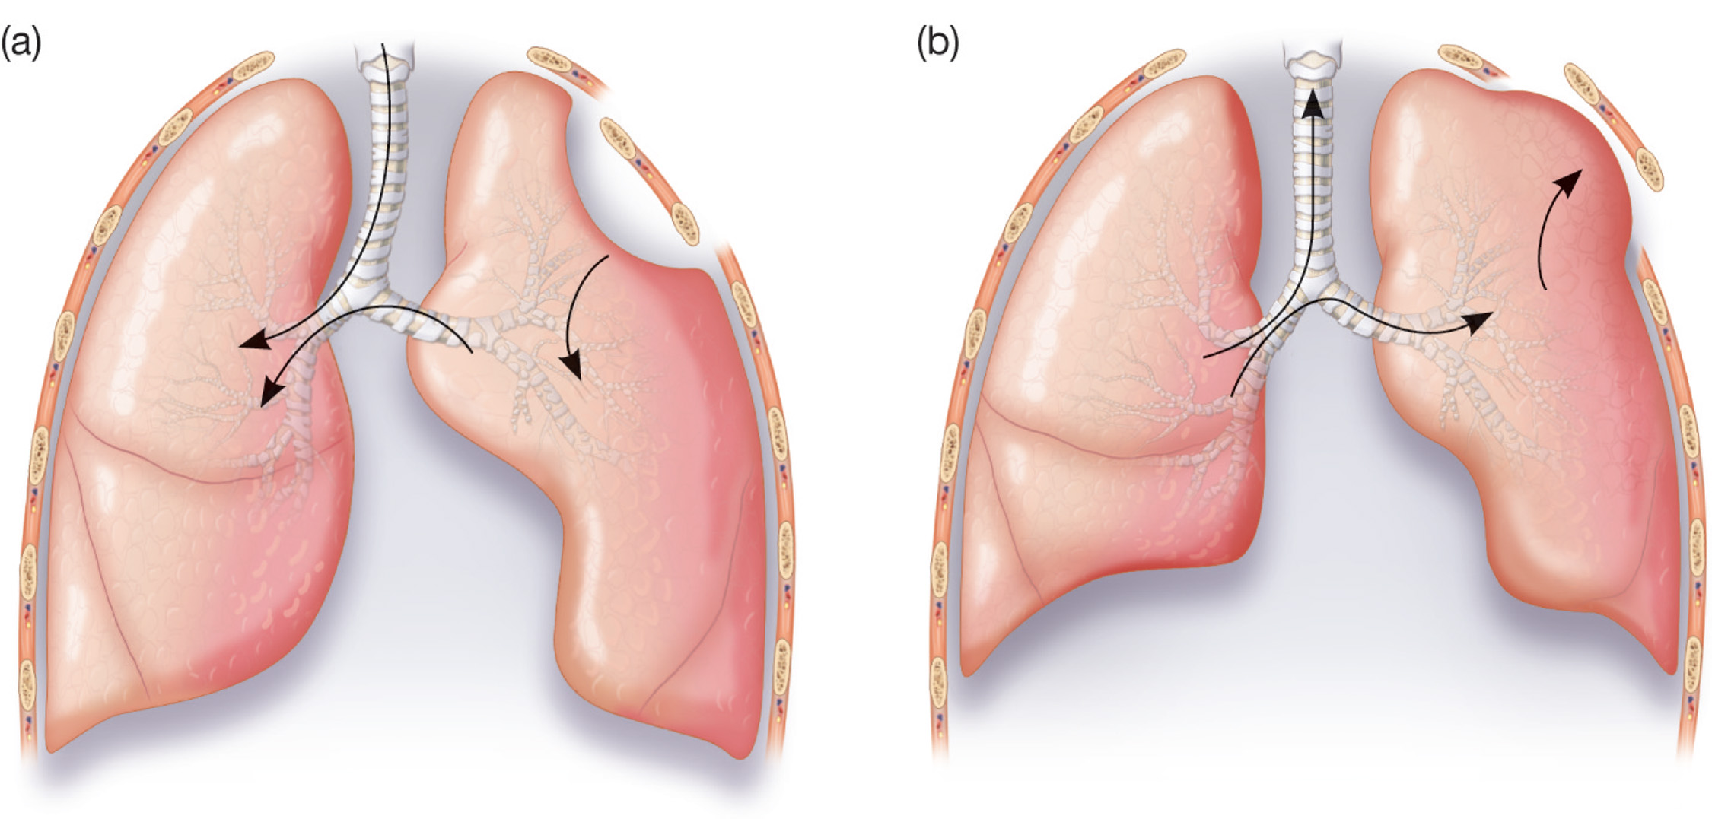
With a flail chest, (a) the flail segment is drawn inward as the rest of the lung expands with inhalation; (b) the flail segment is pushed outward as the rest of the lung contracts with exhalation.

Slide 13
Pathophysiology (cont’d)
Hemothorax
  Similar to pneumothorax
  Pleural cavity fills with blood (chest trauma)
  Collapse of lung tissue creates hypoventilation
  May also cause hypovolemia
  Assessment findings
Notes:
Discuss the etiology, pathophysiology, and basic assessment findings for a hemothorax.

Slide 14
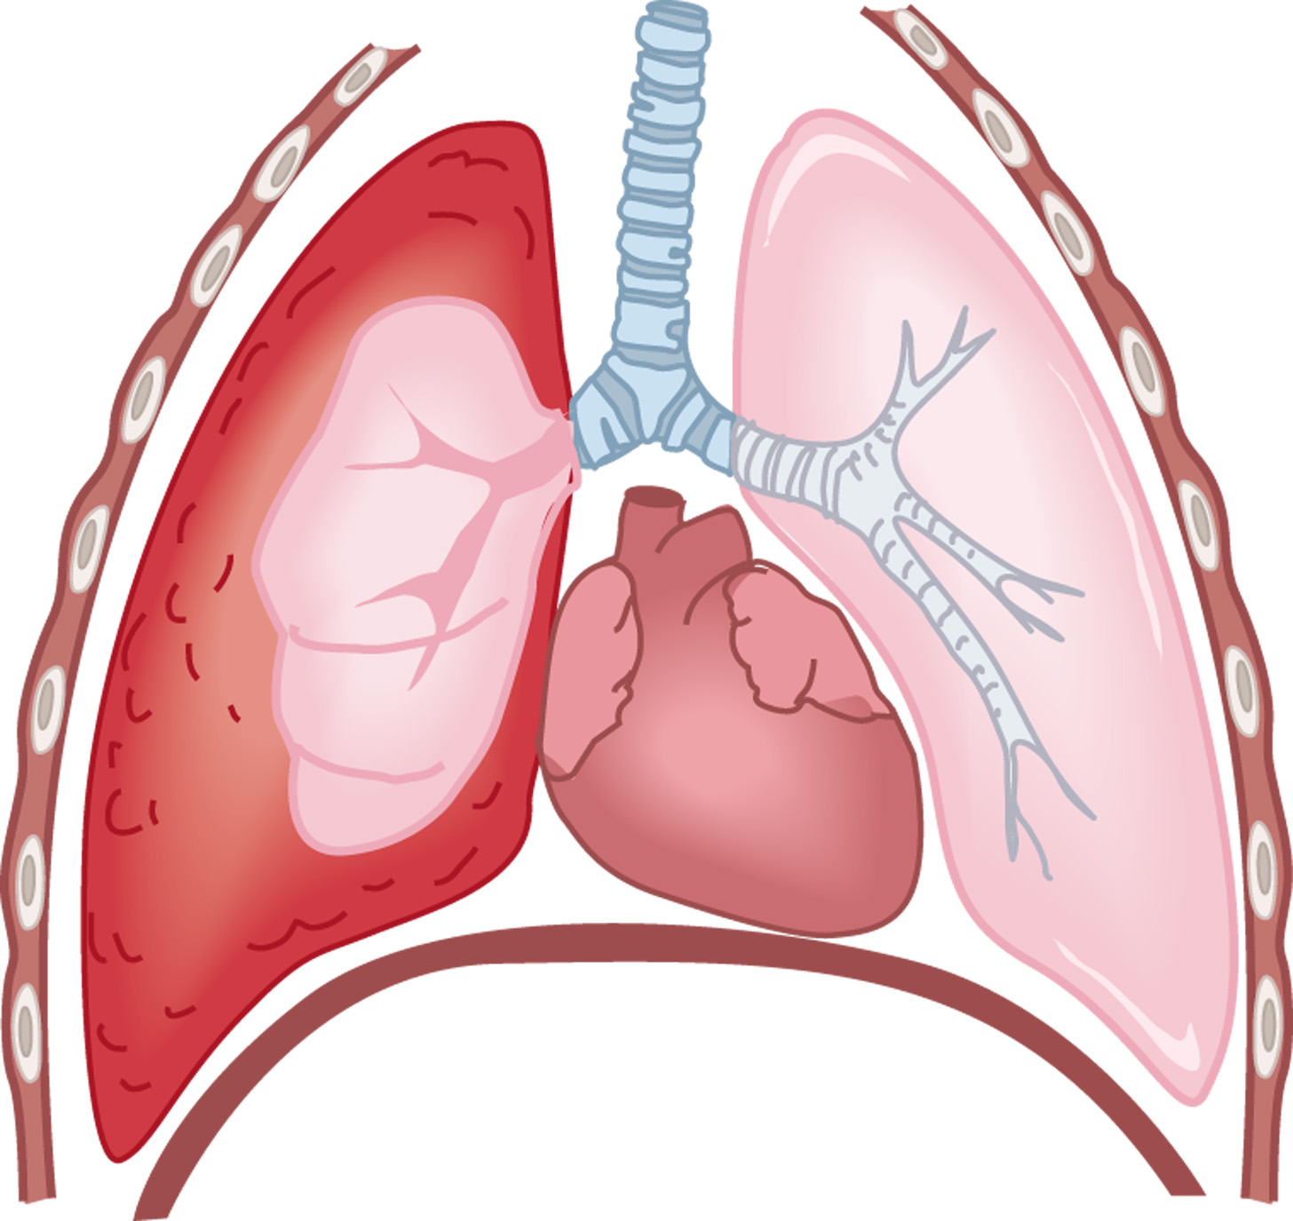
In a hemothorax, blood leaks into the chest cavity from lacerated vessels or the lung itself, and the lung compresses.

Slide 15
Pathophysiology (cont’d)
Acute pericardial tamponade
  Injury to heart causes blood to collect in pericardial sac
  Pericardial sac nondistendable
  Collapsed ventricles, poor stroke volume
  Assessment findings
Notes:
Discuss the etiology, pathophysiology, and basic assessment findings for an acute pericardial tamponade.

Slide 16
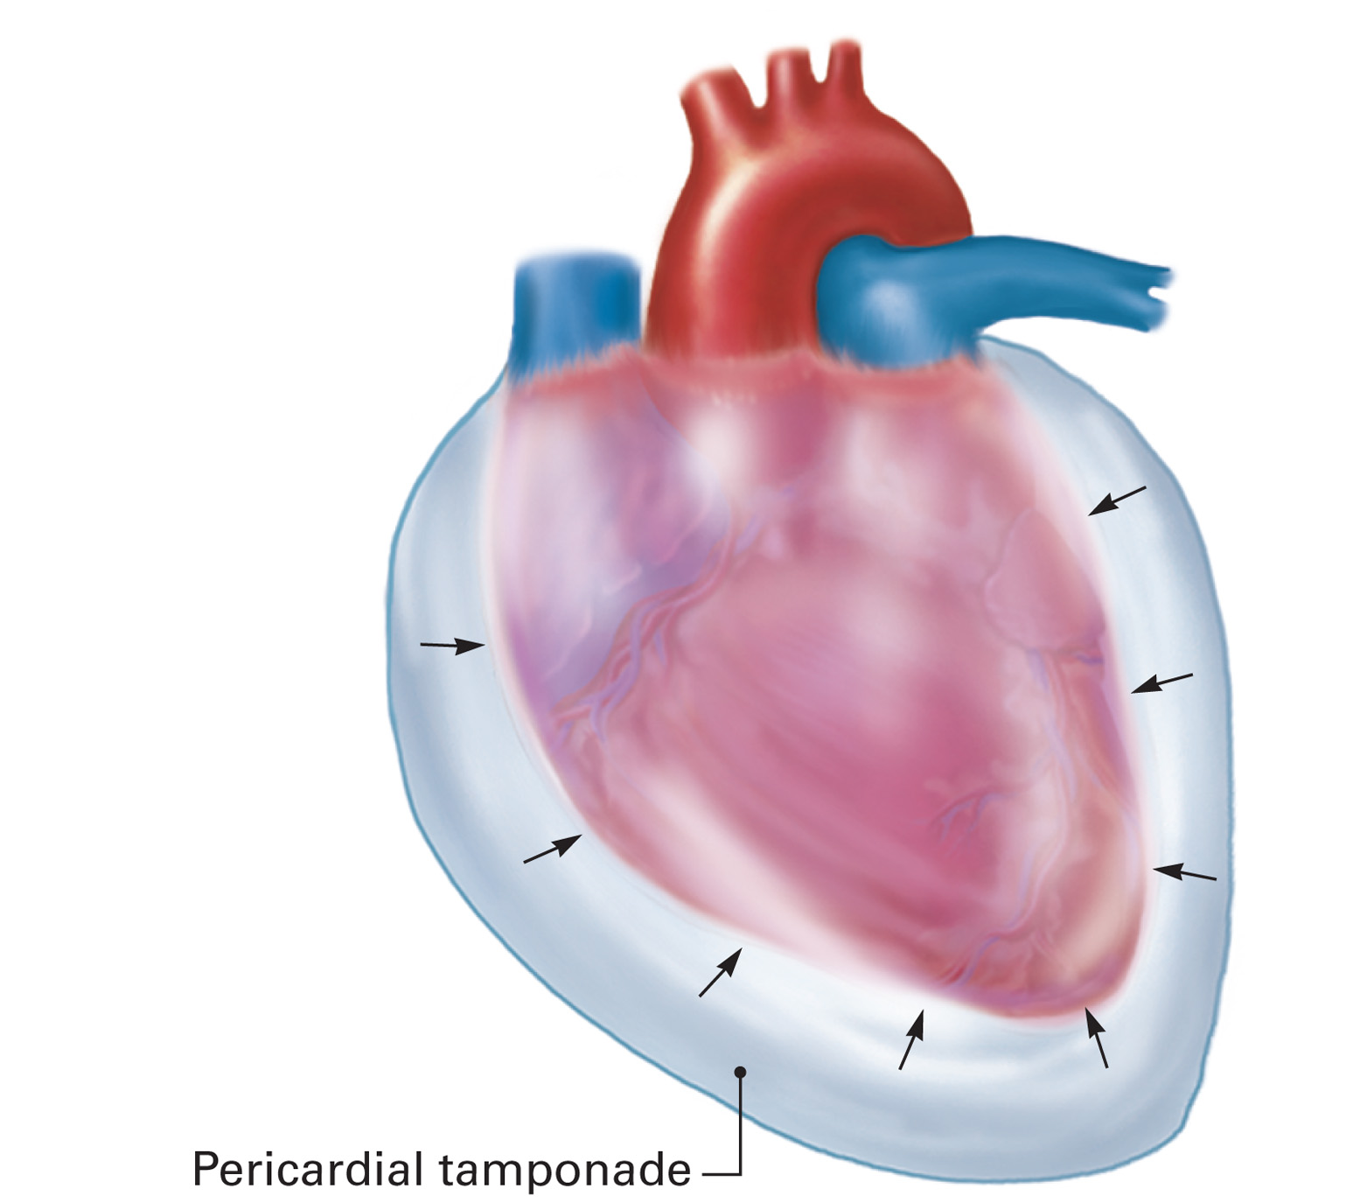
In pericardial tamponade, accumulating blood compresses the heart inward.

Slide 17
Assessment Findings
Inspection
  Any open chest injuries
  Any structural abnormalities
Auscultation
  Type, quality, location of breath sounds
Palpation
  Structural abnormalities
  Subcutaneous emphysema
Notes:
With chest trauma, there is not a specific sign or symptom that identifies one clinical syndrome from another, rather, it is a collection of symptoms coupled with the mechanism of injury that will identify the underlying pathology.

Slide 18
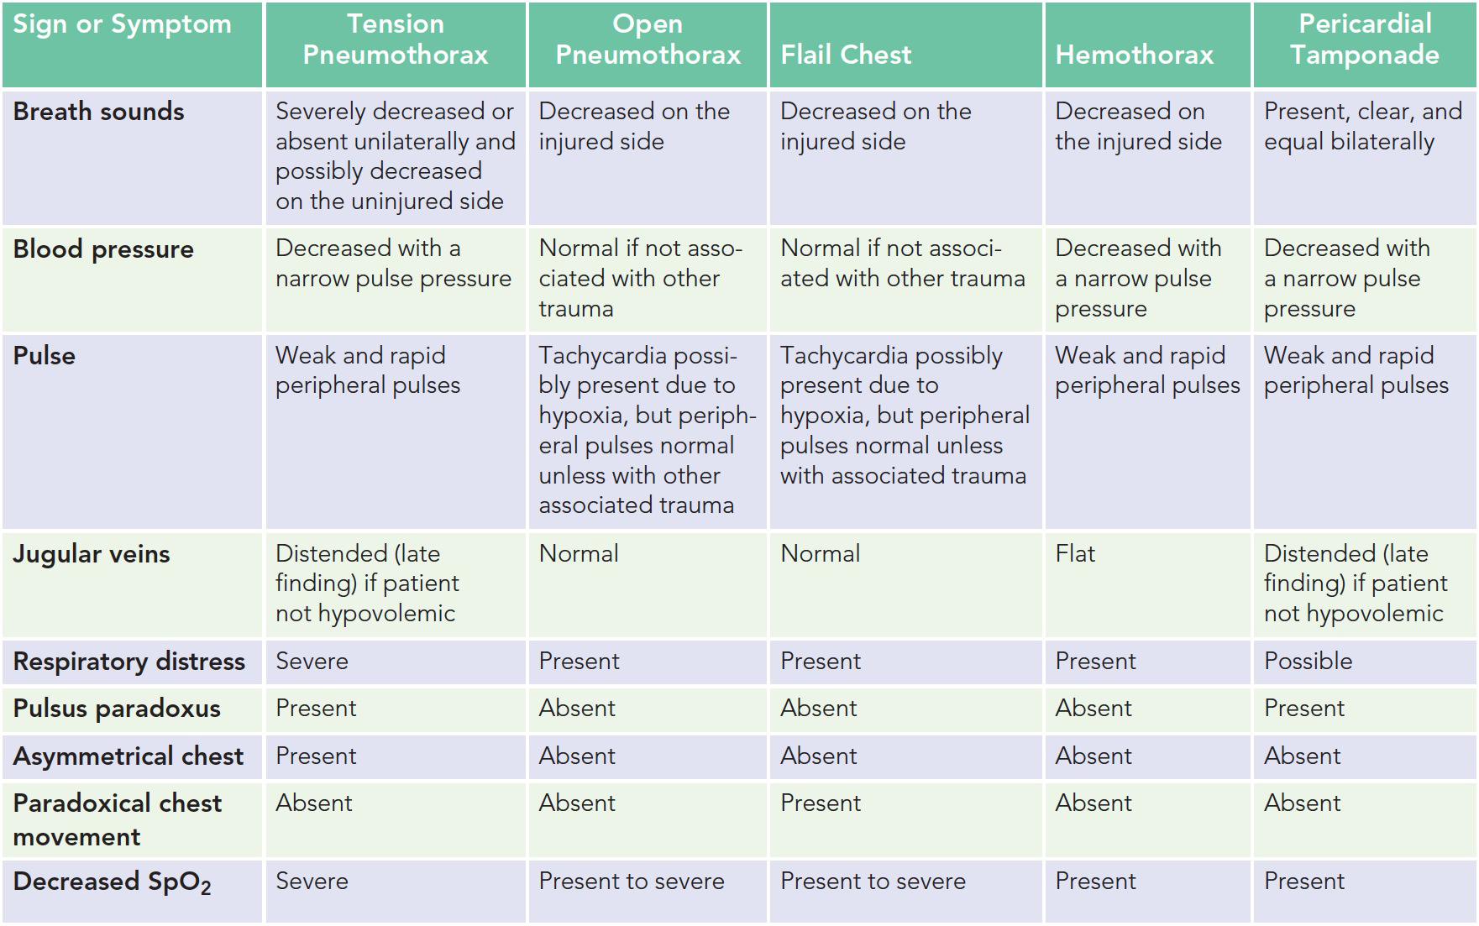
Differential Field Diagnosis of Chest Injury

Slide 19
Emergency Medical Care
Spinal immobilization considerations
Assess and maintain the airway.
Determine breathing adequacy.
  High-flow via NRB with adequate breathing.
  High-flow via PPV @ 10-12/min if inadequate.
  Occlude any punctures to chest wall.
Notes:
Review and discuss the slide. Stress the need to ensure life threats are properly managed.

Slide 20
Emergency Medical Care (cont’d)
Assess circulatory components
  Check pulse, skin characteristics
  Control major bleeds
Provide full immobilization
Initiate safe and expeditious transport
Notes:
The most immediately life-threatening thoracic injuries that require rapid recognition and intervention and expeditious transport are:
Tension pneumothorax
Open pneumothorax
Flail chest
Massive hemothorax
Acute pericardial tamponade

Slide 21
Emergency Medical Care (cont’d)
Do not delay transport to start an IV line.
Use a large-bore catheter (14 or 16 gauge).
Run the fluids to maintain a systolic blood pressure of 80 to 90 mmHg or until radial pulses are regained.
Notes:
Some protocols require that the systolic blood pressure be maintained at 70 mmHg to reduce the incidence of hemodilution and increased bleeding associated with aggressive fluid administration in the trauma patient with uncontrolled bleeding. Follow your local protocol.

Slide 22
Emergency Medical Care (cont’d)
Once this is achieved, reduce the fluid infusion and titrate to maintain the systolic blood pressure at 80 to 90 mmHg or to maintain radial pulses.
Notes:
Some protocols require that the systolic blood pressure be maintained at 70 mmHg to reduce the incidence of hemodilution and increased bleeding associated with aggressive fluid administration in the trauma patient with uncontrolled bleeding. Follow your local protocol.

Slide 23
Case Study
Your EMS unit is summoned for a patient who was injured while hunting. Upon your arrival, you find a male patient holding his hand over his right thorax. Some blood is seeping past his fingers, and the breathing looks labored. Friends report he was accidently shot with an arrow.
Notes:
Discuss the case study.

Slide 24
Case Study (cont’d)
Scene Size-Up
  Standard precautions taken.
  Scene is safe, no sign of struggle.
  Young male, 18 years old.
  Patient found sitting along edge of road.
  No patient entry nor egress problems.
  No additional resources needed presently.
Notes:
Discuss the case study.

Slide 25
Case Study (cont’d)
Primary Assessment Findings
  Patient responsive.
  Airway open and maintained by self.
  Breathing is rapid, patient is dyspneic.
  Carotid and radial pulses present but radial gets weaker with inhalation.
  Peripheral skin cool, pale, sweaty.
  No other major bleeds or concerns.
Notes:
Discuss the case study.

Slide 26
Case Study (cont’d)
Is this patient a high or low priority? Why?
What interventions should be provided at this time?
Notes:
This is a potentially unstable patient for two reasons.
First, the soft-tissue injury the patient is applying pressure to may be deep enough to pierce into the pleural cavity of the thorax. Or, it may be a significant bleed, or it may be neither and it's just a soft-tissue wound.
Treatment at this time would be high-flow oxygen, and the application of an occlusive dressing over the chest wall injury and then reapplication of direct pressure to help minimize the bleeding.

Slide 27
Case Study (cont’d)
What are your differentials thus far that the patient could be suffering from?
Do you think that this patient will have a problem with the ventilation or perfusion side of the V/Q ratio?
Notes:
At this time, the differentials include:
An open pneumothorax
Major bleed
Tension pneumothorax
Flailed chest wall
If the underlying injury is an open pneumothorax, then there is a disturbance on the
ventilation side of the equation.
If the patient has a hemothorax, the patient will have perfusion disturbances as well.

Slide 28
Case Study (cont’d)
Medical History
  Patient denies any
Medications
  Patient denies any
Allergies
  Patient denies any
Notes:
Discuss the case progression.

Slide 29
Case Study (cont’d)
Pertinent Secondary Assessment Findings
  Pupils dilated but reactive, membranes pale.
  Airway patent, breathing tachypneic.
  Peripheral perfusion diminishing.
  Absent breath sounds to right thorax.
  Patient's mental status still continuing to deteriorate.
Notes:
Discuss the case progression.

Slide 30
Case Study (cont’d)
Pertinent Secondary Assessment Findings (continued)
  Penetration injury 4th ICS, right anterior chest.
  Occlusive dressing “burped.”
  Pulse oximeter reading 98%.
  B/P 102/palp, heart rate 114, respirations 20.
Notes:
Discuss the case progression.

Slide 31
Case Study (cont’d)
What would be key clinical indications the patient is deteriorating despite treatment?
What advantage does “burping” the occlusive dressing have?
Why would PPV possibly be detrimental to the patient?
Notes:
Changes to the mental status, drop in pulse oximeter, declining breath sounds, increased agitation, worsening lung compliance.
Burping the dressing during exhalation would allow the expulsion of any accumulating air in the chest, which should allow the subsequent breaths to start inflating the lung.
In a patient with a penetrating chest wall injury, the provision of PPV could allow air to escape the lung tissue (if the visceral pleura is also damaged), and accumulate in the pleural cavity. This then will collapse the lung and interfere with normal ventilation.

Slide 32
Case Study (cont’d)
Care provided:
  Patient immobilized.
  High-flow oxygen via NRB mask, switched to PPV due to failing ventilations.
  Occlusive dressing to chest injury.
  Rapid transport to hospital initiated.
  Minimize Scene Time
  Established intravenous access (en-route) to ED
Notes:
Discuss the care provided.

Slide 33
Summary
Chest wall injuries can result in significant disturbances to the V/Q ratio.
Although the injury typically can't be “fixed” in the prehospital setting, the patient can have supportive treatment provided that will support lost function.
With any severe trauma patient, minimize scene time and perform interventions en-route to ED.
Notes:
Review as appropriate.

