Slide 1
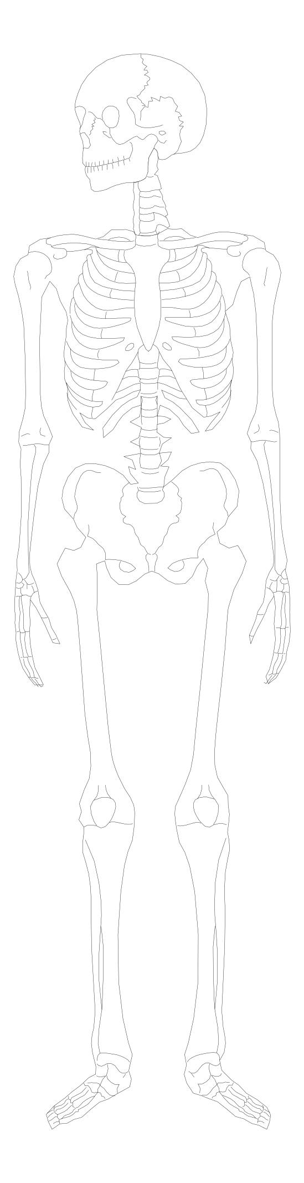
POLYTRAUMA MANAGEMENT
Odesa National Medical University
Department of surgery
Prof. Grubnik V.
Odesa 2023

Slide 2
POLYTRAUMA
World wide No.1 killer amongst the younger age group (18-44 yrs).
Third most common cause of death in all age group.
Great economic & social loss to country.
Less than 2% of budgets for health services spend on trauma patients.
TRAUMA- Neglected Disease of Modern Society

Slide 3
POLYTRAUMA
Defined as “a clinical state following injury to the body leading to profound physiometabolic changes involving multisystem’’.
OR
Patient with anyone of the following combination of injuries
TWO MAJOR SYSTEM INJURY + ONE MAJOR LIMB INJURY.
ONE MAJOR SYSTEM INJURY + TWO MAJOR LIMB INJURY.
ONE MAJOR SYSTEM INJURY + ONE OPEN GRADE III SKELETAL INJURY.
UNSTABLE PELVIS FRACTURE WITH ASSOCIATED VISCERAL INJURY.

Slide 4
POLYTRAUMA / MULTIPLE FRACTURES
Polytrauma is not synonym of multiple fractures.
Multiple fractures are purely orthopaedic problem as there is involvement of skeletal system alone.
While in Polytrauma there is involvement of more than one system,Like associated head/spinal injury, chest injury, abdominal or pelvic injury.
Polytrauma is a multi-system injury and needs management by a team of surgeons and physicians. Orthopaedic surgeon is one of the team member of trauma unit.

Slide 5
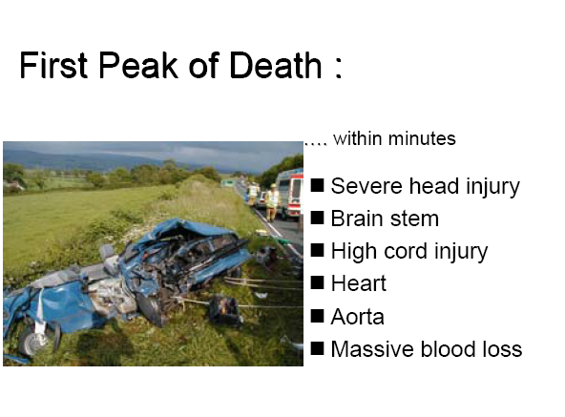

Slide 6
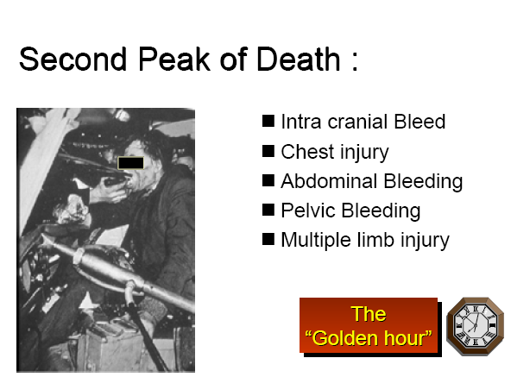

Slide 7
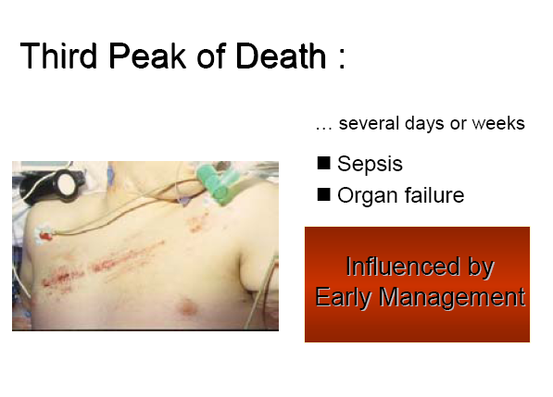

Slide 8
LIFE SALAVAGE
50% deaths due to trauma occur before the patient reaches hospital.
30% occur within 4 hrs of reaching the hospital.
20% occur within next 3 weeks in the hospital.
If preventive measures are taken 70% deaths can be prevented meaning 30% deaths are nonsalvagable deaths.

Slide 9
AIMS IN MANAGEMENT
“TO RESTORE THE PATIENT BACK TO HIS
PREINJURY STATUS”
HAVING FOLLOWING PRIORTIES:
LIFE SALVAGE
LIMB SALVAGE
SALVAGE OF TOTAL FUNCTION IF POSSIBLE

Slide 10
PHILOSOPHY FOR MANAGEMENT
ADVANCED TRAUMA LIFE SUPPORT -- based on
‘TREAT LETHAL INJURY FIRST, THEN REASSESS AND TREAT AGAIN’
The steps in management are:
Primary survey
Resuscitation
Secondary survey
Definitive care

Slide 11
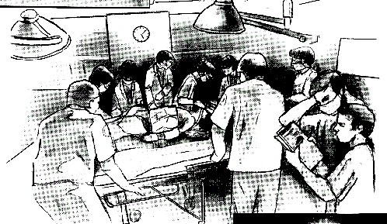
TEAM APPROACH
A TEAM consists of:
Anesthetist.
General surgeon
NeuroSurgeon
Orthopedic surgeon
Every team must have a final decision maker,the captain.The team must be:
a) able to evaluate the patient swiftly.
b) Willing to discuss the effect of the management
of one problem on other.
c) Able to arrive at decisions quickly.
d) Efficient in regard to performing lifesaving procedures .

Slide 12
PREHOSPITAL PHASE
Basic Emergency Medical Technician Skills
1. Maintenance of airway (endotracheal intubation?).
2. Cardiopulmonary resuscitation.
3. Intravenous access and Ringer’s lactate therapy.
4. Reduction and splintage of fractures.
5. Perform primary survey of patient and report findings to destination center.

Slide 13
TRIAGE
Triage is the sorting of patients based on the need for treatment and the available resources to provide that treatment
Ideally must be followed right from the site of the Accident
2 types usually exist
The number of patients and severity of injuries do not exceed the ability of facility to render care. IN THIS SITUATION , PATIENTS WITH LIFE-THREATING PROBLEMS AND THOSE SUSTAINING MULTIPLE SYSTEM INJURIES ARE TREATED FIRST
The number of patients and the severity of their injuries exceed the Capacity of the facility and the staff. IN THIS SITUATION ,THOSE PATIENTS WITH GREATEST CHANCE OF SURVIVAL , WITH LEAST EXPENDITURE OF TIME , EQUIPMENTS , SUPPLIES AND PERSONNEL , ARE MANAGED FIRST

Slide 14
“The Golden Hour”
  The Golden Hour is a theory stating that the best chance of survival occurs when a seriously injured patient has emergency management within ONE hour of the injury.
  Platinum 10 minutes: Only 10 minutes of the Golden Hour may be used for on-scene activities

Slide 15
Primary Survey
Airway with cervical spine control.
Breathing and ventilation
Circulation –control external bleeding.
Dysfunction of the central nervous system
Exposure (undress)/Environment(temp.)
Control

Slide 16
PRIMARY SURVERY
During the primary survey life threatening conditions are identified and management is instituted SIMULTANEOUSLY.
Airway obstruction
Tension pneumothorax
Hemothorax
Open thoracic injury and Flail chest
Cardiac temponade
Massive internal or External hemorrhage
Priorities for the care of Adult , Pediatrics & Pregnancy women are all the same.

Slide 17
Assess Airway
If pt conscious airway is maintained
Open if necessary using jaw-thrust maneuver
Consider oro- or naso-pharyngeal airway
Note unusual sounds and correct cause
  Snoring – oro-/naso-pharyngeal airway
  Gurgling – suction
  Stridor – consider intubation

Slide 18
SIGNS OF AIRWAY OBSTRUCTION
LOOK
AGITATION
POOR AIR MOVT.
RIB RETRACTION
DEFORMITY
FOREIGN MATERIAL.
LISTEN
SPEECH?”HOW ARE YOU’’
HOARSENESS.
NOISY BREATHING
GURGLE.
STRIDOR.
FEEL
FRACTURE CREPITUS.
TRACHEAL DEVIATION.
HEMATOMA.
FACE.

Slide 19
DEFINITIVE AIRWAY
Cuffed tube in trachea secured thoroughly with oxygen enriched gas supplementation.
Indications for definitive airway-
A=Airway-Obstructed airway.
-Inadequate Gag reflex
B=Breathing-Inadequate breathing.
-oxygen saturation less then 90%.
C=Circulation-systolic BP < 70 mm Hg despite resuscitation.
D=Disability-Coma.
-GCS less then 8/15.
E=Environment-Hypothermia
Core temp<33degree C.

Slide 20
BREAHTING
Airway patency does not assure adequate ventilation.
Rate, Rhythm, Depth (tidal volume)
Use of accessory muscles/retractions
LOOK
Cyanosis
Chest asymmetry
Tachypnea.
Distended neck veins.
Paralysis.
LISTEN
I can’t breathe?
Stridor
Wheezing
Decreased breath
Sounds.
FEEL
Chest tenderness.
Deviated trachea.
Surgical
emphysema.

Slide 21
WHEN TO VENTILATE? Apnoea
Hypoventilation.
Flail chest.
High Spinal cord injury.
Diaphragmatic injury.
Head injury GCS < 8
Hypercapnia.
Hypothermia.

Slide 22
*Protection of the spine & spinal cord is the important management principle.
*Neurological exam alone does not exclude a cervical spine injury.
*Always assume a cervical spine injury in any pt with multi-system trauma, especially with an altered level of consciousness or blunt injury above the clavicle.
Airway Maintenance with
Cervical Spine Protection

Slide 23
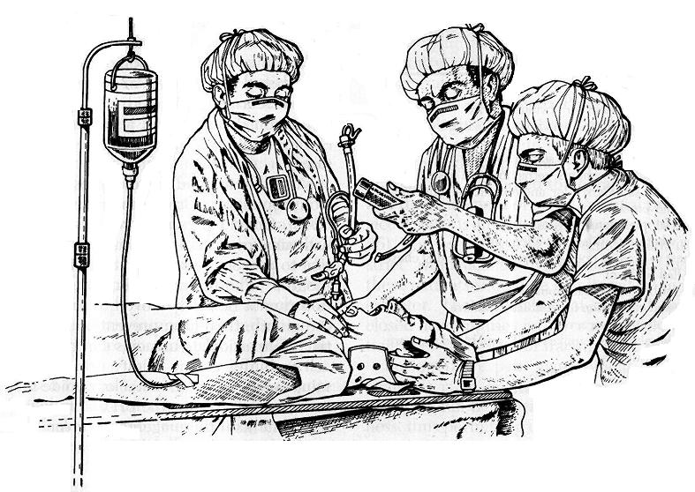
INTUBATION IN PATIENTS OF CERVICAL INJURY

Slide 24
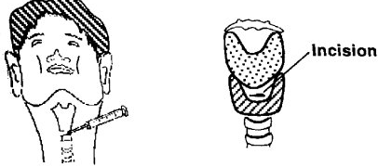
EMERGENCY RESUSC. MEASURES TO MAINTAIN
ADEQUATE AIRWAY AND BREATHING
cricothyroidotomy
•last resort for airway control.
•Y connector with O2 at 15 l/min.
•Intermittent jet insufflation- sedate & paralyze, only for 30-45min.

Slide 25
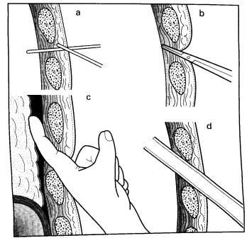
EMERGENCY RESUSC. MEASURES TO MAINTAIN
ADEQUATE AIRWAY AND BREATHING
Intercostal drain
4th or 5th intercostal space, mid-axillary line
local anaesthetic down to pleura
‘above the rib below’
blunt dissection. finger exploration
pass large drain on forceps superior & posterior.
underwater drain
pursestring suture

Slide 26
ASSESS CIRCULATION - PULSES
Compare radial and carotid pulses
Rhythm
  Regular
  Irregular
Quality
  Weak
  Thready
  Bounding
Rate
  Normal
  Fast
  Slow
“Rapid,low amplitude with narrow pulse pressure
indicates SHOCK.”

Slide 27
ASSESS CIRCULATION
SKIN -Color
-Temperature
-Moisture
BRAIN - Level of consciousness.
KIDNEYS - Urine output.

Slide 28
CAUSES OF MAJOR BLEEDING
THE BIG FIVE:
EXTERNAL
visual inspection
Local Pressure
THORACIC
Primary survey and CXR .
intercostals tube insertion
PELVIC
Usually self limiting/ pelvic ring closure
pelvis X-ray.
LONG BONES
clinical examination.
Spontaneously traction splintage
clinical findings/exclusion of other/USG/CT/DPL
ABDOMEN
Lapratomy

Slide 29
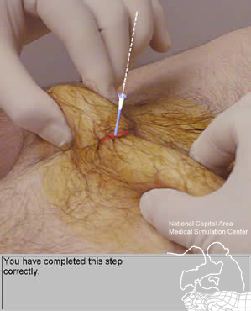
DIAGNOSTIC PERITONEAL LAVAGE (CLOSED TECHNIQUE)
Positive if
Bile or intestinal contents
More than 20ml frank blood aspirated
prior to running in the lavage fluid
After infusion of the fluid, more than
100,000 red cells/mm3 (blunt trauma) or
10-50,000/mm2 (penetrating trauma)
Elevated amylase
WBC > 500 / mm3

Slide 30
DISABILITY ( NEUROLOGICAL EVALUATION)
50% of trauma death are due to head injuries
Simple Mnemonic to describe level of consciousness
A : Alert
V : Responds to Vocal stimuli
P : Responds to Painful stimuli
U : Unresponsive to all stimuli
Not forget to use also Glasgow Coma Scale.

Slide 31
Glasgow Coma Score
If GCS < 10 CT head is indicated
Limitations of GCS:-
Does not include pupillary
assessment
Does not identify
abnormal lateralization of
motor response
Minimum score is 3
Eye Opening
Spontaneous 4
To voice 3
To pain 2
None 1
Verbal Response
Oriented 5
Confused 4
Inappropriate words 3
Incomprehensible sounds 2
None 1
Motor Response
Obeys command 6
Localizes pain 5
Withdrawn (pain) 4
Flexion (pain) 3
Extension (pain) 2
None 1

Slide 32
Signs of Severe Head Injury
Unequal pupils
Unequal motor examination
An open head injury with exposed brain tissue
Neurological deterioration
Depressed skull fracture
These are signs of severe head injury irrespective of CGS score

Slide 33
E. EXPOSURE /
ENVIRONMENTAL CONTROL
Patient should be undressed to facilitate thorough examination.
Warm environment (room temp) should be maintained
Intravenous fluid should be warm.
Early control of hemorrhage.

Slide 34
RESUSCITATION
Airway
Definite airway if there is any doubt about the pt’s ability to maintain airway integrity.
A definite airway is a cuffed tube in the trachea.
B. Breathing /Ventilation/Oxygenation
Every multiple injured pt should received supplement oxygen.
A clear distinction must be made between an adequate airway and adequate breathing.

Slide 35
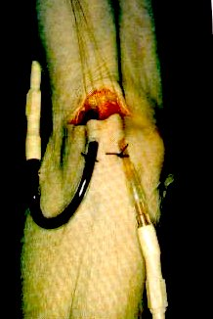
RESUSCITATION
C. Circulation
Control bleeding by direct pressure or operative intervention
Minimum of two large caliber IV(16G) should be established
Lactated Ringer is preferred & better if warm.

Slide 36
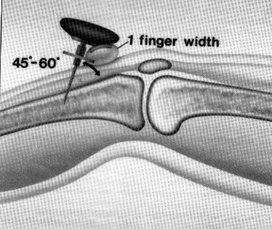
Children less than 6 y/o for IV access is impossible due to circulatory collapse or for whom percutaneous peripheral venous cannulation had failed on two attempt
Venescetion
Greater saphenous vein 2cm ant and superior to medial malleolus
Antecubital medial basilic vein 2cm lateral to medial epicondyle
Intraosseous Puncture/Infusion

Slide 37
Initial Fluid Therapy
Lactated Ringer is preferred
For adult 1-2 liters bolus
For child 20ml/kg bolus

Slide 38
3 FOR 1 Rule
a rough guideline for the total amount of crystalloid volume acutely is to replace each ML of blood loss with 3 ML of crystalloid fluid, thus allowing for restitution of plasma volume lost into the interstitial & intracellular space
RL
RL
RL
AB+

Slide 39
RESPONSE TO EARLY RESUSCITATION
RAPID
RESPONSE
TRANSIENT
RESPONSE
MINIMAL
RESPONSE
MONITER:
PULSE.
BP.
SKIN - PERFUSION.
CONSCIOUSNESS
URINE OUTPUT.
-ABGs
BE CAREFULL ,MAY STILL BECOME UNSTABLE AGAIN.
& REQUIRE SURGERY .
REMEMBER
THE “BIG 5”’
-GO TO O.T.
STOP THE
BLEEDING.
COAGULOPATHY.
HYPOTHERMIA
UNDER RESUSCITATION
ADVERSE
RESPONSE

Slide 40
Focused History and Physical
AMPLE History
A – allergies
M – medications
P – past medical history
L – last oral intake
E – events leading up to the incident

Slide 41
ADJUNCT TO PRIMARY SURVEY & RESUSCITATION
A. Electro-cardiographic Monitoring
B. Urinary & Gastric Catheter
C. X-Ray & Diagnostic Studies
C-spine lateral , CXR, Pelvic film (TRAUMA SERIES)
Essential x-ray should NOT be avoid in pregnant pt.

Slide 42
SECONDARY SURVEY
Does not begin until the primary survey (ABCDEs) is completed, resuscitative effort are well established & the pt is demonstrating normalization of vital sign.
Head to Toe evaluation & reassessment of all vital signs.
A complete neurological exam is performed including a GCS score.
Special procedure is order.

Slide 43
7. ADJUNCT TO THE SECONDARY SURVEY
include additional x-ray and all other special procedure.
8. RE-EVALUATION
Adult urine output 1ml/kg/hr
Pediatric urine output 1ml/kg/hr
9. DEFINITE CARE

Slide 44
End point of resuscitation
Stable hemodynamics
Stable oxygen saturation
Lactate level below 2 mmol / L
No cogaulation disturbance
Normal temp
Urinary output > 1ml /kg/hr
No requirement of inotropic support

Slide 45
Polytrauma in pregnant female
Tratement priorities are same as for non pregnant pt
Unless spinal injury is present pt should be examined in left lateral position
Pt can loss upto 35%of blood before tachycardia and hypotension appears
Fetus may be in shock while mother appears normal
1st resuscitate the female than monitor the fetus

Slide 46
Management of life threatening orthopedic injuries

Slide 47
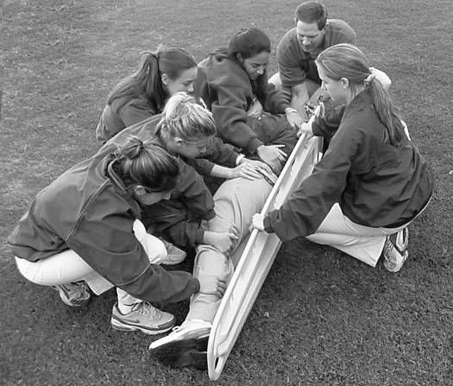
Spinal injuries
Any pt suspected of spinal injury must be immobilised unless spine has been cleared
Cervical collar
Spine board
Log roll technique
Log roll technique

Slide 48
Signs in an Unconcious patients
Neurological shock (Low BP & HR)
Spinal shock - Flaccid areflexia
Flexed upper limbs (loss of extensor innervation below C5)
Responds to pain above the clavicle only
Priapism – may be incomplete.
Diaphragmatic breathing

Slide 49
Spine clearance
Purpose:
to identify accurately and early following blunt injury to the spine the presence or absence of a diagnosis of spinal column injury
Ensure that
There is no spinal injury to produce avoidable disabiity or symtomps
There is no important Fracture
We avoid overprotection with its attendant risk
In all pt consistent with spinal injury maintain spinal preacutions untill thorough clinical and radiographic evaluation of spine is completed

Slide 50
Pelvic injuries
Pelvic injury is one of few bony injury that can lead to pt death
Pelvic injuries are assesed during secondary survey
Pelvis x ray is mandatory in polytrauma pt
Can lead to life threatening hemorrhage
Open pelvic # 50% mortality
Uretheral injury transurtheral catheter or suprapubic catheter

Slide 51
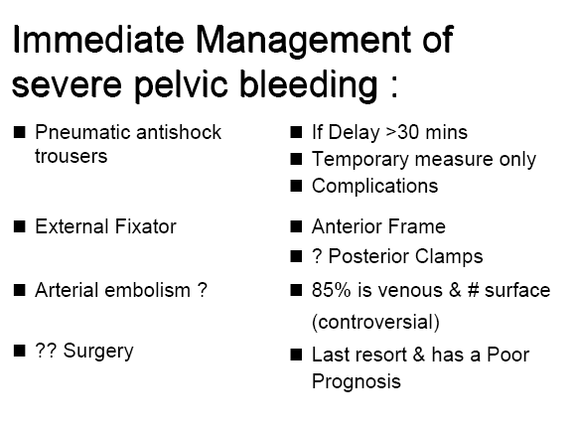
(

Slide 52
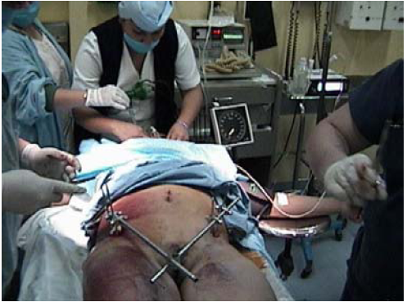

Slide 53
Definitions of pt conditions
Stable no life threatening injuries, haemodynamically stable
Borderline intially respond to
resuscitation but can deteriorate
Unstable remain haemodynamically unstable despite initial resuscitation
Extremis close to death uncontrollable blood loss

Slide 54
Early total care (ETC)
That is defenitive fracture tretement within 24 hr ,unreamed nail prefered
Used in stable pts
Avoid in severe thoracic injuries
haemorrhagic shock
head injury
Advantage pain relief , less infection, eary mobilisation, dec throemboembolism

Slide 55
Damage control
Described by us navy as the capacity of ship to absorb damge and maintain integrity
Polytrauma pts means that surgical tratements intends to control but not to defenitively repair the trauma induced injuries early after trauma
Used in unstable and extremis pts

Slide 56
DAMAGE CONTROL
Stage 1:Minimum surgery is done
achieve haemostasis.
Limit the contamination
Temporary stabilisation of unstable fractures
Stage 2:Physiological restoration in ICU.
Stage 3:Return to operation theatre for definitive
surgery.

Slide 57
Damage Control Surgery
        (“STAGED LAPROTOMY”)
Arrest bleeding , and the resulting coagulopathy.
Limit contamination and the sequelae .
Close the abdomen to limit heat and fluid loss,
and to protect viscera.
Damage control orthopaedics
1st stage temporary stabilisation of #
2nd stage resuscitation and optimisation
3rd stage definitive fracture fixation
External fixator is most commonly used for temporary stabilisation
Change to definitive # fixation is done in 2nd week

Slide 58
Priorities in fracture care
Tibia
Femur
Pelvis
Spine
Upper extremity

Slide 59
CONCLUSION
Favorable outcome for a critically injured patient
demands an integrated team effort.
Initial treatment is dictated by patient’s immediate
physiologic requirement for survival.
The definitive treatment requires rapid assessment
and life preserving therapy.
Damage control surgery should have a defined place
in surgeons armamentarium.

Slide 60


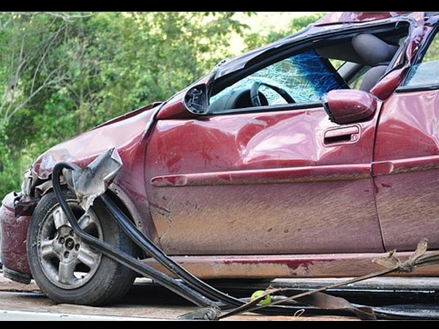
Crush Syndrome
Crush syndrome: Also termed rhabdomyolysis, involves a series of metabolic changes produced due to an injury of the skeletal muscles of such a severity as to cause a disruption of cellular integrity and release of its contents into the circulation.

Slide 61
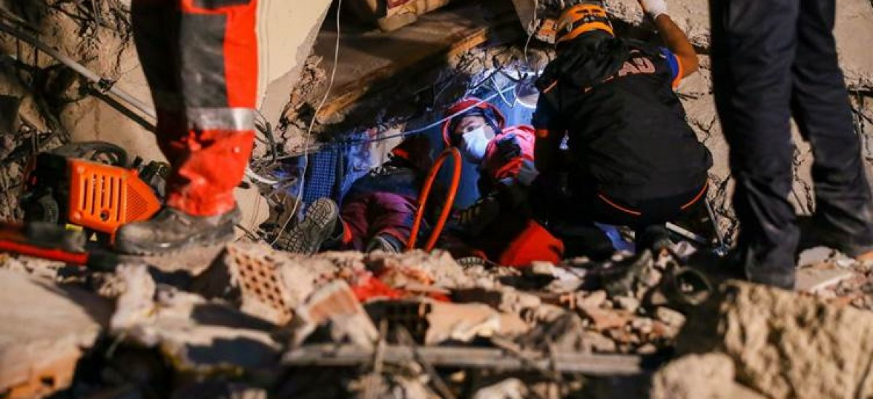

Causes Of Crush Syndrome
Several known mechanisms induce crush syndromes such as crush injuries, compartment syndrome (pressure buildup in the legs due to internal bleeding), burns, electrocution and other inquiries that result in damage to the muscles.

Slide 62

Symptoms Of Crush Syndrome
Muscle pain, especially from the injured body part
Brown coloured urine or tea-coloured urine
Weakness
Numbness on the affected area
Swelling
Acidemia (decreased pH)

Slide 63



Complications Of Crush Syndrome
Delay in the treatment after crush syndrome can cause complications such as:
Loss of muscle power
Mental stress due to extreme pain
Paralysis
Renal failure
Death pale skin or blisters on the compressed body areas
Sepsis
Complications Of Crush Syndrome
Delay in the treatment after crush syndrome can cause complications such as:
Loss of muscle power
Mental stress due to extreme pain
Paralysis [4]
Renal failure
Death pale skin or blisters on the compressed body areas
Sepsis

Slide 64


Serum creatinine kinase (CKMM) levels greater than 1000 IU/l with associated clinical features is generally taken as an indicator of crush syndrome. Normal range is 25-175 U/l, usually rises 2 to 12 hrs after a crush, peaks in 1 to 3 days and declines after 3 to 5 days.
Among the other investigations, serum aldolase may be of some help; serum myoglobin and myoglobin degradation products are highly sensitive tests; serum lactic acid, AST, ALT and LDH show a steady rise; serum uric acid -moderate rise may be noticed; serum urea and creatinine – steep rise is seen especially after a prolonged crush; serum potassium levels show an early rise and is a predictor for dialysis.
Hypocalcaemia and stress related hyperglycaemia may be seen. Urine RE may show presence of myoglobin products. Blood gas analysis, haemogram and ECG are also helpful. Intracompartmental pressure monitoring is useful as it is generally accepted that levels greater than 30 mm Hg point towards the need for a fasciotomy. Doppler studies are done to look for limb ischaemia, and the body weight is recorded.
Investigation

Slide 65

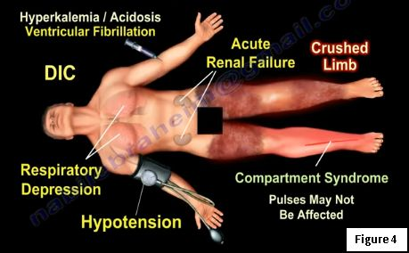
TREATMENT
A multidisciplinary approach involving the medical and surgical team is necessary in treating crush syndrome. Non-surgical treatments will include fluid replacement—ideal fluid is normal saline, ventilatory support, the correction of metabolic acidosis, and dialysis may need to be considered.

Slide 66
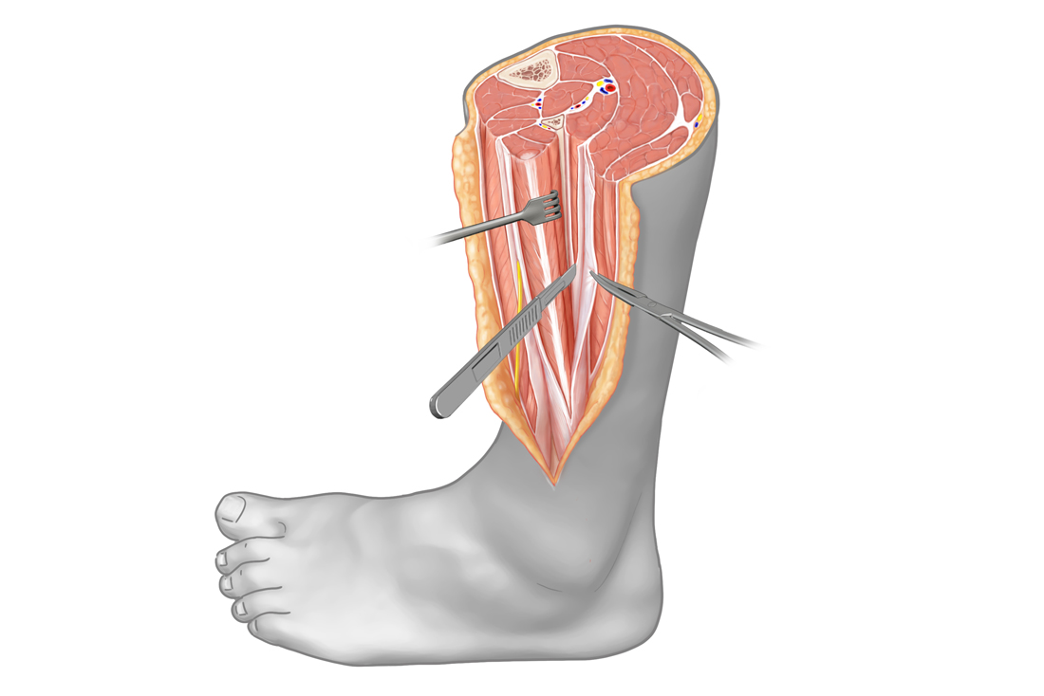

A surgical team may be required to perform an emergency fasciotomy because compartment syndrome can occur even when a patient is trapped less than an hour. Compartment syndrome can happen without a fracture and even when good pulses are felt. An early fasciotomy must be done. Surgery may also be necessary to debride necrotic muscle and to apply a VAC for wound coverage. A skin graft may be needed to in these situations.

Slide 67
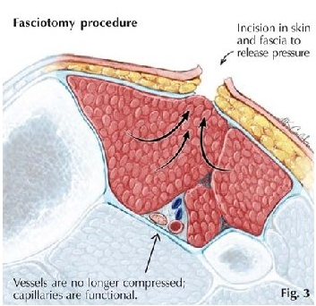
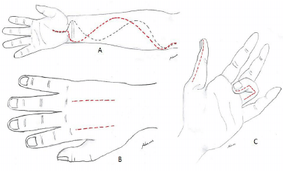

Fasciotomy incisions in the forearm, hand and fingers.
Fasciotomy - ﻿﻿a surgical incision or splitting of the fascia.
﻿Principles:
﻿Timely
﻿Adequate incisions (skin and fascia)

Slide 68
POLYTRAUMA
In an injury with multiple fractures, most important is
a. Airway
b. Blood Transfusion
c. IV fluids
d. Open reduction of fractures
2. Correct order of priority in management of head injury is
a. Airway, breathing, circulation, treatment of extra-cranial injuries
b. treatment of extra-cranial injuries, Airway, breathing, circulation
c. breathing, circulation, treatment of extra-cranial injuries, Airway
d. circulation, treatment of extra-cranial injuries, Airway, breathing
3. Severely injured patient with spinal fractures and unconsciousness, first thing to do is ?
a. Airway
b. GCS scoring
c. Manniotl drip
d. Spinal stabilizationby cervical collar

Slide 69
4. Patient comes with fracture femur in acute accident, first thing to do is
a. Secure airway and treat shock
b. Splinting
c. Physical examination
d. X-rays
5. Tetanus is usually noticed in
a. Burns
b. Open fractures
c. Gunshot wounds
d. All of the above
6. Which of the following is not a component of crush syndrome ?
a. Myohemoglobinuria
b. Massive crushing of muscles
c. Acute tubular necrosis
d. Bleeding diathesis

Slide 70
7. Of the following signs – pallor, restlessness, air hunger and water hammer pulse, hemorrhagic shock includes
a. 1and 4
b. 1 and 2
c. 1,2 and 4
d. 2,4 and 4
8. Compound fracture is initially treated by antibiotics, wound toilet and
a. Skin cover
b. External splint
c. Prosthesis
d. Internal fixation
9. Tarsometatarsal amputation is known as
a. Choparts amputation
b. Lisfranc amputation
c. Symes amputation
d. Powells amputation

Slide 71
10. Compound fracture is
a. Fracture with artery involvement
b. Fracture with nerve involvement
c. Fracture with muscle involvement
d. Fracture with skin involvement

Slide 72
“ ADD LIFE TO DAYS AND NOT DAYS TO LIFE ” .
THANK YOU

