Slide 1

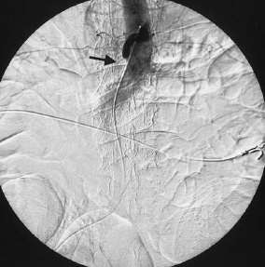
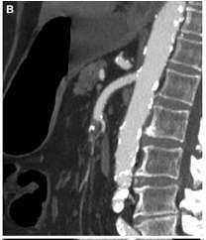
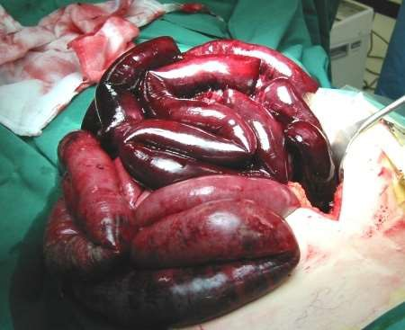
Mesenteric Thrombosis
Odessa National Medical University
Assistant Professor, PhD, Oleksandr Chaika
www.surgical-tutor.org.uk

Slide 2
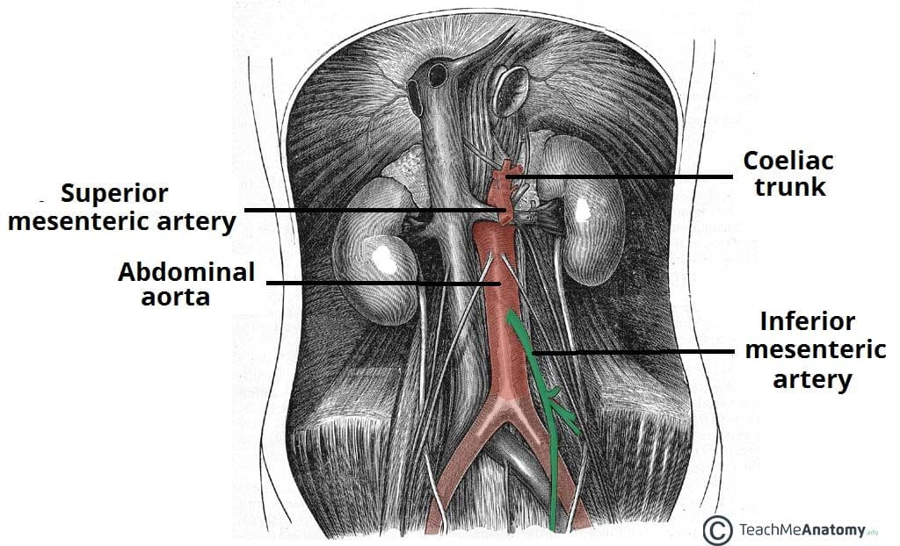
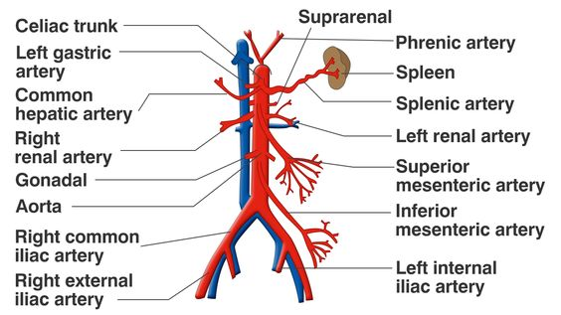
Anatomy

Slide 3
Definition of Acute Mesentery ischamia (mesentery thrombosis) :
Acute Mesentery ischemia (mesenteric thrombosis) is a catastrophic abdominal emergency characterized by sudden critical interruption to the intestinal blood flow which commonly leads to bowel infarction and death.
It is uncommon but life-threatening disease
Incidence ~1 in every 1000 hospital admissions₁
Mortality remains as high as 60-80%
Prognosis is poor
1. Mark et al Semin Vasc Surg 23:9-20 ,2010

Slide 4
Mesenteric thrombosis
Acute
Mesenteric thrombosis
Chronic
Mesenteric thrombosis
Arterial
occlusion
Venous
occlusion
Non-occlusive
Mesenteric Venous thrombosis
(MVT) 5-10%
Non-occlusive Mesenteric ischaemia (NOMI)
15-20%
Embolism
40-50%
Thrombosis
25-30%

Slide 5
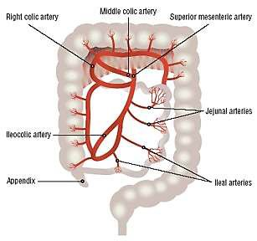
SMA Occlusion
SMA Embolism
SMA Thrombosis
Aortic ostium
~15%
Aortic ostium
~60-80%
Around
Middle colic artery
~40%
Around
Middle colic artery
~15%
Distal branches
~45%
Distal branches
~5%

Slide 6
Acute Mesenteric Ischemia due to Embolism
Embolism - commonest cause of acute mesenteric ischaemia.
Majority of emboli arise from the heart, most commonly the left atrium in patients of atrial fibrillation.
SMA is most commonly affected – acute angle of origin from abdominal aorta.

Slide 7
Acute Mesentery thrombosis due to nonocclusive disease
Results from systemic hypoperfusion, or low flow states – CCF, Shock,
critically ill patients following surgery
Cause - Intense vasospasm and Sympathetic-induced vasoconstriction.
Most Lethal - Because once arterial vasospasm is initiated, it may persist even after correction of the initiating event.
Prognosis is very poor

Slide 8
Cause
Aetiology
Incidence (%)
1.Embolism
Cardiac
Atrial fibrillation
Commonest (60-
70%)
Mural Thrombus following Myocardial Infarction
Left atrial myxoma
Prosthetic heart valves
Proximal aortic disease, e.g. aneurysm, atheromas
Iatrogenic, e.g. arteriography
2.Thrombosis
Mesenteric Atherosclerosis
25-30%

Slide 9
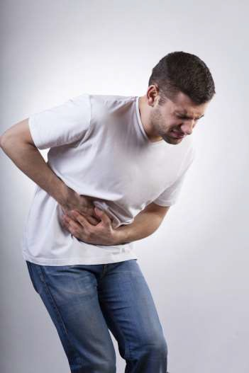
Symptoms
▶ Classical description of early symptom
▶ Severe Abdominal pain that is out of proportion to physical findings in 95% cases

Slide 10



Symptoms
▶ Early
▶ Prominent symptoms of GI emptying
( nausea, vomiting ,
diarrhea )
▶ Late
▶ Bloody diarrhea
▶ Abdominal distension
▶ Features of Peritonitis-
▶ Fever
▶ Shock
▶ Tachycardia
Early diagnosis requires high index of suspicion

Slide 11
Pathophysiology
Ischemia
Mucosal barrier disruption
Release of bacteria,
toxins, vasoactive substance
Substantial protein-rich fluid
loss into the gut
SIRS
Hypovolemia
MODS
Death
Notes:
SIRS - Systemic inflammatory response syndrome
MODS - Multiple organ dysfunction syndrome

Slide 12
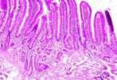


What happens to bowel during absolute ischaemia?
15 mins
- Structural changes to intestinal villi
Time is crucial !
3 hours
  Mucosal sloughing
  Still reversible
6 hours
  Transmural necrosis
  Gangrene
  Perforation
Signs of Peritonitis appear
15 mins 3 hours
Absolute ischaemia
6 hours
Udassin R, et al. J Surg Res 1994;56:221-5

Slide 13
Investigation (Preliminary)
Blood test:
▶ Most common laboratory abnormalities are:
▶ Haemoconcentration
▶ Leukocytosis (Neutrophilic)
▶ Metabolic acidosis
▶ Lactic acidosis (in more advanced case)
▶ Other serum markers
▶ Raised
Neither sensitive nor specific.
▶ amylase
▶ ALP
But Ix help exclude other DDx

Slide 14
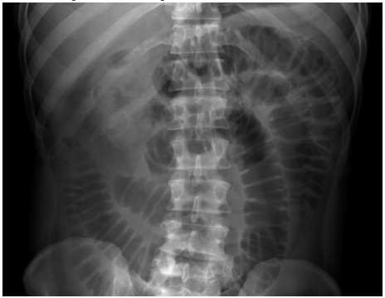

Straight X-ray Abdomen (Erect Posture)
Dilated Bowel Loops

Slide 15
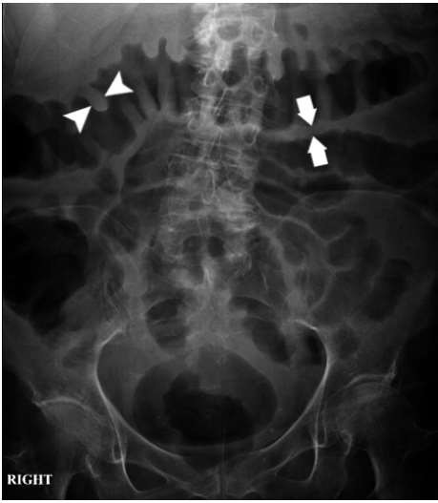
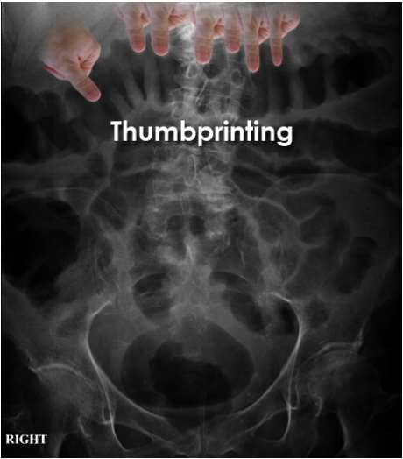
Thumb-printing Sign (Signifying Bowel wall oedema and thickening)

Slide 16
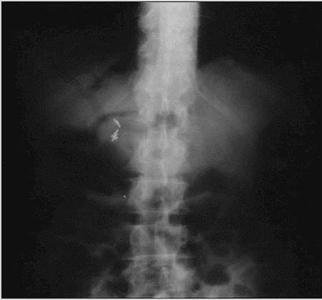
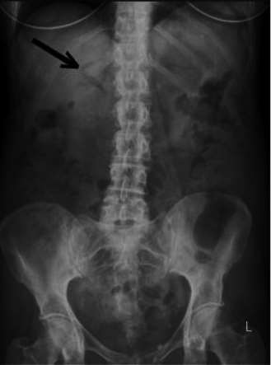
Gas in the Portal Vein

Slide 17
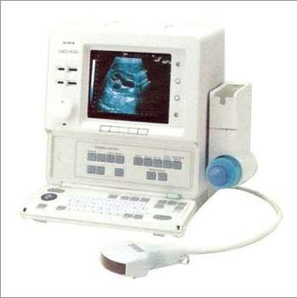
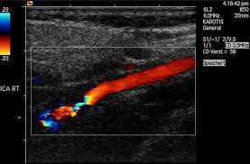
Doppler USG
Able to identify severe stenosis or total or partial occlusion and velocity of blood flowing through the vessels
Unable to detect
  emboli beyond the proximal main vessel
  Non-obstructive mesenteric ischaemia
Colour Doppler USG showing partially occluded Artery

Slide 18
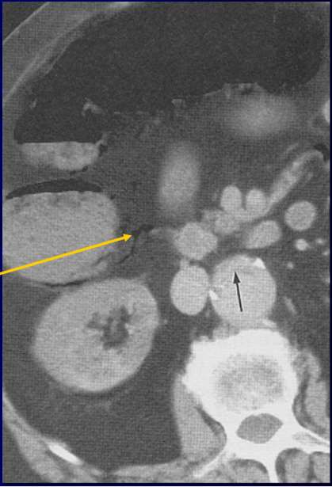
CECT abdomen
Gas in Bowel wall (Pneumatosis intestinalis)
Gas in Mesenteric Vein

Slide 19
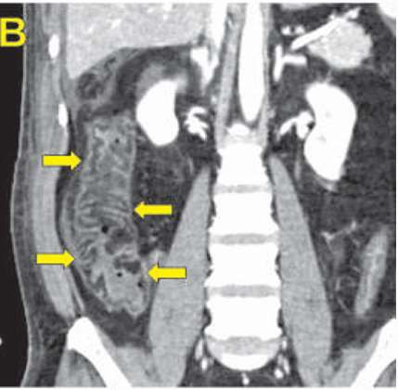
Bowel Wall Oedema

Slide 20
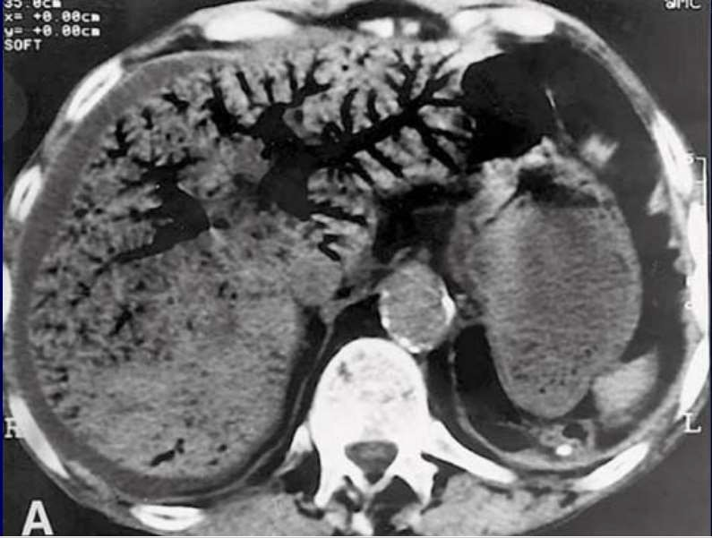
CECT showing in Extensive Portal Venous Gas

Slide 21
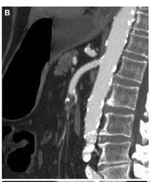
SMA occlusion with embolus

Slide 22
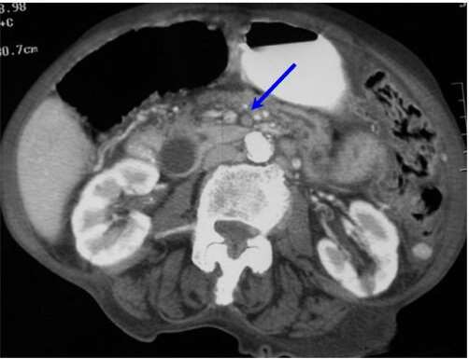
SMA thrombosis

Slide 23
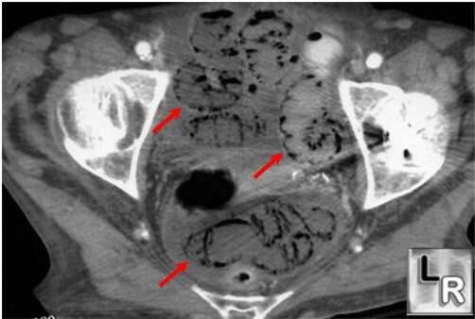
Extensive Pneumatosis intestinalis

Slide 24
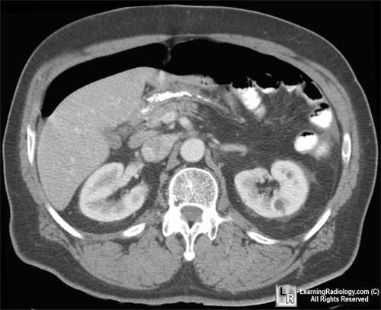
CECT showing Pneumoperitonium

Slide 25
Angiography – Gold Standard
▶ Non-invasive
▶ CT-Angiography
▶ Magnetic Resonance Angiography
▶ Invasive
▶ Catheter (Conventional Method)
▶ Findings on Angiography:
▶ Filling defects
▶ Stenosis or blockage

Slide 26
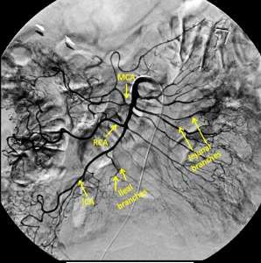
SMA on Angiography

Slide 27
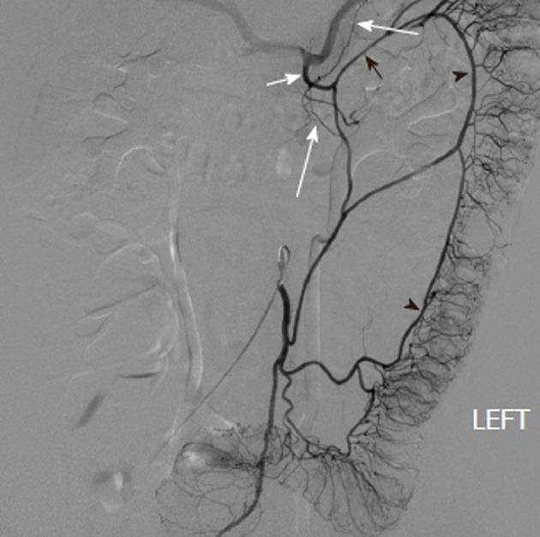

IMA on Angiography

Slide 28
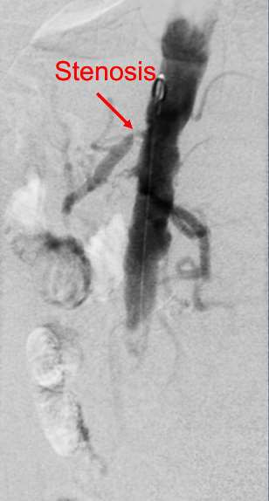
Angiogram (Aortogram)
showing Stenosis of SMA

Slide 29
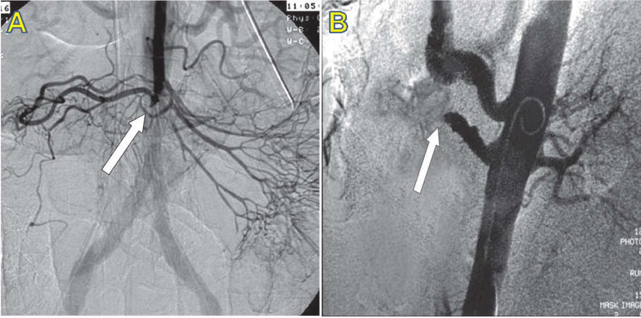
A. cut-off of the middle colic artery, B. Embolism of SMA (arrow).
due to emboli (arrow).

Slide 30
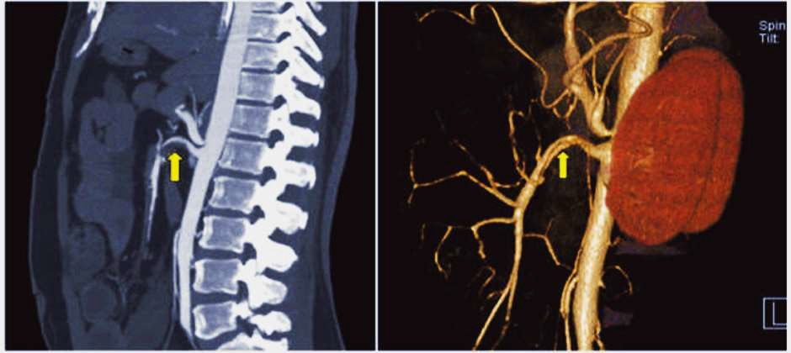
CT Angiogram showing partial thrombosis of SMA

Slide 31
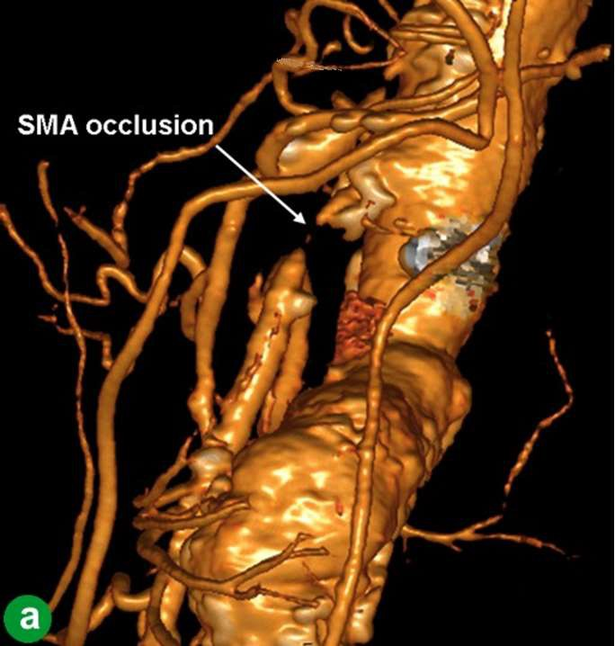
3D
CT-Angiography

Slide 32
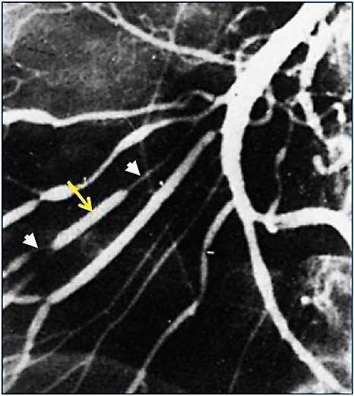

Superior Mesenteric Angiography showing the string of “Sausages Sign” in a patient of Non-occlusive mesenteric ischaemia

Slide 33
Management
Patient presents with severe abdominal pain consistent with ischemic bowel
Obtain history and perform physical examination.
Pain is out of proportion to physical findings is a significant clue. Look for risk factors for acute mesenteric ischemia.
Order investigative studies:
Laboratory tests: WBC count, lactate, AST
Imaging: abdominal X-ray, Doppler USG, CT-Angiography, MRA
Peritoneal sign is present
Peritoneal sign is absent
Laparotomy
+/- Revascularisation
+/- Bowel Resection
Acute mesenteric ischemia established
Treat with: Moist O2 , Fluid Resuscitation, Naso- Gastric decompression, Broad Spectrum Antibiotics, Bowel rest,Stop Vasopressor drugs/Digitalis, Invasive haemodynamic monitoring, Treat Arrhythmia or Heart failure, IV HEPARIN 5000IU

Slide 34
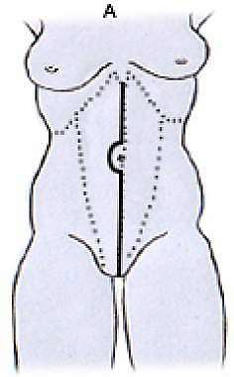
Definitive surgical exploration
Midline laparotomy
Assessment of bowel viability
Determination of underlying cause
Mesenteric revascularization
Resection of necrotic bowel
Second look laparotomy

Slide 35
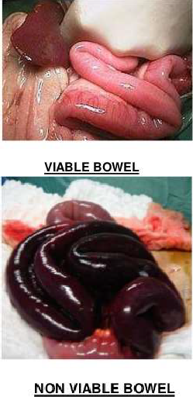
Assessment of bowel viability
Clinical Judgment
  pink serosa
  visible peristalsis
  positive pulsations
  bleeding from cut edges
2. Doppler USG
- hand-held Doppler(Detects anti-mesenteric blood flow)
3. Fluorescein
-Injection of IV Sodium fluorescein(1gm) and inspection under Wood’s lamp
(Viable bowel has smooth, uniform fluorescence)

Slide 36
Assessment of bowel viability
Necrotic bowel
(Gangrenous)
Equivocal viability
Or Marginally-viable bowel
Allow 30 mins intraoperatively to assess bowel viability
Extensive Infarction Or
Frankly Necrotic
Limited
infarction
Revascularization procedures
Bowel Resection

Slide 37
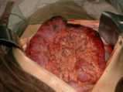
Resection of Necrotic Bowel
▶ Frankly necrotic bowel segments
▶ Resection
▶ Marginal-viable bowel (Equivocal viability)
▶ may improve over hours
▶ consider second-look laparotomy

Slide 38
After revascularization
(embolectomy or bypass)
▶Consider postrevascularization papaverine. (arterial spasm may persist even after embolectomy or thrombectomy)
44

Slide 39
Who should have second look laparotomy?
▶ Some surgeons advocate routine second-look laparotomy at 24-48hr
▶ Claimed reduced mortality rate
▶ Other adopt a selective approach and perform a second laparotomy when patient deterioates clinically.
▶ Can avoid unnecessary second operation if patient remains
well

Slide 40
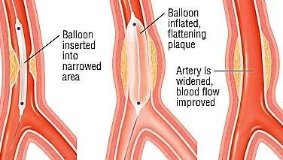
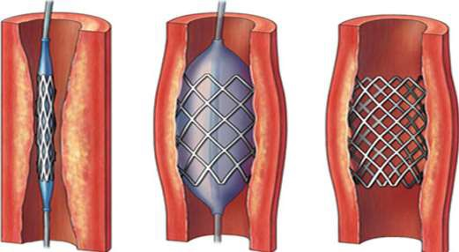
Alternative to surgery… Endovascular therapy
Limited use in acute situations Cannot assess bowel viability
Only indicated in early cases without bowel infarction
Acute SMA thrombosis
NOMI
Transarterial infusion of vasodilator
Percutaneous transluminal Balloon angioplasty ± stenting
Transarterial Thrombolysis

Slide 41
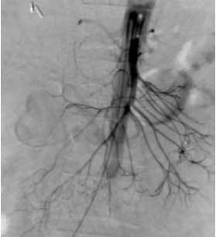
Management of non-occlusive mesenteric ischemia
▶ Correct underlying condition.
▶ Optimize fluid status, improve cardiac output, and eliminate vasopressors (alpha-blocker)
▶ Consider catheter-directed intra-arterial infusion of vasodilator (papaverine 30-60mg/hr)
▶ Laparotomy if peritoneal signs develop
Bradbury et al The British Journal of Surgery Vol 82(11), November 1995 ACS surgery : principles and practice

Slide 42
Summary
▶ Acute Mesenteric Ischaemia is an abdominal emergency both if physical signs are present or absent.
▶ We have very less time for investigation, so assessing clinically is
important.
▶ Every minute we waste is every centimeter of small bowel we loose.
▶ Angiography is diagnostic as well as therapeutic.
▶ Preoperative heparin infusion and postoperative papaverine infusion is must.
▶ Still Prognosis is Poor & Mortality is High as 80%

Slide 43



Slide 44
Thank You

