Slide 1


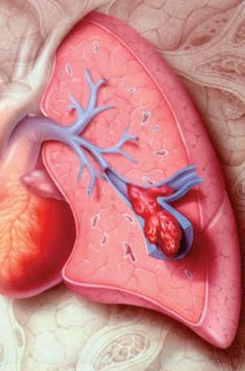
Pulmonary Embolism
Odessa National Medical University
Assistant Professor, PhD, Oleksandr Chaika
1

Slide 2

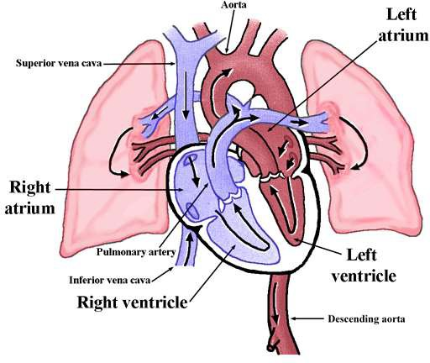
Pulmonary circulation

Slide 3

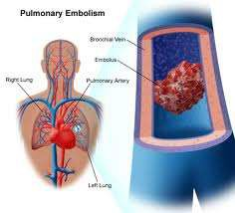
Pulmonary Embolism
Occlusion of a pulmonary artery(ies) by a blood clot.
Results from DVTs that have broken off and travelled to the pulmonary arterial circulation.
PE is one of the leading causes of preventable deaths in hospitalized patients.

Slide 4




Source
DVT
IEC of the right side of heart
Air embolism
Fat embolism
Amniotic fluid embolism
Septic embolism
Tumor embolism

Slide 5




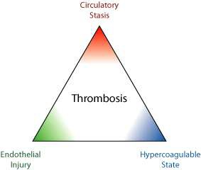
Risk Factors
Virchow’s Triad

Slide 6
Risk Factors
VTE is most prevalent in three clinical conditions:
Major surgery (particularly if it is cancer related or involves the hip or knee)
Acute stroke
Major trauma (especially spinal cord injury)

Slide 7
Risk Factors
Prior DVT or PE
Congestive Heart Failure
Malignancy
Obesity
smoking
Estrogen, OCP, HRT
Pregnancy
Lower limbs injury
Orthopedic Surgery
Prolonged immobilization, travel
Surgery requiring > 30 minutes general anesthesia

Slide 8




Risk Factors Cont’d
Age > 40
Venous Stasis
Factor V Leiden mutation
Protein C deficiency
Protein S deficiency
Antithrombin deficiency
Prothrombin G20210A mutation
Anticardiolipin antibodies
SLE, APS
Hyperhomocystinemia
10

Slide 9
Risk Factors Cont’d
ICU-related factors:
Immobility
Neuromuscular paralysis (drug-induced)
Central venous catheters
Severe sepsis
11
Notes:
ICU – intensive care medicine

Slide 10



Symptoms
Small PE: Asymptomatic, SOB, chest discomfort.
Medium PE: SOB, Haemoptysis, Pleuritic chest pain, Tachycardia, Tachypnea, Pleural rub.
Massive PE: Death, Shock, Severe central chest pain, Syncope, Pallor, Sweating, Central cyanosis, Elevated JVP, Loud P2, S2 split, gallop rhythm.
DVT

Slide 11


Differential Diagnosis
Myocardial Infraction
Pleurisy
Pneumonia
Bronchitis
Pneumothorax
Costochondritis

Slide 12






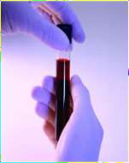
Investigations
Laboratory:
CBC, Coagulation profile, ESR, LDH, ABG
D-dimer:
Sensitive but not specific
Up to 80% of ICU patients have elevated D- dimer in the absence of VTE
More than 500 Mg/mL

Slide 13






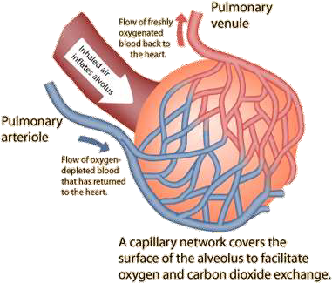
Alveolar-Arterial O2 Gradient
A-a O2 gradient = PaO2 (alveolar) - PaO2 (arterial)
Gradient > 15-20 is considered abnormal.
16

Slide 14

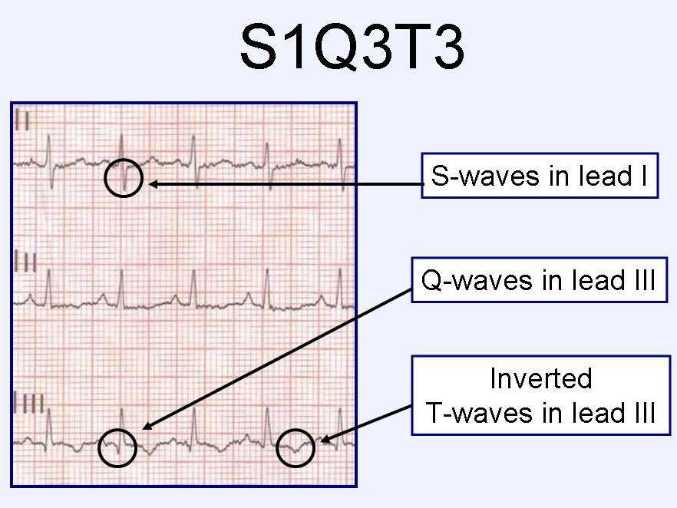
ECG

Slide 15
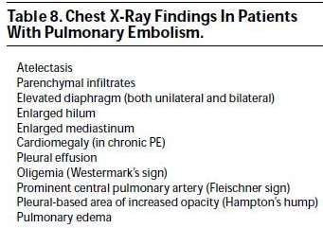
Imaging Investigations

Slide 16
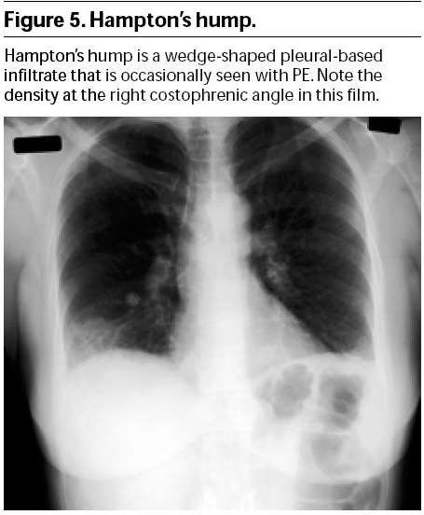

Slide 17




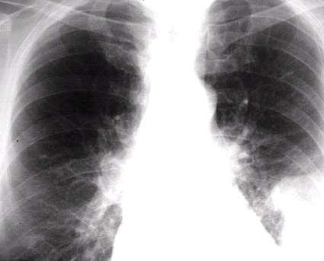
Westermark’s sign
20

Slide 18


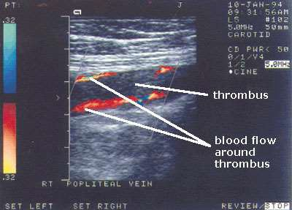
Lower limb venous system Ultrasonography & Doppler
21

Slide 19
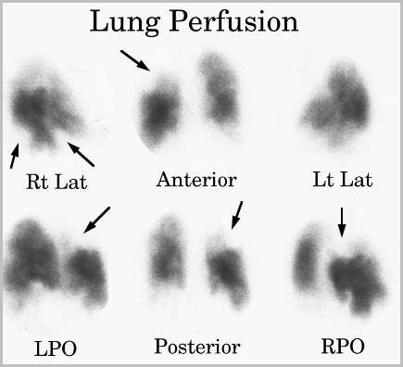
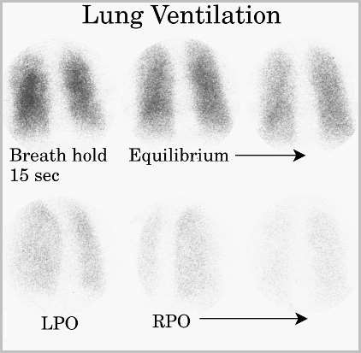
Ventilation/Perfusion Ratio

Slide 20
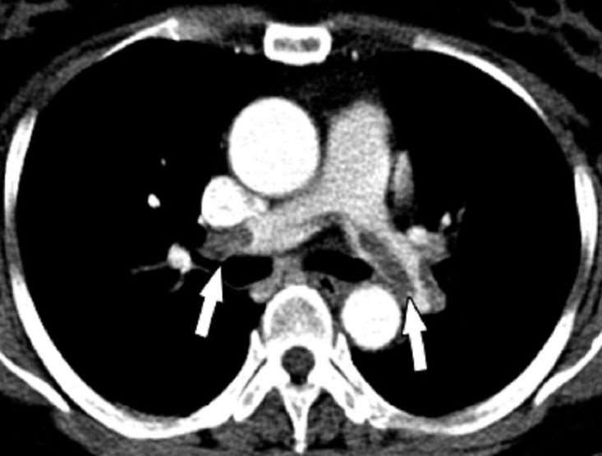
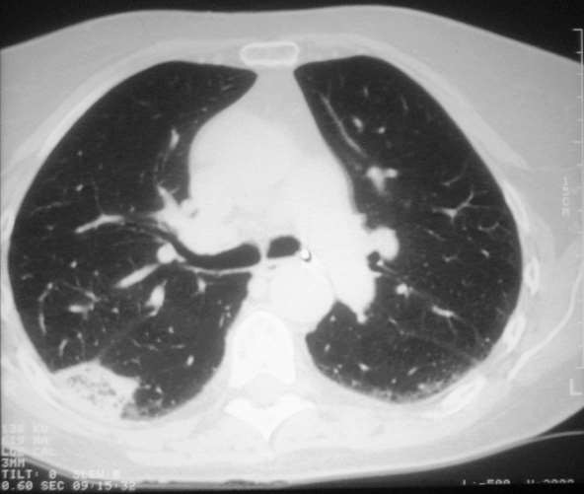
CT Pulmonary Angiography

Slide 21
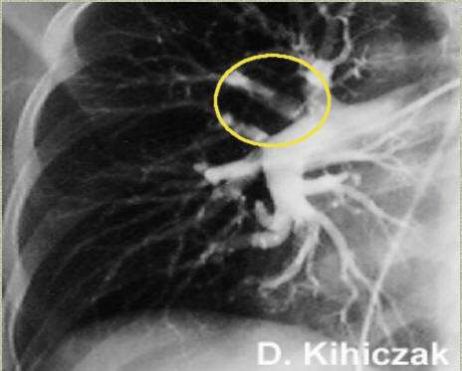
Pulmonary Angiography

Slide 22

Other Tests
Echocardiography
Cardiac troponin

Slide 23

Management
Emergency management
Further management: Anticoagulation, Thrombolysis, ......

Slide 24


Resuscitation
ABC
Oxygen 100%
IV access. Send baseline bloods, including clotting profile. Perform ECG
Analgesia: Pethidine, Morphine 5-10 mg IV
Management of cardiogenic shock (fluids and inotropes- Dobutamine)

Slide 25

Thrombolytic Therapy
Streptokinase, Urokinase, Alteplase
,Recombinant tissue plasminogen activator
Streptokinase 250,000 U over 30 mins
Aim to: Relieve pulmonary vasculature obstruction, Improve right ventricular efficacy, Correct the hemodynamic instability.

Slide 26

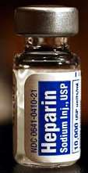
Anticoagulant Therapy
Heparin
5000-10000 Units IV Loading Dose Then 1000 Units/hr IV infusion drip
Duration: 7-10 days OR till clinical improvement
Follow up by PTT (1.5-2.5)

Slide 27




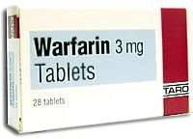
Anticoagulant Therapy Cont’d
Warfarin
2.5-7.5 mg/day Orally
Started with Heparin (5-7 days to start acting)
Duration: 3-6 months
Monitor INR (2-3)
30

Slide 28
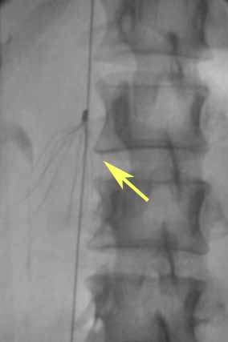
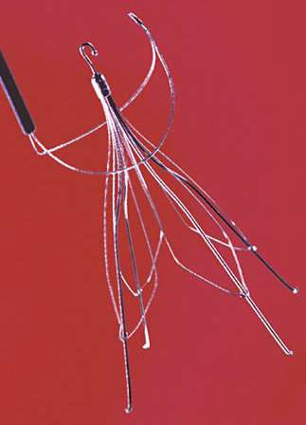
Recurrent DVT & PE: Vena cava filter

Slide 29

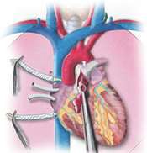
Embolectomy
Surgical Embolectomy
Catheter Embolectomy
Massive life-threatening PE

Slide 30


Complications
Instant Death
Chronic pulmonary hypertension
Respiratory failure
Congestive heart failure
Recurrence

Slide 31


Prevention
Prophylaxis is the single most important measure for ensuring patient safety in hospitalized patients
Compressive stockings, Aspirin, Anticoagulation
Management of risk factors
Follow up

Slide 32
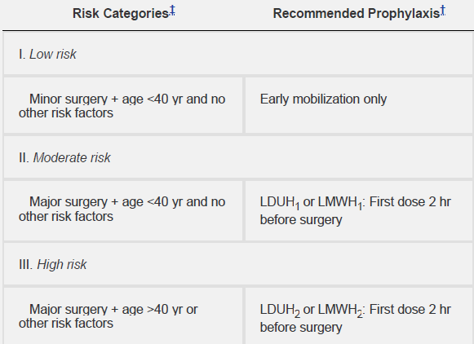
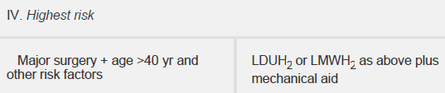

Slide 33
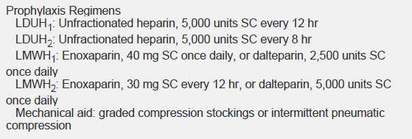


Slide 34


