Slide 1

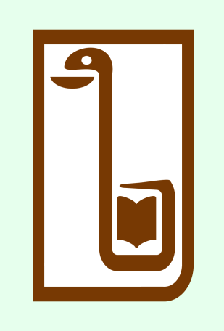
Aneurysms of the aorta and peripheral arteries.
Odessa National Medical University
Assistant Professor, PhD, Oleksandr Chaika

Slide 2
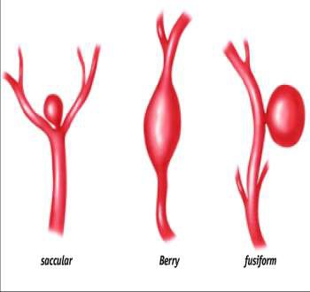
Aneurysm
An aneurysm is a distention of an artery brought
by a weakening/ destruction of the arterial wall.
An aneurysm is a balloon-like bulge in an artery.

Slide 3
Types of Aneurysms
Aortic aneurysm
There are two types of aortic aneurysm
  Abdominal aortic aneurysm
  Thoracic aortic aneurysm
Cerebral aneurysm - occurs in an artery in the brain.
Others: Peripheral Aneurysm

Slide 4
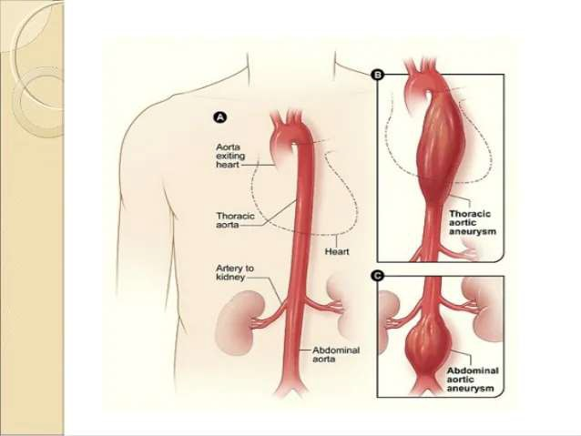

Slide 5
Abdominal Aortic Aneurysms
An aneurysm that occurs in the abdominal portion of the aorta is called an abdominal aortic aneurysm (AAA). Most aortic aneurysms are AAAs.
Thoracic Aortic Aneurysms
An aneurysm that occurs in the chest portion of the aorta (above the diaphragm) is called a thoracic aortic aneurysm (TAA).

Slide 6
Brain Aneurysms
Aneurysms in the arteries of the brain are called cereberal aneurysms or brain aneurysms. Brain aneurysms also are called berry aneurysms because they're often the size of a small berry.
Peripheral Aneurysms
Aneurysms that occur in arteries other than the aorta and the brain arteries are called peripheral aneurysms.
Common locations for peripheral aneurysms include the popliteal, femoral and carotid arteries.

Slide 7
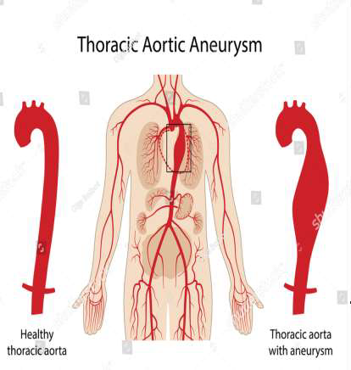
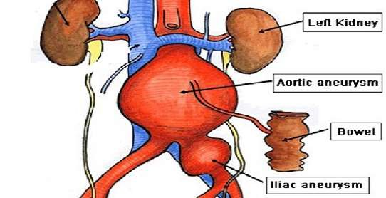
Abdominal Aortic Aneurysm

Slide 8
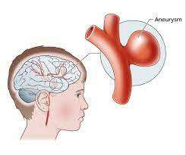
Brain Aneurysm

Slide 9
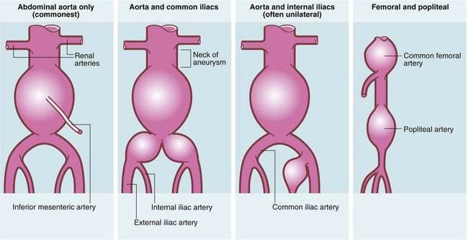
Peripheral Aneurysm

Slide 10
Causes
Abdominal aortic aneurysm causes:
Atherosclerosis
Smoking
Hypertension
Vasculitis (infection in the aorta)
Cocaine use Genetic factors
Thoracic aortic aneurysm causes: About 1 in 4 aortic aneurysms occur in the thoracic area of the aorta (higher up in the chest). Causes are the same as with aortic aneurysms, plus the following below:
Marfan Syndrome
Previous aorta injury Traumatic injury

Slide 11
Clinical manifestations
: Abdominal Aortic Aneurysms
A throbbing feeling in the abdomen
Deep pain in back or the side of the abdomen
Steady, gnawing pain in the abdomen that lasts for hours or days
If an AAA ruptures, symptoms may include :
Sudden, severe pain in lower abdomen and back
Nausea and vomiting
Constipation
Problems with urination
Clammy, sweaty skin
Light-headedness
Rapid heart rate when standing UP
Shock

Slide 12
Thoracic Aortic Aneurysms
Pain in jaw, neck, back, or chest
Coughing and/or hoarseness
Shortness of breath and/or trouble breathing or swallowing
Loss of voice
If a TAA ruptures or dissects
Sudden, severe, sharp or stabbing pain starting in the upper back and moving down into the abdomen.
Pain in chest and arms
Shock.

Slide 13
Risk factors
Male gender - Men are more likely than women to have aortic aneurysms.
Age - Abdominal aortic aneurysms are more likely to occur in people who are aged
65 or older.
Smoking - Smoking can damage and weaken the walls of the aorta.
Family history - People who have family histories of aortic aneurysms are at higher risk for the condition, and they may have aneurysms before the age of 65.
History of aneurysms in the arteries of the legs.
Certain diseases and conditions that weaken the walls of the aorta. Such as high BP and atherosclerosis
Having a bicuspid aortic valve - can raise the risk of having a thoracic aortic aneurysm. A bicuspid aortic valve has two leaflets instead of the typical three.
Car accidents or trauma - also can injure the arteries and increase the risk for
aneurysms.

Slide 14
Diagnostic tests
Abdominal or chest X-ray may show calcification that outline aneurysm
Ultrasound and Echocardiography: These tests can show the size of an aortic aneurysm
Computed Tomography Scan A computed tomography scan, or CT scan : CT scan can show the size and shape of an aneurysm.
Magnetic Resonance Imaging: detect aneurysms and pinpointing their size and exact location.
Angiography: This test shows the amount of damage and blockage in
blood vessels.

Slide 15
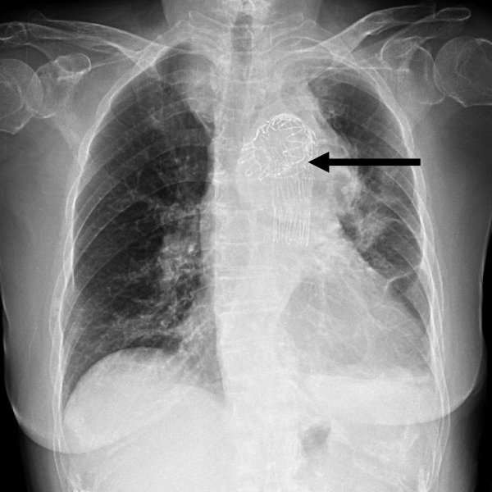

Slide 16
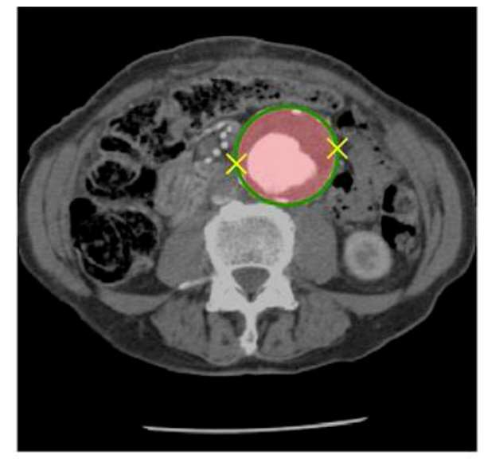

Slide 17
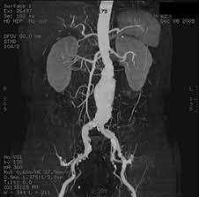
Man, this abdominal aorta is thick!

Slide 18
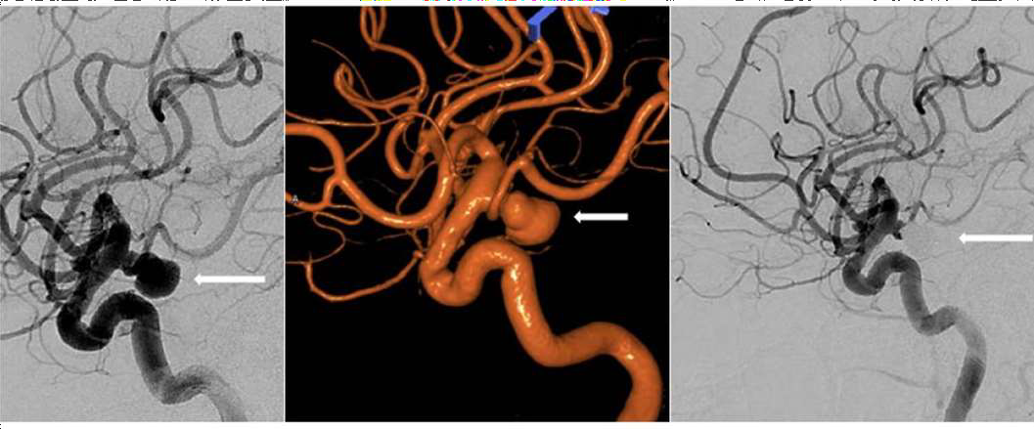

Slide 19
Management
The goals of management may include:
Preventing the aneurysm from growing Preventing or reversing damage to other body structures
Preventing or treating a rupture or dissection
Allowing the pt. to continue doing their normal daily activities

Slide 20
Medical management
In aortic aneurysm
Medicines are used to lower blood pressure, relax blood vessels, and lower the risk that the aneurysm will rupture (burst).
Beta blockers and calcium channel blockers are the medicines most commonly used.

Slide 21
Surgical management
The two main types of surgery to repair aortic aneurysms are:
1. Open Abdominal or Open Chest Repair
In aortic aneurysms, open abdominal or open chest repair. This surgery involves a major incision (cut) in the abdomen or chest. General anesthesia is used during this procedure. During the surgery, the aneurysm is removed. Then, the section of aorta is replaced with a graft made of material such as Dacronor Teflon.

Slide 22
2. Endovascular Repair
In endovascular repair, the aneurysm isn't removed. Instead, a graft is inserted into the aorta to strengthen it. The surgeon first inserts a catheter into an artery in the groin (upper thigh) and threads it to the aneurysm. Then, using an x ray to see the artery, the surgeon threads the graft (also called a stent graft) into the aorta to the aneurysm. The graft is then expanded inside the aorta and fastened in place to form a stable channel for blood flow. The graft reinforces the weakened section of the aorta. This helps prevent the aneurysm from rupturing.

Slide 23
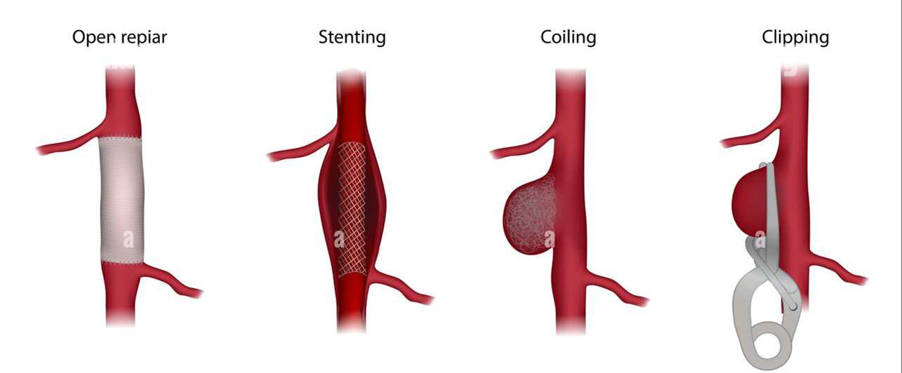

Slide 24
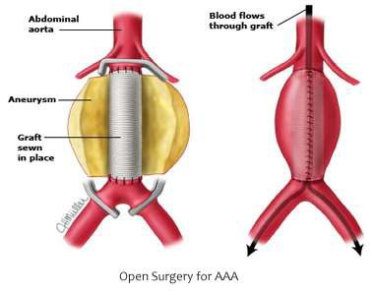

Slide 25
Complications
❏ Haemorrhage leading to shock and even death
❏ Myocardial ischemia
❏ Stroke
❏ Paraplegia due to interruption of anterior spinal artery
❏ Abdominal ischemia
❏ Graft occlusion Graft infection
❏ Acute renal failure
❏ Lower extremity ischemia :

Slide 26
Prevention
A large percentage of aneurysms are caused by arteriosclerosis. The following steps will help prevent the development of arteriosclerosis and aneurysms:
Quit smoking
Keep blood pressure under control
Keep blood cholesterol levels under control
Eat a healthy, well balanced diet, rich in fruit and vegetables, unrefined carbohydrate, dietary fiber, good quality fats, and lean protein
Keep bodyweight within the ideal limits for height
Get at least 7 hours of good quality sleep each night
Keep yourself physically active

Slide 27
