Slide 1
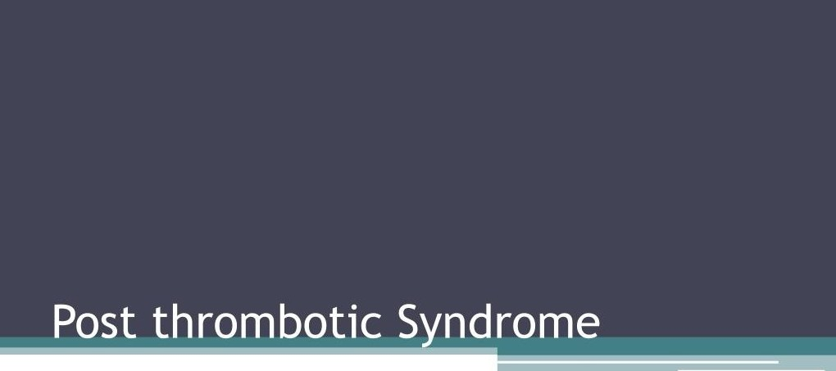

Odessa National Medical University
Assistant Professor, PhD, Oleksandr Chaika

Slide 2
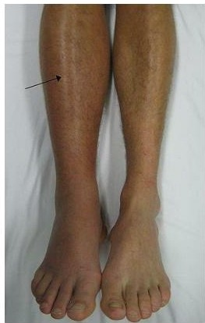
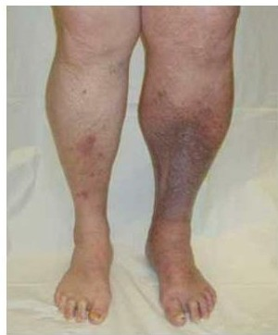
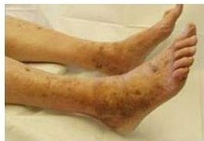
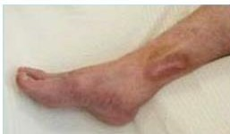
DVТ
Post thombotic syndrome

Slide 3
Risk factors
Age >65
Sex
Location of DVГ
Recurrent DVГ
Lack of long-term anticoagulation
Obesity

Slide 4
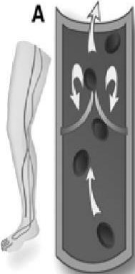
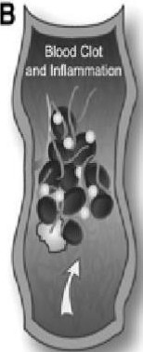
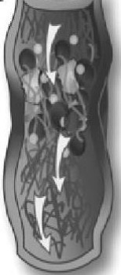
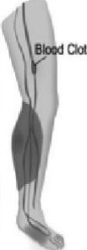
Damage
1о Les Veif15
Normal В:lood F1ow
VЭl'l'eВесоmез
Leaky,AIIO'Мn9
Fluio to PassThrough
С --
L.egPaii'I,Sw.elling
anclRedneм
D

Slide 5
PTS vs recurrent DVT
Over 24h span (DVТ):
Dramatic onset of pain
Persistent swelling
Duplex ultrasound
Мау difficult to distinguish due to abnormalities still present in the venous segment
0

Slide 6
Venous thromЬos,s
l
I
1
Recanalization
Venous valve damage
Outflow obslruction
.
Collateral venous circulation
l
Venous reflux
l
Venous hypertension
I
1
Telangiectas,ae Venous ectas,a
Cap,Uary leakage
Edema Hyperp,gmentat,on llpodermatoscleros,s Ulcerahon

Slide 7
What is post-thrombotic syndrome?
Long-term complication of deep venous thrombosis (DVТ) that is characterized Ьу chronic, persistent pain, swelling and other signs in the affected limb
Caused Ьу damage to veins and valves

Slide 8
Signs and Symptoms
Signs
Edema
Eczema
Hyperpigmentation
Redness
Secondary varicose veins
Lipodermatoschlerosis
(LDS)
Venous Ulcers
Symptoms
Heaviness
Pain
Swelling
Itching
Cramps
Aching
Symptoms worsen with activity and standing

Slide 9
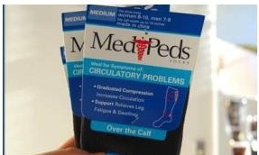
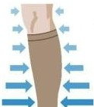
Prevention
DVТ Prophylaxis
Optimal duration of anticoagulation
After initial DVТ:
Prevention of recurrent DVТ
Compression stockings
lncreosing Compression

Slide 10
Sociat impact
Costs
Increased medical costs
Lost of productivity at work/home
0
0
Decreased quality of life

Slide 11


