Slide 1
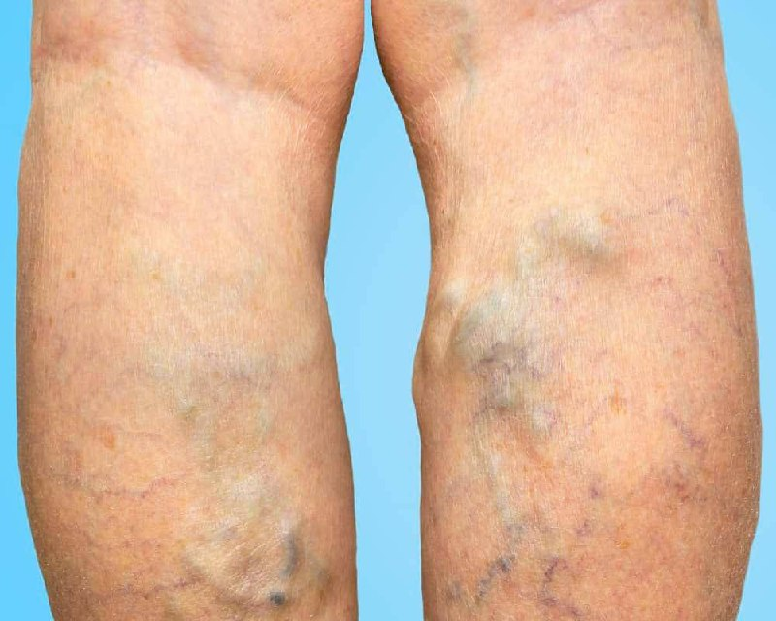

VARICOSE VEIN
Odessa National Medical University
Assistant Professor, PhD, Oleksandr Chaika

Slide 2
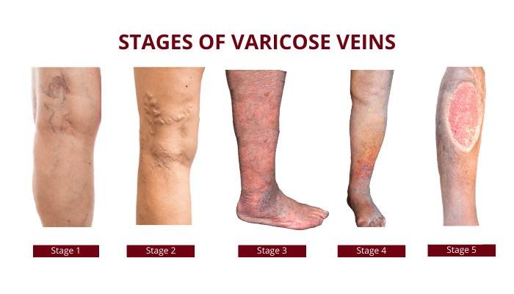

Slide 3


Definition
Varicose veins are defined as dilated, elongated, tortuous and palpable superficial veins as a result of venous hypertension.

Slide 4
Varicose presentation
  More common affects females (55-60%)
  Left lower limb more commonly involved
  Long saphenous system affected in 2/3 of cases

Slide 5

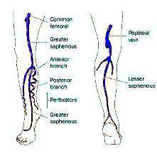
Venous System of lower limb
Consists of:
Deep system of veins which lies below the deep fascia.
Superficial system of veins which lies outside the deep fascia (carry 10% blood)
Perforating veins which pass through the deep fascia joining the superficial to the deep system of veins.

Slide 6

Valves in the veins
Valves present in superficial veins.
Prevent flow of blood from proximal to distal and from deep to superficial
Absent from above groin level
Valves can resist pressure up to 300 mm of Hg.

Slide 7


Factors Helping in Venous return
Negative pressure in thorax during inspiration to -6 mm.
Calf muscle pump: Normal venous pressure in relaxed state 20mm of Hg. Rises to 80-100 mm of Hg during muscle contraction.
Vis a tergo: arterial pressure transmitted to venous side through capillary bed
Competent valves
Venae commitants: lie by the side of artery, helped by arterial pulsation to propel blood.

Slide 8

Types
Primary ( idiopathic)
More common in women
Lower extremities
Strong family history
SECONDARY
PREVIOUS DVT
other identifiable obstruction
Also occur in esophagus, haemorrhoids, arterivenous malformation

Slide 9
Etiology
•Long hours of standing, which increase the hydrostatic pressure of gravity,
Family history
Pregnancy
Ageing
Deep vein thrombosis
Oral contraceptives
obesity

Slide 10

Pathophysiology
Etiological factors
•
enlargement of veins
valves are stretched and become incompetent Back flow of the venous blood
further increased distention of veins
clinical manifestations

Slide 11

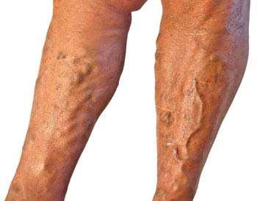
CLINICAL MANIFESTATION
Cosmetically disfigurement
Dull aches, muscle cramps, and increased muscle fatigue in the lower legs.
Ankle edema and a feeling of heaviness of the legs
Nocturnal cramps

Slide 12

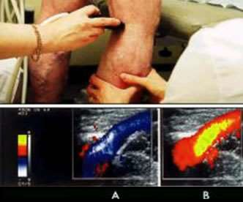
DIAGNOSIS
HISTORY COLLECTION
PHYSICAL EXAMINATION
DUPLEX ULTRASONOGRAPHY
VENOGRAPHY
Ascending
descending

Slide 13

Complications
Bleeding
Thrombophlebitis
Venous Hypertension leading to venous ulcer
Calcification
Eczematoid dermatitis and pigmentation

Slide 14

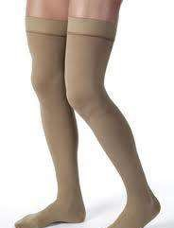
Conservative management
Avoiding prolonged standing
Crepe bandaging and elastic stockings from toe to thigh, which causes decreased edema, venous volume and reflux and increases venous return.
Limb elevation above the level of heart while lying down

Slide 15
Sclerotherapy
A chemical is injected into the vein, irritating the venous endothelium and producing localized phlebitis and fibrosis, thereby obliterating the lumen of the vein
Under Ultrasound guidance.

Slide 16
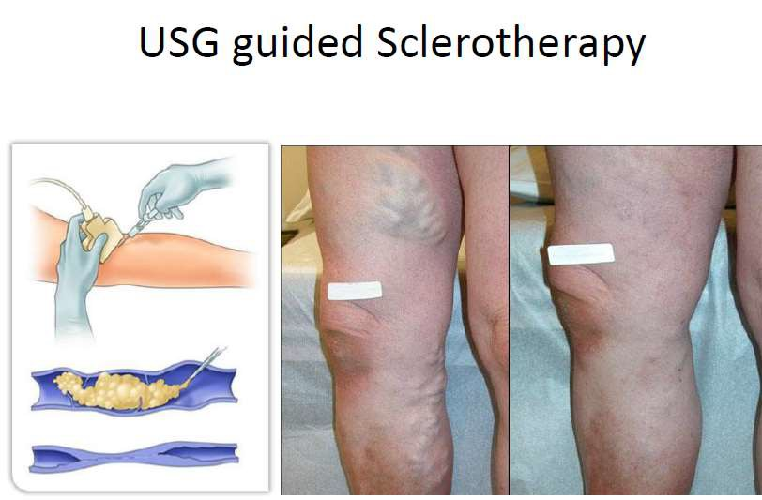
Spread of foam monitored under USG guidance as it spreads.
Apex of saphenous opening compressed by probe to prevent foam entering deep veins.
Leg also elevated
After leg is wrapped with
elastic bandage 24-72 hrs

Slide 17

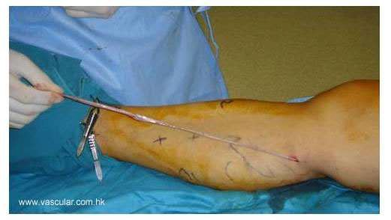
Surgical management
High end ligation and stripping
Ligation of entire vein and dissection and removal of its tributaries

Slide 18

Nursing management
Bed rest is maintained for 24 hours, after which the patient begins walking every 2 hours for 5 to 10 minutes.
Elastic compression stockings are used to maintaincompression of the leg. They are worn continuously for about 1 week after vein stripping
The foot of the bed should be elevated, Standing still and sitting are discouraged
Usually, the patient may shower after the first 24 hours. The patient is instructed to dry the incisions well with a clean towel using a patting technique rather than rubbing

Slide 19
