Slide 1

DEEP VEIN THROMBOSIS
Odessa National Medical University
Assistant Professor, PhD, Oleksandr Chaika

Slide 2
What Is Deep Vein Thrombosis ?

Slide 3
INTRODUCTION :
Venous thromboembolism (VTE) A condition in which a blood clot (thrombus) forms in a vein, which in some cases then breaks free and enters the circulation as an embolus, finally lodging in and completely obstructing a blood vessel, e.g., in lungs causing a PE (PULMONARY EMBOLISM)
The most common type of venous thromboembolism is DEEP VEIN THROMBOSIS, which occurs in veins deep within the muscles of the leg,arm and pelvis.
A superficial venous thrombosis (also called phlebitis or superficial thrombophlebitis) is a blood clot that develops in a vein close to the surface of the skin. These types of blood clots do not usually travel to the lungs unless they move from the superficial system into the deep venous system first.

Slide 4
DEF:
Deep vein thrombosis is the formation of a blood clot in one of the deep veins of the body, usually in the leg

Slide 5
Symptoms
Common symptoms include :
swelling in your foot, ankle, or leg, usually on one side
cramping pain in your affected leg that usually begins in your calf
severe, unexplained pain in your foot and ankle
An area of skin that feels warmer than the skin on the surrounding areas
skin over the affected area turning pale or a reddish or bluish color

Slide 6
ETIOLOGY
Starts in Lower extremity calf veins
progressing proximally to involve
Popliteal, Femoral, iliac system

Slide 7
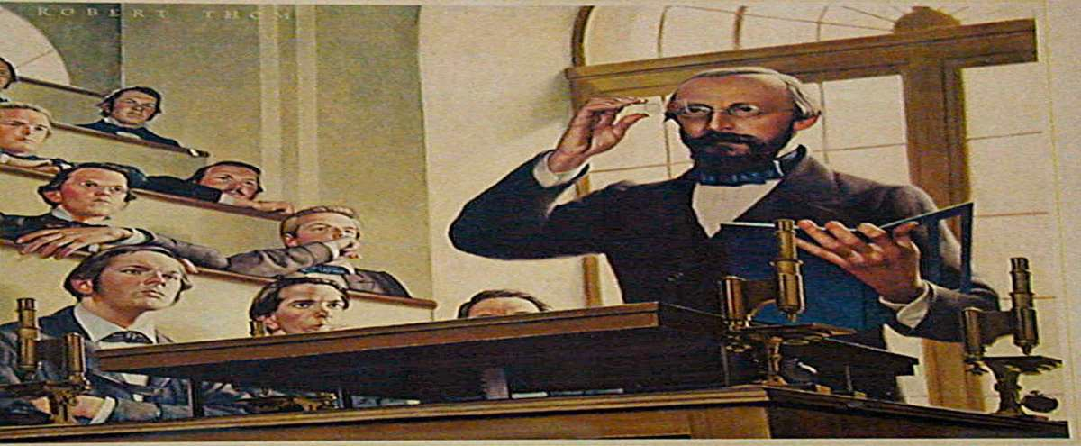
Virchow triad
More than 100 years ago, Rudolf Virchow described a triad of factors of
-

Slide 8



Venous stasis
Hypercoagula ble state
Endothelial damage

Slide 9
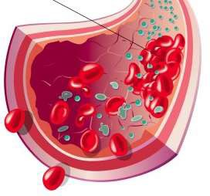
Venous stasis
prolonged bed rest (4 days or more)
A cast on the leg
Limb paralysis from stroke
spinal cord injury
extended travel in a vehicle

Slide 10
Hypercoagulability
Surgery and trauma - 40% of all thrombo embolic disease
Malignancy
increased estrogen
Inherited disorders of coagulation -Deficiencies of protein-S, protein-C, anti-thrombin III.
Acquired disorders of coagulation- Nephrotic syndrome, Anti- phospholipid antibodies
•

Slide 11
Endothelial Injury
Trauma
Surgery
Invasive procedure
Iatrogenic causes –
central venous catheters
Subclavian
Internal jugular lines
These lines cause of upper extremity DVT.

Slide 12
Pathophysiology
Vessel trauma stimulates the clotting cascade.
Platelets aggregate at the site particularly when venous stasis present
Platelets and fibrin form the initial clot RBC are trapped in the fibrin meshwork

Slide 13
The thrombus propagates in the direction of the blood flow.
Inflammation is triggered, causing tenderness, swelling, and
erythema.
Pieces of thrombus may break loose and travel through circulation- emboli.
Fibroblasts eventually invade the thrombus, scarring vein wall and destroying valves. Patency may be restored valve damage is permanent, affecting directional flow.

Slide 14
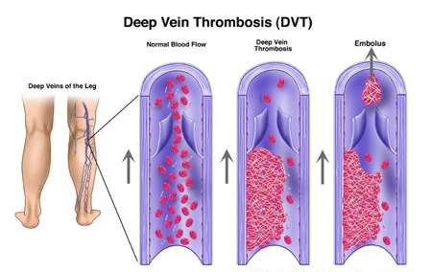

Slide 15
Presentation and Physical Examination
Calf pain or tenderness, or both
Swelling with pitting oedema
Increased skin temperature and fever
Superficial venous dilatation
Cyanosis can occur with severe obstruction
Less frequent manifestations of venous thrombosis include
Phlegmasia alba dolens,
Phlegmasia cerulea dolens, and
Venous gangrene.
These are clinical spectrum of the same disorder.

Slide 16
Complications
Pulmonary embolism
A pulmonary embolism occurs when a blood vessel in your lung becomes blocked by a blood clot (thrombus) that travels to your lungs from another part of your body, usually your leg.
A pulmonary embolism can be fatal. So, it's important to be on the lookout for signs and symptoms of a pulmonary embolism and seek medical attention if they occur. Signs and symptoms of a pulmonary embolism include:
Unexplained sudden onset of shortness of breath
Chest pain or discomfort that worsens when you take a deep breath or when you cough
Feeling lightheaded or dizzy, or fainting Rapid pulse
Coughing up blood

Slide 17
Postphlebitic syndrome
A common complication that can occur after deep vein thrombosis is a condition known as postphlebitic syndrome, also called postthrombotic syndrome. This syndrome is used to describe a collection of signs and symptoms, including:
Swelling of your legs (edema) Leg pain
Skin discoloration Skin sores
This syndrome is caused by damage to your veins from the blood clot. This damage reduces blood flow in the affected areas. The symptoms of postphlebitic syndrome may not occur until a few years after the DVT.

Slide 18
Tests and diagnosis
Ultrasound. A wand-like device (transducer) placed over the part of your body where there's a clot sends sound waves into the area. As the sound waves travel through your tissue and reflect back, a computer transforms the waves into a moving image on a video screen. A clot may be visible in the image.
Sometimes a series of ultrasounds are done over several days to determine whether a blood clot is growing or to be sure a new one hasn't developed.
Blood test. Almost all people who develop severe deep vein thrombosis have an elevated blood level of a clot-dissolving substance called D dimer.
Venography. A dye (contrast agent) is injected into a large vein in your foot or ankle. An X-ray procedure creates an image of the veins in your legs and feet, to look for clots. However, less invasive methods of diagnosis, such as ultrasound, can usually confirm the diagnosis.
CT or MRI scans. Both computerized tomography (CT) scan and magnetic resonance imaging (MRI) can provide visual images of your veins and may show if you have a clot. Sometimes a clot is found when these scans are performed for other reasons.

Slide 19
Treatments and drugs
Deep vein thrombosis treatment is aimed at preventing the clot from getting any bigger, as well as preventing the clot from breaking loose and causing a pulmonary embolism. After that, the goal becomes reducing your chances of deep vein thrombosis happening again.
Deep vein thrombosis treatment options include:
Blood thinners. Medications used to treat deep vein thrombosis include the use of anticoagulants, also sometimes called blood thinners, whenever possible. These are drugs that decrease your blood's ability to clot. While they don't break up existing blood clots, they can prevent clots from getting bigger or reduce your risk of developing additional clots.
Usually, you'll first be given a shot or infusion of the blood thinner heparin for a few days. After starting heparin injections, your treatment may be followed by another injectable blood thinner, such as enoxaparin (Lovenox), dalteparin (Fragmin) or fondaparinux (Arixtra). Other blood thinners can be given in pill form, such as warfarin (Coumadin, Jantoven) or rivaroxaban (Xarelto). Newer blood thinners also may offer additional options in the near future.
You may need to take blood thinners for three months or longer. If you're prescribed any of these blood thinners, it's important to take your medication exactly as your doctor instructs. Blood-thinning medications can have serious side effects if you take too much or too little.

Slide 20
Clotbusters. If you have a more serious type of deep vein thrombosis or pulmonary embolism, or if other medications aren't working, your doctor may prescribe different medications.
One group of medications is known as thrombolytics. These drugs, called tissue plasminogen activators (TPA), are given through an IV line to break up blood clots or may be given through a catheter placed directly into the clot. These drugs can cause serious bleeding and are generally used only in life-threatening situations. For these reasons, thrombolytic medications are only given in an intensive care ward of a hospital.
Filters. If you can't take medicines to thin your blood, a filter may be inserted into a large vein — the vena cava — in your abdomen. A vena cava filter prevents clots that break loose from lodging in your lungs.
Compression stockings. These help prevent swelling associated with deep vein thrombosis. These stockings are worn on your legs from your feet to about the level of your knees.
This pressure helps reduce the chances that your blood will pool and clot. You should wear these stockings during the day for at least two to three years if possible. Compression stockings can help prevent postphlebitic syndrome.

Slide 21
Prevention
To prevent deep vein thrombosis, some common preventive measures include the following: Take any prescribed medications as directed. If you're having surgery, such as orthopedic surgery, you'll probably be given blood thinners while you're in the hospital. Your doctor may also prescribe aspirin or other medications that help prevent clots to be taken for a while after surgery.
Avoid sitting still. If you've had surgery or have been on bed rest for other reasons, try to get moving as soon as possible. If you're sitting for a while, try not to cross your legs because this can limit blood flow. If you're traveling a long distance by car, stop every hour or so and walk around. If you're on a plane, try to stand or walk occasionally. If you can't do that, at least try to exercise your lower legs. Try raising and lowering your heels while keeping your toes on the floor, then raising your toes while your heels are on the floor.
Make lifestyle changes. Lose weight and quit smoking. Obesity and smoking increase your risk of deep vein thrombosis.
Get regular exercise. Exercise lowers your risk of blood clots, which is especially important for people who have to sit a lot or travel frequently.

Slide 22


