Slide 1
PEPTIC ULCER. PERFORATED ULCER. GASTROINTESTINAL BLEEDING
ODESSA NATIONAL MEDICAL UNIVERSITY
UNIVERSITY CLINIC DEPARTMENT of SURGERY #3

Slide 2
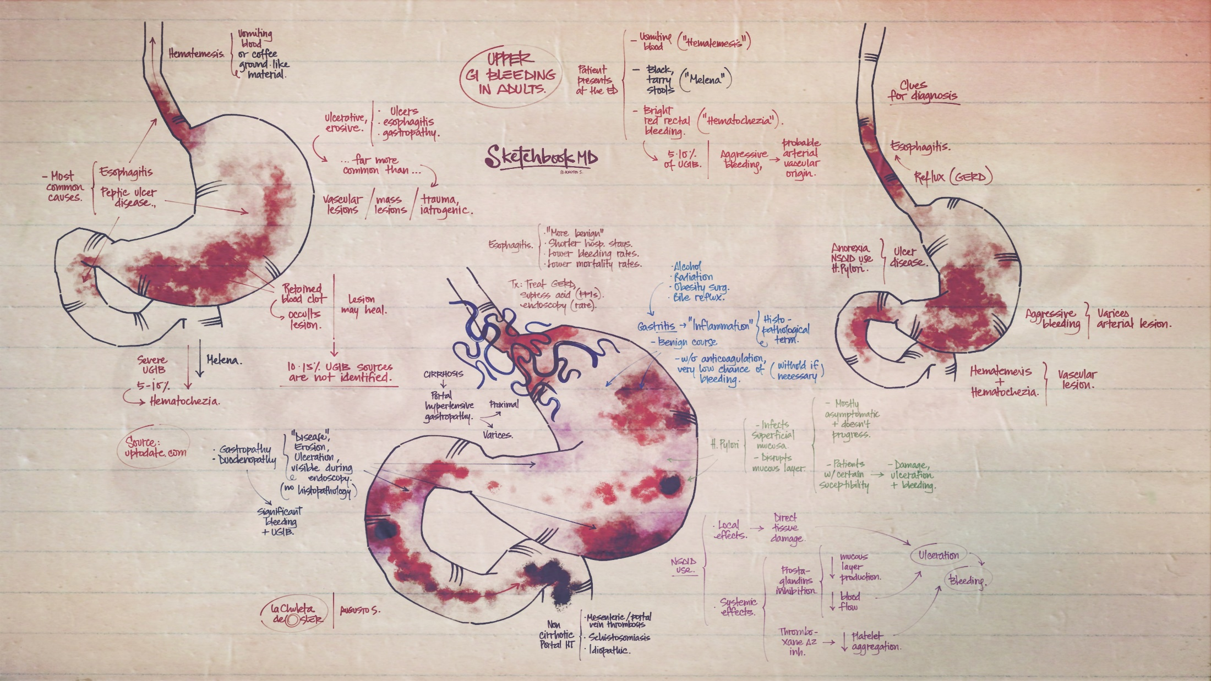

Slide 3
Peptic ulcer disease
Peptic ulcer disease (PUD) refers to the full-thickness ulcerations of duodenal or gastric mucosa. The ulcerations form when exposure to acid and digestive enzymes overcomes mucosal defense mechanisms.
The most common etiologies include Helicobacter pylori (H. pylori) infection and prolonged use of non-steroidal anti-inflammatory drugs (NSAIDs). Patients may be asymptomatic or may present with abdominal pain, nausea, and early satiety.
Peptic ulcer disease typically responds well to medical treatment consisting of H. pylori eradication, eliminating risk factors, and proton pump inhibitors (PPIs).
If left untreated, it can lead to bleeding, perforation, gastric outlet obstruction, and gastric cancer.

Slide 4
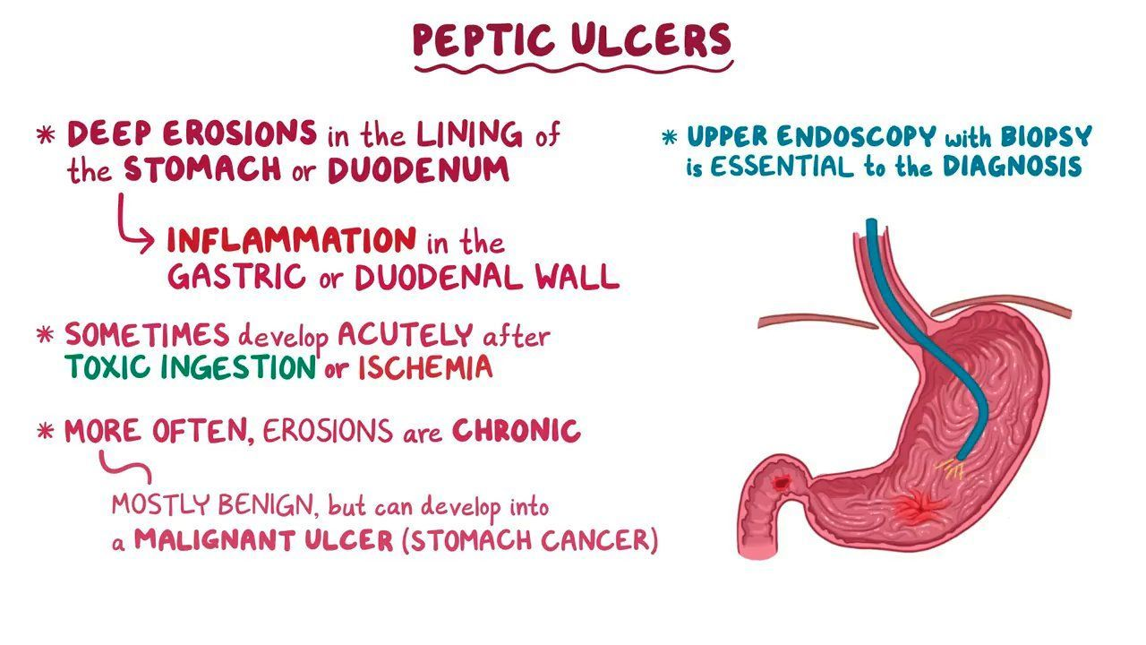

Slide 5
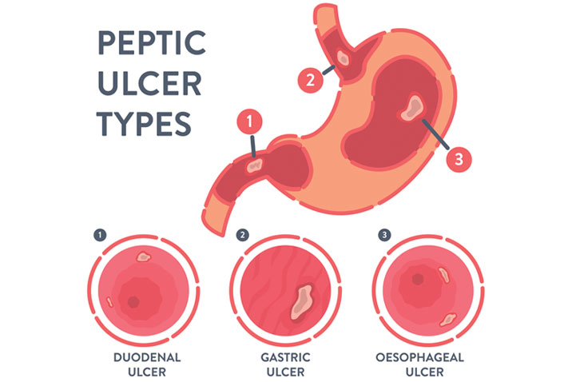

Slide 6
Introduction
Definition
A peptic ulcer is a mucosal defect in the wall of the stomach or duodenum that penetrates the muscularis mucosa.
Epidemiology
Incidence:
  Uncomplicated peptic ulcer disease (PUD): 1 case per 1,000 person-years in the general population
  PUD complications: 0.7 cases per 1,000 person-years in the general population
Duodenal ulcers > gastric ulcers (3:1)
Affects men and women equally
Duodenal ulcers occur, on average, 2 decades earlier than gastric ulcers.
PUD rates have been falling over the past few decades.

Slide 7
Etiology
Infection:
  Helicobacter pylori or H. pylori (most common):
    80%–90% duodenal ulcers
    70%–80% gastric ulcers
  Viruses:
    Herpes simplex virus (HSV)
    Cytomegalovirus (CMV)
  Rare infections:
    Tuberculosis (TB)
    Syphilis
    Mucormycosis
Medications:
  Non-steroidal anti-inflammatory drugs (NSAIDs; most common)
  Medications linked to PUD or risk exacerbated by combination with NSAIDs:
    Bisphosphonates
    Clopidogrel
    Corticosteroids
    Spironolactone
  Chemotherapy
  Sirolimus
  Mycophenolate mofetil
  Potassium chloride

Slide 8
Etiology
Hormonal:
  Gastrinoma (Zollinger-Ellison syndrome)
  Antral G-cell hyperplasia/hyperfunction (gastritis)
Post-surgical:
  Antral exclusion
  Gastric bypass
Ischemic: cocaine use
Decompensated chronic diseases:
  Cirrhosis
  Renal failure
  Chronic obstructive pulmonary disease (COPD)
  Prolonged intensive care unit (ICU) stay for any reason
Idiopathic
Other rare causes:
  Annular pancreas
  Sarcoidosis
  Crohn’s disease
  Radiation

Slide 9
Risk factors
In many cases, the listed etiologies are not enough to produce PUD.
Contributing risk factors to PUD development:
Smoking
Alcohol
Stress (severe illness–related, psychologic)
Diet
Genetic predisposition
Blood types A and O

Slide 10
Pathophysiology
Anatomic location of ulcers
Duodenal ulcer: an ulcer located in the duodenum, typically in the duodenal bulb (1st part)
Gastric ulcer: an ulcer in the stomach lining, commonly in the lesser curvature of the stomach near the junction of the fundus and antral mucosa (or type I)

Slide 11
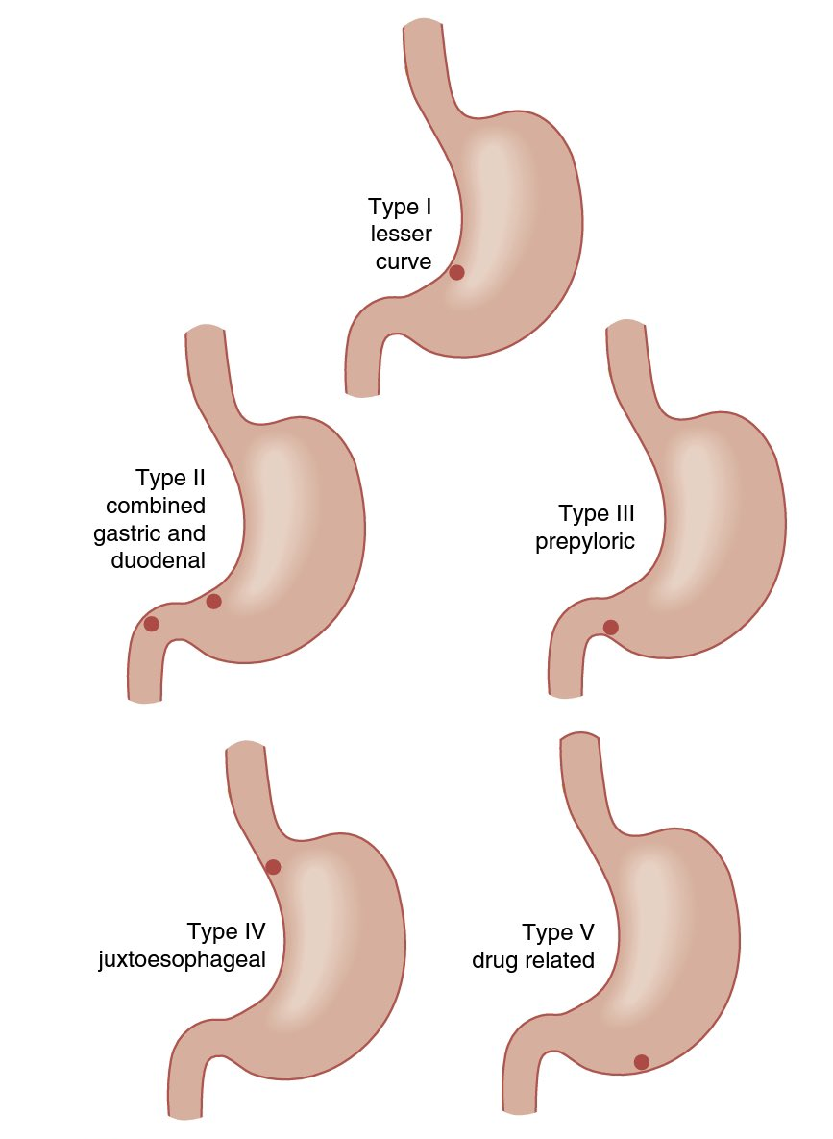
Table: Classification of gastric ulcers by location (modified Johnson classification)
Type | Location | Acid level
I | Lesser curve of the stomach at the incisura angularis | Low to normal
II | Gastric body; coexists with duodenal ulcer | Increased
III | In the pyloric channel (within 3 cm of pylorus) | Increased
IV | Proximal gastroesophageal ulcer | Normal
V | Anywhere in the stomach (aspirin/NSAID induced) | Normal

Slide 12
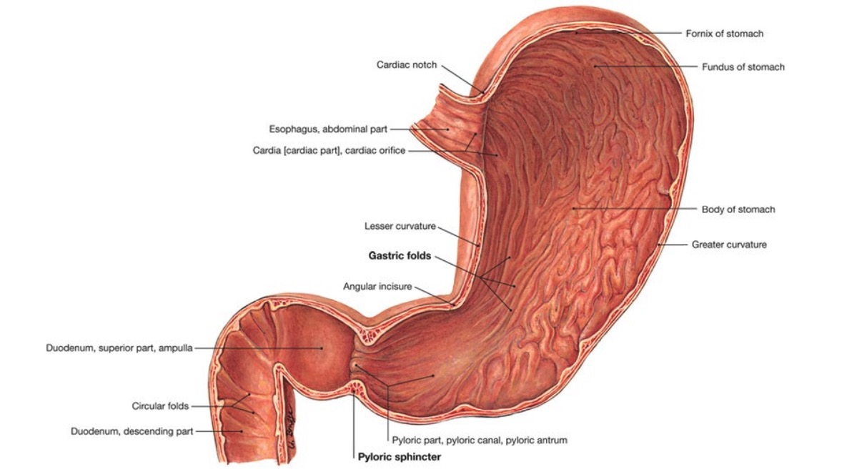

Slide 13
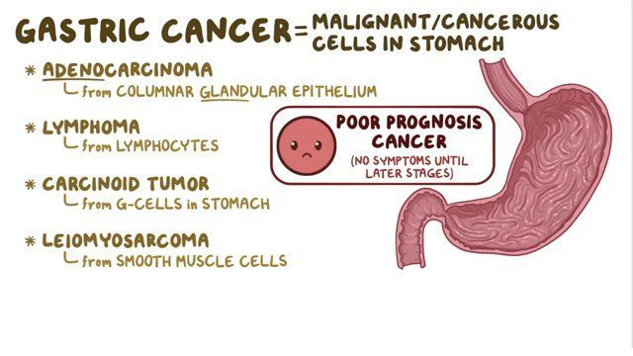

Slide 14
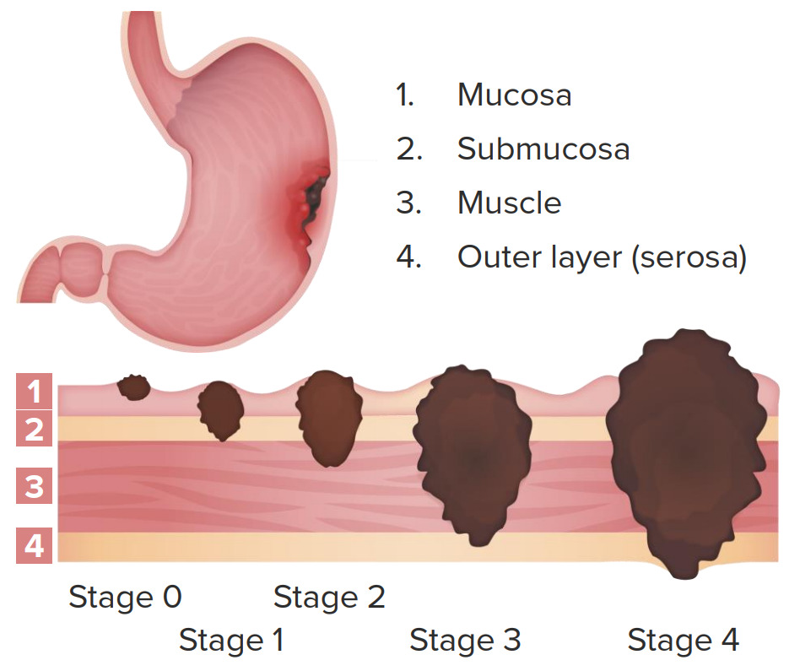

Slide 15
Pathophysiology
Stomach and duodenum:
  Normally exposed to a toxic environment (acid + pepsin)
  Imbalance between offending agents and defense mechanisms leads to PUD.
Defense preventing mucosal injury:
  Mucus-bicarbonate-phospholipid layer
  Epithelial layer (repair of which is regulated by prostaglandins)
  Subepithelial defense (mucosal blood flow for supply of nutrients and oxygen, disposal of noxious agents)

Slide 16
Pathophysiology
Mechanisms by offending agents:
  Increased gastric acid secretion:
    H. pylori gastritis or inflammation: ↑ gastric acid, inhibits somatostatin, ↓ mucus
    NSAID inhibition of COX 1 → ↓ prostaglandin (↓ mucus, ↓ mucosal blood flow, ↓ epithelial proliferation)
    NSAID inhibition of COX 2 → delays healing
  Impaired duodenal bicarbonate secretion (in patients with duodenal ulcers)
  Effects of other etiologies or risk factors:
    Smoking → ↑ acid secretion, ↓ prostaglandin
    Zollinger-Ellison syndrome (gastrinoma) → ↑ gastrin
    Brain injury increases intracranial pressure, overstimulates vagus nerve → ↑ gastric acid (Cushing’s ulcer)
    Burn injury (stress) → reduced volume, cell necrosis → gastric mucosal sloughing → impaired barrier (Curling’s ulcer)

Slide 17
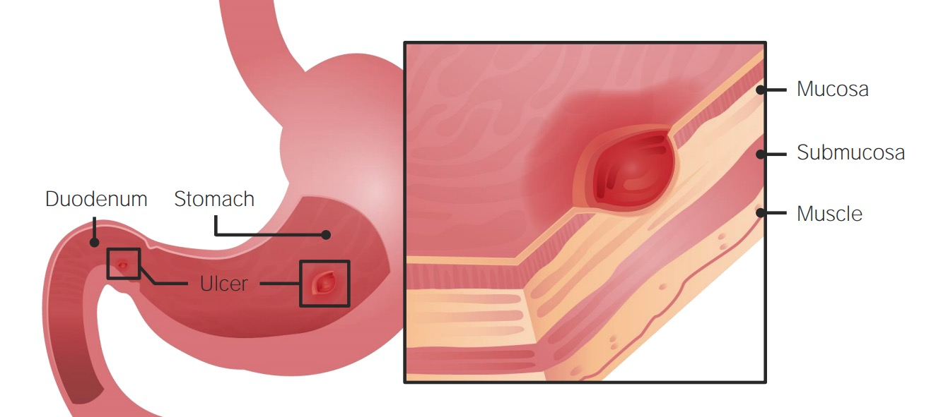

Slide 18
Clinical Presentation
Asymptomatic
70% of PUD patients
Older adults
Patients taking NSAIDs
Complication(s) (bleeding or perforation) may be the 1st clinical presentation without antecedent symptoms.

Slide 19
Clinical Presentation
Symptomatic
Abdominal pain:
  Epigastric with radiation to left or right upper quadrants
  Sometimes radiates to the back
  Classic duodenal ulcer pain: 2–5 hours after eating and at night (when acid is secreted without food)
  Sometimes exacerbated by eating (pyloric channel ulcers)
Other symptoms:
  Nausea/vomiting
  Early satiety
  Postprandial fullness/bloating
  Belching

Slide 20
Diagnosis
History
Review of common risk factors:
NSAID/aspirin use
Concomitant use of high-risk medications
Underlying chronic disease
Prior gastric surgery or radiation
Laboratory studies
Anemia (occult bleeding and/or iron malabsorption)
High fasting gastrin levels (if Zollinger-Ellison syndrome is suspected)

Slide 21
Diagnosis
Esophagogastroduodenoscopy (EGD)
Most accurate diagnostic test
Findings:
  Gastric ulcer:
    Usually solitary discrete mucosal lesions, with punched-out smooth base
    Benign lesions have smooth, rounded edges (as opposed to irregular edges noted in malignant lesions).
    Typically in lesser curvature
  Duodenal ulcer:
    Small breaks in the mucosa, often < 1 cm
    Noted usually in the 1st part of the duodenum

Slide 22
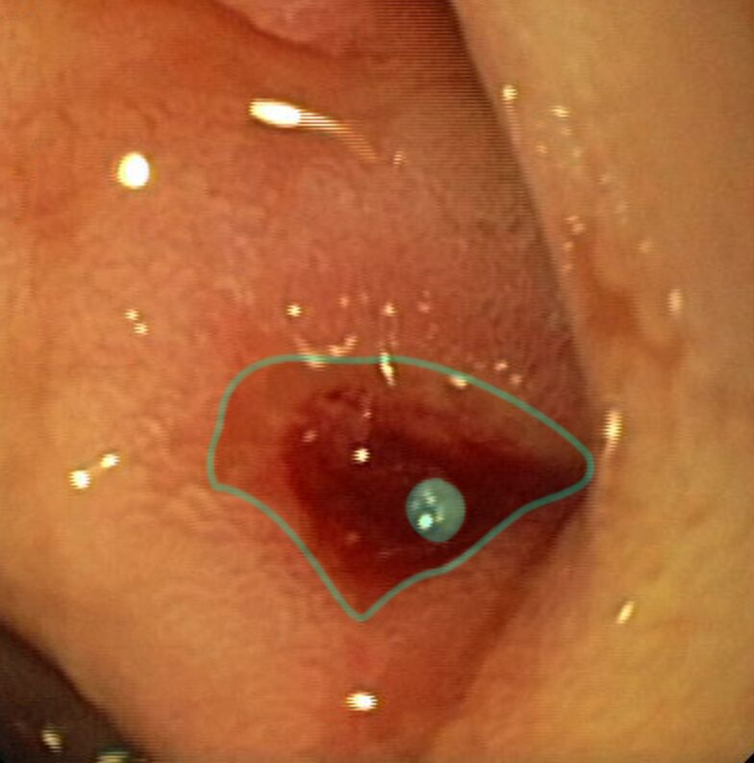
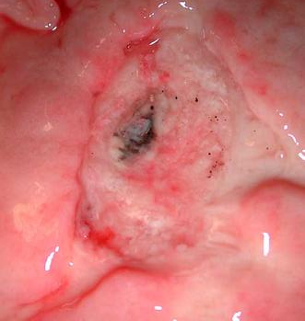

Slide 23
Diagnosis
Indications for biopsy:
  Suspected malignancy (ulcerated mass, irregular margins, abnormal mucosal folds)
  Any gastric ulcer in areas with a high incidence of gastric cancer
  If unusual etiology is suspected (e.g., sarcoidosis)
  Gastric mucosal biopsy of antrum and body (in addition to the ulcer itself) for H. pylori detection

Slide 24
Tests for H. pylori
Non-invasive:
  Stool antigen assay:
    For initial diagnosis
    To confirm eradication
  Urea breath test:
    Patient is given radioactively labeled urea orally.
    Urease produced by H. pylori splits urea and liberates CO₂.
    Radioactive CO₂ is detected in the breath.
  Serology:
    Detection of serum IgG against H. pylori
    Low accuracy
    IgG remains positive after eradication.

Slide 25
Tests for H. pylori
Invasive (require sampling of gastric mucosa):
  Biopsy urease test:
    Urease produced by H. pylori liberates ammonia from urea.
    Alkaline pH changes color of a pH reagent.
  Histology:
    Accuracy improved by stains (immunohistochemical, Giemsa stains)
    Curved, flagellated gram-negative rods are seen.
  Bacterial culture and sensitivity

Slide 26
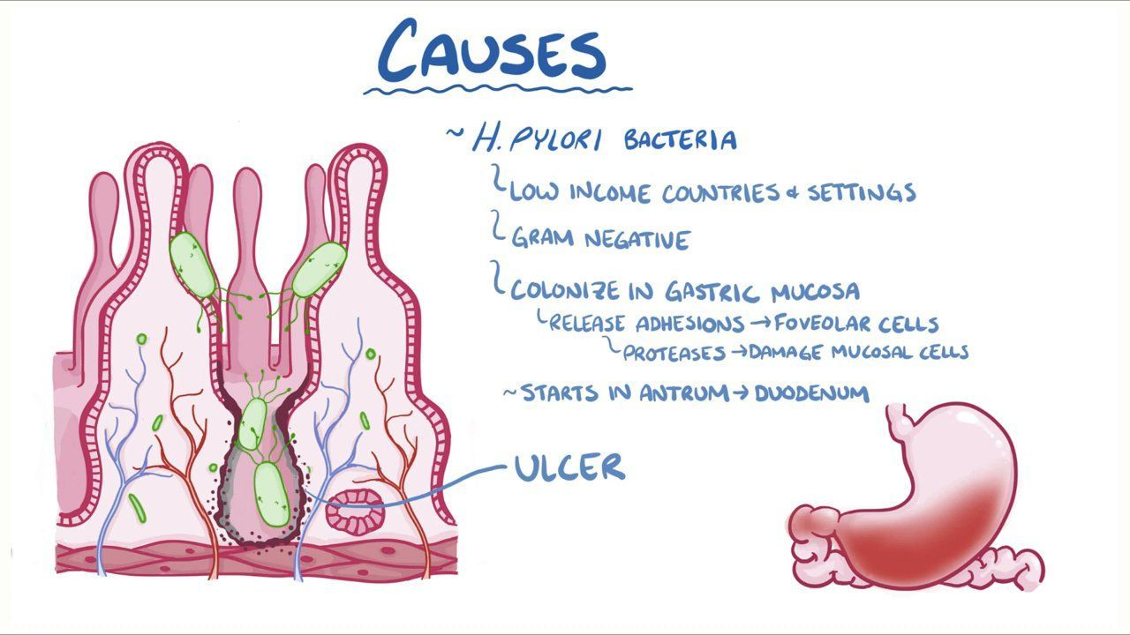

Slide 27
Management
Risk factor modification
Discontinue NSAIDs.
Stop smoking, and discontinue intake of alcohol and drugs.
Bland diet
Medications
H. pylori eradication:
  A combination of an antibiotic regimen and proton pump inhibitors (PPIs):
    Triple therapy: PPI + clarithromycin + amoxicillin or metronidazole
    Bismuth-containing quadruple therapy: PPI + bismuth + tetracycline + metronidazole
  Confirm H. pylori eradication after treatment.

Slide 28
Management
PPIs:
  Uncomplicated ulcers:
    Given for 2 weeks (plus antibiotic treatment for H. pylori if positive)
    Longer if the patient has indications for maintenance therapy
  Complicated ulcers (bleeding, penetration, obstruction, or perforation):
    Duodenal ulcer: 4–8 weeks
    Gastric ulcer: 8–12 weeks (confirmation of ulcer healing needed)
    Longer if the patient has indications for maintenance therapy
  Maintenance therapy:
    If NSAIDs or aspirin need to be continued
    Giant ulcer (> 2 cm)
    H. pylori negative, NSAID-negative ulcers
    Recurrent PUD (> 2/year)

Slide 29
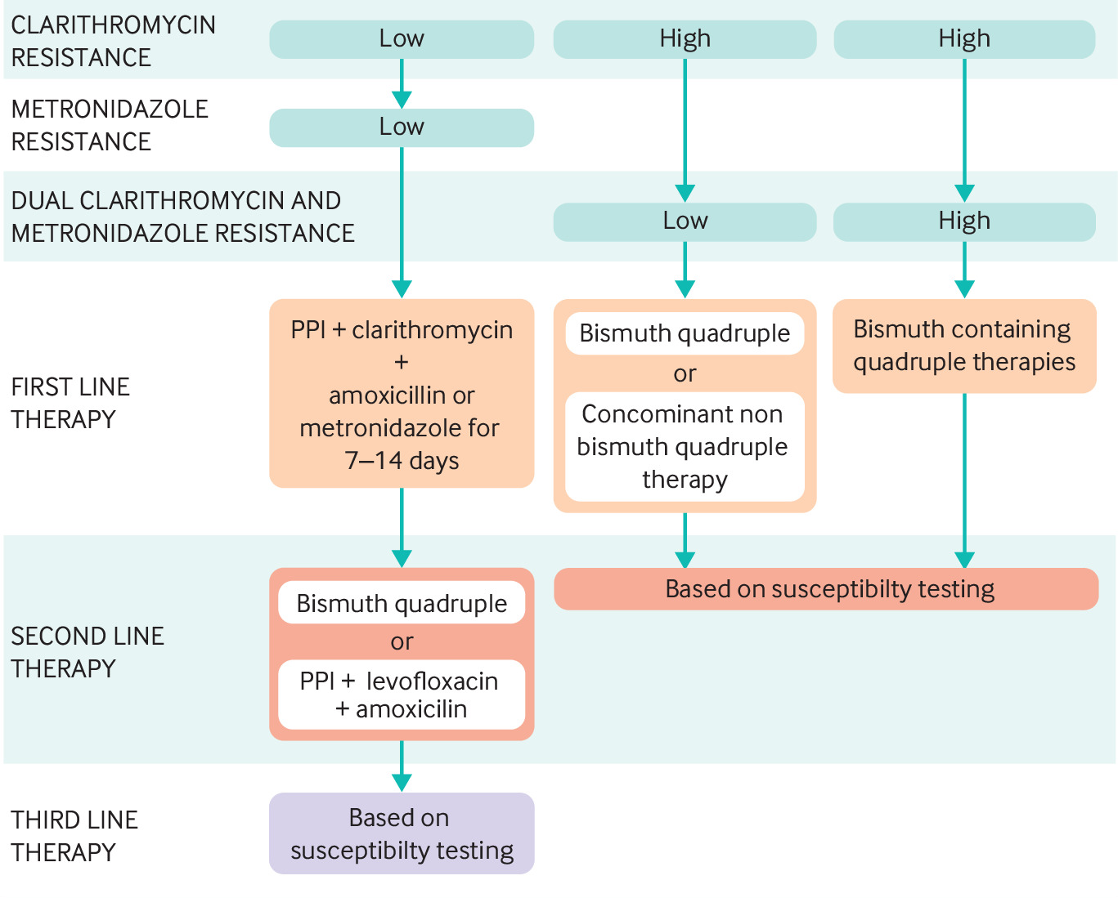

Slide 30
Management
Repeat endoscopy
Duodenal ulcers:
  Usually not necessary
  If symptoms persist with treatment > 4 weeks
  If evidence of ongoing bleeding
Gastric ulcers:
  Persistent symptoms despite 8–12 weeks of medical therapy
  Unclear etiology
  Giant ulcer (> 2 cm)
  Ulcer was suspicious for malignancy on the 1st endoscopy (even with negative biopsy).
  Evidence of ongoing bleeding
  Failure to eradicate H. pylori infection
  Risk factors for gastric cancer:
    Age > 50
    H. pylori
    Family history
    Immigrants from endemic areas (Japan, Korea)
    Gastric atrophy, metaplasia/dysplasia, adenoma

Slide 31
Surgical treatment
Uncommon because medical therapy is very effective
Indications for surgery:
  Management of complications:
    Bleeding
    Perforation
    Gastric outlet obstruction
  PUD refractory to medical management
  Non-compliance or intolerable side effects of medications

Slide 32
Surgical treatment
Surgical principles:
  Prevent ulcer complications: ulcer resection
  Reduce acid secretion: vagotomy, antrectomy
  Minimize postoperative physiologic disturbances: pyloroplasty to facilitate gastric emptying after vagotomy
Procedures:
  Highly selective vagotomy: Only the vagal branches stimulating acid secretion are transected.
  Vagotomy and drainage (pyloroplasty or gastrojejunostomy)
  Procedures involving partial stomach resection:
    Vagotomy and antrectomy: removes the acid-producing portion of the stomach
    Partial gastrectomy: removes the portion of the stomach containing the gastric ulcer
    Reconstruction needed for a partial gastrectomy: by gastroduodenal (Billroth I) or gastrojejunal (Billroth II) anastomosis

Slide 33
Complications
Gastrointestinal bleeding
Patients present with hematemesis and/or melena.
May be chronic/low grade and present as anemia
Acute bleeding is usually approached with endoscopic intervention.
Dieulafoy lesion: vascular malformation in the stomach (submucosa) that ulcerates and causes massive bleeding
Surgery may be required if unable to achieve control endoscopically.
Perforation
Sudden onset of severe diffuse abdominal pain, peritonitis, tachycardia
Emergent surgery is required.
Penetration
Walled-off perforation or perforation into the retroperitoneal space
Symptoms not as pronounced as with a free perforation; subacute onset
Often results in an abscess formation or fistulas to the surrounding organs (colon, biliary tree, blood vessels)

Slide 34
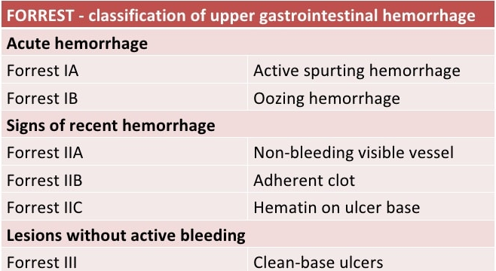

Slide 35
Complications
Gastric outlet obstruction
Mechanical obstruction from peri-pyloric inflammation and scarring
1st-line treatment is H. pylori eradication and PPIs.
Endoscopic dilation for failure of medical management
Surgery as a last resort
Gastric cancer
Adenocarcinoma
MALToma (mucosa-associated lymphoid tissue)
Both associated with chronic H. pylori infection and atrophic gastritis

Slide 36
Complications
Upper GI bleeding is the most common complication of peptic ulcer disease. The next most common complication is perforation.
The annual incidence of upper GI bleeding secondary to a peptic ulcer is estimated to be between 19 to 57 cases per 100,000 individuals. In comparison, ulcer perforation is expected to be 4 to 14 cases per 100,000 individuals.
Advanced age is a risk factor as 60% of patients with PUD are older than 60. Infections with Helicobacter pylori and the use of nonsteroidal anti-inflammatory drugs (NSAIDs) are each identified as risk factors for the development of bleeding ulcers and peptic ulcer perforation.

Slide 37
Perforating Ulcer
Clinical Presentation
Most patients with a perforated peptic ulcer will present with symptoms. The most common symptom in patients with peptic ulcer disease is dyspepsia or upper abdominal pain. This pain may be vague upper abdominal discomfort or it may be localized to either the right upper quadrant, left upper quadrant, or epigastrium.
Gastric ulcers may be worsened by food whereas pain from a duodenal ulcer may be delayed 2-5 hours after eating. Patients who are experiencing bleeding from a peptic ulcer may complain of nausea, hematemesis, or melanotic stools. Some patients may report bright red blood per rectum or maroon-colored stool if the upper GI bleeding is brisk.
A thorough physical examination should be done on all patients complaining of abdominal pain. Those with a perforated peptic ulcer are likely to have diffuse abdominal tenderness that progresses to guarding and rigidity.

Slide 38
Perforating Ulcer
Evaluation
The evaluation of a patient in whom perforated peptic ulcer is suspected should be done quickly as the morbidity and mortality increase significantly with time. Even if a perforated peptic ulcer is suspected due to history and physical examination, diagnostic studies should be obtained to confirm the diagnosis and to rule out other possible etiologies.
Typical workup includes labs and imaging studies. Standard labs should include complete blood count (CBC), chemistry panel, liver function tests, coagulation profile, and lipase levels (to rule out pancreatitis). Blood type and screening should be done as well.

Slide 39
Perforating Ulcer
Evaluation
Duodenal perforation can cause acute pain associated with free perforation, or less acute symptoms associated with abscess or fistula formation.
Perforation of the duodenum with spillage of intraluminal contents into the peritoneal cavity causes acute chemical peritonitis. This is followed by a systemic inflammatory response syndrome (SIRS), which can progress to secondary bacterial peritonitis and sepsis. Patients with retroperitoneal perforation may lack peritoneal signs and present more indolently.
Double-contrast computed tomography (CT) scan is the most valuable method for diagnosing duodenal perforation. It should be performed whenever there is a clinical suspicion and the patient does not need immediate surgery. CT features of perforation include discontinuity of the duodenal wall and the presence of extraluminal air or extravasated oral contrast. Other CT findings include duodenal wall thickening, fat stranding and periduodenal fluid collection.

Slide 40
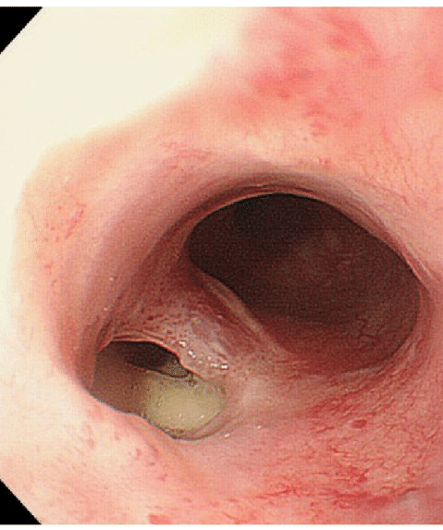
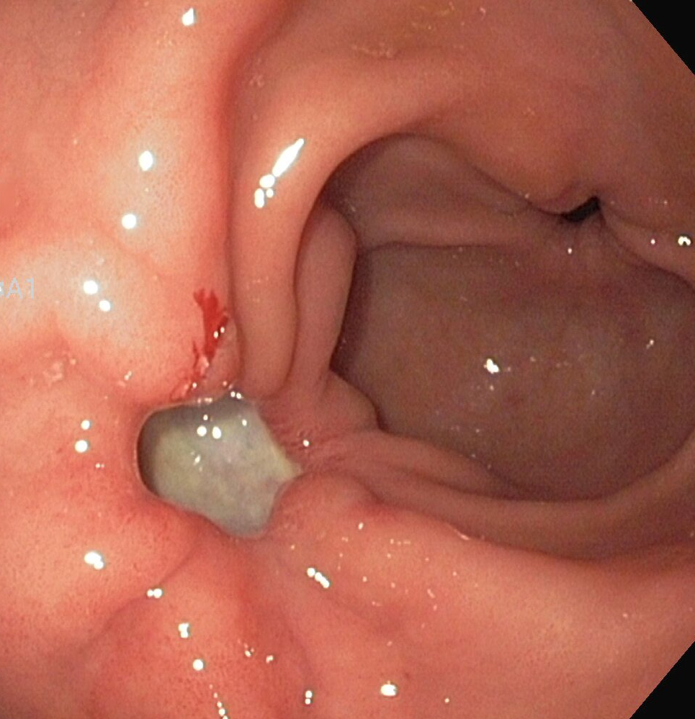

Slide 41
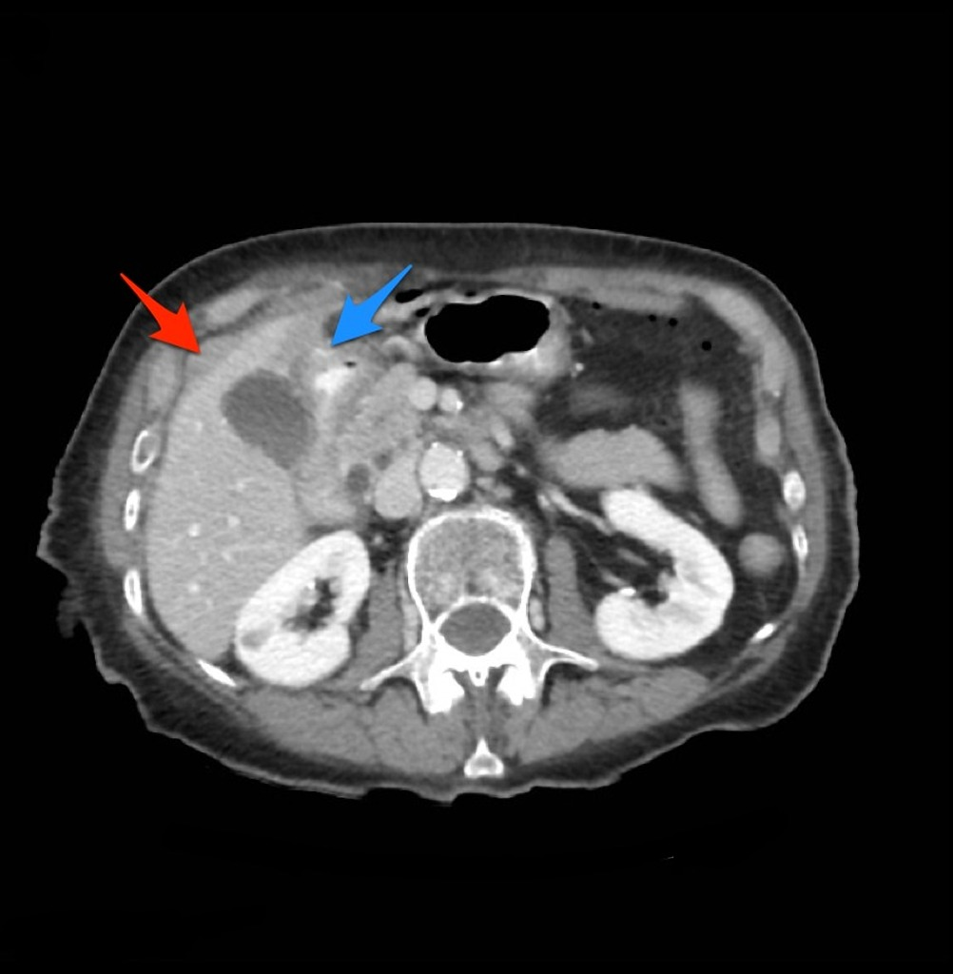
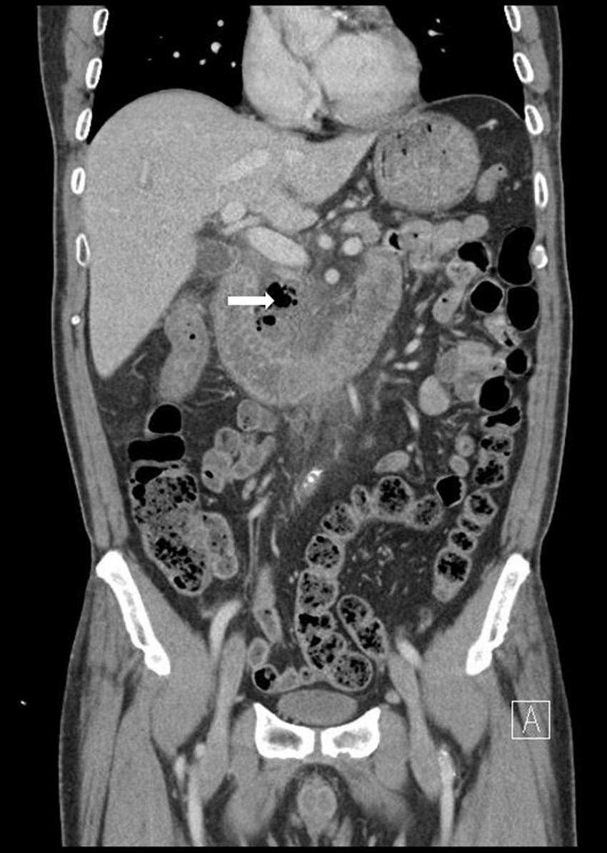

Slide 42
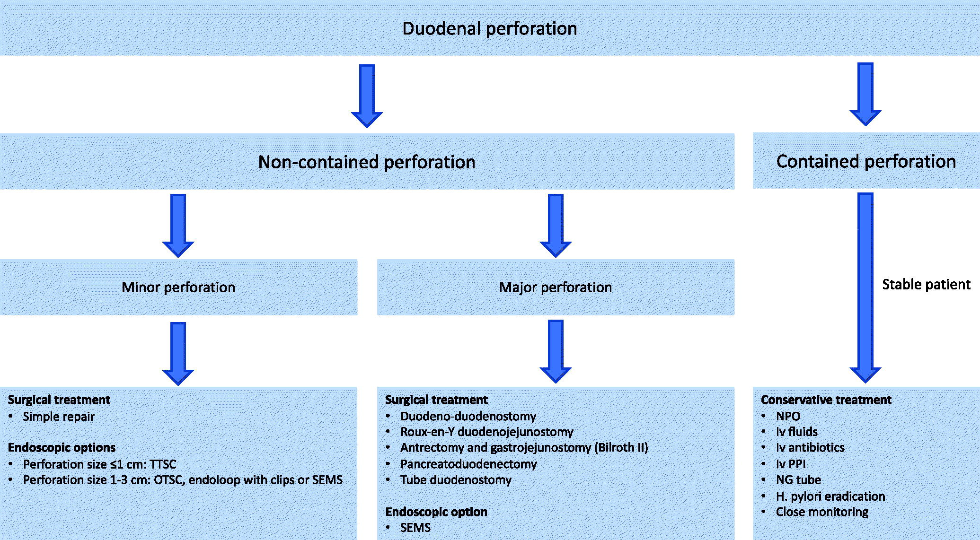

Slide 43
Management
The main goals of treatment are resuscitation, control of infection, nutritional support and restoration of gastrointestinal tract continuity.

Slide 44
Management
The main goals of treatment are resuscitation, control of infection, nutritional support and restoration of gastrointestinal tract continuity.

Slide 45
Management
Conservative treatment
Initial conservative management consists of nil per os, intravenous fluid therapy, broad-spectrum antibiotics, intravenous PPIs, nasogastric tube insertion and H. pylori eradication. The added value of somatostatin remains controversial.
Non-operative management of perforated duodenal ulcers is feasible in selected patients. Perforated ulcers may seal spontaneously with fibrin, omentum or by fusion of the duodenum to the underside of the liver between the gallbladder and the falciform ligament.
Operative management is usually recommended if there is free leakage of contrast medium into the peritoneal cavity. Progressive abdominal signs or intra-abdominal sepsis should warrant surgery.
In high-risk patients, who cannot tolerate surgical treatment, conservative management may also include percutaneous drainage of fluid collections.

Slide 46
Management
Endoscopic management
Endoscopic treatment is an attractive treatment modality due to its minimally invasive nature. Early endoscopic closure (<24 h) is considered to be technically easier because the inflammatory changes are less pronounced.
TTSC
Through-the-scope clips (TTSC) can be used for endoscopic closure of small duodenal perforations. Linear perforations <1 cm are most suitable for the use of TTSC.
OTSC
In contrast to common endoscopic clips, the over-the-scope clips (OTSC) are able to compress larger quantities of tissue. The OTSC technique can be used for perforations ranging from 1 to 3 cm.
Endoloop with clips
A combined technique using TTSC and an endoloop can be used if the OTSC technique is unavailable.
SEMS
Self-expandable metal stents (SEMS) are alternative endoscopic treatment options for duodenal perforations.

Slide 47
Management
Surgical treatment
The choice of surgical treatment depends on the size and localization of the perforation, the viability of the duodenal walls, the degree of local contamination and underlying etiology.
Simple surgical repair
The main surgical treatment is simple repair of the perforation site. This can be performed as a primary closure with or without the addition of an omental patch.
Alternatively, a pedicled omental flap (Cellan–Jones repair) or free omental plug (Graham patch) can be sutured into the perforation.
Sutureless techniques have also been developed using a gelatin sponge and fibrin glue to seal off the perforation. There seem to be no significant differences in terms of postoperative morbidity and mortality rates when comparing primary closure, omentopexy or tegmentation (without closure).
Surgical repair can be performed either with conventional open surgery or with laparoscopy.

Slide 48
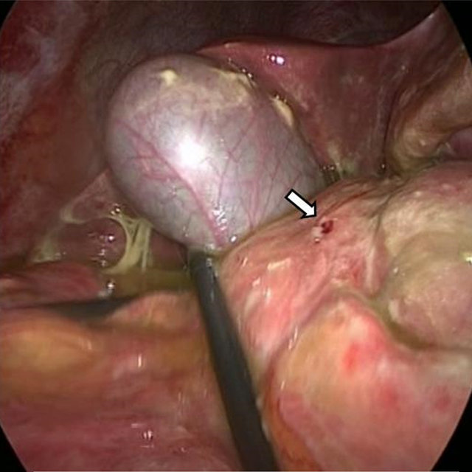
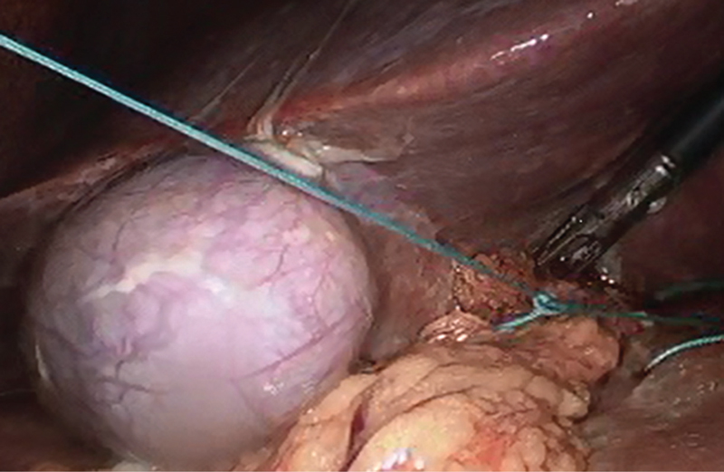

Slide 49
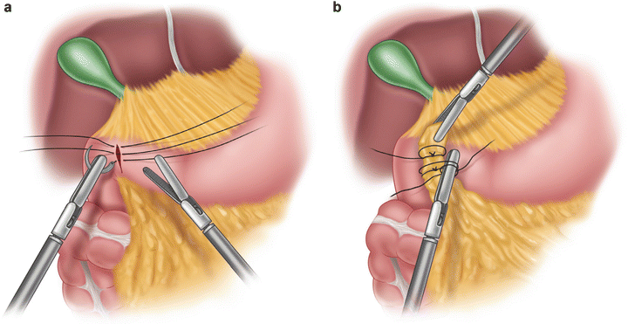

Slide 50
Management
Surgical treatment
Abdominal drains
The routine placement of abdominal drains after surgical repair is controversial. The literature suggests no benefit in preventing postoperative fluid collections or abscesses. Furthermore, drains may be associated with increased morbidity such as drain wound site infection.
Pyloric exclusion
Pyloric exclusion involves surgical repair of the duodenum, gastrotomy and closure of the pylorus from within and finally the formation of a gastrojejunostomy. The rationale behind this procedure is to divert all gastric and biliary secretions from the duodenum. The added benefit of using a gastric diversion procedure such as pyloric exclusion for duodenal perforations has been questioned in recent years. Importantly, the procedure has been associated with more postoperative complications and longer hospital stay compared to simple repair without pyloric exclusion.

Slide 51
Management
Surgical treatment
Reconstructive surgery
For large duodenal perforations, a duodeno-duodenostomy may be necessary. If this is not possible, a Roux-en-Y duodenojejunostomy may be performed over the perforation. A Billroth II operation may be necessary if the perforation is to the first or proximal second portion of the duodenum. If the duodeno-pancreatic head complex is destroyed, a pancreaticoduodenectomy may be necessary.
Tube duodenostomy
Tube duodenostomy is a damage control procedure for large duodenal perforations when other repair techniques are not possible due to the magnitude of duodenal damage, hemodynamic instability of the patient or the lack of surgical expertise for complex reconstruction. The perforation is sutured around a catheter inserted into the perforation to enhance directed fistulation of the perforation. The catheter is removed after a minimum of 6 weeks. A feeding jejunostomy may be placed for enteral nutritional support.

Slide 52
Prognostic factors
The main prognostic factor remains the time interval between the perforation and treatment. Mortality increases when the delay is greater than 24 h.
Other prognostic factors have been reported but are mainly related to clinical signs of sepsis, such as increased Acute Physiology and Chronic Health Evaluation II (APACHE II) score.
Old age and co-morbidity are also strong adverse prognostic factors.

Slide 53
Gastrointestinal Bleeding
Gastrointestinal bleeding (GIB) is a symptom of multiple diseases within the gastrointestinal (GI) tract.
Gastrointestinal bleeding is designated as upper or lower based on the etiology’s location to the ligament of Treitz.
It is more common to have bleeding in the upper GI tract, with peptic ulcer disease being the most frequent cause.
Depending on the location of the bleeding, the patient may present with hematemesis (vomiting blood), melena (black, tarry stool), or hematochezia (fresh blood in stools).
Some patients presenting with GIB can be hemodynamically unstable and require emergent stabilization and evaluation. The source of the bleed can often be located and treated with endoscopy.

Slide 54
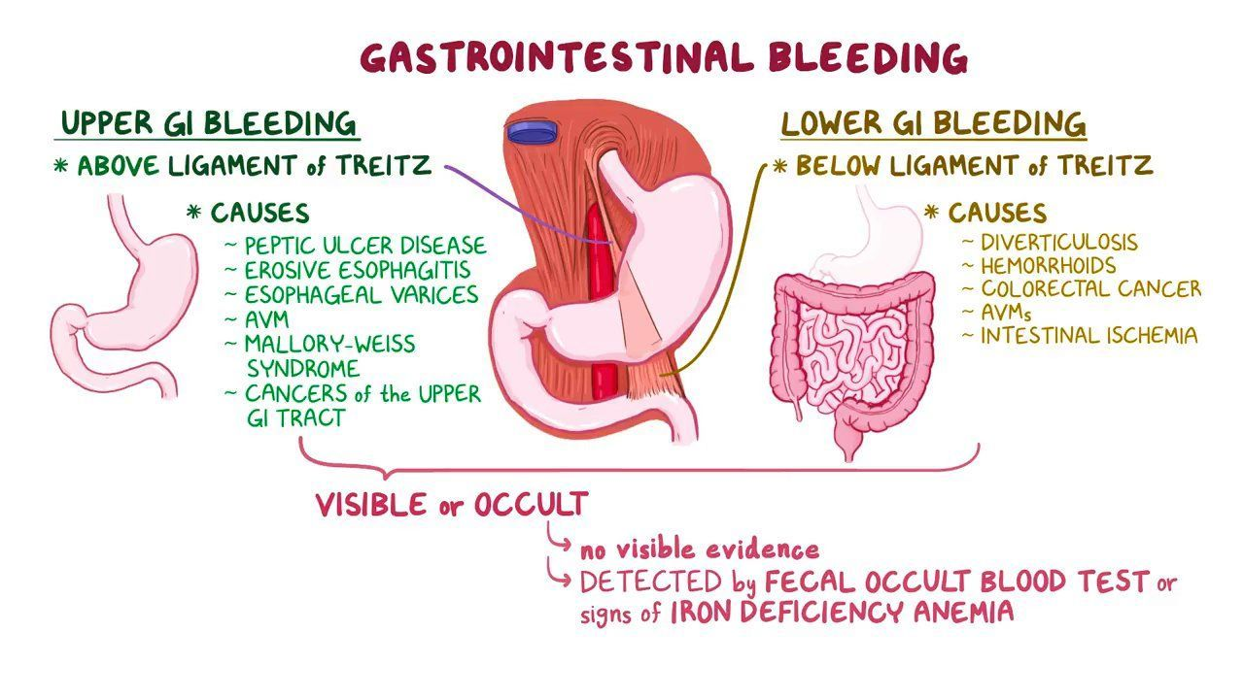

Slide 55
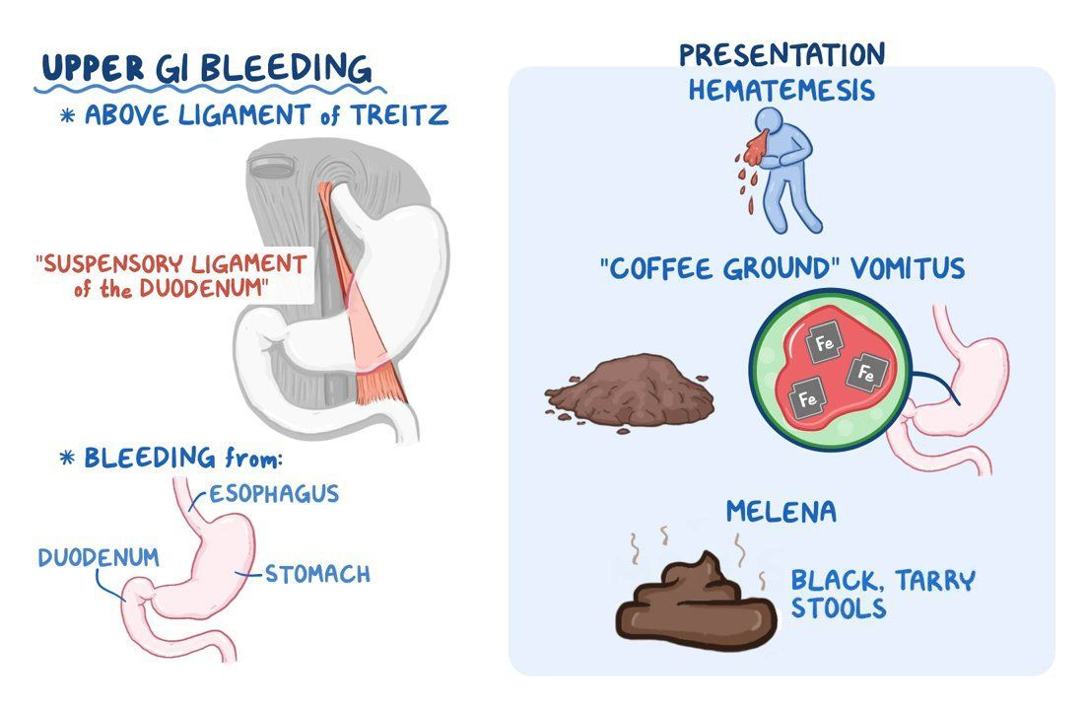

Slide 56
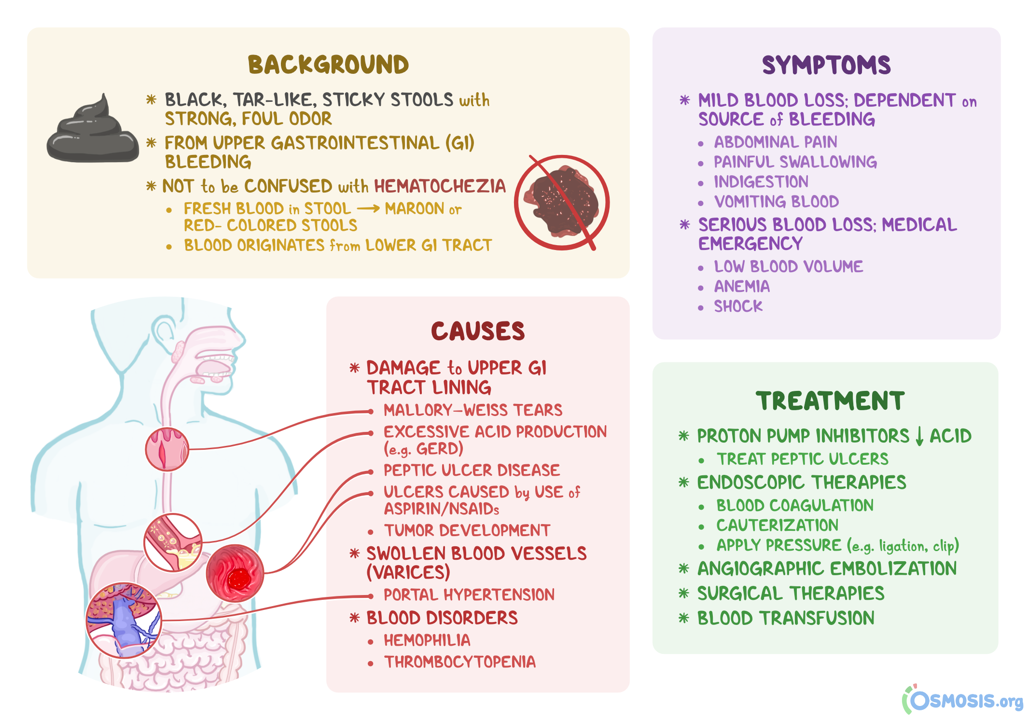

Slide 57
Epidemiology
Upper gastrointestinal bleeding (UGIB):
  Incidence of about 100 per 100,000 adults per year
  Twice as common in men
  Increased risk with age (> 60 years)
Lower gastrointestinal bleeding (LGIB):
  Incidence of about 20.5 per 100,000 adults per year
  Increased risk with age (200-fold increase in the 3rd to 9th decades)
  Somewhat more common in men
Risk factors:
  Helicobacter pylori infection
  Nonsteroidal anti-inflammatory drugs (NSAIDs)
  Alcohol use
  Cirrhosis
  Vascular disease

Slide 58
Etiology
Upper gastrointestinal bleed (proximal to the ligament of Treitz):
Esophagus
  Esophageal varices
  Esophagitis: infection or inflammation in the esophagus
  Esophageal cancer
  Mallory-Weiss tear: a tear in the esophageal lining due to forceful vomiting
Stomach
  Gastric ulcer
  Erosive gastritis
  Gastric antral vascular ectasia (GAVE): dilated small blood vessels in the pyloric antrum (uncommon)
  Portal hypertensive gastropathy
  Dieulafoy lesion: large, tortuous vessel that can erode and bleed
  Angiodysplasia: abnormal collection of blood vessels
Duodenum
  Duodenal ulcer
  Angiodysplasia
  Aortoenteric fistula (rare)
Gastric and duodenal ulcers are the most common causes.

Slide 59
Etiology
Lower GIB (distal to the ligament of Treitz):
Diverticular disease
  Diverticulosis: sac-like protrusion of the colonic wall (common)
  Diverticulitis: less commonly associated with GI bleed
  Meckel’s diverticulum: congenital outpouching in the ileum
Vascular disease
  Angiodysplasia
  Ischemia (e.g., mesenteric ischemia, ischemic colitis)
  Hemorrhoids: venous structures of the anorectum that engorge, prolapse, and bleed
Trauma
  Anal fissure: a small tear in the anal mucosa
Neoplasm
  Colon polyp
  Colorectal cancer
Inflammatory disease
  Infectious colitis
  Ulcerative colitis and Crohn’s disease: autoimmune inflammatory bowel diseases that cause inflammation and ulcers
Iatrogenic
  After biopsy or polypectomy
  Radiation colitis: radiation-induced inflammation in the colon
  Aortoenteric fistula (rare, but serious)

Slide 60
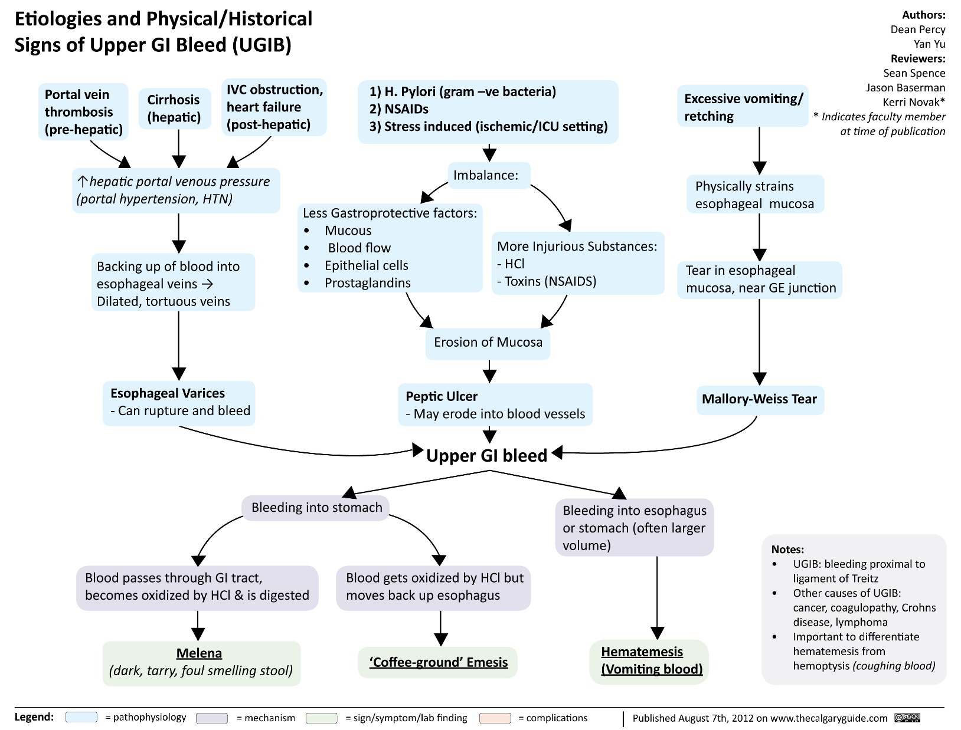

Slide 61
Clinical Presentation
Clinical manifestations
Patients with occult bleeding
may be asymptomatic.
Symptoms of anemia:
  Fatigue, weakness
  Dyspnea
  Pallor
  Lightheadedness
  Syncope
Abdominal pain or heartburn → ulcers, gastritis, ischemia
Coffee-ground emesis → UGIB
Hematemesis → UGIB
Melena (black, tarry stool)
Hematochezia (bright-red blood in stools)
  Usually seen in LGIB
  Can be from brisk, large-volume UGIB
Weight loss → malignancy

Slide 62
Clinical Presentation
Physical exam
Patients with mild or occult bleeding
may not have significant findings.
Evidence of hemodynamic instability:
  Tachycardia
  Hypotension
  Altered mental status
Orthostatic hypotension: seen with acute blood loss of ≥ 2 units
Pale skin color and conjunctiva
Some may have abdominal tenderness (e.g., ischemia).
Rectal exam:
  Black or bloody stools
  Normal, brown stool may be seen in occult bleeding
  Hemorrhoids
  Anal fissure
  Rectal mass
Evaluate for signs of chronic liver disease:
  Spider angiomata
  Splenomegaly
  Abdominal distension and ascites
  Asterixis

Slide 63
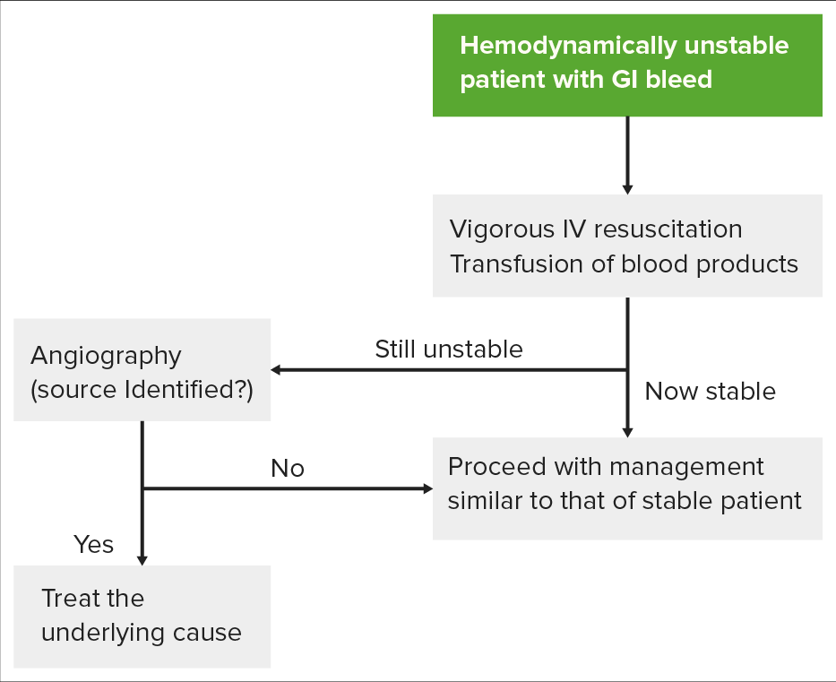

Slide 64
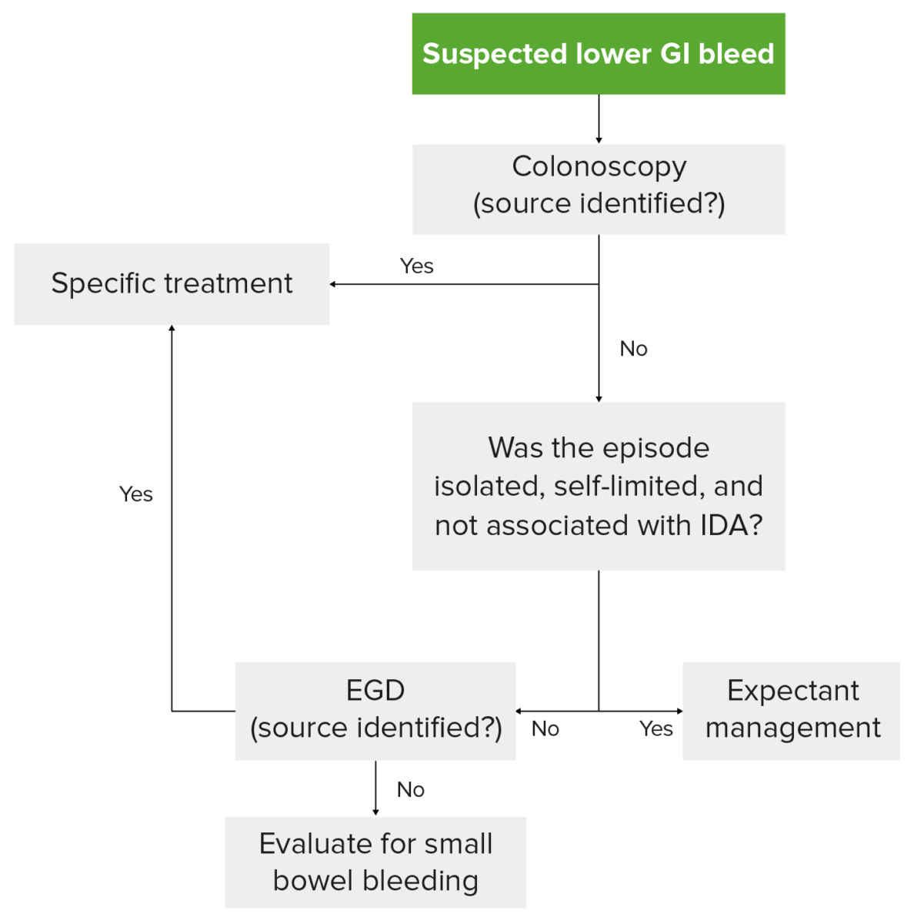

Slide 65
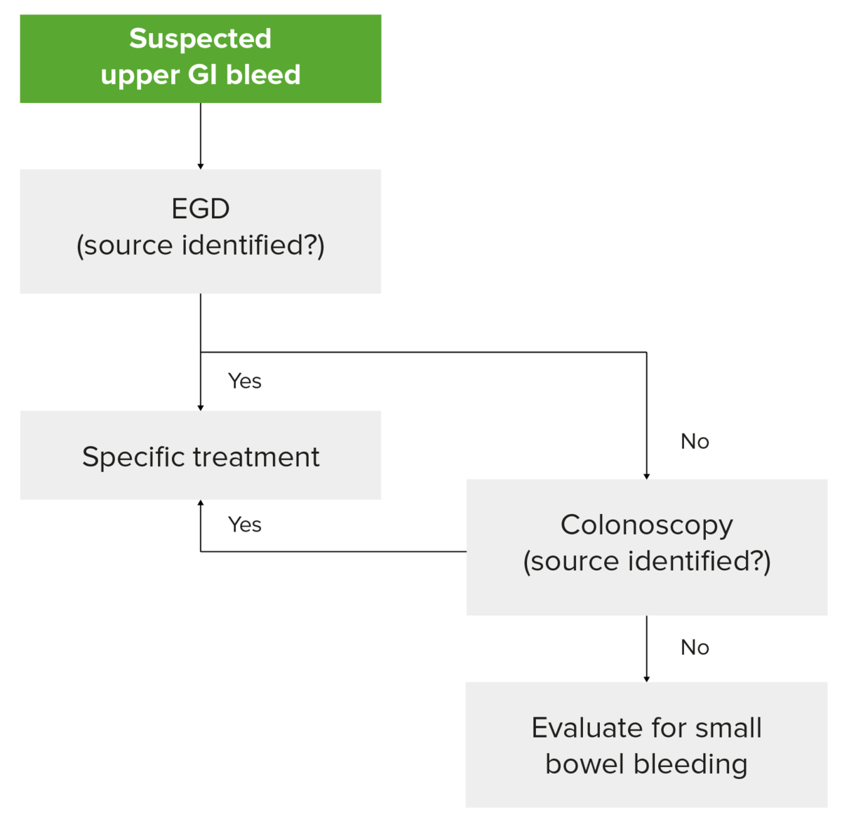

Slide 66
Diagnosis
Diagnosis and management of GIB tend to go hand-in-hand and will vary depending on the hemodynamic stability of the patient.
Laboratory evaluations
Complete blood count → anemia from blood loss
  Hemoglobin may initially be normal in acute bleeds.
  Potential thrombocytopenia may be seen in cirrhosis.
Fecal occult blood testing → detect occult bleeding
Coagulation factors → coagulopathy, which may need reversal
Liver function tests → underlying liver disease
Basic metabolic panel → ↑ BUN (blood urea nitrogen) may signal upper GIB
Iron, ferritin → iron deficiency

Slide 67
Diagnosis
Procedures
Esophagoduodenoscopy (EGD)
  Modality of choice in UGIB
  Visualize the site of hemorrhage within the esophagus, stomach, or duodenum.
  Collect pathology specimens.
Colonoscopy
  Modality of choice in LGIB
  Visualize the site of hemorrhage within the large intestine and terminal ileum.
  Collect pathology specimens.
  Colon preparation is required

Slide 68
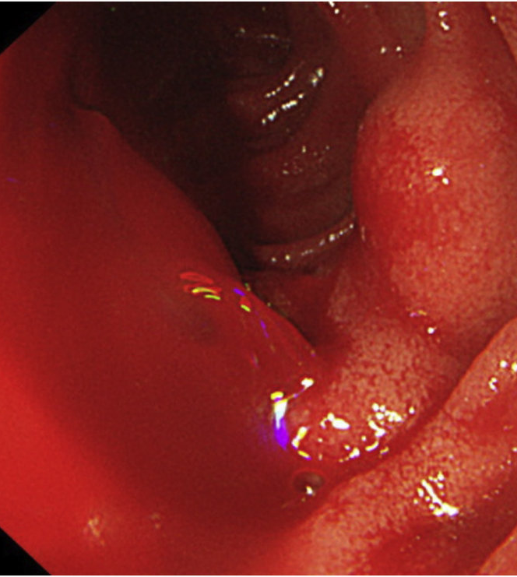
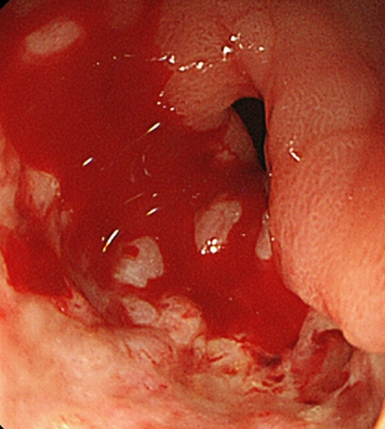

Slide 69
Diagnosis
Procedures
Capsule endoscopy
  Provides imaging of the small intestine
  Patient swallows a wireless camera, which takes pictures along the digestive tract.
  Most often used for continued or intermittent bleeding when EGD and colonoscopy are unremarkable
Angiography
  Bleeding rate of at least 0.5–1 mL/min is required for detection.
  Reserved for patients who cannot undergo endoscopy due to hemodynamic instability

Slide 70
Management
Initial steps
Assess the patient’s hemodynamics and stabilize:
Protect the patient’s airway:
  Patient may need intubation for severe hematemesis
  Prevent aspiration
Obtain adequate IV access: 2 large-gauge peripheral IVs and/or central line
IV fluid resuscitation
Send a blood type and screen evaluation.
Blood transfusion

Slide 71
Management
Medications
Proton pump inhibitors (pantoprazole)
Octreotide
  Somatostatin analog, which causes splanchnic vasoconstriction
  Used for esophageal bleeding

Slide 72
Management
Interventions
Around 80% will stop bleeding without intervention.
EGD and colonoscopy
  Injection of epinephrine around bleeding point
  Thermal hemostasis (electrocoagulation)
  Endoclips
Angiography
  Vasoconstriction via vasopressin
  Embolization
  Procedure runs the risk of bowel ischemia or infarction.

Slide 73
Management
Interventions
Balloon tamponade
  Used for esophageal varices
  Tube is inserted into the esophagus, and balloon is inflated.
  Provides short-term hemostasis until definitive treatment can be arranged.
Surgery
  Considered when bleeding cannot be contained through the above interventions (rare)
  Localization of the source is important before pursuing surgery.

Slide 74
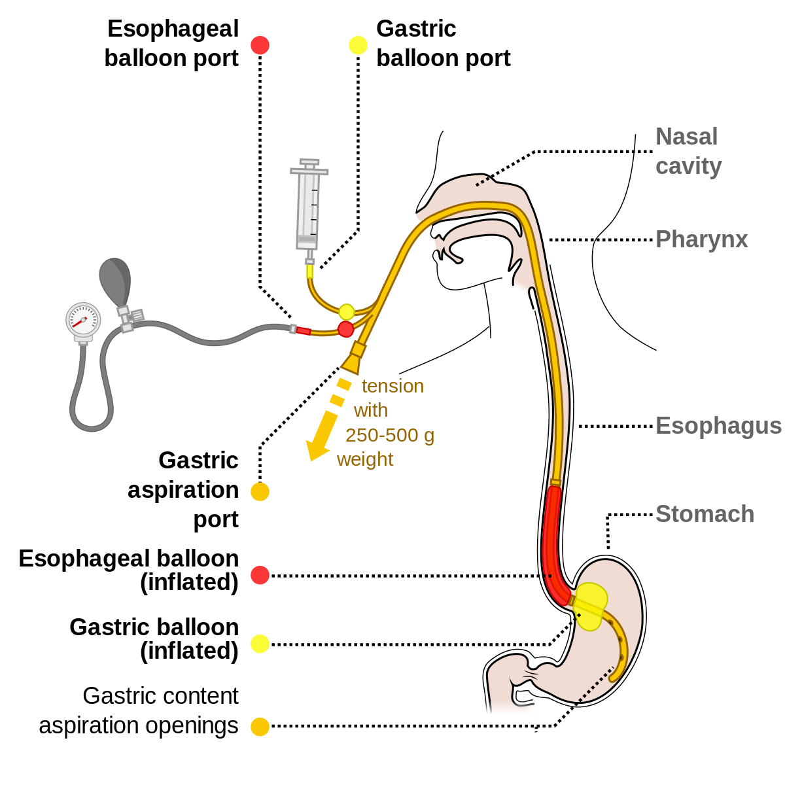
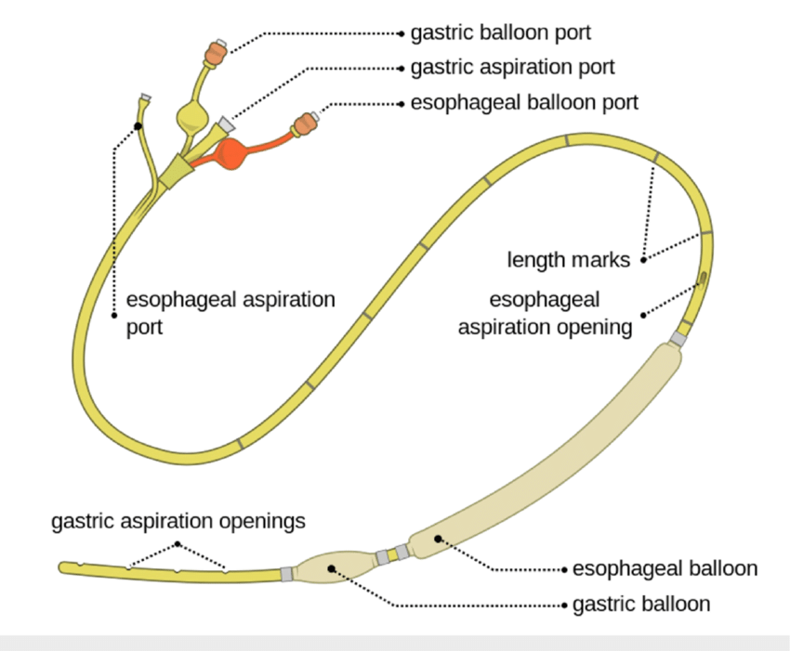
Sengstaken–Blakemore Tube Upper Gastrointestinal Bleeding Balloon Tamponade

Slide 75
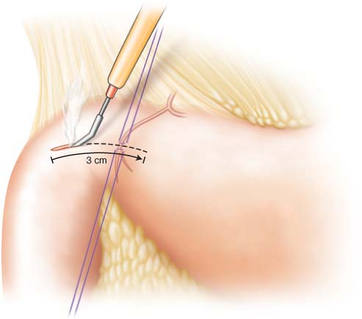
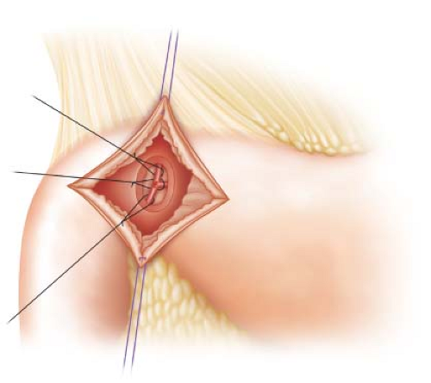

Slide 76
Management
Special considerations
Patients with cirrhosis and variceal bleeding should have antibiotic prophylaxis to prevent spontaneous bacterial peritonitis.
Reverse any anticoagulation.
Hold antihypertensive medications.

Slide 77
THANK YOU FOR
ATTENTION
ODESSA NATIONAL MEDICAL UNIVERSITY
UNIVERSITY CLINIC DEPARTMENT of SURGERY #3

