Slide 1
SURGICAL DISEASES of the LIVER
ODESSA NATIONAL MEDICAL UNIVERSITY
UNIVERSITY CLINIC DEPARTMENT of SURGERY #3

Slide 2
LIVER TRAUMA

Slide 3
INTRODUCTION
LIVER TRAUMA is one
of the most common abdominal lesions
in severely injured
trauma patients.
DIAGNOSIS and TREATMENT of hepatic trauma has evolved with the use of modern diagnostic and therapeutic tools.

Slide 4
ABBREVIATIONS
EVTM endovascular trauma and bleeding management
NOM non-operative management
SBP systolic blood pressure
DPL diagnostic peritoneal lavage

Slide 5
HISTORY
Recently, most cases with blunt abdominal trauma were managed by exploratory laparotomy.
Several innovative multimodal approaches as EVTM have allowed to greatly increase the likelihood of NOM for selected patients.
Nowadays, even borderline patients, without other indications for laparotomy, may be considered for NOM in well-developed centers.

Slide 6
ACRTUAL PRINCIPLES
This advanced strategy necessitates a multidisciplinary approach to deal with the complexity of moderate and severe liver injury.
The majority of patients with minor or moderate liver injuries are successfully treated by NOM. In contrast, one third of severe injuries allow for NOM.
In determining the optimal treatment strategy, the anatomical description of liver lesions is fundamental but not sufficient.
In fact, the decision whether patients need to be managed operatively or undergo NOM is based mainly on the hemodynamic status, associated injuries, and on the anatomical liver injury grade.

Slide 7
Hemodynamic instability
SBP < 90 mmHg and clinical hemorrhagic shock with skin vasoconstriction, altered level of consciousness and/or shortness of breath
SBP > 90 mmHg but requiring bolus infusions/transfusions and/or vasopressor drugs and/or admission base excess (BE) > -5 mmol/l or transfusion requirement of at least > 4 units of RBC within the first 8 h
Transient responders shows an initial response to adequate fluid resuscitation, but then have signs of ongoing blood loss and perfusion deficits. These patients do not reach sufficient stabilization to undergo endovascular procedures or NOM.

Slide 8
Diagnosis
The diagnostic methods are determined by the hemodynamic status.
Extended-focused abdominal sonography (E-FAST) for trauma is rapid in detecting intra-abdominal free fluid.
However, abdominal ultrasound may be falsely negative due to clotted blood or suboptimal quality views.
CT scan with intravenous contrast is the gold standard in hemodynamically stable trauma patients.

Slide 9
Diagnosis
Computed tomography scan is considered the gold standard in trauma imaging assessment with a sensitivity and specificity approaching 96–100%.
CT must be immediately performed only in hemodynamically stable or stabilized patients or in those who transiently responded to fluid resuscitation in special circumstances and under the supervision.
Delayed-phase CT helps in differentiating patients with active bleeding from those with contained vascular injuries.
Active contrast extravasation is a sign of active hemorrhage. CT scan may help in subsequent surgical procedures and angiography/angioembolization.

Slide 10
Diagnosis
Diagnostic peritoneal lavage (DPL) should be considered diagnostic modality when CT scan or US is not promptly available.
It should be considered in the presence of massive subcutaneous emphysema
in a shocked patient in whom ultrasound cannot be done
in the presence of free peritoneal fluid without solid organ injury in a hemodynamically stable patient
The possibility of DPL-related complications (up to 2%) should be considered.

Slide 11
AAST liver trauma classification
Grade | Injury type | Injury description
I | Haematoma | Subcapsular < 10% surface
 | Laceration | Capsular tear < 1 cm parenchymal depth
II | Haematoma | Subcapsular 10-50% surface area; intraparenchymal, < 10 cm diameter
 | Laceration | 1-3 cm parenchymal depth, < 10 cm in length
III | Haematoma | Subcapsular > 50% surface area or expanding, ruptured subcapsular or parenchymal haematoma. Intraparenchymal haematoma > 10 cm
 | Laceration | > 3 cm parenchymal depth
IV | Laceration | Parenchymal disruption 25-75% of hepatic lobe
 | Vascular | Juxtavenous hepatic injuries i.e. retrohepatic vena cava/central major hepatic veins
V | Vascular | Hepatic avulsion

Slide 12
WSES liver trauma classification
 | WSES grade | AAST | Hemodynamic
Minor | WSES grade I | I–II | Stable
Moderate | WSES grade II | III | Stable
Severe | WSES grade III | IV–V | Stable
 | WSES grade IV | I–VI | Unstable
Minor hepatic injuries:
WSES grade I includes AAST-OIS grade I–II hemodynamically stable lesions.
Moderate hepatic injuries:
WSES grade II includes AAST-OIS grade III hemodynamically stable lesions.
Severe hepatic injuries:
WSES grade III includes AAST-OIS grade IV–V hemodynamically stable lesions.
WSES grade IV includes AAST-OIS grade I–VI hemodynamically unstable lesions.

Slide 13
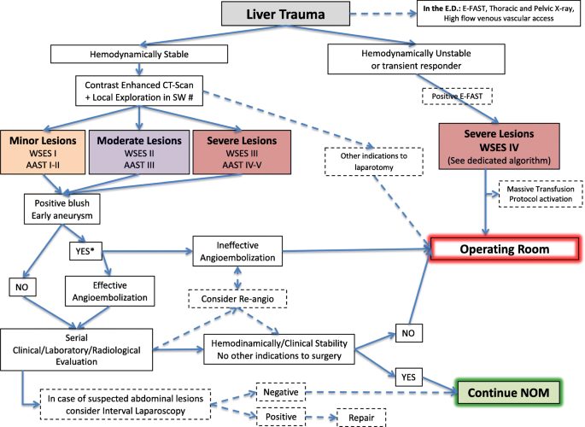
Liver trauma management algorithm (stab wound).

Slide 14
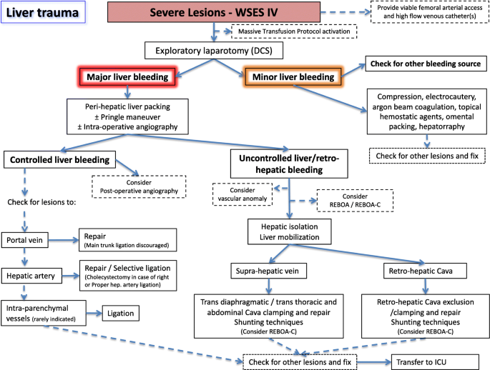
Unstable liver trauma management algorithm)

Slide 15
Diagnostic procedures | The diagnostic methods are determined by the hemodynamic status E-FAST is rapid in detecting intra-abdominal free fluid CT with IV contrast is the gold standard in hemodynamically stable patients
Non-operative management (NOM) | In the absence of other internal injuries requiring surgery In moderate and severe injuries in selected settings (immediate availability of surgeons, operating room, ICU, angiography, blood products) A CT scan with intravenous contrast should always be performed in patients being considered for NOM AG/AE may be considered as a first-line intervention in hemodynamically stable patients with arterial blush on CT scan In concomitant head trauma and/or spinal cord Intensive care unit only for moderate and severe lesions In low-resource settings with negative physical examinations, imaging and blood tests

Slide 16
Operative management (OM) | Hemodynamically unstable and non-responder patients Primary to control the hemorrhage and bile leak Major hepatic resections should be avoided at first and only considered in subsequent operations Angioembolization in persistent arterial bleeding after non-hemostatic or damage control procedures Resuscitative endovascular balloon occlusion of the aorta as a bridge to more definitive procedures
Short- and long-term follow-up | Intrahepatic abscesses may be successfully treated with percutaneous drainage Delayed hemorrhage without severe hemodynamic compromise may be managed at first with AG/AE Hepatic artery pseudoaneurysm should be managed with AG/AE to prevent rupture Combination of percutaneous and endoscopic techniques for post-traumatic biliary complications
Thrombo-prophylaxis, feeding, and mobilization | Mechanical prophylaxis in all patients with no absolute contraindication LMWHs in selected patients with liver injury treated with NOM Individualization of the risk-benefit balance is suggested Early mobilization should be achieved in stable patients Enteral feeding should be started as soon as possible

Slide 17
Follow-up
Mandatory late follow-up imaging is not indicated (only if the patient’s clinical condition requires for diagnosis)
After moderate and severe liver injuries, patients may usually resume normal physical activities after 3–4 months.
During the recovery phase, patients should return immediately to the hospital in case of increasing abdominal pain, lightheadedness, nausea, or vomiting

Slide 18
Conclusions
Management of liver trauma is multidisciplinary.
When feasible, non-operative management should always be considered as the first option in adults.
Clinical condition, anatomical injury grade, and associated injuries should be considered together in deciding the best treatment option.

Slide 19
LIVER ABSCESS

Slide 20
INTRODUCTION
Bacterial abscess of the liver is relatively rare; however, it has been described since the time of Hippocrates (400 BCE), with the first published review by Bright appearing in 1936.
In 1938, Ochsner's classic review heralded surgical drainage as the definitive therapy; however, despite the more aggressive approach to treatment, the mortality remained at 60-80%.
The development of new radiologic techniques, the improvement in microbiologic identification, and the advancement of drainage techniques, as well as improved supportive care, have reduced mortality to 5-30%; yet, the prevalence of liver abscess has remained relatively unchanged.
Untreated, this infection remains uniformly fatal.

Slide 21
CLASSIFICATION
Pyogenic abscess, which is most often polymicrobial, accounts for 80% of hepatic abscess cases
Amebic abscess due to Entamoeba histolytica accounts for 10% of cases
Fungal abscess, most often due to Candida species, accounts for fewer than 10% of cases

Slide 22
Pathophysiology
The liver receives blood from both systemic and portal circulations. Increased susceptibility to infections would be expected given the increased exposure to bacteria.
However, Kupffer cells lining the hepatic sinusoids clear bacteria so efficiently that infection rarely occurs.
Multiple processes have been associated with the development of hepatic abscesses.

Slide 23
SOURCES of PYOGENIC LIVER ABSCESS
Appendicitis was traditionally the major cause of liver abscess
Biliary tract disease is now the most common source of pyogenic liver abscess
Infections in organs in the portal bed can result in a septic thrombophlebitis
Microabscess formation can be due to systemic bacteremia
Cryptogenic causes account for a significant proportion of cases
Penetrating hepatic trauma can inoculate organisms into the liver parenchyma
Pyogenic liver abscess may be as a secondary infection of amebic abscess, hydatid cystic cavities, and metastatic and primary hepatic tumors
The right hepatic lobe is affected more often than the left hepatic lobe by a factor of 2:1. Bilateral involvement is seen in 5% of cases

Slide 24
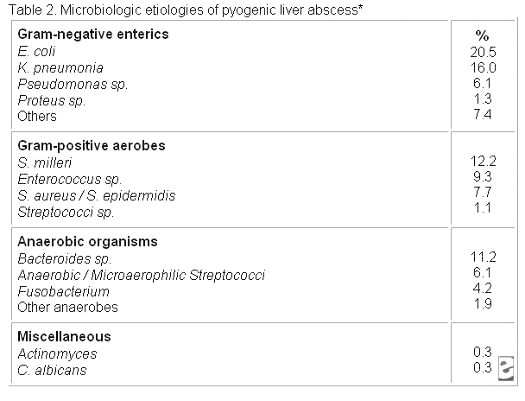
Etiology
Polymicrobial involvement is common, with Escherichia coli and Klebsiella pneumoniae being the two most frequently isolated pathogens.

Slide 25
Etiology
Abscesses involving K pneumoniae have been associated with multiple cases of endophthalmitis.
Staphylococcus aureus abscesses usually result from hematogenous spread of organisms involved with distant infections, such as endocarditis.
Amebic liver abscess is most often due to E histolytica. Liver abscess is the most common extraintestinal manifestation of this infection.
Fungal abscesses primarily are due to Candida albicans and occur in individuals with prolonged exposure to antimicrobials, hematologic malignancies, solid-organ transplants, and congenital and acquired immunodeficiency.
Other organisms reported in the literature include Actinomyces species, Eikenella corrodens, Yersinia enterocolitica, Salmonella typhi, and Brucella melitensis.

Slide 26
Epidemiology
The frequency in hospitalized patients is in the range of 8-16 cases per 100,000 persons. Studies suggest a small, but significant, increase in the frequency of liver abscess.
Prior to the antibiotic era, liver abscess was most common in the fourth and fifth decades of life, primarily due to complications of appendicitis.
Cases of liver abscesses in infants have been associated with umbilical vein catheterization and sepsis.
When abscesses are seen in children and adolescents, underlying immune deficiency, severe malnutrition, or trauma frequently exists.
While abscesses once showed a predilection for males in earlier decades, no sexual predilection currently exists. Males have a poorer prognosis from hepatic abscess than females.

Slide 27
Prognosis
Untreated, pyogenic liver abscess remains uniformly fatal. The most common causes of death include sepsis, multiorgan failure, and hepatic failure.
Indicators of a poor prognosis in amebic abscess include a bilirubin level of greater than 3.5 mg/dL, encephalopathy, hypoalbuminemia (ie, serum albumin level of < 2 g/dL), and multiple abscesses; all are independent factors that predict poor outcome.
An underlying malignant etiology and an Acute Physiology and Chronic Health Evaluation (APACHE II) score greater than 9 increases the relative mortality by 6.3-fold and 6.8-fold, respectively.

Slide 28
HISTORY
The most frequent symptoms of hepatic abscess include the following:
Fever (either continuous or spiking)
Chills
Right upper quadrant pain
Anorexia
Malaise
Cough or hiccoughs due to diaphragmatic irritation may be reported. Referred pain to the right shoulder may be present.
Individuals with solitary lesions usually have a more insidious course with weight loss and anemia of chronic disease. With such symptoms, malignancy often is the initial consideration.
Fever of unknown origin (FUO) frequently can be an initial diagnosis in indolent cases. Multiple abscesses usually result in more acute presentations, with symptoms and signs of systemic toxicity.
Afebrile presentations have been documented.

Slide 29
WORK-UP
Physical Examination
Fever and tender hepatomegaly are the most common signs. A palpable mass need not be present. Midepigastric tenderness, with or without a palpable mass, is suggestive of left hepatic lobe involvement.
Decreased breath sounds in the right basilar lung zones, with signs of atelectasis and effusion on examination or radiologically, may be present. A pleural or hepatic friction rub can be associated with diaphragmatic irritation or Glisson capsule inflammation.
Jaundice may be present in as many as 25% of cases and usually is associated with biliary tract disease or the presence of multiple abscesses.

Slide 30
WORK-UP
Laboratory Studies
Laboratory studies may include a complete blood count (CBC) with differential (to identify anemia of chronic disease or neutrophilic leukocytosis) and liver function studies (hypoalbuminemia and elevation of alkaline phosphatase are the most common abnormalities; elevations of transaminase and bilirubin levels are variable.
Blood cultures are positive in roughly 50% of cases. Culture of abscess fluid should be the goal in establishing microbiologic diagnosis.
Enzyme immunoassay should be performed to detect E histolytica in patients either from endemic areas or who have traveled to endemic areas.

Slide 31
WORK-UP
Imaging Studies
Computed tomography (CT) with contrast and ultrasonography remain the radiologic modalities of choice as screening procedures and also can be used as techniques for guiding percutaneous aspiration and drainage.
Lesions on CT evaluation are well-demarcated areas hypodense to the surrounding hepatic parenchyma. Peripheral enhancement is seen when intravenous (IV) contrast is administered. Gas can be seen in as many as 20% of lesions. CT is superior in its ability to detect lesions less than 1 cm. This technique also enables evaluation for an underlying concurrent pathology throughout the abdomen and pelvis. Indium-labeled white blood cell (WBC) scans are somewhat more sensitive in this regard.
Ultrasonographic evaluation (sensitivity, 80-90%) reveals hypoechoic masses with irregularly shaped borders. Internal septations or cavity debris may be detected. It allows close evaluation of the biliary tree and simultaneous aspiration of the cavity. The major benefits of this modality are its portability and diagnostic utility in patients who are too critical to undergo prolonged radiologic evaluation or to be moved out of monitored setting. Operator dependence affects its overall sensitivity.

Slide 32
Percutaneous Aspiration and Drainage
Needle aspiration enables rapid recovery of material for microbiologic and pathologic evaluation. It can be performed with the initial diagnostic procedure.
Percutaneous drainage has become the standard of care and should be the first intervention considered for small cysts.
For cysts larger than 5 cm, ruptured cysts, and multiloculated cysts, surgical drainage is generally recommended over percutaneous intervention.
Failure to respond to catheter drainage is the main reported complication and is also an indication for surgical intervention.
Contraindications include coagulopathy; a difficult access path to the cavity; peritonitis; and/or a complicated, multiloculated, thick-walled abscess with viscous pus.

Slide 33
Medical Care
An untreated hepatic abscess is nearly uniformly fatal as a result of complications that include sepsis, empyema, or peritonitis from rupture into the pleural or peritoneal spaces, and retroperitoneal extension. Treatment should include drainage, either percutaneous or surgical.
Antibiotic therapy as a sole treatment modality is not routinely advocated, though it has been successful in a few reported cases. It may be the only alternative in patients too ill to undergo invasive procedures or in those with multiple abscesses not amenable to percutaneous or surgical drainage.
Antimicrobial treatment is a common adjunct to percutaneous or surgical drainage.

Slide 34
Medication Summary
Until cultures are available, the choice of antimicrobial agents should be directed toward the most commonly involved pathogens.
Amebic abscess should be treated with metronidazole, which will be curative in 90% of cases.
Systemic antifungal agents should be initiated if fungal abscess is suspected and after the abscess has been drained percutaneously or surgically.
Ultimately, the organisms isolated and antibiotic sensitivities should guide the final choice of antimicrobials.
Currently 4-6 weeks of therapy is recommended for solitary lesions that have been adequately drained.

Slide 35
Surgical Care
With the refinement of image-guided techniques, percutaneous drainage and aspiration have become the standard of care.
Current indications for the surgical treatment of pyogenic liver abscess are for the treatment of underlying intra-abdominal processes, including signs of peritonitis; existence of a known abdominal surgical pathology; failure of previous drainage attempts; and the presence of a complicated, multiloculated, thick-walled abscess.
A laparoscopic approach is also commonly used in select cases. This minimally invasive approach affords the opportunity to explore the entire abdomen and to significantly reduce patient morbidity. A growing literature is defining the optimal population for this mode of intervention.
Postoperative complications are not uncommon and include recurrent pyogenic liver abscess, intra-abdominal abscess, hepatic or renal failure, and wound infection.

Slide 36
Long-Term Monitoring
Aggressively seek an underlying source of the abdominal pathology.
Perform weekly serial CT or US examinations to document adequate drainage of the abscess cavity.
Drain care may be required. Maintain drains until the output is less than 10 mL/day.
Persistent fever after 2 weeks of therapy may indicate the need for more aggressive drainage.
For patients with an underlying malignancy, definitive treatment, such as surgical removal of the mass, should be pursued if at all possible.
Patients will require prolonged parenteral antimicrobial therapy that may continue after discharge.

Slide 37
Hydatid disease

Slide 38
Introduction
Hydatid disease in people is mainly caused by infection with the larval stage of the dog tapeworm Echinococcus granulosus.
Cystic hydatid disease usually affects the liver (50–70%) and less frequently the lung, the spleen, the kidney, the bones, and the brain.
Treatment of hydatid liver cyst has to be considered mandatory in symptomatic cysts and recommended in viable cysts because of the risk of severe complications.
The modern treatment of hydatid cyst of the liver varies from surgical intervention to percutaneous drainage or medical therapy.
Surgery is still the treatment of choice and can be performed by the conventional or laparoscopic approach.
Percutaneous Aspiration-Injection-Reaspiration Drainage (PAIR) seems to be a better alternative to surgery in selected cases.

Slide 39
Epidemiology
Echinococcus granulosus is spread almost all over t he world, especially in areas where sheep are raised, and is endemic in Asia, North Africa, South and Central America, North America, Canada and the Mediterranean region.
The life cycle of E. granulosus requires both an intermediate host usually (a sheep, a cattle, or a swine), and a primary canine host. Aman becomes both an accidental and an intermediate host through contact with infected dogs or by ingesting food or water contaminated with eggs of the parasite.
Once the eggs are ingested, they release larvae into the duodenum. The larvae migrate through the intestinal mucosa and gain access to mesenteric vessels which carry them to the liver. The liver is the site of up to 70% of echinococcal lesions.
From the lungs, larvae may be disseminated to any part of the body. Larvae that escape the host's defenses and persist in a host organ develop into small cysts surrounded by a fibrous capsule. These cysts grow at a rate of 1-3 cm/year and may remain undetected for years.

Slide 40
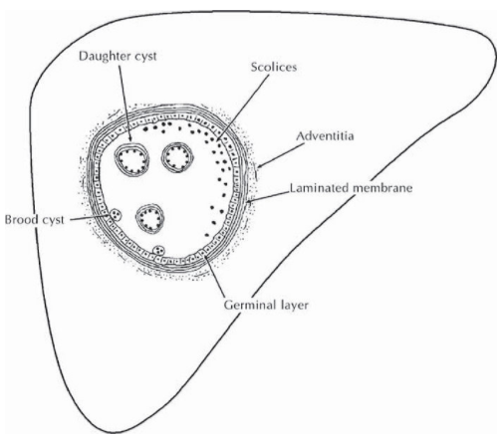
Pathology- Hydatid cyst structure
A primary cyst in the liver is composed of three layers:
Adventitia (pericyst): compressed liver parenchyma and fibrous tissue.
Laminated membrane (ectocyst): is elastic white covering, easily separable from the adventitia.
Germinal epithelium (endocyst) – is a single layer of cells lining the inner aspects of the cyst and is the only living component, being responsible for the formation of the other layers as well as the hydatid fluid and brood capsules within the cyst.

Slide 41
Natural history and genesis of complications
The first phase is that of growth during which rupture can occur when the pressure of the hydatid liquid becomes more important than resistance of the hydatic wall (pericyst). Finally, the complications such as acute allergic manifestations, infection, jaundice, vomique, are only the consequence of the rupture of the cystic wall.
The second phase is a phase of ageing and of progressive involution. It is the consequence of the overproduction of scolices and daughter cysts. During this phase, the hydatid cyst will be full of scolices and membranes which replace the hydatic liquid. Calcifications occur in the pericyst; the host is at the origin of the image of pericystic wall. Then the reaction of the host leads to a progressive calcification of the walls.
As the cysts enlarge local pressure causes a mass effect on surrounding tissue producing commensurate symptoms and signs. These may be generalized with upper abdominal pain and discomfort or more specific. Such as; obstructive jaundice. Biliary rupture may occur through a small fissure or bile duct fistula.
A wide perforation allows the access of hydatid membranes to the main biliary ducts, which can cause symptoms simulating choledocholithiasis. Alternatively, it may produce a picture very similar to ascending cholangitis with fever, pain and jaundice.

Slide 42
Complications of hydatid cyst of the liver
Echinococcal cysts of the liver can cause complications in about 40% of cases.
The most common complications in order of frequency are infection, rupture to the biliary tree; rupture to the peritoneal cavity; rupture to the pleural cavity.
Intrabiliary rupture of a hepatic hydatid cyst is a common complication and may occur in 2 forms: an occult rupture and frank rupture.
Intrabiliary rupture mainly occurs in centrally localized cysts, and an intracystic water pressure up to 80 cm is also a predisposing factor for the rupture.
The rupture of the hydatid cyst in the biliary ducts and the migration of the hydatid material in the biliary tree lead to the apparition of other biliary complications like: cholangitis, sclerosis odditis, hydatid biliary lithiasis etc.

Slide 43
Clinical feature
After infection with Echinococcus granulosus, humans are usually asymptomatic for a long time. The growth ranges 1-5 mm per year. The symptoms depend not only on the size and number of cysts, but also on the mass effect within the organ and upon surrounding structures.
Non complicated cysts
Hydatid cyst of the liver is frequently silent and only diagnosed incidentally during abdominal investigation for other pathology. The most common symptom, is right upper quadrant or epigastric pain and enlarged liver and a palpable mass. Pressure effects are initially vague. They may include non-specific pain, cough, low-grade fever, and the sensation of abdominal fullness.
Complicated cysts
Patients may also present with complications of the cyst such as biliary communication, intraperitoneal rupture and intrathoracic rupture. Cyst rupture may be associated with anaphylaxis. With secondary infection, tender hepatomegaly, chills, and spiking temperatures occurs. With biliary rupture the classic triad of jaundice, biliary colic and urticaria occurs.

Slide 44
Serology and immunological tests
Serological tests detect specific antibodies to the parasite and are the most commonly employed tools to diagnose past and recent infection with E. granulosus.
Detection of IgG antibodies implies exposure to the parasite, while in active infection high titers of specific IgM and IgA antibodies are observed.
Detection of circulating hydatid antigen in the serum is of use in monitoring after surgery and pharmacotherapy and in prognosis.
Elisa techniques have a high sensitivity above 90% and are useful in mass scale screening.
The counter-immuno-electrophoresis has the highest specificity (100%) and high sensitivity (80 – 90%).

Slide 45
DIAGNOSIS
The diagnosis is most easily set by ultrasound or other imaging techniques such as CT-scan or MRI, combined with case history.
Serology tests such as ELISA or immunoblotting can be used in addition, being 80-100% sensitive for liver cysts but only 50-56% for lungs and other organs.
False positive reactions may occur in persons with other tapeworm infections, cancer, or chronic immune disorders. Whether the patient has detectable antibodies depend on the physical location, integrity and viability of the cyst. Patients with senescent, calcified or dead cysts usually are sero-negative.
Fine needle biopsy should be avoided if dealing with E. granulosus since there is a great danger of leakage with subsequent allergic reactions and secondary recurrence.

Slide 46
Imaging techniques
Imaging modalities range from simple to complex and invasive.
Ultrasonography (US) is the screening method of choice.
CT and MRI are mandatory in liver hydatidosis because they allow thorough knowledge regarding lesion size, location, and relations to intrahepatic vascular and biliary structures, providing useful information for effective treatment and decrease in post-operative morbidity.

Slide 47
Ultrasonography
Type | Ultrasound Appearance
I | Pure fluid Collection
II | Fluid collection with a split wall (detached membrane)
III | Fluid collection with septa and/or daughter cysts
IV | Heterogeneous echo pattern (Hyperechoic with high internal echoes)
V | Reflecting walls (Cyst with reflecting calcified thick wall)
Ultrasonography is the screening method of choice. It is currently the primary diagnostic technique and has diagnostic accuracy of 90%. Findings usually seen are:
Solitary Cyst – anechoic univesicular cyst with well defined borders and enhancement of back wall echoes in a manner similar to simple or congenital cysts.
Daughter cysts - probably the most characteristic sign with cysts within a cyst, producing a cartwheel or honeycomb cyst.

Slide 48
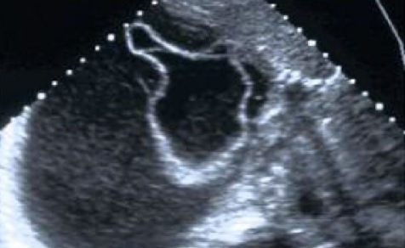
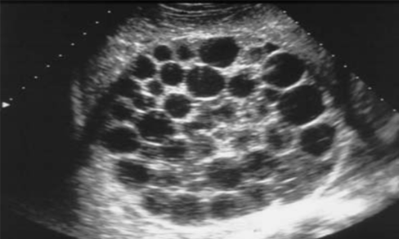

Slide 49
WHO classification
CL Active; Single cysts. Cysts are developing and are fertile. Cyst wall not visible.
CE1 Active; simple cyst often full of hydatid sand (snow flake sign). Visible cyst wall. Fertile.
CE2 Active; multiple, or multiloculated cysts. May appear honeycomb like with daughter cysts. Fertile.
CE3 Transition; degenerating cysts but still contain viable protoscoleces. Often see floating membranes in fluid filled cysts
CE4 Inactive; degeneration is advanced. Cysts may be calcified. Not likely to be fertile. Heterogeneous appearance with few or no daughter cysts.
CE5 Inactive. Often calcified. Usually infertile.

Slide 50
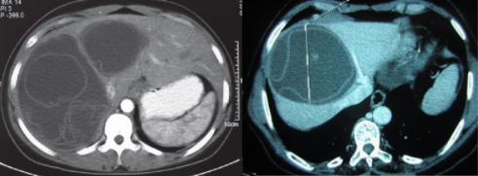

Slide 51
Computed Tomographic scan
Computed tomography has the highest sensitivity of imaging of the cyst (100%).
It is the best mode to detect the number, size, and location of the cysts.
It may provide clues to presence of complications such as infection, and intrabiliary ruptures.
CT features include sharply marginated single or multiple rounded cysts of fluid density (3 – 30 Hounsfield units) with a thin dense rim.

Slide 52
Magnetic resonance Imaging
Magnetic resonance Imaging - MRI delineates the cyst capsule better than CT scan, as a low intensity on both T1 and T2 weighted images.
However, CT scan is better in demonstrating mural calcifications, cysts less than 3 cm may not show any specific features and small peritoneal cysts may be missed.

Slide 53
Treatment
Surgery remains the gold standard treatment for hydatid liver disease.
However, surgery may be impractical in patients with multiple cysts localised in several organs and if surgical facilities are inadequate.
Conservative procedures are safe and technically simple, and are useful in the management of uncomplicated hydatid cysts.
Marsupialization was the most common used procedure because it is quick and safe. However, their main disadvantageis the high frequency of postoperative complications,the most common being bile leak from a cyst-biliary communication, bilomas and bile peritonitis (4%-28%).

Slide 54
Radical surgical procedures
Radical surgical procedures include cystectomy, pericystectomy, lobectomy and hepatectomy. Radical procedures have lower rate of complications and recurrences but many authors consider them inappropriate, claiming that intraoperative risks are too high for a benign disease.
Cystectomy. The procedure involves removal of hydatid cyst, comprising laminar layer, germinal layer and cyst contents (daughter cysts and brood capsules). The procedure is simple to perform and has low recurrence rates. The management of the residual cavity is a challengingproblem especially in patients with gianthydatid Cysts. Various techniques have been described for the management of residual cavities, such as; external drainage,Capitonnage and omentoplasty
Pericystectomy. Tthis procedure involves a non-anatomical resection of cyst and surrounding compressed liver tissue. This is technically a more difficult procedure than cystectomy and can be associated with considerable blood loss; it can also be hazardous in the case of large and complicated cysts when the cyst distorts vital anatomical structures such as; hepatic veins or biliary ducts
Hepatic resections. The arguments against hepatic resection as a primary modality of treatment are: firstly, outside of the dedicated liver units there is considerable morbidity and mortality from resection of what is essentially a benign condition.What is more, the distortion of the anatomy makes surgery harder

Slide 55
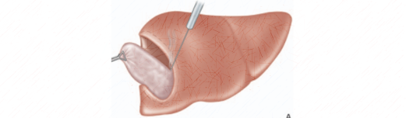
Radical surgery: partial cystectomy

Slide 56

Drainage of the residual cavity
after partial cystectomy

Slide 57

Technique of the pericystectomy

Slide 58
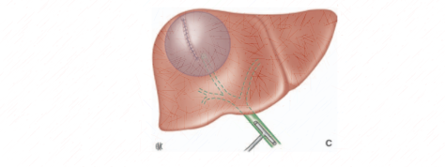
Internal drainage technique

Slide 59
Laparoscopic management of hydatid cysts
The Criteria to exclude laparoscopic treatment of hydatid cyst of liver are
Rupture of the cyst in biliary tract
Central localization of the cyst
Cysts dimension >15 cm
Number of cysts > 3
Thickened or calcified walls
opening of bile ducts that leak bile
Nevertheless, a disadvantage of laparoscopy is the lack of precautionary measures to prevent spillage under the high intraabdominal pressures caused by pneumoperitoneum, allergic reactions are more common in laparoscopic interventions due to peritoneal spillage.
Laparoscopic experience has shown that spillage of scolices-rich cyst fluid or daughter cysts is common, and it is difficult to evacuate the cysts without spillage in the absence of the proven techniques available to open surgery.
Spillage may lead to peritoneal hydatidosis

Slide 60
Percutaneous treatment of hydatid cyst
PAIR (puncture, aspiration, injection, and reaspiration) is a percutaneous treatment technique for hydatid disease.
Indications for PAIR Nonechoic lesion greater than 5 cm Cysts with daughter cysts Multiple cysts if accessible to puncture Infected cysts Patients who refuse surgery. Patients who relapse after surgery. Patients in whom surgery is contraindicated Patients fail to respond to chemotherapy Children over 3 years. Pregnant women | Contraindications for PAIR Non cooperative patients Inaccessible or risky location of the liver cyst Cyst in spine, brain, and/or heart Inactive or calcified lesion Cyst communicating with the biliary tree

Slide 61
Endoscopic management of hydatid cyst
The Endoscopic management is useful in presence of intrabiliary rupture, which requires exploration and drainage of the biliary tract and also after surgery in presence of residual hydatid material (membranes and daughter cyst) left in biliary tree.
During the endoscopic exploration the biliary tree is cleared of any hydatid material with a balloon catheter or a dormia basket. The endoscopic sphincterotomy is also performed to facilitate drainage of the common bile duct.

Slide 62
Complications of surgery
Morbidity: Biliary leakage is the most frequent postoperative complication following surgery for hydatid cysts of liver.
Endoscopic sphincterotomy is performed after a 3-week waiting period in patients with low-flow fistulas or can be performed earlier in patients with high-flow fistulas
Some other complications can occur in the post-operative period such as; infection of the residual cavity; which is mainly true for big hydatid cysts, in the hepatic dome and treated by partial cystectomy.
Mortality: The surgical management of hydatid disease of liver carries a mortality rate of 0.9 to 3.6 %.
Recurrence rate varies with type of surgery; it is estimated up to 11.3 % within 5 years.

Slide 63
Chemotherapy for hydatid disease of liver
Medical treatment of hydatid liver cysts is based on albendazole.
The factors for success seem to be the ability of the drug to penetrate the cyst wall and the persistence of adequate levels of the active metabolites. Albendazole seems to be more effective owing to better penetration and absorption.
However, their clinical efficacy still remains doubtful. They are used mainly for disseminated systemic disease, inoperable cases, and—combined with surgery—to prevent postoperative recurrence.
The different schedules for the treatment are:
Inoperable cases - as primary treatment - 3 cycles
Pre-operatively – to reduce the risk of recurrence 6 weeks continuous treatment
Post-operatively to prevent recurrence in cases of intraoperative cyst spillage 3 cycles.
The results showed that chemotherapy is not the ideal treatment for uncomplicated hydatid liver cyst when used alone, and the level of evidence was too low to help in choosing between radical or conservative treatment. Percutaneous drainage plus albendazole proved to be safe and effective in selected patients.

Slide 64
Conclusion
Hydatid disease remains a continuous public health problem in endemic countries. The liver is the most common site for hydatid disease (75%of cases), followed by the lungs (15%), the spleen (5%),and other organs (5%).
Diagnosis of liver hydatid disease is made with Ultrasonography and computed tomography. Surgery combined with medical treatment by albendazole is effective in the eradication of hepatic hydatid disease and in the prevention of local recurrences.
Although surgery is the recommended treatment for liver hydatid disease, percutaneous treatment has been introduced as an alternative to surgery. PAIR is a valuable alternative to surgery. It is safe and efficient in selected patients

Slide 65
BENIGN LIVER TUMORS

Slide 66
Abstract
The widespread use of imaging modalities and the continuous improvement in their sensitivity have lead to an increasing number of incidental findings of focal liver masses, either solitary or multiple.
Most of these so-called incidentalomas are benign and are discovered in healthy, asymptomatic patients.
The main issue is to ensure the proper diagnosis, so that clear management recommendations can be provided. Surgery is rarely indicated in these circumstances.
Infrequently, benign liver tumors are diagnosed because of symptoms or complications, and require urgent management including surgery as a major role in the cure.

Slide 67
Introduction
Benign liver tumors (BLT) are extremely frequent, varied, and mostly asymptomatic. Each cellular component of the liver (e.g., hepatocyte, biliary, endothelial, or other mesenchymal cells) can undergo benign proliferation, but only four lesions have common clinical relevance: hemangioma, focal nodular hyperplasia, hepatocellular adenoma, and hepatic cysts. The affected population usually consists of young women. Clinical management should take into account the symptoms, history, hormonal status (present and future), nature of the tumor, and psychological aspects.
The widespread use of highly sensitive imaging has led to an increasing incidence of focal liver masses, either solitary or multiple. In these so-called incidentalomas, the patient is healthy and asymptomatic; therefore, the major goal is to ensure the diagnosis so that clear management recommendations, including rare and strictly justified surgical options, may be provided. Infrequently, BLTs are diagnosed because of symptoms or complications, and surgery may play a major role in cure under these circumstances.
Nonetheless, for practitioners treating BLT, the initial step is to establish an accurate diagnosis. The next step is to decide on the proper management of the patient, based first on the symptoms, and second, on the nature of the tumor. To reach these goals, it is mandatory to (1) know the natural history of the various tumors and be familiar with their radiological behavior, and (2) consider the surgery guidelines for the particular indication. The operative procedures must be justified, be safe (with no mortality and minimal morbidity), involve no blood transfusions, be as minimally invasive as possible, and have no long-term aftereffects.

Slide 68
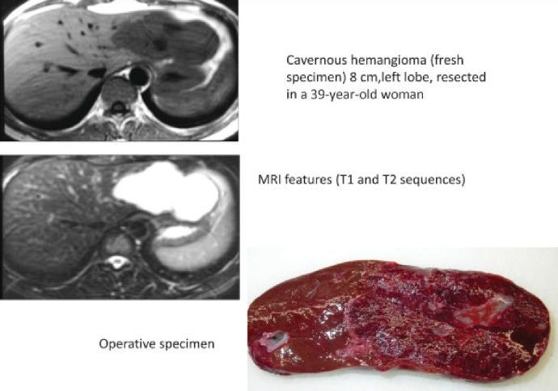
Common Benign Liver Tumors
Cavernous hemangiomas are the most common BLT, with an incidence of up to 20% in the general population. This usually small lesion is a congenital hamartomatous proliferation of vascular endothelial cells and may be multiple in 10% of cases.
Hemangiomas are rarely symptomatic (pain due to necrosis, infarction, or thrombosis), except in cases involving large tumors (> 10 cm).
Hemangiomas may increase in size during pregnancy and shrink after menopause. Although estrogen receptors have been identified in certain tumors, oral contraceptive (OC) intake is not a risk factor associated with the growth of hemangiomas.
Angiomatosis is an extremely rare condition with multiple hemangiomas, which is commonly asymptomatic and associated with hemangiomas in the skin or other organs.

Slide 69
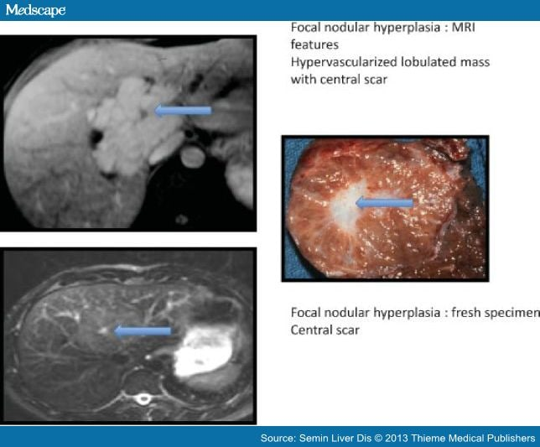
Common Benign Liver Tumors
Focal Nodular Hyperplasia Focal nodular hyperplasia (FNH) is the second most common solid BLT, occurring in up to 3% of the population.
FNH is considered to be a nonneoplastic lesion that is caused by a hyperplastic response to a congenital vascular malformation or a disruption in blood supply.
Focal nodular hyperplasia has a higher prevalence in women from their second to fourth decades. In 10 to 20% of cases, the lesions are multifocal.
Oral contraceptive use is not involved in FNH formation, but its effects on FNH progression still remain controversial.
Focal nodular hyperplasia has no malignant potential and usually remains stable or decreases in size over time. Less than 20% of patients with FNH develop symptoms.

Slide 70
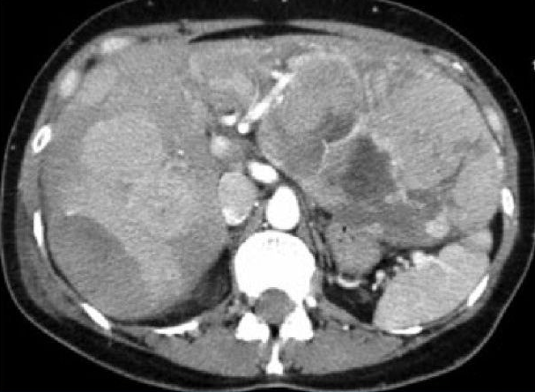
Common Benign Liver Tumors
Hepatocellular Adenoma Hepatocellular adenoma (HCA) is a very rare, benign hepatic neoplasia (incidence: 1/10⁶) that is usually identified as a well-defined, solitary lesion.
Hepatocellular adenoma occurs predominantly in childbearing women (M:F 1:8-15) and is related to endogenous or exogenous estrogen levels.
High doses and long duration of OC, as well as pregnancy, are associated with a higher incidence of HCA, whereas discontinuation of OC is associated with regression of HCA.
The use of anabolic androgen steroids, glycogen storage diseases (type I and III), and galactosemia also promote HCA, with a male preponderance.
Furthermore, HCAs associated with type I and type III glycogen storage diseases are more likely to be multifocal and to become malignant.

Slide 71
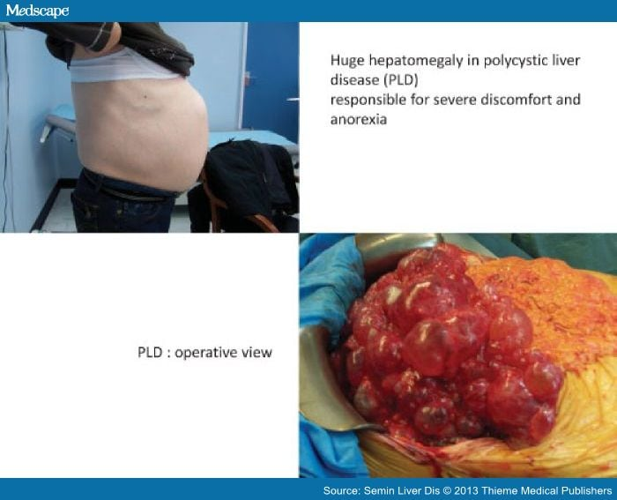
Common Benign Liver Tumors
Hepatic Cyst Simple hepatic cysts (SHCs) are congenital biliary hepatic lesions that are thought to result from progressive dilatation of biliary microhamartomas.
They do not communicate with the biliary tree. They are mostly found in women between 50 and 60 years of age.
Multiple cysts are quite common, typically less than five small or medium cysts. This is distinct from polycystic liver disease (PCLD) defined by the gross number of cysts.
Repeat pregnancies and OC intake are associated with faster development of hepatic cysts, which could explain why massive hepatomegaly rarely occurs before the fourth decade and why the prevalence and size of cysts are greater in women compared with men.
Approximately 80% of patients with PCLD are asymptomatic.

Slide 72
Common Benign Liver Tumors
Hepatocellular Adenoma Hepatocellular adenoma (HCA) is a very rare, benign hepatic neoplasia (incidence: 1/10⁶) that is usually identified as a well-defined, solitary lesion.
Hepatocellular adenoma occurs predominantly in childbearing women (M:F 1:8-15) and is related to endogenous or exogenous estrogen levels.
High doses and long duration of OC, as well as pregnancy, are associated with a higher incidence of HCA, whereas discontinuation of OC is associated with regression of HCA.
The use of anabolic androgen steroids, glycogen storage diseases (type I and III), and galactosemia also promote HCA, with a male preponderance.
Furthermore, HCAs associated with type I and type III glycogen storage diseases are more likely to be multifocal and to become malignant.

Slide 73
Less Common Benign Liver Tumors
An angiomyolipoma is a very rare hepatic tumor consisting of fat, epithelioid, and smooth muscle cells with thick-walled blood vessels. An association with tuberous sclerosis and renal angiolipomas are found in 10% of cases with a female preponderance.
Hepatic lipoma is a homogeneous and well-defined lesion that is less common than angiomyolipoma. Background hepatic steatosis may be associated with hepatic lipoma in 50% of the cases. The lesions may be associated with obesity, diabetes, alcoholism, steroids, total parental nutrition, chemotherapy, and antiretroviral therapy.
A mesenchymal hamartoma is another uncommon benign lesion, which is composed of bile ducts, immature mesenchymal cells, and hepatocytes and is usually diagnosed during childhood. Benign biliary hamartomas, such as bile duct adenomas, biliary adenofibromas and Von Meyenburg complexes are small, often subcapsular nodules.
Hepatobiliary cystadenomas are uncommon, benign cystic neoplasms of the biliary system, and comprise less than 5% of all hepatobiliary cystic masses. These arise more often within the liver (80%), but can affect the extrahepatic bile duct, and rarely, the gallbladder. They can be serious, or more commonly, mucinous, characterized by the presence of an ovarian-like stroma under the mucin-secreting epithelium. These tumors are premalignant, and transformations into cystadenocarcinomas are not uncommon.
Mucinous cystic neoplasms occur predominantly in women of middle age (40-60 years) and are usually discovered based on symptoms at a large size (> 10 cm). Complications may occur due to mass effect and include obstructive jaundice, chronic cholecystitis, and cholelithiasis.

Slide 74
Clinical Features
Symptomatic Patients
In cases of pain or severe discomfort, the first step is to ensure these symptoms are related to the liver mass and to evaluate the severity of these symptoms. Symptoms are usually related to large cysts, or necrotic/hemorrhagic adenomas.
Asymptomatic Patient
Incidentalomas are increasingly frequent because of the development of imaging modalities. A common clinical discovery involves one or several focal lesions on an ultrasound (US) or computed tomography (CT) scan performed for reasons unrelated to the liver.
The clinical interview should address the personal or familial history of malignancy and age-appropriate screening, past history of hepatitis or blood transfusions or intravenous drug use, and estrogen or progesterone use. Liver biochemistry, viral serologies, and tumor markers are useful for excluding liver disease or with atypical presentations.

Slide 75
Diagnostic Tools
The diagnostic tools in this field principally involve US, contrast-enhanced CT scan, and magnetic resonance imaging (MRI).
Ultrasound is usually the first investigation that detects the focal mass. It is a simple and noninvasive technique to differentiate solid from cystic lesions.
Tripe-phase CT is an excellent modality for characterizing lesions, yielding specific signs in cases of large hemangiomas or FNH.
MRI is the best imaging modality in terms of specificity for diagnosing hepatic lesions, particularly when liver-specific contrast agents are utilized.

Slide 76
Management of Benign Tumors
The management of BLT is still evolving because of several advances: the improvement in diagnostic radiological imaging; recent histopathological and biomolecular findings; the widespread use and safety of laparoscopic surgery; and improved identification and knowledge of the multiple lesions.
In fact, four types of surgery can be identified:
life-saving surgery for emergency situations,
symptomatic surgery for patients with pain or discomfort,
preventive surgery for tumors presenting a high probability of complications,
diagnostic surgery.

Slide 77
Indications for Surgery
Bleeding Tumors
This clinical feature consists of an acute onset of abdominal pain related to a subcapsular giant hematoma and/or hemoperitoneum with hemorrhagic shock, generally caused by spontaneous rupture of an adenoma, or in exceptional cases, a hemangioma.
The first step is appropriate resuscitation in a monitored setting. Usually, the patient can be stabilized and a CT scan performed to make the diagnosis.
If the patient remains hemodynamically unstable, arterial embolization is the initial treatment of choice as emergent operative exploration is highly morbid with high rates of mortality.
In cases of misdiagnosis or clinical instability, a laparotomy may be emergently performed and the ruptured tumor intraoperatively discovered.
Some authors recommend embolization to support the delayed surgery.

Slide 78
Solitary Symptomatic Tumors
The symptomatic tumors are usually large lesions. The indications for surgery, which include complete removal of the solid lesion, should be discussed based on the severity of symptoms and the risks of surgery.
For cystic tumors, percutaneous aspiration may serve as a "diagnostic tool" proving that the symptoms are commensurate with the cyst; however, this procedure is not a valid treatment. Laparoscopic fenestration or deroofing of the cyst is the gold standard. Alternative surgical treatment consists of aspiration-sclerotherapy with alcohol under US guidance.

Slide 79
Solitary Asymptomatic Tumor
Hemangioma, FNH, and cysts, if diagnosed with certainty by imaging, must be managed conservatively regardless of their size. No follow-up is recommended because even if the tumor size increases, surgery will not be indicated if the patient remains asymptomatic. No change in lifestyle is necessary for any of these lesions, such as refraining from contact sports or terminating OC use. The only condition to be discussed is the desire for pregnancy in a woman with a large subcapsular hemangioma.
For asymptomatic adenomas, surgery must be discussed in terms of a preventive strategy because of the risks of bleeding and malignancy. Routine surgery for adenomas is controversial, and conservative management may be recommended in many cases.
If the tumor is inflammatory or if it increases in size, then discuss surgery with the patient. Otherwise, observation appears to be justified. If pregnancy is planned, discuss surgery or radiofrequency ablation. For patients with large adenomas (> 5 cm), surgery should be scheduled.

Slide 80
Multiple Lesions
Management of the multiple forms of benign tumors is difficult because surgical clearance is often impossible and because no clear recommendations are available.
In cases of hemangiomatosis, the same rules as for solitary hemangiomas are applied: only symptomatic forms require surgery and follow-up is unnecessary.
Multiple FNHs are usually asymptomatic and also require no follow-up. Surgical management depends on the type of adenomatosis, the histological subtype, the symptoms, and the patient.
Resection of the largest or most complicated adenomas may be performed, with or without intraoperative radiofrequency ablation, while small, uncomplicated lesions may be surveyed.
Arterial embolization has been applied to progressive adenomatosis with good results. In the rare cases of iterative complications or proven malignant transformation, liver transplantation should be discussed.
In PCLD patients, the indications for surgery depend only on the severity of symptoms. The surgical options consist of fenestration, liver resection, and liver transplantation.
Before considering resection or transplantation, which are potentially morbid procedures, alternative medical management should also be discussed.

Slide 81
LIVER CANCER

Slide 82
Epidemiology
Liver cancer is the sixth most common cancer worldwide, with 841,080 new liver cancer cases in 2018, and the fourth leading cause of cancer-related death globally.
The highest incidence and mortality of HCC are observed in East Asia and Africa, although HCC incidence and mortality are increasing in different parts of Europe.
Indeed, Surveillance Epidemiology End Results (SEER) reported HCC as the fastest increasing cause of cancer-related death since the early 2000s and HCC is projected to become the third leading cause of cancer-related death by 2030 if these trends continue.

Slide 83
Epidemiology
Liver cancer is the sixth most common cancer worldwide, with 841,080 new liver cancer cases in 2018, and the fourth leading cause of cancer-related death globally.
The highest incidence and mortality of HCC are observed in East Asia and Africa, although HCC incidence and mortality are increasing in different parts of Europe.
Indeed, Surveillance Epidemiology End Results (SEER) reported HCC as the fastest increasing cause of cancer-related death since the early 2000s and HCC is projected to become the third leading cause of cancer-related death by 2030 if these trends continue.

Slide 84
Type of Liver Cancer | Description | How Common
Hepatocellular carcinoma (HCC) | Hepatocellular carcinoma can have different growth patterns. Some spread tentacle-like growths through the liver. This pattern is the most common one in the United States. Some start as a single tumor that spreads to other parts of the liver as the disease develops. Others develop as nodules at several different places in the liver. Occasionally, a pattern isn't clear. | Approximately 75% of primary liver cancers in adults are hepatocellular carcinomas.
Cholangiocarcinoma, also called bile duct cancer | A cholangiocarcinoma develops from cells in the bile duct of the liver. The bile duct is a thin tube that extends from the liver to the small intestine. The bile duct starts inside the liver as several smaller tubes that join together. | About 10% to 20% of primary liver cancers in adults are cholangiocarcinomas.
Angiosarcoma | Angiosarcoma starts in the blood vessels of the liver and grows very quickly. | About 1% of primary liver cancers in adults are angiosarcomas.

Slide 85
RISK FACTORS
Cirrhosis.
Obesity, NAFLD, and diabetes.
Viral hepatitis.
Age.
Male.
Environmental factors (aflatoxin).

Slide 86
Clinical features
People with liver cancer may experience no symptoms, particularly when the tumor is detected early as part of a screening program.
Pain, especially at the top right of the abdominal area
Unexplained weight loss
Weakness or fatigue
Yellowing of the skin or eyes

Slide 87
Diagnosis
Given that most cases of HCC occur in an identifiable patient population, that is, in those with chronic hepatitis B or cirrhosis, many patients are diagnosed through surveillance.
Nevertheless, given the under-implementation of screening in some clinical practices, a proportion of patients with HCC might present incidentally with a liver mass, identified on cross-sectional imaging performed for other reasons or owing to symptomatic advanced-stage HCC after developing abdominal pain, weight loss or worsening of liver dysfunction.
Such incidental diagnosis has been estimated to occur in 50% of cases globally, particularly in developing jurisdictions.

Slide 88
Imaging
Patients with an abnormal surveillance test, that is, detection of a liver nodule in abdominal ultrasonography or high serum α-fetoprotein levels (>20 ng/ml), belong to at-risk populations and require timely diagnostic evaluation. Most lesions <1 cm in diameter detected on ultrasonography are not HCC or are very difficult to diagnose.
Hence, cross-sectional imaging is not required and short-term follow-up with a repeat ultrasonography after 3 months is sufficient. For lesions ≥1 cm in diameter, either quadruple-phase CT or dynamic contrast-enhanced MRI should be performed.
HCC lesions are brighter than the surrounding liver in the arterial phase in a CT scan or MRI and less bright than the surrounding parenchyma in the venous and delayed phases, related to the differential blood supply of the tumour compared with the background liver. This phenomenon of ‘arterial enhancement and delayed washout’ has a sensitivity of 89% and a specificity of 96% for HCC and is regarded as the radiological hallmark of HCC, which is sufficient for a diagnosis without requiring histological confirmation.
The specificity of MRI using hepatobiliary contrast agents seems to be lower than that using extracellular agents; therefore, its role in the non-invasive diagnosis of HCC remains unclear.

Slide 89
Histopathology
Although most HCCs have characteristic features in imaging, ~10% of the tumours (but up to 30% of tumours 1–2 cm in diameter) have an atypical presentation, lacking the imaging hallmarks of HCC. T
he International Consensus Group for Hepatocellular Neoplasia has proposed major histological features of HCC, which include stromal invasion, increased cell density, intratumoural portal tracts, unpaired arteries, pseudo-glandular pattern and diffuse fatty changes.
If there is a clinical suspicion for HCC but the appearance is atypical by imaging, a biopsy or second contrast-enhanced study should be performed. The sensitivity of a biopsy is ~70% and is even lower in tumours <2 cm because of the potential for missed lesions as well as the difficulty in distinguishing well-differentiated HCC from dysplastic nodules.
Some patients require multiple biopsies for a diagnosis, so patients with a negative biopsy should continue to be followed with serial contrast-enhanced imaging. If the lesion enlarges but retains its atypical appearance for HCC, a repeat biopsy should be considered.

Slide 90
Management
HCC is a unique neoplasm as 80–90% of cases develop in patients with cirrhosis and, therefore, the application of different therapeutic options might be limited because of the patient’s overall health status.
The treatment is assigned according to tumour stages and the expected benefits of major interventions, following the Barcelona Clinic Liver Cancer (BCLC) staging system.
In principle, patients with early-stage HCC tumours are the preferred candidates for resection, transplantation and local ablation, whereas patients at intermediate stages are first candidates for Transarterial Chemoembolization and those with advanced disease will first receive systemic therapies.

Slide 91
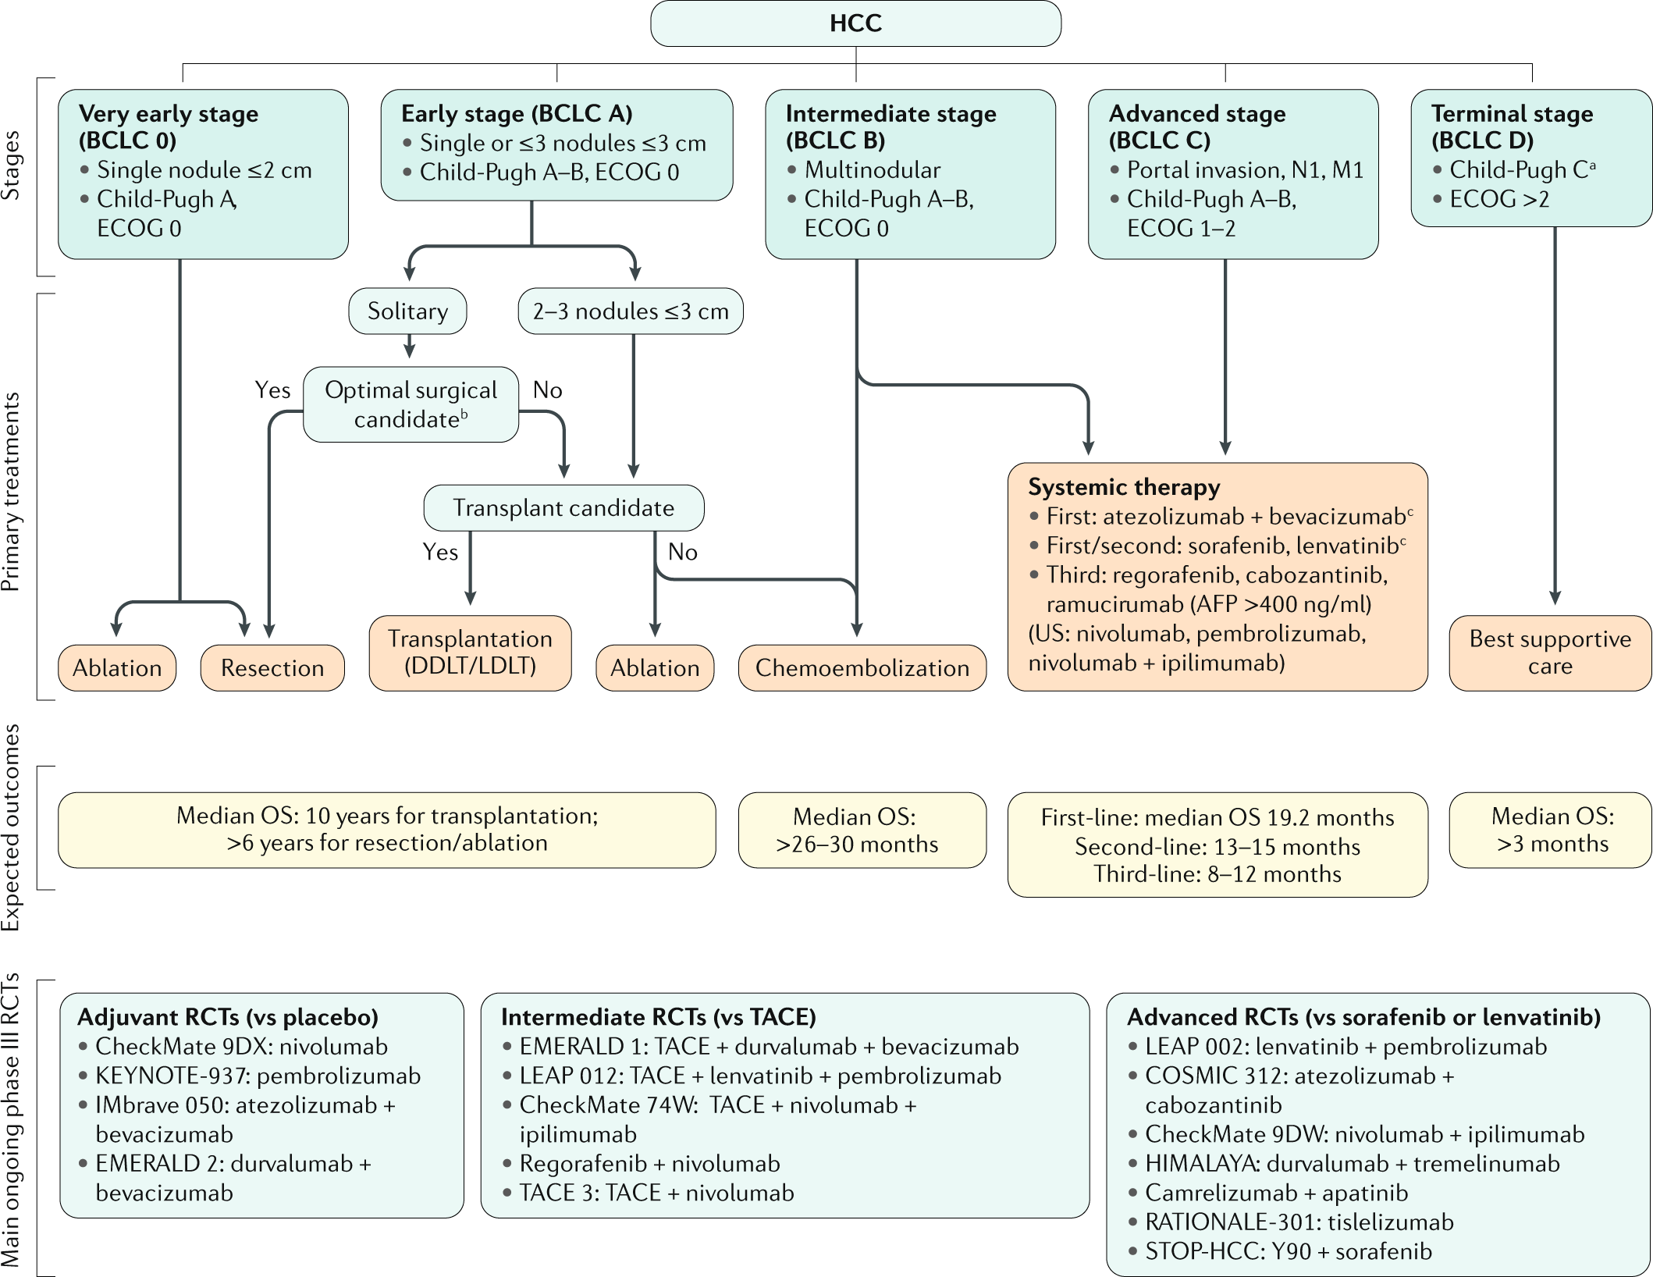
The Barcelona Clinic Liver Cancer (BCLC) staging system

Slide 92
Summary of key results of randomized and cohort studies in the management of early HCC
HCC stage | Treatment arms | Outcomes
 |  | Overall survivalª | Otherª
Resection
Early | HCC ≤5 cm, no PHT | 50–70% | NA
 | HCC >5 cm or PHT | 35–55% | NA
Early or intermediate | Optimal candidates | 65% | NA
 | Suboptimal candidates | 35% | NA
Liver transplantation
Early | Milan | 70–80% | 70%^{b}
Early or intermediate | Down-staged | 60–70% | 60%^{b}
Ablation
Early | RFA | 70% | 5–10%^{c}
 | PEI | 60% | 10–15%^{d}
 | MWA | 65% | 11%^{d}
 | Cryoablation | 40% | 35%^{e}
 | RFA + LTLD | 54 months^{f} | 14 months^{g}
Adjuvant treatment (after resection or ablation)
After resection | Sorafenib vs placebo | NA | 33.3 vs 33.7 months^{h}
 | CIK cells vs BSC | NA | 65% vs 70%^{i}
After transplantation | Sirolimus-free IS vs Sirolimus-based IS | 68% vs 75%^{j} | NA

Slide 93
Summary of key results of randomized and cohort studies in the management of intermediate HCC
HCC stage | Treatment arms | Outcomes
 |  | Overall survival (months) | Time to progression (months)
Transarterial therapies
Intermediate | TACE | 26–32 | 5
 | TACE plus brivanib | 26 | 8
 | TACE plus sorafenib | 21 | 11
 | TACE plus orantinib | 31 | 3
Advanced | HAIC plus sorafenib | 12 | 5
 | TACE plus sorafenib | 13 | 5
Transarterial radioembolization
Advanced | TARE | 8–9 | 6
 | TARE plus sorafenib | 12 | NA

Slide 94
Summary of main outcomes and adverse events among systemic therapies approved for advanced HCC
Study name | Treatment | Median overall survival (months) | Median PFS (months) | ORR mRECIST; RECIST | Treatment-related adverse events |  |  | Adverse events leading to drug withdrawal
 |  |  |  |  | Grade 3–4 | Most common grade 3–4 | Leading to death
First-line therapies
IMbrave150 | Atezolizumab + bevacizumab | 19.2ª | 6.8 | 35.4%; 29.8%ª | 36% | Hypertension 10%; increased AST 4%; proteinuria 3% | 2% | Any drug: 16%; both drugs: 7%
SHARP (IMbrave150, REFLECT) | Sorafenib | 10.7–13.4ª | 3.7–4.3 | NA; 2% | 45% | Diarrhoea 8%; HFS 8%; fatigue 4% | NA | 11%
REFLECT | Lenvatinib | 13.6 | 7.4 | 24.1%; 18.8% | 57% | Hypertension 23%; weight loss 8% increased BR 7% | 2% | 9%
Second-line therapies
RESORCE | Regorafenib | 10.6 | 3.1 | 11%; 7% | 50% | Hypertension 13%; HFS 13%; fatigue 9% | 2% | 10%
CELESTIAL | Cabozantinib | 10.2 | 5.2 | NA; 4% | 68%ª | HFS 17%^{b}; Hypertension 16%^{b}; increased AST 12%^{b} | 1% | 16%
REACH-2 | Ramucirumab | 8.5 | 2.8 | NA; 5% | NR | Hypertension 8%; liver injury or failure 4%; proteinuria 2% | 2% | 11%

Slide 95
Surgical interventions
Surgical treatment, which includes both hepatic resection and liver transplantation, has long been the backbone of curative therapies for HCC, yielding the best outcomes, with a 5-year survival of ~70–80%.
The decision between resection and transplantation requires consideration of the patient’s liver function, the presence and extent of portal hypertension, performance status, and tumour characteristics such as size, number and involvement of the hepatic and portal veins.
Nonetheless, level 1 evidence supporting this approach of resection for non-ideal candidates is not yet available.

Slide 96
Image-guided ablation
Image-guided ablation is accepted as a potentially curative therapy for small, early-stage HCC tumours.
In principle, there are two indications for these therapies according to guidelines, either as first choice therapy for single, very early tumours <2 cm or as an alternative to surgery in early-stage single tumours, generally up to 4 cm, or 2–3 tumours ≤3 cm.
The latter patients are unsuitable for resection due to liver dysfunction or tumour multi-nodularity and additionally present with formal contraindications for liver transplantation.
Ablation is used to direct injury to the tumour and is achieved via chemical, thermal or electrical methods.
Historically, percutaneous ethanol injection is the seminal technique for local ablation and is still recommended for tumours <2 cm, especially when located in the proximity of major vessels or bile ducts.
Currently, radiofrequency ablation (RFA) is the established thermal technology along with microwave ablation (MWA), whereas other ablative techniques, such as cryoablation (CRA) and laser interstitial thermotherapy, are less used.
Irreversible electroporation (IRE) achieves tumour destruction by inducing electrical damage to the tumour cells without a significant thermal component.

Slide 97
Radiotherapy
External beam radiation therapy can achieve radiological responses in HCC tumours across a range of sizes and stages within the liver as well as palliation of extrahepatic metastases.
In HCC tumours confined to the liver, prospective studies of stereotactic body radiation therapy with photons or protons show high rates of radiological responses with acceptable safety in predominantly Child-Pugh A populations, although these findings are limited by uncontrolled study designs.
Collectively, these studies support a potential role for radiotherapy in selected patients, particularly those with small tumours not amenable to resection or transplantation.

Slide 98
Transarterial therapies
Two RCTs and a subsequent meta-analysis involving patients with intermediate-stage HCC have demonstrated survival benefits with TACE compared with suboptimal therapies, including tamoxifen or best supportive care.
Over the past few years, the introduction of drug-eluting bead TACE has offered an alternative to conventional lipiodol TACE.
Drug-eluting bead TACE has been associated with a reduction in systemic drug exposure and drug-related adverse events
TACE is usually indicated by physicians on demand according to radiological response, generally assessed according to mRECIST.
However, combinations of TACE and TKIs have so far failed to provide beneficial clinical outcomes.

Slide 99
Systemic therapies
The benchmark for clinical trial design in HCC is the SHARP study, which established the selection criteria and stratification factors, such as the use of the BCLC staging system, Child-Pugh A liver function and performance status (ECOG 0 or 1), all of which form the basis for future phase III trials investigating advanced-stage HCC.
Several studies over the past decade have established other prognostic factors that led to modifications in study designs.
These modifications include the separation of extrahepatic spread and macrovascular invasion, the importance of elevated α-fetoprotein levels, and the incorporation of mRECIST assessments.

Slide 100
First-line therapies
In patients with advanced-stage HCC, the SHARP trial demonstrated the superiority of sorafenib to placebo, which represented a breakthrough in HCC management. Sorafenib was the only available standard of care for advanced HCC for a decade.
A global open label randomized phase III study (REFLECT) demonstrated the efficacy of lenvatinib, which was the first new drug approved for advanced-stage HCC in the first-line setting in over 10 years.
The combination of atezolizumab (anti-PDL1 antibody) and bevacizumab (anti-VEGF antibody) was the first regimen to improve overall survival compared with sorafenib.

Slide 101
Second-line therapies
Currently, based on positive phase III data, three regimens (regorafenib, cabozantinib and ramucirumab) are approved for the treatment of advanced HCC after progression on sorafenib according to guidelines.
Regorafenib, a multi-kinase inhibitor targeting VEGFR1–3 and other kinases, was the first agent to be approved in the second-line setting upon demonstrating a survival advantage over placebo for patients who tolerated and had documented progression on sorafenib.
Cabozantinib is a multi-kinase inhibitor with unique activity against VEGFR2, AXL and MET. The CELESTIAL trial demonstrated an improvement in the median overall survival for cabozantinib compared with placebo and an improvement in median PFS.
Ramucirumab is the only biomarker-guided therapy for HCC. The REACH-2 trial that investigated ramucirumab was enriched for patients with baseline α-fetoprotein levels of ≥400 ng/dl. Ramucirumab demonstrated an improvement in overall survival.
Based on phase Ib/II data, nivolumab and pembrolizumab (anti-PD1 inhibitors) were approved as single agents and ipilimumab (CTLA4 monoclonal antibody) was approved in combination with nivolumab

Slide 102
THANK YOU FOR
ATTENTION
ODESSA NATIONAL MEDICAL UNIVERSITY
UNIVERSITY CLINIC DEPARTMENT of SURGERY #3

