Slide 1
VARICOSE VEINS of LOWER EXTREMITIES. SUPERFICIAL THROMBOPHLEBITIS
ODESSA NATIONAL MEDICAL UNIVERSITY
UNIVERSITY CLINIC DEPARTMENT of SURGERY #3

Slide 2
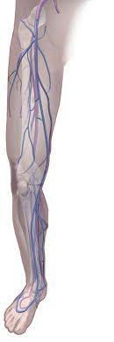
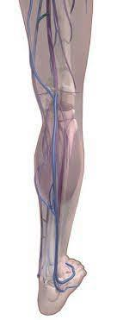
ANATOMY
DEEP VENOUS SUSTEM
f
PERFORATOR VEINS
f
MUSCLE SINUSES
f
SUPERFICIAL VEINS
ff
TRIBUTARY VEINS

Slide 3
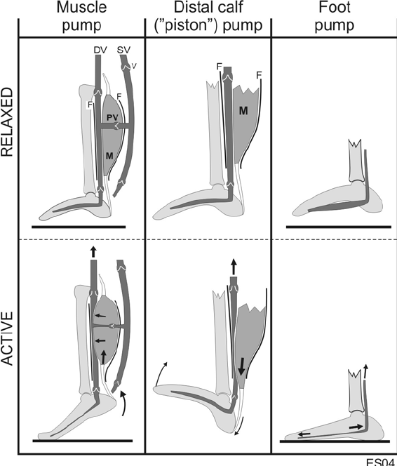
PHYSIOLOGY
VENOUS BLOOD from the LE
rises up against the GRAVITY
DUE to the ACTIVE WORK
of the LEG MUSCLES (PUMP)
and DOES NOT FALL DOWN
OWING to the VALVE SYSTEM

Slide 4
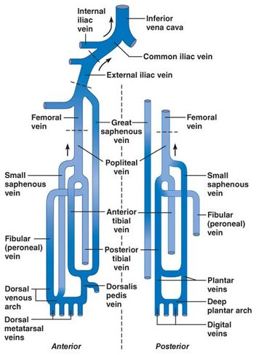
HEMODYNAMICS
SUPERFICAIL VEINS and MUSCLE SINUSES
COLLECT BLOOD from TRIBUTARY VEINS
and CARRY IT to the DEEP VENOUS SYSTEM
through the JUNCTIONS and PERFORATORS
*saphenofemoral and saphenopopliteal junctions
* medial and posterior calf and thigh perforators

Slide 5
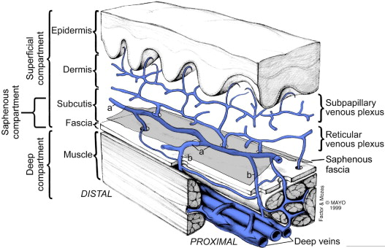
ANATOMY

Slide 6
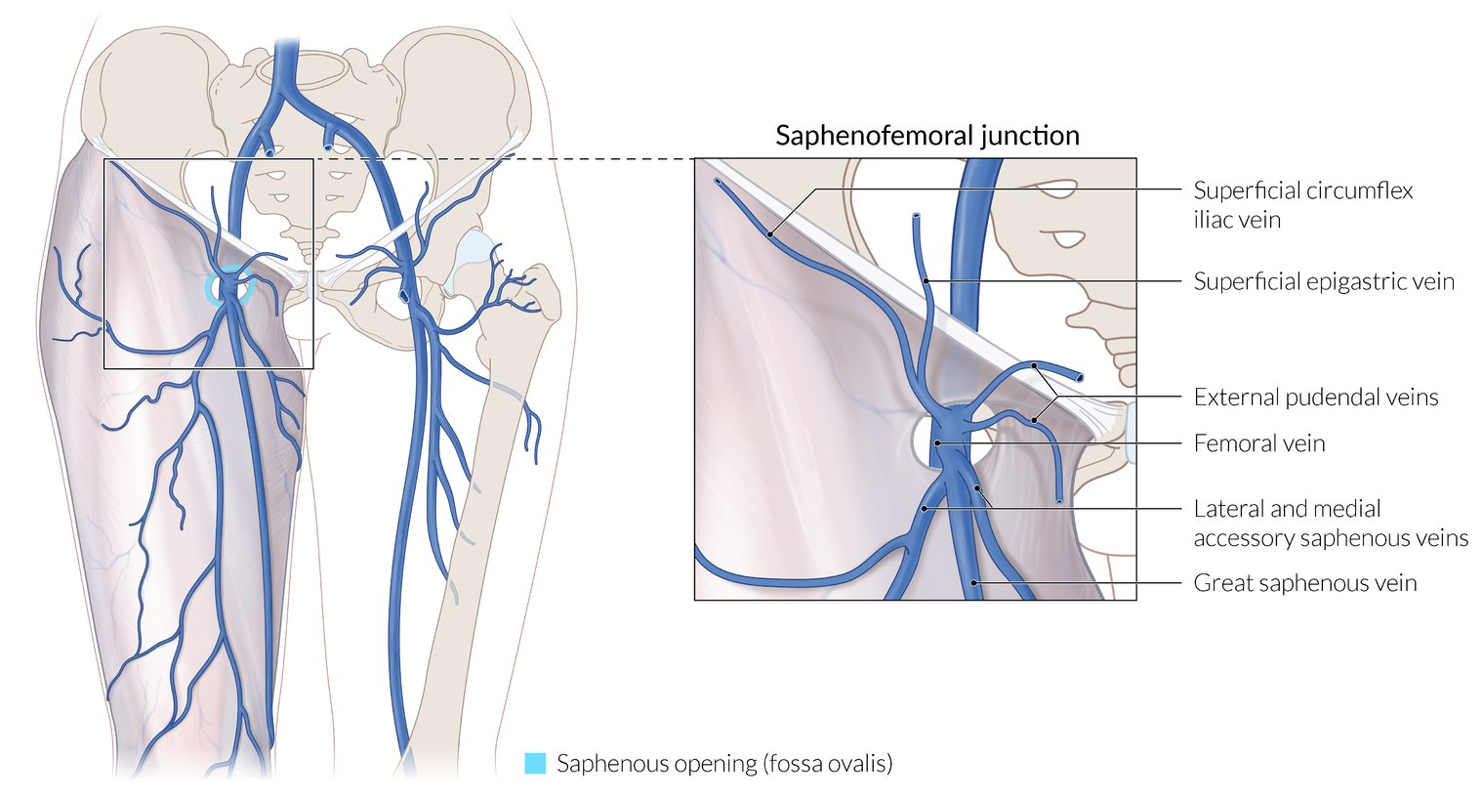
ANATOMY

Slide 7
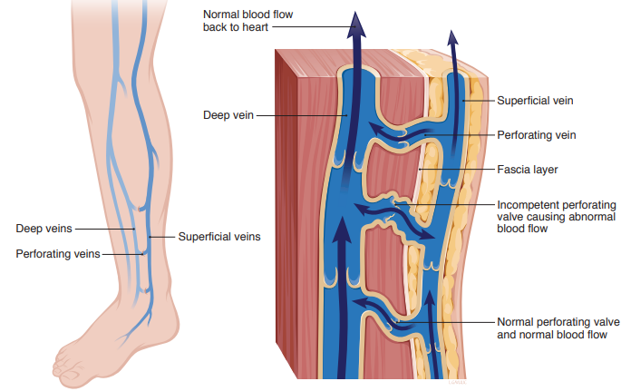
ANATOMY

Slide 8
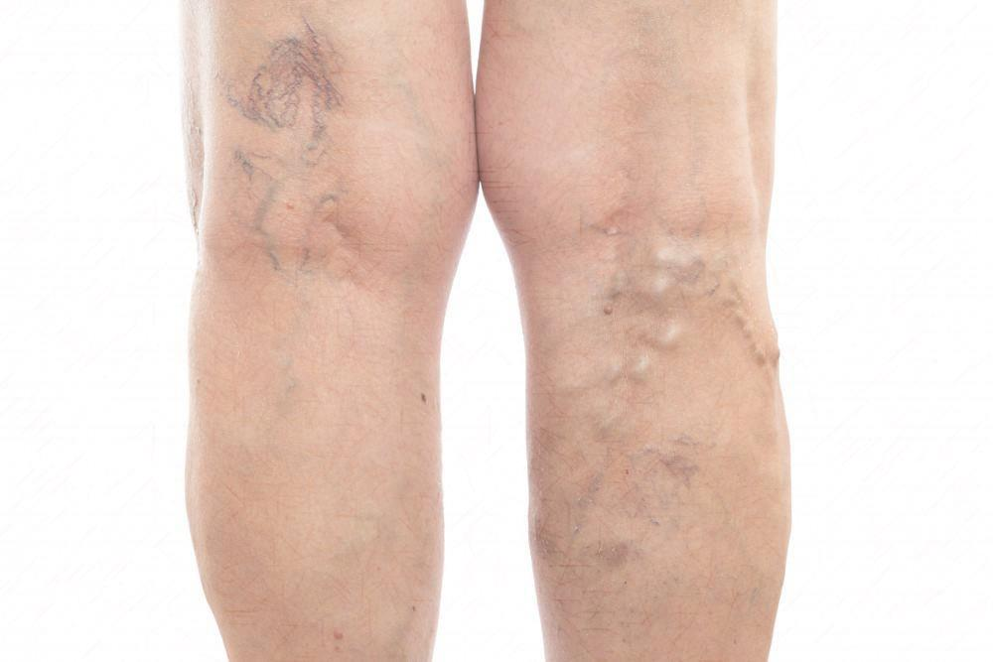
VARICOSE VEINS
VV - medical condition
when superficial veins
become enlarged and twisted
VV are most common after 50 yo.
It is more prevalent in females.
There is a hereditary role.

Slide 9
ETHIOLOGY
HEREDITARY FACTOR of the venous wall weakness
d
LIFE STYLE PECULIARITIES casing venous hypertension
d
SECONDARY CHANGES due to the uplying processes
f
trauma, obesity, pregnancy, heavy weights
standing or sitting for a long time, obstipations

Slide 10
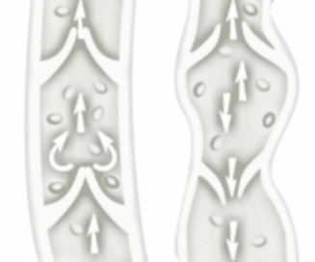
PATHOLOGY
VENOUS INSUFFISIENCY
VENOUS BLOOD REFLUX
VENOUS HYPERTENSION
BLOOD DISCIRCULATION

Slide 11
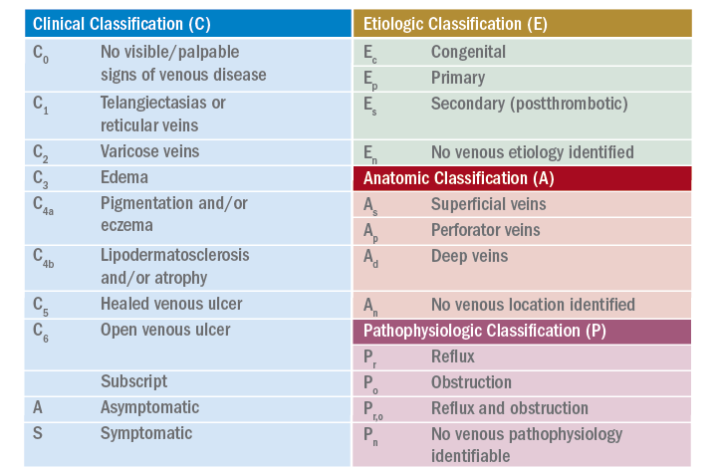
CLASSIFICATION

Slide 12
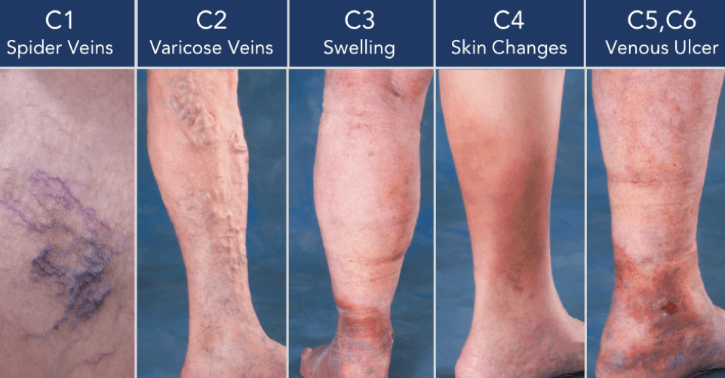
CLASSIFICATION

Slide 13
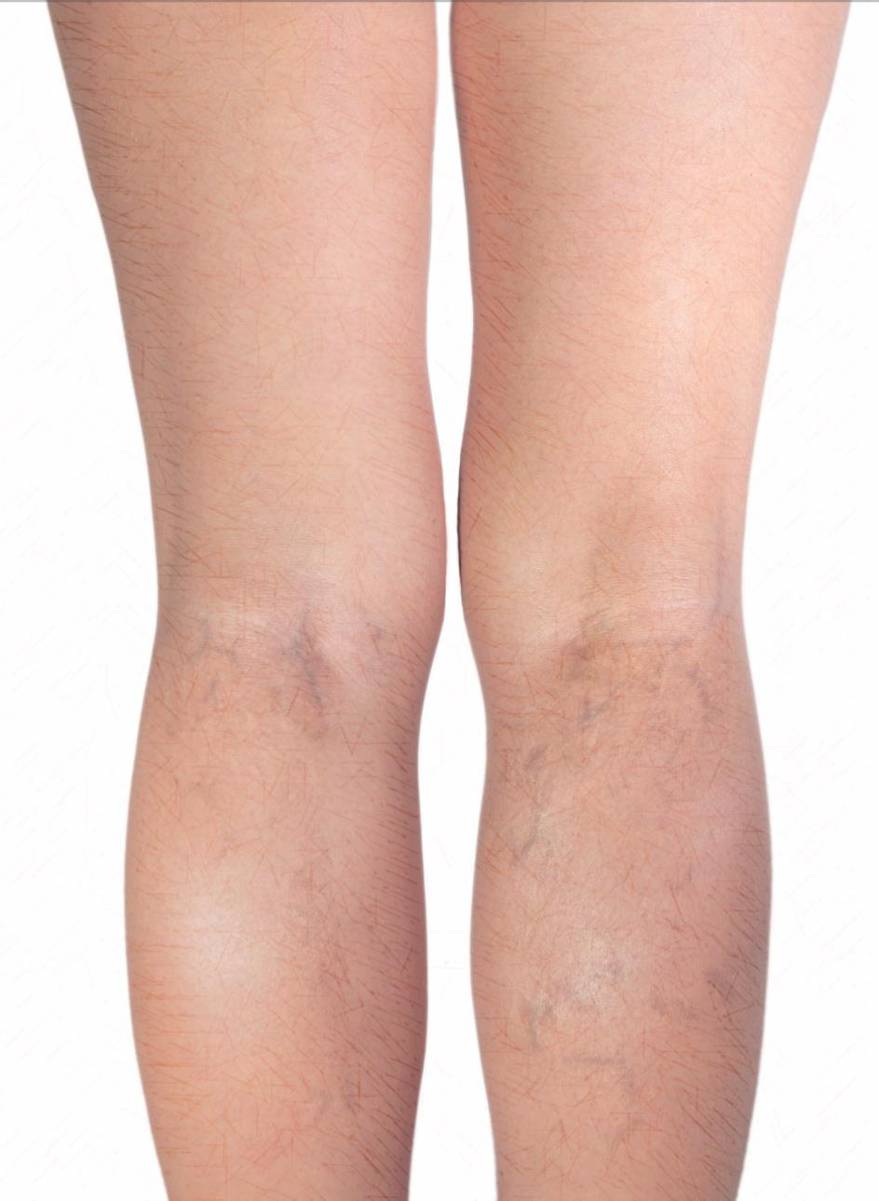
CLINICAL FEATURES
Aching, heavy legs
Ankle swelling
Skin discoloration
Stasis dermatitis
Venous eczema
Muscle cramps
Abnormal healing
Lipodermatosclerosis
Restless legs
Atrophie blanche
Burning sensation

Slide 14
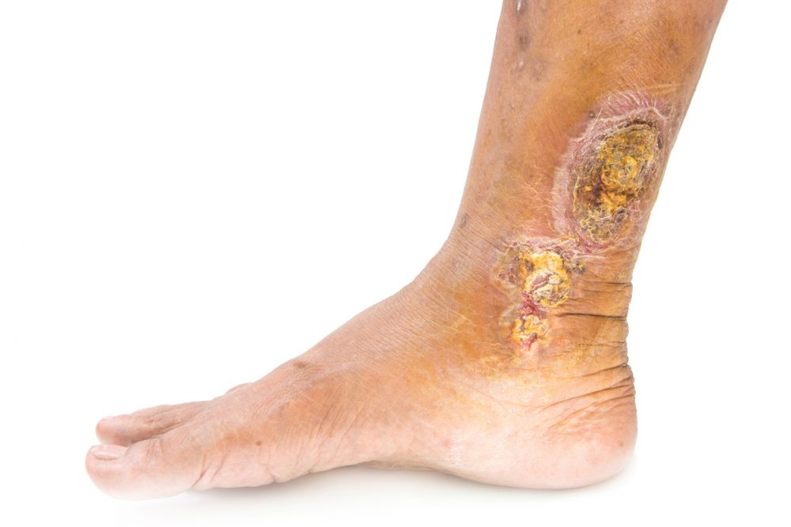
COMPLICATIONS
Inability to walk or stand
Skin conditions / dermatitis
Severe bleeding from minor trauma
Superficial thrombophlebitis
Skin ulcers especially near the ankle

Slide 15
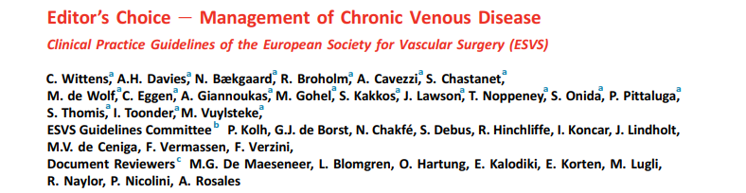
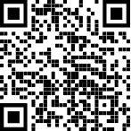
GUIDELINES

Slide 16
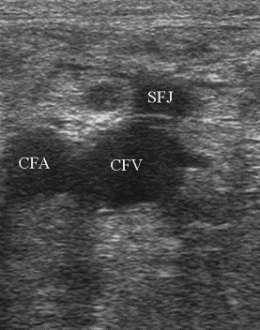
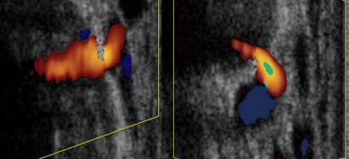
DIAGNOSTICS
GOLDEN STANDART
COLOR ULTRASOUND
+
Valsalva maneuver

Slide 17
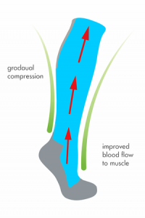
Treatment
CONSERVATIVE TREATMENT
GRADUATED COMPRESSION
ANTIAPLATELETS – if necessary
VENOTONICS – FLAVONOIDS

Slide 18
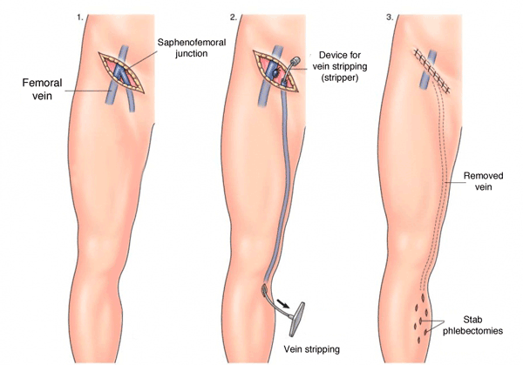
SURGERY
CROSSECTOMY
+ STRIPPING
f
* Crossectomy – ligation the SFJ
* Stripping – extraction of the GSV

Slide 19
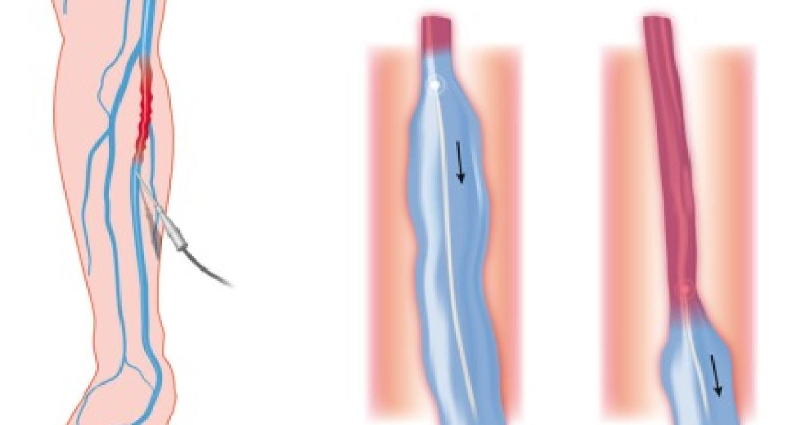
MINIMALLY INVASIVE SURGERY
ENDOVENOUS LASER ABLATION
RADIOFREQUENCY ABLATION
ENDOVENOUS ELECTRIC WELDING
ULTRASOUND NAVIGATED
HEAT-INDUCED COAGULATION
OF THE INNER VEIN WALL

Slide 20
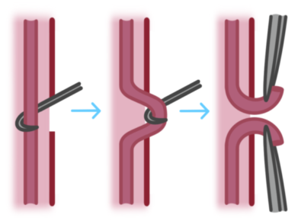
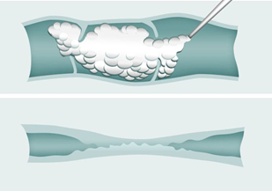
PROCEDURES
MINIFLEBECTOMY
removal of tributary veins
through the small incision
SCLEROTHERAPY
filling of the superficial veins
with a foam-form detergent

Slide 21
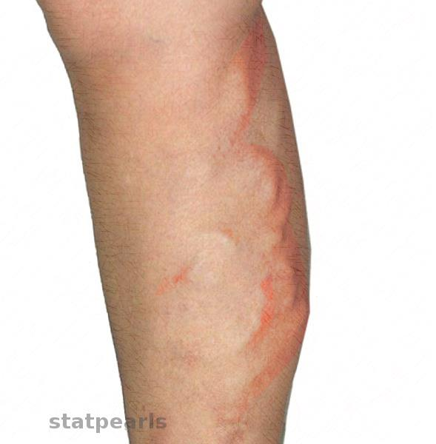
THROMBOPHLEBITIS
Superficial thrombophlebitis
thrombosis and inflammation
of superficial veins
0.64 per 1000 persons per year
Increased incidence at 3-8 decade
Predominant in women at 55-70%
The average mean age is 60 years

Slide 22
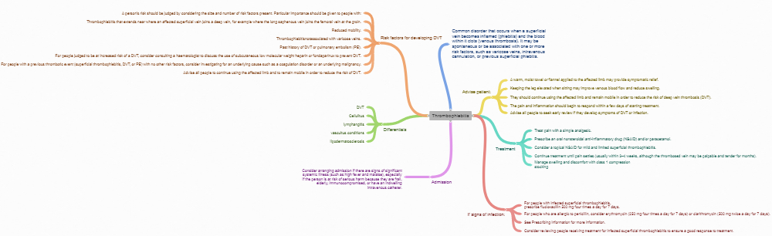
ETHIOLOGY
SVTs of the legs are often due to varicose veins,
though most people with VV do not develop SVTs.
Patient characteristics and predisposing factors
for thrombophlebitis nearly mirror those for DVT.
Thrombophlebitis is a risk factor for the DVT,
and vice versa.

Slide 23
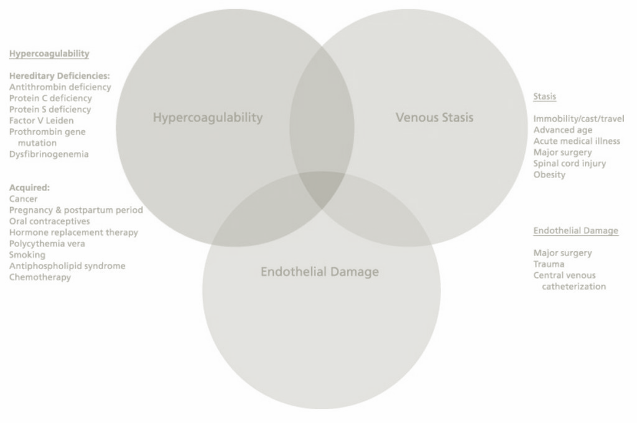
ETHIOLOGY
Traditionally, the three factors of Virchow's triad
venous stasis, hypercoagulability, and changes in the endothelium
contribute to thrombophlebitis and are used to explain its formation
Abnormalities of coagulation
Endothelial dysfunction
Infections and venous stasis
IV therapy and drug abuse

Slide 24
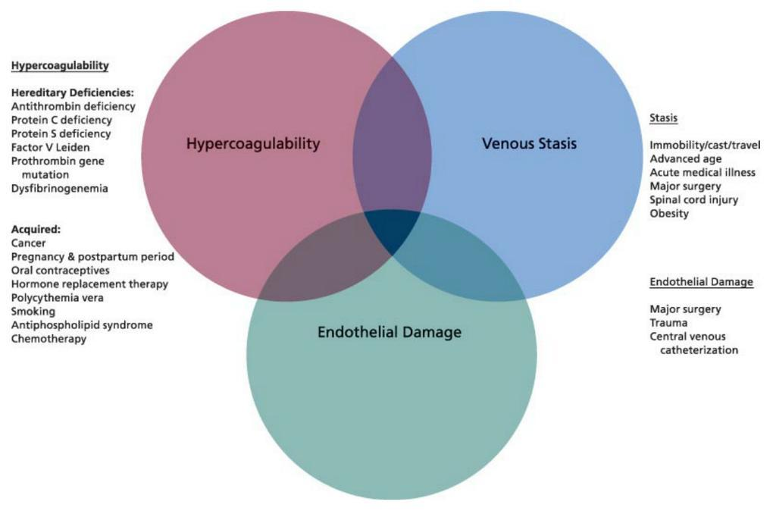
Virchow's triad

Slide 25
PATHOLOGY
BLOOD DISCIRCULATION
BLOOD HYPERCOAGULATION
BLOOD CLOTH FORMATION
VEIN WALL INFLAMATION

Slide 26
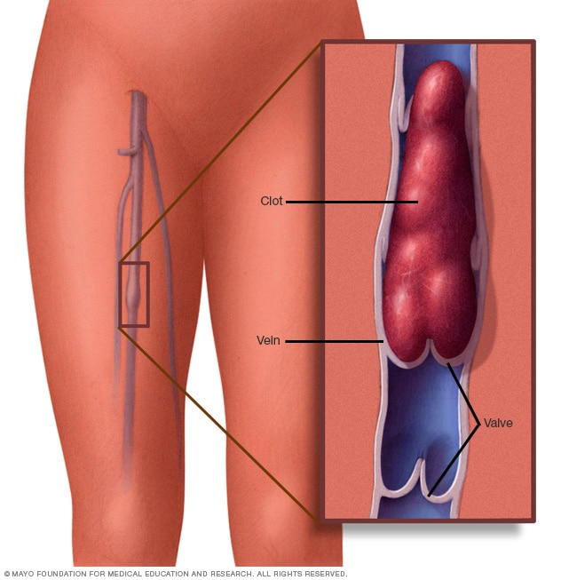
CLINICAL FEATURES
Tenderness + Induration
Painfullness + Erythema
along the superficial vein
+ palpable nodules / cord

Slide 27
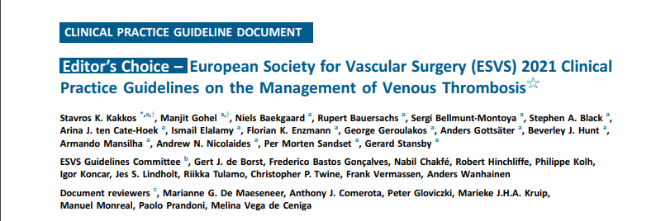
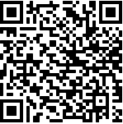
GUIDELINES

Slide 28
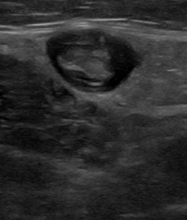
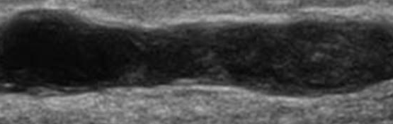
DIAGNOSTICS
GOLDEN STANDART
COLOR ULTRASOUND
+
compression sign

Slide 29
Treatment
CONSERVATIVE TREATMENT
GRADUATED COMPRESSION
ANTIINFLAMATORY - NSAIDs
ANTICOAGULANTS - NOACs
* if increased risks for thromboembolism
* LMWH – if not possible to swallow

Slide 30
SURGERY
CROSSECTOMY + STRIPPING
d
INDICATIONS
clot in 1 cm from the SFJ
unreliability for anticoagulation
failure of anticoagulation
patients with intense pain
f

Slide 31
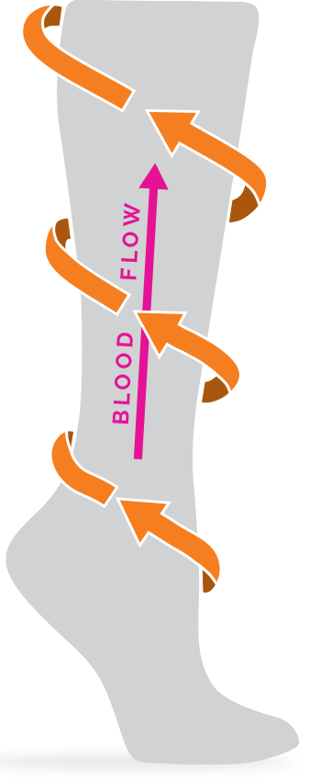
FURTHER TREATMENT
CONSERVATIVE TREATMENT
GRADUATED COMPRESSION
PHISICAL ACTIVITY
OBSERVATION + ULTRASOUND
DURATION of treatment - INDIVIDUAL

Slide 32
THANK YOU FOR
ATTENTION
ODESSA NATIONAL MEDICAL UNIVERSITY
UNIVERSITY CLINIC DEPARTMENT of SURGERY #3

