Slide 1
BENIGN DISEASES of the BREAST
ODESSA NATIONAL MEDICAL UNIVERSITY
UNIVERSITY CLINIC DEPARTMENT of SURGERY #3

Slide 2
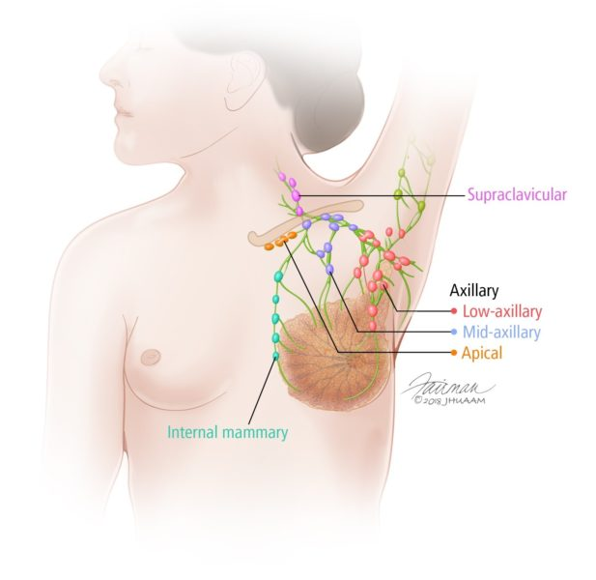
Anatomy of the breast
Breasts (mammary glands) are modified sebaceous glands.
BREAST BORDERS:
Upper border: collar bone.
Lower border: 6th or 7th rib.
Inner border: edge of sternum.
Outer border: mid-axillary line.
BREAST DIVISIONS:
Each breast is divided into 5 segments.
Four quadrants: By horizontal and vertical lines intersecting at the nipple.
Tail of Spence (the axillary tail): an additional lateral extension of the breast tissue toward the axilla.

Slide 3
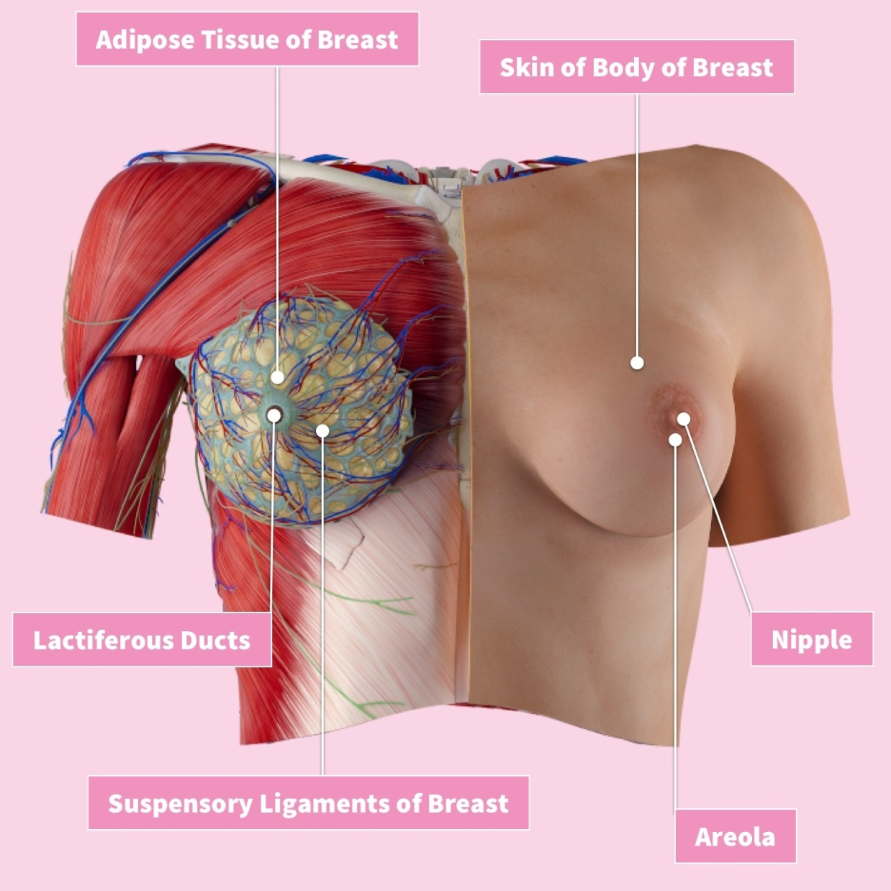

Slide 4
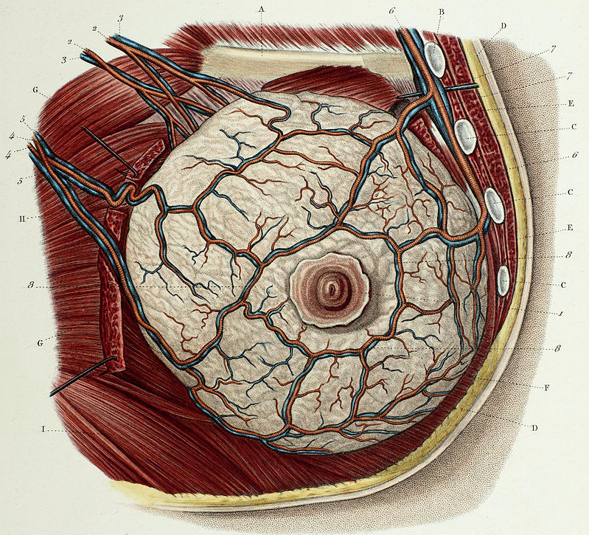
Anatomy of the breast
EXTERNAL ANATOMY OF THE BREAST:
Nipple: pigmented and cylindrical, at the 4th intercostal space (at age 18)
Areola: pigmented area surrounding the nipple.
Glands of Montgomery (Montgomery‟s Tubercles): sebaceous glands within the areola, which act to lubricate the nipple during lactation.
MUSCULATURE RELATED TO THE BREAST:
The breast lies over the muscles that encase the chest wall.
The muscles involved include the pectoralis major (60%), pectoralis minor, serratus anterior (30%), external oblique, latissimus dorsi, subscapularis, and rectus abdominis fascia (10%).

Slide 5
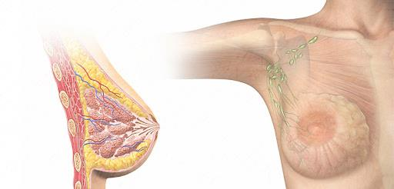

Slide 6
Anatomy of the breast
INTERNAL ANATOMY OF THE BREAST
The breast is composed of 3 different types of tissue
1. Glandular tissue
It is the milk-producing tissue. Each mammary gland consists of 15-20 lobes. Each lobe is further divided into 20-40 lobules composed of clusters of milk-secreting glands (alveoli/acini) and is drained by a lactiferous duct that opens onto the nipple.
2. Fibrous (supporting) tissue
Strands of connective tissue called the suspensory ligaments of the breast (Cooper’s ligaments) extend through the breast to the underlying muscle separating the breast’s lobes à any pathology that makes the breast increases in size or becomes edematous will lead to cooper’s ligaments becoming tight causing dimpled appearance or what’s called Peau d'orange “French for orange peel skin"
3. Fatty tissue
Subcutaneous and retro- mammary fat. It gives the bulk of breast. No fat beneath areola and nipple.

Slide 7
Anatomy of the breast
LYMPHATIC DRAINAGE OF THE BREAST:
Superficial lymphatic nodes drain the skin and deep lymphatic nodes drain the mammary lobules.
Axillary (main lymphatic drainage goes to the axillary area), infraclavicular, supraclavicular, parasternal
Lymphatic drainage of the breast:
- The medial portion of the breast - to the internal mammary nodes
- The central and lateral portions 75-80% à drain to the axillary lymph nodes
Axillary lymph nodes can be classified anatomically into 5 groups and clinically into 3 levels.
1. Anterior (pectoral) group: deep to pectoralis major.
2. Posterior (subscapular) group: along subscapular vessels.
3. Lateral group: along the axillary vein.
4. Central group: within the axillary pad of fat.
5. Apical group: which drains all of the other groups, lies behind the clavicle at the apex of axilla.
Clinical/surgical classification of axillary lymph nodes:
1. Level 1: any lymph node below pectoralis minor (first group involved in malignancy), account for 80% of lymph nodes.
2. Level 2: any lymph node behind pectoralis minor.
3. Level 3: any lymph node above pectoralis minor

Slide 8
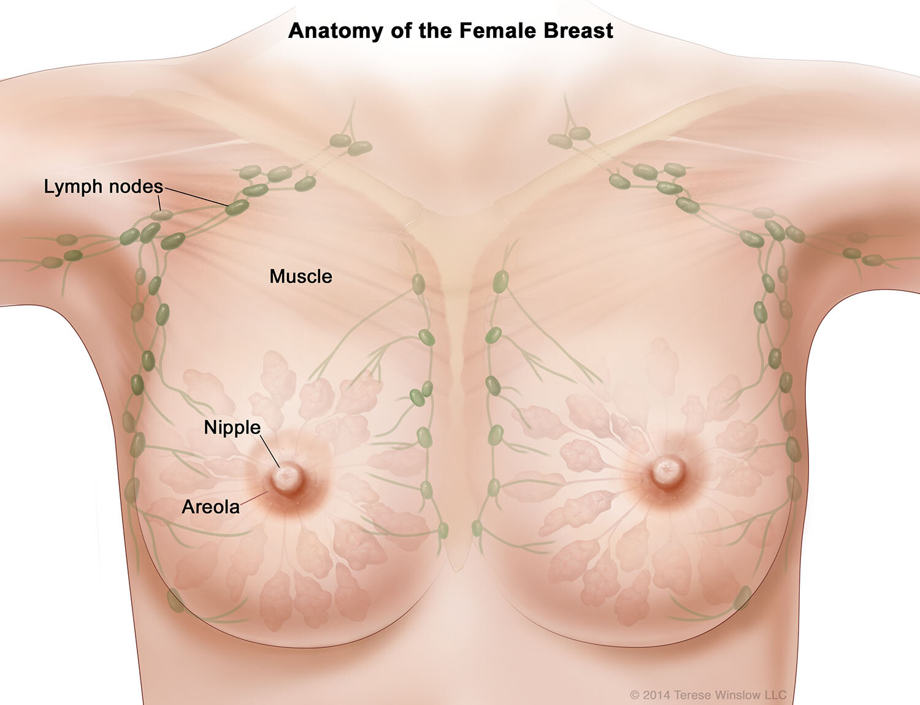

Slide 9
Physiology of the breast
Puberty
Estrogen: growth and appearance, milk-producing system.
Progesterone: development of lobes & alveoli, alveolar cells become secretory.
Menses
Progesterone: 3-7 days prior to menses, engorgement.
Physiologic nodularity: retained fluid.
Mastalgia.
Pregnancy and lactation
Glandular tissue displaces connective tissue.
Increases in size.
Nipples prominent and darker.
Mammary vascularization increases.
Colostrum present.
Aging
Perimenopause: decrease in glandular tissue, loss of lobular and alveolar tissue.
Fatten, elongate, pendulous.
Infra-mammary ridge thickens.
Suspensory ligaments relax.
Nipples flatten.
Tissue feels “grainy”.

Slide 10
Clinical approach
Triple assessment of a patient with a lump:
• History and examination
• Mammogram (99%) if above 35 years old
• Fine Needle Aspiration

Slide 11
Full and complete history should be taken:
• Age of the patient
• Age at menarche, breast development.
• How regular the cycle is and quantity of blood.
• Endocrine status of patient.
• Hormonal medications (OCP, HRT)
• Family history of breast diseases.
• Size of lump in relation to menses.
• Pattern of pain in relation to menses.
• Number of pregnancies, breast feeding
• Changes in breast during pregnancies
• Nipple discharge.
• Date of menopause.

Slide 12
Physical examination
Inspect both breasts by having the patient perform the following maneuvers while sitting:
- Patient’s arms by her side.
- Patient’s arms above her head.
- Patient’s arms on her hips with valsalva (pectoral contraction maneuver).
- Leaning forward while sitting.
Note for size, symmetry, skin changes (dimpling or tethering), nipple complex (inversion or retraction), color, contour, and scars.
Inspect axillae with the patient's arms over her head.
• Patient should be lying and then sitting with raised hands
• Palpate all lymph nodes
• Examine normal side first.

Slide 13
Clinical Presentation of Breast Diseases
Pain (mastalgia):
May be cyclical with menses or noncyclical.
Diffuse cyclical pain : has no pathologic significance.
Non-cyclical pain : can be caused by ruptured cysts or areas of prior injury or infection, or no specific cause.
2. Palpable mass: the most serious presentation.
3. Nipple discharge:
• Milky discharge: not associated with malignancy.
• Bloody or serous discharges: commonly associated with benign lesions “nipple duct papilloma “ but, rarely, can be due to a malignancy.

Slide 14
Nipple discharge
CAUSES OF NIPPLE DISCHARGE
- Carcinoma
Intra-ductal papilloma
Fibrocystic changes
Duct ectasia
Hypothyroid
Pituitary adenoma
CLINICAL CHARACTERISTICS:
Physiologic discharge (e.g. lactation) - usually bilateral, multiple ducts, non-spontaneous, screen for phenothiazine use
Pathologic discharge - Unilateral, spontaneous (without squeezing the nipple), single duct, discolored discharge
CLINICAL EVALUATION
Is it spontaneous or on pressure? Is it coming from single or multiple?
Colors: Serous, serosanguinous, bloody, clear, milky, green, blue-black.
Identify source of discharge and test for presence of blood in discharge
Consider ductography
MANAGEMENT:
Physiologic - Treat cause if present o Follow-up 6 months (observation)
Pathologic - Biopsy and excise (single duct excision or total duct excision)

Slide 15
Imaging
Mammography
Screening tool - age of 40
Densities and calcification
MRI
High risk patients
History of breast cancer
LCIS, atypia
1st degree relative with breast cancer
Very dense breast - High sensitivity
10 – 20% will have a biopsy

Slide 16
Cytology and Biopsy
Fine-needle aspiration cytology
- Fast, inexpensive
- 96% accuracy
- Unable to differentiate between in-situ vs. CA - as it gives only cells not tissue
Core biopsy
Image guided
Stereotactic
Suspicious mammographic abnormalities
Patients lay prone
Biopsy under mammogram

Slide 17
Mammographic Screening
The value of mammography lies in its ability to identify small, non-palpable cancers.
Mammographic screening is generally recommended to start at age 40.
The principal mammographic findings of breast carcinoma are:
Densities (mass):
Due invasive carcinomas, fibroadenomas, or cysts.
Most tumors appear radiologically denser than the normal breast.
Calcifications: Calcium gets deposited on secretions, necrotic debris, or hyalinized stroma.
Can be seen in benign and malignant conditions.
Benign conditions are apocrine cysts, fibroadenomas, and sclerosing adenosis.
Calcifications associated with malignancy are usually small, irregular, numerous, and clustered.
Ductal carcinoma in situ (DCIS) is most commonly detected as mammographic calcifications. Mammographic screening has increased the diagnosis of DCIS .

Slide 18
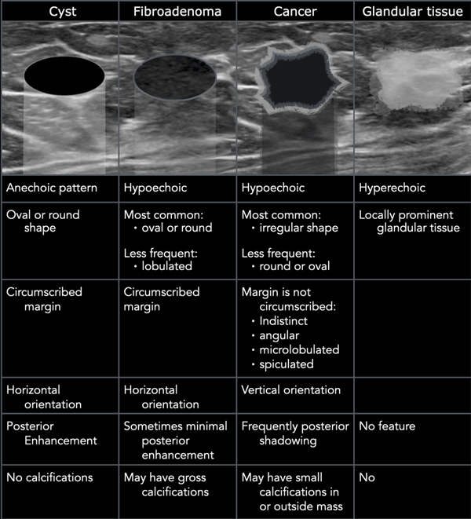

Slide 19
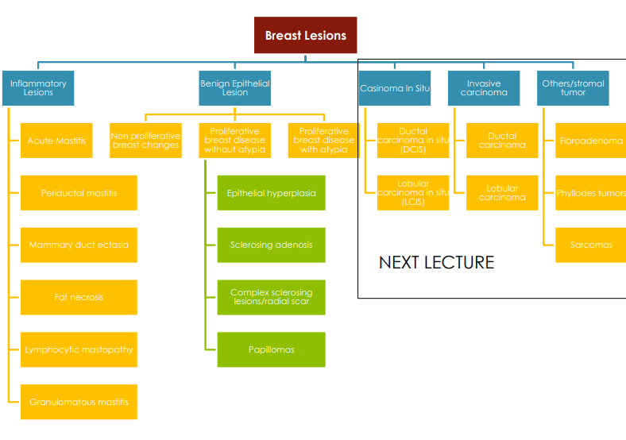

Slide 20
FIBROADENOMA
Rare after menopause
Totally benign, and NO malignancy potential
Commonest in young age group
Popcorn microcalcification in mammogram
Signs & Symptoms
Firm, rubbery, round, mobile mass
Painless, non-tender
Solitary, 15-20% are multiple
Well circumscribed
Mostly located in upper-outer quadrant of the breast
1-5 cm or larger
Investigations
Triple assessment
Imaging: U/S and mammogram
Biopsy
Excision and close follow-up

Slide 21
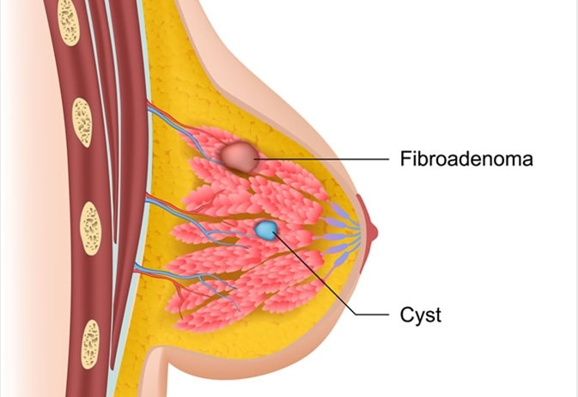

Slide 22
FIBROADENOMA
Fibroadenomas of the breast is considered to be one of the most commonly diagnosed benign breast tumors in women up to the age of 30.
What are Breast Fibroadenomas?
Characterized as a non-fluid-filled solid lump, fibroadenomas of the breast are benign tumors that are typically painless and unilateral in form.
They are most prevalent in women aged between 14 to 35 years old and are considered to be one of the most common breast masses in young people.
The lumps are made up of stromal and epithelial components found just beneath the breast’s skin and typically measure between 2-3cm in size.
However, in some cases, they can grow in excess of 10cm, and as a result, hypertrophy or asymmetry of the breast may occur.

Slide 23
FIBROADENOMA
There are three main types of fibroadenomas; cellular, juvenile, and giant.
Cellular fibroadenomas grow rapidly and can be diagnosed upon review of the patient’s breast tissue biopsy results.
Juvenile fibroadenomas are most prevalent in those aged between 10-18 years old, and despite having a quicker rate of growth, they will often reduce in size over time.
Giant fibroadenomas are larger in size than cellular and juvenile masses, and patients with this form typically undergo surgery to remove the tumor.
Some women may just have one breast fibroadenoma, while others may have multiple.
The size of the fibroadenoma may fluctuate spontaneously or change in response to the varying hormone levels associated with the menstrual cycle.
The level of pain can also vary between cases. Some women may experience high levels of pain while others may be asymptomatic.

Slide 24
FIBROADENOMA
Causes of Breast Fibroadenomas
Research is yet to conclusively pinpoint one singular cause of breast fibroadenomas.
However, one popular notion links to the female hormone, estrogen.
breast fibroadenomas typically reduce in size in menopausal women and get larger during pregnancy
The gene MED12 is thought to play a roll in the developed of breast fibroadenomas.
Other risk factors identified include a history of benign breast disorders.
In contrast to this, the number of births and the consumption of the combined pill prior to menopause are thought to reduce the prevalence of breast fibroadenomas.

Slide 25
FIBROADENOMA
Diagnosis of Breast Fibroadenomas
In order to diagnosis breast fibroadenomas, patients should typically undergo a physical examination as well as a review of their family and medical history.
A physical examination should aim to assess the consistency of the lump, its mobility, and its size.
Examination of the lymph nodes is also recommended as well as discharge from the nipple or skin.
The patient may be questioned about how long they have had the mass, its location, if it has changed in size and if this occurs in line with their menstrual cycle, as well as any experience of pain.
Depending on the age of the woman, either one of the following imaging options may be used to examine the mass further and enable diagnosis: magnetic resonance imaging, mammography, or ultrasound.

Slide 26
FIBROADENOMA
Management of Breast Fibroadenomas
Management of fibroadenomas of the breast can range from observing potential changes over time to surgical removal of the mass.
Observation of Breast Fibroadenomas
Observation of the fibroadenomas may be recommended in instances where the masses are not causing deformity, are asymptomatic and not rapidly increasing in size.
The patients may undergo annual ultrasounds to check the progress of the fibroadenomas as well as engaging in regular self-examinations.
Surgical Removal of Breast Fibroadenomas
For large fibroadenomas or ones that pose a risk of malignancy, patients may undergo surgery to remove the mass.

Slide 27
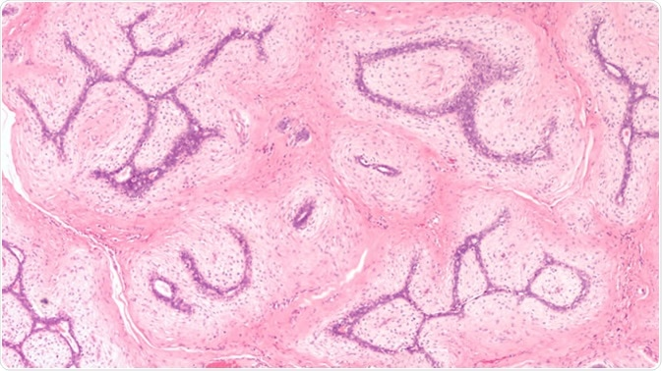

Slide 28
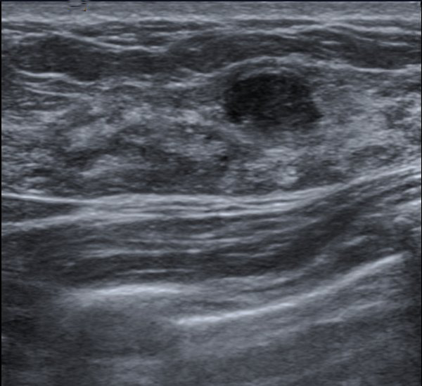
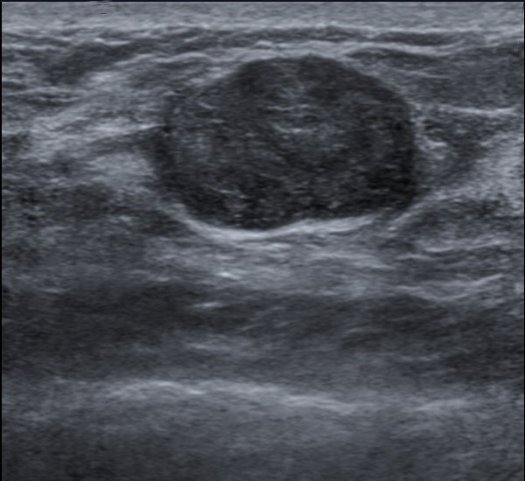

Slide 29
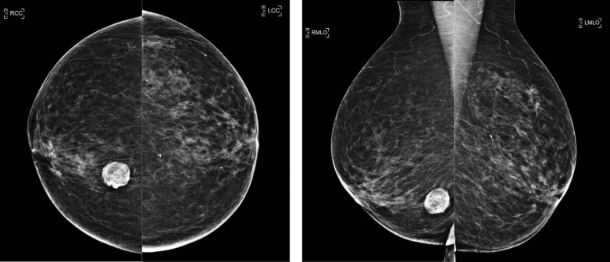

Slide 30
FIBROCYSTIC CHANGES
Lumpy, bumpy breasts
50-80% of all menstruating women
“Middle aged women/child baring age”
Caused by hormonal changes prior to menses
Signs & Symptoms
Mobile cysts with well-defined margins
Singular or multiple
May be symmetrical
Upper outer quadrant or lower breast border
Pain, discomfort and tenderness
Cysts may appear quickly and decrease in size
Lasts half of a menstrual cycle
Subside after menopause, if no HRT.
Investigations
Aspirate cyst fluid
If bloody - go for surgical biopsy.
If non-bloody and disappear completely - observe.
If non-bloody and doesn’t resolve - surgical biopsy.
Imaging for questionable cysts
In young patients only U/S
In 40 and above patients both U/S and mammogram

Slide 31
FIBROCYSTIC CHANGES
Fibrocystic disease of the breast is not really a disease condition and hence it is better referred to as fibrocystic breast changes.
Breasts in many women develop a lumpy or cord-like feel, made up of prominent glandular epithelial tissue without any tumorous change.
However, this is a variation of normal rather than a discrete condition by itself.
In many women, fibrocystic breast changes are accompanied by (but do not cause) pain, tenderness and nodular texture of the breasts.
The most common area for this type of symptom is the upper outer quadrant.
They tend to cluster in the premenstrual time of the cycle, especially associating with the days immediately preceding menstruation.

Slide 32
FIBROCYSTIC CHANGES
Causes
The most common period for fibrocystic breasts to become noticeable is the age between 20 and 50. It is not a coincidence that this is also the period when female hormones are acting upon the woman’s body.
Fluctuations in estrogen level, which encompasses the hormonal drop to its lowest just before menstruation begins, and rise thereafter, can be linked to breast soreness, swelling in the form of diffuse or localized lumpiness and tender breasts which may respond by pain even to the touch of light clothing.
Once this stimulation is over, the swelling may disappear. It is hypothesized that fibrocystic breast changes are the result of repeated stimulation by estrogen and progesterone over a long period, thus risk factors for fibrocystic breasts include:
Early menarche
Late first childbirth (at or after 30 years of age)
Infertility
Breast infections are also thought to be associated with fibrocystic breasts.

Slide 33
FIBROCYSTIC CHANGES
Treatment
The only urgent aspect of fibrocystic breast management is to rule out malignancy of the breast tissue. This is usually by a guided biopsy from any palpable mass.
Once it is diagnosed to be part of fibrocystic breasts, the most effective treatment of fibrocystic breasts may be simple self-care.
This includes measures such as:
wearing a soft support bra to prevent other clothing from brushing against the tender breasts, and to support the increased weight. Sports bras are particularly effective at this.
over-the-counter pain relievers such as acetaminophen (Tylenol)
warm fomentation to relieve the pain
avoiding caffeine
reducing dietary fat
stopping hormone replacement therapy if your doctor agrees

Slide 34
FIBROCYSTIC CHANGES
Treatment
Medical management includes administration of drugs which antagonize the effects of the female hormones, such as danazol and tamoxifen.
Another effective and less hazardous treatment consists of oral contraceptives which stabilize the hormone fluctuations by abolishing them.
Lumpectomy is advised if the lump is suspicious for cancer or if the rest of the breast is normal except for one palpable well-defined lump.
Large or painful cysts are sometimes advised to be aspirated but the risk of recurrence is present.
If a cyst is persistently recurring after treatment by aspiration or has any features of abnormality, it may be best to remove it surgically.
Even without any treatment, fibrocystic disease is not a precursor of breast cancer; however, it may mask the appearance of a real malignancy within the dense breast tissue.

Slide 35
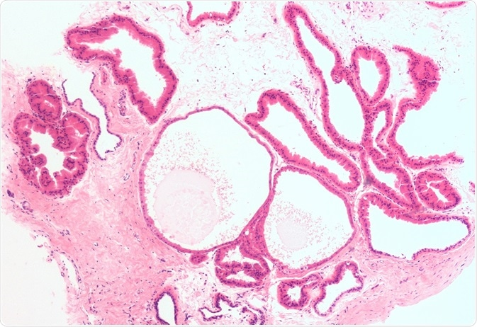

Slide 36
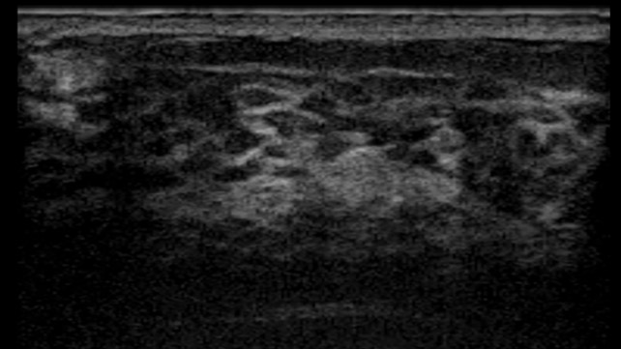

Slide 37
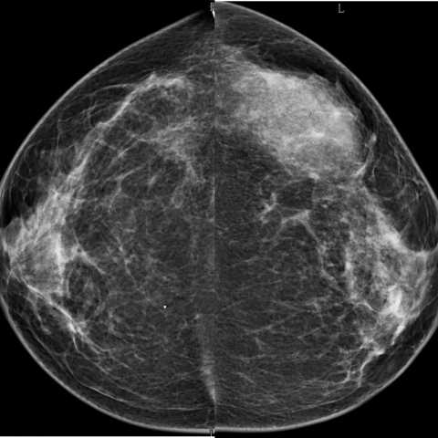
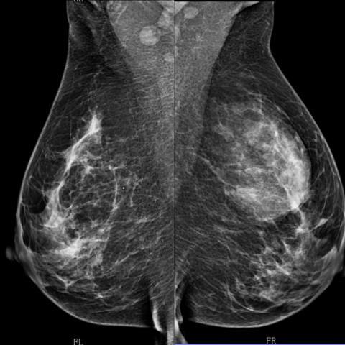

Slide 38
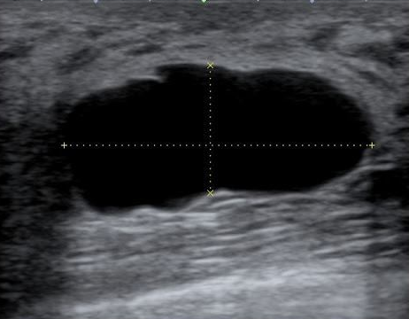

Slide 39
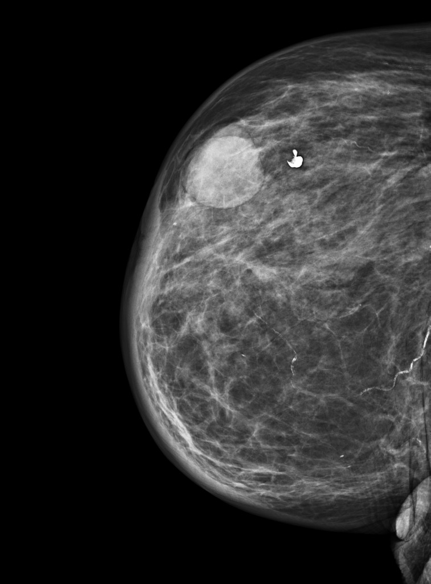
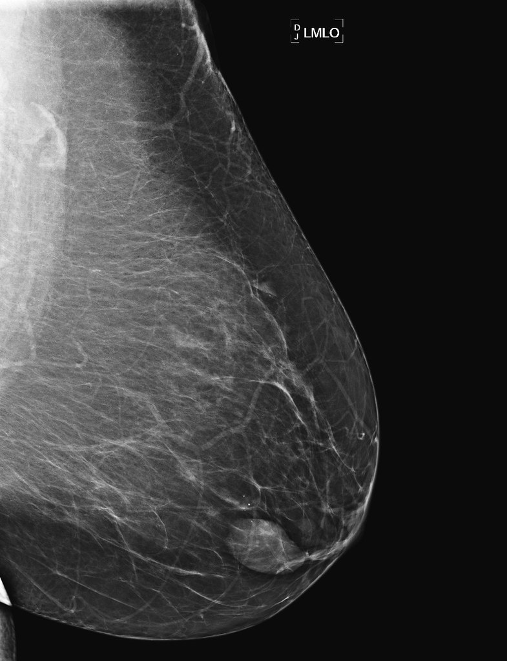

Slide 40
INTRADUCTAL PAPILLOMA
Slow-growing
Overgrowth of ductal epithelial tissue
Usually not palpable
Cauliflower-like lesion
Length of involved duct
Most common cause of bloody nipple discharge
40-50 years of age
Signs & Symptoms
Watery, serous, serosanguinous, or bloody discharge
Spontaneous discharge
Usually unilateral
Often from single duct - pressure elicits discharge
50% no mass palpated
Investigations & Treatment
Test for occult blood
Ductogram
Biopsy
Excision of involved duct

Slide 41
Management
Comfort measures:
Eliminate Methylxantines (coffee, chocolate): may take 6 months for relief.
Local heat/cold
Wear a good supporting bra
Medications for mastalgia:
NSAIDS (simple analgesia)
Monophasic oral contraceptive pills (to stabilize hormonal levels)
Spironolactone § Dopamine Agonists: Bromocriptine §
** Big cyst >2 cm - must aspirate.
** Atypia or hyperplasia - if atypia / hyperplasia / dysplasia changes were present must EXCISE.
** Complicated cyst - Biopsy is needed from solid component to exclude malignancy.
** Constant cyst - must biopsy

Slide 42
INTRADUCTAL PAPILLOMA
Intraductal papillomas are a group of benign tumors of the breast that stem from the epithelium of the lactiferous ducts.
The incidence of these changes is low and usually in the range of 2 to 3%, affecting women between 30 and 77 years of age.
There are two general types of intraductal papillomas: central and peripheral.
The central type is characteristic for the subareolar region of the breast, usually appearing in solitary fashion during perimenopause.
On the other hand, peripheral intraductal papillomas develop in young women, are often multiple, and emerge inside the terminal duct-lobular unit.

Slide 43
INTRADUCTAL PAPILLOMA
Clinical Presentation and Pathological Features
Clinically, intraductal papillomas most often present as pathological nipple discharge, accounting for about 5% of all women that attend symptomatic breast clinics.
Still, as this symptom is not sufficient for establishing a correct diagnosis, experts have to rely on histologic features to delineate different findings.
In benign intraductal papillomas, the eptihelial layer is supported by myoepithelial cells, whereas papillary carcinoma show disrupted or completely absent myoepithelial cell layer.
Generally, intraductal papilloma is characterized by fibrovascular cores that branch and protrude into the ductal lumen. Those cores are composed of fibrous branches with centrally located vessels lined by endothelial cells and a rather uniform myoepithelial cell layer that faces the lumen.

Slide 44
INTRADUCTAL PAPILLOMA
Different Evaluation Techniques
Cytological diagnosis of intraductal papilloma can be established by either examining the serous or bloody nipple secretions or by using fine-needle aspiration of a palpable lesion.
Ductography represents a safe and simple method for visualizing the affected duct systems, and it reveals intraductal papillomas as filling defects within the dilated ducts.
On magnetic resonance imaging, intraductal papillomas range from small luminal masses to irregular enhancing lesions that are often hard to discriminate from invasive malignancy.
Ultrasound techniques with 3D views represent a good complementary approach in visualizing intraductal papillomas and other disorders inside the ducts.

Slide 45
INTRADUCTAL PAPILLOMA
Management of the Disease
Central intraductal papillomas that are not associated with epithelial atypia are considered benign lesions of the breast. Thus, the patients can be monitored clinically without the need for surgical excision.
Nevertheless, individuals with multiple intraductal papillomas do have a higher risk of developing breast cancer, so annual review with repeated digital mammography should be recommended.
Microdochectomy remains an effectual surgical procedure for managing intraductal papillomas.
Intraductal biopsy guided by mammary ductoscopy can be both diagnostic and curative approach, although the latter requires additional validation in the quotidian clinical practice.

Slide 46
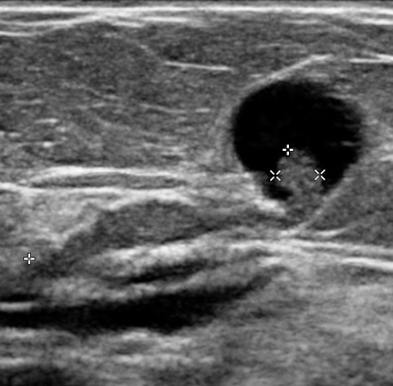
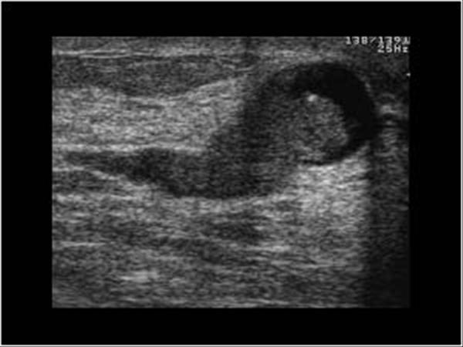

Slide 47
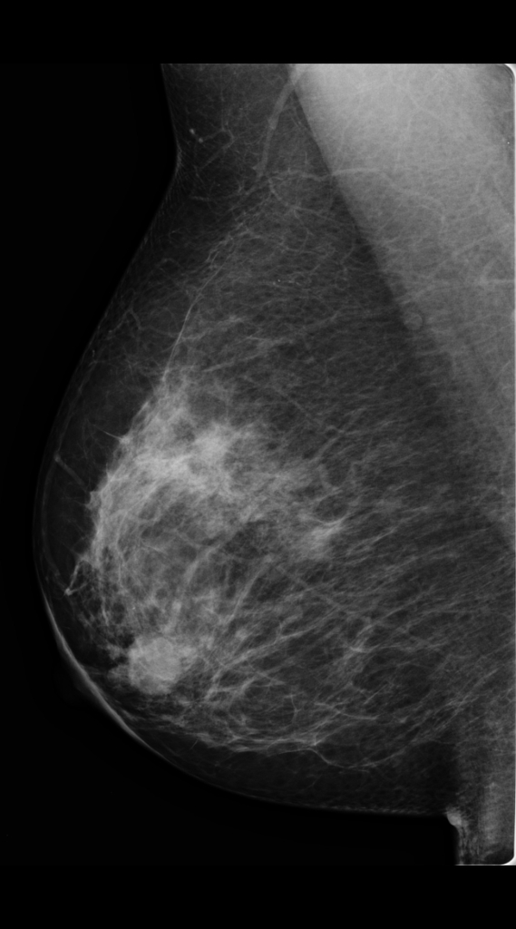
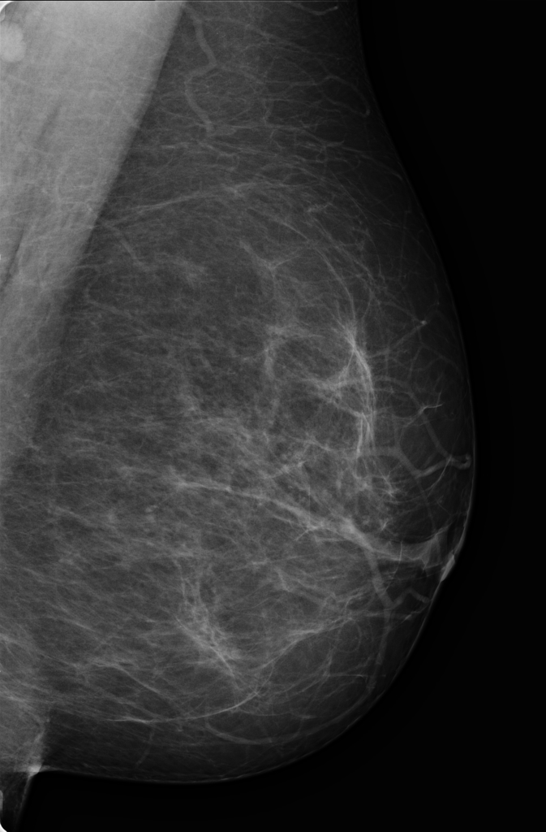

Slide 48
THANK YOU FOR
ATTENTION
ODESSA NATIONAL MEDICAL UNIVERSITY
UNIVERSITY CLINIC DEPARTMENT of SURGERY #3

