Slide 1
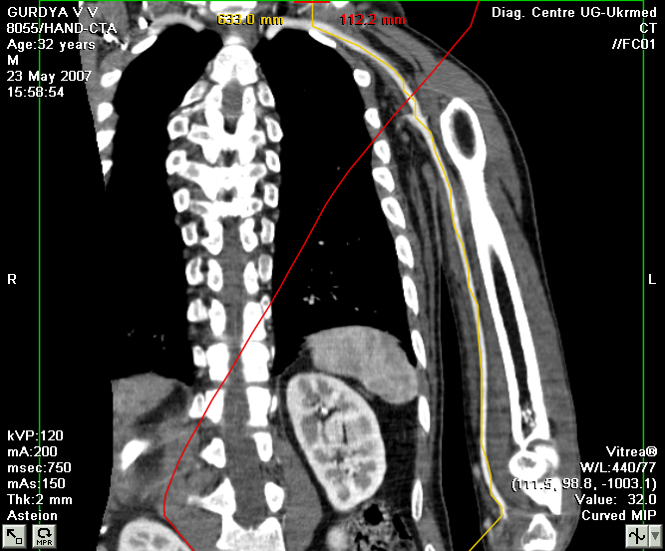
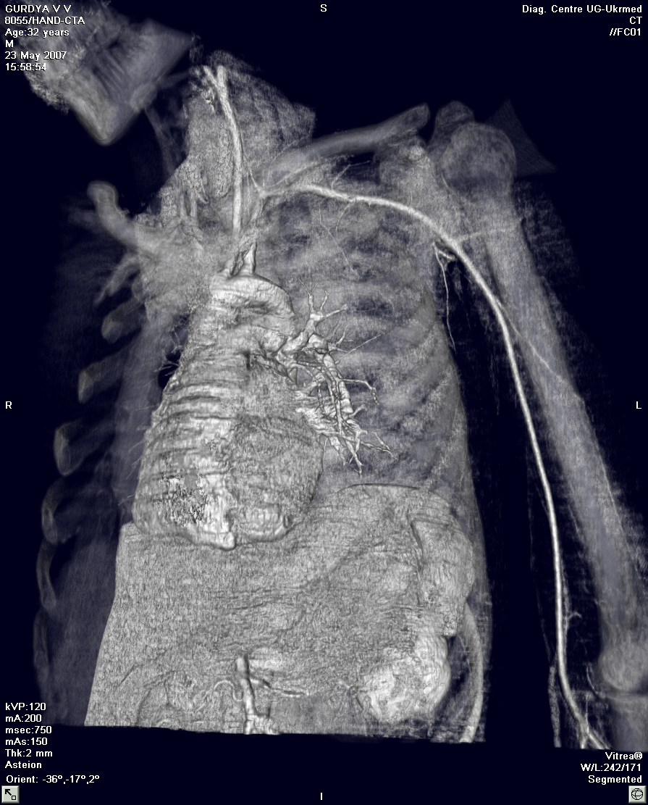
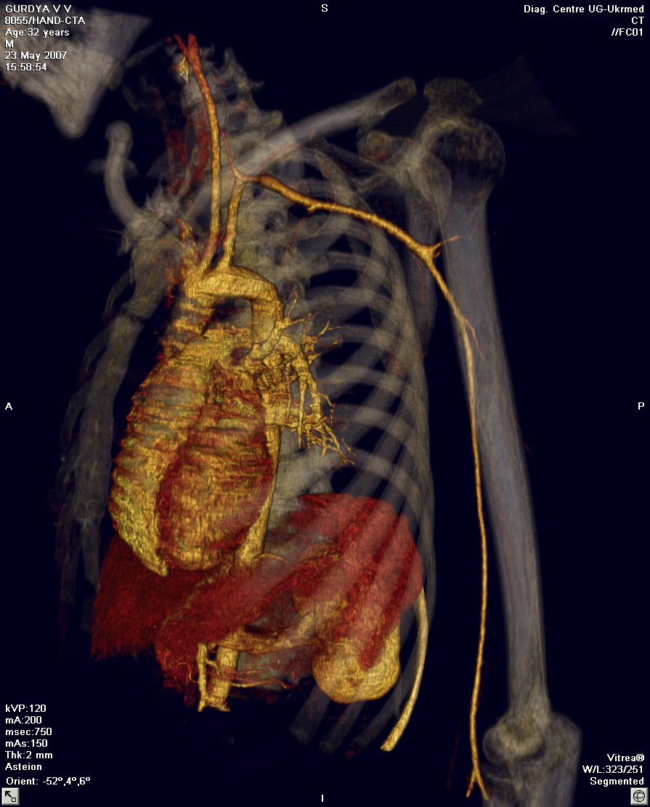
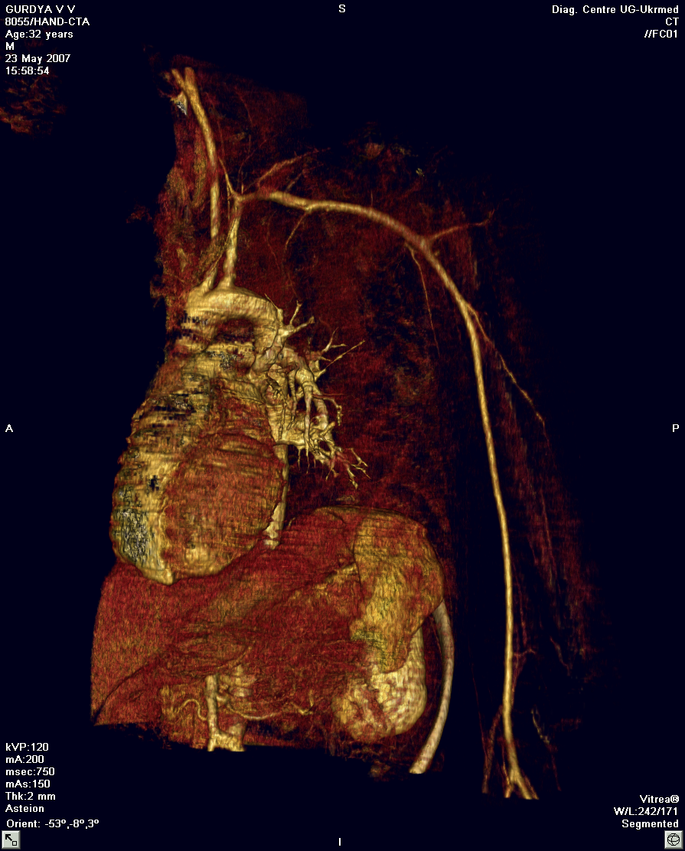
Respiratory radiology. Cardiovascular radiology.
Radial methods of research.
Текст надписи
ROZHKOVSKAYA GALYNA M.
Cand.Sc. (Medicine)
Associate professor

Slide 2
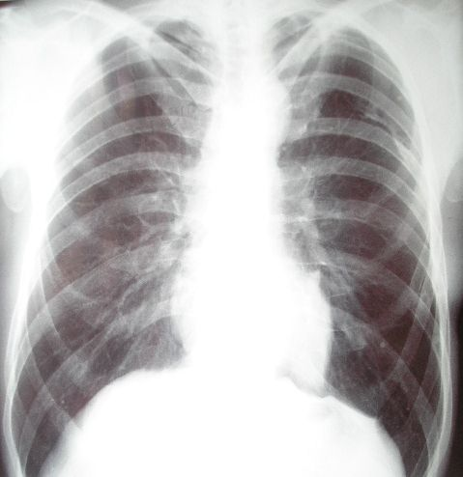
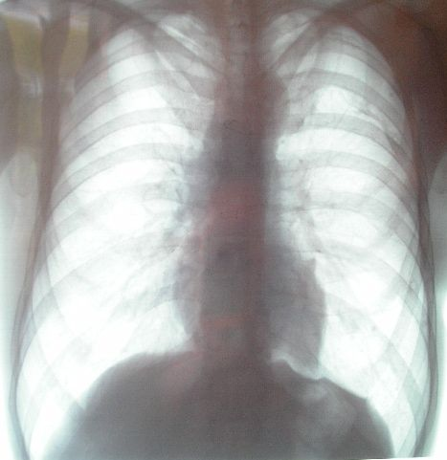
Plain x-ray of the chest
Fluoroscopy of the chest
skiology

Slide 3
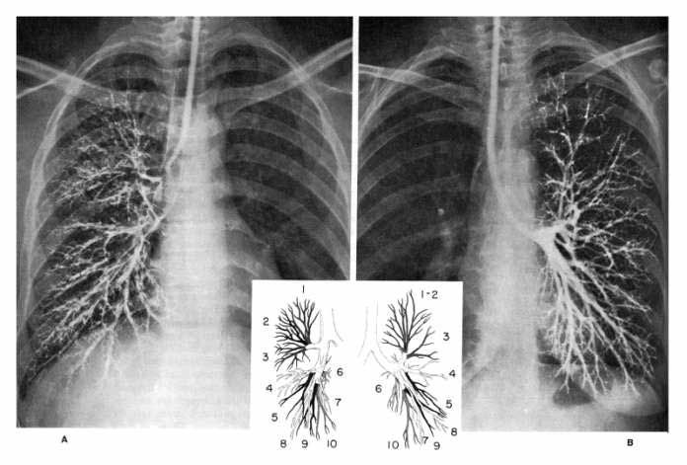
Anterior bronchograms.
A, Right lung. B, Left lung.

Slide 4
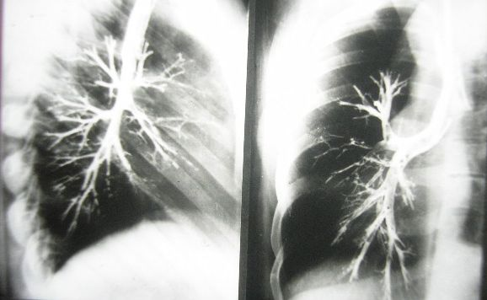
Bronchography

Slide 5
Factors to Evaluate
Penetration
Inspiration
Rotation
Angulation

Slide 6
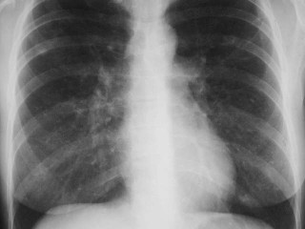
Penetration
You should be able to just see the thoracic spine through the heart.

Slide 7
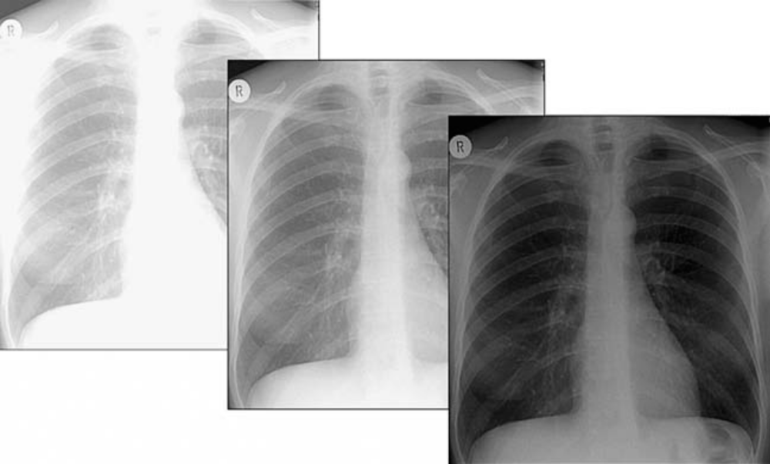
Assessment of exposure quality
The effect of varied exposure on the quality of the final image.

Slide 8
Inspiration
About 10 posterior ribs visible is an excellent inspiration
In many hospitalized patients 9 posterior ribs is an adequate inspiration

Slide 9
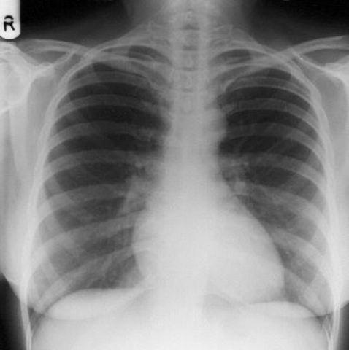
Anterior vs. Posterior Ribs
Anterior ribs will be visible but are harder to see. They run more or less at a 45 degree angle downward toward the feet.
Posterior ribs are those that are most apparent on the chest x-ray. They run more or less horizontally.

Slide 10
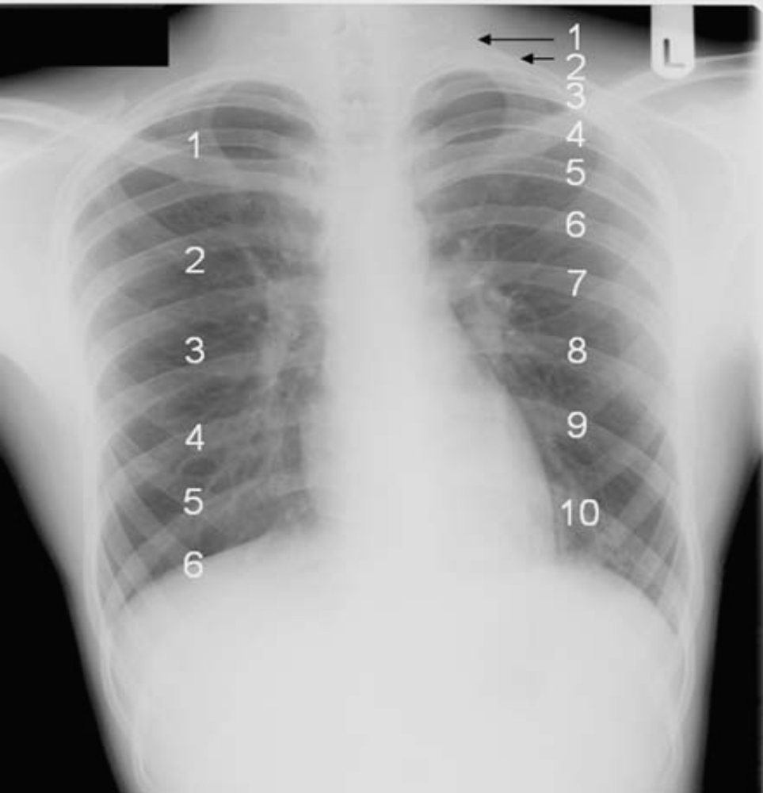
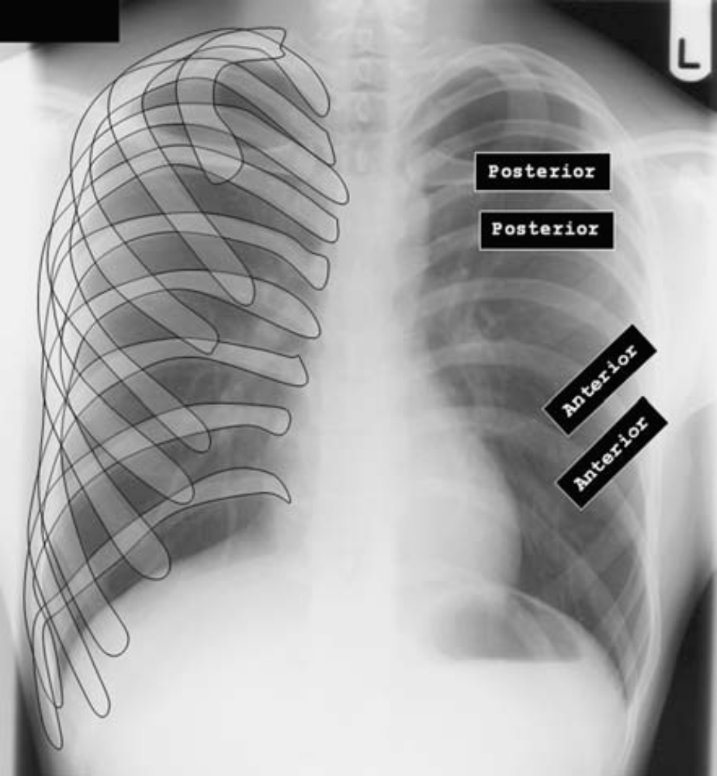
Remember to scrutinize every rib,
(from the anterior to posterior), the clavicles and vertebrae.

Slide 11
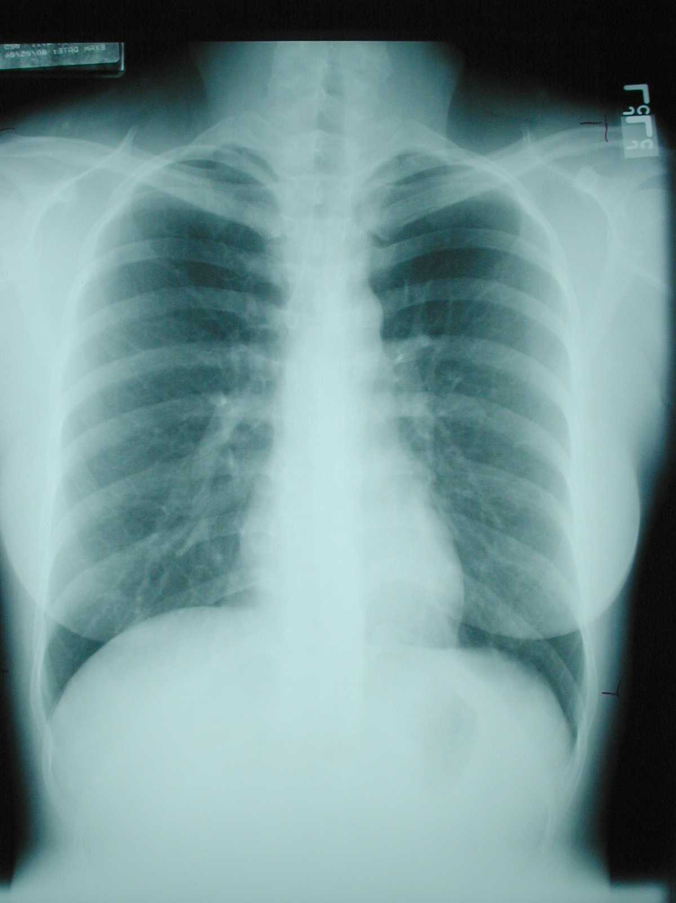
10
Ten posterior ribs showing is an excellent inspiration

Slide 12
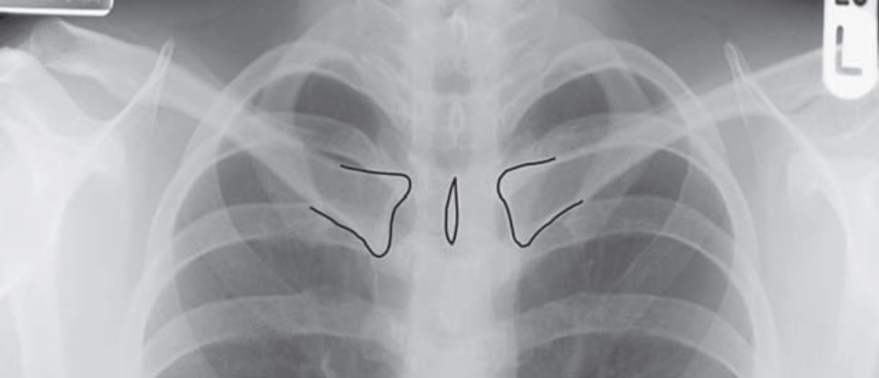
Rotation
If the spinosus process of the vertebral body is equidistant from the medial ends of each clavicle, there is no rotation

Slide 13
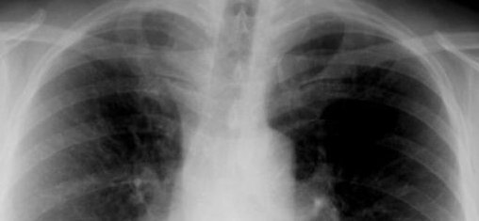
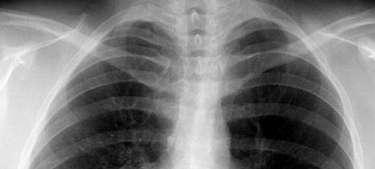
If spinous process appears closer to the right clavicle (red arrow), the patient is rotated toward their own left side 
If spinous process appears closer to the left clavicle (red arrow),
the patient is rotated toward their own right side 

Slide 14
Angulation
If the x-ray beam is angled toward the head (mostly because the patient is semi-recumbent), the film so obtained is called an “apical lordotic” view
Anterior structures (like the clavicles) will be projected higher on the film than posterior structures

Slide 15
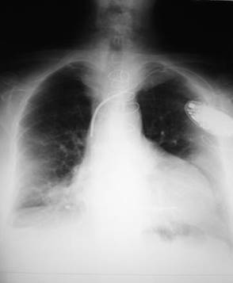
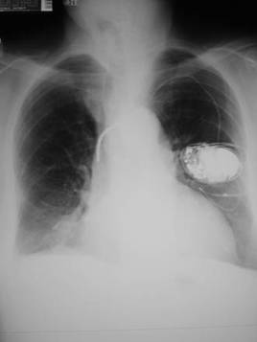
Pitfall Due to Angulation
Apical lordotic
Same patient, not lordotic
A film which is apical lordotic (beam is angled up toward head) will have an unusually shaped heart and the sharp border of the left hemidiaphragm will be absent

Slide 16
Important Points
The factors to evaluate the quality of a chest x-ray are:
  Penetration – see spine through the heart
  Inspiration – at least 8-9 posterior ribs
  Rotation – spinosus process between clavicles
  Angulation – clavicle over 3rd rib

Slide 17
Roentgenographic Patterns
Airway obstruction
Hilar enlargement
Mediastinal node enlargement
Cavitation
Pleural involvement

Slide 18
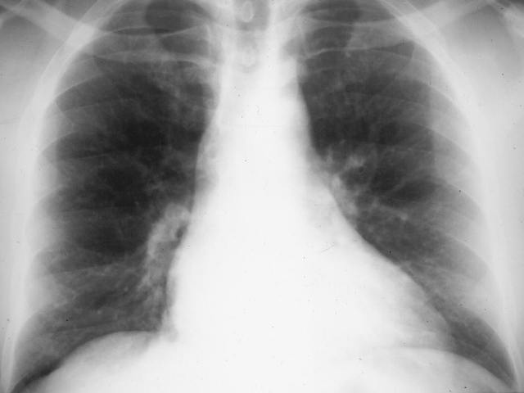
Normal Vasculature - review
2
RDPA
< 17 mm in diameter
Gradual tapering of vessels from central to peripheral
1
3
Lower lobe vessels larger than upper lobe vessels
2

Slide 19
2. Normal Distribution of Flow
Upper Versus Lower Lobes
In erect position, blood flow to bases > than flow to apices
Size of vessels at bases is normally
> than size
of vessels
at apex
You can’t measure size of vessels at the left base because the heart obscures them

Slide 20
3. Normal Distribution of Flow
Central versus peripheral
Central vessels give rise to progressively smaller peripheral branches
Normal tapering of vessels from central to peripheral

Slide 21
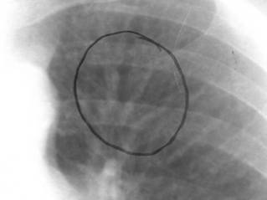
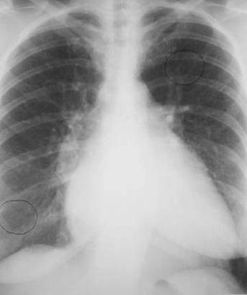
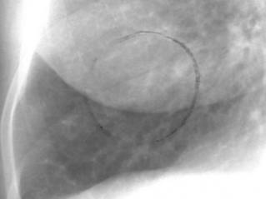
Venous Hypertension
RDPA usually
> 17 mm
Upper lobe vessels equal to or larger than size of lower lobe vessels = Cephalization

Slide 22
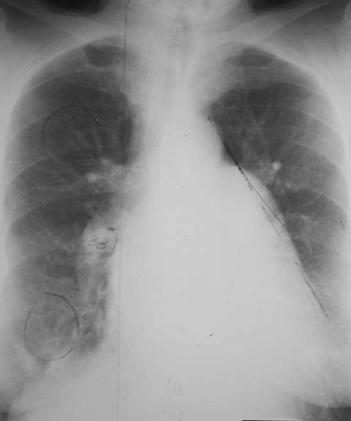
Pulmonary Arterial Hypertension
Main Pulmonary Artery projects beyond tangent line
RDPA usually
> 17 mm
23

Slide 23
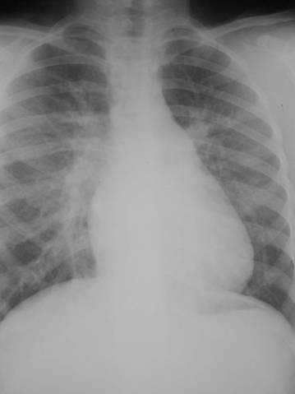
Increased Flow
RDPA usually
> 17 mm
All of blood vessels everywhere in lung are bigger than normal

Slide 24
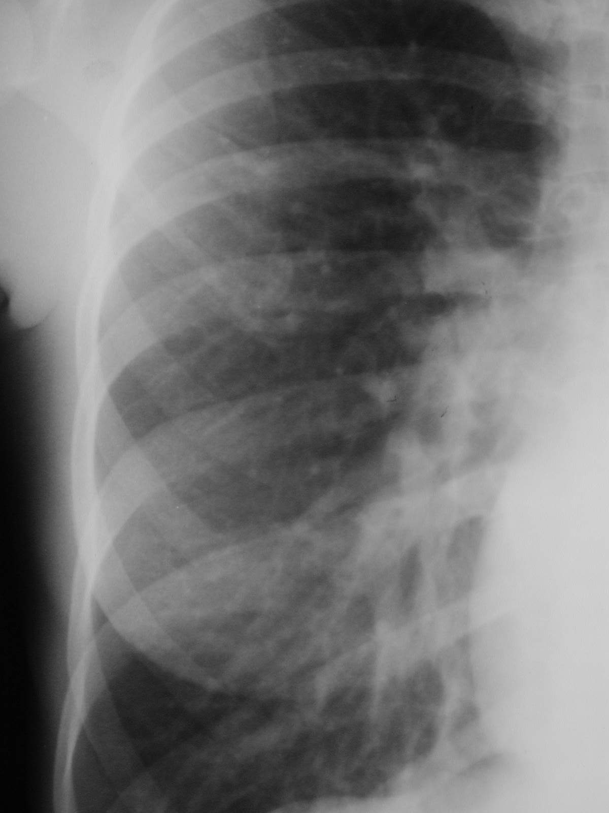
Increased Flow
Distribution of flow is maintained as in normal
Gradual tapering from central to peripheral
Lower lobe vessels bigger than upper lobe

Slide 25
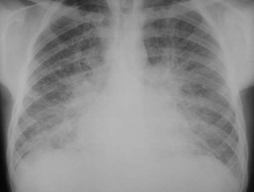
Pulmonary Interstitial Edema

Slide 26
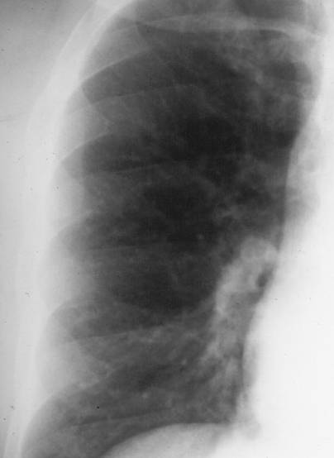
Normal
Increased Flow

Slide 27
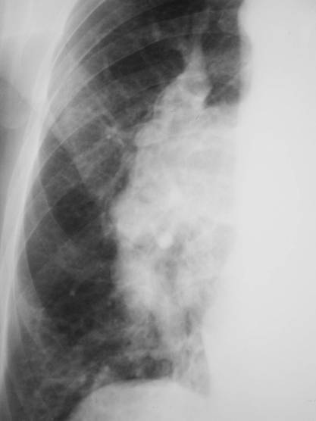
Increased Flow
PAH

Slide 28
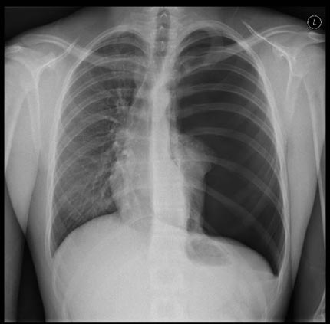
Frontal x-ray of the chest showing a collapsed left lung.

Slide 29
Kerley B Lines
B=distended interlobular septa
Location and appearance
  Bases
  1-2 cm long
  Horizontal in direction
  Perpendicular to pleural surface

Slide 30
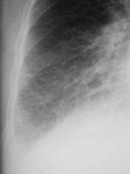
Kerley B Lines are short, white lines perpendicular to the pleural surface at the lung base.

Slide 31
Kerley A and C Lines
A=connective tissue near bronchoarterial bundle distends
  Location and appearance
    Near hilum
    Run obliquely
    Longer than B lines
C=reticular network of lines
  C Lines probably don’t exist

Slide 32
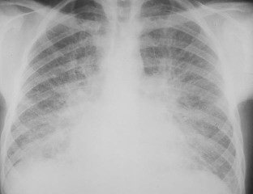
Kerley A and C Lines form a pattern
of interlacing lines in the lung

Slide 33
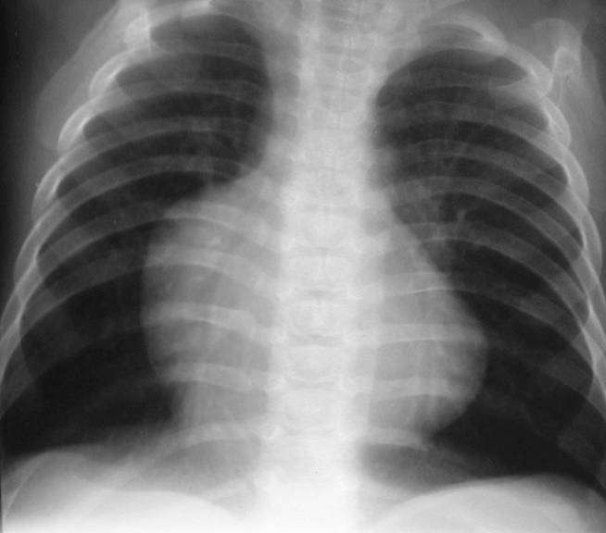
Decreased Flow
Unrecognizable most of the time
Small hila
Fewer than normal blood vessels

Slide 34
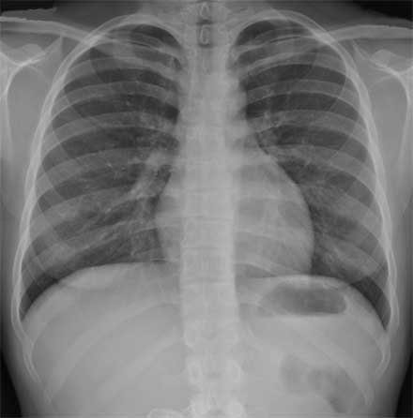
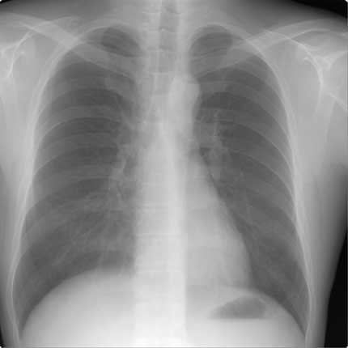
Root of the lung. Normal

Slide 35
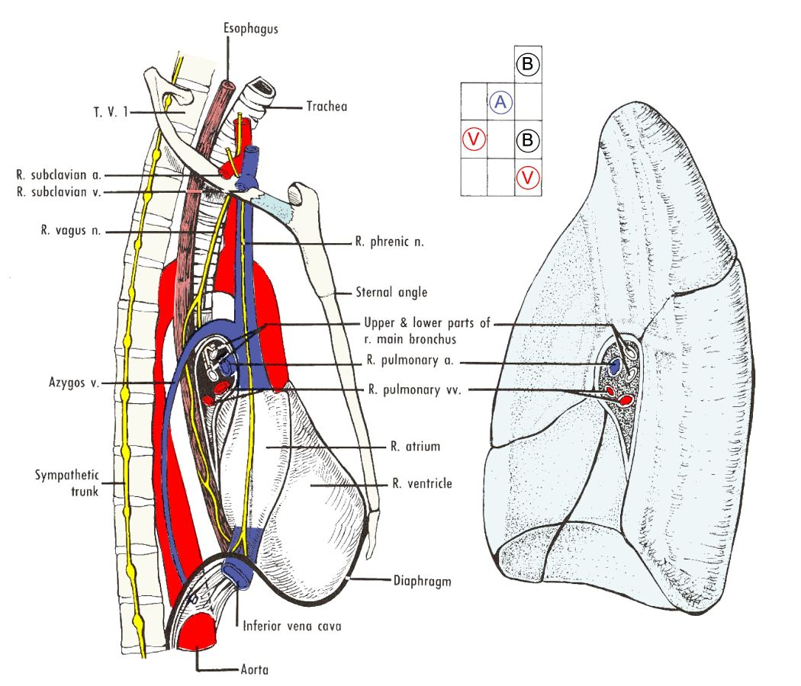
image views of the right lung and mediastinal structures

Slide 36
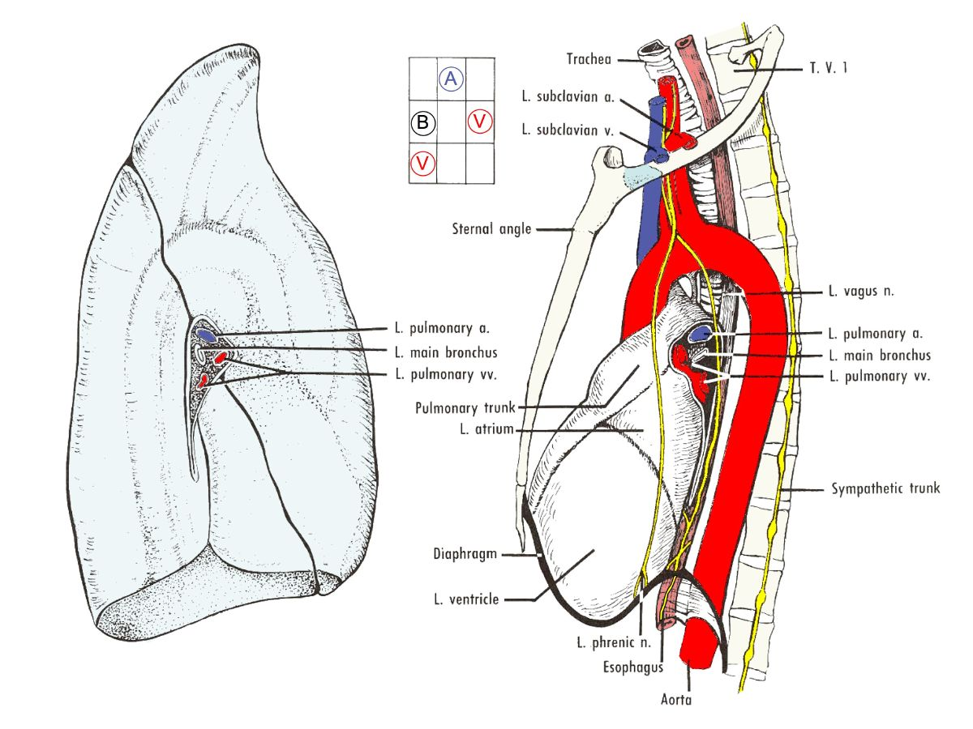
image views of the left lung and mediastinal structures

Slide 37
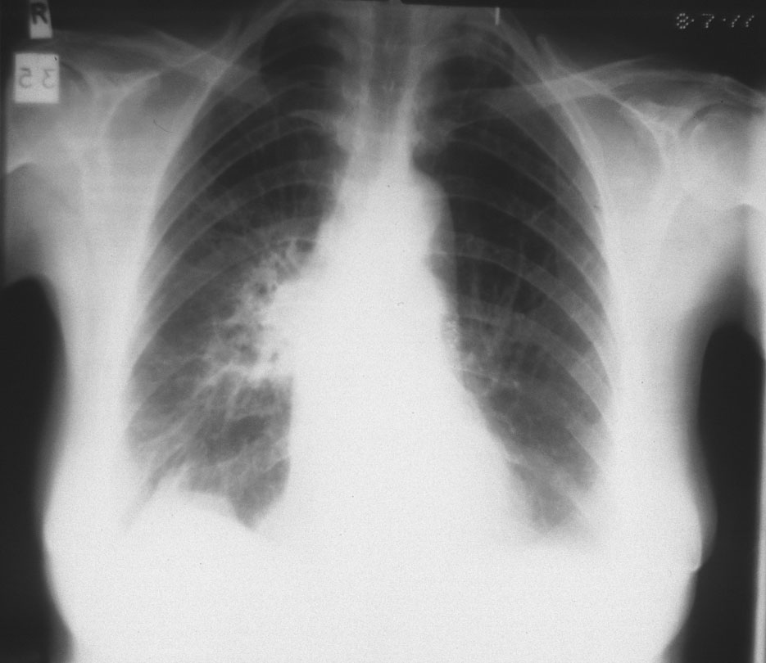
Root of the lung

Slide 38
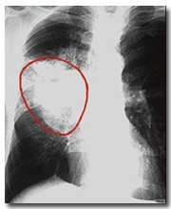
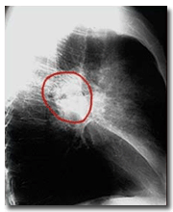
A CXR in a patient with central cancer of the right lung.
A lateral view of a CXR in a patient
with central cancer of the lung.

Slide 39
Normal anatomy
Visceral pleura covers lung, including fissural surfaces.
Parietal pleura lines thoracic cavity and covers mediastinum medially.
Normally only a few cc’s of fluid on each side.
Visible on CXR only as fissure and with pneumothorax.
Visible on CT normally as a very fine line along chest wall and in fissures.

Slide 40
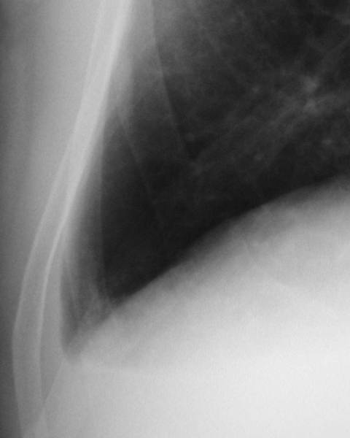
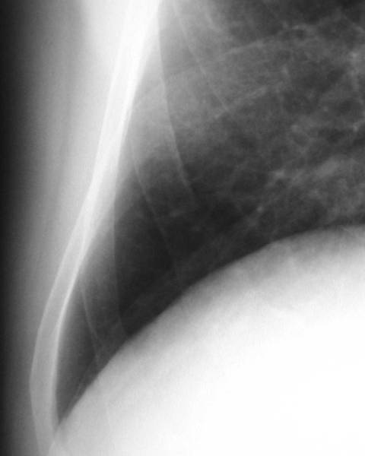
Laminar Effusion
Parietal pleura
Visceral pleura

Slide 41
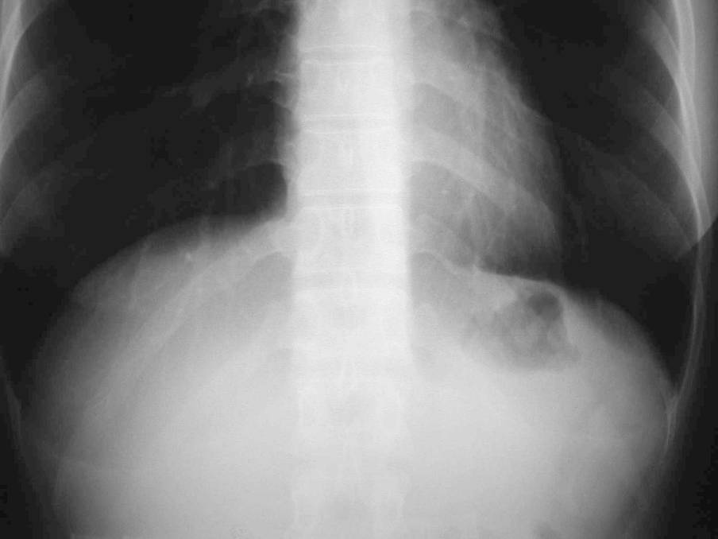
Level of lateral costophrenic angles
Inferior extent of pleural space

Slide 42
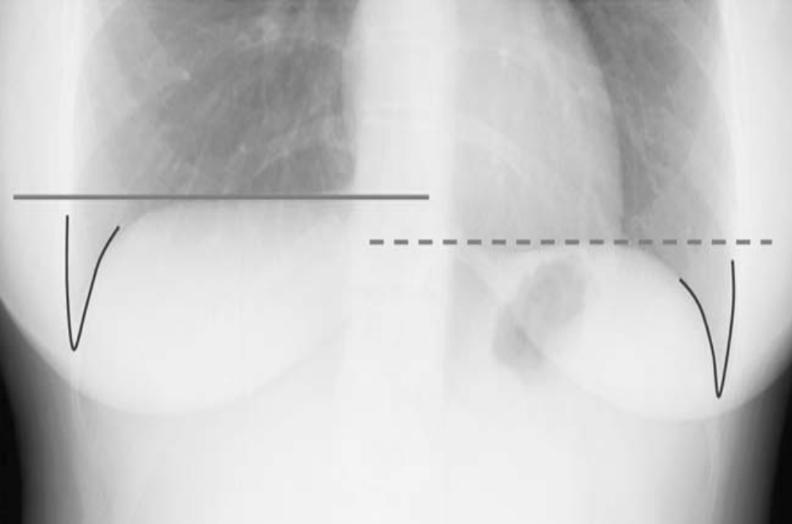
The right hemidiaphragm is ‘higher’ than the left. Both costophrenic angles are sharply outlined.

Slide 43
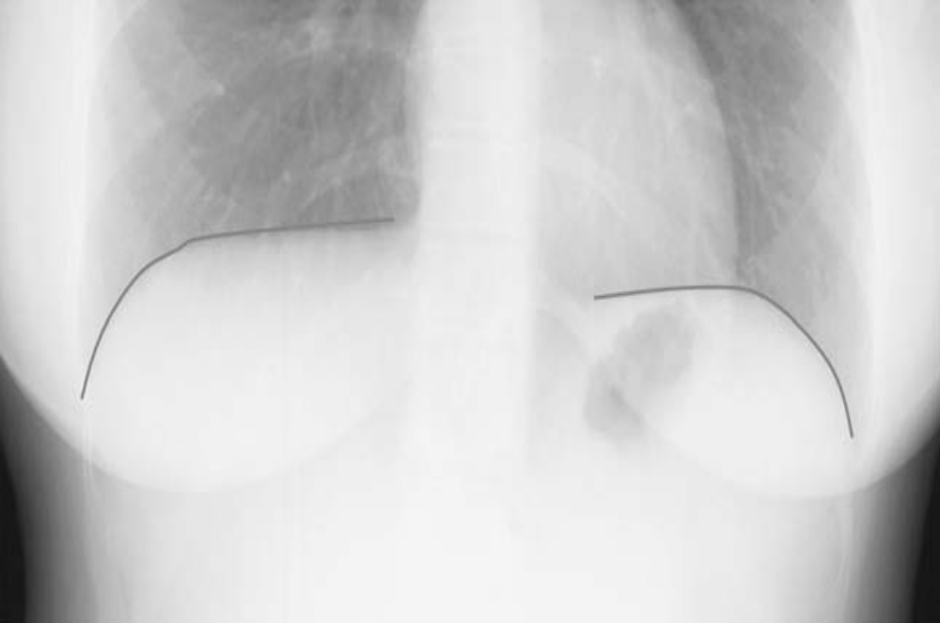
The outlines of both hemidiaphragms should be clearly visible.

Slide 44
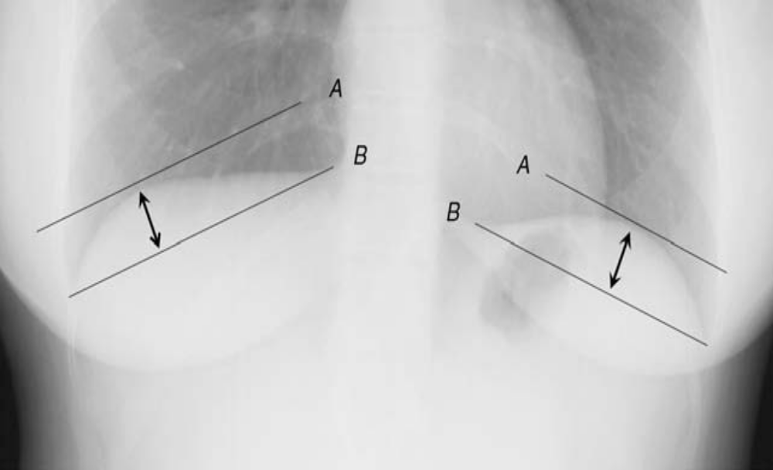
Assess for diaphragmatic flattening.
The distance between A and B should be at least 1.5 cm.

Slide 45
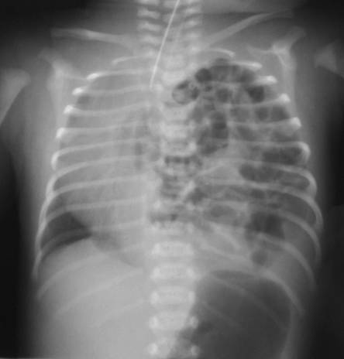
Congenital Absence of the Diaphragm

Slide 46
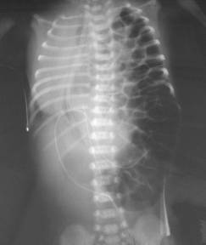
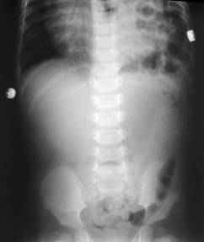
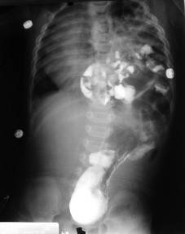
R3
Congenital Absence of the Diaphragm

Slide 47

Diaphragm projected here on film
Bottom of pleural space is here

Slide 48

The right hemidiaphragm is usually ‘higher’ than the left.
The outline of
the right can be seen extending from the posterior to anterior chest wall.
The outline of the left hemidiaphragm stops at the posterior heart border.
Air in the gastric fundus is seen below the left hemidiaphragm.

Slide 49


Blunted posterior CP angle

Slide 50

Important anatomy relating to the lateral CXR
There should be a decrease in density from superior to inferior in the
posterior mediastinum.
The retrosternal airspace should be of the same density as the retrocardiac
airspace.

Slide 51
Mediastinum
Bounded laterally by parietal pleura of each lung
Superior margin is thoracic inlet
  Defined by plane of 1st ribs
Inferior margin is diaphragm
Tissue planes extend superiorly into neck around great vessels, trachea and esophagus
Connects to abdominal cavity via esophageal, caval and aortic hiatuses
Connects to lungs along hilar vessels and bronchi

Slide 52


Slide 53
Mediastinum
Radiologic anatomy
  CXR
  CT
Normal or not?
Compartments and their pathologies:
  Anterior
  Middle
  Posterior

Slide 54
Anterior mediastinum
Space anterior to great vessels and heart, behind the sternum

Slide 55
Anterior Mediastinal Masses
1. Thymoma
2. Teratoma
3. Substernal thyroid
4. Lymphoma

Slide 56






Anterior mediastinal masses
Thymic hyperplasia
teratocarcinoma
thymoma
teratoma
lymphoma
hemorrhage

Slide 57

Thymoma

Slide 58


Foramen of Morgagni Hernia

Slide 59
Middle mediastinum
Contains heart, great vessels, esophagus, trachea, lymph nodes, nerves.
CXR abnormality in paratracheal area, azygo-esophageal recess, retrocardiac area
May be difficult to see on lateral view

Slide 60
Middle Mediastinal Masses
1. Lymphadenopathy
2. Aneurysms
3. Esophageal duplication
4. Bronchogenic cysts

Slide 61


Tracheal air column
Should be straight
Slight bend to right due to aortic arch on its left.

Slide 62
Aortic contour

Slide 63


Right Aortic Arch

Slide 64

Lymphoma

Slide 65


Ascending Aortic Aneurysm.

Slide 66


Aortic Aneurysm and trombosis of arc

Slide 67

Bronchogenic Cyst
M=2

Slide 68
Posterior mediastinum
Paraspinal area
Masses usually visible on lateral film overlying spine
May obscure descending aorta contour

Slide 69
Posterior Mediastinal Masses
1. Neurogenic tumors
2. Lymphadenopathy
3. Extramedullary hematopoesis

Slide 70

Dissecting Aortic Aneurysm

Slide 71

Posterior mediastinum
Neurogenic tumors
  Schwannoma
  Sympathetic nerve tumors e.g. ganglioneuroma
  Neurenteric cyst, lateral meningocele
Lymph nodes (unusual as only area involved)
Extramedullary hematopoesis
Vertebral tumors, spurs

Slide 72



Schwannoma

Slide 73



Lateral meningocele

Slide 74

Neurofibroma

Slide 75
Anatomy of the Diaphragm
Muscle slips attach to 7-12th ribs
Innervated by phrenic n. (C4, C3 and C5)
Central portion is tendinous; outer portion muscular
Right is 1/2 interspace higher than left in 90%
Mean diaphragmatic excursion = 0.8-8.0cm

Slide 76


Elevation of the Hemidiaphragm
Causes
Subpulmonic effusion
  Dome is laterally displaced
  Straight edge on lateral at major fissure

Slide 77


Elevation of the Hemidiaphragm
Causes
Decreased lung volume
  Atelectasis
  Hypoplastic lung
    Small pulmonary artery, dextrocardia, scimitar vein

Slide 78

Elevation of the Hemidiaphragm
Causes
Abdominal Disease
  Subphrenic abscess
    Right=subhepatic-appendicitis
    Left 2° ulcer perforation
  Liver mass
  Interposition of the colon
  Distended stomach
R3
Hepatocellular carcinoma

Slide 79

Elevation of the Hemidiaphragm
Causes
Congenital Diaphragmatic Hernia
Traumatic Rupture of the Diaphragm
Eventration of the Diaphragm

Slide 80
One of the easiest observations to make is something you already know: the cardio-thoracic ratio which is the widest diameter of the heart compared to the widest internal diameter of the rib cage
Cardio-thoracic Ratio
<50%

Slide 81
Sometimes, CTR is more than 50%
But Heart is Normal
Extracardiac causes of cardiac enlargement
  Portable AP films
  Obesity
  Pregnant
  Ascites
  Straight back syndrome
  Pectus excavatum

Slide 82


>50%
Here is a heart that is larger than 50% of the cardiothoracic ratio, but it is still a normal heart. This is because there is an extracardiac cause for the apparent cardiomegaly. On the lateral film, the arrows point to the inward displacement of the lower sternum in a pectus excavatum deformity.

Slide 83
Sometimes, CTR is less than 50%
But Heart is Abnormal
Obstruction to outflow of the ventricles
  Ventricular hypertrophy
Must look at cardiac contours

Slide 84

<50%
Here is an example of a heart which is less than 50% of the CTR in which the heart is still abnormal. This is recognizable because there is an abnormal contour to the heart (yellow arrows).

Slide 85

1. Pericardial effusion
2. Cardiomyopathy
Cardio-thoracic ratio > 65%

Slide 86

Dilated Cardiomyopathy

Slide 87


Amersham
Hypertrophic Cardiomyopathy
ECG-gated spin-echo image in
coronal plane - severe symmetrical hypertrophy of LV

Slide 88


Constrictive Pericarditis
Thick calcification as seen in tuberculous pericarditis

Slide 89
The Cardiac Contours
Aortic knob
Ascending Aorta
Main pulmonary artery
“Double density” of LA enlargement
Indentation for LA
Right atrium
Left ventricle
There are 7 contours to the heart in the
frontal projection in this system.

Slide 90
The Cardiac Contours
Aortic knob
Ascending Aorta
Main pulmonary artery
“Double density” of LA enlargement
Indentation for LA
Right atrium
Left ventricle
But only the top five are really important
in making a diagnosis.

Slide 91
Ascending Aorta
Low density,
almost straight edge
represents size
of ascending aorta

Slide 92


Ascending Aorta
Small
Prominent

Slide 93
Double density of left atrial enlargement
Indentation where “double density” of left atrial enlargement will appear

Slide 94

Even though we are on the right side of the heart, we can see left atrial enlargement. Normally the left atrium sits right in the middle of the heart posteriorly and does not form a normal border on the frontal film.
Left atrium
forms no border of normal heart in PA view
Left atrium
sits in middle of heart posteriorly
RA
LV
This inset from a CT scan of the chest shows how RA and LV obscure LA from forming a heart border on the frontal film.
LA

Slide 95
When the LA enlarges, it will do something on the left side of the heart we’ll talk about in a minute. And it may produce a “double-density” on the right side of the heart.
“Double Density”
of left atrial enlargement

Slide 96
Aortic Knob
The first bump on the left-side is the aortic arch. We can measure the knob from the lateral border of air in the trachea to the edge of the aortic knob.
Aortic knob should measure
< 35mm

Slide 97

Aortic Knob
42mm
Enlarged with:
Increased pressure
Increased flow
Changes in aortic wall

Slide 98
Main Pulmonary Artery
Important
The next bump down is the main pulmonary artery and is the keystone of this system.

Slide 99
Finding the Main Pulmonary Artery

Slide 100
Finding the Main Pulmonary Artery
Adjacent to left pulmonary artery
We can measure the main pulmonary artery . . .

Slide 101
0 mm
15 mm
Ao
Ao
Main
Pulmonary
Artery
Main
Pulmonary
Artery
LV
LV
Main pulmonary
artery ranges from
0 mm–15mm
from tangent line

Slide 102
Left ventricle
Left Ventricle

Slide 103

Which Ventricle is Enlarged?
If Heart Is Enlarged,
And Main Pulmonary Artery is Big
>50%
Then Right Ventricle is Enlarged

Slide 104

Which Ventricle is Enlarged?
If Heart Is Enlarged,
And Aorta is Big
Then Left Ventricle is Enlarged
>50%

Slide 105
Which ventricle is enlarged?
The best way to determine which ventricle is enlarged is to look at the corresponding outflow tract for each ventricle
  Aorta for the LV
  MPA for the RV

Slide 106
Five States of the Pulmonary Vasculature
Normal
Pulmonary venous hypertension
Pulmonary arterial hypertension
Increased flow
Decreased flow

Slide 107
1. Right Descending Pulmonary Artery
Right Descending Pulmonary Artery
Serves right middle and lower lobes

Slide 108

1. Right Descending Pulmonary Artery
Diameter can be measured (before bifurcation)
RDPA
< 17 mm
Normally, the right descending pulmonary artery should not be more than 17mm in diameter

Slide 109

Normal heart contours
Left atrium
Right atrium
Left ventricle

Slide 110


Left atrial enlargement-mitral stenosis
Mitral valve

Slide 111


Left atrial enlargement
Straightened left heart border
LA enlarged
“Double density”
LV normal

Slide 112


Mitral regurgitation

Slide 113


Difference in heart size – MS and MR
Mitral Stenosis
Mitral Regurgitation

Slide 114

Enlarged ascending aorta in AS

Slide 115


Calcific Aortic Stenosis
Enlarged ascending aorta, normal arch, normal overall heart size
LVH

Slide 116


LV enlargement

Slide 117

Dilated cardiomyopathy multichamber enlargement

Slide 118
Penetrating Atherosclerotic Ulcer
May result in aneurysms, particularly saccular type
Often occur in elderly with atherosclerosis
Typically involve arch and descending aorta

Slide 119




1
2
4
3

Slide 120
Saccular aneurysm of arch caused by penetrating ulcer, unenhanced shows aneurysm with thrombus enhanced shows out pouching of contrast from lumen

Slide 121
Pneumococcal Pneumonia
X-ray Findings
Organism aspirated into lungs
Predilection for lower lobes
Extensive infiltrate abutting pleural surface
Prominent air bronchograms
  DDX: Staph has no air bronchogram
Does not respect segmental boundaries

Slide 122

Pneumococcal pneumonia

Slide 123
Acute Alveolar infiltrate
1. Pulmonary edema
2. Pneumonia
3. Aspiration
4. Hemorrhage

Slide 124


Hemorrhage-Pulmonary Contusion
Day 1
Two days later

Slide 125
Opacified Hemithorax
1. Atelectasis
2. Pleural effusion
3. Pneumonia
4. Post-pneumonectomy

Slide 126
Pleural Effusion
Radiographic signs:
  Meniscus sign
  Laminar effusion

Slide 127
Pleural effusion
Radiographic signs - learn to recognize it!
  Meniscus sign
  Laminar effusion
  Fluid in a fissure

Slide 128

Pleural Effusion

Slide 129



Slide 130
Pleural Effusion
Radiographic signs - learn to recognize it!
  Meniscus sign
  Laminar effusion
  Fluid in fissure
  Subpulmonic effusion

Slide 131




Slide 132


Subpulmonic Effusion
Lung floats on effusion
Lateral peaking of “diaphragm”
Change in “diaphragm” contour
Distance to stomach bubble - upright view only

Slide 133



Slide 134


Slide 135



Empyema
“split pleura” sign

Slide 136

Empyema
Compressed lung drapes over pleural collection

Slide 137



Pneumonia

Slide 138



Pneumonia

Slide 139
Staph Aureus Pneumonia
Appearance In Children
Rapidly developing lobar/multilobar consolidation
Pleural effusion (90%)
Pneumatocoele

Slide 140


Day 1
Day 4
Staph pneumonia

Slide 141

Staph pneumonia with pneumatocoele

Slide 142

Staph pneumonia

Slide 143
Staph Aureus Pneumonia
Appearance In Adults
Patchy bronchopneumonia, segmental distribution
Frequently bilateral
May be associated with atelectasis since airways are filled
  Not so with pneumococcal
Pleural effusion (50%)

Slide 144

© R3
Staph pneumonia

Slide 145

© Gower
Staph pneumonia with atelectasis

Slide 146
Streptococcal Pneumonia
X-ray Findings
Looks like staph pneumonia
  Less tendency to produce pneumatocoeles
Almost always lower lobes
  Patchy bronchopneumonia
Empyemas do form

Slide 147

Strep pneumonia

Slide 148

© R3
Strep pneumonia in newborn

Slide 149
Streptococcal Pneumonia
Complications and Associations
Complications
  Bronchiectasis
  Lung abscess
  Glomerulonephritis
Associated with
  Delayed onset of diaphragmatic hernias in newborns

Slide 150
Nocardiosis
Gram-positive, acid-fast bacterium
Occurs in immunocompromised
Multiple nodules with or without cavitation
Empyemas occur

Slide 151

© R3
Nocardiosis – nodules with cavitation

Slide 152
Gram Negative Pneumonias
Pseudomonas
Klebsiella
Enterobacter
Serratia
Anaerobic

Slide 153

Pseudomonas pneumonia with multiple cystic lucencies

Slide 154

Pseudomonas

Slide 155

Pseudomonas lung abscess

Slide 156


© R3
Cavitating Klebsiella pneumonia

Slide 157

Anaerobic lower lobe cavitary pneumonia

Slide 158

Anaerobic pneumonia with effusion

Slide 159

© R3
Pneumocystis Pneumonia

Slide 160


© R3
Two different patients
Pneumocystis Pneumonia

Slide 161
Pulmonary Actinomycosis
X-ray Findings
Abscess
Empyema
Osteomyelitis of the rib
  Wavy periosteal reaction, rarely rib destruction
Draining chest wall sinuses
If chronic, it results in severe fibrosis

Slide 162

Actinomycosis

Slide 163

Actinomycosis extends from lung through pleura

Slide 164

© Gower
Mycoplasma pneumonia with B/L infiltrates

Slide 165

Chronic Coccidiomycosis

Slide 166

Coccidiomycosis

Slide 167


Pulmonary Differentials
Atelectasis
Effusion

Slide 168


Pulmonary Differentials
Pneumonia
Pneumonectomy

Slide 169
Pneumomediastinum
1. Ruptured esophagus
2. Ruptured trachea/bronchus
3. Iatrogenic
4. Asthma
5. Pneumoperitoneum

Slide 170


Asthmatic with pneumomediastinum

Slide 171
Chronic Alveolar Disease
1. Alveolar cell ca
2. Alveolar sarcoid
3. Lymphoma
4. Alveolar proteinosis

Slide 172

Alveolar Sarcoid
July ’65
June ‘72

Slide 173
Large Cavitary Lung Lesions
1. Abscess
2. Carcinoma
3. TB

Slide 174

Bronchogenic Carcinoma

Slide 175
Bibasilar Interstitial Disease
1. Bronchiectasis
2. Aspiration
3. DIP
4. Asbestosis
5. Sickle Cell Disease
6. Scleroderma

Slide 176

Scleroderma

Slide 177
Upper Lobe Disease
1. TB (2° TB)
2. Silicosis
3. Eosinophilic granuloma
4. Ankylosing spondylitis
5. PCP rxd with Pentamadine prophylaxis

Slide 178

Silicosis (Progressive Massive Fibrosis)

Slide 179
Micronodular Lung Disease
1. Mets
2. Sarcoid
3. Pneumoconiosis
4. Miliary TB

Slide 180

Sarcoid

Slide 181
Chronic Interstitial Disease
Pulmonary Fibrosis
1. Pneumoconiosis
2. Interstitial Pneumonia
3. Granulomatous disease
4. Neoplastic disease
5. Idiopathic fibrosis
6. Collagen vascular disease

Slide 182


Idiopathic Interstitial Fibrosis

Slide 183

Congestive Heart Failure

Slide 184
Rapidly Clearing Alveolar Infiltrate
1. Hemorrhage
2. Pulmonary edema
3. Aspiration
4. Pneumococcal pneumonia

Slide 185


Pulmonary Edema
3/29/96
Hours later

Slide 186
Cavitating Pneumonia
1. Staph
2. Strep
3. TB
4. Gram negative (Klebsiella)

Slide 187

Staphylococcal Pneumonia

Slide 188


Extramedullary hematopoesis

Slide 189
Masses with Air Bronchograms
1. Lymphoma
2. Alveolar cell ca
3. Pseudolymphoma (Maltoma)

Slide 190

Lymphoma

Slide 191
Hilar Adenopathy
1. Sarcoid
2. TB
3. Lymphoma
4. Bronchogenic ca
5. Mets

Slide 192


Slide 193
Infiltrates with Effusion
1. Staph pneumonia
2. Strep pneumonia
3. TB
4. Pulmonary infarct

Slide 194

Staph Pneumonia

Slide 195
Solitary Pulmonary Nodule
1. Bronchogenic ca
2. Hamartoma
3. Histoplasmoma
4. TB granuloma
5. Bronchial adenoma
6. Solitary met
7. Round pneumonia
8. Rounded atelectasis

Slide 196


Hamartoma

Slide 197
Pleural Effusion
1. CHF
2. Mets
3. Pancreatitis
4. Pulmonary embolism
5. Trauma
6. Empyema
7. Collagen vascular
8. Ovarian tumor (Meig’s Syndrome)
9. Chylothorax

Slide 198

Congestive Heart Failure

Slide 199
AIDS and Lung Disease
Lymphadenopathy
  Hyperplasia
  Lymphoma
  Kaposi’s
  Mets

Slide 200
Lymphoma

Slide 201
AIDS and Lung Disease
Tumors
  Kaposi’s
  Non-Hodgkin’s lymphoma

Slide 202
Alveolar Cell Carcinoma
X-ray
Local
Diffuse
Pleural effusion in 10%

Slide 203
Alveolar Cell Ca
Local
More common
Solitary mass containing air bronchogram
  DDx: Lymphoma, pseudolymphoma, inflammatory pseudotumor, sarcoid
Commonly have “participating tail” of atelectasis to pleura

Slide 204

Metastases from Head and Neck Tumor

Slide 205
Alveolar Cell Carcinoma
Diffuse
May present as multiple discrete nodules
May present as area of chronic consolidation
  Resembles pneumonia which does not clear

Slide 206
Aspiration Pneumonia
Acute
Acute aspiration Ô to fleeting infiltrate (when non-infected)
  Typically clears in 24-48 hours
Aspiration of undiluted gastric acid Ô pulmonary edema pattern (Mendelsohn’s syndrome)
Anaerobic organisms from GI tract can produce longer lasting pneumonia

Slide 207
Aspiration Pneumonia
Chronic
Results from repeated aspiration of foreign material over prolonged time
    Zenker’s diverticulum
    Achalasia
    TE fistula
    Neuromuscular diseases
    Chronic reflux
    Lipoid pneumonia
      Mineral oil (used as a laxative)
      Oily nose drops (not used anymore)

Slide 208
Atelectasis
Definition
Loss of lung volume
Not necessarily associated with increased lung density

Slide 209
Bullae
Radiologic Signs
Seen more in upper lobes
Thin-walled, sharply demarcated areas containing no visible blood vessels
Only portion of wall is usually seen
Trap air
  Larger on expiration

Slide 210
Chronic Bronchitis
Roentgenographic Patterns
Cannot be diagnosed radiographically
More than half are normal
Thickened bronchial walls
  Tramlines or doughnuts
Prominent lung markings
  The “Dirty Chest”

Slide 211
Asthma
Chronic X-ray Changes
Most have normal chest x-ray (3/4)
Abnormal chest x-ray more likely if onset early and disease severe
Bronchiectasis
Scarring from multiple infections

Slide 212
Asthma
Complications
Pneumonia
  Twice as frequent as in non-asthmatics
Atelectasis
  From mucous plugs
Pneumomediastinum, pneumothorax and subcu emphysema
  Mostly in children

Slide 213
Hiatal Hernia
General
Most common form of diaphragmatic hernia in adult
Air/fluid level(s) in “mass” posterior to heart
May contain entire stomach
  Can lead to volvulus
Usually projects to left of spine

Slide 214


Diaphragmatic Rupture

Slide 215


Hiatal hernia

Slide 216


Eventration left hemidiaphragm

Slide 217
Multiple Small Calcifications
1. Histoplasmosis
2. Silicosis
3. Chicken pox pneumonia
4. Pulmonary ossification 2° MS
5. Alveolar microlithiasis

Slide 218

Chicken Pox Pneumonia

Slide 219
Reverse “Pulmonary Edema”
1. Eosinophilic lung disease, e.g. Loeffler’s
2. Sarcoid
3. Pulmonary contusions

Slide 220

Loeffler’s Syndrome

Slide 221
Types of Bronchogenic Carcinoma
Squamous cell ca 30-35%
Adenocarcinoma 25-35%
Small cell or oat cell 25%
Large cell undifferentiated 10%

Slide 222
Squamous Cell Carcinoma
Central Location (2/3)
  Mass
  Atelectasis
    "Reverse S sign of Golden"
  Post-obstructive pneumonia
Peripheral location (1/3)
  May cavitate
Most closely associated with smoking

Slide 223

Central Mass

Slide 224
Adenocarcinoma
Usually peripheral nodule
Found in scars-bronchoalveolar cell ca
Solitary pulmonary nodule (52%)
Upper lobe distribution (69%)

Slide 225

Peripheral Nodule

Slide 226

Chronic Infiltrate

Slide 227

Adenopathy

Slide 228

Large Cell-Undifferentiated
Peripheral Mass

Slide 229
Metastases
In 30% at autopsy
Multiple in 2/3
Metastases also found in
  Kidney
  GI tract
  Liver
  Contralateral lung

Slide 230

Multiple Nodules

Slide 231

Borders
Malignant
  Lobulated
  Spiculated
  Irregular

Slide 232

Borders
Benign
  Smooth
  (but 21% of malignant nodules are smooth, esp. metastases)

Slide 233
Calcification
Benign
Only 38-63% of benign nodules
  Laminated
  Dense central (“popcorn”)
  Entire nodule
Malignant
Ca++ seen in up to 6% of cases
  Stippled
  Granular
  Eccentric
Especially common in carcinoid tumor, adenoCa

Slide 234



Squamous cell Ca: “stippled” Ca++
Patterns of calcification
Hamartoma: “Popcorn” Ca++
Granuloma: laminated Ca++

