Slide 1
Radiation techniques for the study of the reproductive system.
Radiation anatomyand signs of certain diseases of the genital system.
Ass. Kabachynska O.G
Department of Radiation Diagnostics, Therapy , Medicine and Oncology
Odessa 2022

Slide 2
Radiation diagnostics in andrology
The main methods of radiological diagnosis in andrology are:
-UZD
-MRI
-KT
-Radionuclide method
-X-ray methods

Slide 3
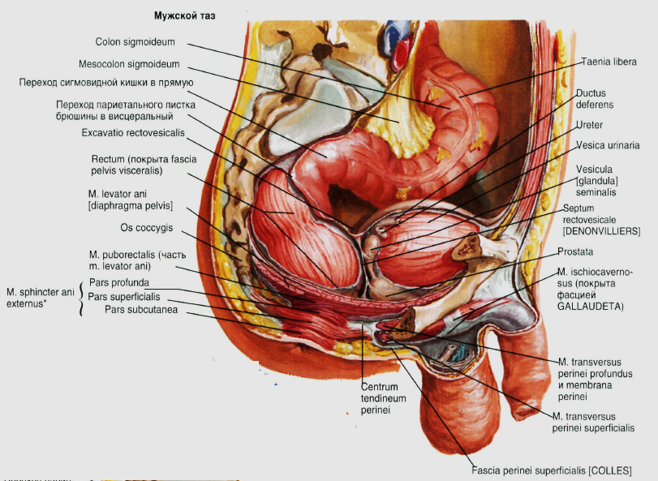
Anatomy of the male pelvic organs

Slide 4
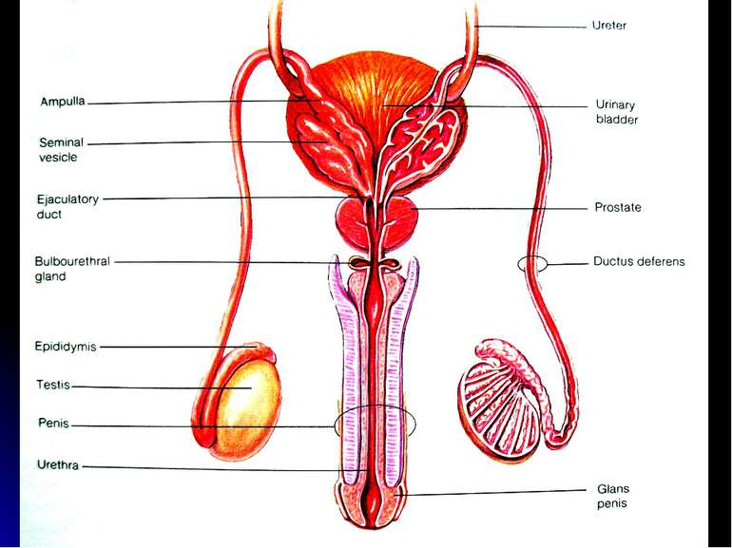

Slide 5
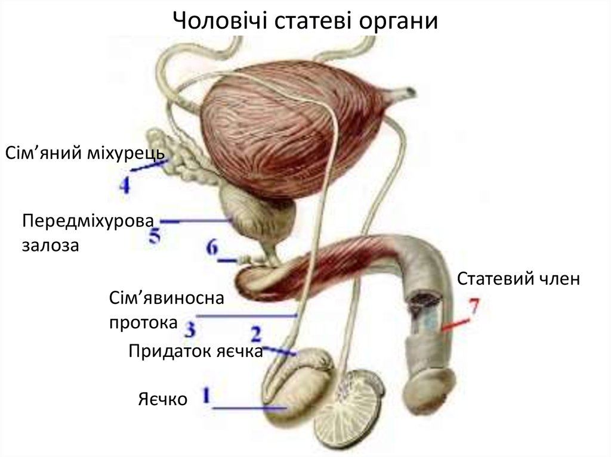
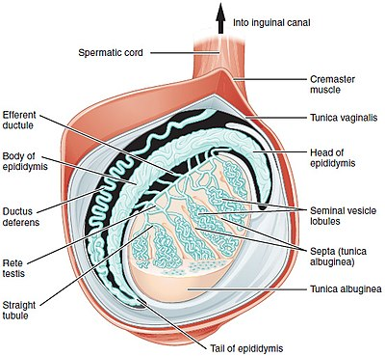
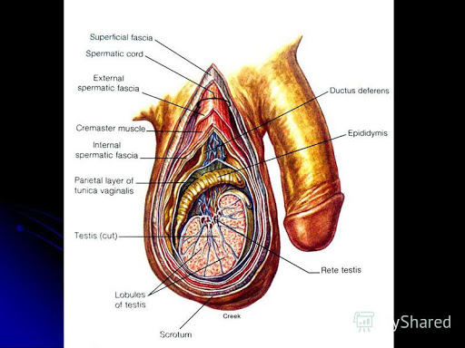

Slide 6
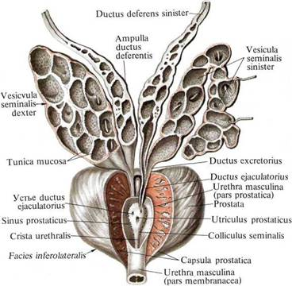

Slide 7
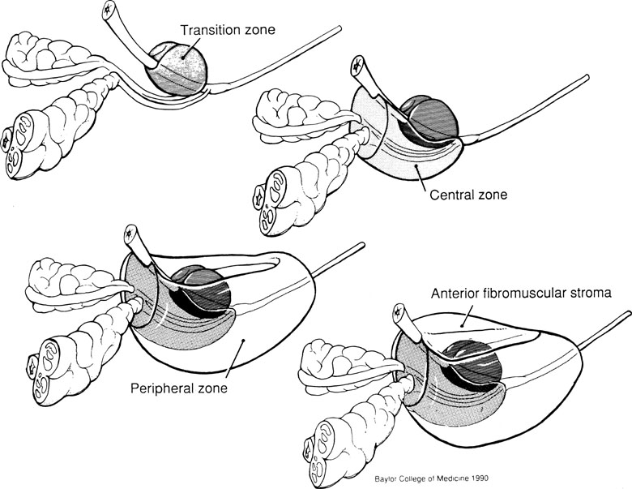
Anatomy of the prostate gland

Slide 8
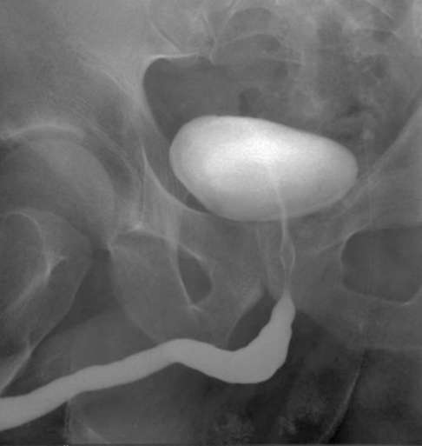
X-ray method
Urethrography - X-ray examination of the urethra when it is filled with RKS
Urinary urethrography - X-ray image can be obtained in the form of the final stage of excretory urography during urination.
Gives an idea of ​​the functions of urination (change in the tone of the detrusor, bladder neck and membranous sphincter)Direct retrograde urethrography - in direct contrast through the external opening of the urethra
Direct antegrade urethrography - through the epicystostomy and the inner opening of the urethra
Direct (antegrade or retrograde) urethrography allows you to more clearly visualize the lumen of the prostate, membranous and spongy parts of the male urethra
On urethrograms the urethra is visible in the form of a tape-like shadow with clear, equal contours, the gleam of an urethra is uneven and corresponds to a phase of contrast and physiological narrowing.

Slide 9
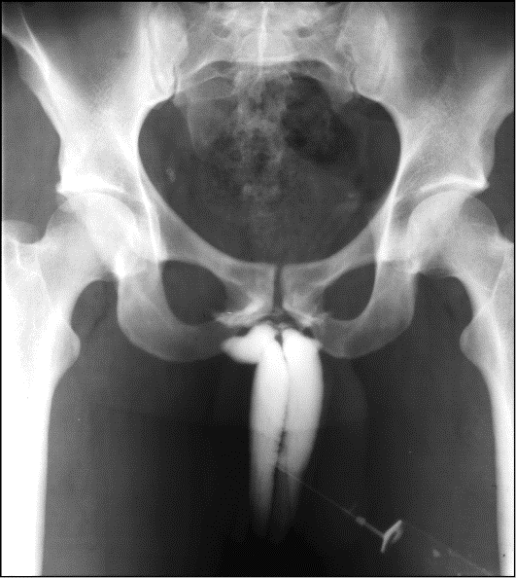
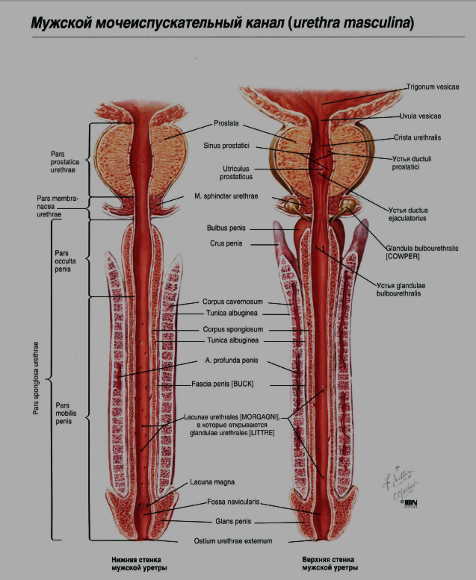
Cavernosography is an X-ray examination of the cavernous bodies of the penis by injecting LCD into them.The technique allows to obtain information about the blood supply to the corpora cavernosa and is most often performed to determine the venous discharge of blood in erectile dysfunction..
Cavernosography. Norm.Radiation diagnostics: textbook: Vol. 1 / ed. prof. G.Ye. Trufanova. - 2011, Fig. 13.1

Slide 10
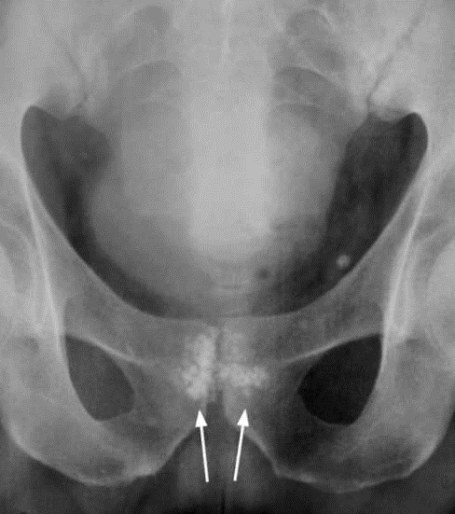
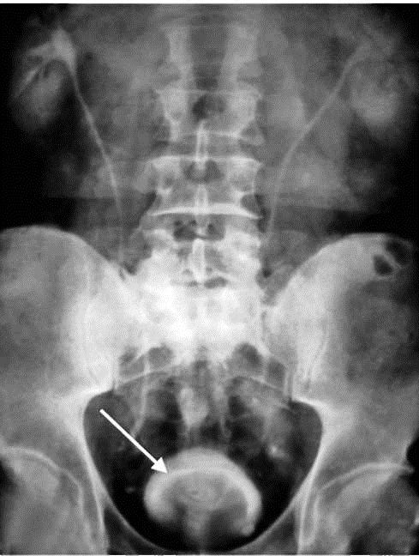
Excretory urogram with descending cystogram. The big rounded defect of filling on the lower contour of a bladder caused by a benign hyperplasia of a prostate gland is defined
Review pelvic radiograph. Prostate stones (arrows)

Slide 11
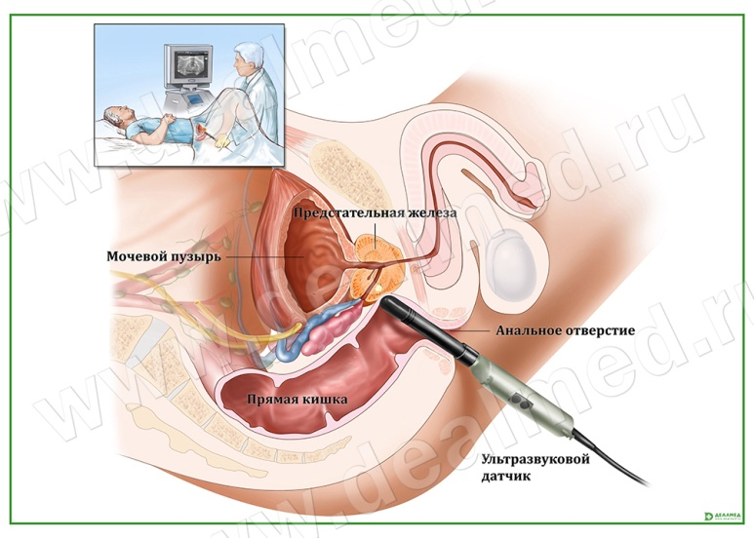
Ultrasound method
Ultrasound of extra-pelvic genitals (penis, spongy part of the male urethra, scrotum, testicles, their appendages and spermatic cords) is performed using surface high-frequency sensors
Transrectal ultrasound - TRUZD - examination of the pelvic genitals (seminal ducts, seminal vesicles, prostate, membranous and prostatic parts of the male urethra) with a rectal sensor
TRUZD allows to visualize a zonal structure of a prostate on a difference of echogenicity of its peripheral zone and the central area
Of particular importance is TRUZD as a method of navigation when performing invasive procedures (prostate biopsy)The pelvic genitals can also be visualized by transabdominal scanning

Slide 12
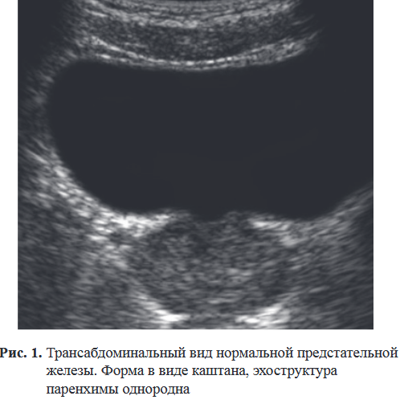
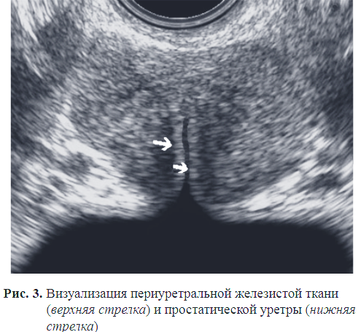
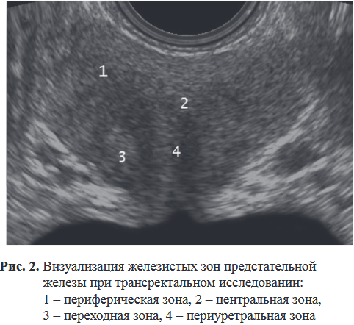

Slide 13
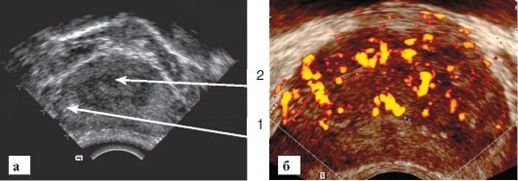
Sonograms of the prostate:
a- the image obtained by transrectal access,
b - energy Doppler blood flow in the gland
1 - peripheral zone bets
2 - the central zone

Slide 14
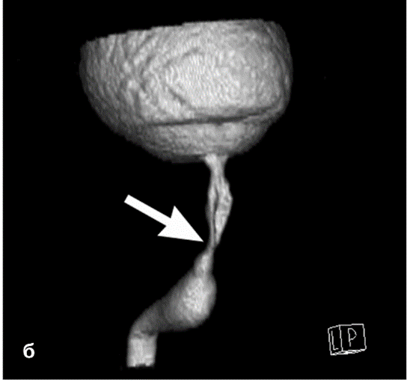
X-ray computed tomography
CT in the study of the genitals allows you to assess the condition of the surrounding tissues in trauma and to detect regional and distant metastases in malignant tumors
In some cases, use special techniques that give a more detailed spatial picture of the pathological process:
CT urethrography
CT fistulography
CT urethrogram in the mode of ZD

Slide 15
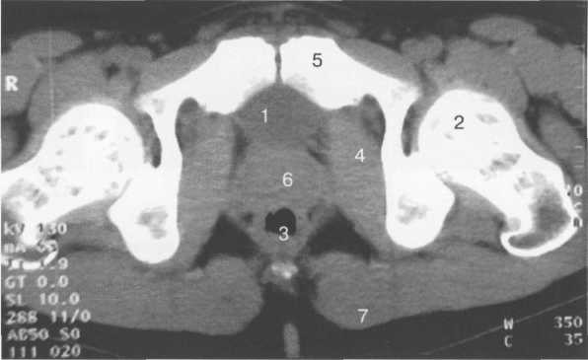
CT of the prostate.
1 - bladder;
2 - the head of the femur;
3 - ampoule of the rectum;
4 - internal occlusal muscle;
5 - pubic bone;
6 - prostate gland;
7 - large gluteal muscle.

Slide 16
Magnetic resonance imaging
MRI is one of the most informative methods of visualization of genitals and diagnosis of their pathological changes
MRI gives an idea of ​​the topography of the pelvic organs, allows you to visualize changes in the structure of the genitals and surrounding tissues
The use of endorectal coil in MRI most clearly visualizes the zonal architecture of the prostate, the structure of the seminal ducts, urethra
This is the most informative technique in detecting tumor changes in these organs and determining the local spread of the process (detection of invasive tumor growth, regional and non-regional lymphadenopathy, bone metastases)
MR spectroscopy for hydrogen allows in vivo and noninvasive to quantify the composition of tissue metabolites
The technique is of particular importance in the diagnosis of prostate cancer

Slide 17
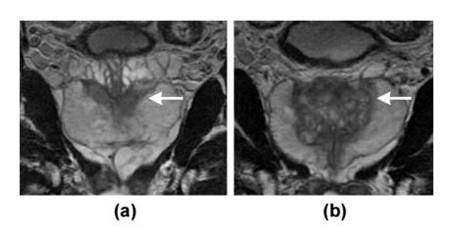
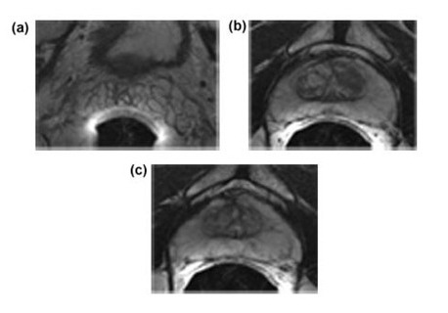
Frontal T2-weighted magnetic resonance imaging of a normal prostate. The presented "slices" show the central zone (a, {arrow}) and the intermediate zone (b, {arrow}).
Axial T2-weighted magnetic resonance imaging of a normal prostate.Presented "slices" from the seminal vesicle (a),middle bets (b)and the apex (c) of the prostate.

Slide 18
Radionuclide method
In the study of the genitals, this method is of secondary importance.
A specific labeled metabolite used in PET in the diagnosis of prostate cancer is 11C-sodium acetate, which selectively accumulates in the tumor and its metastases.
Perfusion scintigraphy can be used to search for the undescended testis: scan with 99mTc sodium pertechnetate.

Slide 19
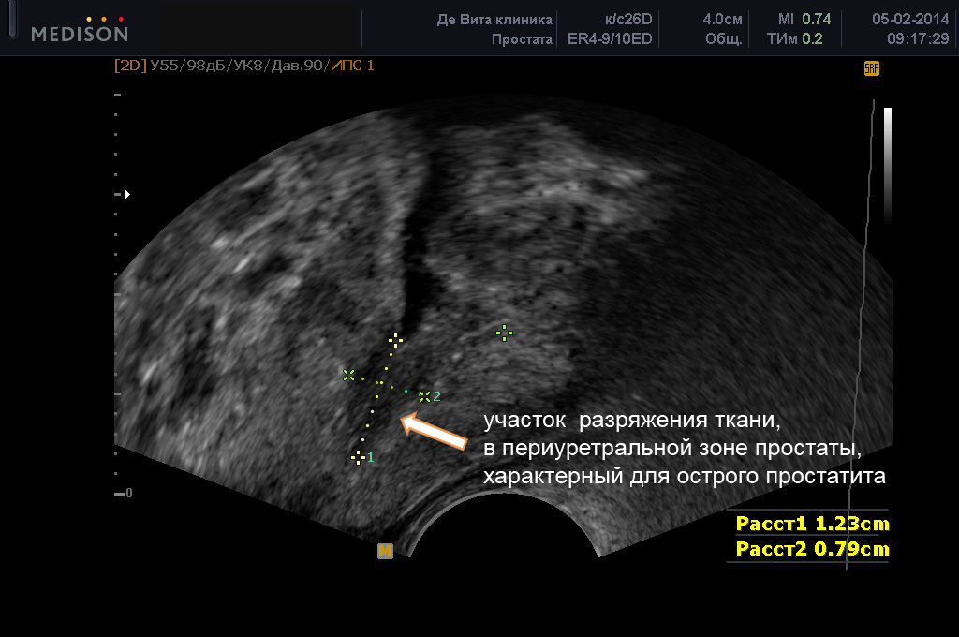
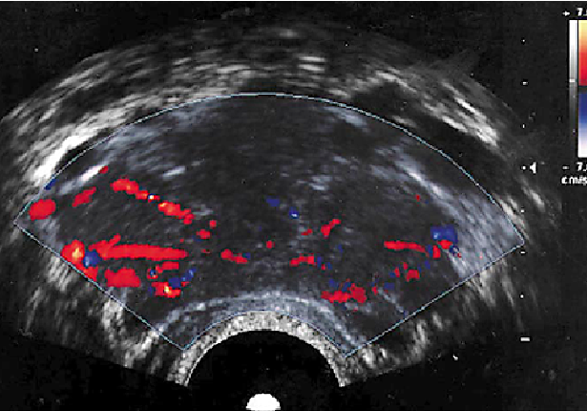
Ultrasound symptoms of acute prostatitis
1Moderate enlargement of the gland
2. Expansion along the seminal ducts and capsules
3. Lack of zonal differentiation of the prostate
4. Diffuse decrease in echogenicity of the gland
5. Blurring of the gland capsule (swelling, enlargement of the plexuses)
6. Changes in vascular architecture

Slide 20
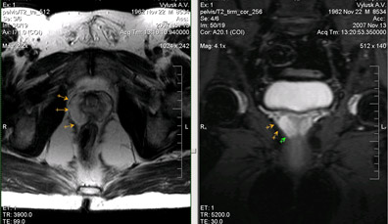
А)
Б)
Male., 45 years old. Acute prostatitis. On the presented tomograms in T2-VI the axial plane (a) and
T2 with fat suppression in the coronal plane is determined by an increase in the volume of the peripheral zone, its swelling.

Slide 21
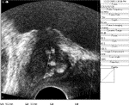
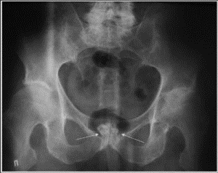
Chronic prostatitis
ТрУЗД:
Heterogeneity of echostructure:
Multiple hyperechogenic areas (fibrosis, calcifications),
Cystic elements in the prostate
At an exacerbation there can be hypoechogenic sites
Blurring and unevenness of the contour (capsule) of the gland
Chronic prostatitis: sclerosis of the central zone of the prostate.

Slide 22
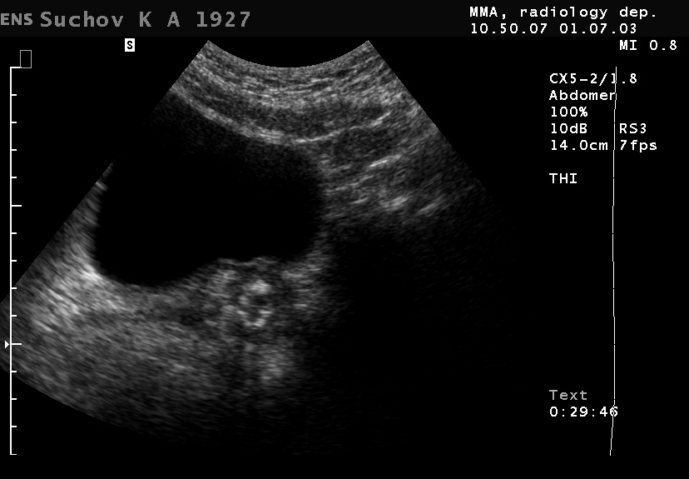
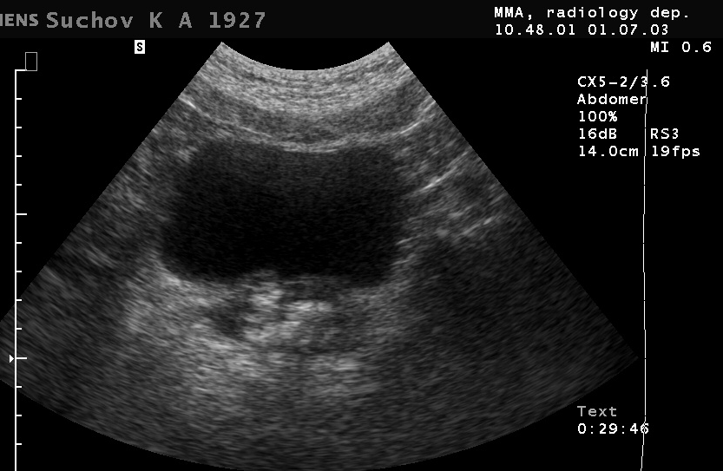
Chronic prostatitis

Slide 23
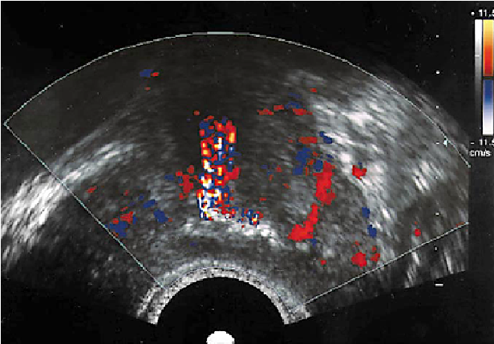
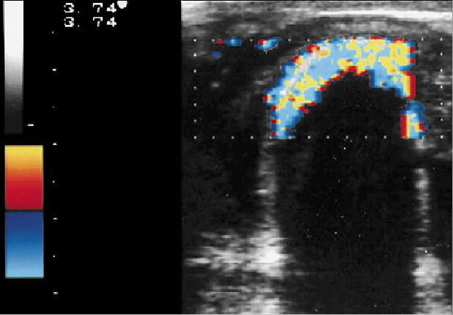
Dopplerography:
Doplerohrafiya:
14 / 5000
Результаты перевода
Dopplerography:
Doplerohrafiya:
14 / 5000
Результаты перевода
Dopplerography:
Dopplerography:
Changes in vascular architecture
Diffuse reduction of vascularization with avascular areas in the scar zones
Artifacts of reflection of speed streams from echo density of sites

Slide 24
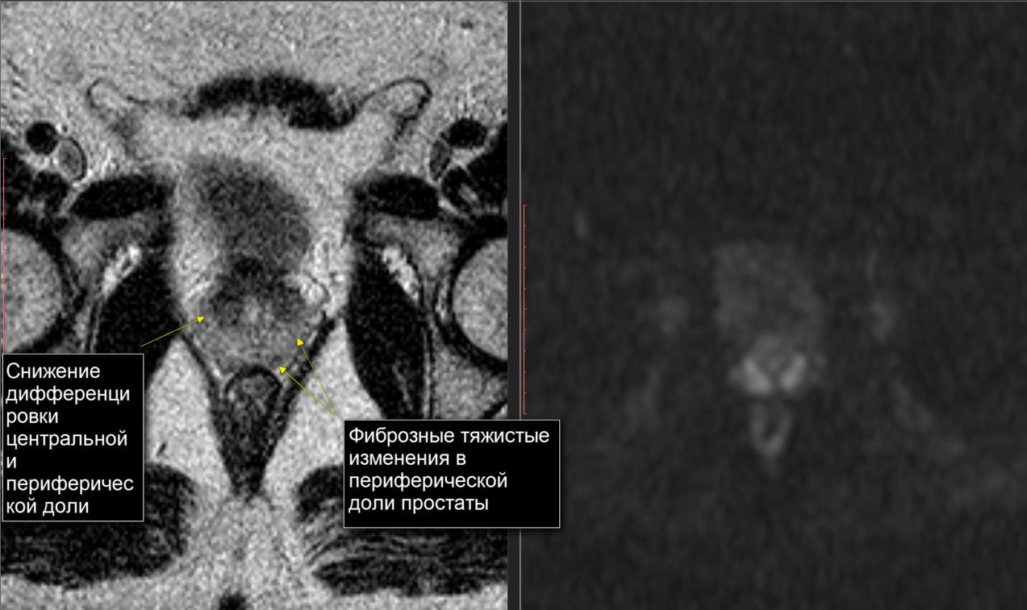
Chronic prostatitis
Reduction of zonal differentiation of the prostate,
Diffuse and focal (linear structures) decrease in the intensity of the MR signal from the peripheral zone on the t2 (fibrosis);
Hypointensive rounded inclusions on t2 and t1 are calcinates

Slide 25
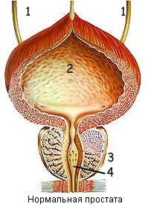
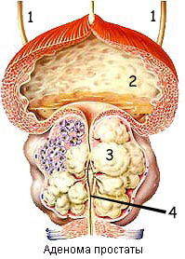
Clinical symptoms of BPH
Symptoms of lower urinary tract changes:
- obstructive symptoms (mechanical compression of the bladder neck and prostatic urethra)
- difficulty urinating, sluggish urine flow, increased duration of urination, feeling of incomplete emptying of the bladder, etc.
- irritative symptoms (dysfunction of the detrusor, bladder sphincters, receptors of the bladder neck and prostatic urethra)
- nocturia, pollakiuria, false urge to urinate, urinary incontinence.
2. Symptoms of secondary changes in the kidneys and upper urinary tract;
3. Symptoms of complications of the disease.

Slide 26
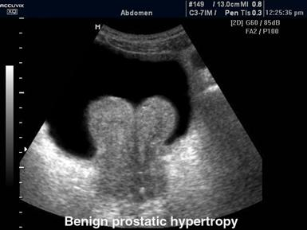
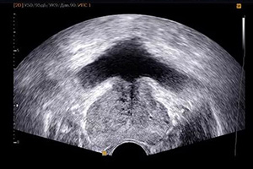
Ultrasound symptoms of BPH
increase in size (more than 40 ml), change in shape (spherical, elongated with penetration into the bladder cavity)
change in the zonal ratio (increase in the central part of the gland, thinning of the peripheral)
increasing echogenicity in the Central part of the nodal or diffuse type
formation of a hyperechoic "surgical" capsulepredominance of periurethral group of vessels over capsular (Doppler scan)
no signs of invasive growthSigns of infravesical obstruction: trabecular bladder + diverticula;hydroureteronephrosis

Slide 27
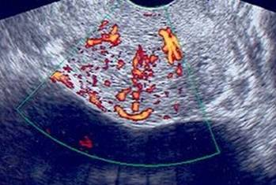
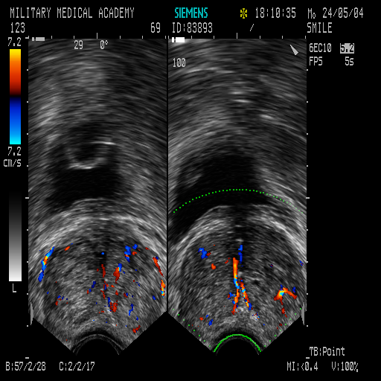
Ultrasound symptoms of BPH (Doppler scan)
The predominance of the periurethral group of vessels over the capsular
Curvature of blood vessels
Depletion of vascular pattern

Slide 28
Different ratios of stromal and glandular components determine the echostructure of the gland in hyperplasia.
The predominance of stromal elements of hyperplasia is manifested by a more hypoechoic echostructure of the gland, and the predominance of glandular elements determines the isoechogenic or hyperechogenic echostructure in comparison with the echostructure of the normal gland.
Therefore, the gland has a pronounced heterogeneity of its echostructure, which is determined by the detection of hyperechogenic calcifications and secretory stones, anechogenic cysts

Slide 29
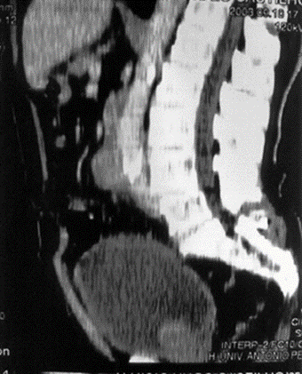
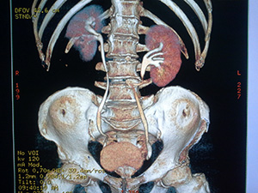
Computed tomography in BPH
increase in size, change in shape (spherical, elongated with prolapse into the bladder cavity);
glandular tissue calcifications;
no signs of invasive growth.

Slide 30
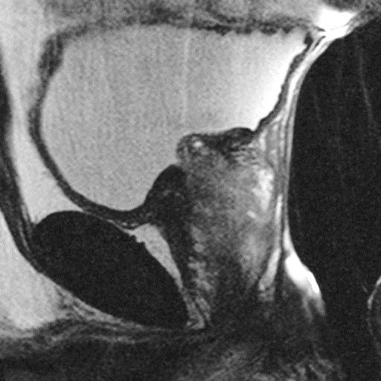
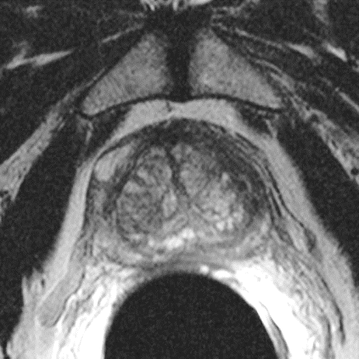
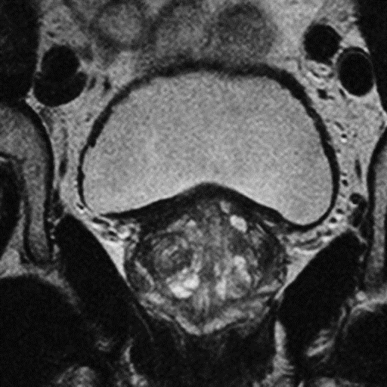
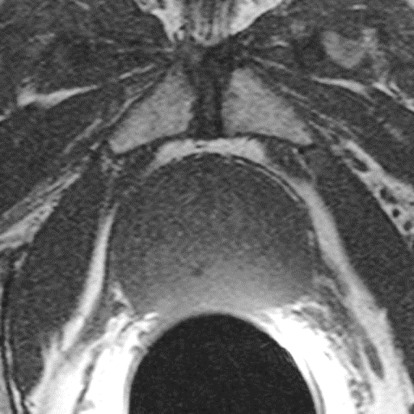
MR signs of benign prostatic hyperplasia
T2-VI: cystic inclusions (glandular proliferation) and / or nodular isointensive areas (stromal proliferation)
T1: homogeneous isointensive MR structure (sometimes areas of hypointensive MR signal - cysts, calcifications)
compression of the central and peripheral zones and the formation of a pseudocapsule
Prolapse of the paraurethral region into the bladder cavityabsence of MR signs of invasive growth
change in the nature (inhomogeneous) and speed (slow) accumulation of the contrasting drug

Slide 31
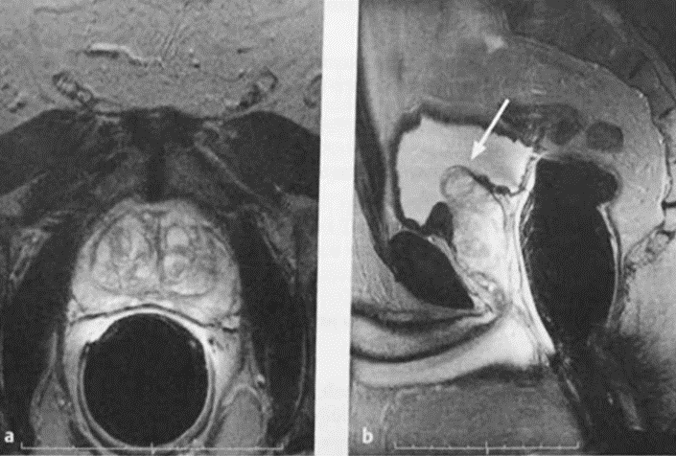
a, b T2-weighted MRI. The zonal anatomy of the prostate is well visible. The increased transition zone is defined, it will be possible in a gleam of a bladder:
(A) Axial image, (b) sagittal image.

Slide 32
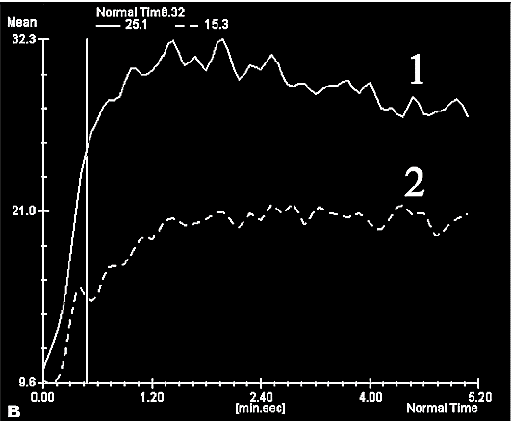
Benign prostatic hyperplasia
Dynamic contrast enhancement in MRI:
With benign prostatic hyperplasia - slow accumulation (several minutes) and slow leaching of HF (curve №2 on the graph)
In prostate cancer -fast accumulation and slow leaching (curve №1 on the graph)

Slide 33
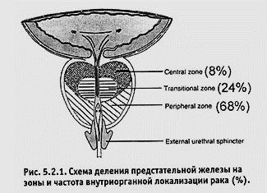

Slide 34
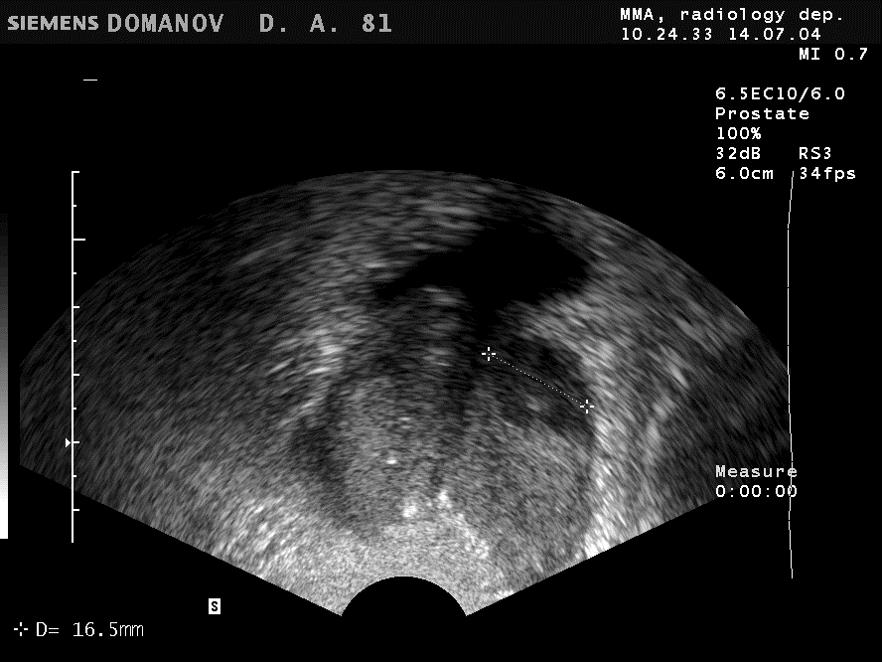
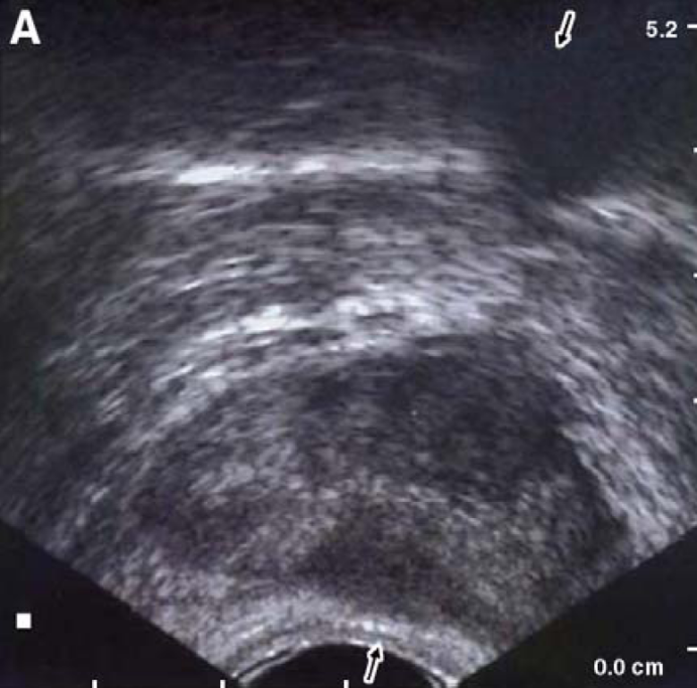
Ultrasound symptoms of prostate cancer (B-mode - primary diagnosis)
local change of echogenicity in the peripheral zone of the gland (hypoechoic node in 90%), with uneven and fuzzy contours
diffuse change of echogenicity of the peripheral zone of one of the parts of the gland or the whole gland with loss of zonal differentiation
general asymmetry of the geometry and echogenicity of the gland

Slide 35
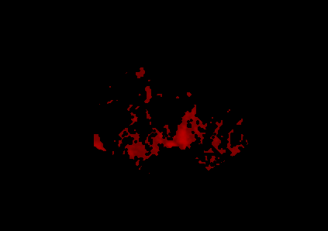
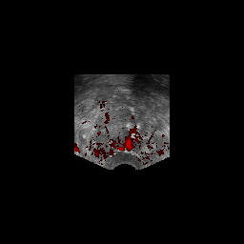
Ultrasound symptoms of prostate cancer (Doppler)
"Disorganized "type of vascular pattern in the detected altered location of the gland.
no change in vascularization (18% of cases)
the presence of local asymmetry of the nature and degree of vascularization of the gland;

Slide 36



MR signs of prostate cancer
change in the shape of the gland
increase in the size of the glandchange in the intensity of the MR signal from the areas of the gland
change in the zonal architecture of the gland
change in the nature of the contours of the gland

Slide 37



MR signs of prostate cancer
change in the nature (heterogeneous) and speed (early and rapid) accumulation and slower "leaching«
MR signs of local spread and metastasis of the tumor
рак
гиперплазия

Slide 38


Axial CT image of the prostate. Adenocarcinoma of the prostate with invasion of the bladder wall, surrounding prostate tissue and seminal vesicles. regional lymphadenopathy
Sagittal Multiplanar CT prostate reconstruction. Uneven accumulation of contrast agent by tumor masses with signs of invasion into the bladder wall

Slide 39

T2-cor b) T2-tra c) T1FS din + C
It is determined by the large size of the tumor of the right lobe of the prostate with the invasion of its capsule, spreading to the paraprostatic tissue (arrows).At intravenous dynamic contrast (in) in an arterial phase the expressed, diffusely inhomogeneous strengthening of fabric of a tumor is defined.

Slide 40


Anatomy of the female pelvis

Slide 41

Жіноча репродуктивна система

Slide 42


Slide 43
Radiation diagnostics in gynecology
The main methods of radiological diagnosis in gynecology are methods that allow with high tissue contrast to visualize changes in the genitals depending on age, phase of the menstrual cycle, during pregnancy and lactation:
Ultrasound
MRI
In the study of female genitals often use special radiological techniques and CT

Slide 44

X-ray method
Hysterosalpingography - X-ray examination with the introduction of water-soluble RKS into the uterine cavity and fallopian tubes using a special catheter-syringe
Contrasting uterine cavity has a triangular shape with a proximal base, from which (uterine horns) depart thin, long, sometimes twisted linear fallopian tubes
With preserved patency of the fallopian tubes, the contrast agent is poured into the peritoneal cavity.
Contraindications to GHA are active bleeding, inflammation, condition after recent operations on the uterus or fallopian tubes, uterine curettage.
Гистеросальпінгограмма. Норма

Slide 45

Ultrasound examination of the pelvic organs in women
Ultrasound plays a key role in the diagnosis of diseases of the female genitalia is performed using surface sensors
Given that the structure and size of the female reproductive organs can vary greatly depending on the specific situation, when conducting a gynecological ultrasound examination must take into account the anamnestic data:
the patient's age,
the day of the menstrual cycle (or the number of years of postmenopause),
pregnancy results,
postponed surgical interventions
taking hormonal drugs.
Ultrasound imaging in gynecology can be obtained using two complementary techniques - transabdominal (TA) and transvaginal (TB) scan access.
The study should always begin with TA ultrasound according to conventional methods with a full bladder to determine
the topography of the pelvic organs, determine the size and structure of the detected pathological three-dimensional formations and, if necessary, assess the condition of the organs
abdominal cavity and
retroperitoneal space.

Slide 46

Ultrasound examination of the pelvic organs in women
The advantages of TA research include:possibility for all categories of patients (including children),complete absence of invasiveness,"Panoramic" examination of the entire pelvic cavity,evaluation of the bladder and the possibility of using standard convex sensors.
The disadvantages of this method are the need to fill the bladder with a significant volume of fluid, which leads to some changes in the ultrasound anatomy of the studied organs - "flattening", pushing outside the focal zone of the sensor, which in turn can cause visual impairment.
In addition, the image quality during TA ultrasound is greatly influenced by the thickness of the anterior abdominal wall, intestinal peristalsis and the presence of adhesions.
AND scanning of the pelvic organs in the longitudinal plane.
1 - bladder;
2 - the body of the uterus;
3 - endometrium.

Slide 47

Ultrasound examination of the pelvic organs in women
TV research is carried out by special vaginal sensors, as close as possible to the studied organs, which allows the use of higher scanning frequencies.
Benefits:
Gives a much better image, allows you to evaluate the fine details of the studied structures,The image does not depend on the patient's obesity or adhesions, to a lesser extent worsens with the phenomena of intestinal hyperperistalsis and additionally there is the possibility of palpation of the abdomen with the free hand.
Disadvantages:
Cannot be used in a number of patients, especially in pediatric practice.
It is not possible to scan the entire volume of the pelvis, which can lead to serious diagnostic errors: distant or large formations do not fall into the plane of the scan;
The mutual arrangement of organs and pathological processes is not always determined.
TV test has a risk of infection and must be accompanied by strict adherence to the rules of asepsis: the use of protective disposable covers for the sensor, mandatory treatment of the sensor after each study with special antiseptic solutions, the presence of disposable gloves to the doctor.
TV ultrasound affects the intimate sphere of patients, so it requires compliance with a number of conditions. The patient should be fully informed about the procedure, the bladder should be empty. The cabinet must be equipped with a screen.
TV scan of the pelvic organs in the longitudinal plane.

Slide 48

Ultrasound examination of the pelvic organs in women
Echohysteroscopy (ECHOS) is a method of assessing the uterine cavity using ultrasound scanning using intrauterine fluid, which is an echonegative contrast.
Both saline and a special gel can be used as contrast agents.
ECHOS is usually performed in an outpatient setting after a preliminary ultrasound examination of the pelvic organs, during which the structure of the uterus, ovaries, and the presence of free fluid in the ectopic space are assessed in detail.
30 minutes before the study, sedatives and antispasmodics are prescribed for emotionally labile patients. The patient is placed on a gynecological chair. Irrigation of the cervix with a solution of lidocaine. After 3-5 minutes, the cervix and vagina are treated with a disinfectant solution, the cervix is ​​fixed with ball forceps. Then the uterine cavity is probed, after which the catheter, pre-filled with a contrast agent, is inserted into the uterine cavity. The location of the catheter in the uterine cavity is monitored by TA ultrasound scan. Ball forceps and mirrors are removed, a TV sensor in the cover is inserted into the vagina. Further manipulations are controlled by TV scanning. A contrast agent of 2-5 ml is slowly injected into the uterine cavity in portions. The uterine cavity is evaluated by the introduction of the first 5-10 ml of contrast.
Optimal is the image of the uterine cavity in ECHOS, provided that the contrast agent allows you to fully examine the entire cavity; incomplete - if the uterine cavity is only partially dilated;EHOGS is considered unsuccessful if there is no image of fluid in the uterine cavity.
Echohysterogram of the normal uterine cavity. TV scan.

Slide 49


Uterus
On sagittal echograms, it is manifested as the formation of a characteristic pear-shaped shape, located in close proximity behind the bladder. The unchanged myometrium has a generally homogeneous fine-porous structure of medium echogenicity.
There are several phases of the menstrual cycle, which are reflected in the ultrasound examination of the endometrium.
The first phase of the cycle, which includes subphases of desquamation, regeneration and proliferation, lasts 12-17 days. In the phase of desquamation, the uterine mucosa is represented by a heterogeneous structure of the middle complex with inclusions of increased and decreased echogenicity.
In the phase of regeneration and early proliferation of the endometrium is represented by a strip of homogeneous echostructure of reduced echogenicity with a thickness of 2-4 mm. Then, as the thickness of the endometrium on the background of its reduced echogenicity, there is increased echogenicity, a thin strip on the border of the endometrium and myometrium and a hyperechogenic line of closure of the anterior and posterior layers of the endometrium ("periovulatory endometrium").
Measurement of the length and thickness of the uterus, the thickness of the endometrium.

Slide 50

Echograms of the endometrium in the phase:
proliferation (A),
periovulatory phase (B),
phase of early (B)
andlate (D) secretion.
TV scan.

Slide 51


Cervix.
The ratio of uterine body length / cervical length is 2/1 in normal organ development since late puberty. Before puberty, this ratio is equal to 1/3.
The thickness of the unchanged endocervix in reproductive age is on average 2-5 mm (maximum - 6 mm) and practically does not change according to the phases of the cycle.
The cervical canal can normally be expanded to a few millimeters in the periovulatory period due to mucus, which has the form of anechoic content.
In contrast to the body of the uterus in the postmenopausal period, the cervix is almost not reduced in size, and the endocervix may not be visualized.

Slide 52

Uterine tubes
Unchanged fallopian tubes are usually not visible on transabdominal ultrasound.
Sometimes at ultrasonic research at cross scanning of a uterus the linear tubular formations departing from uterine corners are visible. It should be remembered that these formations may be fallopian tubes, but in reality they are more often ligaments. In addition, the fallopian tubes are sometimes mistaken for varicose veins of the pelvis, which are easily identified by Doppler examination.
In transvaginal ultrasound using high-resolution ultrasound in some patients it is possible to visualize unchanged fallopian tubes.
When fluid accumulates in the lumen of the fallopian tubes, for example, during the inflammatory process, they become available for ultrasound imaging.

Slide 53



Ovaries.
The ovaries after the age of 17 are usually defined more laterally than the lateral wall of the uterus and more medially than the iliac vessels.
The ovaries are homogeneous in structure, isoechoic to the uterus and hypoechoic to the loops of the intestine.
Due to the vessels of the cerebral layer may be hyperechoic in comparison with the cortex.
Anechogenic follicles are located in the cortical layer on the periphery. The dominant follicle usually reaches 2.0 to 2.8 cm
echogram of a normal ovary in reproductive age. The normal ovary has several anechoic follicles on the periphery.TV scan.
Echogram of the ovary with a dominant follicle (arrows).TV scan.

Slide 54
X-RAY COMPUTER TOMOGRAPHY
The method of multislice computed tomography (MSCT) is not a first-rate method in the diagnosis of pelvic diseases. Unlike ultrasound and MRI, MSCT has an indistinguishable structure of the uterine wall, especially the endometrium and its changes during the cycle.
It allows you to visualize the anatomical structure and detect pathological formations of the pelvis.CT allows you to assess the condition of regional lymph nodes and surrounding tissues in malignant tumors of the genitals.
Thus, the MSCT of the pelvis is performed to detect:
the spread of tumors of the uterus and appendages, bladder cancer, rectal cancer outside the body;
infectious and vascular diseases (inflammatory diseases of the pelvis, tuboovarian abscess, pyometra, varicose veins of the pelvis);
to determine postoperative, inflammatory changes in the pelvic tissue in difficult cases for ultrasound.
to clarify the mechanical damage to the pelvic organs
differential diagnosis of free and encapsulated effusion in the pelvis
lesions of the pelvic lymph nodes
assessment of bone structures

Slide 55


Radiation semiotics of diseases of the female genital organs
Doubling of the uterus Hysterosalpingography, ultrasound, MRI: enlargement, change of shape,septum in the uterine cavity (with incomplete doubling),two uterine cavities and two cervical canals (with complete doubling)
Doubling of the uterus:
Hysterosalpingogram
b) echogram (arrows indicate the uterine cavity)
c) MR tomogram

Slide 56

Salpingo-oophoritis
Ultrasound, MRI: a large amount of fluid in the pelvis, not associated with ovulation, visualization of fluid in the fallopian tube cavity, enlargement of the affected ovary with a change in its structure

Slide 57



Uterine fibroids
Fibroids are the most common benign formation of the uterus.
Ultrasound, MRI: enlargement of the uterus, multiple rounded inhomogeneous (hypoechoic on ultrasound, hypointense on T2-VI on MRI) formations with clear and smooth contours in the body or bottom of the uterus, located subserous, submucosal or intramural.
Uterine fibroids do not have specific CT - signs, their presence can be suspected by the increase in the size of the uterus, the deformation of its contours and the appearance of calcifications.
Node density at CT - 40-50 HU
Areas of calcification are often found
Uterine fibroids (arrows indicate fibroids)
echogram
b) MR tomogram
c) computed tomography

Slide 58


MRI, frontal tomogram.
The uterus is displaced to the right.
Uterine fibroids are defined as rounded or oval hypointensive formations (here with signs of degeneration) with clear contours with expansive growth, without infiltration of adjacent structures depending on the size with deformation of the uterine contours.
Large subserous fibroids of irregular shape and small submucosal fibroids
Visualized irregular oval-shaped additional formation that deforms the uterine cavity (submucosal fibroids)

Slide 59

Adenomyosis is an ectopia of the glands and stroma of the basal endometrium into the subordinate inner layer of the myometrium, accompanied by smooth muscle hyperplasia.
It occurs in about 25% of women, more often in those who have given birth to many.
Clinical symptoms of adenomyosis appear before menopause. Adenomyosis is characterized by vaginal discharge before and after menstruation, have a dark brown color; excessively abundant menstruation; PMS; pain in the pelvis before menstruation, during and for some time after; pain during intercourse; menstrual irregularities.
The figure shows focal adenomyosis of the posterior wall of the uterus. Determined expansion of the transition zone (replaces the entire thickness of the posterior wall) and the heterogeneity of its structure, due to the presence of small rounded cystic inclusions. The outer contour of the uterus is smooth, clear.

Slide 60


Endometriosis is a non-neoplastic hormone-dependent disease characterized by the growth of the uterine mucosa (endometrium) in the muscular layer of the uterus and other organs, where it should not normally be (fallopian tubes, ovaries, bladder, peritoneum, etc.). usually in women older than 30 years.
Ultrasound: multiple formations of the myometrium and ovaries, different echogenicity, fluid in the pelvic cavity
MRI: heterogeneity of the MR structure of the endometrium and myometrium, ovaries, fluid in the pelvic cavity. Protein-containing endometrioid cysts in the pelvic cavity, ovaries, hemorrhagic peritoneal infiltration
MR-hysterosalpingography, X-ray hysterosalpingography: determination of fallopian tube patency to identify the cause of female infertility
Endometrioid cyst of the right ovaryLesions of the bladder wall
In the images (a and b) is determined by the irregular shape of the focus in the Douglas space, between the body of the uterus and the anterior wall of the rectum (endometrioma) with the deformation of their contours

Slide 61

Endometrial cancer.
Ultrasound in the early stages is nonspecific. signs:
-uneven thickening of the endometrium
-increased echogenicity and heterogeneous structure
-lack of continuity of the image of the basal layer of the endometrium (a sign of invasion into the myometrium)
at widespread process of increase in a body of a uterus, focal changes of a myometrium, hypo-or anechogenic contents.
CT: formation of inhomogeneous structure with hypodense areas. They are best detected with contrast enhancement. The presence of infiltration of the surrounding tissues, lymphadenopathy and MTS indicates malignancy.
MRI: increasing the thickness and increasing the brightness of the signal on T1 and T2-VI. Violation of the clarity of the basal layer.
Endometrioid cancer of the uterine body. III A stage.

Slide 62

Cervical cancer.
Ultrasound: hypoechoic area with fairly clear contours and with chaotic hypervascularization in the SCC mode. Further - thickening of the cervix.
MRI is not leading. ON T2-VI - high-intensity signal.
Stage IIIb cervical cancer. Determined by the invasion of the tumor in the parameters and germination of n / 3 of the right ureter with the development of ureteroectasis, hydronephrosis of the first degree. right kidney

