Slide 1
Radiation examination of the thyroid gland.
Radiation anatomy. Radiological signs of thyroid disease.
Odesa 2022
Doikova E.M.
Assistant of the Department of Radiation Diagnostics, Therapy and Radiation Medicine and Oncologe ONMedU.

Slide 2
METHODS FOR STUDYING THE THYROID GLAND
Ultrasound:
-sonography,
-dopplerography,
-color Doppler mapping,
- fine needle biopsy (TIB) under ultrasound control.
CT and MRI
RADIONUCLIDE METHODS:
In vivo-scanning;
-scintigraphy;
- study of the iodine storage function of the thyroid gland according to ¹²³I, ¹³¹I;
-test-capture of ⁹⁹mТс
-pertechnetat.
In vitro
-radioimmunological analysis of organic phases of iodine metabolism.

Slide 3
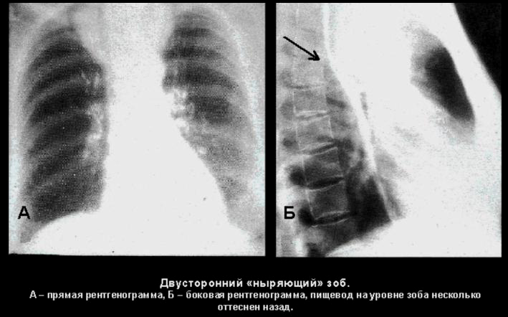
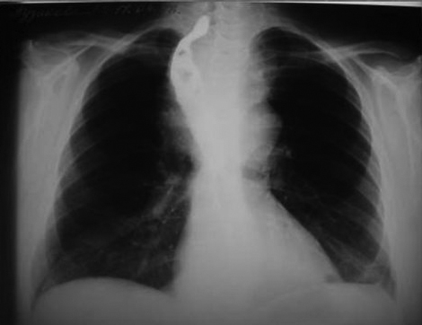
Methods of radiography with esophageal contrast, tomography in direct and oblique projections have lost their relevance, but sometimes they are carried out to assess the uniformity of the lumen of the trachea, its deviation, narrowing, assessment of the width of the posterior tracheal space at the level of the thyroid gland if it is not possible to apply other more modern methods.
Tomography (not computerized) is also practically not used; in the absence of other available methods, it will be performed in the frontal plane with slices of 0.5-2.5 cm at the depth of the thyroid cartilage. 3 slices are performed with a tomographic step of 0.5 cm.
If an intrathoracic or retrosternal goiter is suspected, radiographs are performed in two projections with esophageal contrast, as well as CT, MRI. On conventional radiographs and tomograms in these cases, the presence of a goiter is diagnosed by the displacement of anatomical structures.

Slide 4
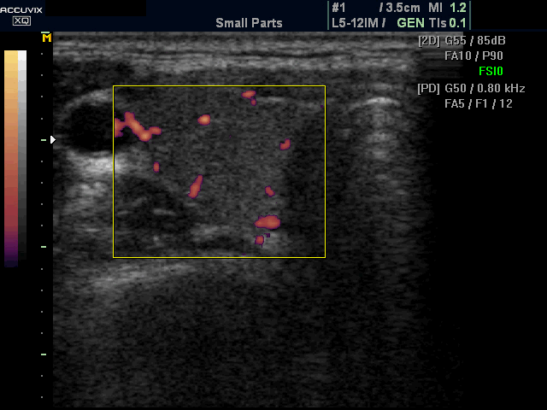
Ultrasound is the gold standard for thyroid research today. This method is highly informative, simple and economical, it does not give radiation exposure, therefore, it allows you to trace the patient in dynamics.
Blood flow in the unchanged thyroid gland in power Doppler mode.

Slide 5
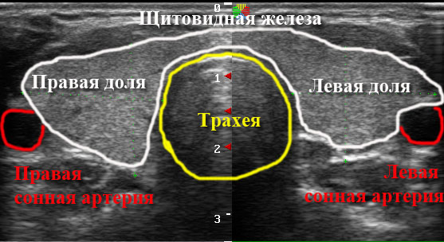
- Ultrasound - is prescribed to almost all patients to confirm or exclude thyroid pathology:
Determination of the size, position, shape, clarity of the contours of the capsule, structure (differential diagnosis between nodular, diffuse and mixed goiter, auto-immune thyroiditis);
Determination of the size, position, shape, structure of nodes (echogenicity), peculiarities of the location of microcalcifications, the presence of a capsule;
Anatomical and topographic features of the neck organs;
Definition of enlarged lymph nodes, indicating their size, position, shape, clarity of contours, structure.

Slide 6
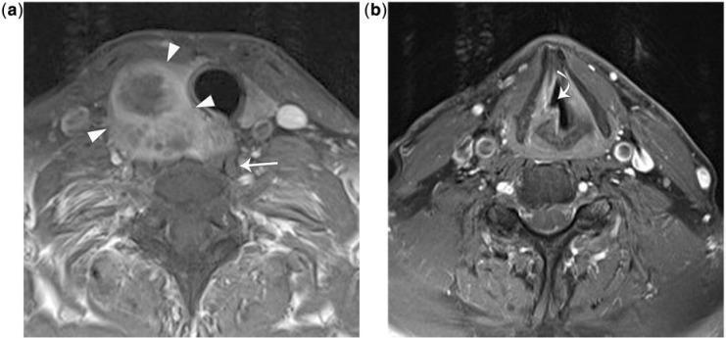
CT and MRI are performed with the patient supine at a depth of deep inspiration while holding the breath. The thickness of the cross section is 4-8 mm, the step of the tomograph is 8-16 mm. To increase the information content, contrast enhancement is usually used: the introduction of intravenous iodine-containing non-ionic contrast by infusion or bolus.
Under the control of ultrasound, CT or MRI, biopsy (cysts, solid formations) can be performed.
MRI. Thyroid cancer with recurrent nerve invasion. T1 and T2 modes.

Slide 7
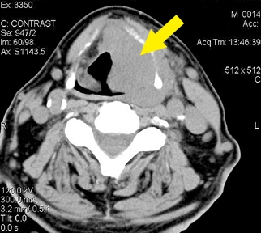
CT examination
Normally, the concentration of iodine in the thyroid gland is 300 times higher than the content in the rest of the body, so its image on CT looks very contrast and is higher in density (110 + 12 HU) than muscles (40 HU). In young people, its density is higher due to active blood flow than in the elderly.
Dimensions in an adult: transverse 50-60 mm, longitudinal - each lobe-50-80mm, thickness 10-20 mm. The vertical dimension of the isthmus is 25-50 mm, the thickness is 2-6 mm. The thyroid gland is generally examined with a bolus (enhanced with contrast agent) to improve visualization and detect silent areas.
The parathyroid glands (2-4) are located along the posterior-inferior surface of the thyroid gland.
CT. Thyroid tumor

Slide 8
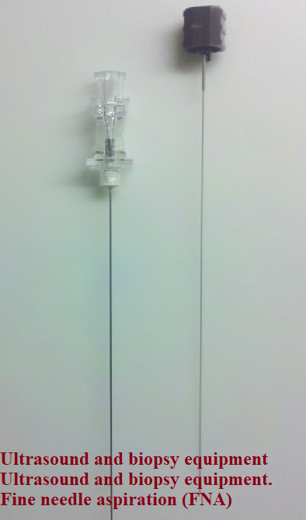
- Fine needle biopsy (TIB-FNA) under ultrasound control - has no contraindications, it is performed on an outpatient basis without anesthesia. Allows you to determine the nature of the process (malignancy or benignity) and the histological affiliation of the tumor.
Indications:
-the presence of a node in the thyroid gland,
multiple nodes, when the good quality of the process is in doubt,
- autoimmune thyroiditis,
-the presence of metastatic nodes on the neck,
- inoperable forms of thyroid cancer for process verification,
- relapses of goiter, adenomas, malignant tumors.

Slide 9
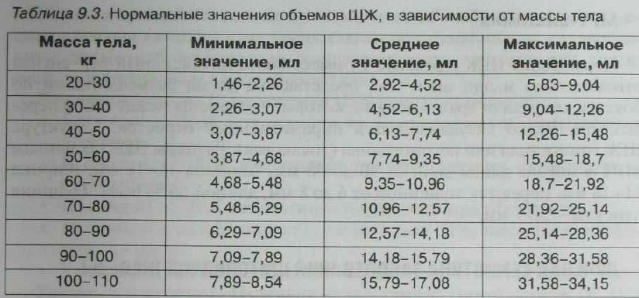
The normal thyroid gland has a uniform appearance, the capsule may appear as a thin hyperechoic line.
Each share is usuallylength:
4-7 cmdepth:
<2 cmisthmuses
<0.5 cm deepvolume (excluding the isthmus if it is> 3 mm thick)
10-15 ml for women
12-18 ml for men

Slide 10
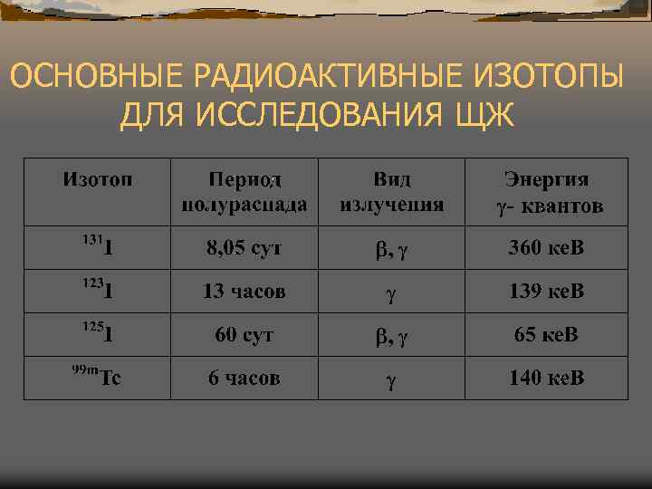
In vivo radionuclide studies
Determination of the iodine storage capacity of the thyroid gland (¹²³I, ¹³¹I).
Test-grip with ⁹⁹mТс
-pertechnetateScanning and scintigraphy.
The RFPs used are divided into 2 groups. :
-organotropic (Na ¹²³I, Na ¹³¹I and ⁹⁹mТс);
-tumorotropic (TlCl, ⁹⁹mТс -MIBI (detoxyisobutylisonitrile), ⁹⁹mТс -DMCA,
In-DTPA-octreotide, F-FDG (fluorodeoxyglucose).

Slide 11
Determination of iodine storage capacity of the thyroid gland
Method principle
Based on the registration of the dynamics of the accumulation of iodine radionuclides by the functioning tissue of the thyroid gland according to a certain time program.
RFP
¹²³I, ¹³¹I. More often ¹²³I T1 / 2 - 13.3 hours, pure γ-emitter.
Indications:
Assessment of the functional state of the thyroid gland function (euthyroidism, hyperthyroidism, hypothyroidism) in the case of thyroid pathology and in cases of diseases of other organs and endocrine disorders.
Contraindications
Pregnancy, lactation, childhood, severe liver and kidney damage.
Preparation for research.
Avoiding medication, food, procedures that can lead to a blockage of the thyroid gland or a change in its function. These include:
1.taking iodine-containing preparations and food with a high iodine content, Lugol's solution, iodized salt, seaweed, skin treatment with iodine tincture)
2.conducting X-ray studies using iodine-containing contrast agents (iodolinol, sergozin, bilitrast, etc.)
3. taking bromine-containing drugs (medicine of Bekhterev, Pavlov, Charcot, etc.)
4.taking hormonal drugs (thyroid hormones, hormones of the pituitary gland, gonads, adrenal glands)
5.reception of thyreostatics (potassium perchloride, methylthiourocyl.mercazolil, etc.)
The study is possible in 1-2 months after the withdrawal of iodine- or bromine-containing drugs.

Slide 12
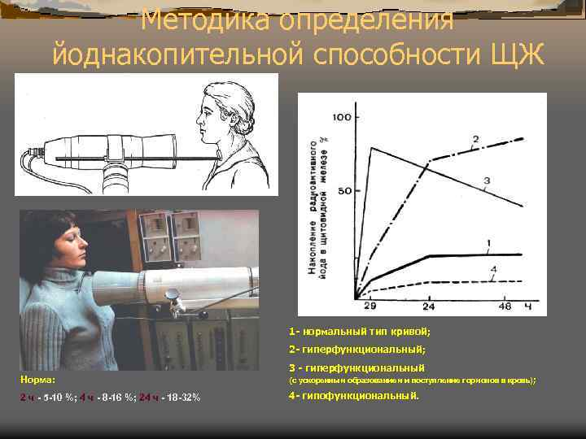

Slide 13
Test grip with ⁹⁹mТс-pertechnetate
The principle of the technique.
Based on the similarity in the accumulation of the thyroid gland of iodine and pertechnetate ions. At an early stage of its presence in the body, ⁹⁹mTc-pertechnetate is absorbed by thyroid cells in the same way as iodide, and participates in the inorganic phase of iodine metabolism. It does not take part in the organic phase and the synthesis of thyroid hormones and reflects the blood supply of the thyroid gland and the permeability of cell membranes.
Indications
Hyperthyroidism, recurrence of goiter after surgery.
Evaluation of results
Normally, the accumulation of ⁹⁹mTc-pertechnetate in the thyroid gland is up to 6%. With hyperthyroidism, it is significantly higher than 6%. In hypothyroidism, this test is not very informative.

Slide 14
Scanning and scintigraphy of the thyroid gland.
Method principle
is based on the registration of γ-radiation of thyrotropic RFP in the form of a line or digital line-by-line image during scanning or scintigraphic - on a gamma camera. The density of shading and scintillation flares is in direct proportion to the degree of RFP accumulation.
RFP
sodium iodide (131J) or 99mTc-pertechnetate.
Indications:
1.determination of the anatomical and topographic features of the thyroid gland (shape, size, contours)
2. identification of ectopically located elements of the thyroid parenchyma (subligual, behind the breastbone, etc.);
3. study of its relationship with surrounding tissues;
4. determination of the presence of nodes and their differentiation;
5.diagnostics of malignant tumors and the extent of their spread (presence of metastases)
6.dynamic monitoring of the pathological process and the effectiveness of the therapy
7. timely detection of goiter recurrence after treatment.

Slide 15
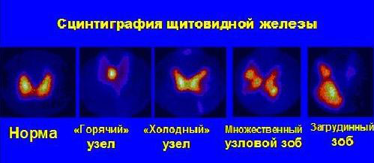
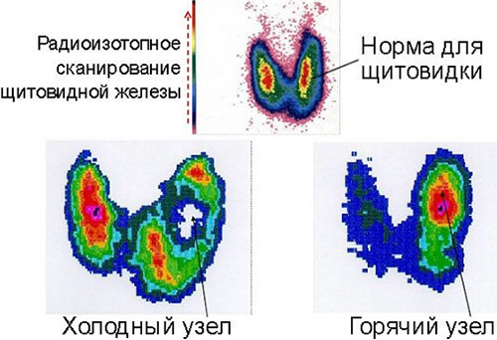

Slide 16
RADIONUCLIDE METHODS IN VITRO
presented by radioimmunological analysis of the organic phase of the immune metabolism of iodine, the main indicator of which is the assessment of the synthesis of thyroid hormone.
It is the level of thyroid hormones in the blood, the violation of hormonal homeostasis that determines its functional status as eu-, hypo- or hyperthyroidism.Iodine is the main element in the synthesis of thyroid homones, it comes in an inorganic form from the outside (alimentary).
The amount of assimilated iodine depends on the functional state of the thyroid gland, in which thyrocytes convert iodide into atomic iodine with its subsequent incorporation into the molecules of monoiodotyrosine (MIT) and diiodotyrosine (DYT).
Under the influence of the enzyme peroxidase, they condense into triiodotyrosine (T3) and thyroxine (T4).
T4 is synthesized 20 times more than T3. But the activity of T3 is 3-5 times higher than that of T4.
T3 and T4 can enter the peripheral blood only by contacting a special transport protein of the globulin series, thyroglobulin, produced by thyrocytes of the thyroid gland.When released into the blood, T3 and T4 are cleaved from thyrocytes under the influence of proteases and peptidases, but immediately combine with transport blood proteins - up to 80% with thyroxine-binding globulin, together with which they are delivered to the tissues.

Slide 17
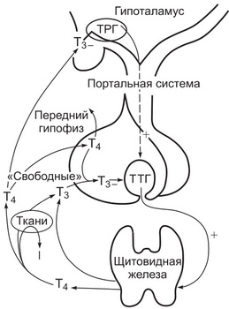
Only a small part of unbound T3 and T4 circulate in the blood, but they are the most active and significant in metabolic processes. The influence of the central nervous system in the regulation of thyroid function is carried out through the hypothalamus, where the releasing factor is produced. This substance, passing through the portal vein and the pituitary gland, determines the level of synthesis of tropic hormones (primarily TSH), which in turn is a regulator of the production of T3 and T4 in the gland itself.
Thus, there is a clear feedback: the release factor is TSH-T3 and T4.A decrease in the production of T3 and T4 leads to an increase in TSH, and an increase in the level of T3 and T; leads to a decrease in the synthesis of TSH.

Slide 18
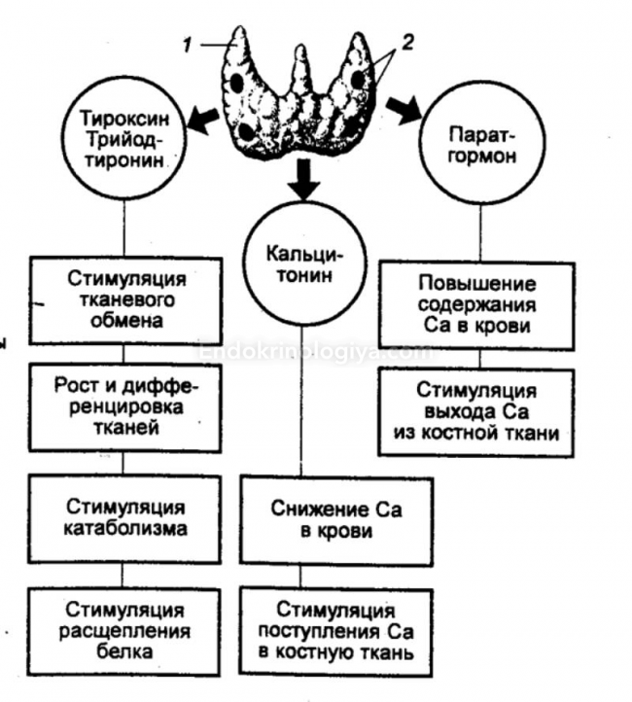
Thyroid hormones play a leading role in the development and regulation of the central nervous system, CVS, immune system, digestion, in the formation and development of the fetus, especially the differentiation of the bone and muscular system.
All the complexity of the function of the thyroid gland, depending on possible deviations from the norm, makes it possible to evaluate the radioimmunological method:
-thyroid hormones (total thyroxine with T4, free thyroxin T4, T3, thyroglobulin (TG);
hormone of the anterior pituitary gland - thyroid stimulating hormone (TSH);
- antithyroid antibodies - to thyroglobulin (ATTG), to the microsomal fraction (ATMS);
-transport proteins - thyroxine-binding globulin (TSH).

Slide 19
Normal levels of T3 and T4 in an adult. The content of T4 is 75-140 nmol / L (free T4 10-25 nmol / L), T3 -1.4-2.8 nmol / L (free T3-2.5-5.8 nmol / L).
Increasing the level of T3 and T4:
- with thyrotoxicosis;-adenoma of the thyroid gland;
- myeloma;
- taking contraceptives;-pregnancy.
Decrease in the level of T3 and T4:
with thyroiditis;
deficiency of alimentary iodine;impaired absorption from the intestine;thyroidectomy;
nephrotic syndrome;
liver diseases;
taking medications (thyreostatics, glucocorticolides, salicylates, antibiotics, sulfonamides).

Slide 20
Normally, the level of thyroglobulin (TG) in an adult is up to 50 ng / ml. It is of the greatest importance for the diagnosis and monitoring of the effectiveness of treatment for differentiated thyroid cancer. With undifferentiated carcinoma, its concentration may not change. There is a direct connection between the level of TG and the presence of metastases of thyroid cancer: its concentration increases.
The hormone of the anterior lobe of the pituitary gland is thyroid-stimulating hormone (TSH) - at a rate of 0.3-3.5 IU / L. The definition of its level is used in the definition of hypo and hyper. Reducing it entails an increase in the size of the thyroid gland.
Antithyroid antibodies grow during autoimmune processes against thyrocyte receptors and other selective structures.
They are strictly specific.Distinguish:- antibodies to the microsomal fraction - AtMS (Hashimoto's disease, hypothyroidism, thyroid cancer, pernicious anemia, collagenosis),- antibodies to thyroglobulin - ATTG (hypothyroid state, normally 0-60 IU / ml),- antibodies to TSH (normally up to 20 IU / ml), antibodies to T3 and T4.
Calcitonin is a peptide hormone produced by thyroid cells. Normally, its content is 5.5-28 pmol \ l. Relevant for the diagnosis of thyroid cancer and a comprehensive assessment of Ca-exchange (together with parathyroid hormone and vitamin D3)

Slide 21

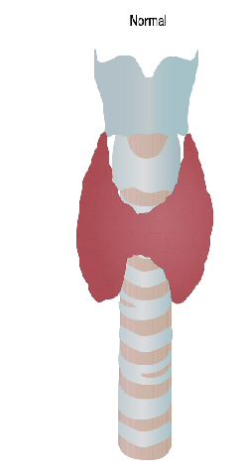
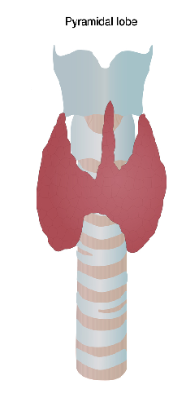
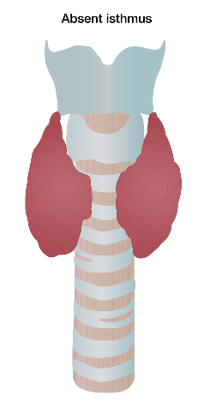
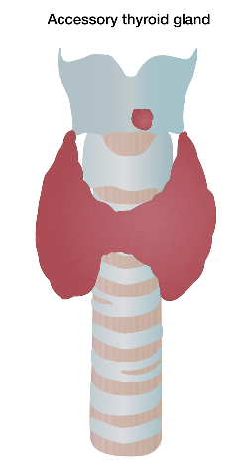
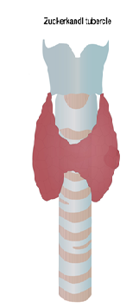
Thyroid anatomy
The thyroid gland is an endocrine organ located superficially under the skin and superficial neck muscle at the C5 - T1 level, completely covered by the superficial and pretracheal plates of the cervical fascia.
It covers the front and sides of the lower parts of the pharynx (laryngeal part), the initial part of the esophagus, the upper part of the trachea and the anterior semicircle of the common carotid artery.
The thyroid gland is an unpaired organ, most often consisting of two lobes and an isthmus.
The most common construction options are shown in the illustrations.
The parathyroid glands lie posteriorly and sometimes intracapsularly.
Trabeculae depart from the capsule, dividing the tissue of the gland into lobules, consisting of follicles.

Slide 22
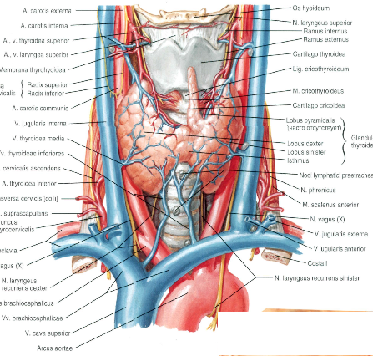

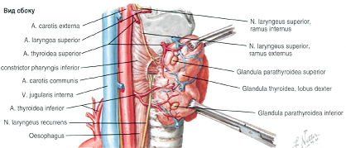
Blood supply
arterial nutritionsuperior
thyroid artery (from the external carotid artery)
lower thyroid artery (from the thyrocervical trunk)
The inferior thyroid artery (accessory, is not always found)
departs from the subclavian artery.
venous drainagesuperior
thyroid vein (flows into the internal jugular vein)
middle thyroid vein (flows into the internal jugular vein)
inferior thyroid vein (flows through the plexus into the brachiocephalic veins)

Slide 23
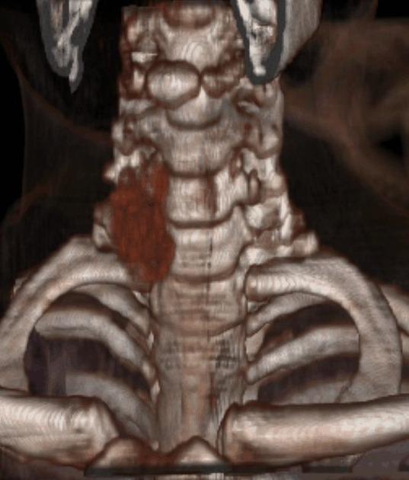
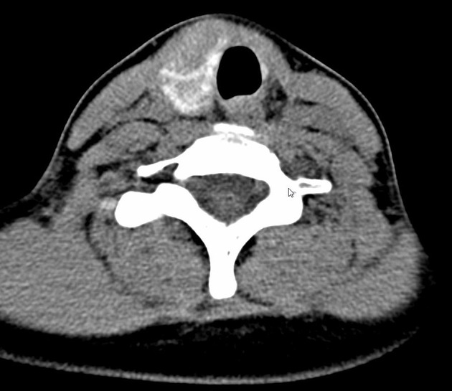
ANOMALIES OF DEVELOPMENT
Agenesis and hypoplasia are rare. Aplasia due to a violation of the differentiation of the embryonic rudiment of the gland into mature tissue, hypoplasia is caused by iodine deficiency in the body of a pregnant woman.Signs of pathology is a volumetric decrease or absence of the gland or its lobe.Clinically, the child develops cretinism.
Agenesis of the left lobe of the thyroid gland. The isthmus is absent.

Slide 24
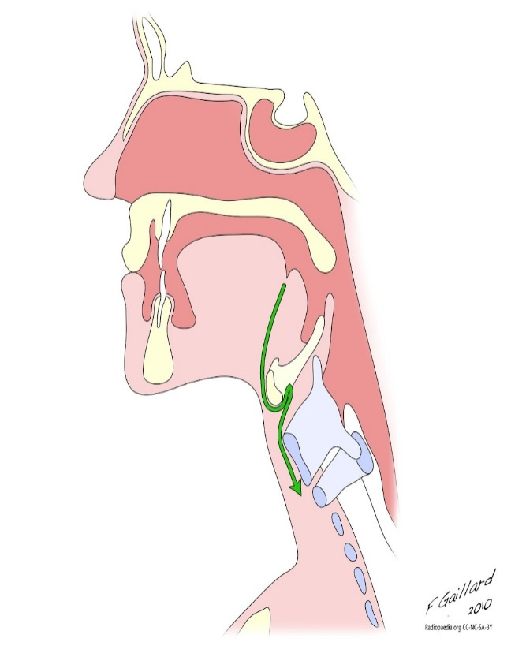

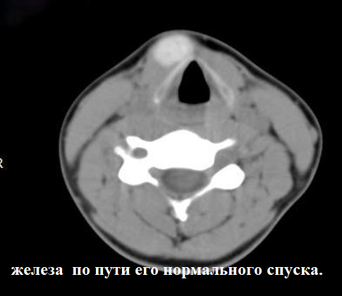
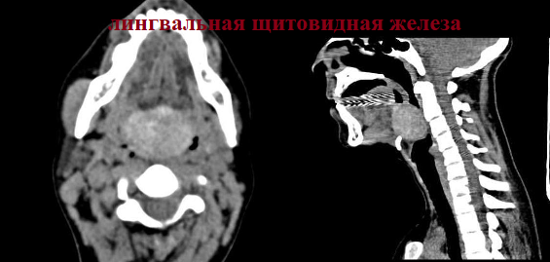
Ectopia of the thyroid gland
Dystopia of the thyroid gland or its lobules can be observed along the tract of its migration.An atypical position can occur when the position of the rudiment of the gland is deviated, shifting into the wall of the trachea, pharynx, myocardium, pericardium, and soft tissues of the neck.
Ultrasound is only used to show missing thyroid tissue in a normal position, which is the case in most cases. Rarely, patients have thyroid tissue both at the base of the tongue and elsewhere in the neck.
Путь миграции щитовидной железы

Slide 25
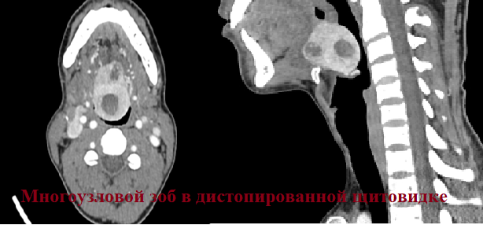
Dystopia of the thyroid gland
Dystopic gland can become a source of tumor or cyst development.
Lingual thyroids (located at the base of the tongue) make up 90% of the ectopic thyroid glands.Most cases show an absence of thyroid tissue in its normal anatomical position.Can be clinically asymptomatic, but in some cases can cause bleeding from mucosal ulcers, dysphagia, hoarseness, shortness of breath, or even airway obstruction (most often in infants).

Slide 26
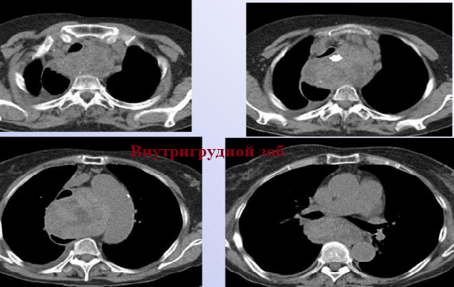
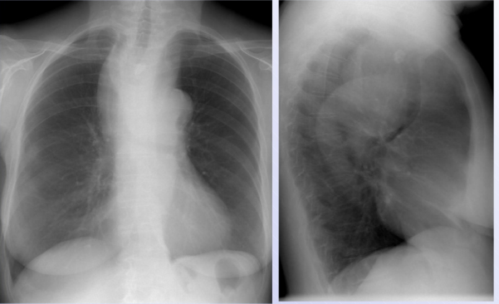
The displacement of the primordium of the gland is the reason for the placement of the thyroid gland into the mediastinum. There are the following types of goiter:
diving goiter (most of it is located retrosternal, the smaller part is located on the neck);
2) retrosternal goiter (completely retrosternal location, with the Valsalva maneuver - you can palpate its upper part);
3) intrathoracic goiter (completely retrosternal position, with the Valsalva maneuver - cannot be palpated)

Slide 27
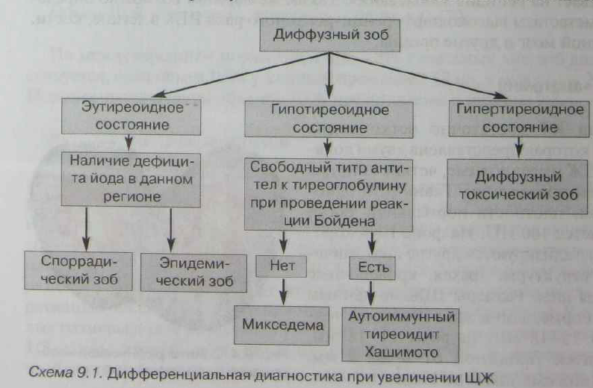
Pathological changes in the thyroid gland can be diffuse or focal, which in turn are divided into single or multiple.

Slide 28

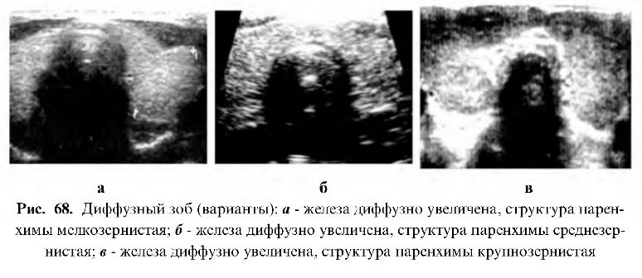
An enlarged thyroid gland is called a goiter.
Endemic goiter is one of the most common diseases of the thyroid gland.
It usually occurs in residents of areas with a low iodine content.
Outside endemic zones, the episodic occurrence of this disease in individual patients is due to impaired absorption of iodine from the intestine.
Distinguish between diffuse and nodular and mixed forms of endemic goiter.

Slide 29
Inflammatory Conditions: Thyroiditis
The term "thyroiditis" includes diseases of the thyroid gland, differing in etiology, pathogenesis, an essential component of which is inflammation. With different pathogenesis, diseases have clinically similar symptoms, which in some cases complicates differential diagnosis.
Classification:
For practitioners, it is more expedient to use a classification that takes into account the peculiarities of pathogenesis and clinical course, proposed by
Herrman in 1980:
1.Acute thyroiditis (diffuse or focal):
- acute purulent;
- acute non-purulent
2.subacute thyroiditis
- diffuse;
- focal;
3.chronic thyroiditis:
autoimmune thyroiditis (atrophic form);
fibro-invasive (ridel)specific thyroiditis (tuberculous, syphilitic, septicomycotic).

Slide 30
Thyroid formation is the most common in radiological practice.
hyperplastic / colloidal node / nodular hyperplasia:
85%adenomafollicular:
5%others: rarecarcinomapapillary:
60-80% carcinomafollicular:
10-20%medullary:
5%anaplastic:
1-2%thyroid lymphoma:
1%thyroid metastases:
1%othersfatty lesions of the thyroid glandthyroid adenolipomathyroid liposarcoma
Risk factors for malignancy
Young age
Male gender
Solitary node
With a history of thyroid radiation therapy.
The first three risk factors reflect the fact that in older women with multiple thyroid nodules, these nodules are very often benign.

Slide 31
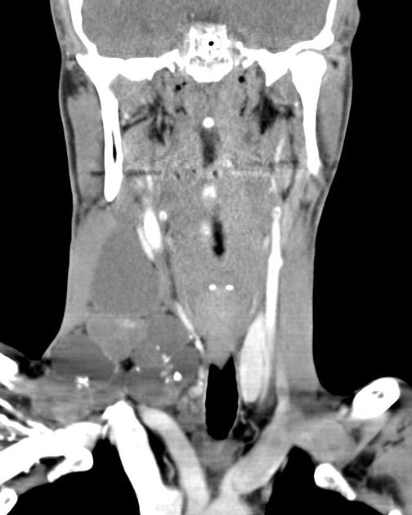
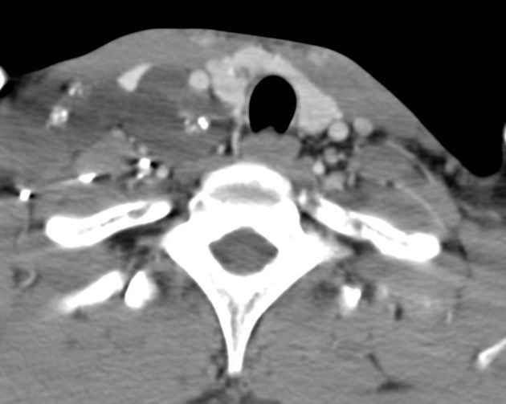
papillary carcinoma

Slide 32
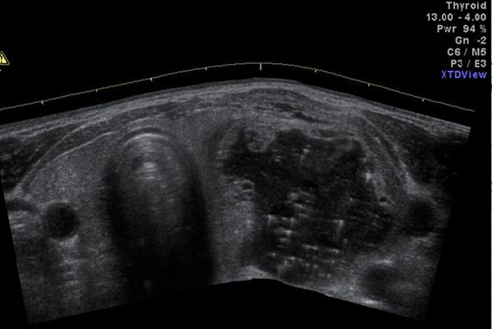
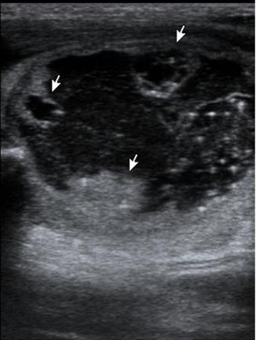
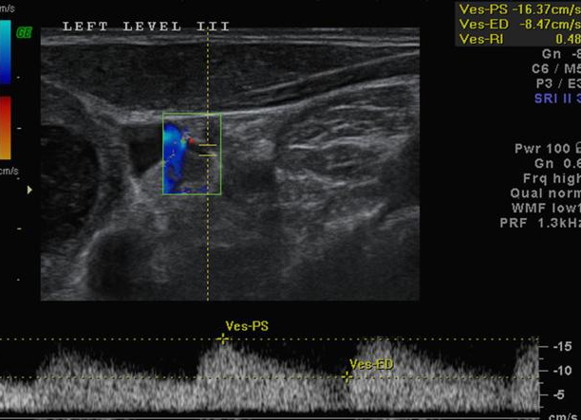
On the left is a hyperplastic node in the left lobe of the thyroid gland with extensive degeneration leading to a cystic lesion, with a thick wall, with intracystic residual tissue in the form of dense walls and cystic avascular nodules.
The cystic node has several bright lesions with artifacts (comet tail), probably due to the presence of microcrystals in the classic form of a colloidal node. Doppler analysis gave a favorable picture, suggesting benignity. Histopathology reveals reactive lymphadenopathy

Slide 33
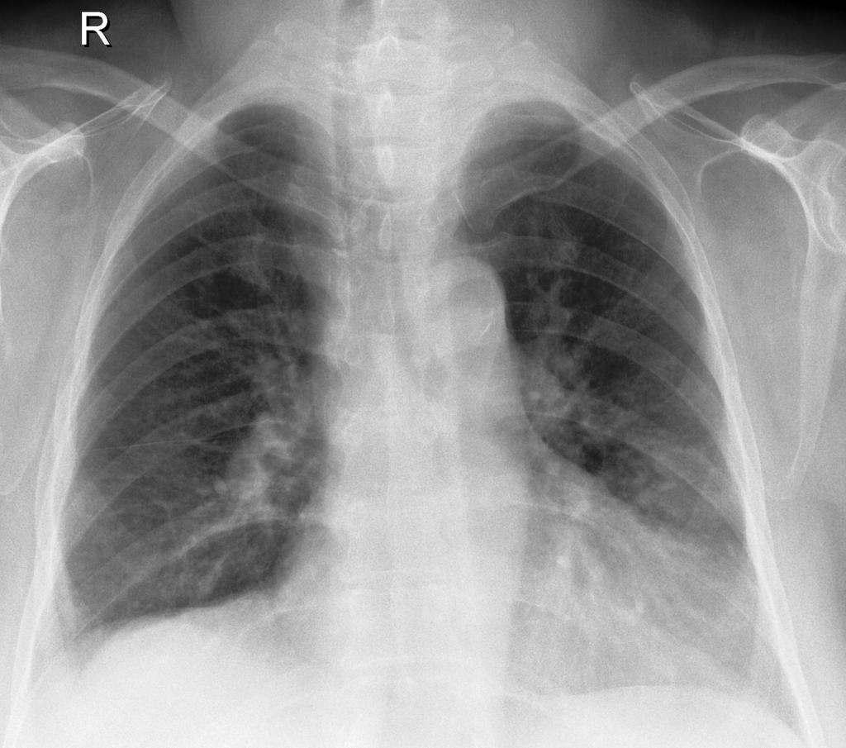
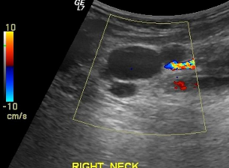
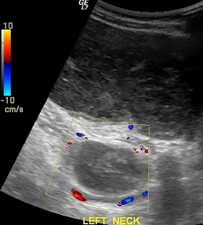
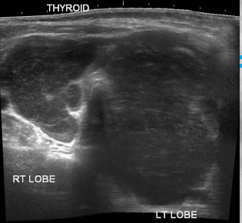
Ultrasonography shows an enlarged thyroid gland, which is largely replaced by heterogeneous masses with pronounced hypoechoicity.
No noticeable vascularization or calcification was observed. Several hypoechoic lymph nodes are visible.

Slide 34
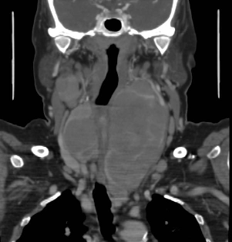
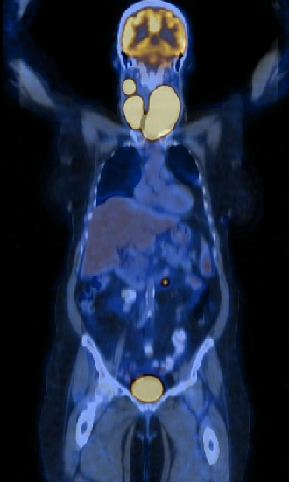
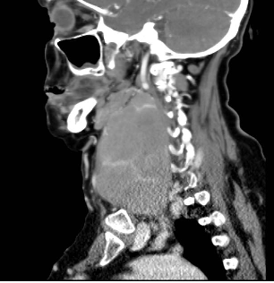
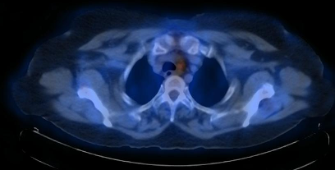
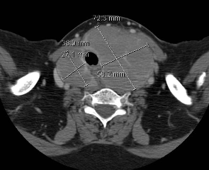
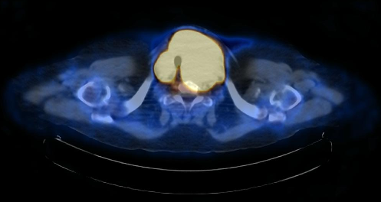
On CT with contrast in the venous phase, the septa accumulate contrast, and the gland itself loses its density.
On PET CT - a single lesion of the abdominal cavity

Slide 35
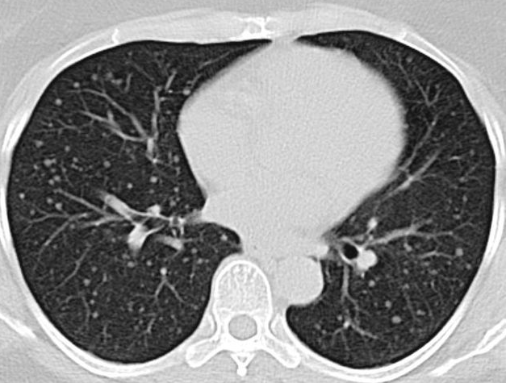
The patient has a history of a malignant tumor of the thyroid gland, surgically removed, followed by radiation therapy with radioactive iodine.
Note multiple lung metastases.

Slide 36
American Thyroid Association (ATA)
The American Thyroid Association (ATA) guidelines for the evaluation of thyroid nodules on ultrasound are aimed at improving consistency in the interpretation of results and facilitating communication with endocrinologists.
https://radiopaedia.org/articles/ata-guidelines-for-assessment-of-thyroid-nodules
The 2015 Basic Principles emphasize the importance of a sonographic picture of a node in determining the likelihood of developing a malignant transformation. This, as well as the size of the nodule, are the two main criteria for FNA.
Initial assessment
should receive serum thyrotropin (TSH)
if TSH is below normal limits, thyroid scintigraphy should be performed
if a focal induration is incidentally detected in a thyroid nodule> 1 cm, then FNA is mandatory.
if the nodule is <1 cm, then it should be monitored similarly to a sub-centimeter thyroid nodule with a high-level ultrasound pattern.
if the thyroid shows diffuse uptake consistent with chronic lymphocytic thyroiditis, further imaging or FNA does not guarantee reliable monitoring.

Slide 37
Sonographic pattern
All detected nodes on ultrasound can be divided into 5 categories:
Significant no risk (0%): biopsy not indicated;
2) Very low risk of malignancy (3%):
a biopsy is performed at a size ≥ 2 cm (ultrasound dynamic control is possible);
Low risk of malignancy (5-10%): biopsy is performed at size ≥ 1.5 cm;4) Intermediate risk of malignancy (10-20%):
biopsy is performed at ≥1.0 cm5)
High probability of malignancy (≥ 70-90%): biopsy is performed at ≥ 1.0 cm

Slide 38
Sonographic pattern radiological presentation
The reliably benign group (0%) includes: completely cystic nodules with well-defined uniform walls.
To the very low risk group (3%): spongy nodes and nodes with cystic dissemination, without any other more suspicious signs.
3) The group with a low probability of malignancy (risk 5-10%) includes several options for radiological presentation: - isoechoic or hyperechoic node;- cystic node with peripheral dense edges, in which there is nonone of the following:
microcalcifications (see other points below),
B) irregular zones,
C) extrathyroidal spread,
D) the predominance of height over width.

Slide 39
  4) The group with an average risk of malignancy (10-20%) includes a dense knot with a smooth (tender) edge, in which none of the following signs are present: A) microcalcifications (see other points below),
  B) irregular zones,
  C) extrathyroidal spread,
  D) the predominance of height over width
  5) The group with a high probability of malignancy (≥70-90%) includes a dense hypoechoic nodule (or a cystic nodule within which there is a dense component) with at least one of the following signs:
  A) microcalcifications (see other points below),
  B) irregular zones,
  C) extrathyroidal spread,
  D) the predominance of height over width,
  E) lymphadenopathy,
  G) fuzzy contour of a knot with sprouting (extrusion) into adjacent tissues. Other items
  Dystrophic calcifications (for example, gross macrocalcification, capsule hardening), in contrast to microcalcifications, increase the risk, but to a lesser extent than microcalcifications;
  An overview of the cervical lymph nodes should be performed on all ultrasound examinations of the neck

Slide 40


