Slide 1
RADIATION DIAGNOSTICS OF EMERGENCY CONDITIONS
Odesa
Doikova K.M.
Assistant of the Department of Radiation Diagnostics, Therapy and Radiation Medicine and Oncologe ONMedU.

Slide 2
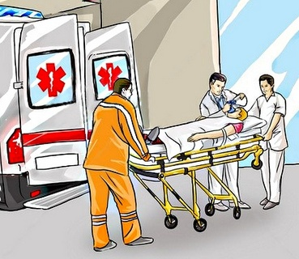
It is customary to call emergencies such pathological changes in the human body that lead to a sharp deterioration in health, can threaten life and, therefore, require emergency treatment.

Slide 3
Features of emergency radiation research
90-95% of victims need urgent radiological diagnostic examination. In the case of traumatic injury, depending on the location and nature of the injury, in 30-90% of cases, it is necessary to perform a control study immediately after the provision of emergency medical care, or in the process of surgical interventions in order to determine their effectiveness and completeness.
It is important not only to identify complications arising in the area of ​​damage, but also to early diagnosis of pulmonary complications, which often develop in severe head, chest and abdominal injuries, extensive burns, temporary cardiac arrest, etc.
Contraindications to urgent radiation examination are extremely limited and are relative: - the presence of profuse internal or external bleeding, requiring immediate surgical intervention; - a sharp violation of the vital functions of the body; - severe movement disorders;
Emergency radiation examinations should be performed at any time of the day
Each doctor on duty in a medical facility and providing emergency medical care must clearly know the indications and contraindications for emergency radiation examination and determine its volume.
An urgent X-ray examination, depending on the nature of the disease, the general condition of the victim, can be carried out in the ICU or operating room.
Emergency X-ray examination should be carried out sparingly and as quickly as possible.

Slide 4
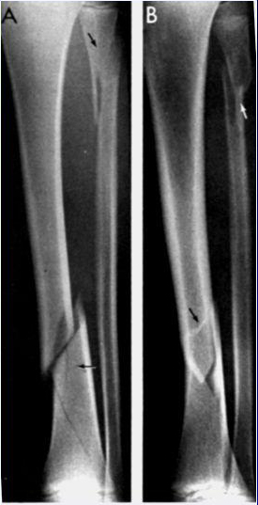
Multiple trauma
Upon admission to a hospital, the consciousness of patients with multiple injuries is often confused or absent, they can be intubated. And only a clinical examination is not able to exclude serious traumatic injuries.
In such a situation, the doctor should focus not only on complaints and examination results, but also on knowledge about the mechanism of injury.
According to the recommendations "Modern methods and approaches in the treatment of patients with severe trauma" (ATLS; Bell et al., 1999), the following radiation methods are routine for the initial assessment of the patient's condition after a serious injury or with loss of consciousness:
Anteroposterior radiography of the OGC - to identify life-threatening injuries that require immediate treatment (tension pneumothorax, massive hemothorax, chest flotation) or further examination (mediastinal dilatation, suspicion of damage to a large vessel).
Anteroposterior pelvic radiography.
Abdominal ultrasound to quickly detect free intraperitoneal fluid, indicating abdominal bleeding.

Slide 5
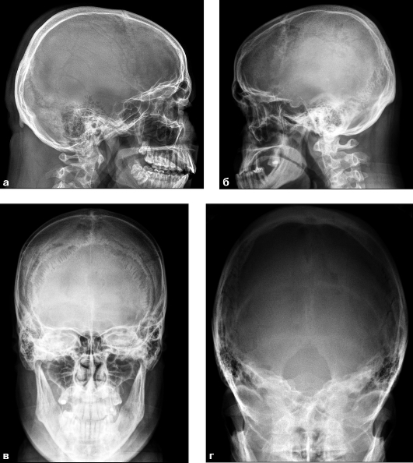
Radiation diagnosis of emergency conditions for diseases and injuries of the skull and brain.
X-ray examination begins with taking pictures of the skull in two mutually perpendicular planes - straight and lateral.
X-ray of the skull in direct projection carries general information about the state of the bones of the vault, their internal relief and cranial sutures.
When studying a craniogram in a lateral projection, one should pay attention primarily to the thickness and structure of the bones of the fornix, furrows of the branches of the meningeal arteries and venous sinuses.

Slide 6
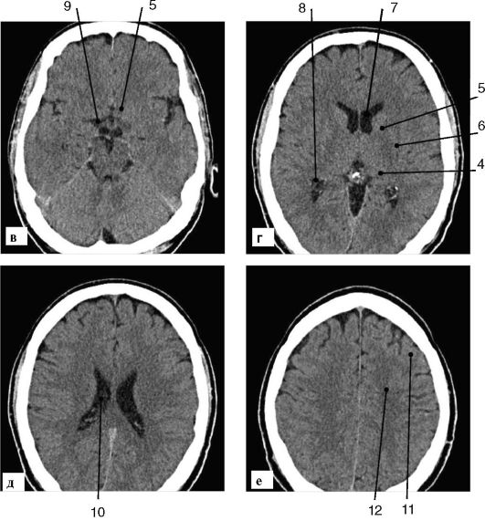
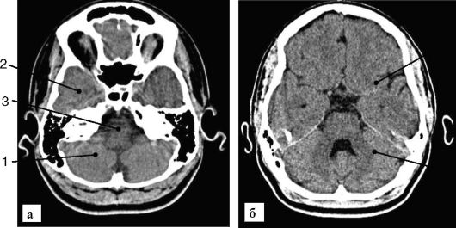
Possibilities of CT in the study of the brain:
Bones, soft tissues and pathological changes in them are depicted.
2. Differentiated gray and white matter, cerebrospinal fluid spaces.
3. Most of the pathological formations in the brain are visualized.
Disadvantages of CT: bone artifacts limit the detection of focal changes in the posterior cranial fossa and in the basal parts of the brain, difficulties in visualizing fresh ischemic changes

Slide 7
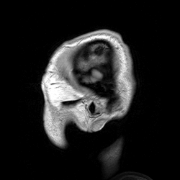
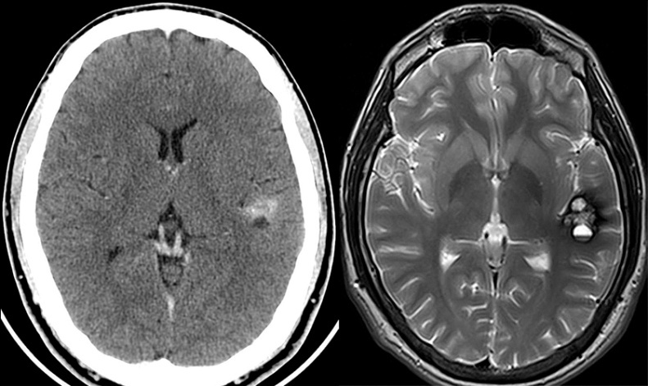
MRI capabilities:
1. Provides better than CT, contrast between intracranial pathological formations and brain tissue.
2. Obtaining an image in any planes.
3. Absence of bone artifacts.
4. Visualization of vessels: MRI - angiography without contrasting vessels of the neck and vessels of the base of the brain
Disadvantages of MRI: it is inferior to CT in visualization of changes in the bones of the skull, intracranial calcifications and fresh blood, MRI is contraindicated in the presence of metal objects (magnetic materials), in childhood, and in the serious condition of the patient.

Slide 8
The Glasgow Coma Scale (GCS) is a scale for assessing the depth of coma in adults and children over 4 years of age.
Severity of traumatic brain injury
3-8 points - severe traumatic brain injury,
9-12 points - moderate traumatic brain injury,
13-15 points - slight traumatic brain injury
Interpretation of results
15 points - clear consciousness.
14 points - light stun.
13 points - moderate stun.
12 points - deep stun.
11-9 points - stupor.
8-7 points - moderate coma.
6-5 points - deep coma.
4-3 points - transcendental coma, brain death

Slide 9
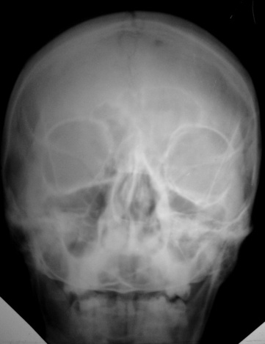
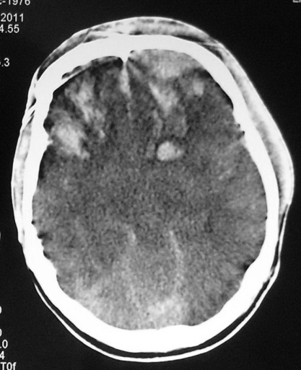
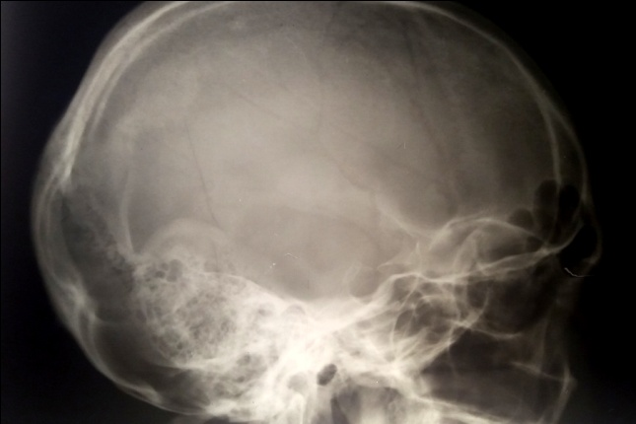
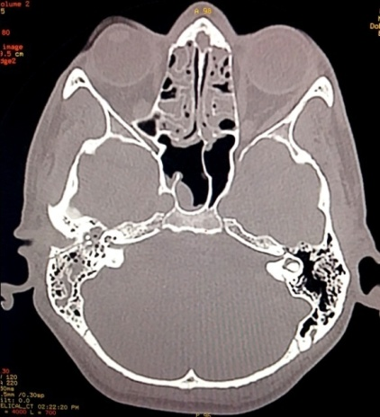
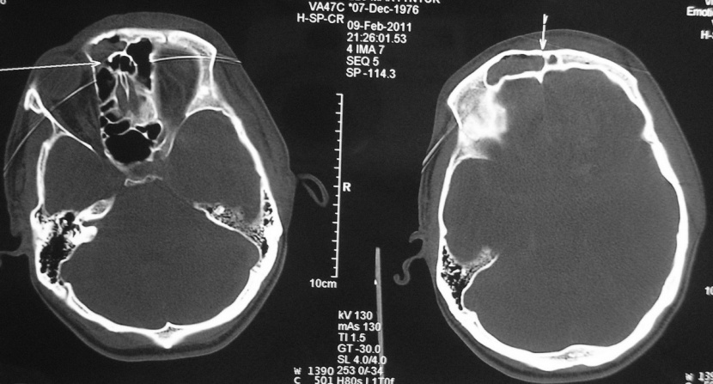
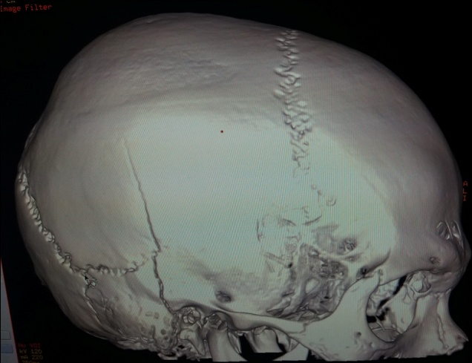
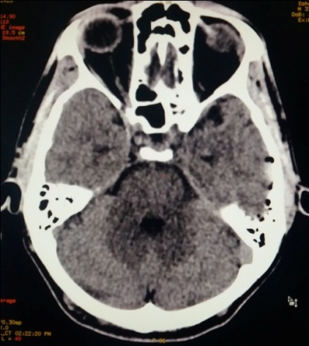
Radiation diagnosis of emergency conditions in traumatic injuries of the skull and brain.
Skull X-ray is no longer the recommended test for routine assessment of TBI.
Studies have shown that the course and outcome of head and brain trauma hardly correlates with X-ray data of the skull, since only skull injuries do not yet indicate severe brain injury.
CT is considered the recognized method of choice for the initial assessment of head injuries.
Linear fracture of the frontal bone with partial divergence of the sagittal suture, fracture of the anterior and posterior walls of the frontal sinus. Hemosinus.
Multiple brain contusions in the right and left frontal lobes
Linear fracture of the right temporal bone with the transition to the pyramid, clivus and left temporal bone. Subdural hematoma, pneumocephalus on the left

Slide 10
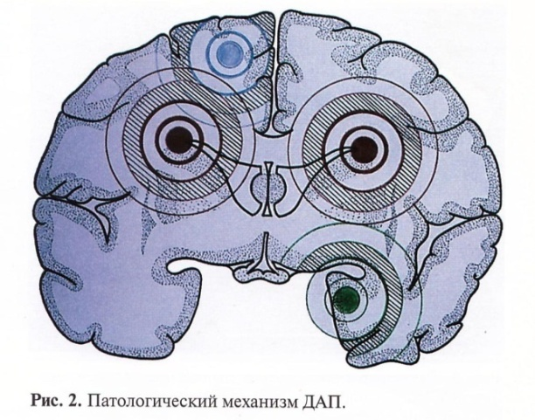
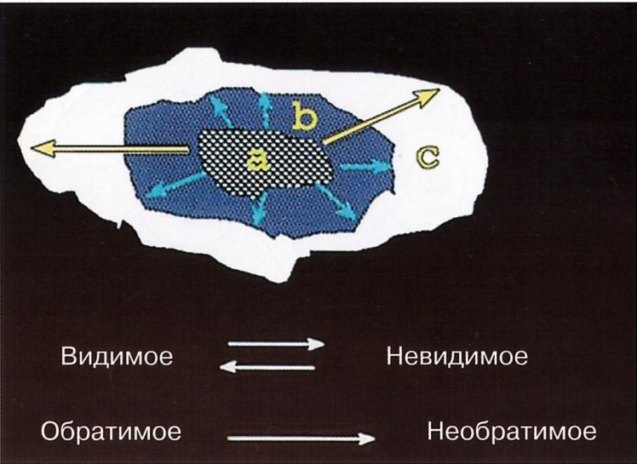
Traumatic brain injury.
According to the WHO, traumatic brain injury is not decreasing, but increasing by an average of 2% per year.
For the correct interpretation of images in case of brain damage, knowledge of the biomechanical and pathological changes in its substance due to trauma is required. Traumatic forces can be translational (causing a linear shift of the brain), rotational and angular
At the moment of injury, the epicenter of irreversible primary damage occurs, where ruptures of the parenchyma, supporting structures and blood vessels of the brain occur. The most vulnerable structure is the axon, and the most stable are the vessels.
A focal lesion at the epicenter is surrounded by an area of ​​lesser but also irreversible damage that is not visible to the naked eye, but microscopically resembles a diffuse damage known as diffuse axonal damage.
a - epicenter,
b - irreversibly damaged tissue
c - penumbra
The visible is the invisible;
Reversible - irreversible.

Slide 11
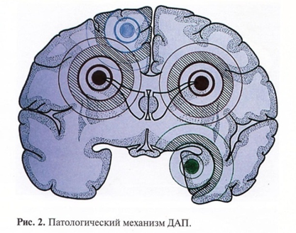
The second type of injury (primarily reversible), occurring at the time of injury, also spreads from the epicenter to the periphery. This is a traumatic (ischemic) penumbra.
These changes represent the zones of "least resistance" to various favorable and unfavorable secondary factors that arise in the post-traumatic period and lead to the transformation of visible changes into invisible and reversible into irreversible ones. Therefore, re-imaging may reveal changes that are not visible on the initial examination.

Slide 12
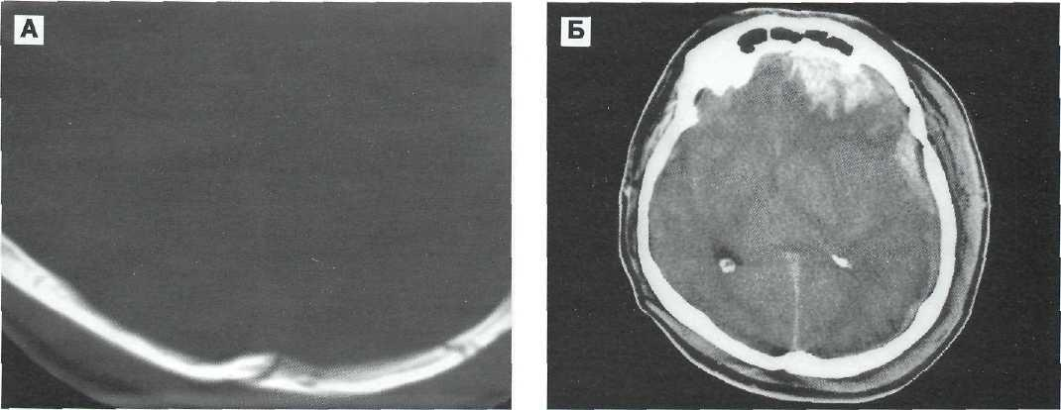
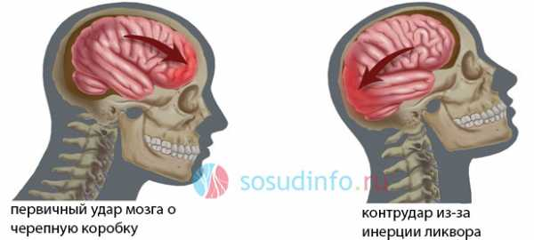
Traumatic brain injury
A detailed clinical classification of traumatic brain injury, developed on the basis of the experience of the N.N. N.N. Burdenko and based on a comprehensive account of its biomechanics, type, type, character, shape, severity of damage, etc.
According to biomechanics, TBI is distinguished:
1) shockproof
(shock wave propagating from the place of application of the traumatic agent to the head through the brain to the opposite pole with rapid pressure drops in the places of impact and counter-impact); shock-resistant bruises occur in the area directly opposite the impact zone. Most often found at the poles of the frontal and temporal lobes.
Shock-resistant mechanism of the formation of a contusion focus in the left frontal lobe in combination with subdural hematoma with a fracture of the occipital scales.
CT. A - bone regimen. Multiple fractures of the occipital scales are visible.
B — tissue mode. A large crush site and a subdural hematoma on the left are visible.
Primary impact of the brain on the cranium
Contrudar due to cerebrospinal fluid innervation

Slide 13
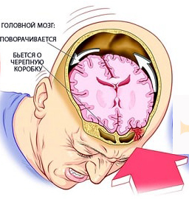
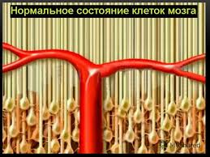
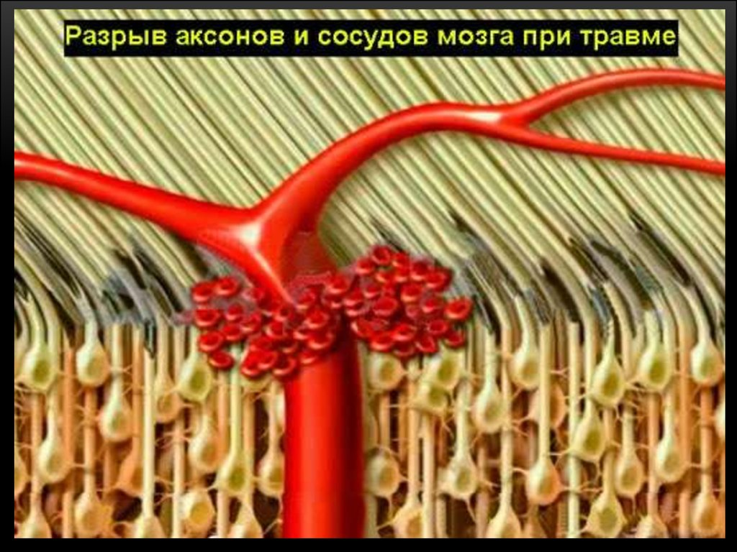
Traumatic brain injury.
2) acceleration-deceleration (movement and rotation of massive cerebral hemispheres relative to a more fixed brain stem); collision of the head with a traumatic object does not occur, and if it is observed, then it has no dominant significance.
Most often, this type of impact is observed during an accident (for example, with an injury inside the cabin, when the head is sharply displaced forward and then sharply back).
The main morphological type of damage in such an injury is diffuse axonal injury (DAP) of the brain.
3) combined (when both mechanisms act simultaneously).
In case of injury, the brain turns, beats against the skull
The normal state of brain neurons
Rupture of axons and blood vessels of the brain in case of injury

Slide 14
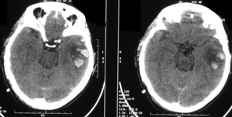
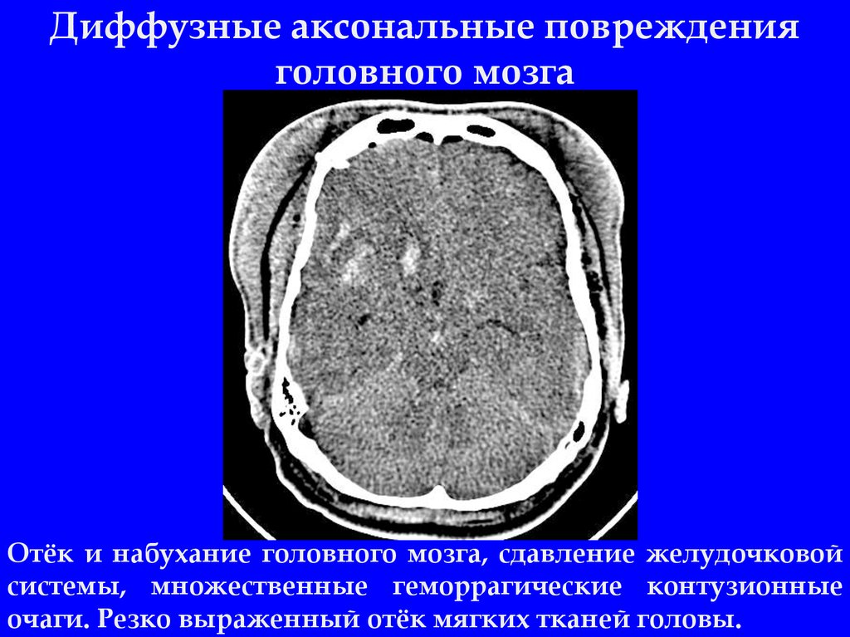
By the type of damage:
1) focal, mainly due to shock and shock injury (characterized by local macrostructural damage to the medulla
varying degrees, including areas of destruction with the formation of detritus, hemorrhagic
impregnation of brain tissue, punctate, small and large-focal hemorrhages - in the place of shock-counterblow, along the course of the shock wave);
2) diffuse, mainly caused by trauma, acceleration-deceleration (characterized by transient asynapsia, tension and widespread primary and secondary ruptures of axons in the semi-oval center, subcortical formations, the corpus callosum, the brain stem, as well as punctate and small focal hemorrhages in the same structures);
3) combined, when there are simultaneously focal and diffuse damage to the head
brain.
Diffuse axonal brain damage.
CT scan of the brain. Axial slice. Hemorrhagic contusion of the left temporal lobe of the brain.
Edema and swelling of the brain, compression of the ventricular system, multiple hemorrhagic contusion foci. pronounced swelling of the soft tissues of the head.

Slide 15
By genesis, brain lesions are differentiated in TBI:
1) primary lesions - focal bruises and crush injuries of the brain, diffuse axonal injuries, primary intracranial hematomas, ruptures of the trunk, multiple intracerebral hemorrhages;
2) secondary lesions:
a) due to secondary intracranial factors: delayed hematomas (epidural, subdural, intracerebral), disorders of hemo- and liquor circulation as a result of subarachnoid or intraventricular hemorrhage, an increase in brain volume or its swelling due to edema, hyperemia or venous congestion, intracranial infection and;
b) due to secondary extracranial factors: arterial hypotension, hypoxemia, hypercapnia, anemia and others.
Among the types of traumatic brain injury, according to the type of effect on the body, they are distinguished:
1.isolated (if there are no extracranial injuries);
2.combined (if mechanical energy simultaneously causes extracranial damage);
3. combined (if different types of energy are simultaneously affected by mechanical and thermal or radiation, or chemical) trauma.

Slide 16
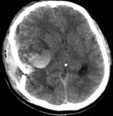
By nature, taking into account the danger of infection of the intracranial contents, TBI is divided into:
1.Closed. Closed TBI includes injuries in which there is no violation of the integrity of the integument of the head or there are superficial wounds of soft tissues without damage to the aponeurosis. Fractures of the bones of the fornix, not accompanied by injury to the adjacent soft tissues and aponeurosis, include closed injuries of the skull.
2. Open. Open head injury includes injuries in which there are wounds of the soft integument of the head with damage to the aponeurosis, or a fracture of the bones of the vault with damage to the adjacent soft tissues, or a fracture of the base of the skull, accompanied by bleeding or liquorrhea (from the nose or ear). If the dura mater is intact, open TBI is referred to as
non-penetrating,
and in violation of its integrity - to the penetrating one.
Depressed fracture of the right temporal and parietal bones. Traumatic intracerebral hematoma in the right temporal and parietal lobes with a volume of 40 cm3. Displacement of the median structures to the left by 12 mm.

Slide 17
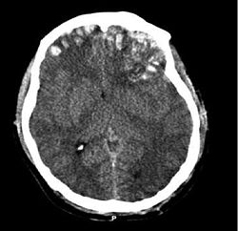
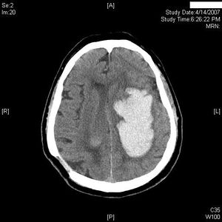
Contusion (contusion) of the brain
- This is compression or rupture of the brain tissue, covered by the dura mater, which occurs due to damage to the capillaries and extravasation of whole blood.
In case of cortical contusion, blood mixes with native tissue, in contrast to intraparenchymal hematoma, in which blood does not mix with brain tissue.

Slide 18
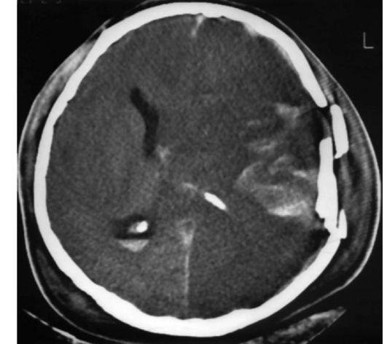
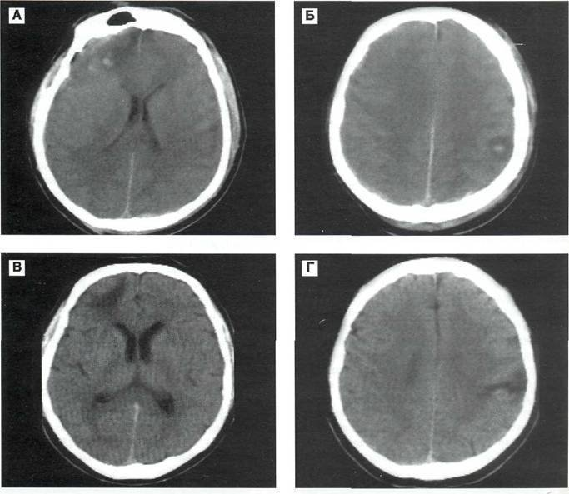
At the 1st stage of bruising of the cortex, hemorrhage is combined with necrosis.
In phase 2, resorption and "organization" of hemorrhage occur.
Then comes the last phase - the phase of the defect containing cerebrospinal fluid
The bruise is a wedge-shaped lesion with a base at the surface of the cortex and apex directed towards the center. Contusions can be diffuse, often multiple, rarely single. They are located in the cortical and subcortical zones. The shape of the injury, its character and anatomical distribution do not correspond to the vascular course, which distinguishes the injury from the characteristic picture of a heart attack.
There are areas of the brain that are prone to bruising: the bases of the frontal lobes, edges, bases and lateral surfaces of the temporal lobes. friction occurs in these zones when moving along the uneven surface of the base of the skull.
CT of the dynamics of shock-counter shock contusion foci in the left parietal and right frontal lobes. CT dynamics.
A, B - upon admission.
C, D - after 37 days.
At the site of the shock focus, a site of local atrophy of the brain substance was formed, at the site of the anti-shock focus, a heterodense zone, reflecting the formation of a cicatricial-atrophic process.
A depressed fracture of the left parietal and temporal bones, a massive bruise of the left parietal-temporal region, intraventricular hemorrhage.

Slide 19
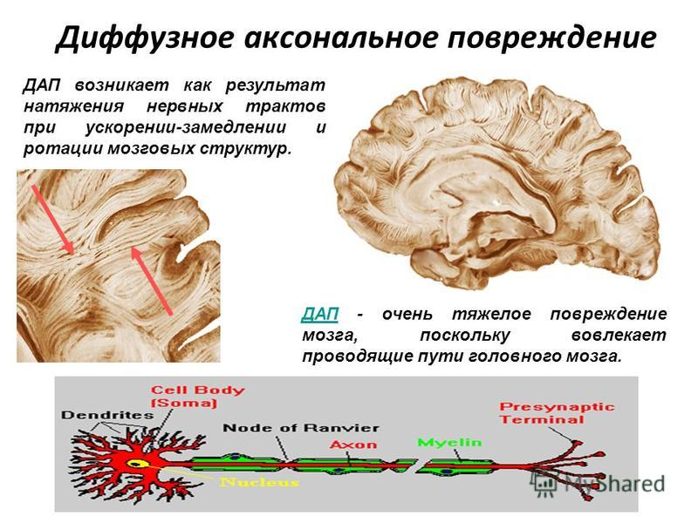
Diffuse axonal injury. ("Shearing injury«)
DAI occurs in almost 50% of patients with severe head trauma, and causes 35% of deaths. This is the most common cause of vegetative state and severe disability in TBI. DAI is characterized by massive axonal destruction that occurs at the time of acceleration and deceleration injury.
This type of lesion occurs in specific areas of the brain:
1. Corpus callosum complex
2. The junction of gray and white matter (since they have different density and adaptive capacity) in the parasagittal subcortical areas
3. Deeply located (near the ventricles) white matter, especially in the frontal region in the corners of the ventricles, hippocompal and parahippocampal regions, brainstem and cerebellum.
4. Therefore, these areas need to be investigated especially carefully in TBI 2
Diffuse axonal damage occurs as a result of tension on the nerve tracts during acceleration (deceleration) and rotation of brain structures

Slide 20
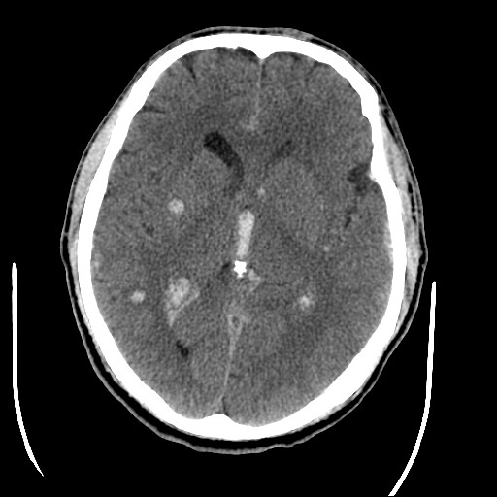
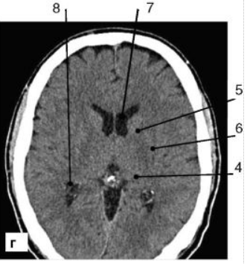
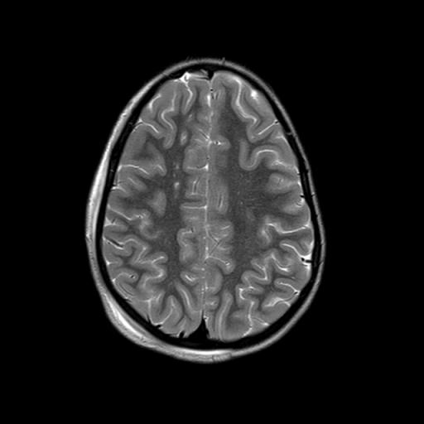
Diffuse axonal injury. ("Shearing injury")
MRI is much more sensitive to DAP than CT, especially for non-hemorrhagic lesions
On a computed tomogram (CT), DAP is characterized by an increase in brain volume of varying degrees (due to its edema, swelling, hyperemia) with compression of the lateral and third ventricles, subarachnoid convexital spaces, and cisterns of the base of the brain. In this case, small-focal hemorrhages are often detected in the white matter of the cerebral hemispheres, the corpus callosum, as well as in the subcortical and stem structures.
The most common finding on MRI is hyper-intense areas of different sizes on the border of gray and white matter, in a pair of ventricular zones, in the corpus callosum, in the brain stem. Subsequently, the intensity of their images decreases.
norm

Slide 21
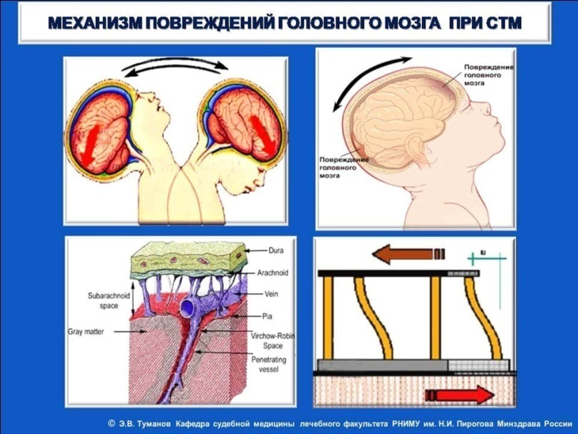
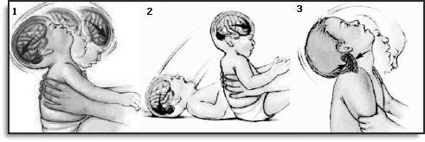
Child traumatic shaking syndrome
Pediatric radiologist J. Caffey (1946) published an article in the American Radiological Journal on the study of the possible relationship of chronic subdural hematomas and fractures of tubular bones in newborns. In 1972, the same author described similar symptoms in a child beaten by his parents with a belt. In 1974 J. Caffey coined the term "whiplash shaken infant syndrome" (WSIS)
"baby", or shaken-baby syndrome SBS, which marked the beginning of numerous studies.
This term was proposed to denote a complex of damage,
arising from shaking a child, spanking him or throwing him on any objects. According to J. Cafey, the shaking effect, sufficient for the development of venous subdural hematomas, can also occur when the child is tossed up, bounced on the parent's knee, the child rotates around the parent, somersaults, etc.
In total, about 27 cases of SBS syndrome are recorded in the world per 100 thousand babies.
Studies carried out in England and the United States have revealed the following pattern: most often, fathers and stepfathers are the culprits of the shaking that led to the development of SBS in a child, followed by nannies and mothers.

Slide 22
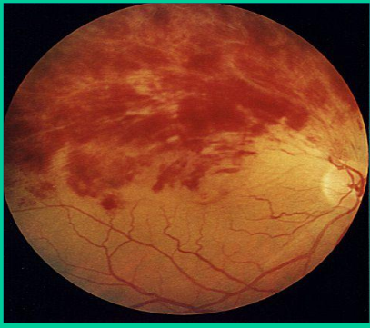
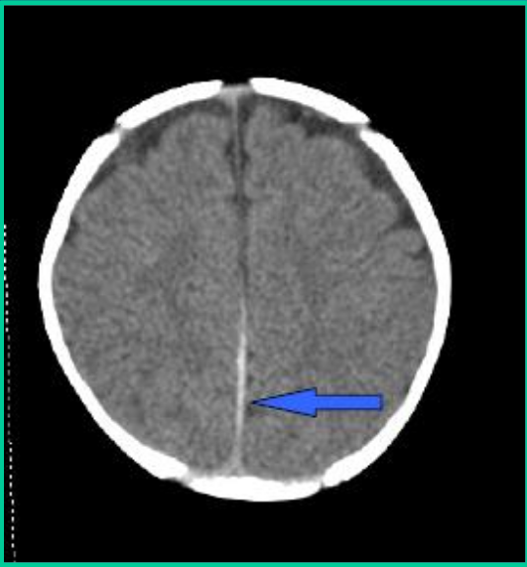
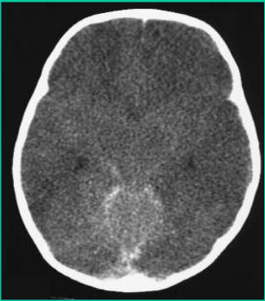
Classical triad
1. Intracranial trauma (subdural hematoma, SAH, parenchymal injuries). Subdural hematoma occurs in approximately 90% of cases and is more often localized above the convexital surface of the brain. They can be both unilateral and bilateral, with a tendency to fill the posterior interhemispheric gap with blood on both sides of the sickle of the brain.
2. Brain edema
3. Hemorrhage in the retina. A feature of hemorrhagic retinopathy associated with STTR is the tendency to form diffuse hemorrhages in all layers and directions of the retina.
Severe total hypoxic injury is the most common finding in concussion injuries in children, and diffuse axonal injury — the most accurate marker of acceleration-deceleration movement — is less common
Brain edema
Retinal hemorrhage
Swelling of the brain. Narrowing of liquor-containing spaces.

Slide 23
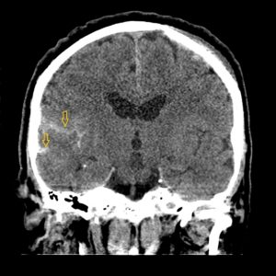
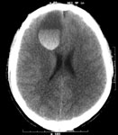
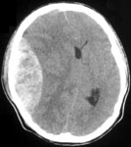
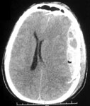
Traumatic intracranial hematomas
Depending on the anatomical relationship of the bones of the skull and the dura mater, the following types of traumatic intracranial hematomas are distinguished:
1. epidural hematomas that are located above the dura mater, are limited by cranial sutures, have a biconvex shape, hyperdense density and clear boundaries.
2.subdural hematomas
- formed between the dura mater and arachnoid, on CT they look like a crescent zone, often extending to the entire hemisphere
3.Subarachnoid hemorrhage on CT is defined as increased density of grooves and cisterns.
4. intracerebral hematomas
- located in the substance of the brain, on CT they have a rounded or irregular shape of increased dense
the density of the contents of the Sylvian clefts is different - on the right is much greater due to the fact that the right Sylvian cleft contains hyperdense blood
intracerebral hematoma
epidural hematoma
subdural hematoma

Slide 24
Emergency diagnostics in pulmonology
Injury to chest organs with / or without lung injury
(chest air leak syndrome)
(shock lung)
Pulmonary edema
TELA
Aspiration syndrome (foreign body of the bronchi and lungs, drowning).
Damage to the aorta.
Damage to the diaphragm and esophagus.

Slide 25
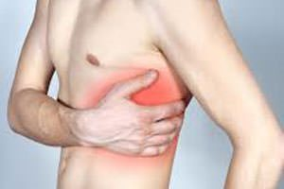
Chest injury
- This is damage to her skeleton (fractures of the ribs, sternum, clavicle, shoulder blades, thoracic vertebrae), soft tissues and internal organs (lungs, trachea, bronchi, esophagus, diaphragm, heart, large vessels, pericardium).
The most common clinical symptoms include pain, shortness of breath, pallor of the skin, sweating, increased heart rate, collapse

Slide 26
Classification of closed injuries and chest injuries
Closed damage.
I. Without damage to internal organs
No bone damage
With bone damage (no paradoxical or paradoxical chest movements)
Wounds.
I. Non-penetrating wounds (blind and through).
No damage to internal organs (no damage to bones, damage to bones)
With damage to internal organs
- without hemothorax, with small and medium hemothorax
- with a large hemothorax
II. Penetrating wounds (blind and through).
1.With injury to the pleura and lung (without hemothorax, with small, medium and large hemothorax)
A) without open pneumothorax
B) with open pneumothorax
B) with valvular pneumothorax
2.With injury to the anterior mediastinum
A) without damage to organs
B) with damage to the heart
B) with damage to large vessels
3.With injury to the posterior mediastinum
A) without damage to organs
B) with damage to the trachea
B) with damage to the esophagus
D) with damage to the aorta
E) with damage to the mediastinal organs in various combinations

Slide 27
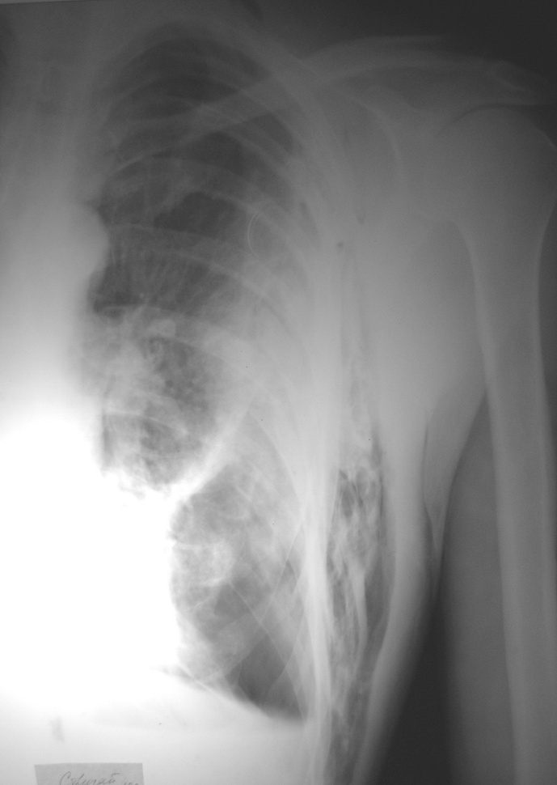
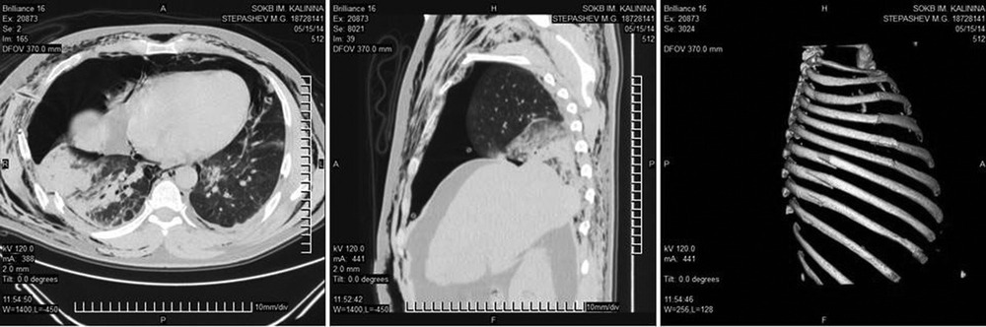
CT must be performed
Victims in serious condition who do not need urgent treatment.
Patients who have significant soft tissue emphysema on the plain chest radiograph.
To the victims, in whom no changes were detected on the general radiograph of the BHC, but hemoptysis continues.
Victims with a fracture of the sternum to identify hematoma of the mediastinum.
Combined damage to the bone framework and intrapleural organs.

Slide 28
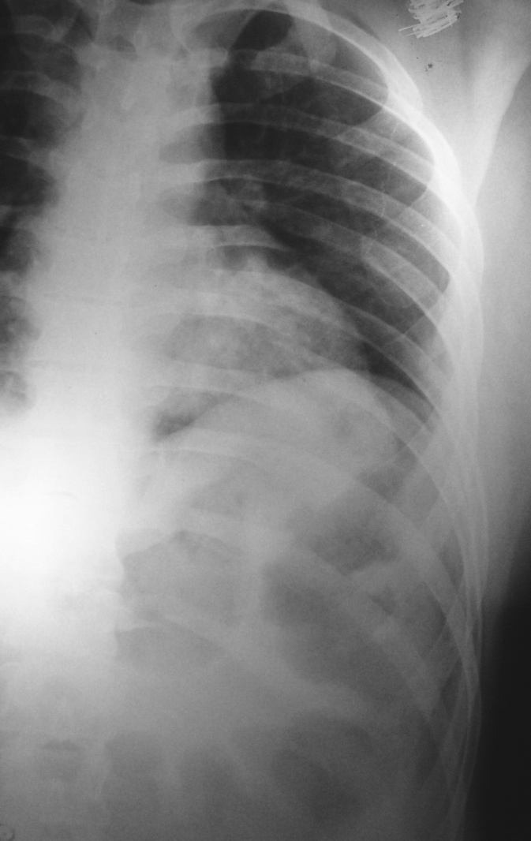
Rib damage
By the number of damaged ribs:
Single (fractures from one to 3 ribs)
Multiple (more than 3 ribs)
By the number of damaged sides of the chest:
Unilateral
Bilateral
By the number of rib fracture lines:
One line, double, triple
By the presence of pathological chest movements
Stable fractures
Unstable fractures

Slide 29
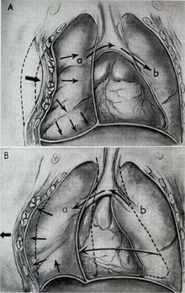
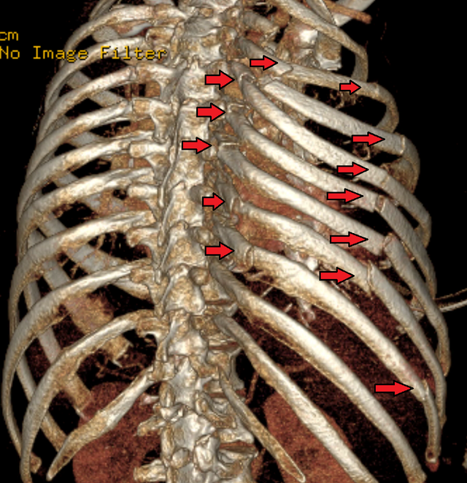
Floating rib fractures
these are fractures of the ribs along several anatomical lines with the formation of a flap of the chest wall.
the leaf floats when breathing: during inhalation it sinks, during exhalation it prolapses
violation of the chest frame leads to a violation of the biomechanics of respiratory movements and leads to the development of acute respiratory failure.
The mechanism of pathological mobility and the development of paradoxical breathing with a fenestrated fracture of the ribs:
on inspiration, the floating part of the chest sinks (A),
on exhalation, the costal "window" bulges out (B).

Slide 30
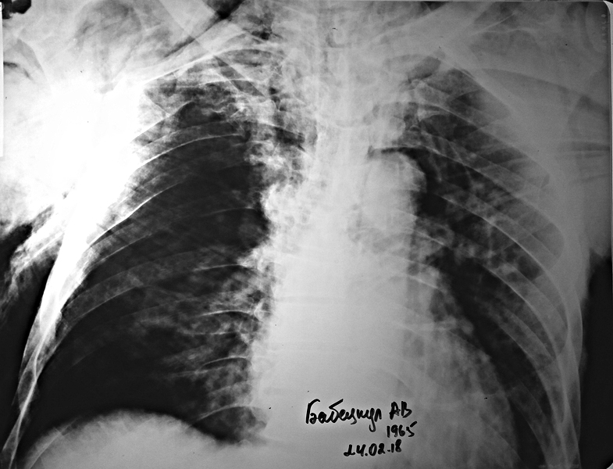
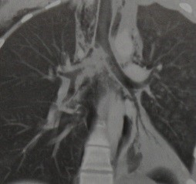
Bronchial rupture
Direct Ro sign
The symptom of a "fallen lung" is that the lung is torn off from the main bronchus and connected to the mediastinum by means of a vascular pedicle. At the same time, the gate of the lung is located significantly below normal.
Indirect Ro signs:
Pneumomediastinum, subcutaneous emphysema, pneumothorax, persistent pneumothorax (with drainage), atelectasis.
On CT in coronal projection, mediastinal emphysema is visible. The continuity of the right main bronchus is broken. There are no signs of collapse of the right lung or tension pneumothorax

Slide 31




https://radiographia.info/case/razryv-pravogo-glavnogo-bronha
Child 5 years old. After an accident. According to the severity of the condition, CT was performed only a week after admission to the ICU. During all this time, along the drains - abundant discharge of air from the right pleural cavity. The section shows an almost complete rupture of the right main bronchus.

Slide 32


Lung damage
1 contusion (contusion of the lung)
changes are usually one-sided (more often on the side of the injury, less often on the opposite)
can be focal, multiple, or diffusely involve one or both lungs.
small focal shadows, which tend to merge, in the root zones, there is a short-term vasodilation.
infiltrates as in pneumonia, but not limited to the segment or lobe.
They can be located sub-segmentally, usually on the periphery of the lung in the area of ​​injury, next to dense structures (vertebrae, ribs).
changes in the lungs due to injury occur immediately after the injury, and after two days they begin to disappear, and after a week they can completely disappear (differential diagnosis with post-traumatic pneumonia)
Contusion of the left lung, pneumothorax, soft tissue emphysema. Multiple rib fractures.
Contusion of the right lung. 2 days after injury.
https://www.mediasphera.ru/issues/khirurgiya-zhurnal-im-n-i-pirogova/2011/4/030023-1207201144

Slide 33


Hematomas
- limited accumulation of blood in the lung tissue with the formation of a cavity in it containing liquid or clotted blood.
By localization - in the interstitium and in the parenchyma.
X-ray
If a hematoma develops in a traumatic cyst, then its contours are even, clear (resembles a benign tumor)
if the hematoma is formed outside the cyst, then its contours are uneven, indistinct, the structure is uniform, the shadow is intense.
Consequences: resorption, organization, calcification.
Intrapulmonary hematoma on the left. Lung contusions. Multiple rib fractures
traumatic hematoma of the right lung

Slide 34


3. Traumatic cysts
With contusion in the lung, thin-walled air cysts, bullae, formed as a result of rupture of the alveolar septa often appear.
When the rupture of the alveolar walls is combined with damage to small vessels, the cyst can fill with blood.
Traumatic air cyst.
On CT, it is easier to distinguish between bruised areas of the lung (black arrow) from ruptures that led to pneumathocele formation (outline arrows)

Slide 35


Traumatic pneumothorax - This is the accumulation of air in the pleural cavity, which occurs due to trauma and leads to partial or complete collapse of the lung
By the volume of air contained in the pleural cavity and the degree of lung collapse:
1. Limited (partial, partial).
2. Full (total).
According to communication with the external environment:
1. Closed.
2. Open.
3. Tense (valve).

Slide 36

Hemothorax
- intrapleural bleeding, leading to the accumulation of blood in the pleural cavity, which is accompanied by compression of the lung and displacement of the mediastinal organs in the opposite direction.
Taking into account the amount of intrapleural bleeding, hemothorax can be:
1. small - the volume of blood loss up to 500 ml, the accumulation of blood in the sinus;
2. medium - volume up to 1.5 liters, blood level to the lower edge of the IV rib;
3. subtotal - the volume of blood loss up to 2 liters, the blood level to the lower edge of the II rib;
4. total - the volume of blood loss over 2 liters, radiologically characterized by total darkening of the pleural cavity on the side of the lesion

Slide 37


Pneumohemothorax
https://radiomed.ru/cases/40162-lyogkie-11

Slide 38


Chest Air Leak Syndrome
Pneumothorax
Pneumomediastinum
Interstitial emphysema
Pneumopericardium
Emphysema of soft tissues
Interstitial emphysema–
a condition when air, after rupture of the airways, penetrates into the interstitial tissue and perivascular, peribronchially spreads through the gate of the lungs into the mediastinum.
Spreading distally forms air cavities, penetrating into the pleural cavity causes pneumothorax.
Descending perivascular or paraesophageally, air can penetrate into the retroperitoneal space and into the abdominal cavity.

Slide 39
Pulmonary embolism.
Is a blockage (occlusion) of the arterial bed of the lungs (trunk, right or left pulmonary artery and / or their branches) by thrombotic masses of various calibers formed in the veins of the systemic circulation (deep vein thrombosis (DVT) of the legs and ileocaval segment, pelvis, i.e. in the basin of the inferior vena cava, rarely - in the basin of the superior vena cava), less often - in the right atrium or in the right ventricle of the heart.
In the 2000 guidelines of the European Society of Cardiology (EOC) on the diagnosis and treatment of PE, it is proposed to distinguish between massive, submassive and non-massive PE.
Classification is proposed to distinguish between pulmonary embolism by the volume of lesions of the vascular bed
1.Massive - obstruction of more than 50% of the vascular bed of the lungs with a clinic of shock or with the development of arterial hypotension.
2. Submassive - occlusion of less than 50% of the volume of the vascular bed of the lungs without hypotension, but with echocardiographic signs of right ventricular dysfunction (hypokinesis).
3. Non-massive - occlusion of less than 50% of the volume of the vascular bed of the lungs with stable hemodynamics and no signs of right ventricular dysfunction during echocardiography.

Slide 40


Development phases of pulmonary embolism
Oligemia and organization of emboli (1-2 days). Immediately after occlusion, an ischemic zone occurs, then stagnation in the capillaries, due to the flow of blood from the bronchial artery. This promotes the penetration of blood outside the vascular bed.
Radiographically: at the beginning, in the affected area, a significant increase in the transparency of the lung tissue, a depletion of the pulmonary pattern are observed. Occlusion of large branches of the pulmonary artery leads to the development of acute pulmonary heart - the right heart enlarges, the arch of the pulmonary trunk bulges, the superior vena cava expands. With occlusion of the lobar branch - a decrease in the size of the corresponding part of the root and expansion of the functioning branch. In the case of occlusion of small branches, there are no signs of oligemia, focal or focal-confluent shadows, effusion in the pleural cavity are observed
Pulmonary infarction phase (3-5 days). This phase is observed in the case of occlusion of large branches (III-IV order). Alveolar wall necrosis. And by 5-7 days, the affected area of ​​the lungs is airless, compacted, hemorrhagic.
Reverse development (2-4 weeks). Resorption of detritus, replacement by granulation tissue, sometimes calcification. X-ray: the contours of the infarction shadow become wavy, the shape is elongated, the structure is less uniform. After 3-4 weeks, a zone of pneumosclerosis or a linear scar is formed.
Scheme of X-ray signs of pulmonary infarction:
Focal shadows
Focal-drainage shadows
Single rounded shadow
Triangular shadow, corresponding to the shape of the segment or sub-segment
Disciform atelectasis
Fluid in the pleural cavity.

Slide 41



Septic pulmonary embolism in a teenager
Massive pulmonary embolism revealed in a patient with computed tomography: in both pulmonary arteries, in their lobar branches, hypodense (against the background of contrasted blood) thrombi are visualized

Slide 42
Lung edema
- a condition resulting from the pathological accumulation in the lung tissue of an excessive amount of extravascular fluid.
Types of pulmonary edema due to the occurrence
1. Hydrostatic (cardiogenic) - violation of the outflow of blood from the small circle, increased hydrostatic pressure in the veins. Causes - acute left ventricular failure, iatrogenic overhydration.
2. Swelling with damage to capillaries:
- endogenous - with trauma, shock, sepsis, blood loss, infections
- exogenous - during aspiration, inhalation of toxic liquids or gases, as part of respiratory distress syndrome.
Depending on the predominance of extravascular fluid:
1.interstitial
2.alveolar

Slide 43


Interstitial pulmonary edema
The caliber of the superior veins prevails.
Decreased transparency of the pulmonary fields.
Indistinctness of the contours of the pulmonary pattern.
Small focal shadows.
Infiltration in the peribronchial regions
Curly Lines A, B and C
There may be pleural and pericardial effusion
CT - peribronchovascular couplings with interstitial pulmonary edema. The outer diameter of the arteries and bronchi is symmetrically increased, the contours of these structures are indistinct. The internal lumen of the bronchi is reduced, the thick walls of the bronchi are clearly visible.

Slide 44




Curly A Lines
Curly B Lines
Curly C Lines

Slide 45




Alveolar pulmonary edema
Bilateral defeat.
Infiltration is localized more in the root zones (butterfly figure).
The roots are expanded. Their contours are indistinct.
Fast dynamics.

Slide 46



Stages of impaired bronchial patency
Foreign bodies of the bronchi
Clinically, there are 3 periods:
Acute Respiratory Disorders
Of the hidden flow
Complications
1st stage (hypoventilation)
X-ray signs of IT include:
the “click” symptom (the healthy lung fills with air faster at the moment of inhalation, and there is a jerky displacement of the mediastinum towards the lung, in which there is hypoventilation);
Positive symptom of Goltsknecht - Jakobson (displacement of the mediastinal organs towards the obturated bronchus), which makes it possible to determine not only the presence of IT (especially X-ray contrast), but also its localization in one or another main bronchus;
Signs of atelectasis of the lung lobe, atelectasis of the whole lung; emphysema of the lung (depending on the stage); pneumothorax; radiological signs of pneumonia.
2st (hyperventilation, valvular emphysema)
3st (atelectasis)

Slide 47



Foreign bodies in the digestive tract
www.radiomed.ru
Пищевой завал
Food blockage
Foreign bodies in the digestive tract

Slide 48



Foreign bodies in the digestive tract
www.radiomed.ru
www.radiomed.ru
www.radiomed.ru

Slide 49


http://www.mif-ua.com/archive/article/36401
Foreign bodies balls-magnets
Child T., 1 year 2 months with complaints from parents about the child swallowing multiple foreign bodies - balls of magnets.
Operation: upper midline laparotomy, no free effusion in the abdominal cavity. Revision of the abdominal organs revealed that the bead magnets perforated the jejunum in two places at a distance of 5 cm from Treitz's ligament and, coming out of the intestinal lumen, locked outside the intestine in the form of a ring. In the area of ​​perforated holes of the fibrin film. The magnetic ring is spread apart, foreign bodies in the amount of 21 balls are removed from the intestinal lumen through the lower perforation hole. Reorganization of the perforated area has been carried out. Perforated holes are sutured with a double-row seam. The abdominal cavity is sutured tightly in layers.
Diagnosis after surgery: foreign bodies of the small intestine (ball magnets), perforation of the small intestine, limited fibrinous peritonitis.
Foreign bodies balls-magnets

Slide 50



Injury to the abdomen
Closed abdominal trauma is called damage to the abdominal organs without violating the integrity of the skin of the abdominal wall. According to a number of authors, severe closed abdominal trauma in 15.6—57.6% of cases is fatal or often leads to permanent disability.
With a closed abdominal injury, there are
bruises of the abdominal wall,
damage to the abdominal organs (hollow, parenchymal organs and their combinations) and retroperitoneal organs. Damage to hollow organs, in turn, is subdivided into bruises, crushing, full and partial ruptures. The latter include damage to the serous and muscular membranes of the organ while maintaining the integrity of the mucous membrane. Among the damage to the parenchymal organs, damage is distinguished without violating the integrity of the capsule (subcapsular hematoma) and with its violation (cracks, ruptures, tears and crushing).
Spleen rupture with two intraparenchymal and subcapsular hematomas at the superior pole of the spleen.
Rectum rupture
CT with contrast, frontal projection. Rupture of the right kidney, peri- and pararenal hematoma, air in the posterior pararenal space.

Slide 51
Abdominal trauma.
CT is the optimal method for assessing abdominal trauma, but the routine use of this method for minor injuries and a large workload of emergency departments leads to unacceptable delays in patient care, is expensive and is associated with increased radiation exposure to the patient.
Therefore, it is initially recommended to carry out an ultrasound scan. If ultrasound of the OBP does not reveal changes, then, according to foreign authors, observation is carried out in the next 12-24 hours and CT is not performed.
To exclude intra-abdominal injuries in a conscious patient, he must perform:
Radiography of the OGK
Ultrasound OBP
Laboratory research.

Slide 52



In case of abdominal trauma, the general images reveal direct or indirect signs of damage to the abdominal organs and the retroperitoneal space
Direct signs include:
1) the presence of free gas in the abdominal cavity or retroperitoneal space;
2) the presence of free fluid (blood) in the abdominal cavity.
Indirect signs include:
1) bloating and displacement of the stomach and intestines;
2) deformation and displacement of parenchymal organs;
3) violation of the position, shape and function of the diaphragm.
Duodenal rupture. Free
gas in the retroperitoneal space around the right kidney.
Intestinal paresis. Paralytic obstruction.

Slide 53

Free gas in the abdominal cavity. In the upright position, gas is collected under the dome of the diaphragm.
In the supine position, only a large amount of gas is visualized.
In lateral position, the least detectable amount of gas

Slide 54
CLASSIFICATION OF INTESTINAL OBSTRUCTION.
Strangulated obstruction of the small, large intestine.
(volvulus of all loops, nodulation between the loops of the small intestine, entrapment in hernial openings, adhesive obstruction)
●
● Obstructive obstruction of the small, large intestine.
(cicatricial narrowing, blockage by a tumor, blockage by roundworms, gallstones, etc., compression by a tumor or inflammatory infiltrate, introduction of the small intestine into the small intestine, congenital narrowing)
●Functional bowel obstruction.
Obstruction due to impaired blood circulation in the mesentery (thrombosis and embolism of the mesenteric vessels, metastases of cancer in the mesentery (cancerous peritonitis).
Obstruction due to intoxication of the body (food poisoning, lead and other poisons, peritonitis (spilled or limited).
Obstruction due to diseases and injuries of various organs and systems of the body:
A. Diseases of the gastrointestinal tract (appendicitis, enteritis, colitis, diverticulitis).
B. Diseases of the rest of the abdominal cavity (hepatitis, cholecystitis, salpingo-oophoritis, etc.).
V. Diseases of the retroperitoneal organs (pancreatitis, pyelitis, paranephritis, kidney stone disease).
G .Zabolevaniya bryushnoy stenki (flegmona, gematoma).
D. Zabolevaniya organov grudnoy kletki (pnevmoniya, plevrit, perelomy nizhnikh reber, pnevmotoraks, gemotoraks, perikardit, infarkt miokarda, rasslaivayushchayasya anevrizma aorty i pr.).
Y. Zabolevaniya nervnoy sistemy (razlichnyye porazheniya golovnogo i spinnogo mozga, nevrozy, isteriya).
R. Diseases of the abdominal wall (phlegmon, hematoma).
S. Diseases of the chest organs (pneumonia, pleurisy, fractures of the lower ribs, pneumothorax,hemothorax, pericarditis, myocardial infarction, exfoliating aortic aneurysm, etc.).
T. Diseases of the nervous system (various lesions of the brain and spinal cord, neuroses, hysteria).

Slide 55



Small intestinal obstruction
Colon obstruction
Kloiber cups

Slide 56





Colon obstruction due to intussusception of a colon tumor
Strangulation obstruction of the sigmoid colon.
Restrained paraesophageal hernia
Traumatic hernia of the diaphragm. Volvulus of the stomach

Slide 57
Diseases of the gastrointestinal tract, complicated by bleeding
- Varicose veins of the esophagus:
bleeding rate up to 38%;
the rate of death from bleeding is up to 84%;
among those who died from acute gastrointestinal bleeding 8.9%
perished from the VRVP.
Mortality from bleeding in portal hypertension 2.5 times
higher than from acute bleeding ulcers of the stomach and duodenum 12.
- Stomach and duodenal ulcers:
the frequency of bleeding in patients with peptic ulcer disease
12 - duodenum 12-20%;
stomach ulcers 20-25%;
postbulbar ulcers 35-90%.
- Hernia of the esophageal opening of the diaphragm is complicated
bleeding in 25-35%.
Stomach cancer in 10-15% is first manifested by bleeding.
Diverticula of the duodenum in 3.5%, bleeding is possible

Slide 58




Diseases of the gastrointestinal tract, complicated by bleeding
Esophageal varicose veins, bleeding
Stomach ulcer
Ulcerated stomach cancer
Multiple diverticula of duodenum and jejunum, intestinal bleeding

