Slide 1
Principles and Basics of Radiation Therapy
Lecturer: Ahmad Kauk
Radiologist, MSc, EDIR.
Teaching assistant at Department of Radiation Diagnostics, Therapy, Medicine and Oncology
Odesa National Medical University
Odesa

Slide 2
Radiation therapy
Radiation therapy or radiotherapy, often abbreviated RT, RTx, or XRT, is therapy using ionizing radiation, generally as part of cancer treatment to control or kill malignant cells and today most of it is delivered by a linear accelerator.

Slide 3
Radiation therapy
Structure of presentation:
WHAT?
WHEN?
HOW?
WHEN?
HOW?
WHAT?

Slide 4
Radiation therapy
Historically, the three main divisions of radiation therapy are:
external beam radiation therapy (EBRT or XRT) or teletherapy
brachytherapy or sealed source radiation therapy
systemic radioisotope therapy or unsealed source radiotherapy.

Slide 5
Radiation therapy
The differences relate to the position of the radiation source:
In external beam radiation therapy the radiation source is located outside the body
In brachytherapy the sealed radioactive source is placed precisely in the area under treatment
In systemic radioisotope therapy radioisotopes are given by infusion or oral ingestion

Slide 6
Radiation therapy
The treatment regimens could be:
with intent to cure - "curative"
Adjuvant if delivered in association with surgery or chemotherapy, or neoadjuvant if precedes other treatments;
Palliative - cure is not possible and the aim is local disease control or symptomatic relief

Slide 7
Radiation therapy
Primary application is treatment of malignant tumors
The precise treatment intent will depend on the tumor type, location, and stage, as well as the general health of the patient.
The subspecialty of oncology concerned with radiotherapy is called radiation oncology

Slide 8
Radiation therapy
Can have applications in non-malignant states:
Dupuytren’s disease and Ledderhose disease, plantar fasciitis, trigeminal neuralgia, acoustic neuromas, severe thyroid eye disease, pterygium, pigmented villonodular synovitis, prevention of keloid scar growth, vascular restenosis, and heterotopic occification.
The use of radiation therapy in non-malignant conditions is limited partly by worries about the risk of radiation-induced cancers.

Slide 9
Mechanism of action

Slide 10
Radiation therapy
Radiation therapy works by damaging the DNA of cancerous cells.
DNA damage is attributed to either direct or indirect ionization of the atoms which make up the DNA chain.
Indirect ionization is a predominant effect of photon therapy and happens as a result of the ionization of water, forming free radicals, notably hydroxyl radicals, which then damage the DNA.
Direct ionization is the main effect of charged particles.

Slide 11
Radiation therapy
Cells have mechanisms for repairing single-strand DNA damage and double-stranded DNA damage.
However, double-stranded DNA breaks are much more difficult to repair, and can lead to dramatic chromosomal abnormalities and genetic deletions.
Targeting double-stranded breaks increases the probability that cells will undergo cell death.
Cancer cells are generally less differentiated and more stem cell-like; they reproduce more than most healthy differentiated cells, and have a diminished ability to repair sub-lethal damage.

Slide 12
Radiation therapy
One of the major limitations of photon radiation therapy is that the cells of solid tumors might become deficient in oxygen.
Solid tumors can outgrow their blood supply, causing a low-oxygen state known as hypoxia.
Oxygen is a potent radiosensitizer, increasing the effectiveness of a given dose of radiation by forming DNA-damaging free radicals.
Tumor cells in a hypoxic environment may be as much as 2 to 3 times more resistant to radiation damage than those in a normal oxygen environment.
Much research has been devoted to overcoming hypoxia including the use of high pressure oxygen tanks, hyperthermia therapy (heat therapy which dilates blood vessels to the tumor site), blood substitutes that carry increased oxygen, hypoxic cell radiosensitizer drugs such as misonidazole and metronidazole, and hypoxic cytotoxins (tissue poisons), such as tirapazamine.
Newer research approaches are currently being studied, including preclinical and clinical investigations into the use of an oxygen diffusion-enhancing compound such as trans sodium crocetinate (TSC) as a radiosensitizer.

Slide 13
Radiation therapy
Charged particles such as protons can cause direct damage to cancer cell DNA through high-LET (linear energy transfer) and have an antitumor effect independent of tumor oxygen supply because these particles act mostly via direct energy transfer usually causing double-stranded DNA breaks.
Due to their relatively large mass, protons and other charged particles have little lateral side scatter in the tissue—the beam does not broaden much, stays focused on the tumor shape, and delivers small dose side-effects to surrounding tissue.
They also more precisely target the tumor using the Bragg peak effect.

Slide 14
Radiation therapy
The response of a cancer to radiation is described by its radiosensitivity.
Highly radiosensitive cancer cells are rapidly killed by modest doses of radiation. These include leukemias, most lymphomas and germ cell tumors.
The majority of epithelial cancers are only moderately radiosensitive, and require a significantly higher dose of radiation (60-70 Gy) to achieve a radical cure.
Some types of cancer are notably radioresistant, that is, much higher doses are required to produce a radical cure than may be safe in clinical practice. Renal cell cancer and melanoma are generally considered to be radioresistant but radiation therapy is still a palliative option for many patients with metastatic melanoma.
It is important to distinguish the radiosensitivity of a particular tumor, which to some extent is a laboratory measure, from the radiation "curability" of a cancer in actual clinical practice. For example, leukemias are not generally curable with radiation therapy, because they are disseminated through the body.
Metastatic cancers are generally incurable with radiation therapy because it is not possible to treat the whole body.

Slide 15
Dose

Slide 16
Radiation therapy
The amount of radiation used in photon radiation therapy is measured in gray (Gy), and varies depending on the type and stage of cancer being treated.
Many other factors influence selection of dose, including whether the patient is receiving chemotherapy, patient comorbidities, whether radiation therapy is being administered before or after surgery, and the degree of success of surgery.
For curative cases, the typical dose for a solid epithelial tumor ranges from 60 to 80 Gy, while lymphomas are treated with 20 to 40 Gy.
Preventive (adjuvant) doses are typically around 45–60 Gy in 1.8–2 Gy fractions (for breast, head, and neck cancers.)
Delivery parameters of a prescribed dose are determined during treatment planning.

Slide 17
Radiation therapy
Fractionation
  The total dose is fractionated (spread out over time)
  Fractionation allows normal cells time to recover, while tumor cells are generally less efficient in repair between fractions.
  Fractionation also allows tumor cells that were in a relatively radio-resistant phase of the cell cycle during one treatment to cycle into a sensitive phase of the cycle before the next fraction is given.
  Similarly, tumor cells that were chronically or acutely hypoxic (and therefore more radioresistant) may reoxygenate between fractions, improving the overal treatment effect.

Slide 18
Radiation therapy
Fractionation
  the typical fractionation schedule for adults is 1.8 to 2 Gy per day
  In some cases, two fractions per day are used near the end of a course of treatment. This schedule, known as a concomitant boost regimen or hyperfractionation, is used on tumors that regenerate more quickly when they are smaller. In particular, tumors in the head-and-neck demonstrate this behavior.
  Hypofractionation is a radiation treatment in which the total dose of radiation is divided into large doses. Typical doses vary significantly by cancer type, from 2.2 Gy/fraction to 20 Gy/fraction. The logic behind hypofractionation is to lessen the possibility of the cancer returning by not giving the cells enough time to reproduce and also to exploit the unique biological radiation sensitivity of some tumors.
  Short course hypofractionated treatments over 3–4 weeks e.g. 40 Gy in 15 fractions or 42.5 Gy in 16 fractions, have been shown to be as effective as more protracted 5-6 week treatments with respect to both cancer control and cosmesis

Slide 19
Side Effects

Slide 20
Radiation therapy
Radiation therapy is in itself painless.
The nature, severity, and longevity of side effects depends on the organs that receive the radiation, the treatment itself (type of radiation, dose, fractionation, concurrent chemotherapy), and the patient.
Side effects are dose- dependent

Slide 21
Radiation therapy
Acute side effects
  Nausea and vomiting
  Damage to the epithelial surfaces
  Mouth, throat and stomach sores
  Intestinal discomfort
  Swelling
  Infertility

Slide 22
Radiation therapy
Late side effects
  Fibrosis
  Epilation (on any hair bearing skin with doses above 1 Gy).
  Dryness (The salivary glands and tear glands have a radiation tolerance of about 30 Gy in 2 Gy fractions, a dose which is exceeded by most radical head and neck cancer treatments).
  Lymphedema
  Cancer
  Cognitive decline
  Radiation enteropathy

Slide 23
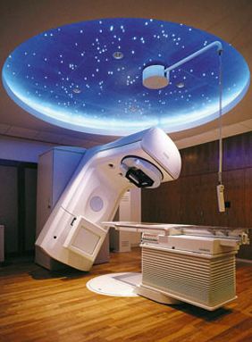
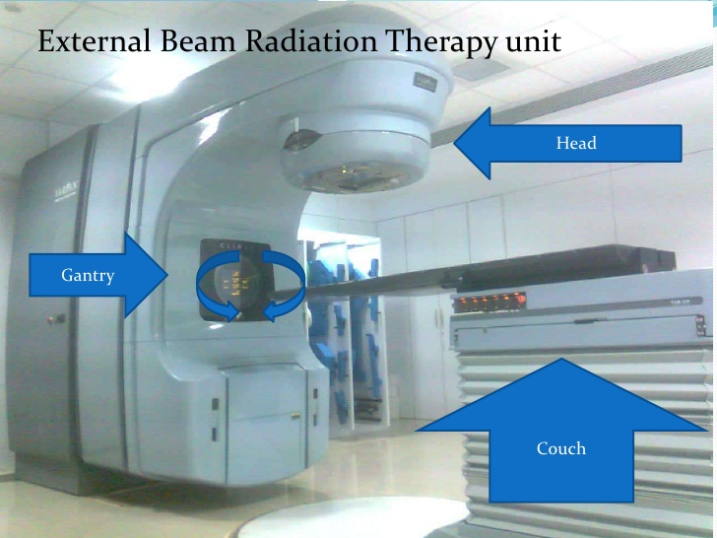
External beam radiation therapy

Slide 24
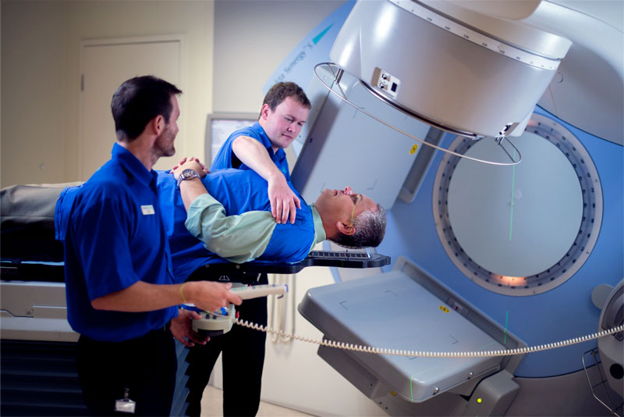
External beam radiation therapy

Slide 25
External beam radiation therapy
Types:
  Conventional external beam radiation therapy
  Stereotactic radiation (Radiosurgery), with
  virtual simulation, and 3-dimensional conformal radiation therapy
  Intensity-modulated radiation therapy (IMRT)
  Volumetric modulated arc therapy (VMAT)
  Particle therapy
  Auger therapy

Slide 26
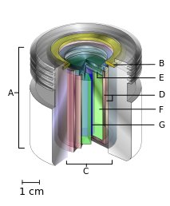
External beam radiation therapy
A teletherapy radiation capsule composed of the following:
an international standard source holder (usually lead) (A)
a retaining ring (B), and
a teletherapy "source" (C)composed of
two nested stainless steel canisters (D) welded to
two stainless steel lids surrounding (E)
a protective internal shield (usually uranium metal or a tungsten alloy) (F) and
a cylinder of radioactive source material, often but not always cobalt-60. (G)

Slide 27
External beam radiation therapy
Conventional external beam radiation therapy (2DXRT) is delivered via two-dimensional beams using kilovoltage therapy x-ray units or medical linear accelerators which generate high energy x-rays.
2DXRT mainly consists of a single beam of radiation delivered to the patient from several directions: often front or back, and both sides.
Conventional refers to the way the treatment is planned or simulated on a specially calibrated diagnostic x-ray machine known as a simulator because it recreates the linear accelerator actions (or sometimes by eye), and to the usually well-established arrangements of the radiation beams to achieve a desired treatment plan.

Slide 28
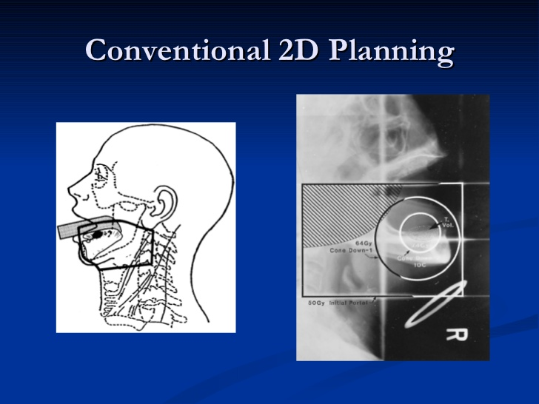
External beam radiation therapy
https://www.slideshare.net/lokpreeth/radiation-therapy-of-oral-cancers

Slide 29
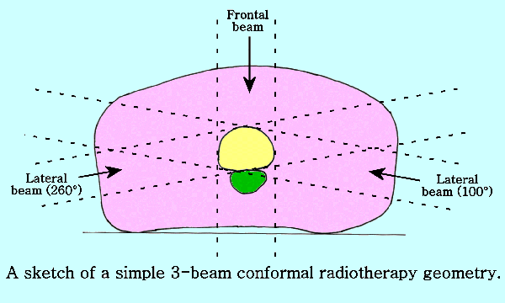
External beam radiation therapy
https://www.slideshare.net/lokpreeth/radiation-therapy-of-oral-cancers

Slide 30
External beam radiation therapy
Stereotactic radiation is a specialized type of external beam radiation therapy. It uses focused radiation beams targeting a well-defined tumor using extremely detailed imaging scans.
The highly precise irradiation of targets mostly within the brain and spine is planned using information from medical images that are obtained via computed tomography, magnetic resonance imaging, and angiography.
Stereotactic treatments can be confusing because many hospitals call the treatments by the name of the manufacturer rather than calling it SRS or SBRT. Brand names for these treatments include Axesse, Cyber Knife, Gamma Knife, Novalis, Primatom, Synergy, X-Knife, Tomo Therapy , Trilogy and Truebeam.

Slide 31
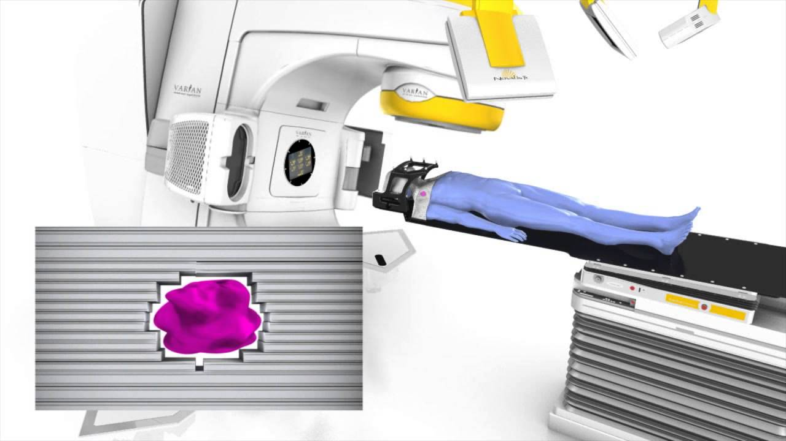
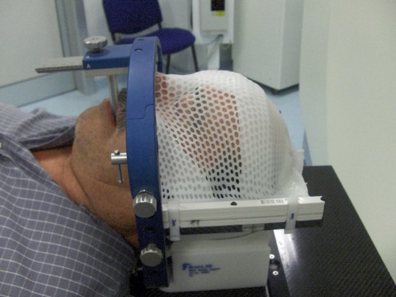
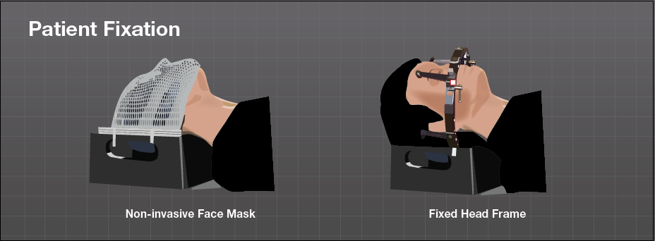
External beam radiation therapy

Slide 32
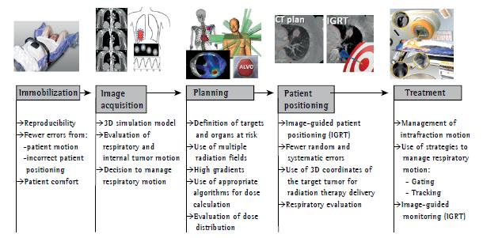
External beam radiation therapy

Slide 33
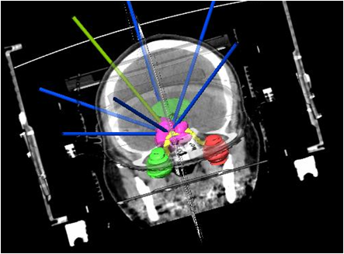
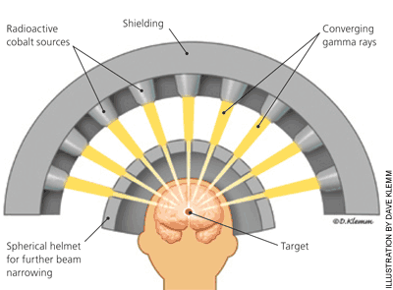
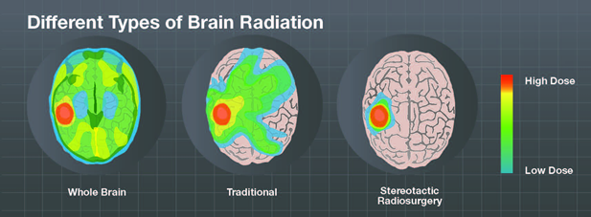
External beam radiation therapy

Slide 34
External beam radiation therapy
Virtual simulation, and 3-dimensional conformal radiation therapy
revolutionized by the ability to delineate tumors and adjacent normal structures in three dimensions using specialized CT and/or MRI scanners and planning software.
Virtual simulation, the most basic form of planning, allows more accurate placement of radiation beams than is possible using conventional X-rays, where soft-tissue structures are often difficult to assess and normal tissues difficult to protect.
An enhancement of virtual simulation is 3-dimensional conformal radiation therapy (3DCRT), in which the profile of each radiation beam is shaped to fit the profile of the target from a beam's eye view (BEV) using a multileaf collimator (MLC) and a variable number of beams. When the treatment volume conforms to the shape of the tumor, the relative toxicity of radiation to the surrounding normal tissues is reduced, allowing a higher dose of radiation to be delivered to the tumor than conventional techniques would allow

Slide 35
External beam radiation therapy
Intensity-modulated radiation therapy (IMRT) is an advanced type of high-precision radiation that is the next generation of 3DCRT
improves the ability to conform the treatment volume to concave tumor shapes, for example when the tumor is wrapped around a vulnerable structure such as the spinal cord or a major organ or blood vessel
Computer-controlled x-ray accelerators distribute precise radiation doses to malignant tumors or specific areas within the tumor.
The pattern of radiation delivery is determined using highly tailored computing applications to perform optimization and treatment simulation.
The radiation dose is consistent with the 3-D shape of the tumor by controlling, or modulating, the radiation beam’s intensity.
The radiation dose intensity is elevated near the gross tumor volume while radiation among the neighboring normal tissues is decreased or avoided completely. This results in better tumor targeting, lessened side effects, and improved treatment outcomes than even 3DCRT.

Slide 36
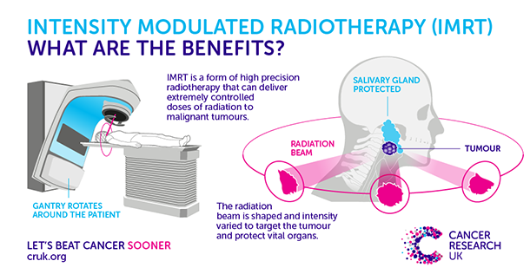
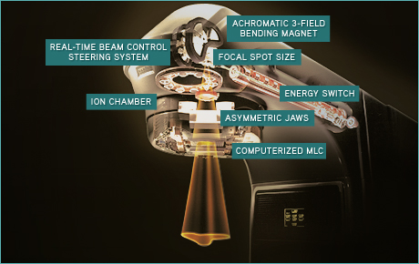

Slide 37
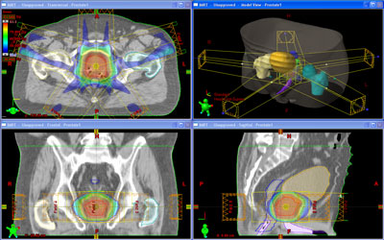
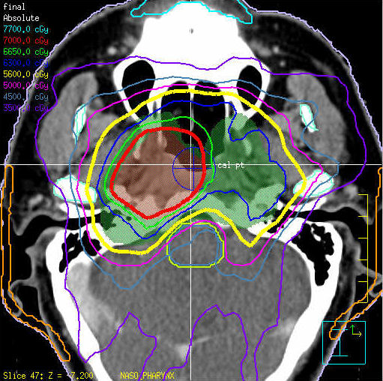
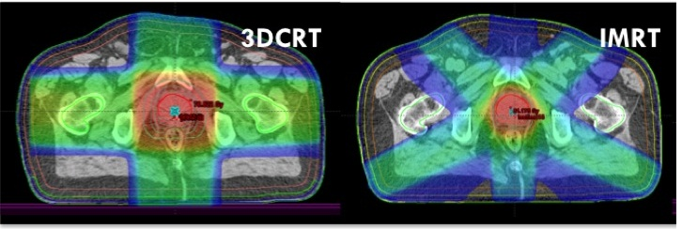
IMRT

Slide 38
External beam radiation therapy
Volumetric modulated arc therapy (VMAT) is a new radiation technique, which can achieve highly conformal dose distributions on target volume coverage and sparing of normal tissues.
The specificity of this technique is to modify the three parameters during the treatment. VMAT delivers radiation by rotating gantry (usually 360° rotating fields with one or more arcs), changing speed and shape of the beam with a multileaf collimator (MLC) ("sliding window" system of moving) and fluence output rate (dose rate) of the medical linear accelerator.
VMAT also has the potential to give additional advantages in patient treatment, such as reduced delivery time of radiation, compared with conventional static field intensity modulated radiotherapy (IMRT)

Slide 39
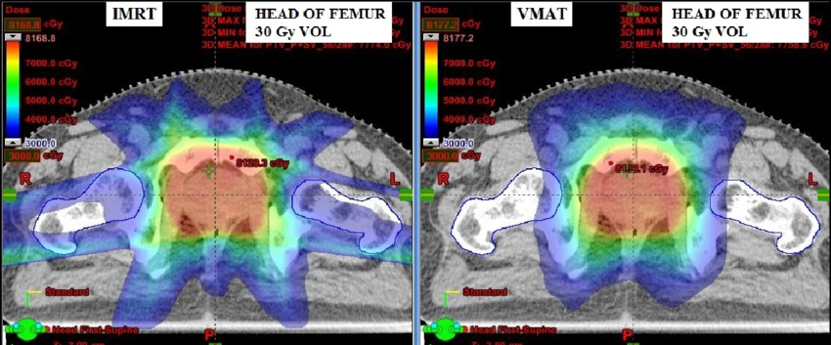
External beam radiation therapy

Slide 40
External beam radiation therapy
Particle therapy
  In particle therapy (proton therapy being one example), energetic ionizing particles (protons or carbon ions) are directed at the target tumor.
  The dose increases while the particle penetrates the tissue, up to a maximum (the Bragg peak) that occurs near the end of the particle's range, and it then drops to (almost) zero.
  The advantage of this energy deposition profile is that less energy is deposited into the healthy tissue surrounding the target tissue.

Slide 41
External beam radiation therapy
Auger therapy
  relies on a large number of low-energy electrons (emitted by the Auger effect) to damage cancer cells, rather than the high-energy radiation used in traditional radiation therapy.
  Auger therapy relies on radiation-induced damage to cancer cells (particularly DNA damage) to arrest cell division, stop tumor growth and metastasis and kill cancerous cells
  Because of their low energy, these electrons damage cells over a very short range: less than the size of a single cell, on the order of nanometers.
  This very short-range delivery of energy permits highly targeted therapies, since the radiation-emitting nuclide is required to be inside the cell to cause damage to its nucleus.
  However, this is a technical challenge; Auger therapeutics must enter their cellular targets to be most effective. Auger therapeutics are small molecules, capable of entering cells of interest and binding to specific sub-cellular components, which contain one (or more) heavy atoms capable of emitting Auger electrons by radioactive decay or external excitation.

Slide 42
Brachytherapy (sealed source radiotherapy)

Slide 43
Brachytherapy (sealed source radiotherapy)
Brachytherapy is delivered by placing radiation source(s) inside or next to the area requiring treatment. Brachytherapy is commonly used as an effective treatment for cervical, prostate,breast, and skin cancer and can also be used to treat tumours in many other body sites.
In brachytherapy, radiation sources are precisely placed directly at the site of the cancerous tumour.
the irradiation only affects a very localized area – exposure to radiation of healthy tissues further away from the sources is reduced.
the tumour can be treated with very high doses of localized radiation, whilst reducing the probability of unnecessary damage to surrounding healthy tissues.
A course of brachytherapy can often be completed in less time than other radiation therapy techniques. This can help reduce the chance of surviving cancer cells dividing and growing in the intervals between each radiation therapy dose.

Slide 44
Unsealed source radiotherapy (systemic radioisotope therapy)

Slide 45
Unsealed source radiotherapy (systemic radioisotope therapy)
Systemic radioisotope therapy (RIT) is a form of targeted therapy.
Targeting can be due to the chemical properties of the isotope such as radioiodine which is specifically absorbed by the thyroid gland a thousandfold better than other bodily organs. Targeting can also be achieved by attaching the radioisotope to another molecule or antibody to guide it to the target tissue. The radioisotopes are delivered through infusion (into the bloodstream) or ingestion.
Examples are the infusion of metaiodbenzylguanidine (MIBG) to treat neuroblastoma, or oral iodine-131 to treat thyroid cancer, and of hormone-bound lutetium-177 and yttrium-90 to treat neuroendocrine tumors (peptide receptor radionuclide therapy).
A major use of systemic radioisotope therapy is in the treatment of bone metastasis.

Slide 46
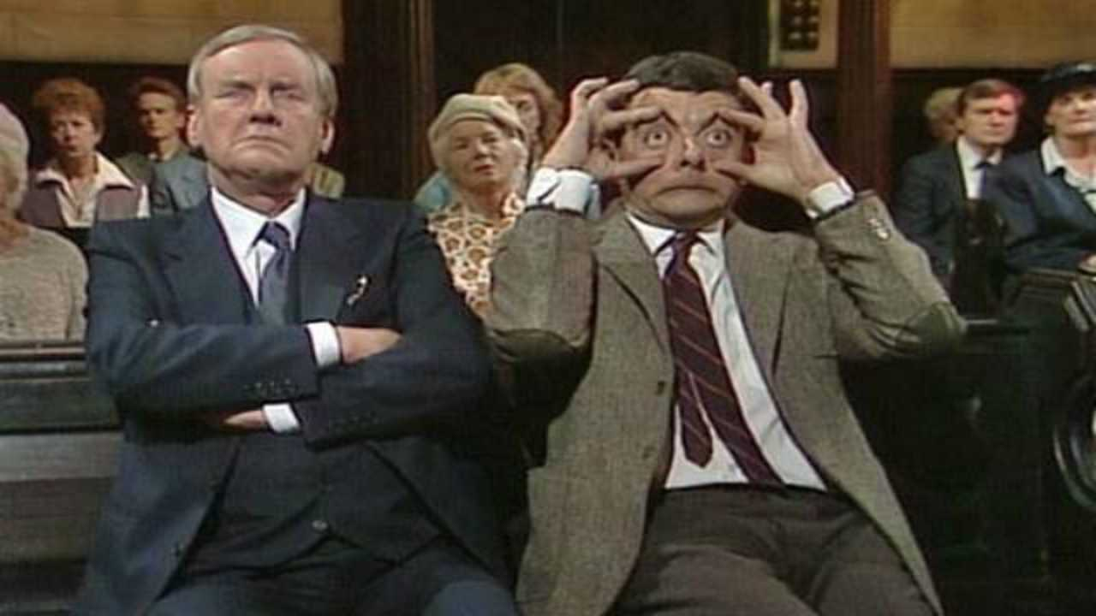
Thank you for your attention

Slide 47
Sources
Ash D, Dobbs J, Barrett, A (1999). Practical radiation therapy planning. London: Arnold. ISBN 0-340-70631-7.
Lawrence Chin, MD and William Regine, MD, Editors (2008). Principles of Stereotactic Surgery. Berlin: Springer. ISBN 0-387-71069-8.
Mayles, P; Rosenwald, JC; Nahum, A (2007). Handbook of Radiation therapy Physics: Theory and Practice. Taylor & Francis. ISBN 978-0-7503-0860-1.
McGarry, M (2002). Radiation therapy in Treatment. AUSG Books. Williams JR, Thwaites DI (1993). Radiation therapy physics in practice. Oxford [Oxfordshire]: Oxford University Press. ISBN 0-19-963315-0.
https://en.wikipedia.org/wiki/Radiation_therapy

