Slide 1
Diagnostic Imaging of the Respiratory system
Dr. Ahmad Kaouk .S.
Department of Diagnostic Imaging, Radiotherapy, Medicine and Oncology.
Odessa National Medical University

Slide 2
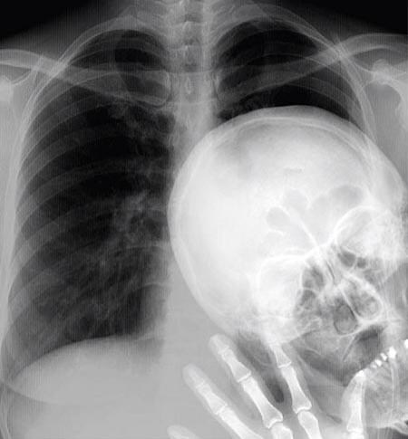
We all have that one Friend.

Slide 3
Imaging Techniques
Chest Radiography
Fluoroscopy
Bronchography
Pulmonary Angiography
CT
MRI
Ultrasonography
PET / SPECT / Scintigraphy (Nuclear Imaging)

Slide 4
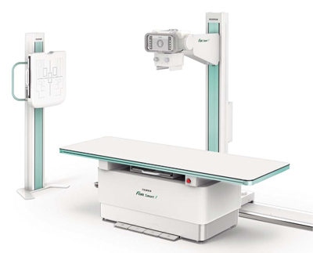
Chest Radiography (CXR)

Slide 5
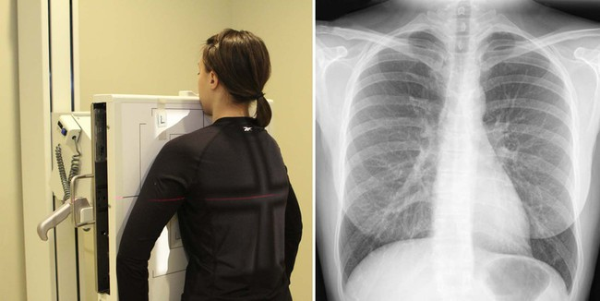
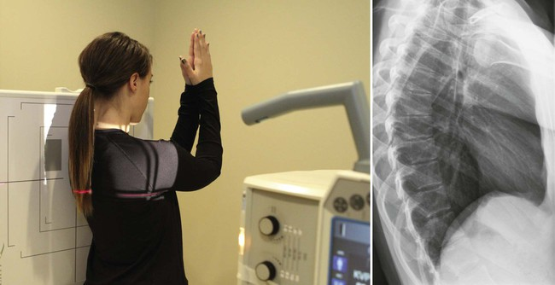
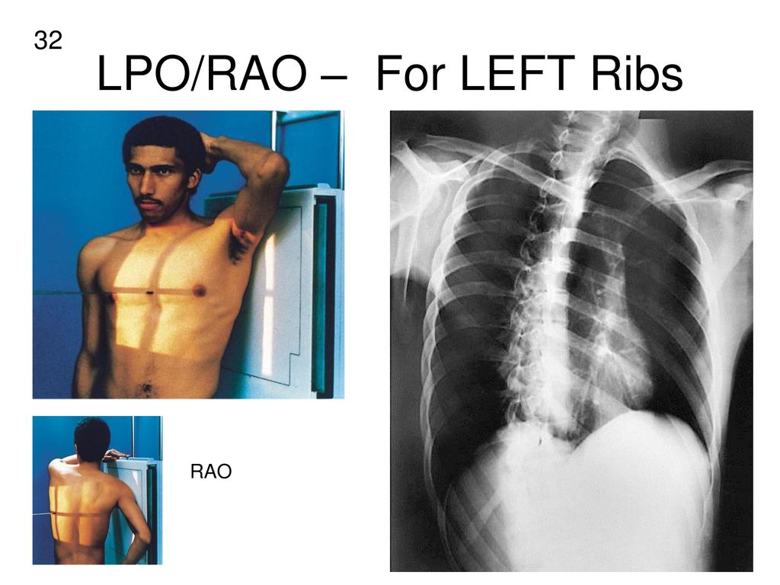
PA positioning
(Posterior-Anterior)
Lateral positioning
Oblique positioning
(Anterior/Posterior)
(Right/Left)

Slide 6
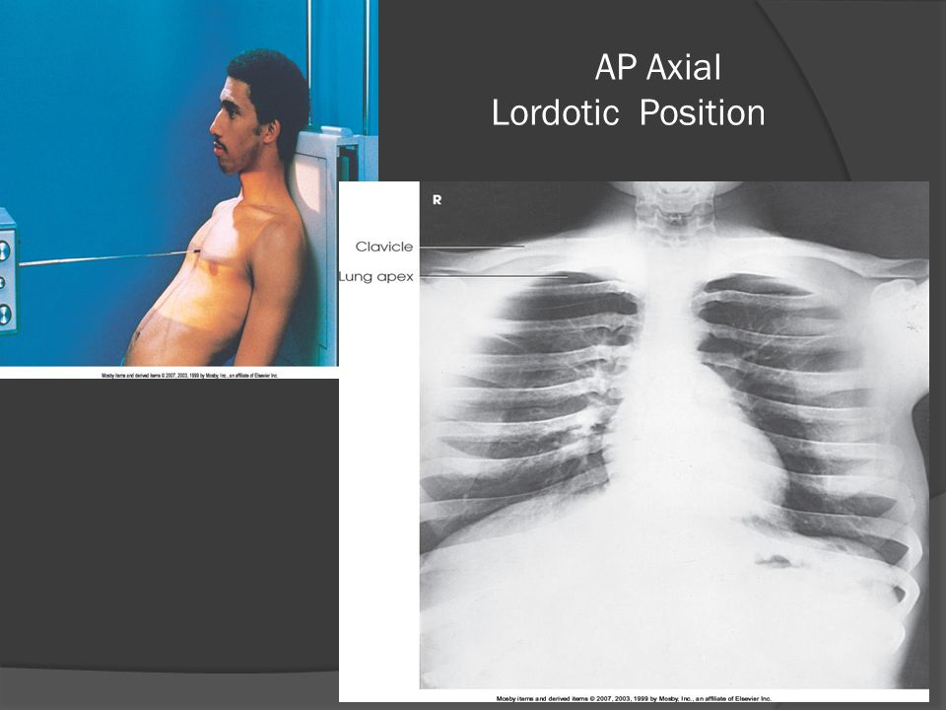
AP – Lordotic position

Slide 7
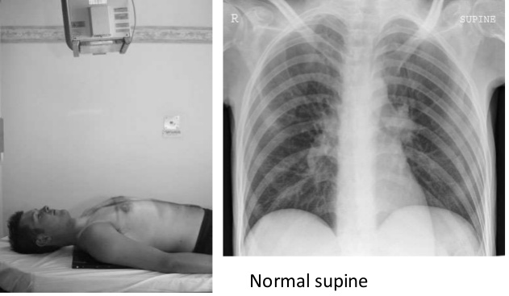
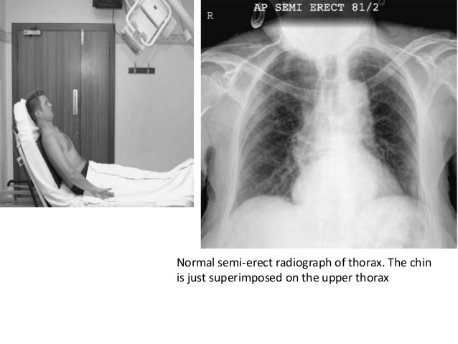
AP – Supine position
AP – Semi-Erect position

Slide 8
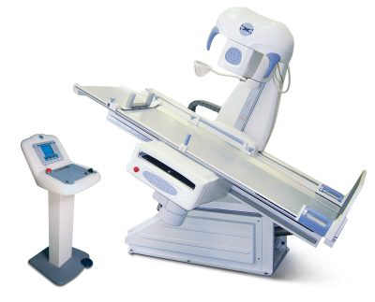
Fluoroscopy

Slide 9
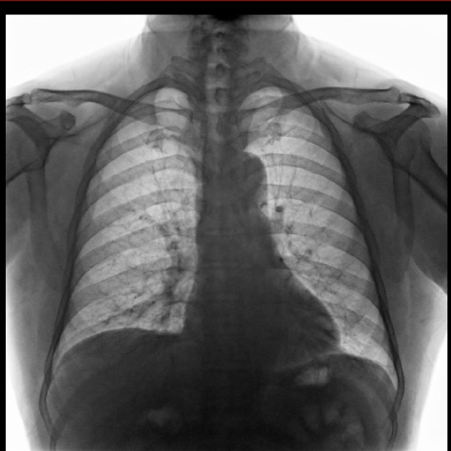
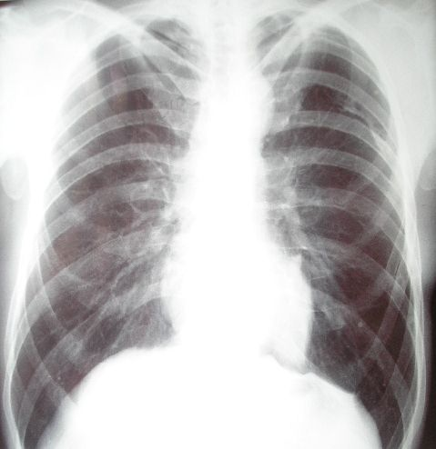
Normal Chest Radiograph
(simple photographic film)
Fluoroscopic image of the chest
(Image-Intensifying System)

Slide 10
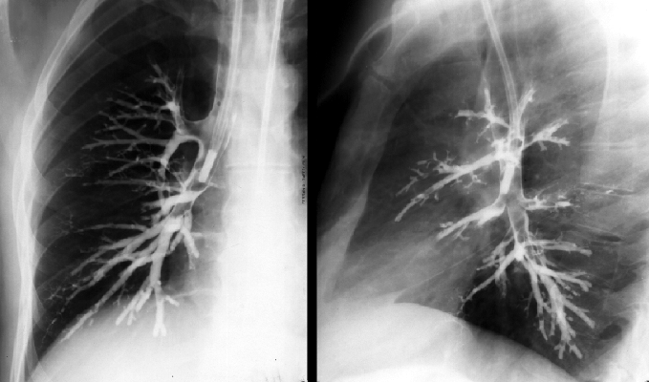
Bronchography
The Bronchography diagnostic technique is rarely used nowadays because of the advanced imaging of CT scans and the availability of Bronchoscopy examination.
Bronchoscopic tube inserted into the right bronchial tree through the esophagus and administering contrast median.

Slide 11
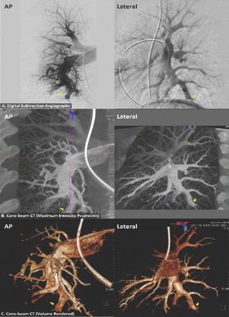
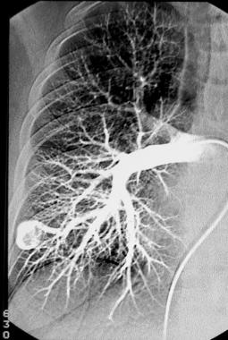
Pulmonary Angiography
An angiogram is an X-ray image of the blood vessels. It’s also called an arteriogram. It’s done to look at blood vessels that have problems. A pulmonary angiogram is an angiogram of the blood vessels of the lungs.

Slide 12
A pulmonary angiogram can show:
Blood clot (pulmonary embolism)
Bulging blood vessel (aneurysm)
An artery abnormally connected to a vein (arteriovenous malformation)
Heart and blood vessel problems present at birth
Foreign body in a blood vessel
Narrowing of a blood vessel wall (stenosis)
CT angiography (CTA) of the chest is done more often than pulmonary angiogram. A pulmonary angiogram is most often done if there is a clot that needs treatment.

Slide 13
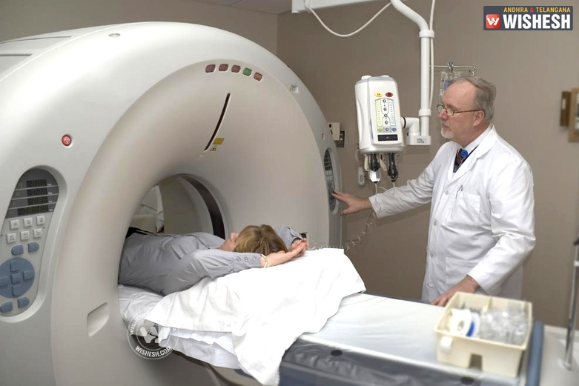
Computer Tomography

Slide 14
Computed tomography, more commonly known as a CT or CAT scan, is a diagnostic medical test that, like traditional x-rays, produces multiple images or pictures of the inside of the body.
The cross-sectional images generated during a CT scan can be reformatted in multiple planes, and can even generate three-dimensional images. These images can be viewed on a computer monitor, printed on film or by a 3D printer, or transferred to a CD or DVD.
CT images of internal organs, bones, soft tissue and blood vessels provide greater detail than traditional x-rays, particularly of soft tissues and blood vessels.
Using a variety of techniques, including adjusting the radiation dose based on patient size and new software technology, the amount of radiation needed to perform a chest CT scan can be significantly reduced. A low-dose chest CT produces images of sufficient quality to detect many lung diseases and abnormalities using much less radiation than a conventional chest CT scan—in some cases lowering the dose by 65 percent or more. Low dose chest CT is routinely used for evaluation of acquired and congenital lung abnormalities, such as pneumonia, interstitial lung disease or tumor evaluation. There is ongoing research to lower radiation doses even further.

Slide 15
Chest CT is used to:
examine abnormalities found on conventional chest x-rays.
help diagnose the causes of clinical signs or symptoms of disease of the chest, such as cough, shortness of breath, chest pain, or fever.
detect and evaluate the extent of tumors that arise in the chest, or tumors that have spread there from other parts of the body.
assess whether tumors are responding to treatment.
help plan radiation therapy.
evaluate injury to the chest, including the heart, blood vessels, lungs, ribs and spine.
evaluate abnormalities of the chest found on fetal ultrasound examinations.
Chest CT can demonstrate various lung disorders, such as:
benign and malignant tumors.
pneumonia.
tuberculosis.
bronchiectasis, cystic fibrosis.
inflammation or other diseases of the pleura (the covering of the lungs).
interstitial and chronic lung disease.
congenital abnormalities.

Slide 16
In many ways CT scanning works very much like other x-ray examinations. Different body parts absorb the x-rays in varying degrees. It is this crucial difference in absorption that allows the body parts to be distinguished from one another on an x-ray film or CT electronic image.
In a conventional x-ray exam, a small amount of radiation is aimed at and passes through the part of the body being examined, recording an image on a special electronic image recording plate. Bones appear white on the x-ray; soft tissue, such as organs like the heart or liver, shows up in shades of gray, and air appears black.
With CT scanning, numerous x-ray beams and a set of electronic x-ray detectors rotate around you, measuring the amount of radiation being absorbed throughout your body. Sometimes, the examination table will move during the scan, so that the x-ray beam follows a spiral path. A special computer program processes this large volume of data to create two-dimensional cross-sectional images of your body, which are then displayed on a monitor. CT imaging is sometimes compared to looking into a loaf of bread by cutting the loaf into thin slices. When the image slices are reassembled by computer software, the result is a very detailed multidimensional view of the body's interior.
Refinements in detector technology allow nearly all CT scanners to obtain multiple slices in a single rotation. These scanners, called multislice CT or multidetector CT, allow thinner slices to be obtained in a shorter period of time, resulting in more detail and additional view capabilities.
Modern CT scanners are so fast that they can scan through large sections of the body in just a few seconds, and even faster in small children. Such speed is beneficial for all patients but especially children, the elderly and critically ill, all of whom may have difficulty in remaining still, even for the brief time necessary to obtain images.
For children, the CT scanner technique will be adjusted to their size and the area of interest to reduce the radiation dose.

Slide 17
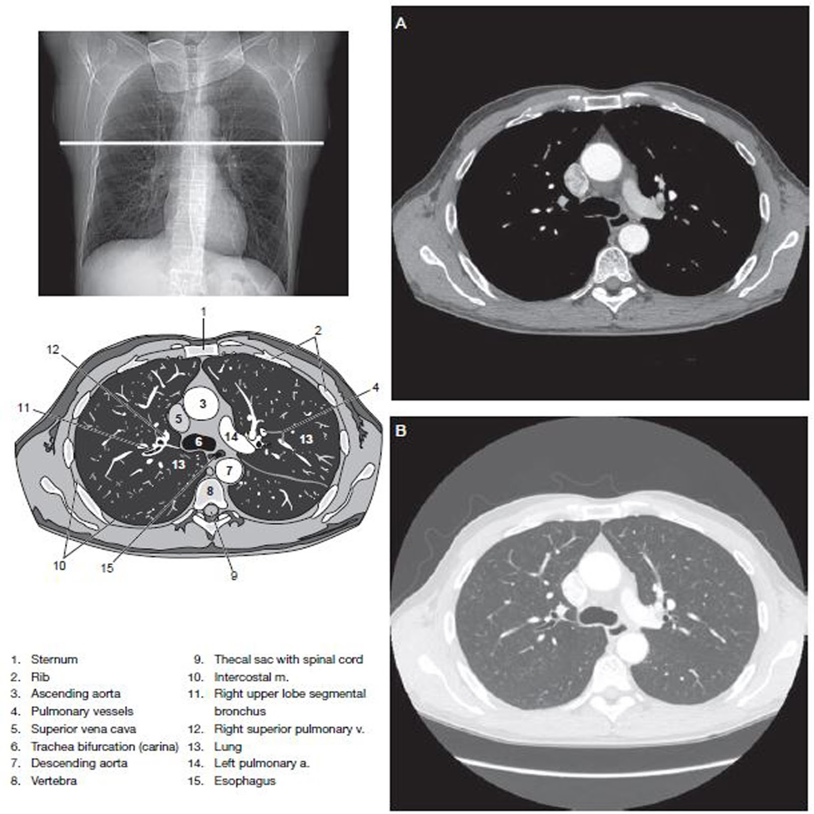

Slide 18
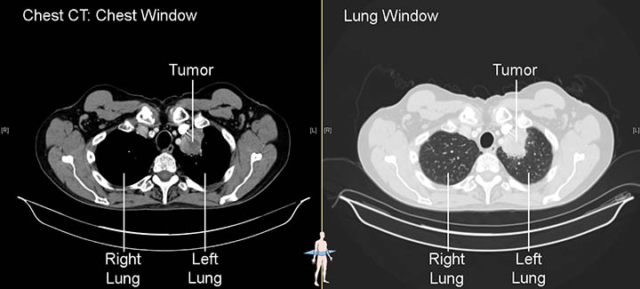
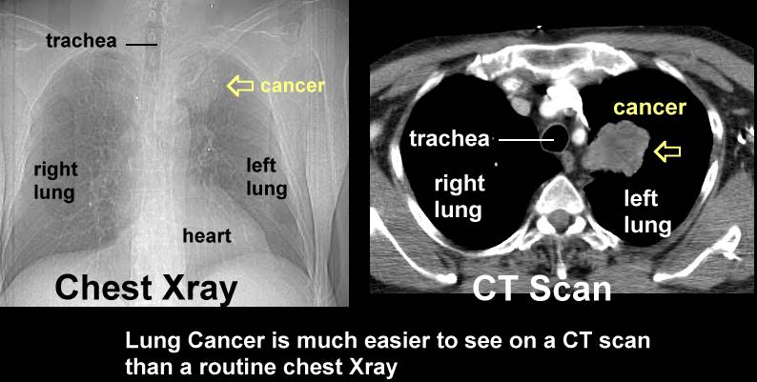

Slide 19
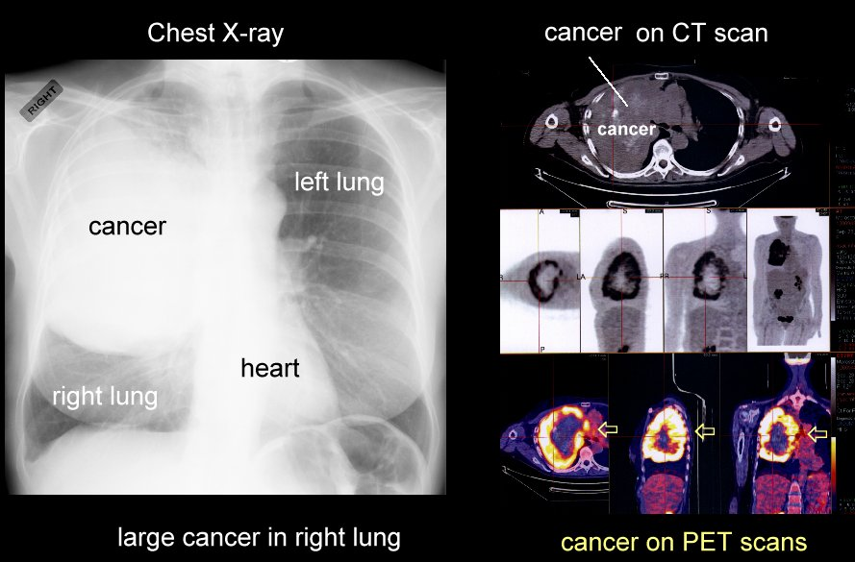

Slide 20
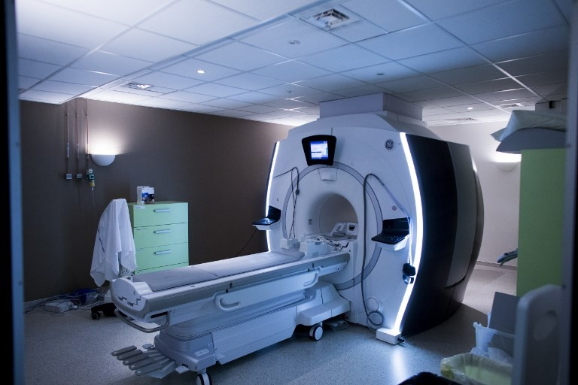
Magnetic Resonance Imaging

Slide 21
Magnetic resonance imaging (MRI) of the chest uses a powerful magnetic field, radio waves and a computer to produce detailed pictures of the structures within the chest. It is primarily used to assess abnormal masses such as cancer and determine the size, extent and degree of its spread to adjacent structures. It’s also used to assess the anatomy and function of the heart and its blood flow.
Magnetic resonance imaging (MRI) is a noninvasive medical test that physicians use to diagnose medical conditions.
MRI uses a powerful magnetic field, radio frequency pulses and a computer to produce detailed pictures of organs, soft tissues, bone and virtually all other internal body structures. MRI does not use ionizing radiation (x-rays).
Detailed MR images allow physicians to evaluate various parts of the body and determine the presence of certain diseases. The images can then be examined on a computer monitor, transmitted electronically, printed or copied to a CD or uploaded to a digital cloud server.
MRI of the chest gives detailed pictures of structures within the chest cavity, including the mediastinum, chest wall, pleura, heart and vessels, from almost any angle. MRI also provides movie-like sequential imaging of the cardiovascular system that is important to assess the health and function of these structures (heart, valves, great vessels, etc.).

Slide 22
MR imaging of the chest is performed to:
assess abnormal masses, including cancer of the lungs or other tissues, which either cannot be assessed adequately with other imaging modalities (typically CT) or which are particularly well-suited to MR imaging.
determine tumor size, extent, and the degree of spread to adjacent structures.
assess the anatomy and function of the heart and its component structures (valves, etc.).
assess myocardial perfusion (blood flow to the heart) and myocardial infarct (scar in the heart muscle due to prior obstruction of blood flow).
determine blood flow dynamics in the vessels and heart chambers.
display lymph nodes and blood vessels, including vascular and lymphatic malformations of the chest.
assess disorders of the chest bones (vertebrae, ribs and sternum) and chest wall soft tissue (muscles and fat).
assess for pericardial (thin sac around the heart) disease.
characterize mediastinal or pleural lesions seen by other imaging modalities, such as chest x-ray or CT.
A special form of MRI called magnetic resonance angiography (MRA) is helpful to assess the vessels of the chest cavity (arteries and veins). MRA can also demonstrate an abnormal ballooning out of the wall of an artery (aneurysm) or a torn inner lining of an artery (dissection).

Slide 23
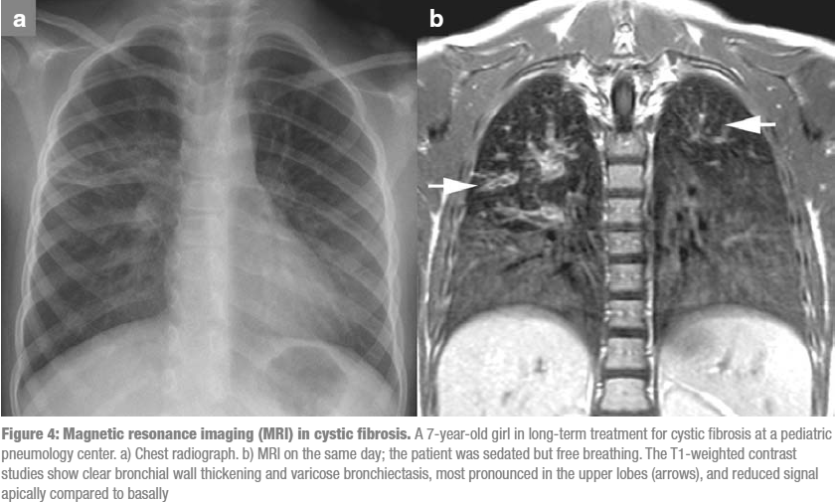

Slide 24
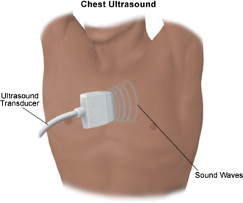
Ultrasonography

Slide 25
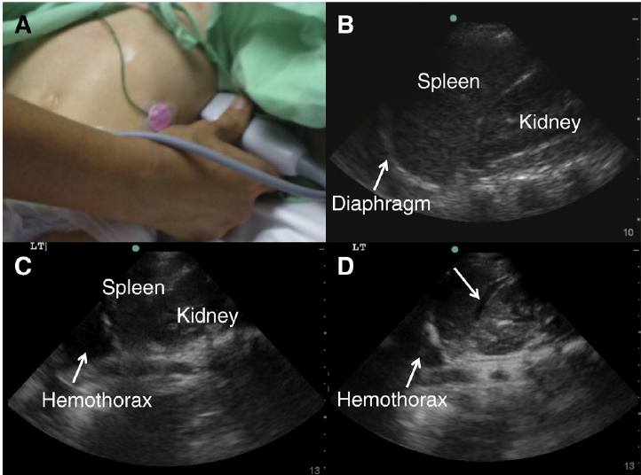

Slide 26
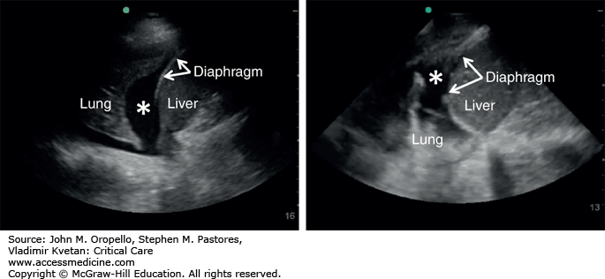
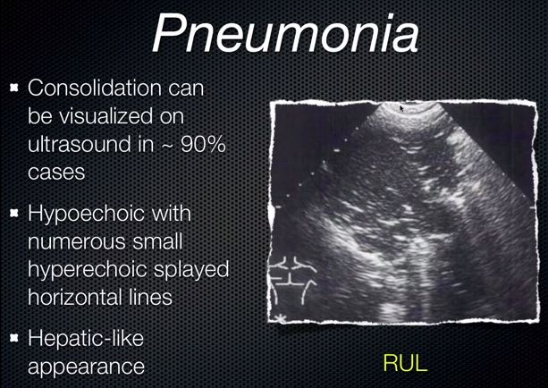

Slide 27
A chest ultrasound is a noninvasive diagnostic exam that produces images, which used to assess the organs and structures within the chest, such as the lungs, mediastinum (area in the chest containing the heart, aorta, trachea, esophagus, thymus, and lymph nodes), and pleural space (space between the lungs and the interior wall of the chest). Ultrasound technology allows quick visualization of the chest organs and structures from outside the body. Ultrasound may also be used to assess blood flow to chest organs.
Ultrasound uses a transducer that sends out ultrasound waves at a frequency too high to be heard. The ultrasound transducer is placed on the skin, and the ultrasound waves move through the body to the organs and structures within. The sound waves bounce off the organs like an echo and return to the transducer. The transducer processes the reflected waves, which are then converted by a computer into an image of the organs or tissues being examined.
The sound waves travel at different speeds depending on the type of tissue encountered - fastest through bone tissue and slowest through air. The speed at which the sound waves are returned to the transducer, as well as how much of the sound wave returns, is translated by the transducer as different types of tissue.

Slide 28
An ultrasound gel is placed on the transducer and the skin to allow for smooth movement of the transducer over the skin and to eliminate air between the skin and the transducer for the best sound conduction.
Another type of ultrasound is Doppler ultrasound, sometimes called a duplex study, used to show the speed and direction of blood flow within the chest. Unlike a standard ultrasound, some sound waves during the Doppler exam are audible.
Ultrasound may be safely used during pregnancy or in the presence of allergies to contrast dye, because no radiation or contrast dyes are used. A chest ultrasound may used to assess the presence of excess fluid in the pleural space or other areas of the chest, especially when the amount of fluid is small. If excess fluid is present, ultrasound may be useful to determine the type of fluid, exudate (seen in inflammatory, cancerous, or infectious conditions) or transudate (fluid that has leaked from blood or lymph vessels for various reasons). It can also be used to evaluate the heart and its valves. When used for this purpose, the procedure is called an echocardiogram.
Chest ultrasound may be performed to guide a needle during thoracentesis(puncture of the chest wall for the removal of fluids) or biopsy. Another use of chest ultrasound is to assess the movement of the diaphragm.
Chest ultrasound may be used along with other types of diagnostic methods, such as CT scanning, X-rays, or magnetic resonance imaging (MRI) for evaluation and diagnosis of conditions of the chest.

Slide 29
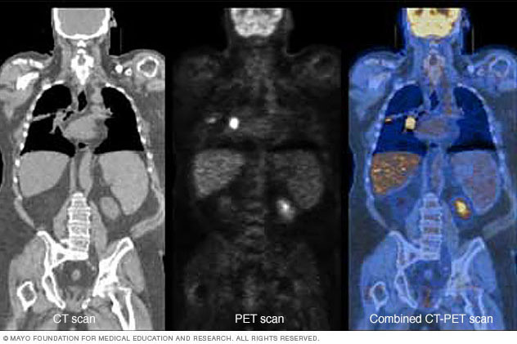
Nuclear Imaging

Slide 30
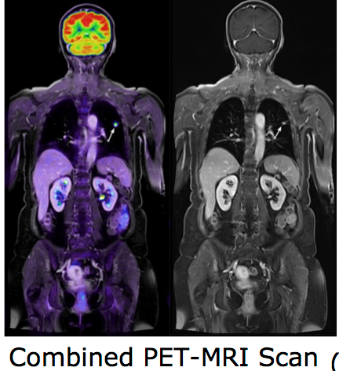
Positron emission tomography (PET or PET scan) is a specialized radiology procedure used to examine various body tissues to identify certain conditions. PET may also be used to follow the progress of the treatment of certain conditions. While PET is most commonly used in the fields of neurology, oncology, and cardiology, applications in other fields are currently being studied.
PET is a type of nuclear medicine procedure. This means that a small amount of a radioactive substance, called a radionuclide (radiopharmaceutical or radiotracer), is used to perform the procedure. Specifically, PET studies evaluate the metabolism of a particular organ or tissue, so that information about the physiology (functionality) and anatomy (structure) of the organ or tissue is evaluated, as well as its biochemical properties. Thus, PET may detect biochemical changes in an organ or tissue that can identify the onset of a disease process before anatomical changes related to the disease can be seen with other imaging processes, such as computed tomography (CT scan)or magnetic resonance imaging (MRI).

Slide 31
PET is most often used by oncologists (doctors specializing in cancer treatment), neurologists and neurosurgeons (doctors specializing in treatment and surgery of the brain and nervous system), and cardiologists (doctors specializing in the treatment of the heart). However, as advances in PET technologies continue, this procedure is beginning to be used more widely in other areas.
PET is also being used in conjunction with other diagnostic tests such as computed tomography (CAT scan) to provide more definitive information about malignant (cancerous) tumors and other lesions. The combination of PET and CT shows particular promise in the diagnosis and treatment of many types of cancer. PET works by using a scanning device (a machine with a large hole at its center) to detect positrons (subatomic particles) emitted by a radionuclide in the organ or tissue being examined.
The radiotracers used in PET scans are made by attaching a radioactive atom to chemical substances that are used naturally by the particular organ or tissue during its metabolic process. For example, in PET scans of the brain, a radioactive atom is applied to glucose (blood sugar) to create a radionuclide called fluorodeoxyglucose (FDG), because the brain uses glucose for its metabolism. FDG is widely used in PET scanning.
Other substances may be used for PET scanning, depending on the purpose of the scan. If blood flow and perfusion of an organ or tissue is of interest, the radionuclide may be a type of radioactive oxygen, carbon, nitrogen, or gallium.

Slide 32
The radionuclide is administered into a vein through an intravenous (IV) line. Next, the PET scanner slowly moves over the part of the body being examined. Positrons are emitted by the breakdown of the radionuclide. Gamma rays are created during the emission of positrons, and the scanner then detects the gamma rays. A computer analyzes the gamma rays and uses the information to create an image map of the organ or tissue being studied. The amount of the radionuclide collected in the tissue affects how brightly the tissue appears on the image, and indicates the level of organ or tissue function.
In general, PET scans may be used to evaluate organs and/or tissues for the presence of disease or other conditions. PET may also be used to evaluate the function of organs such as the heart or brain. Another use of PET scans is in the evaluation of the treatment of cancer.
More specific reasons for PET scans include, but are not limited to, the following:
To diagnose dementias such as Alzheimer's disease, as well as other neurological conditions such as Parkinson's disease (a progressive disease of the nervous system in which a fine tremor, muscle weakness, and a peculiar type of gait are seen), Huntington's disease (a hereditary disease of the nervous system which causes increasing dementia, bizarre involuntary movements, and abnormal posture), epilepsy (a brain disorder involving recurrent seizures), and cerebrovascular accident (stroke)
To locate the specific surgical site prior to surgical procedures of the brain
To evaluate the brain after trauma to detect hematoma (blood clot), bleeding, and/or perfusion (blood and oxygen flow) of the brain tissue
To detect the spread of cancer to other parts of the body from the original cancer site
To evaluate the effectiveness of cancer treatment
To evaluate the perfusion to the myocardium (heart muscle) as an aid in determining the usefulness of a therapeutic procedure to improve blood flow to the myocardium
To further identify lung lesions or masses detected on chest X-ray and/or chest CT
To assist in the management and treatment of lung cancer by staging lesions and following the progress of lesions after treatment
To detect recurrence of tumors earlier than with other diagnostic modalities

Slide 33
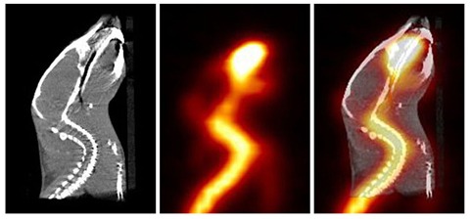
CT of a mouse.
PET of a mouse
Combined CT + PET of the mouse

Slide 34
SPECT imaging instruments provide three-dimensional (tomographic) images of the distribution of radioactive tracer molecules that have been introduced into the patient’s body. The 3D images are computer generated from a large number of projection images of the body recorded at different angles. SPECT imagers have gamma camera detectors that can detect the gamma rayemissions from the tracers that have been injected into the patient. Gamma rays are a form of light that moves at a different wavelength than visible light. The cameras are mounted on a rotating gantry that allows the detectors to be moved in a tight circle around a patient who is lying motionless on a pallet.

Slide 35
PET scans also use radiopharmaceuticals to create three-dimensional images. The main difference between SPECT and PET scans is the type of radiotracers used. While SPECT scans measure gamma rays, the decay of the radiotracers used with PET scans produce small particles called positrons. A positron is a particle with roughly the same mass as an electron but oppositely charged. These react with electrons in the body and when these two particles combine they annihilate each other. This annihilation produces a small amount of energy in the form of two photons that shoot off in opposite directions. The detectors in the PET scanner measure these photons and use this information to create images of internal organs.

Slide 36
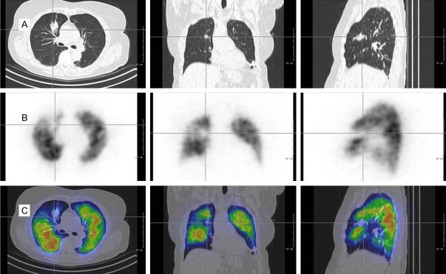
CT scan (line A-transaxial, coronal and sagittal slice) helps to characterize the cause of SPECT perfusion abnormalities (line B). The fused SPECT/CT images (line C) show the perfusion defect to correspond with parenchymal consolidation in this case. The perfusion defect does not correspond to pulmonary embolism but corresponds to parenchymal changes.

Slide 37
V/Q scanning
V/Q scanning uses inhaled radionuclides to detect ventilation and IV radionuclides to detect perfusion. Areas of ventilation without perfusion, perfusion without ventilation, or matched increases and decreases in both can be detected with 6 to 8 views of the lungs.
V/Q scanning is most commonly used for diagnosing pulmonary embolism but has largely been replaced by CT angiography. However, V/Q scanning is still indicated in the diagnostic evaluation for chronic thromboembolic pulmonary hypertension.

Slide 38
