Slide 1
Physical and technical fundamentals of X-ray and CT imaging
Ahmad Kauk , MD Radiologist, EDIR teaching assistant Department of Radiation Diagnostics, Therapy, Radiation medicine and Oncology
Odessa State Medical University

Slide 2
X-ray and СT imaging metods use the same type of energy - X-ray radiation.

Slide 3
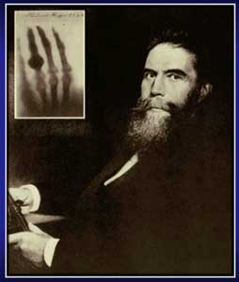
Discovery of X-rays
Wilhelm Conrad Roentgen
Born 1845 in Lennep, Germany. In 1869, he graduated with a Ph.D. from the University of Zurich.

Slide 4
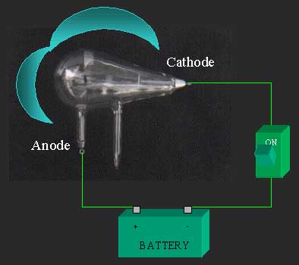
Discovery of X-rays
During 1895 Röntgen was investigating the external effects from the various types of vacuum tube equipment — apparatuses from Heinrich Hertz, Johann Hittorf, William Crookes, Nikola Tesla and Philipp von Lenard — when an electrical discharge is passed through them.
Crookes vacuum tube

Slide 5
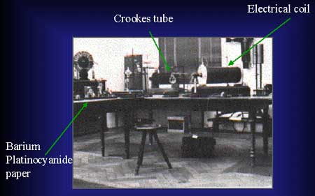
Discovery of X-rays
In early November, he was repeating an experiment with one of Lenard's tubes in which a thin aluminium window had been added to permit the cathode rays to exit the tube but a cardboard covering was added to protect the aluminium from damage by the strong electrostatic field that is necessary to produce the cathode rays.
Roentgen's Laboratory

Slide 6
Discovery of X-rays
He knew the cardboard covering prevented light from escaping, yet Röntgen observed that the invisible cathode rays caused a fluorescent effect on a small cardboard screen painted with barium platinocyanide when it was placed close to the aluminium window. It occurred to Röntgen that the Hittorf-Crookes tube, which had a much thicker glass wall than the Lenard tube, might also cause this fluorescent effect.
Roentgen's Laboratory

Slide 7
Discovery of X-rays
In the late afternoon of 8 November 1895, Röntgen was determined to test his idea. He covered the Hittorf-Crookes tube with the cardboard and attached electrodes to a Ruhmkorff coil to generate an electrostatic charge. Before setting up the barium platinocyanide screen to test his idea, Röntgen darkened the room to test the opacity of his cardboard cover. As he passed the Ruhmkorff coil charge through the tube, he determined that the cover was light-tight and turned to prepare the next step of the experiment. It was at this point that Röntgen noticed a faint shimmering from a bench a few feet away from the tube. Röntgen speculated that a new kind of ray might be responsible.
Roentgen's Laboratory

Slide 8
Discovery of X-rays
8 November was a Friday, so he took advantage of the weekend to repeat his experiments and make his first notes. In the following weeks he ate and slept in his laboratory as he investigated many properties of the new rays he temporarily termed "X-rays", using the mathematical designation ("X") for something unknown. The new rays came to bear his name in many languages as "Röntgen Rays" (and the associated X-ray radiograms as "Röntgenograms").
Roentgen's Laboratory

Slide 9
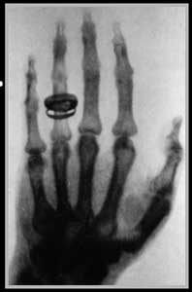
Discovery of X-rays
Nearly two weeks after his discovery, he took the very first picture using X-rays of his wife Anna Bertha's hand. When she saw her skeleton she exclaimed "I have seen my death!“

Slide 10
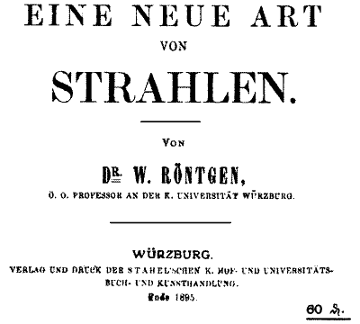
Discovery of X-rays
Röntgen's original paper, "On A New Kind Of Rays" (Über eine neue Art von Strahlen), was published on 28 December 1895. On 5 January 1896, an Austrian newspaper reported Röntgen's discovery of a new type of radiation. Röntgen was awarded an honorary Doctor of Medicine degree from the University of Würzburg after his discovery. He published a total of three papers on X-rays between 1895 and 1897.

Slide 11
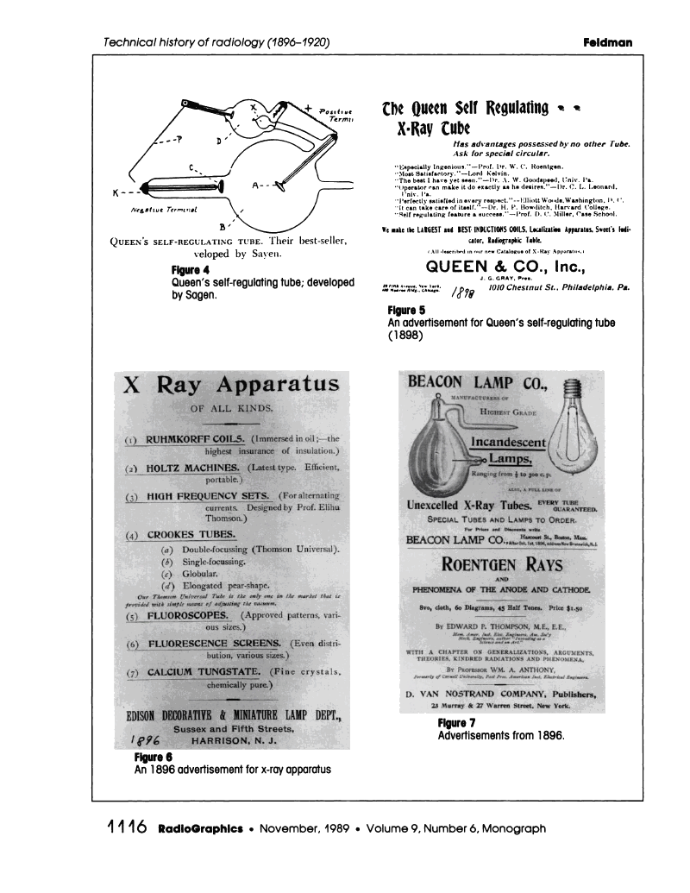
Discovery of X-rays

Slide 12
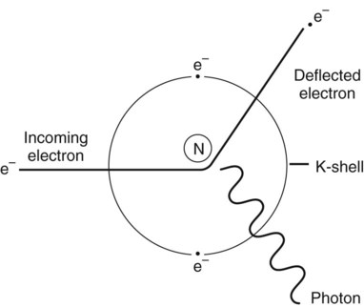
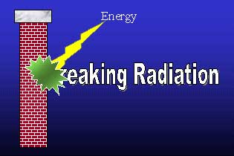
Bremsstrahlung Radiation
Bremsstrahlung is created when an incoming electron slows suddenly near the nucleus (N) of the tungsten atom and abruptly changes direction, resulting in the creation of an x-ray photon.

Slide 13
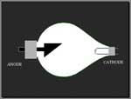
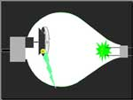
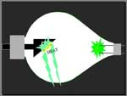
Bremsstrahlung Radiation
Modern Tube

Slide 14
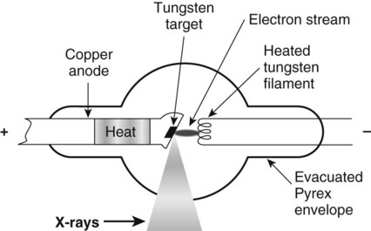
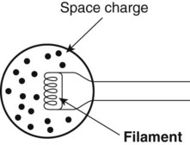
X-Ray Tube
Thermionic emission. As tungsten is heated, electrons in the tungsten atom’s orbits spin faster, moving farther from the nucleus. Electrons in outer orbits are flung out of the atom, forming an “electron cloud” or space charge. The space charge provides the electron source for x-ray production.
Simple x-ray tube. The anode is the positive end of the tube; the target is part of the anode. The cathode is the negative end of the tube; the filament is part of the cathode. The energy of the electron stream is converted at the anode into heat (>99%) and x-rays (<1%).

Slide 15
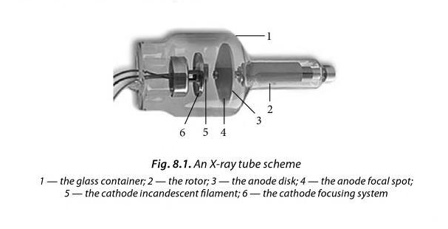
X-Ray Tube

Slide 16
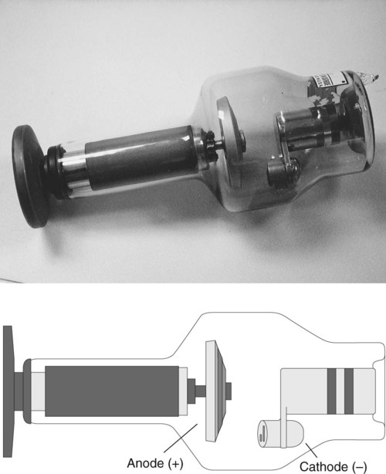
Dual focus
X-Ray Tube

Slide 17
The basic methods of X-ray imaging
Fluoroscopy (roentgenoscopy)
Roentgenography
Fluorography
Additional methods of X-ray imaging
Tomography (X-ray linear tomography, Computed tomography)
Angiography
Funcional Roentgenography

Slide 18
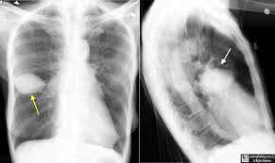
An X-ray image is an object's model which gives the true idea of the localization, form, sizes, structure and, in some cases, function of human organs and systems.

Slide 19
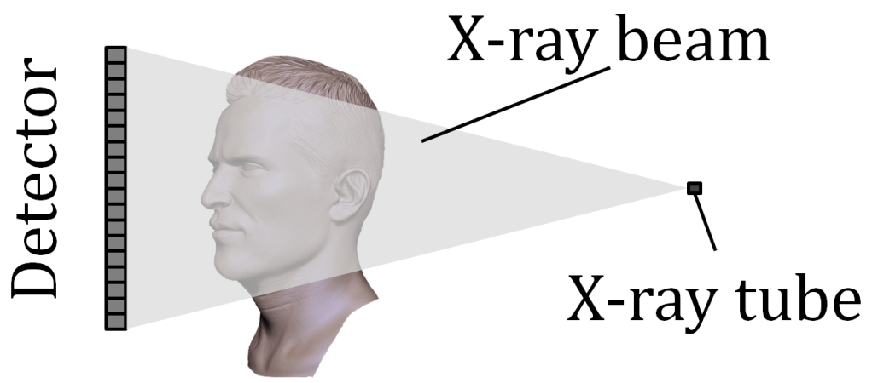
X-Ray Image formation
In radiography, image formation is done by a receptor (i.e. detector) placed at the opposite side of the X ray tube, which captures non-attenuated (primary or scattered) X rays
  Stationary tube/receptor (X-ray machine)
  Moving tube/receptor (CT-scan)
  Receptor = film or digital

Slide 20
Detectors
Receivers (detectors) are necessary for visualizing the X-rays which have passed through the object being investigated. For visualizing an image they use special fluorescent screens, cassettes with X-ray film, radiation detectors with an EOA (electro-optical amplifier) and digital systems of image visualization.
Film detector
Digital detector

Slide 21
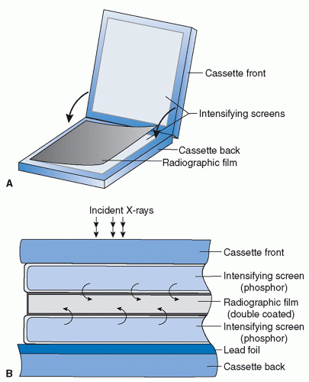
Film detector
A screen-film cassette whose configuration is featured by a double-emulsion sheet in between two phosphor screens (A). Compared to the use of single-emulsion film and/or single screen, this configuration has high sensitivity to incoming X-rays at the expense of compromised spatial resolution (cross-sectional view shown in B)

Slide 22
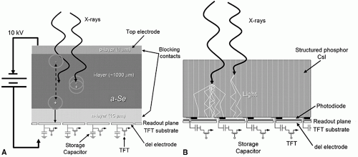
Digital detector
Flat panel detectors (FPDs)
X-ray detection by FPD is a two-step process: first, detected X-ray photons are converted into charges; then these charges are collected and read out by dedicated electronics.

Slide 23
X-Ray Image formation
The detector will capture a projection of the object under investigation
(Simplified representation)

Slide 24
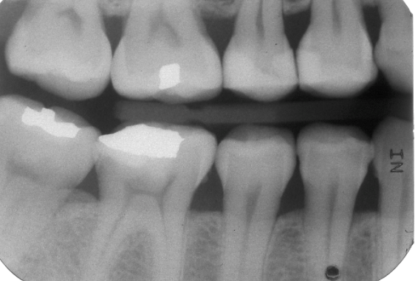
X-Ray Image formation
Based on the intensity of X rays hitting the receptor at a given point, the image at that point will be:
  Darker: more X rays hitting receptor (lower attenuation)
  Brighter: less X rays hitting receptor (higher attenuation)
  This is a convention resulting from the image formation process in film radiography; in digital radiography the signal is inversely proportionate to attenuation, implying that the image is inverted at some point during processing
X RAY TUBE
Low signal
High signal
Low signal

Slide 25
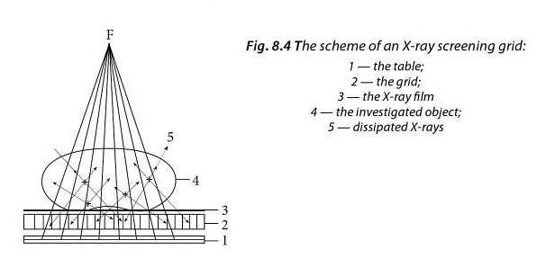
Dissipated radiation and X-ray screening grids
X-ray grids are built of thin lead plates places parallelly to the X-ray beam direction (narrow intervals between plates are left). At the moment of roentgenography the quanta of the X-rays that coincide with the primary beam direction penetrate freely through the grid in the film, while the is absorbed by the lead plates of the grid (Fig. 8.4).

Slide 26
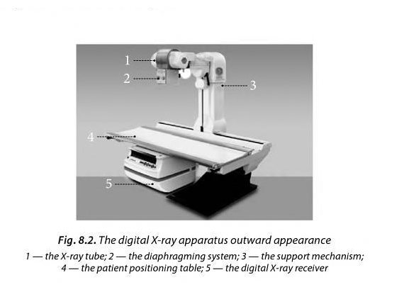
The X-ray diagnostic apparatus
is composed of an X-ray radiation generator (an X-ray tube), a high-voltage source, a support mechanism, an X-ray receiver and a control panel.

Slide 27
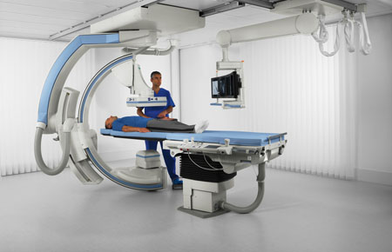
The basic methods of X-ray imaging
Fluoroscopy (roentgenoscopy) — the method of transmissing an object and obtaining an image on the fluorescent screen.
Advantage:
multiaxial, polypositional investigation
studying organs' functional state.
Disadvantage:
low resolution capacity
greater X-ray load as compared to roentgenography.

Slide 28
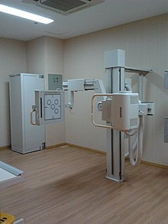
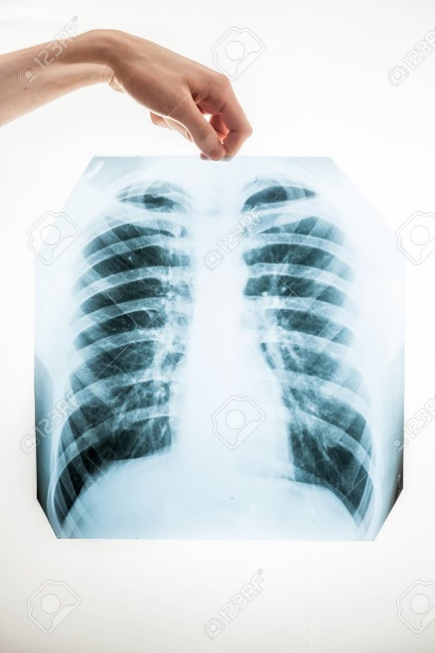
The basic methods of X-ray imaging
Roentgenography (film) is a method of obtaining an X-ray image on an X-ray film on low-dose receivers of X-rays with the digital processing of an object.
Advantages:
high resolution capacity (as compared to fluoroscopy)
lesser X-ray load as compared to fluoroscopy.

Slide 29
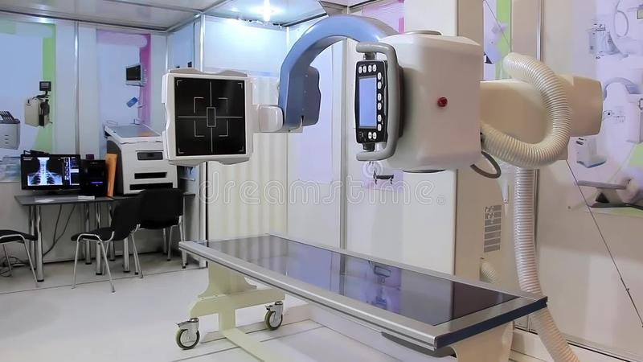
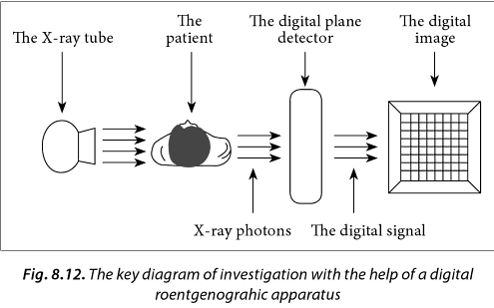
The basic methods of X-ray imaging
The digital technology of X-ray images visualization lies in using low-dose X-ray receivers and digital image processing (digital roentgenography).
Advantages — a decrease as many as 20–30 times of an X-ray load on a patient and excluding the use of an X-ray film and photolaboratory process.

Slide 30
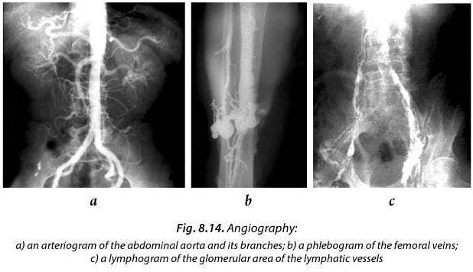
Additional methods of X-ray imaging
Angiography (part of “Interventional Radiology”) is the general name for the methods of blood vessels X-ray imaging during which vessels are filled with a contrast liquid through a special catheter, then a series of X-ray images is performed.

Slide 31
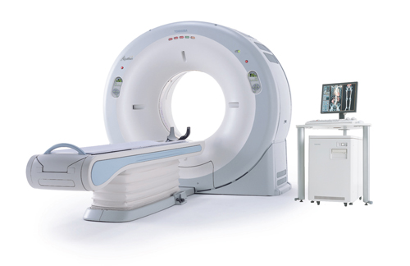
The Additional methods of X-ray imaging
COMPUTED TOMOGRAPHY (CT)
- it is a medical imaging method employing tomography where digital geometry processing is used to generate a three-dimensional image of the internals of an object from a large series of two-dimensional X-ray images taken around a single axis of rotation.

Slide 32
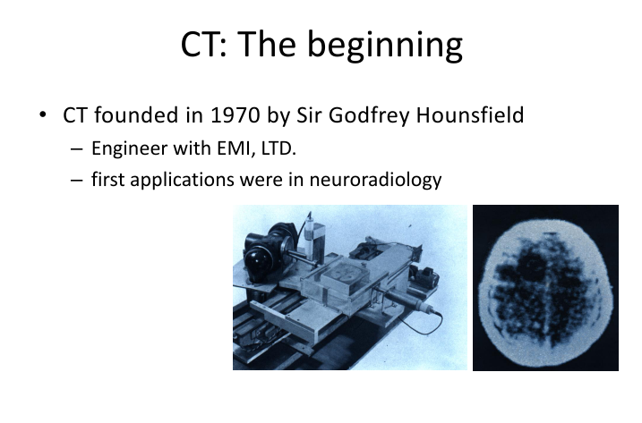

Slide 33
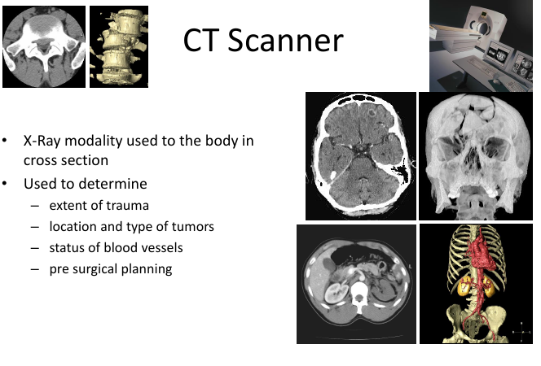

Slide 34
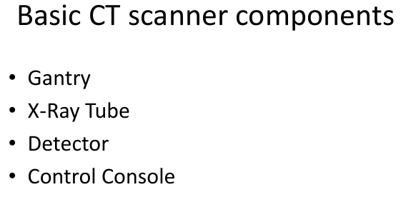

Slide 35
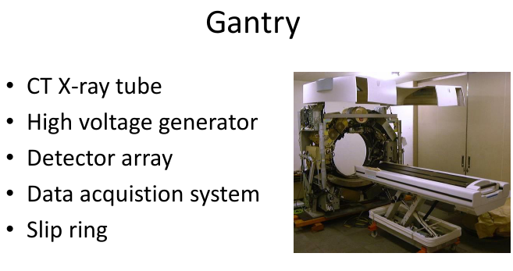

Slide 36
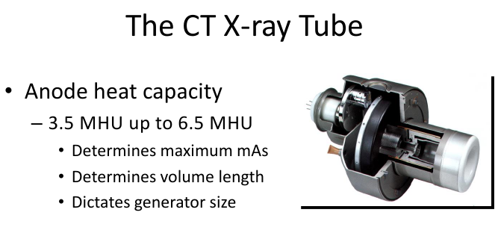

Slide 37
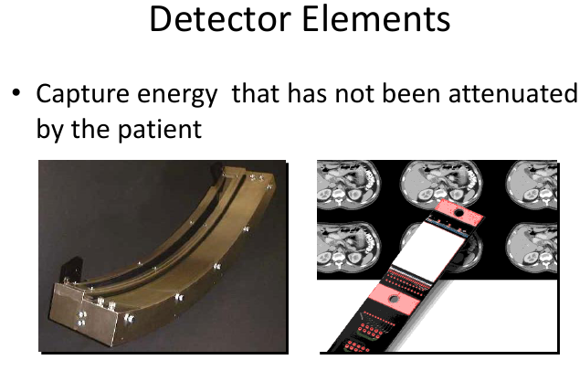

Slide 38
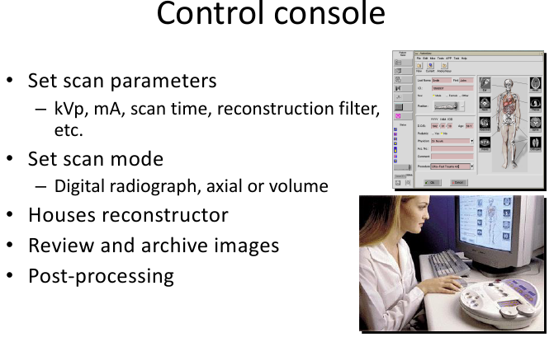

Slide 39
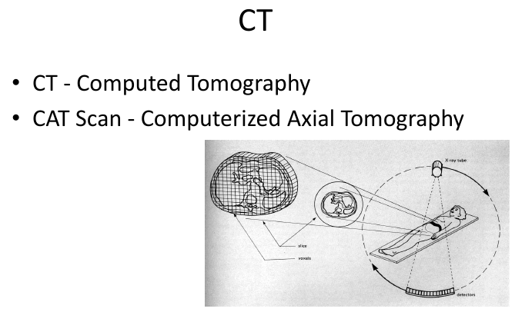

Slide 40
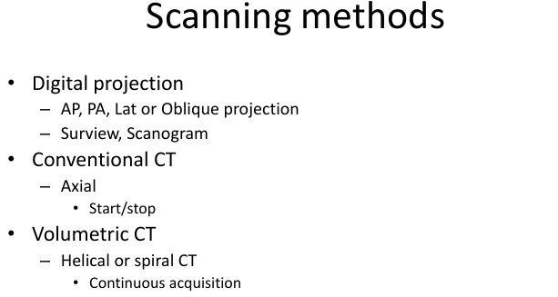

Slide 41
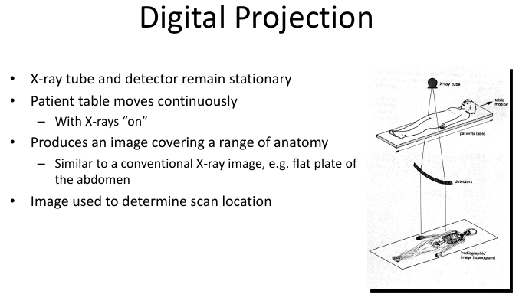

Slide 42
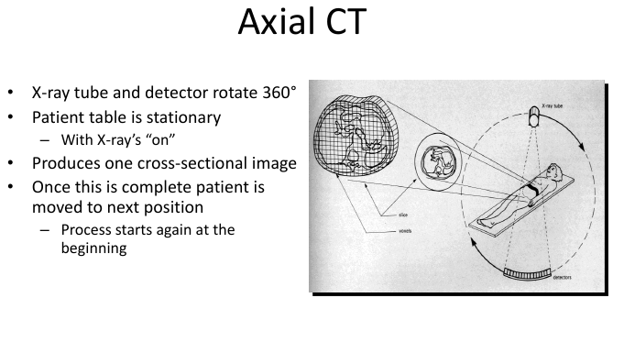

Slide 43
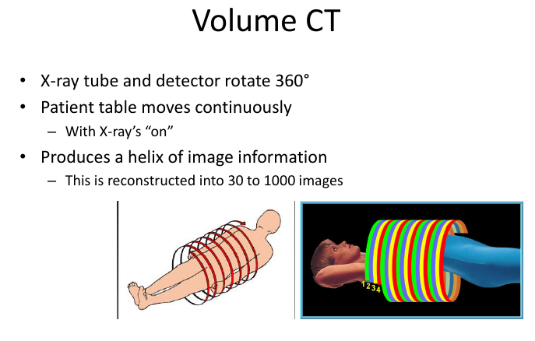

Slide 44
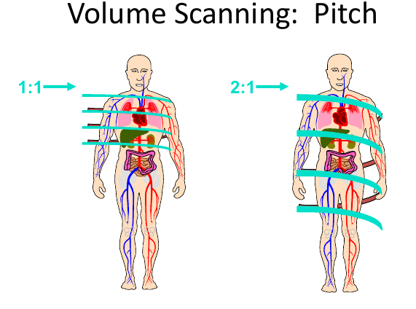
- is a term used in helical CT
The term detector pitch is used and is defined as table distance traveled in one 360° gantry rotation divided by beam collimation
For example, if the table traveled 5 mm in one rotation and the beam collimation was 5 mm then pitch equals 5 mm / 5 mm = 1.0.

Slide 45
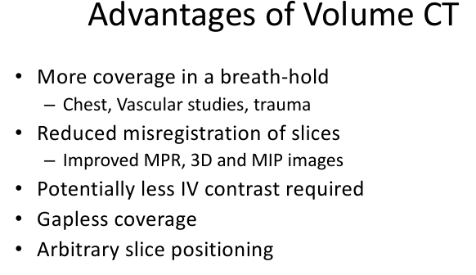

Slide 46
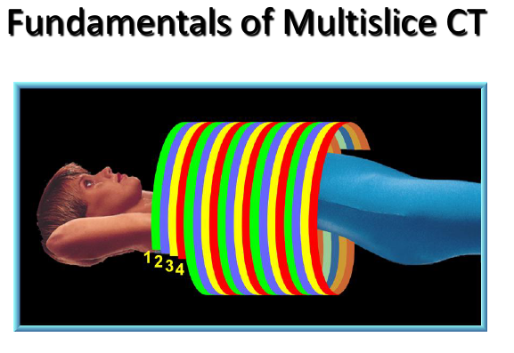

Slide 47
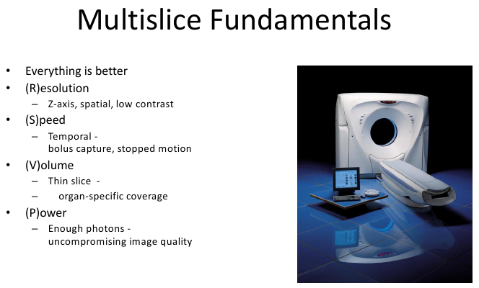

Slide 48
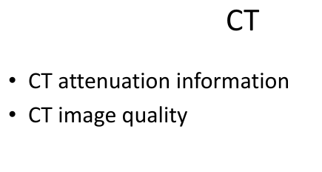

Slide 49
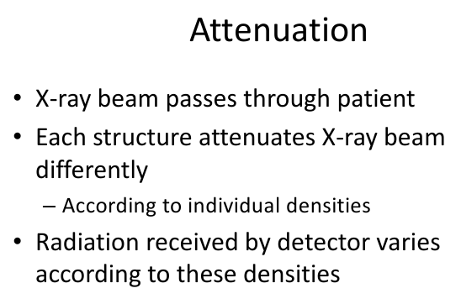

Slide 50
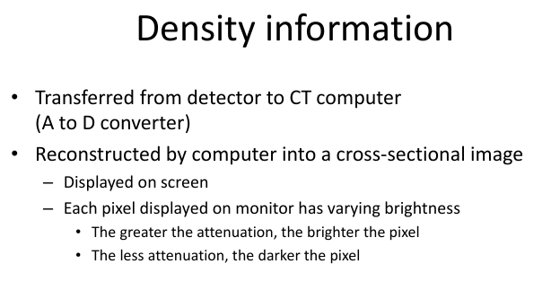

Slide 51
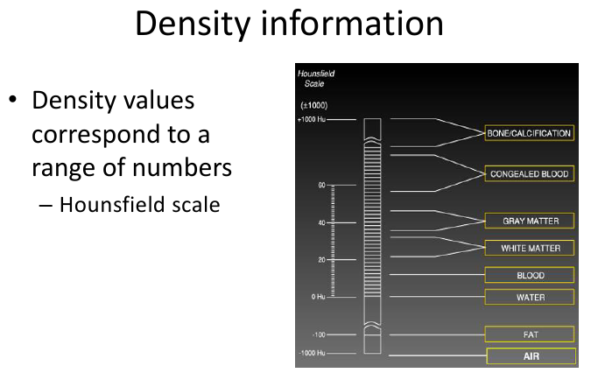

Slide 52
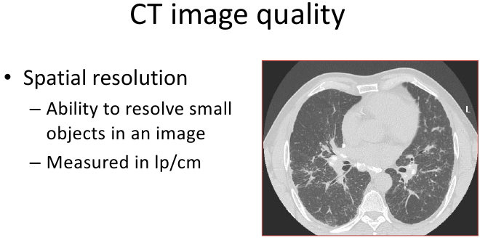

Slide 53


Slide 54


Slide 55


Slide 56


Slide 57


Slide 58


Slide 59


Slide 60


Slide 61
Thank you !

