Slide 1
Radiation signs of diseases of the musculoskeletal system.
Odessa National Medical University
Odessa
As. Elena Kabachynskaya
Department of Radiation Diagnostics, Therapy, Radiation medicine and Oncology

Slide 2
Objectives
Discuss:
  commonly used imaging modalities in the musculoskeletal system
  normal imaging anatomy in the extremities
  fracture description

Slide 3
Imaging Techniques
Plain x-rays
CT
MRI
Ultrasound
Nuclear Medicine (bone scan)

Slide 4
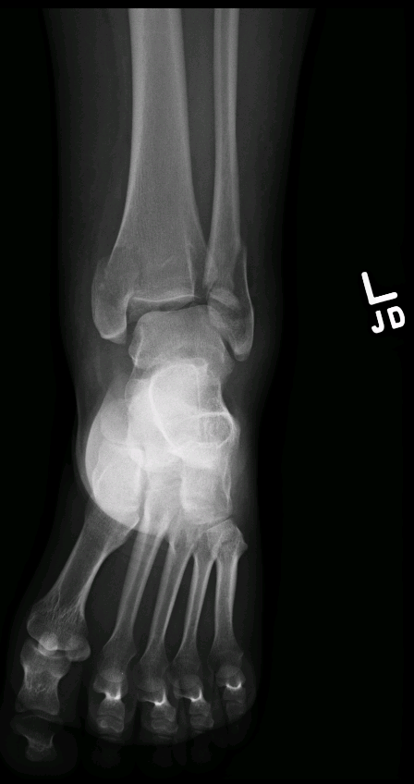
Plain x-rays
For joints like the ankle,
elbow or wrist we always
take 3 views:
AP, lateral and oblique

Slide 5
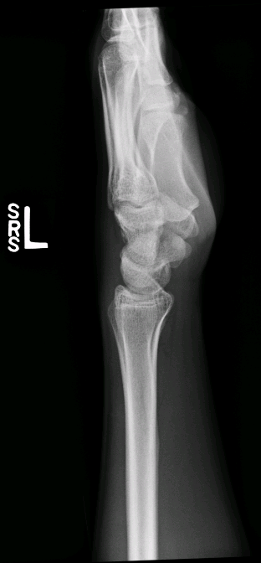
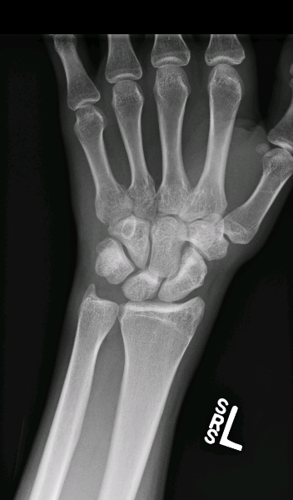
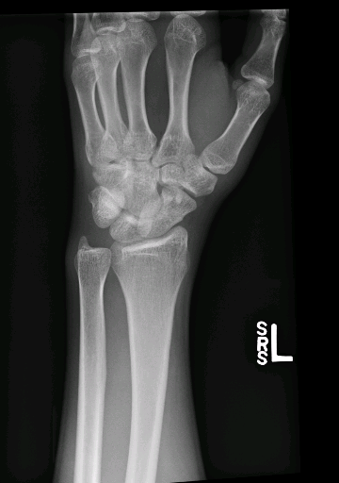
3 views: AP, oblique and lateral

Slide 6
Advantages of plain x-rays
Quick
Not expensive
Relatively low radiation

Slide 7
Disadvantages of plain x-rays
Not 3 dimensional
Can miss pathology
May still require other imaging studies

Slide 8
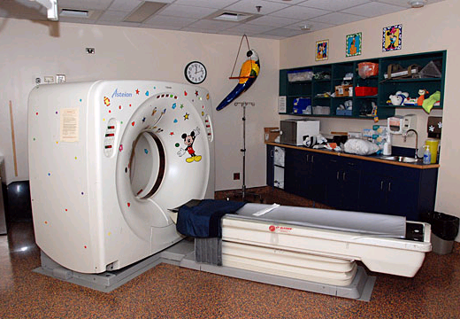
CT scanner

Slide 9
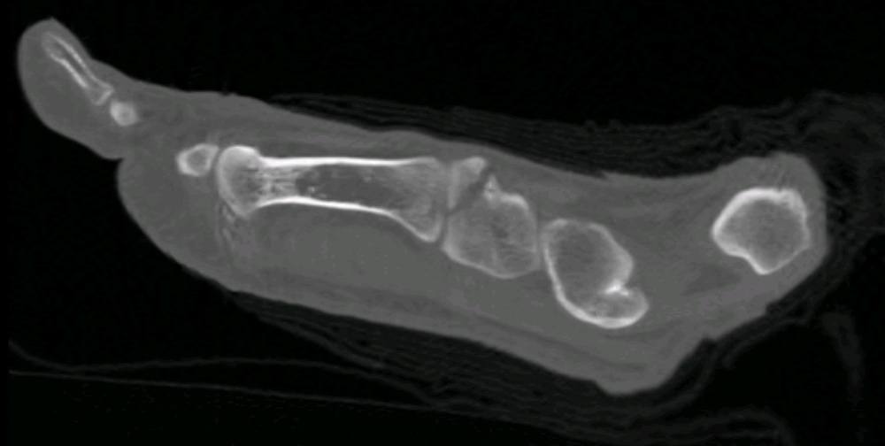
Great toe
This is a CT scan: a longitudinal cross section
This CT shows a fracture through the medial cunieform

Slide 10
Advantages of CT scanning of the musculoskeletal system
Excellent anatomic detail
Will detect almost all pathology related to cortical bone injury
Great for showing displacement or joint involvement
Now multiplanar

Slide 11
Disadvantages of CT
Expensive (x-ray $100, CT $1000)
More radiation
Often not necessary

Slide 12
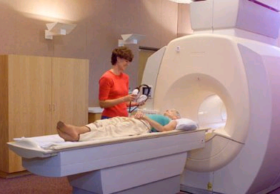
MRI scanner
Looks more like a tunnel, must be very careful of metal

Slide 13
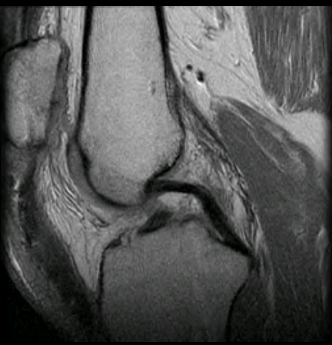
This is an MRI of the knee
There is no radiation used
Circled is a normal posterior cruciate ligament

Slide 14
Advantages of MRI
No radiation
We can slice through the body using any imaging plane
Looks “inside” bone. Marrow evaluation.
MRI is very good for looking at the soft tissues (muscles, ligaments, tendons and cartilage)
MRI is very sensitive in detecting water

Slide 15
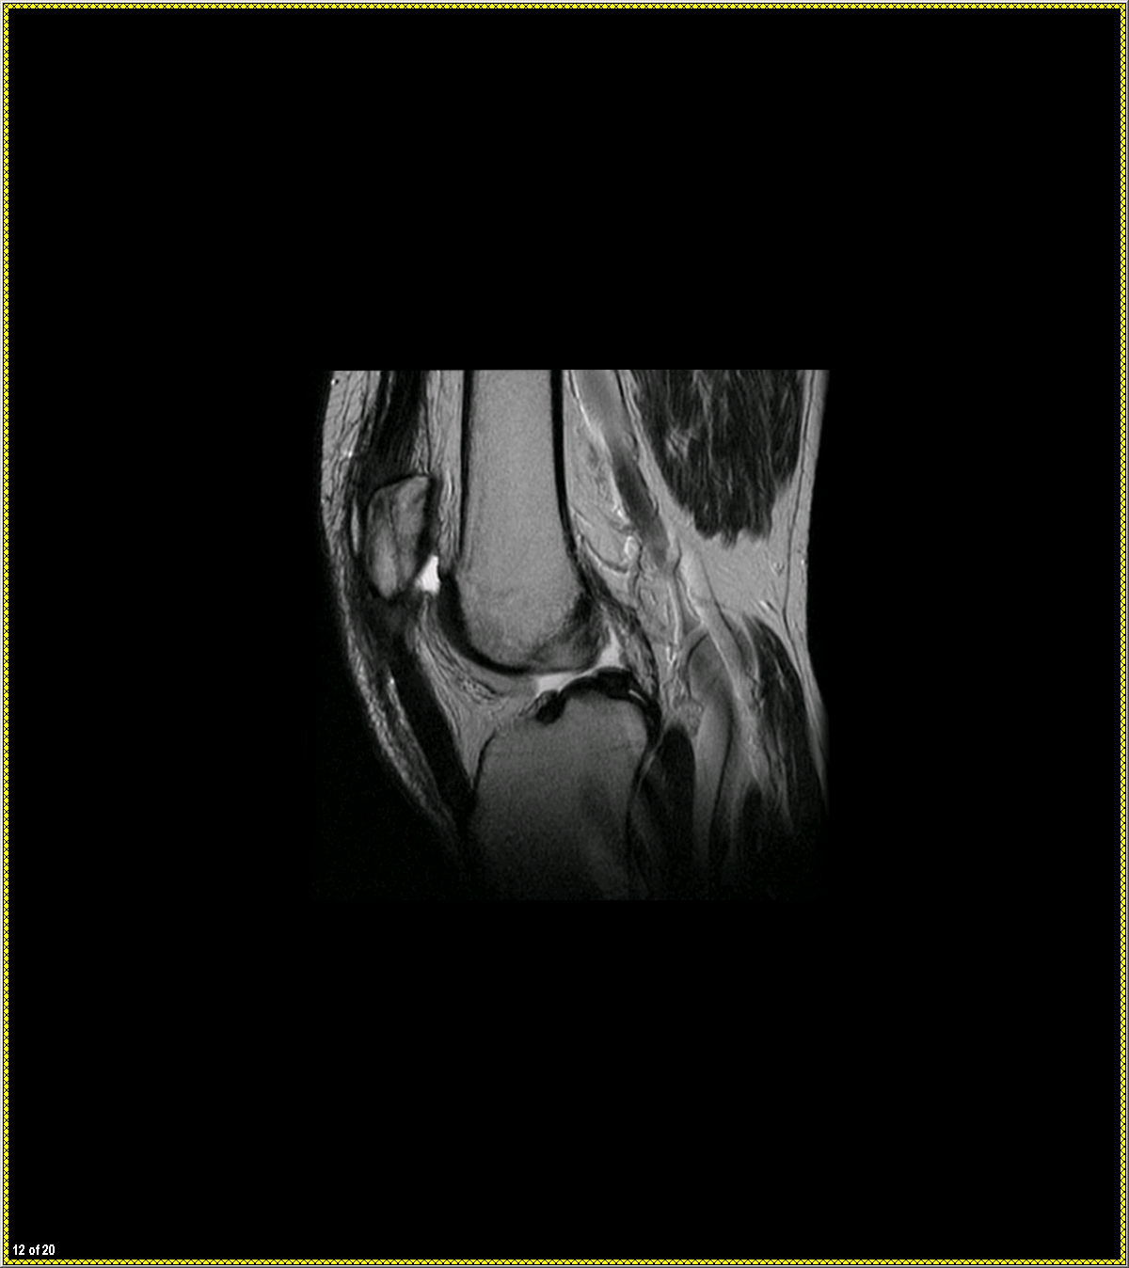
MRI shows water (fluid)
behind the patella
Do you see fluid
anywhere else?

Slide 16
Disadvantages of MRI
Very expensive (x-ray $100, CT $1000,
MRI $2000)
Not as good as CT for cortical bone

Slide 17
This long black line
Is the cortex or cortical bone
3 things are always black
on MRI:
Air
Cortical bone/tendons/ligaments
Flowing blood

Slide 18
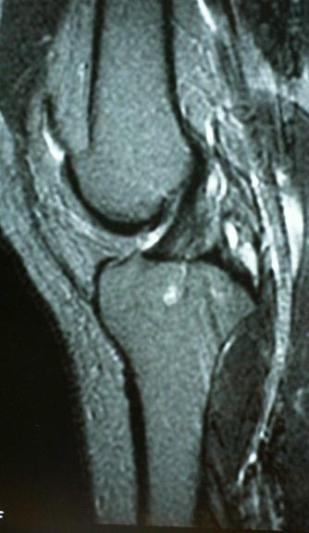
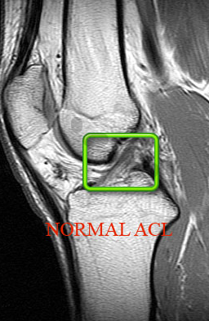
Notes:
18
18

Slide 19
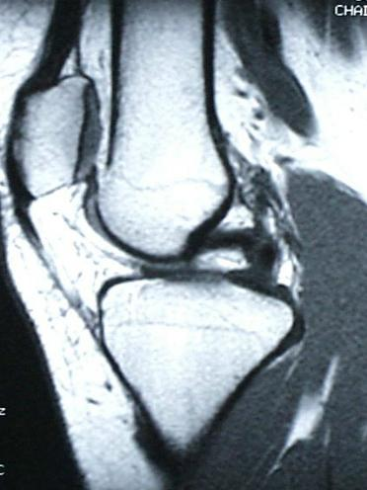
Posterior cruciate ligament
Notes:
19
19

Slide 20
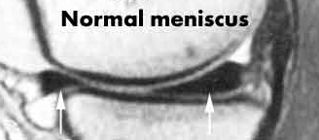
anterior and posterior
horns “bow tie”
Notes:
20
20

Slide 21
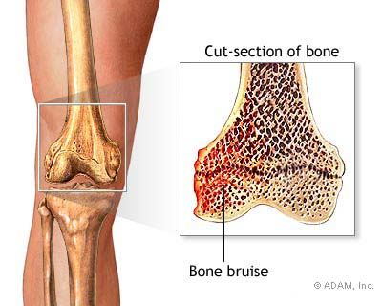

Slide 22
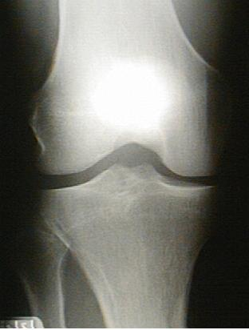
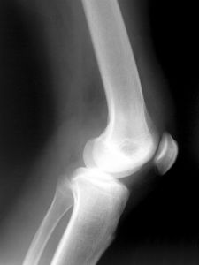

Slide 23
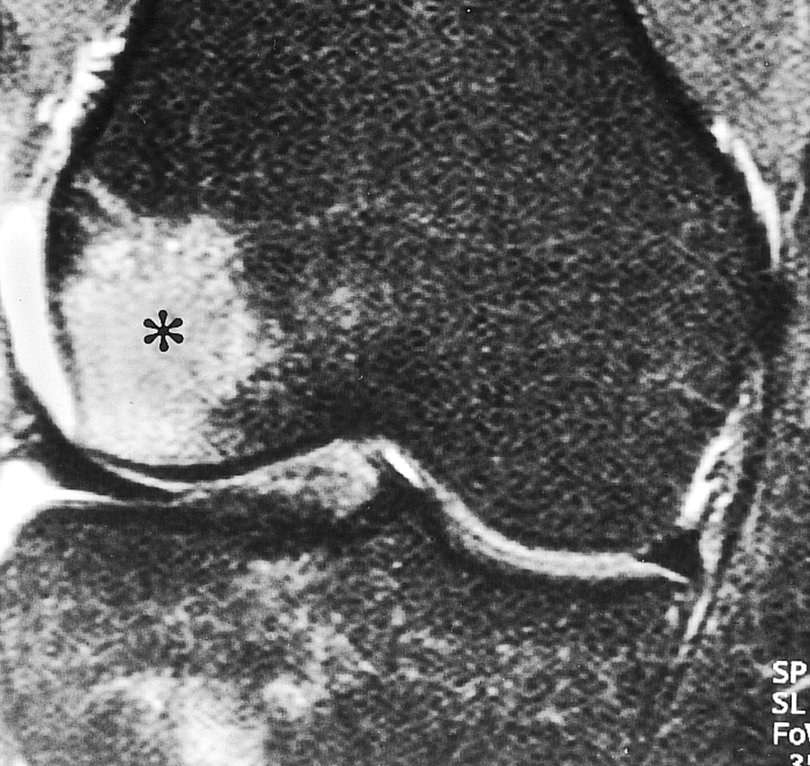

Slide 24
Normal Imaging Anatomy in the Extremities

Slide 25
What are the parts of a long bone?
DME
Terms you will need to know:
  Cortex
  Medullary cavity (marrow)
  Diaphysis
  Metaphysis
  Epiphysis

Slide 26
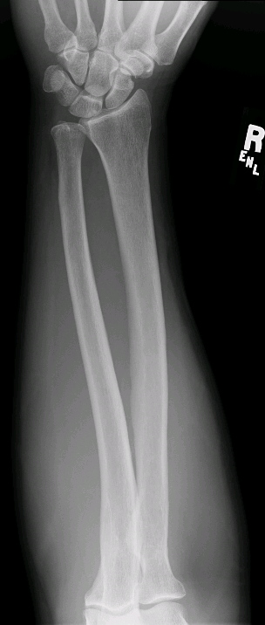
At each end of a long bone is the _________
The tapered part of the bone
is the __________
Medullary cavity (marrow)
cortex
The shaft of the long
bone is the ________
Diaphysis
Metaphysis
Epiphysis

Slide 27
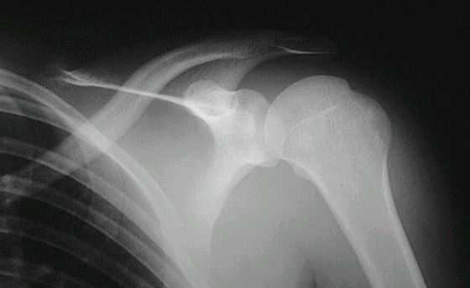
cortex
medullary cavity
Notes:
27
27

Slide 28
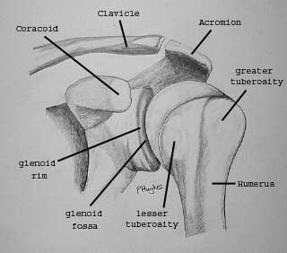

Slide 29
corocoid
acromion
greater tuberosity
clavicle
lesser tuberosity
glenoid fossa
Notes:
29
29

Slide 30
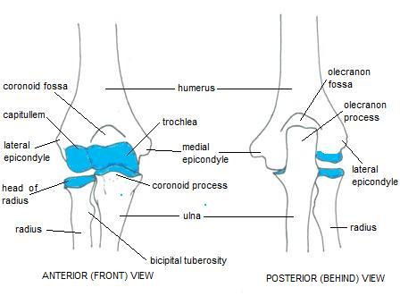
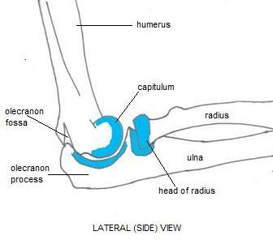

Slide 31
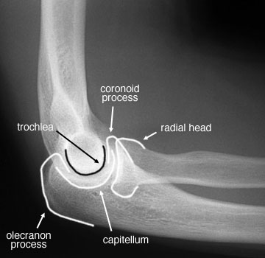

Slide 32
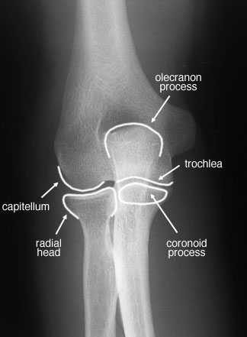

Slide 33
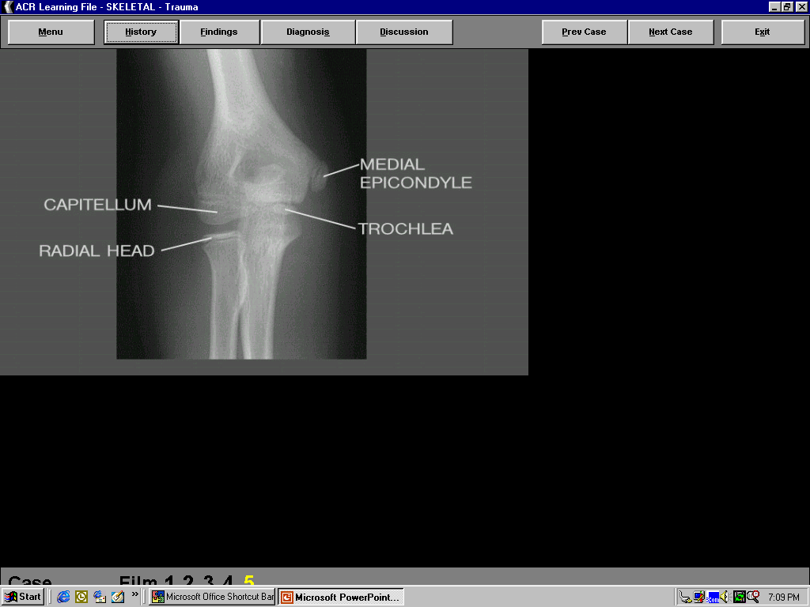
Child or adult?
Notes:
33
33

Slide 34
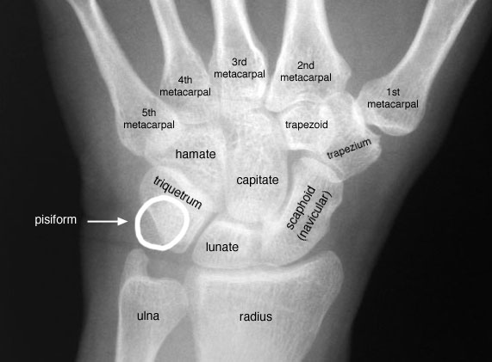
Wrist

Slide 35
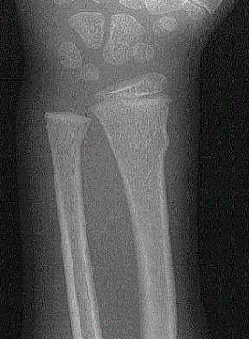
1
2
3
Growth plate
Diaphysis
Metaphysis
Epiphysis
4
Notes:
35
35

Slide 36
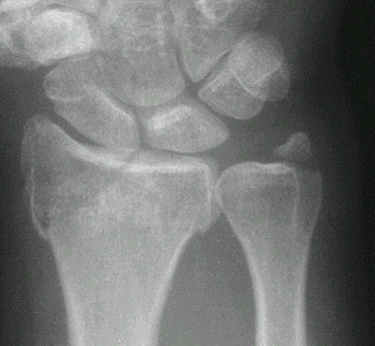
Notes:
36
36

Slide 37
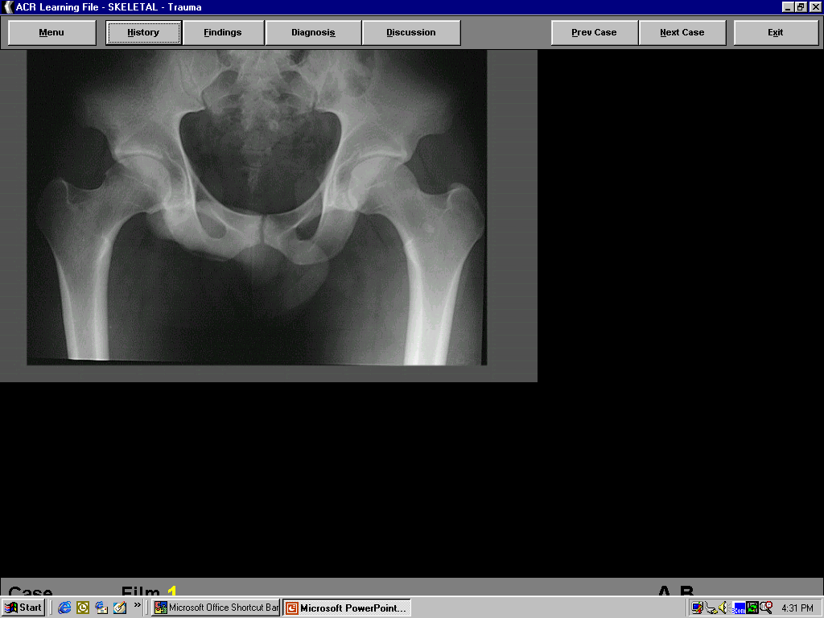
int. iliac spine
acetabulum
greater trochanter
SI joint
symphysis pubis
Notes:
37
37

Slide 38
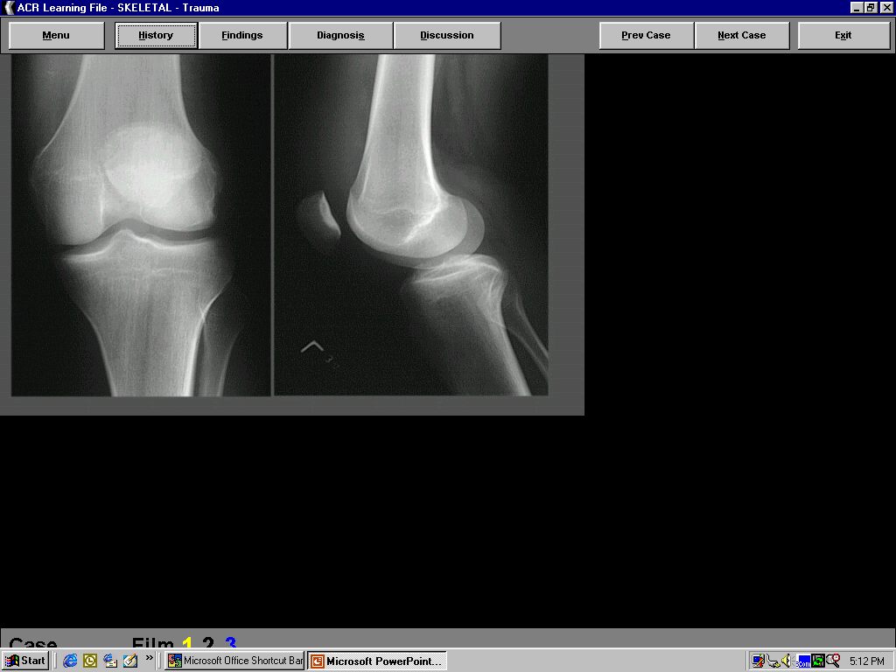
Patella
condyle
Patella
intercondylar spines
fibula
Notes:
38
38

Slide 39
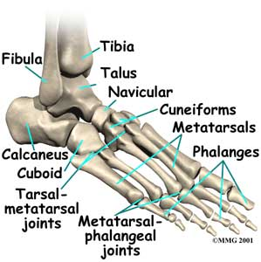
Ankle and Foot

Slide 40
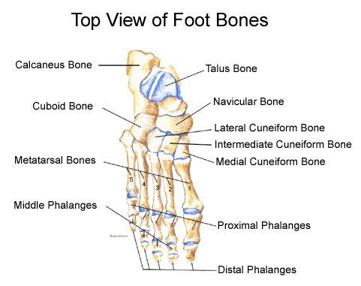

Slide 41
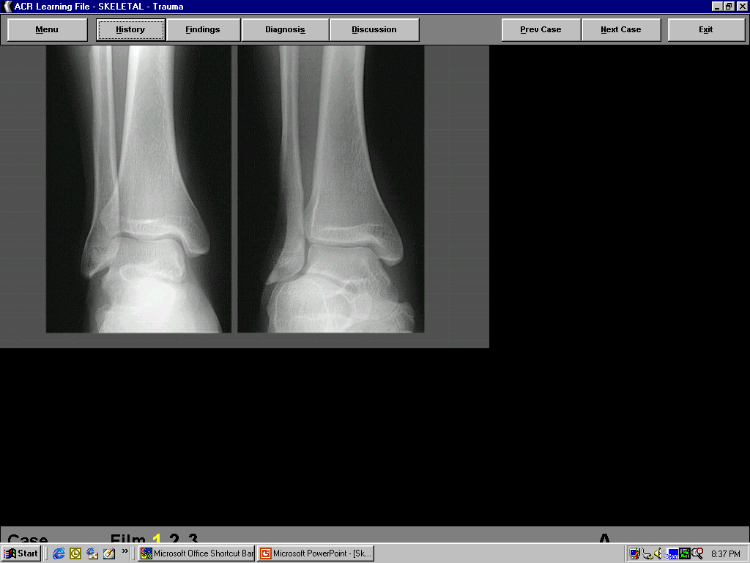
medial
maleolus
lateral maleous
Talus
Notes:
41
41

Slide 42
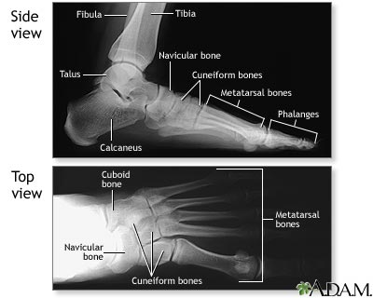

Slide 43
Test your knowledge
1
2
3
4
Notes:
43
43

Slide 44
Finding a Fracture on X-Ray
Start with soft tissue, look for swelling or fat pad displacement
Examine the cortex along the entire length of the bone
Look for cortical irregularities, buckling, or evidence of impaction

Slide 45
Fracture Terminology
Direction of fracture line:
  Transverse
  Oblique
  Spiral
  Longitudinal
Alignment of fracture: Displacement
Angulation
Comminution
Articular Involvement

Slide 46
Fracture Terminolgy
Open vs Closed: fracture is open when exposed to air (laceration or gross exposure)
Pathologic fracture: implies fracture through weakened bone
Stress fracture: implies misuse or overuse

Slide 47
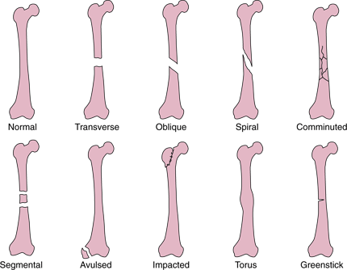
Path of the Fracture

Slide 48

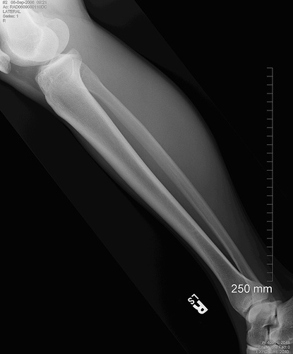
Normal

Slide 49

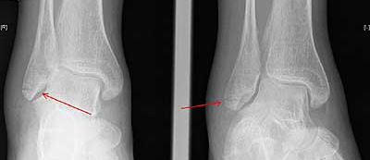
Transverse Fracture

Slide 50
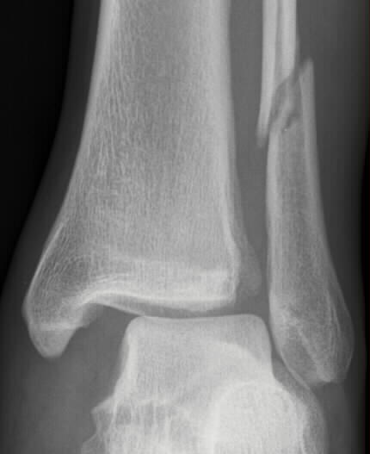

Oblique Fracture

Slide 51
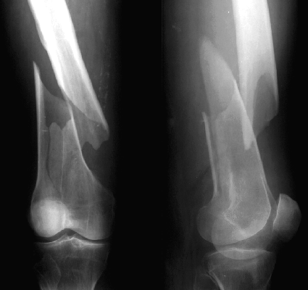

Spiral Fracture

Slide 52
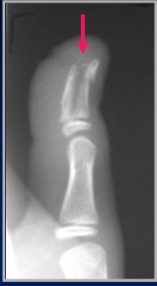
Longitudinal Fracture

Slide 53
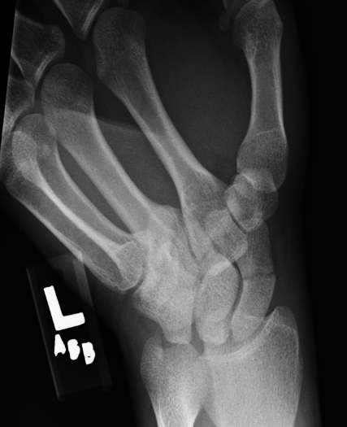
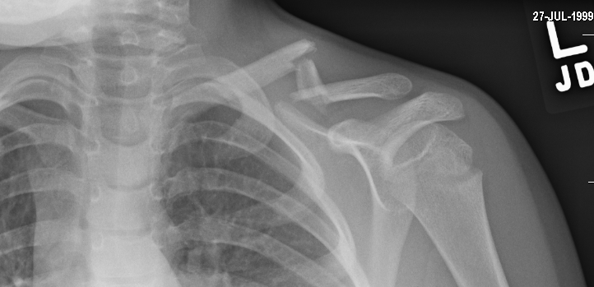
Simple vs Comminuted
Simple-2 bone fragments
Comminuted-greater then 2 fragments

Slide 54
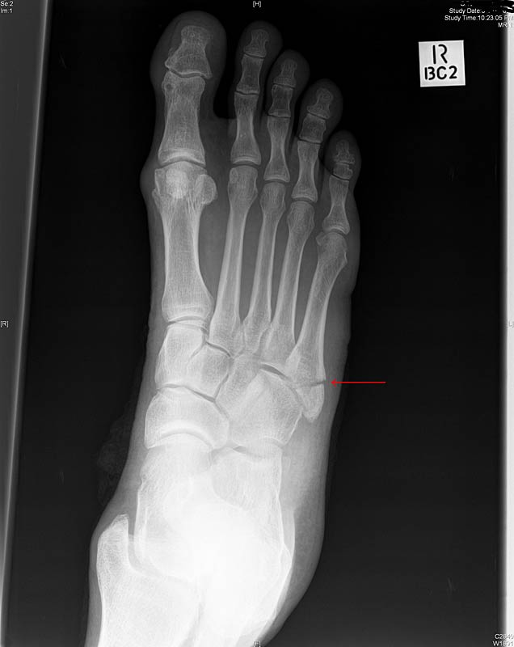

Avulsion Fracture
A bony fragment produced by the pull of ligamentous or tendinous attachment

Slide 55
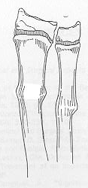
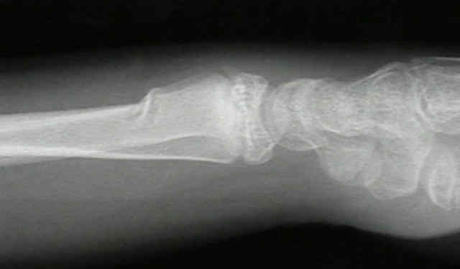
Torus Fractures
Axial forces cause cortex to buckle
Occurs most commonly in the metaphysis

Slide 56
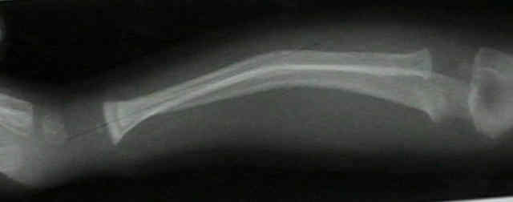
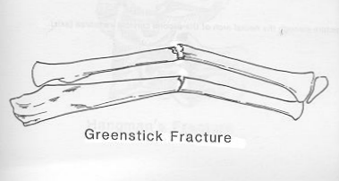
Greenstick fracture
Cortex broken on one side of the bone and only bent or buckled on the other side

Slide 57
Points to take home
There are distinct advantages and disadvantages to plain x-rays, CT and MRI.
Become familiar with terminology: epiphysis, metaphysis, diaphysis, cortex, medullary cavity
Fracture description requires specific vocabulary

Slide 58
Radiologic diagnostics of skeletal system diseases (traumas, inflammatory diseases).
Lecturer: Mikhail Liubchak
Radiologist, MSc, EDIR
Teaching assistant at the Department of Radiology at Odessa State Medical University

Slide 59
Current lecture sections
Skeletal trauma
Inflammatory conditions

Slide 60
Skeletal trauma
The process of reading a bone radiograph should be an active one, looking at cortical margins and bone alignment and looking for typical fracture patterns. Therefore, the habit of looking for abnormalities is more valuable than a passive look at the x-ray.
Most radiographic exams are normal.
Soft tissue abnormalities are valuable indirect signs of injury which can lead to diagnosis when osseous injuries are not apparent, especially in the elbow. Look at the soft tissues!
At least two orthogonal projections of an injured area are required. Additional views should be pursued when there are uncertainties or in areas with complex anatomy.

Slide 61
Skeletal trauma
The human skeleton contains 206 bones. All of these bones can be classified into five groups based on shape. Below are the definitions and a few examples of the five bone classifications.
Long bones - bones of the extremities that have a length greater than the width (e.g., femur).
Short bones - bones of the wrist, ankle and foot that are cuboidal in shape (e.g., carpals and tarsals).
Flat bones - diploic bones of the vault of the skull (e.g., parietal and frontal) and the iliac bone.
Sesamoid bones - small, rounded bones located in tendons (e.g., metatarsophalangeal joint of the great toe).
Irregular bones - as the name implies, these bones have irregular shapes (e.g., vertebrae, sacrum, coccyx).

Slide 62
Skeletal trauma
Long bones

Slide 63
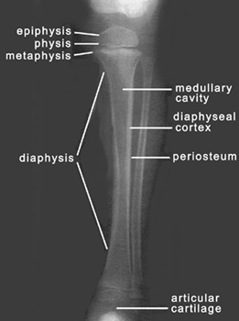
Skeletal trauma

Slide 64
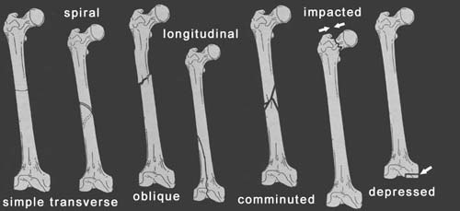
Skeletal trauma. Patterns

Slide 65
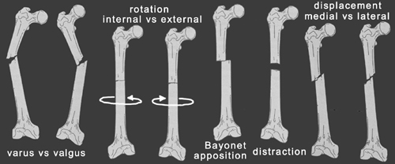
Skeletal trauma. Alignment

Slide 66
Skeletal trauma. Pattern definitions
Simple Transverse Fracture - a fracture in which the fracture line is perpendicular to the long axis of the bone and that results in two fracture fragments.
Oblique Fracture - a fracture in which the fracture line is at an oblique angle to the long axis of the bone.
Spiral Fracture - a severe form of oblique fracture in which the fracture plane rotates along the long axis of the bone. These fractures occur secondary to rotational force.
Longitudinal Fracture - a fracture in which the fracture line runs nearly parallel to the long axis of the bone. A longitudinal fracture can be considered a long oblique fracture.
Comminuted Fracture - a fracture that results in more than two fracture fragments.
Impacted Fracture - a fracture in which the end of the bone is driven into the contiguous metaphyseal region without displacement. This type of fracture occurs secondary to axial or compressive force.
Depressed Fracture - a form of an impacted fracture that involves the articular surface of a bone and results in joint incongruity.
Avulsion Fracture - (not pictured above) a fracture in which the tendon is pulled away from the bone, carrying a bone fragment with it

Slide 67
Skeletal trauma. Types of alignment that result from the fracture patterns
Varus vs Valgus - varus and valgus deformities are both angulations, which are described according to the direction of the apex or the direction in which the distal fragment is angled. In varus deformity, there is apex angulation away from the midline and the distal structure moves medially (i.e., bowleggedness). In valgus deformity, there is apex angulation toward the midline and the distal structure moves laterally (i.e., knock-kneed).
Internal vs External Rotation - rotation is described according to the direction of movement of the distal fragment.
Bayonet Apposition - overlap of fracture fragments.
Distraction - longitudinal separation of fracture fragments.
Medial vs Lateral Displacement - occurs when the cortices are out of alignment. Displacements are described according to the direction of movement of the distal fragment relative to the proximal fragment.

Slide 68
Skeletal trauma
When describing a fracture, one should describe the location, pattern and alignment.
Remember(!), the alignment is described for the distal fragment relative to the proximal, with the patient in anatomical position.

Slide 69


Examples

Slide 70
Skeletal trauma
Short bones

Slide 71

Skeletal trauma

Slide 72


Skeletal trauma

Slide 73
Skeletal trauma
Wrist and hand represent two distinct anatomical sites and clinical suspicion should direct which exam is appropriate.
One exam is not an adequate substitute for the other.
If clinical exam cannot elucidate where the exact site of the injury is, both regions should be evaluated.
Fractures of metacarpals and phalanges occur 20 times more frequently than fractures and dislocations of carpal bones.
Evaluation of the elbow is not necessary for a patient with suspected distal forearm injuries if an adequate physical exam does not reveal symptoms at the elbow.
This, however, may not be so in a patient with distracting injuries or who is unresponsive or incommunicative.

Slide 74

Skeletal trauma
Boxer's Fracture
Occurs during a punch with a closed fist.
Usually involves the fifth metacarpal, but the fourth metacarpal may also be involved

Slide 75

Skeletal trauma
Bennett Fracture
An intra-articular fracture-dislocation of the base of the first metacarpal .
The most common mechanism of fracture is axial loading of the first metacarpal (i.e., during a fist fight).
Dorsal subluxation is the most common dislocation.

Slide 76

Skeletal trauma

Slide 77

Skeletal trauma
The triquetrum is the second most commonly fractured carpal (scaphoid is first).
Fractures are usually avulsions from the dorsal surface.
A lateral view of the hand is typically required for diagnosis.
Soft tissue abnormalities of the dorsum of the wrist can aid in diagnosis.

Slide 78


Skeletal trauma
Perilunate Dislocation
Perilunate fracture-dislocations occur two to three times more frequently than lunate dislocations.
The lateral view shows the lunate in proper alignment with the radius. The capitate is dislocated.
Three quarters of all perilunate dislocations are associated with a scaphoid fracture.
AP view often reveals "crowded carpals" in which the proximal and distal rows of carpals are overlapped.

Slide 79

Skeletal trauma
Scaphoid Fracture
Most commonly fractured carpal.
Rarely occurs in pediatric patients.
Occurs during extreme dorsiflexion of the wrist (i.e., a fall on the hands) or extreme ulnar deviation.
If this fracture is missed, necrosis of the proximal pole may occur due to disruption of the blood supply, that, in many patients is provided only through the distal pole.

Slide 80

Skeletal trauma
Colles Fracture
A distal radius fracture with volar apex angulation and dorsal displacement of the fracture fragment.
Occurs when one falls on an outstretched hand with the wrist extended and forearm pronated.
50% are associated with an ulnar styloid fracture.
The most common group with this fracture are elderly women.

Slide 81


Skeletal trauma

Slide 82
Skeletal trauma
Anatomically, the foot can be divided into three different regions: forefoot, midfoot and hindfoot. The seven tarsal bones of the foot are located within the hindfoot and midfoot, with the hindfoot containing the talus and calcaneus, and the midfoot consisting of the navicular, cuboid, and three cuneiforms. The forefoot contains the metatarsals and phalanges.
Standard radiographic examination includes AP, lateral and oblique films. Occasionally, a different tangential film may be required for diagnosis.

Slide 83

Skeletal trauma
Jones Fracture
Fracture of the base of the fifth metatarsal, at least 1.5 cm. distal to the metatarsal styloid.
It can be confused with an unfused apophysis of the fifth metatarsal. However, the apophysis is usually aligned lengthwise, while the fracture is transverse to the bone .
It can also be confused with an avulsion fracture of the styloid due to contraction of the peroneus brevis muscle, usually occurring closer to the metatarsal styloid.
If a true Jones fracture is not immobilized, nonunion may be a complication.

Slide 84

Skeletal trauma
Lisfranc Injury
A fracture and or dislocation at the tarsometatarsal joint.
It is named after a surgeon in Napoleon's cavalry who originally described them.
At that time, the most common mechanism of injury was getting a foot caught in a stirrup. Now, they are most often seen in patients after a motor vehicle accident and in mountain bikers who get their feet caught in the pedal clips.
The medial border of the second metatarsal is not aligned with the medial border of the second cuneiform. The dislocation is the main radiographic feature of a Lisfranc injury.

Slide 85

Skeletal trauma
Metatarsal Fracture
It is important to remember that a fracture may only be visible on one view. Therefore, a careful look at each metatarsal in each view is necessary.

Slide 86

Skeletal trauma

Slide 87
Skeletal trauma
The knee is the largest joint in the body and consists of three articulations: medial tibiofemoral, lateral tibiofemoral and patellofemoral.
The medial collateral ligament complex, lateral collateral ligament complex, anterior cruciate ligament and posterior cruciate ligament all provide stability for the knee.
Routine radiographic examination of knee trauma includes four projections: AP, lateral and two oblique views. A tunnel projection of the intercondylar notch and/or a sunrise view of the patella may be required depending on the injury.

Slide 88
Skeletal trauma
Knee injuries are common due to the large size and complexity of the knee.
Most commonly injured are the soft tissue and cartilaginous structures, including ligaments and menisci. These injuries are best evaluated clinically or by MRI.
Fractures are the next most common injury, occurring much more often than dislocations.

Slide 89


Skeletal trauma
Patellar Fracture
Patellar fractures can be caused by direct truama such as a blow to the anterior aspect of the knee or may be due to indirect forces generated by the tension of the quadriceps tendon.
The fracture is best seen on a Sunrise or Merchant's view.

Slide 90


Skeletal trauma
Tibial Plateau Fracture Also known as "fender" or "bumper" fractures, tibial plateau fractures most often are the result of a moving vehicle striking the knee.
Plateau fractures (medial and lateral) are the most common fracture sustained at the proximal tibia.
When depression is not present, fracture may be difficult to recognize with standard radiographic exam. Alternative views and/or CT may be required for diagnosis.
CT with multiplanar reconstruction (MPR) can be useful to help understand the anatomy of the fracture in 3D.
Associated damage to the anterior cruciate ligament, medial collateral ligament and medial meniscus is common due to valgus stress placed on the knee during injury.
Postraumatic arthritis and malunion can result.

Slide 91

Skeletal trauma
Segond Fracture
Avulsion of the lateral tibia at the attachment of the lateral capsule.
Varus stress and internal rotation of the leg that occur when the knee is flexed place excess tension on the lateral capsule and associated ligaments. Too much stress can result in avulsion.
Due to the mechanism of injury, anterior cruciate ligament tears are commonly associated with this type of fracture.

Slide 92


Skeletal trauma
Short bones

Slide 93
Skeletal trauma
The five bones that comprise the pelvis are the ilium, ischium, pubis, sacrum, and coccyx.
Most trauma to the pelvis and hips can be evaluated with an AP projection of the pelvis and hips. Other injuries require special projections such as anterior and posterior obliques views of the pelvis, frog-lateral view of the hip and groin-lateral view.
CT of the pelvis is the technique of choice for evaluating complex fracture patterns, degree of displacement and soft tissue injury.
Symptoms from fractures of the hip, acetabulum and pelvis may be quite similar, thus, a full AP pelvis radiograph including the hip must be obtained if any of the above fractures are expected.
The femurs should be internally rotated when obtaining an AP pelvis film so that the femoral necks can be appropriately assessed for fractures.

Slide 94
Skeletal trauma
The pelvis and hips constitute one of the most diagnostically challenging areas of the body for two main reasons. First, it is the single area of the body where obtaining a lateral projection provides little additional information. Second, soft tissue injuries are difficult to assess with radiographs of the pelvis, but have greater clinical significance than in other areas of the body.
Severe pelvic trauma is associated with hemorrhage in approximately 60% of cases. Hemorrhage is a principle factor leading to death in this patient population.
Systematically examine all bony structures of the pelvis and femurs for symmetry, cortical breaks and joint spaces (sacroiliac, hip and symphysis pubis joints). Also carefully examine the common injury regions such as the femoral neck, iliac spine, acetabulum, inferior ramus of the ischium and superior pubic ramus.
Avulsion injuries are common and can be easily missed. Examine the frequent sites of avulsion, which are the anterior superior iliac spine, anterior inferior iliac spine and ischial tuberosity.
Remember that the pelvis is a ring and it is commonly broken in two or more places. The pelvic ring must remain intact for the fracture(s) to be considered stable. If the ring is compromised, it is an unstable pelvic fracture.
Significant pelvic ring disruption (PRD) leads to rupture of the bladder or urethral injury in approximately 20% of cases. Evaluation of the urethra with retrograde uretrogram should be performed in all male patients with PRD prior to Foley catheter placement.

Slide 95

Skeletal trauma
Femoral Neck Fracture
Full evaluation requires internal rotation of the femur on AP pelvic radiograph. If the femurs are neutrally positioned or externally rotated, the femoral neck will be foreshortened and a fracture may be missed.
Occur most commonly in the subcapital region.
Associated with postmenopausal osteoporosis.
Avascular necrosis of the femoral head is a complication that occurs in 10-30% of subcapital fractures secondary to disruption of the femoral circumflex arteries.
Nonunion may occur.

Slide 96

Skeletal trauma
Posterior Hip Dislocation
Posterior dislocation accounts for more than 90% of all hip dislocations.
The most common mechanism for a posterior dislocation is with high-energy trauma, such as during an automobile accident when the knees impact the dashboard.
In 10% of patients, the sciatic nerve is injured as a result.
There are four radiographic features of a posterior hip dislocation:
  Femoral head lateral and superior to the acetabulum.
  Fracture of the posterior rim of the acetabulum in most cases.
  Femur in internal rotation and adduction.
  Affected femoral head may appear smaller secondary to magnification.

Slide 97

Skeletal trauma
Slipped Femoral Epiphysis

Slide 98

Skeletal trauma
Malgaigne Fracture
Articular or para-articular fracture of the sacroiliac joint and ipsilateral ischiopubic rami.
Due to the location of the fractures involved, a Malgaigne fracture renders the pelvis unstable.
A Malgaigne fracture can often be recognized clinically as shortening of the ipsilateral lower extremity. Radiographic diagnosis can be made from an AP view of the pelvis.

Slide 99

Skeletal trauma
There are 12 thoracic vertebrae and 5 lumbar vertebrae. Each vertebrae can be divided into several parts.
A=Body
B=Pedicle
C=Superior articulating facet
D=Inferior articulating facet
E=Transverse process
F=Spinous process
G=Lamina

Slide 100

Skeletal trauma
4 major ligaments that
contribute to the stability of the
spine:
anterior longitudinal ligament,
posterior longitudinal ligament,
ligamentum flavum,
interspinous ligament.

Slide 101


Skeletal trauma

Slide 102
Skeletal trauma
One should consider the three columns of the spine for assessment of stability.
The anterior column consists of the anterior longitudinal ligament and the anterior part of the vertebral body.
The middle column includes the posterior vertebral body and the posterior longitudinal ligament.
The posterior column consists of the pedicles, the ligamentum flavum and ther interspinous ligaments. Fractures involving only one column are stable and those involving all three are unstable.

Slide 103

Skeletal trauma

Slide 104
Skeletal trauma
The Thoraco-Lumbar Injury Classification and Severity score (TLICS) is a classification system for thoracolumbar spine injuries, designed to assist in clinical management.
Unlike other classifications, the TLICS is an easy scoring system that depicts the features important in predicting spinal stability, future deformity, and progressive neurologic compromise.
TLICS also facilitates appropriate treatment recommendations.

Slide 105

Skeletal trauma

Slide 106


Skeletal trauma. TLICS. Morphology. PLC integrity

Slide 107
Skeletal trauma. TLICS
Usually the morphology matches the injury mechanism, but sometimes it does not. Once you realize that, it should not confuse you.
Compression is usually the result of axial force with flexion.
Burst is the result of compression with severe axial loading.
Translation/rotation is the result of displacement in the horizontal plane.
Distraction is the result of displacement in the vertical plane.

Slide 108
Skeletal trauma. TLICS
CT features of PLC pathology are:
Widening of the interspinous space.
Avulsion fractures or transverse fractures of spinous processes or articular facets.
Widening or dislocation of facet joints.
Vertebral body translation or rotation.
When the PLC is definitely injured on CT, it can already be scored as 3.
Since the integrity of the PLC depends mostly on ligamentous structures, MR is sometimes needed to adequately diagnose pathology of the PLC, especially when there is no dislocation or disruption on CT.
MRI features of PLC pathology are:
Definite: 3 points
Loss of normal low signal intensity of the ligamenta flava or supraspinous ligaments on T1 and T2.
Indeterminate: 2 points
Edema without clear rupture; high signal intensity of the interspinous ligaments or along the facet joints on T2 SPIR or STIR.
MRI has a tendency to overdiagnose PLC injury

Slide 109

Skeletal trauma. TLICS .Neurological status
The role of the radiologist is to report the following:
Myelopathy or nerve compression.
Retropulsion of a body fragment and the percentage of narrowing of the spinal canal.
Epidural hematoma.
One of the key points here is that an incomplete cord lesion will likely benefit more from surgery than a complete lesion; therefore a complete cord injury is scored as only 2 points, while an incomplete cord injury gets 3 points.

Slide 110
Skeletal trauma. TLICS .Modifiers
Modifiers are other factors which can affect the decision of appropriate treatment:
Sternum fracture
Rigid spine
Multiple rib fractures at the same levels
Non braceable
Wounds
Pre-existing deformities

Slide 111


Skeletal trauma. TLICS

Slide 112


Skeletal trauma. TLICS. Compression fracture

Slide 113


Skeletal trauma. TLICS. Burst fracture

Slide 114


Skeletal trauma. TLICS

Slide 115

Skeletal trauma. TLICS. Translation-rotation fracture

Slide 116

Skeletal trauma. TLICS. Translation-rotation fracture

Slide 117


Skeletal trauma. TLICS. Distraction fracture

Slide 118
Skeletal trauma.
It is important to trace the outline of each vertebral body, pedicle, transverse process and spinous process for any discontinuity. The distance between the pedicles should be checked on the AP view to assess the integrity of the ring. One should also follow the smooth alignment of the vertebral bodies for any step-off or abrupt angulation.
Injuries in the thoracolumbar spine can be classified by mechanism of injury: hyperflexion, vertical compression or shearing injury.
Hyperflexion injuries are most common and associated with anterior compression and wedging with posterior distraction. Vertical compression injuries decrease the height of the body diffusely with possible retropulsion of fragments into the spinal canal. Shearing injuries are associated with anterior dislocation and may show disruption of the posterior and middle columns, making them unstable.

Slide 119

Skeletal trauma
Thoracic Compression injuries are due to axial loading.
Multiple noncontiguous fractures are associated with burst fracture in nearly 50%, so finding a fracture should make one continue to look and not give up on the search.
One should not confuse the normal 1.5 mm anterior tapering of the anterior thoracic vertebral bodies for compression.
With compression, there is loss of vertebral height and usually disruption of the posterior vertebral line. If the body has lost stature, it may be impossible to tell if this is an acute fracture without old films for comparison.
CT should be performed for full assessment of the spinal canal in compression fracture cases because neurological deficit occurs in 65% of patients.

Slide 120

Skeletal trauma
Rib Fractures are occasionally present in association with fractures of the thoracic spine.
Make sure not to miss an associated rib or transverse process fracture.

Slide 121
Inflammatory diseases of bones and joints
The inflammatory diseases of the bones and joints encompass infections and the consequences of immunologically mediated local and systemic disease.
Septic arthritis
Osteomyelitis (pyogenic, tuberculous, fungal, syphylitic)
Immunologically mediated inflammatory diseases (Rheumatoid arthritis).

Slide 122
Inflammatory diseases of bones and joints. Osteomyelitis
Osteomyelitis refers to inflammation of bone that is almost always due to infection, typically bacterial. May be acute or chronic.
Osteomyelitis can occur at any age. In those without specific risk factors, it is particularly common between the ages of 2-12 years of age and is more common in males.
In most instances, osteomyelitis results from haematogenous spread, although direct extension from trauma and/or ulcers is also relatively common (especially in the feet of diabetic patients).

Slide 123

Inflammatory diseases of bones and joints. Osteomyelitis

Slide 124

Inflammatory diseases of bones and joints. Osteomyelitis

Slide 125
Inflammatory diseases of bones and joints. Osteomyelitis
In the initial stages of infection, bacteria multiply setting up a localised inflammatory reaction and resulting in localised cell death. With time, the infection becomes demarcated by a rim of granulation tissue and new bone deposition.
Although no organisms are recovered in up to 50% of cases, when one is isolated Staphylococcus aureus is by far the most common agent. Different organisms are more common in specific clinical scenarios :
Staphylococcus aureus: 80-90% of all infections
Escherichia coli: IVDU (intravenous drug users) and genitourinary tract infection
Pseudomonas spp: IVDU and genitourinary tract infection
Klebsiella spp: IVDU and genitourinary tract infection
Salmonella spp: sickle cell disease
Haemophilus influenzae: neonates
group B streptococci: neonates

Slide 126
Inflammatory diseases of bones and joints. Osteomyelitis
Location
Frequency in descending order by location :
lower limb (most common)
vertebrae: lumbar > thoracic > cervical
radial styloid
sacroiliac joint
The location of osteomyelitis within a bone varies with age, on account of changing blood supply :
neonates: metaphysis and/or epiphysis
children: metaphysis
adults: epiphyses and subchondral regions

Slide 127

Inflammatory diseases of bones and joints. Osteomyelitis

Slide 128
Inflammatory diseases of bones and joints. Osteomyelitis
Types
Acute suppurative osteomyelitis
Chronic suppurative osteomyelitis
Chronic focal sclerosing osteomyelitis
Chronic diffuse sclerosing osteomyelitis
Garre’s osteomyelitis

Slide 129
Inflammatory diseases of bones and joints. Osteomyelitis
Plain radiograph
The earliest changes are seen in adjacent soft tissues +/- muscle outlines with swelling and loss or blurring of normal fat planes. An effusion may be seen in an adjacent joint.
In general, osteomyelitis must extend at least 1 cm and compromise 30 to 50% of bone mineral content to produce noticeable changes in plain radiographs. Early findings may be subtle, and changes may not be obvious until 5 to 7 days in children and 10 to 14 days in adults. After this time a number of changes may be noted:
regional osteopaenia
periosteal reaction/thickening (periostitis): variable, and may appear aggressive including formation of a Codman's triangle
focal bony lysis or cortical loss
endosteal scalloping
loss of bony trabecular architecture
new bone apposition
eventual peripheral sclerosis
In chronic or untreated cases eventual formation of a sequestrum may be seen.

Slide 130
Inflammatory diseases of bones and joints. Osteomyelitis
Treatment is typically with intravenous antibiotics, usually for extended periods. If a collection, sequestrum is present then drainage and/or surgical debridement is often necessary. Amputation is performed with failure of medical therapy or when the infection is life-threatening.
Complications include ¹:
sinus track formation with occasional superimposed squamous cell carcinoma (Marjolin ulcer)
secondary sarcoma: rare
pathological fracture
secondary amyloidosis

Slide 131
Inflammatory diseases of bones and joints. Osteomyelitis
Differential diagnosis
General imaging differential considerations include:
Charcot joint
metastases
primary bone neoplasm

Slide 132

Inflammatory diseases of bones and joints. Osteomyelitis. Acute

Slide 133

Inflammatory diseases of bones and joints. Osteomyelitis. Acute. Codeman Triangle
Codman triangle is a type of periosteal reaction seen with aggressive bone lesions. With aggressive lesions, the periosteum does not have time to ossify with shells of new bone (e.g. as seen in single layer and multilayered periosteal reaction), so only the edge of the raised periosteum will ossify.
The Codman triangle may be seen with aggressive lesions:
sarcoma
active aneurysmal bone cyst
giant cell tumour
metastasis

Slide 134


Inflammatory diseases of bones and joints. Osteomyelitis. Chronic

Slide 135

Inflammatory diseases of bones and joints. Osteomyelitis. Chronic

Slide 136
Musculoskeletal manifestations of tuberculosis
Musculoskeletal tuberculosis is always secondary to a primary lesion in the lung.
Epidemiology
The prevalence of the disease is around 30 million globally and 1-3% of the 30 million have involvement of their bones and/or joints. Mycobacterium tuberculosis is responsible for almost all of the cases of osteoarticular tuberculosis; although atypical mycobacteria have been reported in lesions of the synovial sheath.
The predisposing factors are protein-energy malnutrition, environmental conditions and living standards such as poor sanitation, overcrowded housing and slum dwelling. Trauma as a causative factor is debatable, but has been reported. Acquired immunodeficiency syndrome and other causes of immunocompromised status and repeated pregnancies and lactation in women are also a factor.

Slide 137
Musculoskeletal manifestations of tuberculosis
Pathology
Osteoarticular tuberculosis can occur in the spine, hip, knee, foot, elbow, wrist, hand, shoulder and as diaphysial foci. It has not been reported to affect the mandible or the temporomandibular joint. The major method of spread is haematogenous. The most common method of spread to the vertebral body is through the Batson prevertebral venous plexus.

Slide 138
Musculoskeletal manifestations of tuberculosis
Pott disease, also known as tuberculous spondylitis, refers to vertebral body and intervertebral disc involvement with tuberculosis (TB). The spine is the most frequent location of musculoskeletal TB, and commonly related symptoms are back pain and lower limb weakness/paraplegia.

Slide 139
Musculoskeletal manifestations of tuberculosis
Epidemiology
One of the more common infections of spine is tuberculosis, especially in countries where TB is prevalent. Unfortunately, the incidence of tuberculous spondylitis, as with other forms of TB, is on the rise, due to new multiple drug resistant strains.
It represents 50% of musculoskeletal tuberculosis, and usually affects the lower thoracic and upper lumbar levels of the spine

Slide 140
Musculoskeletal manifestations of tuberculosis
Clinical presentation
Patients usually present with back pain, lower limb weakness/paraplegia, and kyphotic deformity. Constitutional symptoms (fever and weight loss) are also common.

Slide 141
Musculoskeletal manifestations of tuberculosis
Pathology
The spine is involved due an hematogenous spread via the venous plexus of Batson. There is usually a slow collapse of one or usually more vertebral bodies, which spreads underneath the longitudinal ligaments. This results in an acute kyphotic or "gibbus" deformity. This angulation, coupled with epidural granulation tissue and bony fragments, can lead to cord compression. Unlike pyogenic infections, the discs can be preserved. In late-stage spinal TB, large paraspinal abscesses without severe pain or frank pus are common, leading to the expression "cold abscess".

Slide 142
Musculoskeletal manifestations of tuberculosis
Plain radiograph
The spread of infection is typically described as 'sub-ligamentous': beneath the anterior longitudinal ligament, usually sparing the posterior elements and often involving multiple levels.
Tuberculous spondylitis can be difficult to detect in early stages because of relative preservation of the disc space.
A reduction in vertebral height is often seen with the irregularity of the anterosuperior end plate being relatively early and subtle sign. Due to the subligamentous extension there may be some irregularity of the anterior vertebral margin. This is a classical appearance with TB spondylitis.
Later, paraspinal collections can develop which can be remarkably large.
Ivory vertebrae can result with re-ossification. Other associated features may include:
gibbus deformity
vertebra plana
As with other extrapulmonary TB, the chest film may be unrevealing (no pulmonary lesions seen in up to 50% of cases), with the source being a primary lung lesion that is clinically silent.

Slide 143
Musculoskeletal manifestations of tuberculosis
CT and MRI
Cross-sectional imaging is required to assess better the extent of involvement and particularly for the presence of an epidural component and cord compression. MRI is the modality of choice for this, with CT with contrast being a distant second.
Features include irregularity of both the endplate and anterior aspect of the vertebral bodies, with bone marrow oedema and enhancement seen on MRI:
T1: hypointense marrow in adjacent vertebrae
T2: hyperintense marrow, disc, soft tissue infection
T1 C+ (Gd): marrow, subligamentous, discal, dural enhancement
The paraspinal collections are typically well circumscribed, with fluid centers and well-defined enhancing margins.

Slide 144
Musculoskeletal manifestations of tuberculosis
Differential diagnosis
In many parts of the developing world, TB is the most common cause of vertebral body infection, with the majority of cases seen in patients under the age of 20. TB can also affect the meninges of the spine, causing an intense pachymeningitis that enhances dramatically.
brucellosis: can present as granulomatous osteomyelitis of the spine that can be difficult to distinguish from TB. Both are acid-fast bacilli, which may cause caseating granuloma(s)
fungal infection
sarcoidosis
pyogenic infection
  insidious onset
metastasis

Slide 145
Musculoskeletal manifestations of tuberculosis
Tuberculous arthropathy is a type of musculoskeletal manifestation of tuberculosis (TB) and a common cause of infectious arthritis in developing countries. Any pathological joint lesion where the exact diagnosis is equivocal should be considered tubercular in origin unless proven otherwise.
Please, refer to the main article on tuberculosis for a general and broad discussion of this condition.

Slide 146
Musculoskeletal manifestations of tuberculosis
Epidemiology
Although rare in western countries, tuberculous arthropathy is still a common problem in developing countries. The tubercular arthropathy is never a primary lesion it is always a sequela of pulmonary or lymph node tuberculosis. It can occur at any age. There is no sex predilection for the disease.
Pathology
The primary causative organism is mycobacterium tuberculosis, however atypical mycobacteria i.e. Mycobacterium kansasii, M. xenopi and M. avium intracellulare are also isolated in immunocompromised individuals.
The organism reaches the bone and remains dormant until recrudescence occurs. Any factor which modifies the state of local resistance and resultant activation of dormant tubercle bacilli, microtrauma has been proposed as a mechanism, however no case could it be established that trauma was an etiological factor.

Slide 147
Musculoskeletal manifestations of tuberculosis
Location
The most common form of articular tuberculosis is spondylitis followed by arthritis of weight bearing joints (especially knee and hip). The spine is the most common site followed by the hip joint which constitutes approximately 15% of all cases.
Tubercular arthropathy can affect any joint but frequently reported in knee, ankle, sacroiliac joint, sternaoclavicular joint, shoulder, elbow and wrist. Tubercular arthropathy is usually monoarticular.
Several variants of TB in the shoulder have been described and are discussed separately in the article shoulder tubercular arthropathy.
Laboratory investigation
Initial acid-fast bacilli smears are often negative and synovial culture is positive in ~80% of cases

Slide 148
Musculoskeletal manifestations of tuberculosis
Plain radiograph
Plain films are reliable to detect and follow up of treatment for tubercular arthropathy. A triad of radiologic abnormalities (Phemister's triad) include:
peri-articular osteoporosis
peripherally located osseous erosion
gradual diminution of the joint space
By radiological features, tubercular arthropathy can be divided into early and late stages:
early stages (stage of synovitis and arthritis) - radiographic features include
  periarticular demineralisation
  joint space widening (due to joint effusion)
  mild subchondral erosion
late stages (stage of erosion and destruction)
  gradual narrowing of joint space (there is involvement of articular cartilage)
  severe subchondral erosion and destruction
  pathological subluxation and dislocation
  fibrous ankylosis - in contrast to pyogenic arthritis, the development of bone ankylosis is uncommon in tuberculous arthritis and, when present, is more likely to be secondary to prior surgical intervention
  atrophic changes in bones may occur and lead to atrophic arthropathy (seen in shoulder joint as carries sicca)

Slide 149
Musculoskeletal manifestations of tuberculosis
CT
CT can establish the degree of bone destruction or rarely sequestrum. Extension of infection in surroundings or any sinus tract formation can also be demonstrated on the post-contrast scan.
MRI
The lesions are typically:
T1: hyperintense
T2: hypointense
T1 C+ (Gd): brilliant enhancement
This may be as a result of presence of blood degradation products, inflammation, necrosis and fibrosis which is seldomly seen in other proliferative arthropathies.
MRI can assess associated abnormalities (e.g. osteomyelitis, myositis, cellulitis, para-articular abscess, tenosynovitis, bursitis, skin ulceration or sinus tract formation):
sinus tracts appear linear T2 hyperintensity with marginal ‘tram-track enhancement’
para-articular abscesses have thin, smooth and enhancing wall

Slide 150
Musculoskeletal manifestations of tuberculosis
Differential diagnosis
Differential diagnosis of tubercular arthropathy may include causes of erosive arthritis, monoarticular arthropathy and arthropathies resulting in ankylosis and joint destruction such as:
rheumatoid arthritis; synovial thickening is more uniform and bone erosions are much larger with defined rim enhancement in tuberculous arthritis also extraarticular cystic masses are more frequent and more numerous
  symmetrical polyarticular distribution
septic arthritis
ankylosing spondylitis
osteoarthritis
synovial osteochondromatosis
pigmented villonodular synovitis
gout
haemophilic arthropathy

Slide 151

Musculoskeletal manifestations of tuberculosis

Slide 152



Musculoskeletal manifestations of tuberculosis

Slide 153

Musculoskeletal manifestations of tuberculosis

Slide 154

Musculoskeletal manifestations of tuberculosis

Slide 155


Musculoskeletal manifestations of tuberculosis

Slide 156


Musculoskeletal manifestations of tuberculosis

Slide 157
Thank you

