Slide 1
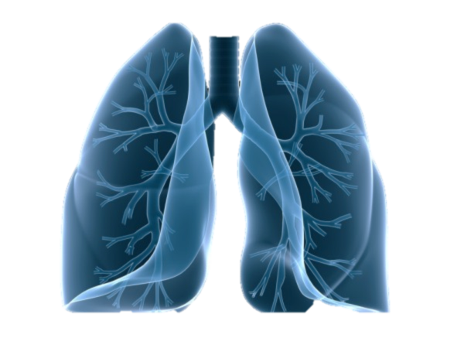
CHRONIC OBSTRUCTIVE PULMONARY DISEASE AND BRONCHIAL ASTHMA
Lecturer: ass. professor Khyzhnyak O.V.
2023-2024

Slide 2
Global Strategy for Diagnosis, Management and Prevention of COPD
Definition of COPD
COPD, a common preventable and treatable disease, is characterized by persistent airflow limitation that is usually progressive and associated with an enhanced chronic inflammatory response in the airways and the lung to noxious particles or gases.
© 2014 Global Initiative for Chronic Obstructive Lung Disease
Notes:
2

Slide 3

Global Strategy for Diagnosis, Management and Prevention of COPD
Mechanisms Underlying Airflow Limitation in COPD
Small Airways Disease
Airway inflammation
Airway fibrosis, luminal plugs
Increased airway resistance
Parenchymal Destruction
Loss of alveolar attachments
Decrease of elastic recoil
AIRFLOW LIMITATION
© 2014 Global Initiative for Chronic Obstructive Lung Disease
Notes:
3

Slide 4

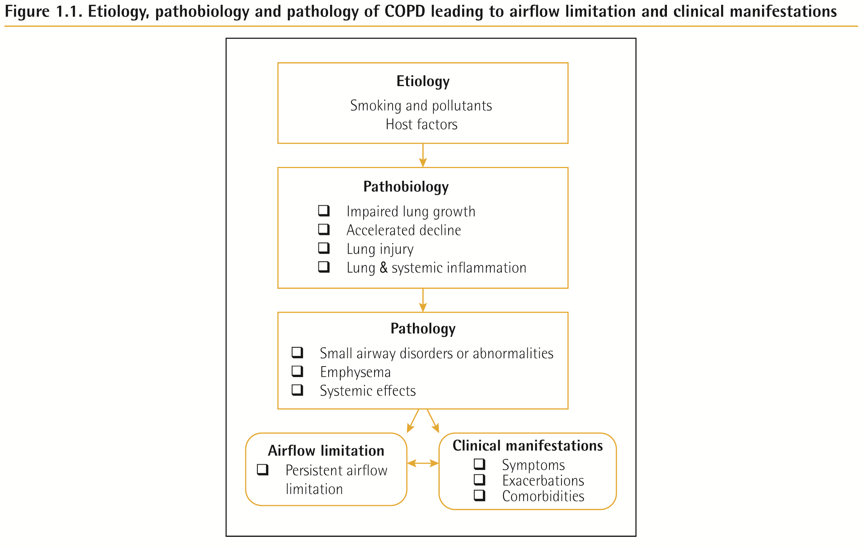
2022 Global Initiative for Chronic Obstructive Lung Disease

Slide 5
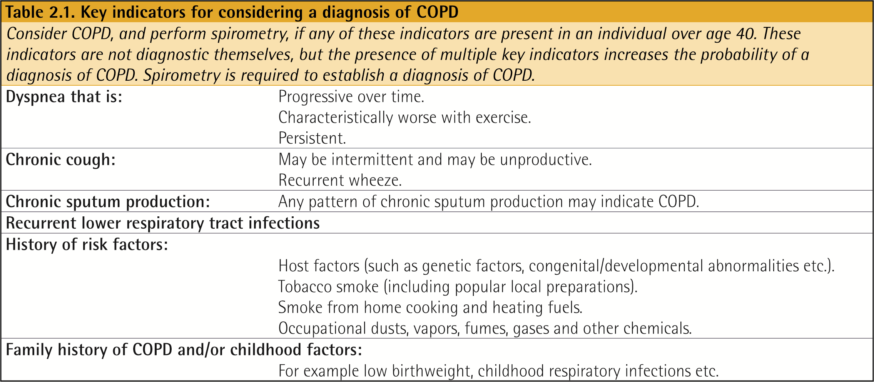

Slide 6
Diagnosis of COPD
EXPOSURE TO RISK
FACTORS
SYMPTOMS
cough
tobacco
sputum
occupation
dyspnea
indoor/outdoor pollution
è
SPIROMETRY
Notes:
6
In all pts at risk and at least annually to assess clinical status and response to therapy

Slide 7
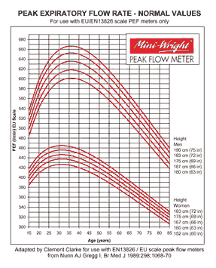

Slide 8
410 ml FEV1 normal
310 ml
76% from predicted
<80%
320 ml
320-310/310 X 100%=3%
<12% - irreversible
>12% -reversible (+bronchodilatator test)

Slide 9
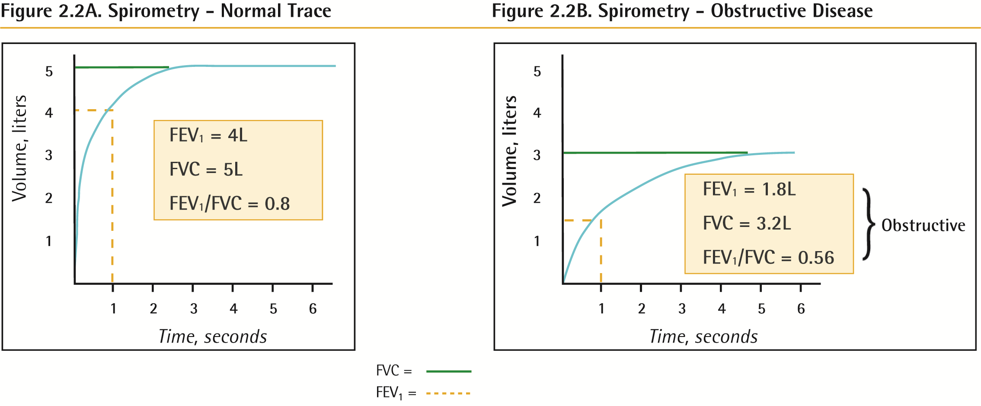

Slide 10
Global Strategy for Diagnosis, Management and Prevention of COPD
Diagnosis and Assessment: Key Points
A clinical diagnosis of COPD should be considered in any patient who has dyspnea, chronic cough or sputum production, and a history of exposure to risk factors for the disease.
Spirometry is required to make the diagnosis; the presence of a post-bronchodilator FEV₁/FVC < 0.70 confirms the presence of persistent airflow limitation and thus of COPD.
© 2014 Global Initiative for Chronic Obstructive Lung Disease
Notes:
10

Slide 11
Global Strategy for Diagnosis, Management and Prevention of COPD
Assessment of Airflow Limitation:
Spirometry
Spirometry should be performed after the administration of an adequate dose of a short- acting inhaled bronchodilator to minimize variability.
A post-bronchodilator FEV₁/FVC < 0.70 confirms the presence of airflow limitation.
Where possible, values should be compared to age-related normal values to avoid overdiagnosis of COPD in the elderly.
© 2014 Global Initiative for Chronic Obstructive Lung Disease
Notes:
11

Slide 12
revised GOLD classification
Looks at 3 things:
Symptoms
FEV₁
History of exacerbations
Notes:
Why the new system? A good question for the listeners is, what if two patients are in the same class but different exercise tolerance or functional capacity? They should not be treated the same, therefore, the revised GOLD classification uses symptoms, FEV₁, history of exacerbations to assess the exacerbation risk and guide therapy
12

Slide 13

Global Strategy for Diagnosis, Management and Prevention of COPD
Assessment of COPD
Assess symptoms
Assess degree of airflow limitation using spirometry
Assess risk of exacerbations
Assess comorbidities
COPD Assessment Test (CAT)
or
Clinical COPD Questionnaire (CCQ)
or
mMRC Breathlessness scale
© 2014 Global Initiative for Chronic Obstructive Lung Disease
Notes:
13

Slide 14
Global Strategy for Diagnosis, Management and Prevention of COPD
Assessment of Symptoms
COPD Assessment Test (CAT): An 8-item measure of health status impairment in COPD
(http://catestonline.org).
Clinical COPD Questionnaire (CCQ): Self-administered questionnaire developed to measure clinical control in patients with COPD
(http://www.ccq.nl).
© 2014 Global Initiative for Chronic Obstructive Lung Disease
Notes:
14

Slide 15
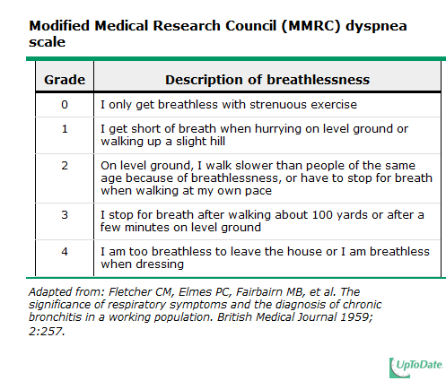
Grading symptoms
Notes:
This is how symptoms are graded in the new system. Can either use this-MMRC or CAT scale
15

Slide 16
Grading severity of airflow
In patients with FEV₁/FVC <0.70
GOLD 1 | Mild | FEV₁>80%
GOLD 2 | Moderate | 50%<FEV_{1<80%}
GOLD 3 | Severe | 30%<FEV₁<50%
GOLD 4 | Very severe | FEV₁<30%
Notes:
Point out that FEV₁/FVC ratio used to be the only factor in the old classification system. In a sense, we are using the same 1-4 ratios of FEV₁ as the old system here, but it is now one of three factors in the new classification system
16

Slide 17
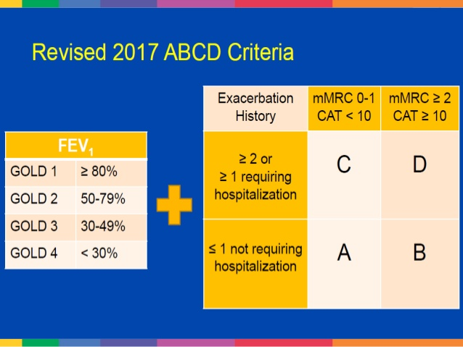

Slide 18
CASE
74 YO M with COPD p/w SOB x 2 days. At baseline he does not have any physical limitations. His last spirometry three years ago showed mild COPD. He was never given any inhalers besides a rescue inhaler that he seldom uses. He has never been intubated, but gets about 3 exacerbations per year. 2 days ago he required it around the clock after having URI symptoms. He has increased greenish sputum over the past couple of days. He called 911 after waking up SOB. He was given duonebs and placed on CPAP.
What classification is he?
Notes:
Grade 0 symptoms, Grade 1 spirometry, >2 exacerbations. So class C
18

Slide 19
Grade 0 symptoms,
>2 exacerbations.
So class C

Slide 20
Global Strategy for Diagnosis, Management and Prevention of COPD
Assess COPD Comorbidities
COPD patients are at increased risk for:
  Cardiovascular diseases
  Osteoporosis
  Respiratory infections
  Anxiety and Depression
  Diabetes
  Lung cancer
  Bronchiectasis
These comorbid conditions may influence mortality and hospitalizations and should be looked for routinely, and treated appropriately.
© 2014 Global Initiative for Chronic Obstructive Lung Disease
Notes:
20

Slide 21
Global Strategy for Diagnosis, Management and Prevention of COPD
Differential Diagnosis:
COPD and Asthma
COPD
ASTHMA
Onset in mid-life
Symptoms slowly progressive
Long smoking history
Onset early in life (often childhood)
Symptoms vary from day to day
Symptoms worse at night/early morning
Allergy, rhinitis, and/or eczema also present
Family history of asthma
© 2014 Global Initiative for Chronic Obstructive Lung Disease
Notes:
21

Slide 22
Global Strategy for Diagnosis, Management and Prevention of COPD
Additional Investigations
Chest X-ray: Seldom diagnostic but valuable to exclude alternative diagnoses and establish presence of significant comorbidities.
Lung Volumes and Diffusing Capacity: Help to characterize severity, but not essential to patient management.
Oximetry and Arterial Blood Gases: Pulse oximetry can be used to evaluate a patient’s oxygen saturation and need for supplemental oxygen therapy.
Alpha-1 Antitrypsin Deficiency Screening: Perform when COPD develops in patients of Caucasian descent under 45 years or with a strong family history of COPD.
© 2013 Global Initiative for Chronic Obstructive Lung Disease
Notes:
22

Slide 23
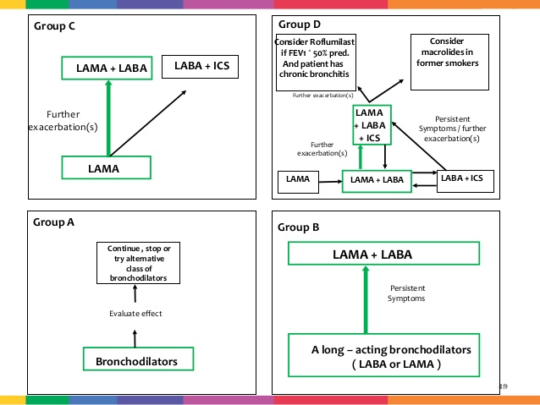

Slide 24
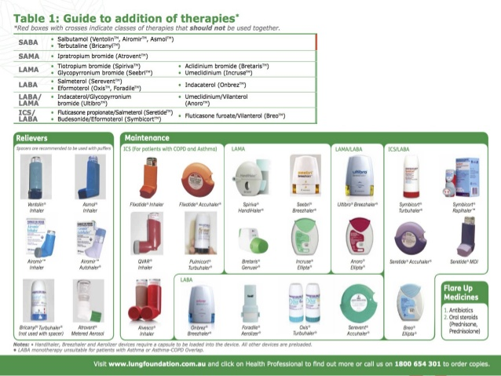

Slide 25
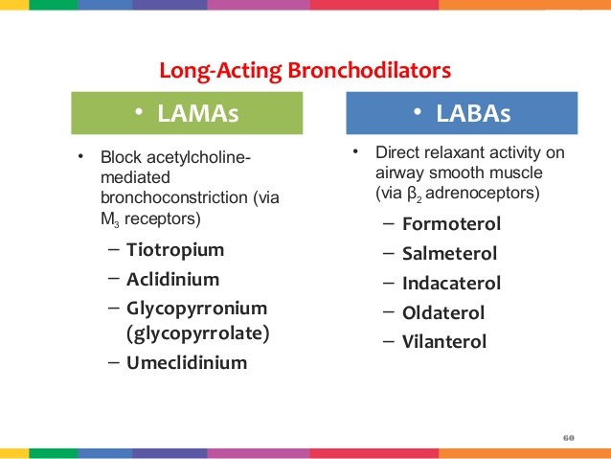

Slide 26
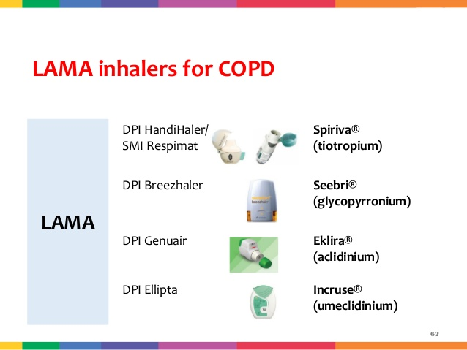

Slide 27
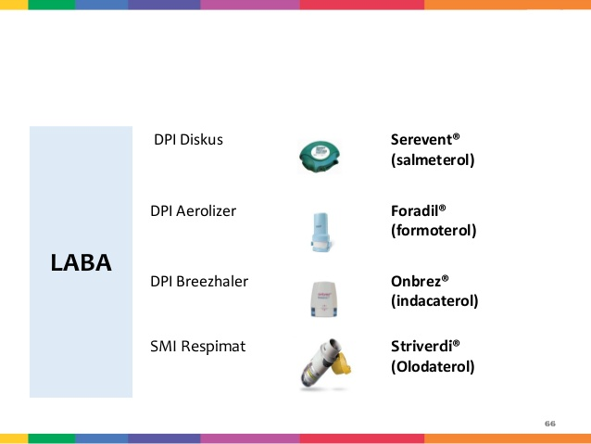

Slide 28
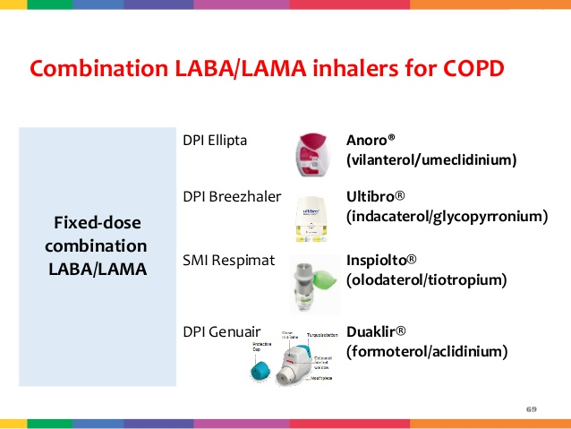

Slide 29
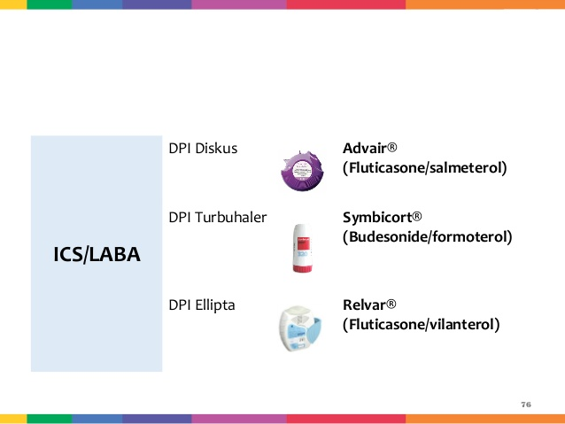

Slide 30
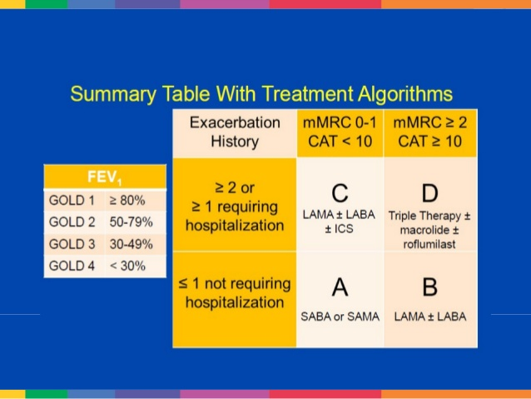

Slide 31
Global Strategy for Diagnosis, Management and Prevention of COPD
Therapeutic Options: Other Pharmacologic Treatments
Alpha-1 antitrypsin augmentation therapy: not recommended for patients with COPD that is unrelated to the genetic deficiency.
Mucolytics: Patients with viscous sputum may benefit from mucolytics; overall benefits are very small.
Antitussives: Not recommended.
Vasodilators: Nitric oxide is contraindicated in stable COPD. The use of endothelium-modulating agents for the treatment of pulmonary hypertension associated with COPD is not recommended.
Notes:
31

Slide 32
Global Strategy for Diagnosis, Management and Prevention of COPD
Therapeutic Options: Other Treatments
Oxygen Therapy: The long-term administration of oxygen (> 15 hours per day) to patients with chronic respiratory failure has been shown to increase survival in patients with severe, resting hypoxemia.
Ventilatory Support: Combination of noninvasive ventilation (NIV) with long-term oxygen therapy may be of some use in a selected subset of patients, particularly in those with pronounced daytime hypercapnia.
© 2014 Global Initiative for Chronic Obstructive Lung Disease
Notes:
32

Slide 33
Global Strategy for Diagnosis, Management and Prevention of COPD
Therapeutic Options: Surgical Treatments
Lung volume reduction surgery (LVRS) is more efficacious than medical therapy among patients with upper-lobe predominant emphysema and low exercise capacity.
LVRS is costly relative to health-care programs not including surgery.
In appropriately selected patients with very severe COPD, lung transplantation has been shown to improve quality of life and functional capacity.
© 2014 Global Initiative for Chronic Obstructive Lung Disease
Notes:
33

Slide 34
Global Strategy for Diagnosis, Management and Prevention of COPD
Manage Exacerbations
An exacerbation of COPD is:
“an acute event characterized by a worsening of the patient’s respiratory symptoms that is beyond normal day-to-day variations and leads to a change in medication.”
© 2014 Global Initiative for Chronic Obstructive Lung Disease
Notes:
34

Slide 35
Global Strategy for Diagnosis, Management and Prevention of COPD
Manage Exacerbations: Assessments
Arterial blood gas measurements (in hospital): PaO₂ < 8.0 kPa with or without PaCO₂ > 6.7 kPa when breathing room air indicates respiratory failure.
Chest radiographs: useful to exclude alternative diagnoses.
ECG: may aid in the diagnosis of coexisting cardiac problems.
Whole blood count: identify polycythemia, anemia or bleeding.
Purulent sputum during an exacerbation: indication to begin empirical antibiotic treatment.
Biochemical tests: detect electrolyte disturbances, diabetes, and poor nutrition.
Spirometric tests: not recommended during an exacerbation.
© 2014 Global Initiative for Chronic Obstructive Lung Disease
Notes:
35

Slide 36
Global Strategy for Diagnosis, Management and Prevention of COPD
Manage Exacerbations: Treatment Options
Oxygen: titrate to improve the patient’s hypoxemia with a target saturation of 88-92%.
Bronchodilators: Short-acting inhaled beta₂-agonists with or without short-acting anticholinergics are preferred.
Systemic Corticosteroids: Shorten recovery time, improve lung function (FEV₁) and arterial hypoxemia (PaO₂), and reduce the risk of early relapse, treatment failure, and length of hospital stay. A dose of 40 mg prednisone per day for 5 days is recommended . Nebulized magnesium as an adjuvent to salbutamol treatment in the setting of acute exacerbations of COPD has no effect on FEV₁.
Notes:
36

Slide 37
Global Strategy for Diagnosis, Management and Prevention of COPD
Manage Exacerbations: Treatment Options
Antibiotics should be given to patients with:
Three cardinal symptoms: increased dyspnea, increased sputum volume, and increased sputum purulence.
Who require mechanical ventilation.
© 2014 Global Initiative for Chronic Obstructive Lung Disease
Notes:
37

Slide 38
Definition of Asthma
A chronic inflammatory disorder of the airways
Many cells and cellular elements play a role
Chronic inflammation is associated with airway hyperresponsiveness that leads to recurrent episodes of wheezing, breathlessness, chest tightness, and coughing
Widespread, variable, and often reversible airflow limitation

Slide 39
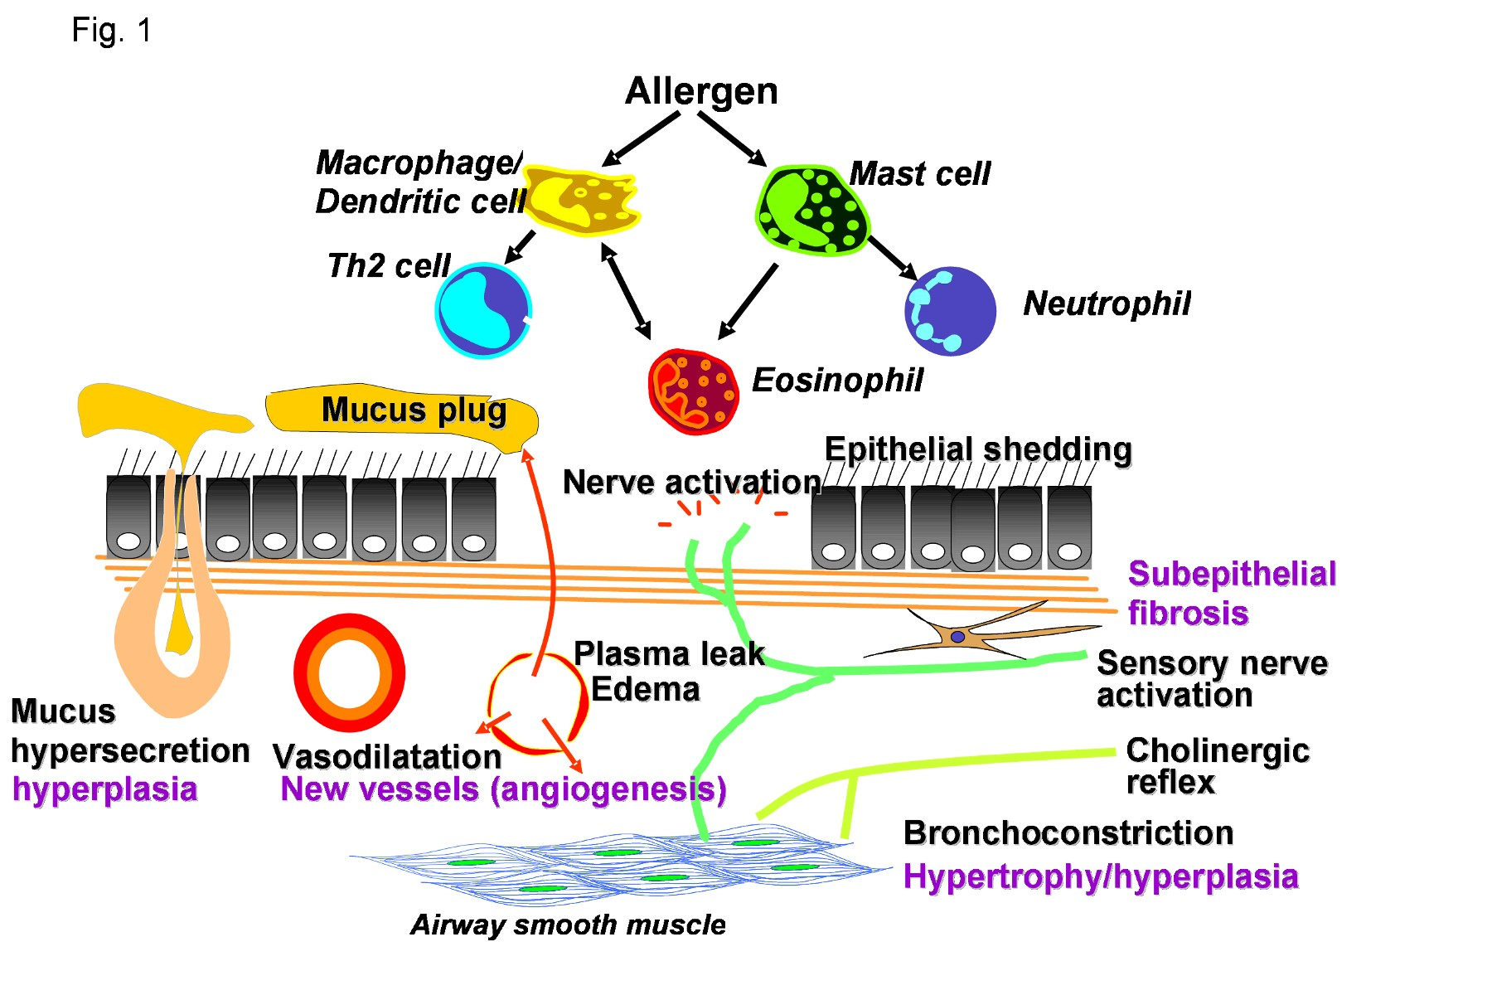
Asthma Inflammation: Cells and Mediators
Source: Peter J. Barnes, MD

Slide 40
Factors that Influence Asthma Development and Expression
Host Factors
Genetic
- Atopy
- Airway hyperresponsiveness
Gender
Obesity
Environmental Factors
Indoor allergens
Outdoor allergens
Occupational sensitizers
Tobacco smoke
Air Pollution
Respiratory Infections
Diet
GINA 2011

Slide 41
Is it Asthma?
Recurrent episodes of wheezing
Troublesome cough at night
Cough or wheeze after exercise
Cough, wheeze or chest tightness after exposure to airborne allergens or pollutants
Colds “go to the chest” or take more than 10 days to clear
GINA 2007: www.ginasthma.org

Slide 42
Classic triad of symptoms:
1) Wheeze (high-pitched whistling sound, usually upon exhalation).
It is different from the monophasic wheezing of a local bronchial narrowing (eg, due to an aspirated foreign body or bronchogenic cancer), which has single pitch and repeatedly begins and ends at the same point in each respiratory cycle
- Transmission of expiratory noises from the upper airway (eg, larynx, pharynx) can mimic wheezing and is often described as wheezing by patients. However, these noises are typically loudest over the neck and greatly diminished over the chest.
2) Cough (typically worsening at night).
3) Shortness of breath or difficulty breathing.

Slide 43
All that wheezes is not asthma
CHF
Upper Airway Obstruction
COPD
Aspiration
Bronchiectasis

Slide 44
The prior probability of asthma:
1) Episodic symptoms: come and go, with a time course of hours to days, resolving spontaneously with removal from the triggering stimulus or in response to anti-asthmatic medications.
2) Characteristic triggers: symptoms triggered by exercise, cold air, and exposure to allergens are suggestive of asthma.
3) Personal or family history of atopy: A strong family history of asthma and allergies or a personal history of atopic diseases (specifically, atopic dermatitis, seasonal allergic rhinitis and conjunctivitis, or hives) favors a diagnosis of asthma in a patient with suggestive symptoms.
4) History of asthmatic symptoms as a child:
As previously mentioned, recollection of childhood symptoms of chronic cough, nocturnal cough in the absence of respiratory infections, or a childhood diagnosis of "chronic bronchitis" or "wheezy bronchitis" favors asthma.
Adapted from GINA 2007: www.ginasthma.org

Slide 45

Typical Spirometric (FEV₁) Tracings
Volume
FEV₁
Normal Subject
Asthmatic (After Bronchodilator)
Asthmatic (Before Bronchodilator)
Increasing of FEV1>12%
1
2
3
4
5
Time (sec)
Note: Each FEV₁ curve represents the highest of three repeat measurements
Notes:
45

Slide 46
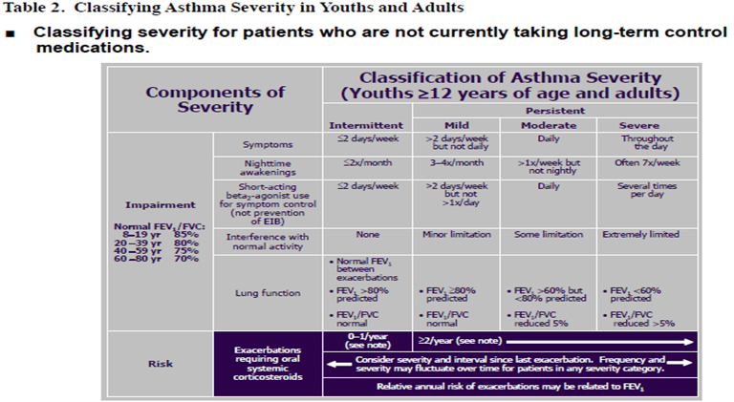

Slide 47
Investigations
Routine CXR is not indicated: Would be normal or would show hyperinflation Is indicated if there is suspicion of pneumonia, CHF, pneumothorax, or other medical concern
Routine CBC is not indicated: Slight Leucocytosis sec. to β2 agonist or steroid use
ABG is not indicated in most mild to moderate cases. It does not predict clinical outcome and should not supersede clinical findings to determine the need for intubation
Theophylline levels
ECG: May show RV Strain, non specific ST-T abnormalities
Cardiac Monitoring for all elderly and/or cardiac patients

Slide 48
Component 3: Assess, Treat and Monitor Asthma
Clinical Control of Asthma
Determine the initial level of control to implement treatment
(assess patient impairment)
Maintain control once treatment has been implemented
(assess patient risk)

Slide 49
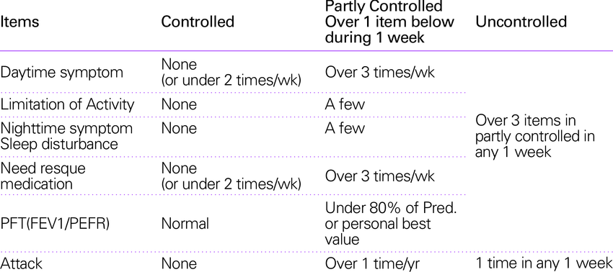
Levels of Asthma control

Slide 50
Assess Patient Risk
Features that are associated with increased risk of adverse events in the future include:
Poor clinical control
Frequent exacerbations in past year
Ever admission to critical care for asthma
Low FEV₁, exposure to cigarette smoke, high dose medications

Slide 51
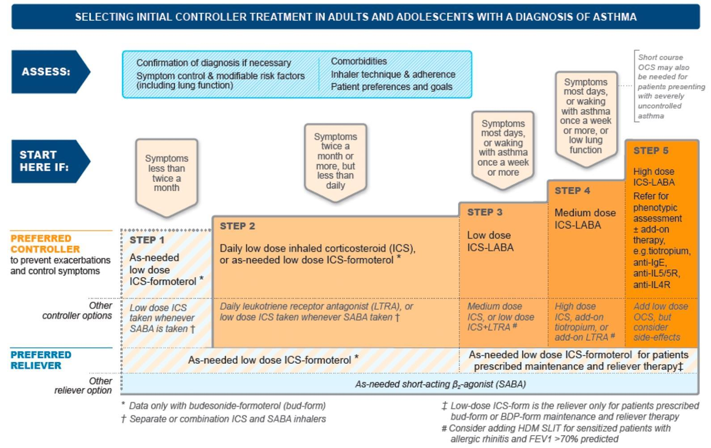

Slide 52
Equivalent dosage of ICS
Drug name | LOW, mcg | Moderate, mcg | High, mcg
Beclomethasone dipropionate CFC | 200 - 500 | 500 – 1000 | 1000 - 2000
Budesonide | 200 – 400 | 400 – 800 | 800 – 1600
Ciclesonide | 80 – 160 | 160 -320 | 320 -1280
Flunisolide | 500 – 1000 | 1000 – 2000 | > 2000
Fluticasone propionate | 100 – 250 | 250 – 500 | 500 - 1000
Mometasone furoate | 200 | ≥ 400 | ≥ 800
GINA 2011; www.ginasthma.org Updated 2011

Slide 53
Antileukotriene druds
Indications:
  Treatment of aspirin-sensitive patients
  Prevention of bronchospasm due to physical overload
  smokers
  BA + allergic rhinitis
  Patients who can’t use inhalated drugs
Zafirlukast – tab. 20 mg; 1 tab OD
Montelukast – tab. 10 mg; 1 tab OD
Can be used as monotherapy at STEP 2 or as combination with ICS

Slide 54
ANTIBODY TO IGe
OMALIZUMAB
Dosage: 75 - 375 mg 1 time per 2 or 4 weeks s/c; is defined in accordance to body weight and baseline IgE level (before treatment)

Slide 55
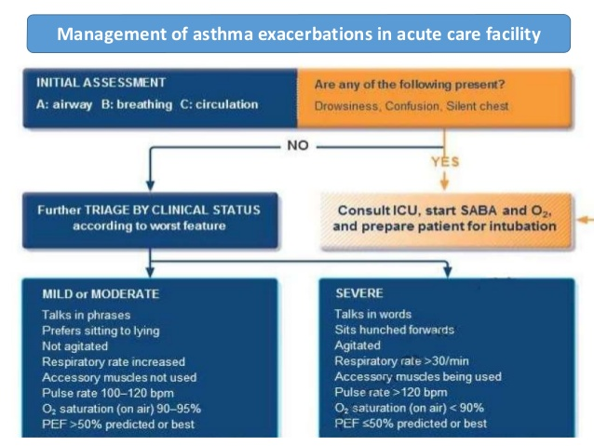
GINA 2019; www.ginasthma.org

Slide 56
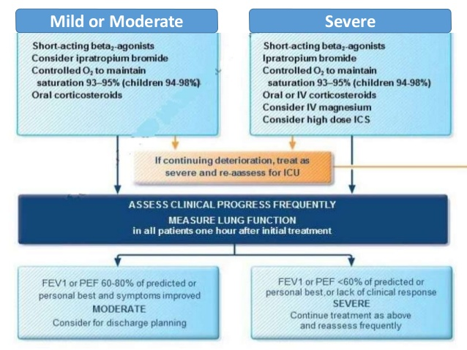
GINA 2019; www.ginasthma.org

Slide 57
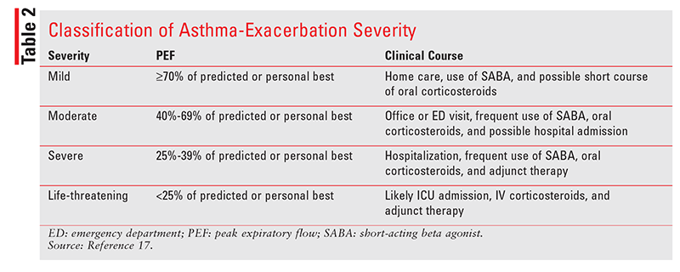
Adapted from GINA 2019: www.ginasthma.org

Slide 58
Asthma Management and Prevention Program
Component 4: Manage Asthma Exacerbations
Primary therapies for exacerbations:
Repetitive administration of rapid-acting inhaled β₂-agonist
Early introduction of systemic glucocorticosteroids
Oxygen supplementation
Closely monitor response to treatment with serial
measures of lung function

Slide 59
Acute severe asthma:
The term ‘status asthmaticus’ was defined as asthma that had failed to resolve with therapy in 24 hours.
Although this term is still used occasionally, it has been mainly discarded and replaced by ‘acute severe asthma’, i.e. severe asthma that has not been controlled by the patient’s use of medication.

Slide 60
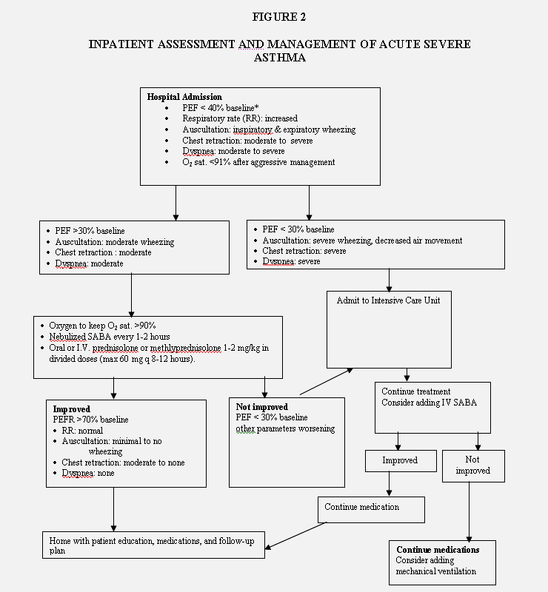
Adapted from ATC 2016

