Slide 1
STOMACH DYSPEPSIA. CHRONIC GASTRITIS. PEPTIC ULCERS OF STOMACH AND DUODENUM
Internal Medicine. Chapter Gastroenterology. Lecture # 4
Internal Medicine #2 ONMedU
Performed by ass. professor Iablonska V.B.
Notes:
1

Slide 2
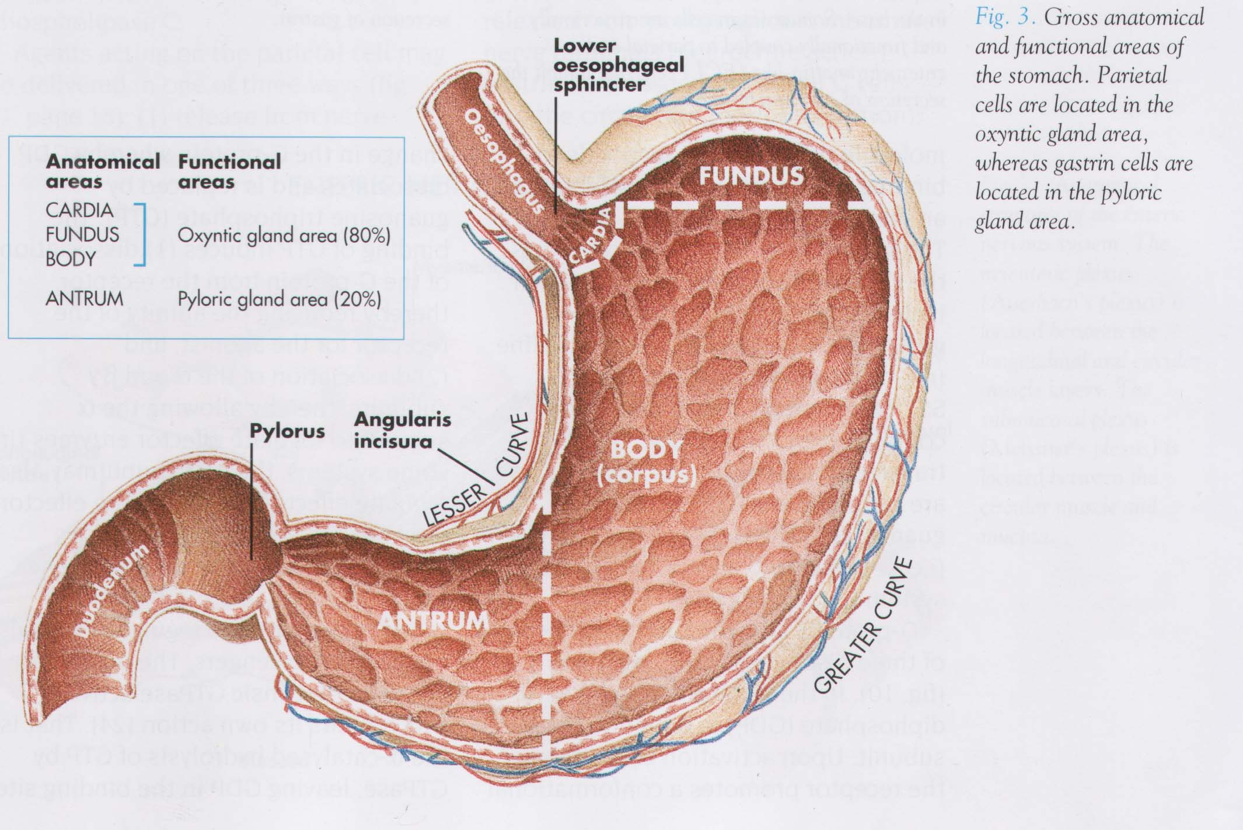

Slide 3
Stomach Dyspepsia
  ‏
  Functional dyspepsia subdivided:
    Postprandial distress syndrome‏
    Epigastric pain syndrome
    according to Rome IV Criteria (2016)
Notes:
3

Slide 4
Definition
Functional dyspepsia is a functional disorder characterized by the onset of dispeptic symptoms, epigastric pain or epigastric burning sensation immediately after a meal, with food and sometimes diminishes with food intake for epigastric pain syndrome

Slide 5
Epidemiology
It is known that 10-30 percent of the world’s population suffers from functional dyspepsia.
Risks of developing functional dyspepsia:
- age,
- female,
- stress,
- low socio-economic status,
- Hp-infection,
- taking NSAID

Slide 6
Pathophysiology of FD
Causing factors of FD:
- delayed gastric emptying,
- deterioration of gastric accommodation degradation (accumulation of
chyme in the antrum and decreased filling of the proximal stomach,
- gastric and duodenal hypersensitivity to stretching, acid and other
stimuli distension,
- Hp – infection,
- low-intensity duodenal inflammatin, increased mucosal permeability,
food antigens, duodenal eosinophilia,
- the impact of external factors (acute infections),
- psychosocial factors (anxiety, depression, neurotization).

Slide 7
Diagnostic criteria for functional dyspepsia
Postrandial distress syndrome
(minimum 3 times a week)
- postprandial feeling of overcrowding
- early satiety
Epigastric pain syndrome
(minimum 1 time a week)
- epigastric pain or burning
- nausea
Additional signs of functional dyspepsia
- postprandial epigastric distention
- belching
Symptoms are annoying and affect daily activity

Slide 8
Differential Diagnosis of Dyspepsia
  Peptic ulcer disease
  Gastroesophageal reflux
  Gastric malignancy
  Biliary pain
  Irritable bowel syndrome
  Drug induced dyspepsia
  Functional (non-ulcer) dyspepsia
Notes:
8

Slide 9
Peptic ulcer disease
  Individual symptoms have NOT been useful in identifying organic from functional dyspepsia
  PUD found in 5-15% of pts with dyspepsia
    May be missed in pts receiving antisecretory therapy (Proton Pomp Inhibitor or Histamin 2 Receptor’s Antagonist)‏
    Duodenal ulcer → H pylori 90%
    Gastric Ulcer → H pylori 70%
Notes:
9

Slide 10
GERD
  Most common symptoms are heartburn and regurgitation
  Clinical diagnosis
    heartburn correlates poorly with 24-hr pH monitoring and esophagogastroduodenoscopy findings
  Reflux esophagitis found in 5-15% of pts with dyspepsia at endoscopy
Notes:
10

Slide 11
Gastric Malignancy
  Alarm Features in Dyspepsia
    Age older than 55 with new-onset dyspepsia
    Family history of upper GI malignancy
    Unintended weight loss
    Progressive dysphagia
    Odynophagia
    Unexplained iron-deficiency anemia
    Persistent vomiting
    Palpable mass or lymphadenopathy
    jaundice
Notes:
11

Slide 12
Biliary Pain
  “Classic” biliary pain characterized by
    episodic acute and severe upper abdominal pain in epigastrium or right upper qudrant
    lasting at least an hour (often several hours or more)‏
    Pain may radiate to back or scapula
    Often associated with restlessness, sweating or vomiting
Notes:
12

Slide 13
Drug Induced Dyspepsia
  NSAID- related dyspepsia is common
    20% of pts taking NSAIDS
    10-20% may develop peptic ulcer disease detectable by endoscopy
  Other drugs
    Calcium channel blockers
    Methylxanthines
    Bisphosphonates
    Potassium supplements
    Antibiotics (erythromycin, metranidazole)‏
    Orlistat, acarbose
Notes:
13

Slide 14
Functional (non-ulcer) Dyspepsia
  Definition
    At least 3 month history of dyspepsia in which there is no obvious structural explanation for the symptoms
  Accounts for up to 60% of all pts presenting with dyspepsia
  Pathophysiology is unclear yet overlapping disorders of upper gastro-intestinal motor and sensory function are implicated
    25-40% have delayed gastric emptying
    30% have altered visceral sensation
    20-60% have H-pylori induced gastritis
      No association between H-pylori and any specific symptom profile
Notes:
14

Slide 15
Clinical examination of patients with FD
- anamnesis and identifying “alarming” symptoms and
iatrogenic causes (for example, taking NSAIDS)
- gastroduodenoscopy
- determination of the presence of Hp-infection
If eradication therapy is not effective, the diagnosis of
functional dyspepsia can be considered.
If eradication therapy (6-12 months) is effective, the
diagnosis of Hp-infection associated dyspepsia can
be determine.

Slide 16
Treatment of FD
- lifestyle modification (refusal to drink coffee, alcohol,
smoking)
- diet (frequent fractional meals in small portions,
refusal to eat fatty foods)
- avoid taking NSAIDS
- eradication of Hp-infection (strategy test and treat)
- psychotherapeutic treatment
- treatment of concomitant gastroesophageal reflux
disease

Slide 17
Drug therapy for patients with FD
First line drugs
- Prokinetics (domperidone, itopridum)
- Proton pump inhibitors (omeprazole, pantoprazolum)
and H2-histamine blockers (ranitidine, famotidine)
Second line drugs
- Antidepressants (amitriptyline, paroxenus)
- Other psychotropic drugs with sedative and prokinetic
properties (levosulpiride)
- Fundic reloxants (acotiamide, buspiron)
- Montelukast and H1-histamine blockers
- Phytotherapy

Slide 18
Diagnostic Strategies for the Evaluation of Dyspepsia
  Empiric Treatment with acid suppression
  Endoscopy in all patients
  Test for H-pylori and treat if positive
Notes:
18

Slide 19
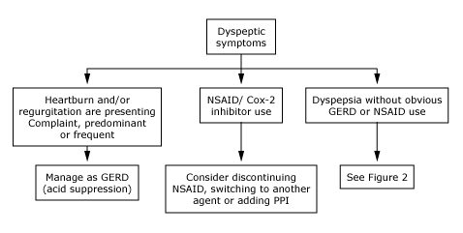

American Gastroenterological Association (AGA) guidelines for the management of Dyspepsia
Notes:
19

Slide 20
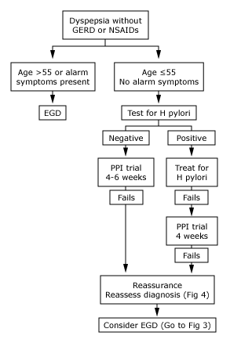
Notes:
20

Slide 21
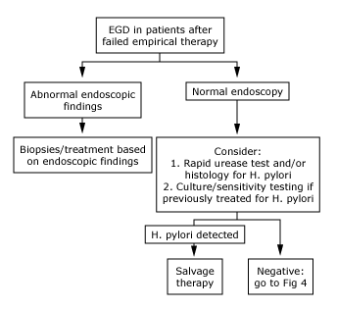
Notes:
21

Slide 22
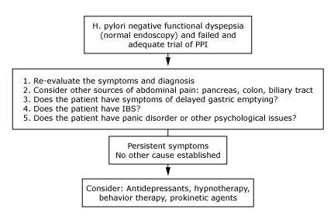
Notes:
22

Slide 23
Case Presentation
  34 year old patient - security guard
  5 years of intermittent epigastric discomfort
  Bloating, postprandial nausea
  Smokes, drinks 3 beers/day,
  4 coffees/day
  Ranitidine prescribed one year ago
    - Initially beneficial, not now
  Family history of peptic ulcer
  Examination is normal
Notes:
23

Slide 24
Case Presentation
  You suspect functional dyspepsia
  The patient requests investigation (worried about cancer or infection)‏
  What investigations would you do?
  What management suggestions would you make?
  Would you suggest any medication?
Notes:
24

Slide 25
  The term gastritis is used to denote inflammation associated with mucosal injury
  Gastritis is mostly a histological term that needs biopsy to be confirmed
  Gastritis is usually due to infectious agents (such as Helicobacter pylori) and autoimmune and hypersensitivity reactions.
Notes:
25

Slide 26
  Epithelial cell damage and regeneration without associated inflammation is properly referred to as "gastropathy.“
  Gastropathy may be referred without histological evidence and just according to gross appearance in endoscopy or radiology
  Gastropathy is usually caused by irritants such as drugs (eg, nonsteroidal antiinflammatory agents and alcohol), bile reflux, hypovolemia, and chronic congestion.
Notes:
26

Slide 27
Definition of Chronic gastritis (CG)
CG – chronic, inflammatory-dystrophic process
in the gastric mucosa, which is accompanied by
a violation of the processes of cell regeneration
and progressive atrophy of the glandular
epithelium.
Diagnosis of CG can be established only by:
- at endoscopic observations,
- histological evaluation of biopsy specimens.

Slide 28
Etiology
● auto-immunologic factor
❖ high positive rate (90%) of serum anti-parietal cell antibody (APCA)
❖ animal model: gastritis induced by
injecting APCA repeatedly
❖ high positive rate (75%) of serum
anti-intrinsic factor antibody

Slide 29
Other factors
❖ H. pylori, other bacteria, viruses, fungi, parasites
❖ reflux of duodenal juice
incompetence of pyloric sphincter
post operate stomach
❖ chemical substances, medicines,
heavy salty foods, food allergy, alcohol
aging, environmental factors
portal hypertension,sarcoidosis
radiation damage, foreign bodies
idiopathic factors, etc.

Slide 30
Etiological Classification of Chronic Gastritis
Kyoto Global International Consensus (2015)
I. Autoimmune CG (etiology unknown, autoimmune
pathogenesis)
II. Infections CG
1. Helicobacter pylori (Hp)-induced CG
2. Bacterial non-Hp CG
a) caused by enterococci
b) caused by mycobacteria
c) caused by pallid treponema (lues), secondary
syphilitic CG
3. Viral CG
a) enteroviral CG
b) cytomegaloviral CG

Slide 31
Etiological Classification of Chronic Gastritis
Kyoto Global International Consensus (2015)
4. Fungal CG
a) CG with gastric mucomycosis
b) CG with gastric pandidiasis
c) CG with gastric histoplasmosis
5. Parasitis CG
a)cryptosporidium-induced CG
b) gastric strongylondosis
c) gastric anisakiasis
III. CG due to external factors
1. Medicinal CG
2. Alcoholic CG
3. Radiation CG
4. Chemical CG
5. CG due to duodenal reflux

Slide 32
Etiological Classification of Chronic Gastritis
Kyoto Global International Consensus (2015)
IV. CG due to specific causes
1. Lymphoblastic CG
2. Menetrier’s Disease
3. Allergic CG
4. Eozinophilic CG
V. CG due to other causes
1. CG due to sarcoidosis
2. CG due to vasculitis
3. CG due to Crohn’s Disease

Slide 33
Classification of Chronic Gastritis
(Sydney 1990, modified in Houston 1994)
Sydney Classification System includes 3 sectious
1. Topography
A) antral (type B)
B) fundic gland (type A)
C) pangastritis (type AB)
2. Histology
- chronic superficial gastritis
- chronic atrophic gastritis
3. Etiology

Slide 34
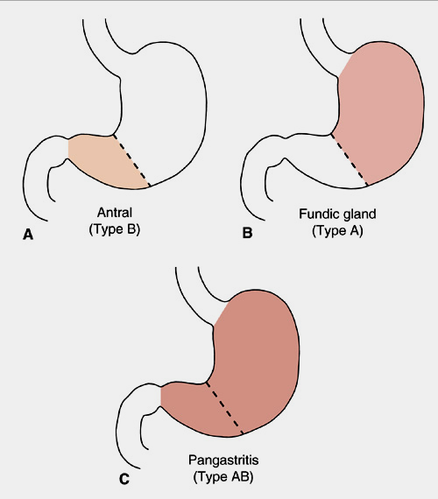
Notes:
34

Slide 35
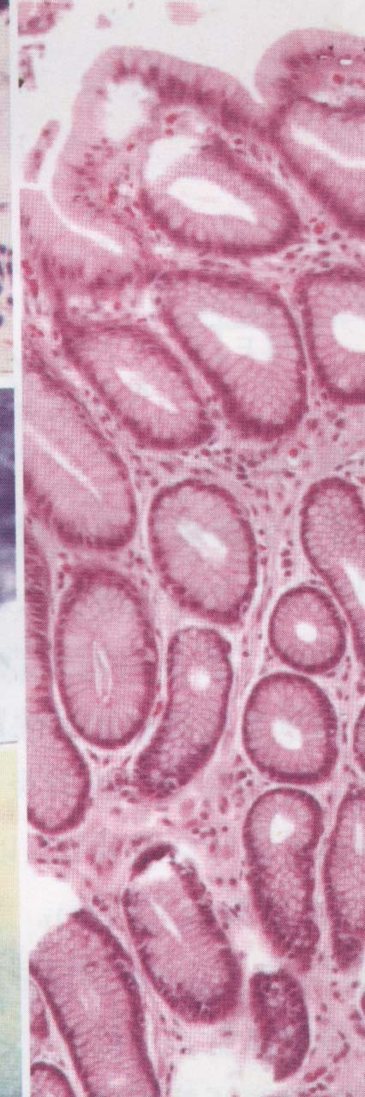
Histology
Chronic superficial gastritis
Chronic inflammation
without glandular
atrophy

Slide 36
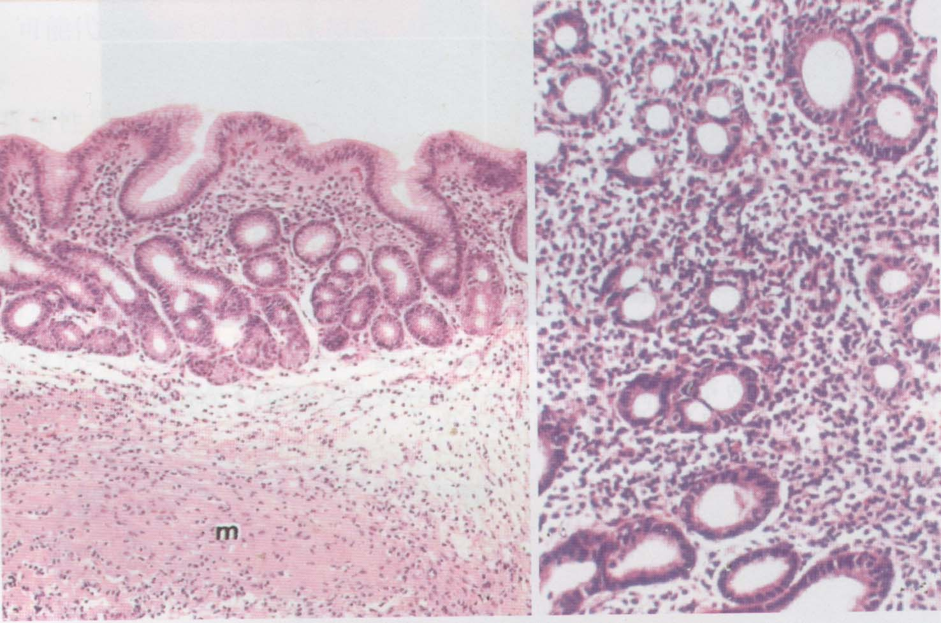
Chronic atrophic gastritis
Chronic inflammation
with glandular atrophy

Slide 37
Classification of Chronic Gastritis (Sydney / Houston)
1. Chronic Atrophic Gastritis (autoimmune,diffuse gastritis of stomach corpus, associated with pernicious anemia, chronic multifocal gastritis, type A), present in 15-18% cases of CG.
2. Chronic Nonatrophic Gastritis ( Helicobacteric antrial gastritis, type B), which represents almost 70% of all gastritis types.
3. Special forms of chronic gastritis:
- Chemical (reactive chronic gastritis, which occurs in case of bile, duodenum-stomach reflux (about 15%), after NSAID therapy (about 10%),
- Granulomatous (in case of Crohn’s disease,Sarkoidosis, Tuberculosis),
- Eozinophilic (in case of Bronchial Asthma, food allergy),
- Lymphocytic (with manifested lymphocytic infiltration of epithelium),
- Gigant Hypertrophic Gastritis (Menetrier’s disease),
- Radiation Gastritis

Slide 38
Clinical Manifestations
● Most of patients are asymptomatic
● Dyspepsia: upper abdominal pain or
discomfort (bloating, belching, nausea,vomiting,diarrhea)
● Symptoms of anemia
● The symptoms are not specific
● No typical physical sign found

Slide 39
Laboratory and other examinations
● Endoscopy examination with mucosal biopsy - the most reliable method for diagnosis

Slide 40
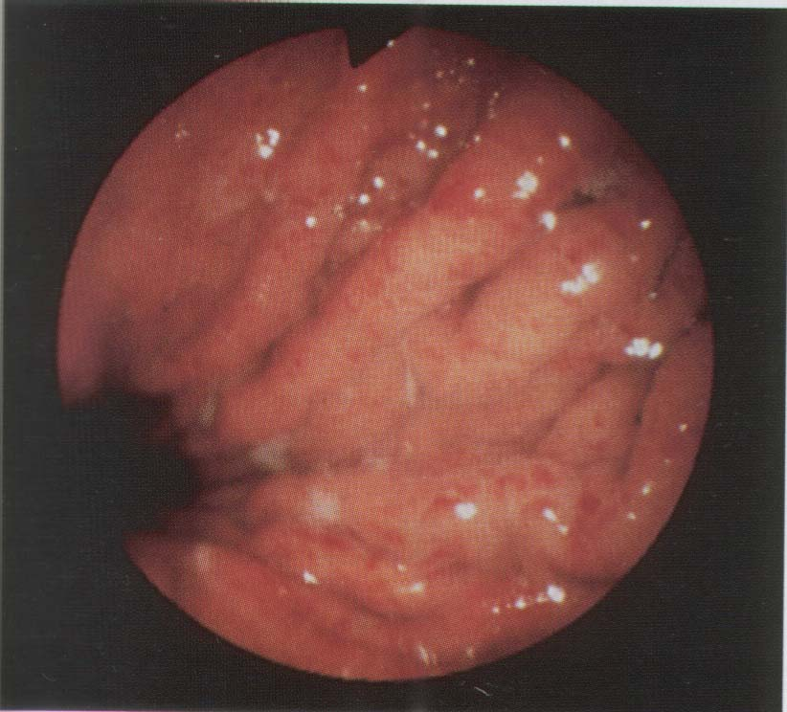
Endoscopy examination
superficial gastritis edema, erythema, exudate, erosion
Edema
erythema

Slide 41
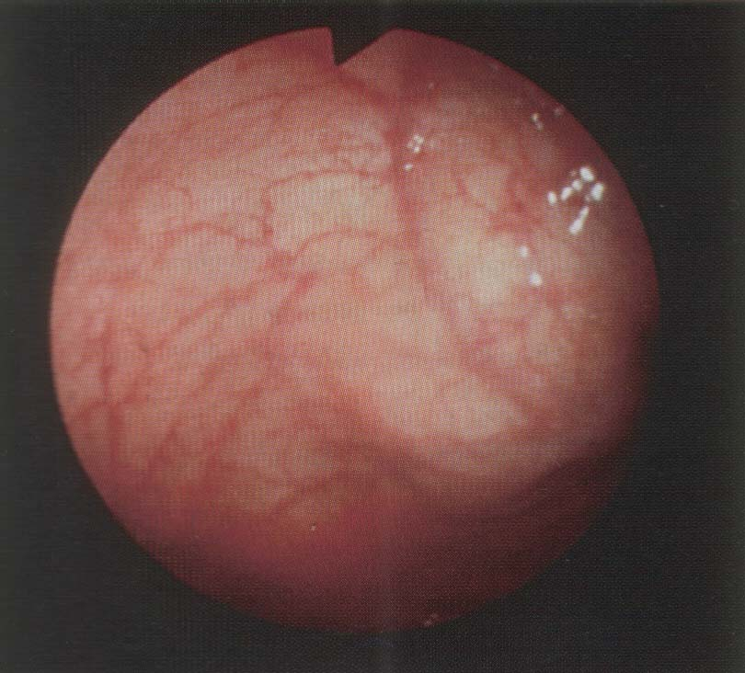
❖ Atrophic gastritis: grey, reduced mucosa folds, submucosal visible vessels
Visible vessels

Slide 42
Gastric biopsy protocol to diagnose gastritis
Biopsy specimens (circles) should be
obtained from
- the greater and lesser curvatures of the
autrum – 2 biopsies
- the greater and lesser curvatures of the
body - 2 biopsies
- the incisura -1 biopsy

Slide 43
Note
imperfect co-relations between endoscopic appearances and histological classification, the final diagnosis should be made by histological examination.

Slide 44
Chronic Gastritis: Autoimmune Gastritis
Characterized by:
  - Antibodies mediated parietal cells damage, decrease intrinsic factor and acid production, increase serum gastrin levels
  - Reduced serum pepsinogen I concentration
  - Antral endocrine cell hyperplasia
  - Vitamin B12 deficiency
  - Defective gastric acid secretion
  - Association with Hashimote thyroiditis,
  Addison’s disease
  - Patient at risk of developing gastric carcinoma/carcinoid tumos
Notes:
44

Slide 45
Hypertrophic Gastropathies: Menetrier’s Disease
Rare; due to excessive secretion of tumor grouth factor (TGF-α)
Diffuse hyperplasia of foveolar epithelium of the body and fundus
Protein-losing enteropathy: hypoproteinemia
Increased risk of gastric adenocarcinoma in adults
Characteristic feature: hyperplasia of foveolar mucous cells
Notes:
45

Slide 46
Menetrier’s Disease
  Epigastric pain – 65 percent
  Asthenia – 60 percent
  Anorexia – 45 percent
  Weight loss – 45 percent
  Edema – 38 percent
  Vomiting – 38 percent
  80 percent of patients had hypoalbuminemia
Notes:
46

Slide 47
Treatment of Chronic Gastritis
- Individual diet
- Eradication of Hp-infection
- Proton pump inhibitors (omeprazole, antoprazolum)
and H2-histamine blockers (ranitidine, famotidine) in
case of increased gastric secretory function
- Substitution therapy (natural gastric juice,
hydrochloric acid, acidin-pepsin) in case of
decrease gastric secretory function
- Enveloping agents
- Vitamin B12 in case of megaloblastic anemia
- Prokinetics (domperidone, itopridum) in case of reflux
gastritis
- Antihistamines in case of eosinophilic gastritis

Slide 48
Recommended Treatment Strategy for the
Eradication of Helicobacter pylori
Fist-line therapy (10-14 days)
PPI (standard dose 2 times/d) PPI (standard dose 2 times/d)
Clarithromycin (0.5g 2 times/d) Clarithromycin (0.5g 2 times/d)
Amoxicillin (1g 2 times/d) Metronidazole (0.5g 2 times/d)
Second-line therapy (10-14 days)
PPI (standard dose 2 t/d) PPI (standard dose 2 t/d) PPI (standard dose 2 t/d)
Bismuth (120mg 4 t/d) Metronidazole (0.5g 2 t/d) Metronidazole (0.5g 2 t/d)
Metronidazole (0.5g 3 t/d) Tetracycline (0.5g 4 t/d) Amoxicillin (1g 2 t/d)
Tetracycline (0.5g 4 t/d)
Third-line therapy (10-14 days)
PPI (standard dose 2 times/d) Empiric rescue therapy Treatment tallored to
Amoxicillin (1g 2 times/d) individual antibiotic
Levofloxacin (0.5g 3 t/d) sensitivity

Slide 49
Risk factors of peptic ulcer
  You’re at risk for peptic ulcer disease if you:
  Are 50 years old or older.
  Diabetes may increase your risk of having
  H. pylori
  Drink alcohol excessively
  Smoke cigarettes or use tobacco.
  Have a family history of ulcer disease.

Slide 50
You’re at risk for NSAID-induced ulcers if you:
  Are age 60 or older (your stomach lining becomes more fragile with age).
  Have had past experiences with ulcers and internal bleeding
  Take steroid medications, such as prednisone.
  Take blood thinners, such as warfarin.
  Consume alcohol or use tobacco on a regular basis.
  Experience certain side effects after taking NSAIDs, such as upset stomach and heartburn.
  Take NSAIDs in amounts higher than recommended
  Take NSAIDs for long periods of time
  Stress does not cause an ulcer, but may be a contributing factor
  Chronic disorders such as liver disease, emphysema, rheumatoid arthritis may increase vulnerability to ulcers
  Improper diet, irregular or skipped meals
  Type O blood (for duodenal ulcers)‏

Slide 51
Classification of the Peptic Ulcers
1. Depending on the etiology:
a) Hp-positive
b) Hp-negative
- medicinal
- symptomatic (stressful, with Zollinger-Ellison
syndrome, with hyperparathyroidism, with brain
damage,shock conditions, cirrhosis of the liver,
tenal failure,Crohn’s disease, other infections

Slide 52
Medicines with an ulcerogenic effect
- Non-steroidal anti-inflammatory drugs
- corticosteroids
- cytostatics
- antibiotics
- digoxin
- teophylline
- diazolin
- potassium and iron preparations

Slide 53
Classification of the Peptic Ulcers
2. Depending on the localization:
- Stomach ulcer (cardiac, subcardial portion, little big
curvature, pyloric region),
- Duodenum ulcer (bulbus, post bulbar region),
- Combined (ulcers of the stomach and duodenum)
3. Depending on the number of ulcers:
- singl,
- multiple

Slide 54
Classification of the Peptic Ulcers
4. Depending on the diameter of the ulcer:
- small (no more than 0.5 cm),
- medium (0.5-1 cm),
- large (more than 1 cm),
- giant (more than 3 cm for stomach, more than 2 cm
for duodenum),
5. Depending on the level of gastric secretion:
- with decreased acidic secretion,
- with increased acidic secretion,
- with preserved acidic secretion,
6. Phase:
- exacerbation,
- remission.

Slide 55
Complication of the Peptic Ulcer
- Penetration in pancreas, gall bladder, liver, colon,
hepatoduodenal legomentum,
- Acute bleeding,
- Perforation,
- Stenosis (compensated, subcompensated,
decompensated, reflux-esophagitis),
- Malignisation

Slide 56
Clinical Manifestations
  As a rule, the patient with an ulcer complains of dull, gnawing pain or a burning sensation in the midepigastrium or in the back. It is believed that the pain occurs when the increased acid content of the stomach and duodenum erodes the lesion and stimulates the exposed nerve endings.
  pyrosis (heartburn), vomiting, constipation or diarrhea, and bleeding. Pyrosis is a burning sensation in the esophagus and stomach that moves up to the mouth. Heartburn is often accompanied by sour eructation, or burping, which is common when the patient’s stomach is empty. Fifteen percent of patients with gastric ulcers experience bleeding.
Notes:
56

Slide 57
Assessment and Diagnostic Findings
  A physical examination may reveal pain, epigastric tenderness, or abdominal distention.
  A barium study of the upper GI tract may show an ulcer; however, endoscopy is the preferred diagnostic procedure because it allows direct visualization of inflammatory changes, ulcers, and lesions-biopsy.
  Stools may be tested periodically until they are negative for occult blood. Gastric secretory studies are of value in diagnosing achlorhydria. H. pylori infection may be determined by biopsy and histology with culture.
  There is also a breath test that detects H. pylori, as well as a serologic test for antibodies to the H. pylori antigen.
Notes:
57

Slide 58
Comparing Duodenal and Gastric Ulcers
DUODENAL ULCER
Age 30–60
Male: female 2–3:1
80% of peptic ulcers are duodenal
Hypersecretion of stomach acid (HCl)‏
May have weight gain
Pain occurs 2–3 hours after a meal; often awakened between 1–2 AM;
ingestion of food relieves pain
Vomiting uncommon
GASTRIC ULCER
Usually 50 and over
Male: female 1:1
15% of peptic ulcers are gastric
Normal—hyposecretion of stomach acid (HCl)‏
Weight loss may occur
Pain occurs 1⁄2 to 1 hour after a meal; rarely occurs at night; may be relieved by vomiting;
ingestion of food does not
help, sometimes increases
pain
Vomiting common
Notes:
58

Slide 59
Differential Diagnosis
  Neoplasm of the stomach
  Pancreatitis
  Pancreatic cancer
  Diverticulitis
  Nonulcer dyspepsia (also called functional dyspepsia)‏
  Cholecystitis
  Gastritis
  GERD
  MI—not to be missed if having chest pain
Notes:
59

Slide 60
Most helpful diagnostic examining
- Endoscopy
- X-ray (not obedient for non-complicated cases)
- Examining of secretory function (increasing of basal
and stimulating secretion fraction) – is helpful to define
functional disorders but not ulcer itself
- Helicobacter pyloric contamination

Slide 61
Gastric analysis includes measurement of:
  Basal acid output (BAO)‏
    Acid output of gastric juice collected via NGT over a 1-hour period on an empty stomach
    Normal = < 5 mEq/hr
  Maximal acid output (MAO)‏
    Acid output of gastric juice that is collected over 1 hour after pentagastrin stimulation
    Normal = 5 – 20 mEq/hr
  BAO:MAO ratio - normally 0.20:1

Slide 62
Detection of H. pylori
Diagnostic methods Sensitivity
Noninvasive type
Urea breath test >95%
Stool antigen test >90%
Serology: IgG 80-90%
Invasive type
- Histology >95%
- Microbiological culture biopsy >95%
- Rapid urease test >95%

Slide 63
Treatment goals
- Eradicate contamination of Hp-infection
- To reduce Peptic Ulcer symptoms and provide
reparation of ulcer defect
- Not only get the healing of defect but restitute
functional capacity of mucous membrane
- Prevent development of exacerbations and
complications

Slide 64
Basic principles of the managing the patient with the Peptic Ulcer
- Reject of smoking, alcohol taking.
- Stop to get non-steroid and steroid medications,
if it can’t be stopped to decrease dosages.
- Rational feeding. It means frequent intake 5-6 times
per day with excluding of spicy products.

Slide 65
Medication treatment
- Helicobacter pylori eradication.
- Suppressing of acidity and peptic factors production.
- Correct motor evacuative function.
- Stimulation of reparative processes.

Slide 66
Management of Hp-infection
The Maastricht Consensus V
Algorithm of the Anti-Helicobacter pylori therapy – 1st line
Low (<15%) High (>15%) clarithromycin resistance
Low Low dual High dual
metronidazole clarithromycin clatithromycin
resistance and metronidazole and metronidazole
resistance (<15%) resistance (>15%)
Standard Triple therapy Bismuth quadruple Bismuth containing
Triple therapy (PPI-amoxicillin- or concomitant non quadruple therapies
(PPI-CLA-AMO) metronidazole) bismuth containing
or bismuth quadruple therapy
containing
quadruple therapy

Slide 67
Management of Hp-infection
The Maastricht Consensus V
Algorithm of the Anti-Helicobacter pylori therapy – 2nd line
Ineffectiveness of Ineffectiveness of Ineffectiveness of non
standart triple bismuth containing bismuth containing
therapy (PPI-CLA-AMO) quadruple therapy quadruple therapy
Bismuth containing Triple/ quadruple Bismuth containing
quadruple therapy therapy with quadruple therapy
or triple/ quadruple levofloxacin or triple/ quadruple
therapy with therapy with
levofloxacin levofloxacin

Slide 68
Management of Hp-infection
The Maastricht Consensus VI (2022)
- In the modern algorithm of eradication therapy in accordance
with the Maastricht VI / Florence Consensus, preference has
been given to quadruple therapy with the use of bismuth drugs.
- The value of triple therapy with clarithromycin has decreased.
- There is a rapid increase in the resistance of H.pylori to
fluoroquinolones.
- Bismuth-containing quadruple therapy with amoxicillin and
tetracycline and triple therapy with rifabutin are among the final
eradication protocols.

Slide 69
Evaluation/Follow-up/
H. Pylori Positive: retesting for control efficacy
    Urea breath test—no sooner than 4-6 weeks after therapy to avoid false negative results
    Stool antigen test—an 8 week interval must be allowed after therapy.
H. Pylori Negative:
    evaluate symptoms after one month.
Notes:
69

Slide 70
Indications for surgical treatment of
Peptic Ulcers
- Complications of ulcers (penetration, bleeding,
perforation, stenosis, malignisation)
- Ineffectiveness of modern conservative treatment
- Long-term incurable stomach ulcers
- Symptomatic ulcers with hyperparathyroidism,
gastrinoma

Slide 71
Hypertrophic Gastropathies:
Zollinger-Ellison Syndrome
The cause of the formation of peptic ulcers is a gastrin-secreting tumors (gastrinomas) → most commonly found in pancreas or duodenum
  60% - 90% of gastrinomas malignant
  25% of patients - men
Clinical: duodenal ulcers or chronic diarrhea
Morphology:
  fivefold increase in number of parietal cells -doubling of oxyntic mucosal thickness
  Hyperplasia of mucous neck cells
  Mucin hyperproduction
  Proliferation of endocrine cells within mucosa

Slide 72
Zollinger-Ellison Syndrome
  0.1 to 1 percent of patients with peptic ulcer disease
  Underestimation!
    symptoms similar to typical peptic ulcer
    symptoms may not be controlled by standard doses of an antisecretory drug
    patients may not be tested for hypergastrinemia
  Multiple ulcers and large ulcers
  Persistent recurrence and frequent complications
  Ulcers combined with poorly controlled diarrhea
  Ulcer in atypical site-postbulbar part of the duodenum, jejunum
  Resistant ulcer
  Enlarged folds
  Ulcers after surgery
  Concomitant severe reflux-esophagitis

