Slide 1
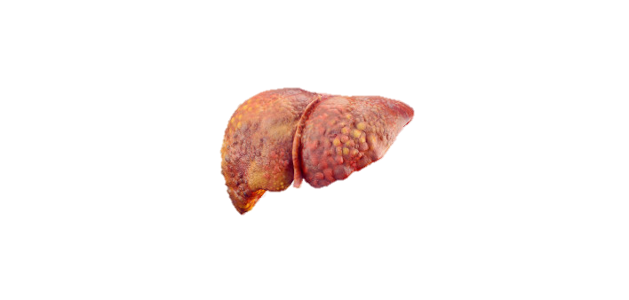
Chronic hepatitis & Cirrhosis
Odesa National Medical University
Dept. of Internal Disease #2
Kholopov Leonid Semenovich, MD, PhD

Slide 2
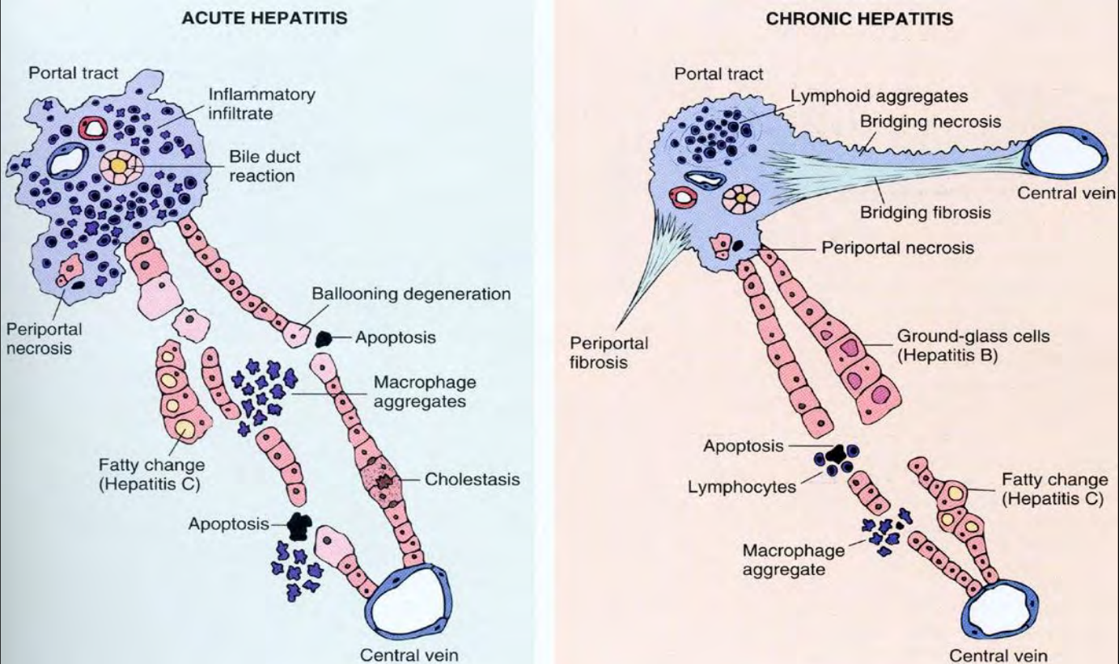
Hepatitis is inflammation of the liver tissue
Hepatitis is common throughout the world.
Hepatitis can be
Acute (short-lived)
Chronic (lasting at least 6 months)
Most cases of acute hepatitis caused by a virus resolve on their own, but some progress to chronic hepatitis.

Slide 3
Chronic hepatitis is inflammation of the liver that lasts at least 6 months
Common causes include hepatitis B and C viruses and certain drugs.
Many people have no symptoms, but some have vague symptoms, such as a general feeling of illness, poor appetite, and fatigue.
Chronic hepatitis can result in cirrhosis with portal hypertension and liver failure.
Chronic hepatitis, although much less common than acute hepatitis, can persist for years, even decades. In many people, it is quite mild and does not cause significant liver damage. However, in some people, continued inflammation slowly damages the liver, eventually resulting in cirrhosis (severe scarring of the liver), liver failure, and sometimes liver cancer.

Slide 4
Causes
The most common causes of chronic hepatitis are
Hepatitis C virus
Hepatitis B virus
Fatty liver not due to alcohol use (nonalcoholic steatohepatitis)
Alcoholic hepatitis
Autoimmune hepatitis

Slide 5
Causes
HCV causes about 60 to 70% of cases, and at least 75% of acute hepatitis C cases become chronic.
About 5 to 10% of HB cases, sometimes with HD coinfection, become chronic. (HD occurs only as a coinfection with HB).
Rarely, HEV causes chronic hepatitis in people with a weakened immune system, such as those who are taking drugs to suppress the immune system after an organ transplant, who are taking drugs to treat cancer, or who have HIV infection.
HAV does not cause chronic hepatitis.

Slide 6
Causes
Alcohol, after being absorbed in the digestive tract, is usually metabolized in the liver. As alcohol is processed, substances that can damage the liver are produced. Alcoholic hepatitis typically occurs in people who drink heavily for many months or years. Alcoholic hepatitis is characterized by fatty liver and widespread liver inflammation that can result in the death of liver cells. If people continue drinking, scar tissue can form in the liver and may eventually replace a large amount of normal liver tissue, resulting in cirrhosis.
Nonalcoholic steatohepatitis usually occurs in people with obesity, diabetes, and/or hypercholesterolemia. All of these conditions cause the body to synthesize more fat or metabolize and excrete fat more slowly. As a result, fat accumulates and is then stored inside liver cells. Fatty liver can lead to chronic inflammation and cirrhosis.

Slide 7
Causes
In autoimmune hepatitis, the chronic inflammation resembles inflammation caused by the body attacking its own tissues (an autoimmune reaction). Autoimmune hepatitis is more common among women than men.
Certain drugs can cause chronic hepatitis, particularly when they are taken for a long time. They include isoniazid, methyldopa, and nitrofurantoin.
Less often, chronic hepatitis results from
Alpha-1 antitrypsin deficiency (a hereditary disorder)
Celiac disease
Hemochromatosis (a hereditary disorder that causes the body to absorb too much iron)
A thyroid disorder
In children and young adults, Wilson disease (a rare hereditary disorder involving abnormal retention of copper in the liver)
No one knows exactly why a particular virus or drug causes chronic hepatitis in some people but not in others or why the degree of severity varies.

Slide 8
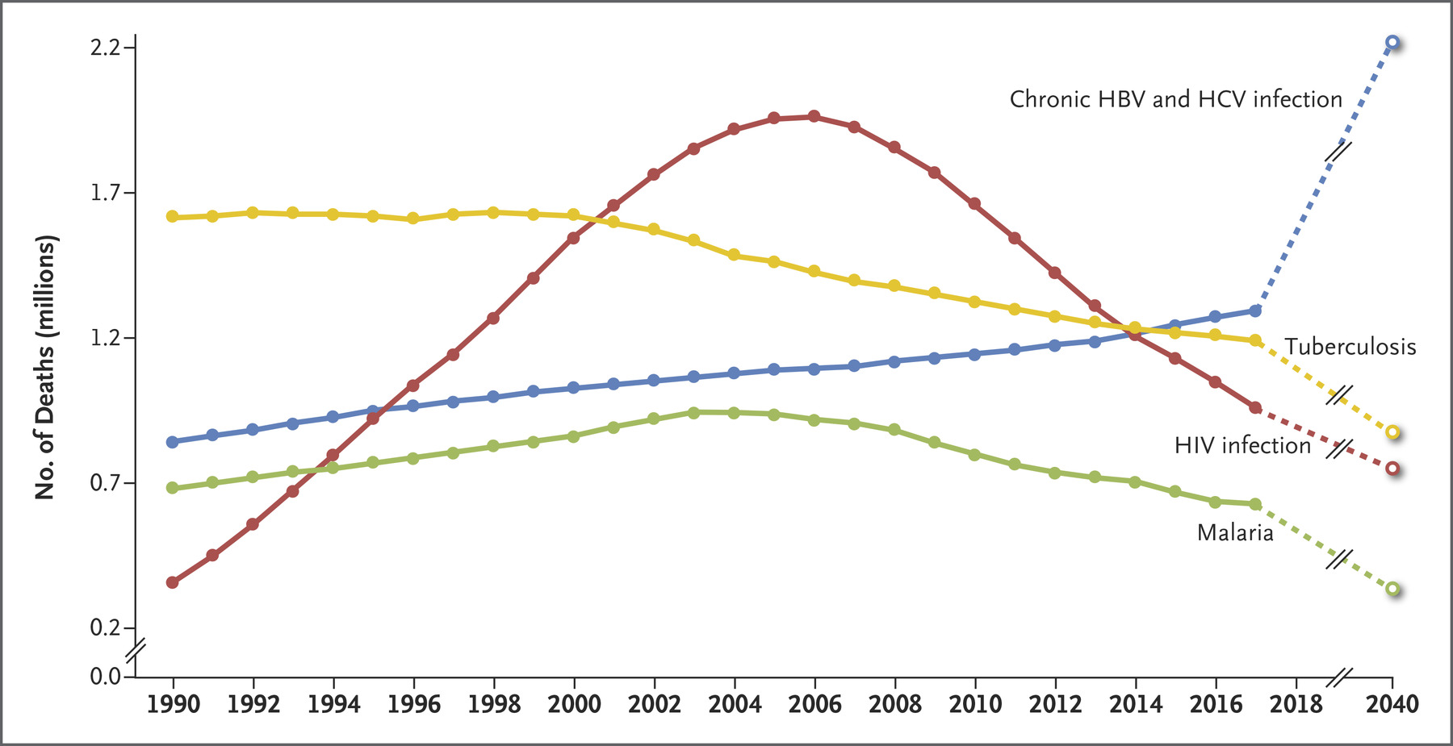
Worldwide Deaths from Chronic Viral Hepatitis as Compared with Deaths from Tuberculosis, HIV Infection, and Malaria.
David L. Thomas N Engl J Med 2019; 380:2041-2050

Slide 9
Hepatitis B – Definition
A hepatotrophic virus;
The liver is the primary site of infection, replication and cellular damage
Chronic hepatitis: presence of clinical, biochemical, and serologic abnormalities for up to 6 months
Habermann T.M., Ghosh A.K. Mayo Clinic internal medicine concise textbook, 2008
Guardino J.M. Primo Gastro: The Pocket GI/Liver Companion, 2008

Slide 10
Hepatitis B – Epidemiology
350 million cases worldwide;
most cases in Asia and Africa;
causes 30% of acute and 15% of chronic hepatitis
10th leading cause of death in the world,
5th leading infectious disease cause of death in the world
Chronicity of HBV acquired during infancy: 90%; acquired during adulthood: 5%
In general, when a patient gets acute HBV: 95% recovery, 5% chronically infected, Fulminant hepatic failure (very rare)
Habermann T.M., Ghosh A.K. Mayo Clinic internal medicine concise textbook, 2008
Guardino J.M. Primo Gastro: The Pocket GI/Liver Companion, 2008

Slide 11
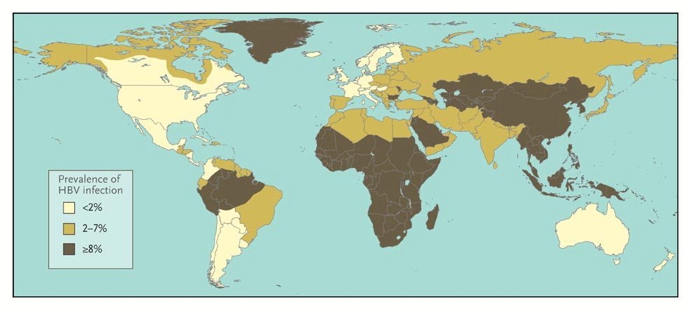
Geographic distribution of HBV infection
Dienstag JL. N Engl J Med 2008;359:1486-1500.

Slide 12
Hepatitis B – Etiology
Virus: DNA, circular gene shape, envelope, 42 nm in size; Replicates at 10¹¹ virions/day
8 genotypes identified: A-H; The future may tell us that certain genotypes are better treated with either Nucleosides analogues or PEG-INF
Spilled blood contaminated with HBV can be infectious for up to one week Transmission: sexual (most common), percutaneous, perinatal
  Household/intimate contacts need to be vaccinated since they are at most risk
Incubation: 1-6 months
Habermann T.M., Ghosh A.K. Mayo Clinic internal medicine concise textbook, 2008
Guardino J.M. Primo Gastro: The Pocket GI/Liver Companion, 2008

Slide 13
Hepatitis C – Definition
A hepatotrophic virus
The liver is the primary site of infection, replication and cellular damage
Chronic hepatitis: presence of clinical, biochemical, and serologic abnormalities for up to 6 months
Habermann T.M., Ghosh A.K. Mayo Clinic internal medicine concise textbook, 2008
Guardino J.M. Primo Gastro: The Pocket GI/Liver Companion, 2008

Slide 14
Hepatitis C – Epidemiology
Blood transfusion before 1985: 1/20 (5%) got HCV; After 1990: 1/200,000 (.0005%) got HCV! Has been and remains a very low risk
The number of new cases of HCV has decreased dramatically over the last 10 years
Acute Hepatitis C leads to: Chronicity of HCV 70-85%,
Recovery of HCV 15-30% (HCV is a chronic disease)
Habermann T.M., Ghosh A.K. Mayo Clinic internal medicine concise textbook, 2008
Guardino J.M. Primo Gastro: The Pocket GI/Liver Companion, 2008

Slide 15
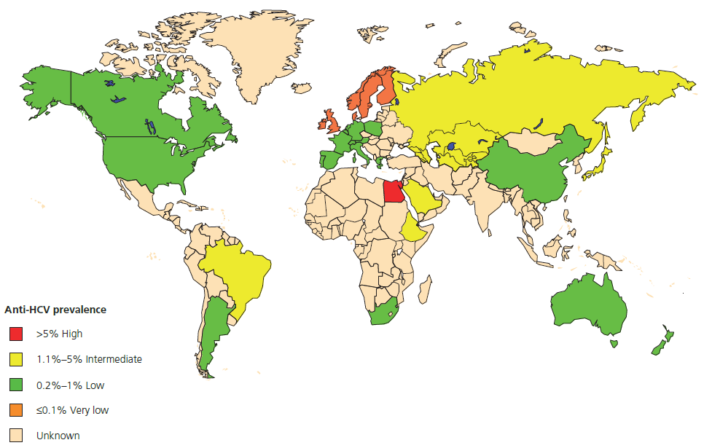
Geographic distribution of HCV infection

Slide 16
Hepatitis C – Etiology
Virus:
  RNA, linear gene shape, envelope, 50 nm in size;
  Several genotypes identified, most common: 1-3
Transmission:
  percutaneous >>> sexual;
  ~ 20% without a clear precipitant
  Needle stick risk: HBV > HCV > HIV
Incubation: 1-4 months
Habermann T.M., Ghosh A.K. Mayo Clinic internal medicine concise textbook, 2008
Guardino J.M. Primo Gastro: The Pocket GI/Liver Companion, 2008

Slide 17
Hepatitis D (delta) – Definition
A hepatotrophic virus
The liver is the primary site of infection, replication and cellular damage
requires the presence of HBsAg to replicate
Habermann T.M., Ghosh A.K. Mayo Clinic internal medicine concise textbook, 2008
Guardino J.M. Primo Gastro: The Pocket GI/Liver Companion, 2008

Slide 18
Hepatitis D – Etiology
Virus: RNA, circular gene shape, envelope, 43 nm in size
Requires HBV: co-infection or superimposed infection
Without HBV, it is non-pathogenic
  Have high suspicion if a patient has acute HBV or acute exacerbation of chronic HBV
Transmission: percutaneous or sexual
IV drug users are the group of HBV patients with highest risk for HDV
Habermann T.M., Ghosh A.K. Mayo Clinic internal medicine concise textbook, 2008
Guardino J.M. Primo Gastro: The Pocket GI/Liver Companion, 2008

Slide 19
Autoimmune hepatitis (AIH)
Definition
AIH - an inflammatory liver disease of unknown cause characterized by suppressor T-cell defects with autoantibodies directed against hepatocyte surface antigens.
Two types are distinguished by the presence of circulating auto-AB:
  Type I
    Affects adults or children
    Anti-nuclear antibodies (ANA) and/or
    Anti-smooth muscle antibodies (SMA) +ve in 80%
  Type II
    Affects children
    Anti-liver/kidney microsomal type 1 (LKM1) antibodies
Oxford Handbook of Clinical Medicine, 6th Edition, 2004

Slide 20
Alcoholic Liver Disease – Definition
Clinical spectrum includes fatty liver, alcoholic hepatitis and alcoholic cirrhosis;
Dependency: impairment or distress, as manifested by three or more of the following within 12 months: Tolerance, Withdrawal, Desire to cut down, Giving up important social activities, Continued use despite knowing of adverse effects
Abuse: impairment or distress, as manifested by one or more of the following within 12 months: Not fulfilling obligation at work/school, Recurrent substance-related legal problems, Continuing situations when physically hazardous
Acute Alcohol Toxicity: large quantities of alcohol consumed over a short period can result in acute liver toxicity (acute alcohol poisoning)
Alcoholic Hepatitis: usually associated with heavy alcohol consumption for more than 10 years
Habermann T.M., Ghosh A.K. Mayo Clinic internal medicine concise textbook, 2008
Guardino J.M. Primo Gastro: The Pocket GI/Liver Companion, 2008

Slide 21
Alcoholic Liver Disease – Epidemiology
Prevalence of alcohol abuse in general population: 9.4%; Alcohol is implicated in >50% of liver-related deaths
Incidence of progressive liver injury or cirrhosis is significantly increased in those who consume >40-60 gm alcohol/day
Habermann T.M., Ghosh A.K. Mayo Clinic internal medicine concise textbook, 2008
Guardino J.M. Primo Gastro: The Pocket GI/Liver Companion, 2008

Slide 22
Alcoholic Liver Disease – Etiology
Moderate alcohol consumption: <20 gm/day ♀ and <40 gm/day ♂; Heavy alcohol consumption: >20 gm/day ♀ and >80 gm/day ♂
60-80 gm/day of ethanol (or 6-8 drinks/day) for 10 years will likely develop cirrhosis in ♂; half as much required in ♀
An average alcoholic beverage raises blood alcohol concentration by 15-20 mg/dl, the amount metabolized by the liver in 1 hour
Habermann T.M., Ghosh A.K. Mayo Clinic internal medicine concise textbook, 2008
Guardino J.M. Primo Gastro: The Pocket GI/Liver Companion, 2008

Slide 23
Alcoholic Liver Disease – Pathophysiology
The total amount of alcohol consumed per weight determines who is at risk for alcohol-related disease
Alcohol is metabolized mainly via the liver: alcohol dehydrogenase metabolizes to acetaldehyde, which in turn is oxidized by the liver via hepatic aldehyde dehydrogenase and the microsomal ethanol-oxidizing system cytochrome P450 to acetate
Most common form of alcoholic liver disease: Fatty liver or hepatic steatosis; Reversible with abstinence from alcohol intake
Alcoholic Hepatitis: usually associated with heavy alcohol consumption for more than 10 years
Related to toxic effects of acetaldehyde production from hepatic metabolism of alcohol, resulting in micronodular fibrosis
Biopsy: hepatocellular disarray, Polymorphonuclear leukocytes, Mallory's hyaline bodies, some cholestasis, fibrosis/necrosis
Habermann T.M., Ghosh A.K. Mayo Clinic internal medicine concise textbook, 2008
Guardino J.M. Primo Gastro: The Pocket GI/Liver Companion, 2008

Slide 24
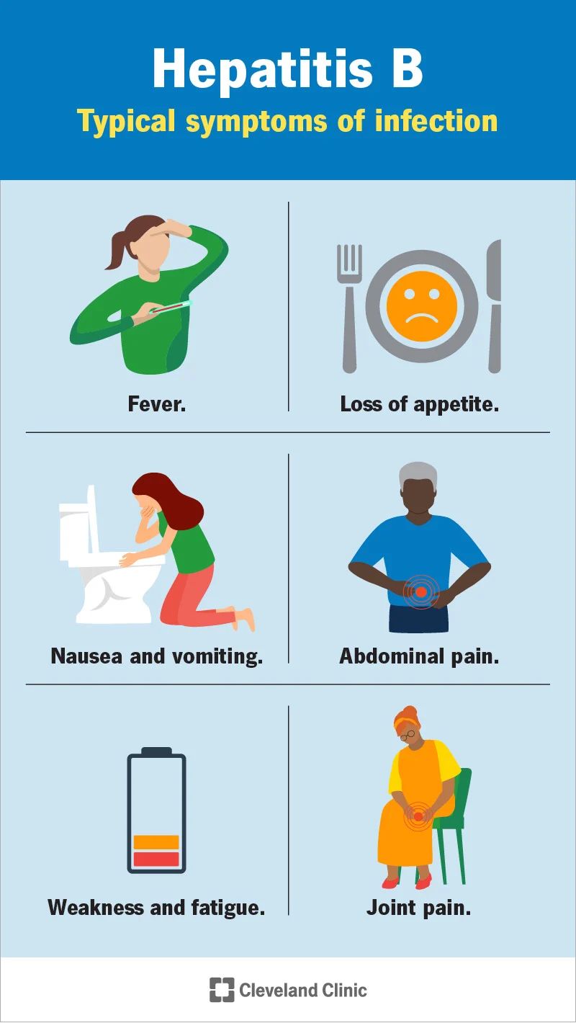
Symptoms of chronic hepatitis
In about two thirds of people, chronic hepatitis develops gradually, often without causing any symptoms of a liver disorder until cirrhosis occurs.
In the remaining one third, it develops after acute viral hepatitis that persists or returns (often several weeks later).
Symptoms of chronic hepatitis often include a vague feeling of illness (malaise), poor appetite, and fatigue.
Sometimes affected people also have a low-grade fever and some discomfort in the upper abdomen.
Jaundice is rare.

Slide 25
Symptoms of chronic hepatitis
Often, the 1st specific symptoms are those of chronic liver disease or cirrhosis:
Splenomegaly
Small spiderlike blood vessels visible in the skin (spider angiomas)
Redness of the palms
Ascites
Hepatic encephalopathy. Brain function deteriorates because the badly damaged liver cannot remove toxic substances from the blood as it normally does.
Portal hypertension develops because the large amount of scar tissue in the liver interferes with blood flowing through the liver. As a result, blood backs up in the veins that bring blood to the liver (portal veins), and pressure in these veins increases.
Blood cannot clot as it normally does because the damaged liver can no longer synthesize enough of the proteins that help blood clot.
A few people have jaundice, itchiness, and light-colored stools. It develop because the damaged liver cannot remove bilirubin from the blood as it normally does and less bilirubin is eliminated in stool.

Slide 26
Symptoms of chronic hepatitis
Autoimmune hepatitis may cause extrahepatic symptoms (cessation of menstrual periods, joint pain and swelling, loss of appetite, and nausea). Pts may also suffer from other autoimmune disorders (type I DM, ulcerative colitis, celiac sprue, or autoimmune injury of the thyroid gland or kidneys.
In many people, chronic hepatitis does not progress for years. In others, it gradually worsens. The outlook depends partly on which virus is the cause:
  Chronic hepatitis C, if untreated, causes cirrhosis in 20-30% pts. However, cirrhosis may take decades to develop. The risk of liver cancer is increased usually only if cirrhosis is present.
  Chronic hepatitis B tends to worsen, sometimes rapidly but sometimes over decades, leading to cirrhosis. Chronic hepatitis B also increases the risk of liver cancer whether cirrhosis develops or not. Occasionally, chronic hepatitis B resolves on its own, without treatment.
  Chronic coinfection with hepatitis B and D, if untreated, causes cirrhosis in up to 70%.
  Autoimmune hepatitis can be effectively treated in most people, but some develop cirrhosis.
  Toxic hepatitis may completely resolve once the toxin is stopped.

Slide 27
Diagnosis
We can suspect chronic hepatitis when
People have typical symptoms.
Blood tests (done for other reasons) detect elevated liver enzymes.
People have had acute hepatitis before.
Also, everyone born between 1945 and 1965, regardless of whether symptoms are present, should be tested once for hepatitis C. Such testing is recommended because hepatitis C is common among this age group and is often unrecognized.
Testing for chronic hepatitis:
blood tests to determine how well the liver is functioning and whether it is damaged (Liver function tests)
Blood tests are also done to help identify which hepatitis virus is causing the infection
If no virus is identified, tests for other hepatitis are needed (AIH etc.)

Slide 28
Diagnosis
Liver biopsy may be necessary:
To confirm the diagnosis. The liver biopsy also enables to do the following:
Determine how severe the inflammation is
Determine whether any scarring or cirrhosis has developed
Possibly help identify the cause of hepatitis
Other tests may be done to determine how badly the liver is damaged:
Specialized imaging tests, such as ultrasound elastography and magnetic resonance elastography
Blood tests for fibrosis markers
Screening for liver cancer (for pts with chronic hepatitis B - every 6 months; for those with chronic hepatitis C - similarly, but only if they have cirrhosis):
Ultrasonography
blood levels of alpha-fetoprotein (liver cancer marker).

Slide 29
Hepatitis B – Clinical Manifestation
Natural History: anorexia, nausea, vomiting, fatigue, abdominal pain, mild fever, jaundice, dark urine, light colored stools
  Acute: 70% subclinical, 30% jaundice, <1% fulminant hepatitis
  Chronic: <5% (adult-acquired), >90% (perinatally-acquired); females are more likely to be chronic carriers
Extra-hepatic: Polyarteritis Nodosa (<1%), Membranoproliferative Glomerulonephritis
Habermann T.M., Ghosh A.K. Mayo Clinic internal medicine concise textbook, 2008
Guardino J.M. Primo Gastro: The Pocket GI/Liver Companion, 2008

Slide 30
Hepatitis B – Serologic Markers
Test | Interpretation of +ve result
HBsAg – Hepatitis B surface antigen | Current infection
anti-HBs – Antibody to hepatitis B surface | Immunity (immunization or resolved infection
IgM anti-HBc – IgM antibody to hepatitis B core | Usually recent infection, occasionally “reactivation” of chronic infection
IgG anti-HBc – IgG antibody to hepatitis B core | Remote infection
HBeAg – Hepatitis B e antigen and/or HBV DNA >105 viral copies/mL | Active viral replication (high infectivity)
Anti-HBe – Antibody to hepatitis B e | Remote infection

Slide 31
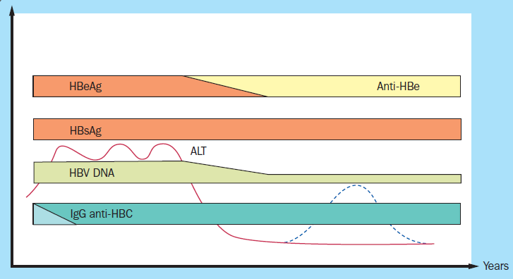
Serologic profile of chronic HBV infection

Slide 32
Hepatitis B – Instrumental studies
Biopsy:
  Stages (Fibrosis): 1. portal fibrosis, 2. periportal fibrosis, 3. septal fibrosis, 4. cirrhosis
  Grade (Inflammation): 1.minimal lobular, 2.mild portal, 3.moderate piecemeal necrosis, 4.severe portal with piecemeal necrosis
Habermann T.M., Ghosh A.K. Mayo Clinic internal medicine concise textbook, 2008
Guardino J.M. Primo Gastro: The Pocket GI/Liver Companion, 2008

Slide 33
Hepatitis C – Clinical Manifestation
Natural History: anorexia, nausea, vomiting, fatigue, abdominal pain, mild fever; jaundice is much less common compared to HAV/HBV
Acute HCV leads to: 75% being subclinical and 25% leading to jaundice; 15-30% lead to full recovery
Fulminant HCV hepatitis very rare
Chronic HCV leads to: 70-85% continuing to be chronic, 20-30% of whom develop cirrhosis (after ~ 20 yrs)
High risk factors of cirrhosis: femail, alcohol use, steatosis, coinfection with HBV or HIV
Hepatocellular carcinoma develops in 2-5% of HCV cirrhotics/year (usually after 20-30 yrs)
Extra-hepatic (38% have at least one extra-hepatic symptom): cryoglobulinemia, porphyria cutanea tarda (PCT), MPGN, lymphoma, aplastic anemia
Habermann T.M., Ghosh A.K. Mayo Clinic internal medicine concise textbook, 2008
Guardino J.M. Primo Gastro: The Pocket GI/Liver Companion, 2008

Slide 34
Hepatitis C – Laboratory studies
↑ ALT/AST
Serologic (ELISA/RIBA) & Virologic (HCV RNA/Genotypes): 4 antigens on HCV virus, body makes antibodies to all 4
anti-HCV (ELISA): + in 6weeks; The antibody does not imply recovery; May become negative (~ 10%) after recovery. Positive (6 wks) = acute infection OR resolving infection OR false positive. Need to confirm positive anti-HCV (ELISA) with HCV Qualitative
HCV RIBA: used to confirm +anti-HCV ELISA with -HCV Qualitative RNA. Need at least 2 of 4 antibodies for HCV to be positive, ↑ specificity compared to ELISA for antibodies. Positive = infection (ELISA +, but Qualitative doesn't detect, i.e. <50 IU/ml) OR remote/resolved infection. Negative = false positive anti-HCV
HCV Qualitative RNA (PCR): ↑ sensitivity, gives a yes/no answer, detection is as low as 50 IU/ml Positive (2 wks) = Marker of active infection
HCV Quantitative RNA (PCR) “Viral load”: gives a numerical answer; >800,000 IU/ml: high; <800,000 IU/ml: low
Genotype (1-6): Type 1 is about 70%
Habermann T.M., Ghosh A.K. Mayo Clinic internal medicine concise textbook, 2008
Guardino J.M. Primo Gastro: The Pocket GI/Liver Companion, 2008

Slide 35
Hepatitis C – Instrumental studies
Biopsy: degree of inflammation (grade) & amount of fibrosis (stage); No other test makes this determination accurately
Stages (Fibrosis): 1. portal fibrosis, 2. periportal fibrosis, 3. septal fibrosis, 4. cirrhosis
Grade (Inflammation): 1. minimal lobular, 2. mild portal, 3. moderate piecemeal necrosis, 4. severe portal with piecemeal necrosis
Habermann T.M., Ghosh A.K. Mayo Clinic internal medicine concise textbook, 2008
Guardino J.M. Primo Gastro: The Pocket GI/Liver Companion, 2008

Slide 36
Hepatitis D – Clinical Manifestation
Natural History: more severe hepatitis,
Faster progression to cirrhosis
Habermann T.M., Ghosh A.K. Mayo Clinic internal medicine concise textbook, 2008
Guardino J.M. Primo Gastro: The Pocket GI/Liver Companion, 2008

Slide 37
Hepatitis D – Laboratory studies
anti-HDV (ELISA)
Habermann T.M., Ghosh A.K. Mayo Clinic internal medicine concise textbook, 2008
Guardino J.M. Primo Gastro: The Pocket GI/Liver Companion, 2008

Slide 38
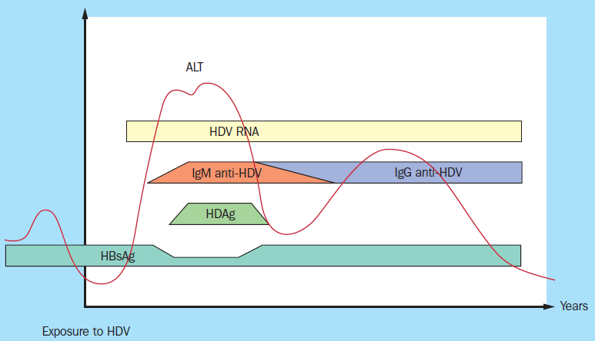
Serologic profile of HDV superinfection on chronic HBV infection

Slide 39
Autoimmune hepatitis (AIH)
Clinical features
Predominantly affects young and middle-aged women.
25% present with acute hepatitis and features of an autoimmune disease, e.g. fever, malaise, urticarial rash, polyarthritis, pleurisy, or glomerulonephritis.
The remainder present insidiously or are asymptomatic and diagnosed incidentally with signs of chronic liver disease.
Amenorrhoea is common.
Oxford Handbook of Clinical Medicine, 6th Edition, 2004

Slide 40
Autoimmune hepatitis (AIH)
Associations
Pernicious anaemia
Autoimmune haemolysis
Ulcerative colitis
Diabetes
Glomerulonephritis
HLA A1, B8, & DR3 haplotype
Autoimmune thyroiditis
Oxford Handbook of Clinical Medicine, 6th Edition, 2004

Slide 41
Autoimmune hepatitis (AIH)
Tests
Abnormal liver function tests (AST increasing),
Hypergammaglobulinaemia (especially IgG),
+ve autoantibodies (ANA, SMA, or LKM1).
Other autoantibodies, eg anti-soluble liver antigen (SLA) and antimeasles virus may be seen.
Anaemia
Hypersplenism
Liver biopsy shows mononuclear infiltrate of portal and periportal areas + piecemeal necrosis, fibrosis, or cirrhosis
Oxford Handbook of Clinical Medicine, 6th Edition, 2004

Slide 42
Alcoholic Liver Disease
Clinical Manifestations
Extrahepatic manifestations of alcoholic liver disease: Ascites, Spider angiomata, Hypogonadism, Gynecomastia, Encephalopathy, Palmer Erythema, Asterixis
Fatty liver or hepatic steatosis: First clinical manifestation is asymptomatic hepatomegaly
Alcoholic Hepatitis: range of presentation is anicteric hepatomegaly to fulminant/acute liver failure
  Jaundice, fever, hepatomegaly, high WBC (25% present with infection and manifestations of portal hypertension, i.e. ascites)
  Up to 30% of patients are infected with HCV as well
Habermann T.M., Ghosh A.K. Mayo Clinic internal medicine concise textbook, 2008
Guardino J.M. Primo Gastro: The Pocket GI/Liver Companion, 2008

Slide 43
Alcoholic Liver Disease
Laboratory & Instrumental Studies
Fatty liver or hepatic steatosis: AST:ALT >2:1 - This abnormality usually resolves after several days of abstinence
Alcoholic Hepatitis: moderate elevation of AST to 2-5 times the upper limits of normal
Liver biopsy: often not needed due to advances in non-invasive studies; indicated if diagnosis is uncertain (transjugular approach is best)
  Helps differentiate Hemochromatosis, Wilson's, AIH, HCV
  Demonstrates: centrilobular PMNs and hepatocyte swelling, ballooning degeneration, macrovesicular steatosis and Mallory bodies
Habermann T.M., Ghosh A.K. Mayo Clinic internal medicine concise textbook, 2008
Guardino J.M. Primo Gastro: The Pocket GI/Liver Companion, 2008

Slide 44
Treatment
Treatment of the cause (such as antiviral drugs for hepatitis B or C)
Treatment of complications
Treatment of chronic hepatitis focuses on treating the cause and managing the complications, such as ascites and hepatic encephalopathy.
If a drug is the cause, the drug is stopped. If another disorder is the cause, it is treated.

Slide 45
Treatment
Hepatitis B and C
If chronic hepatitis B or chronic hepatitis C is worsening or if liver enzyme levels are high, people are usually given antiviral drugs.
In some people, hepatitis B tends to recur once drug treatment is stopped and may be even more severe. Thus, these people may need to take an antiviral drug indefinitely.
For chronic hepatitis C, treatment can last from 8 to 24 weeks. Treating hepatitis C can eliminate the virus from the body and thus stop inflammation and prevent scarring, which can lead to cirrhosis.

Slide 46
Antiviral drugs
Injectable interferon alpha was the first therapy approved for chronic hepatitis B.
Pegylated interferon is dosed just once a week as a SC injection and is both more convenient and effective than standard interferon.[Although it does not develop resistance as do many of the oral antivirals, it is poorly tolerated and requires close monitoring. PEG IFN is not effective in patients with high levels of viral activity and cannot be used in immunosuppressed patients or those with cirrhosis.
Oral nucleoside analogues: Lamivudine, Adefovir dipivoxil, Entecavir, Telbivudine, Tenofovir
A number of direct acting antiviral agents have been licensed and approved for use in recent years for hepatitis C.
NS3/4A protease inhibitors (telaprevir, boceprevir, simeprevir)
NS5A inhibitors (ledipasvir, daclatasvir)
NS5B polymerase inhibitors (sofosbuvir, dasabuvir)

Slide 47
Treatment
Nonalcoholic steatohepatitis
Treatment focuses on managing the conditions that contribute to it and may include:
Losing weight
Eating a healthy diet (which can help control weight, diabetes, and possibly lipid levels)
Taking drugs to treat diabetes
Taking drugs to lower lipid levels
Not taking drugs that can contribute to the disorder (such as tamoxifen, corticosteroids, and synthetic estrogens)

Slide 48
Treatment
Autoimmune hepatitis
Usually, corticosteroids (such as prednisone) are used to treat autoimmune hepatitis, sometimes with azathioprine, a drug used to suppress the immune system. These drugs suppress the inflammation, relieve symptoms, and improve long-term survival. Nevertheless, scarring in the liver may gradually worsen.
Stopping these drugs usually leads to recurrence of the inflammation, so most people have to take the drugs indefinitely. However, taking corticosteroids for a long time can have significant side effects. So doctors usually gradually reduce the dose of the corticosteroid so that people can stop taking it. People then take azathioprine or mycophenolate indefinitely.

Slide 49
Treatment
Treatment of complications
Regardless of the cause or type of chronic hepatitis, cirrhosis, liver failure, and their complications require treatment.
Treating ascites involves restricting salt consumption and taking a drug that helps the kidneys excrete more sodium and water into the urine (a diuretic).
Treating hepatic encephalopathy involves taking drugs to help the body eliminate the toxic substances that can cause the brain function to deteriorate.
Liver transplantation may be considered for people with severe liver failure.

Slide 50
Hepatitis B – Complications & Prognosis
Can lead to chronic infection, more likely to be associated with developing cirrhosis – Chronicity rates: neonates approaching 100%, children 70%, healthy adults: 1%
Increased risk of primary hepatocellular carcinoma
Polyarteritis Nodosa (PAN): acute or chronic systemic necrotizing medium-vessel vasculitis without granuloma formation- Approximately 25% of PAN patients have HBsAg;
Acute Polyarthritis-Dermatitis Syndrome: acute, severe, symmetric, involving both large and small joints, urticarial rash is usually present
Cryoglobulinemia: most associated with hepatitis C, only 5% of essential mixed cryoglobulinemia is due to hepatitis B
Membranous Glomerulonephritis: nephrotic range proteinuria, worse prognosis in men
Habermann T.M., Ghosh A.K. Mayo Clinic internal medicine concise textbook, 2008
Guardino J.M. Primo Gastro: The Pocket GI/Liver Companion, 2008

Slide 51
Hepatitis C – Complications
Can lead to chronic infection, more likely to be associated with developing cirrhosis
Increased risk of primary hepatocellular carcinoma and cholangiocarcinoma; Most get cirrhosis before HCC (unlike Hepatitis B)
Cryoglobulinemia: 10-60% of HCV patients
  Immunoglobulins that precipitate at cold temps as they flow through vessels: small vessel vasculitis (leukocytoclastic vasculitis)
  Cryoglobulins improve with treatment of HCV
Nonerosive Polyarthritis: 5-10% of HCV patients; intermittent, mono-or oligoarthritis affecting large and medium joints
Autoantibody production: RF, ANA, Anticardiolipin antibody, ASMA, Antithyroid, Anti-LKM1
Porphyria Cutanea Tarda
Membranoproliferative Glomerulonephritis: worse prognosis in men
Habermann T.M., Ghosh A.K. Mayo Clinic internal medicine concise textbook, 2008
Guardino J.M. Primo Gastro: The Pocket GI/Liver Companion, 2008

Slide 52
Hepatitis C – Prognosis
Risk of hepatocellular carcinoma (HCC) with chronicity develops in 2-5% of cirrhotics/year (usually after 20-30 yrs)
The risk of relapse after successful treatment is low (<5%)
Habermann T.M., Ghosh A.K. Mayo Clinic internal medicine concise textbook, 2008
Guardino J.M. Primo Gastro: The Pocket GI/Liver Companion, 2008

Slide 53
Hepatitis D – Prognosis
Can lead to chronic infection,
More likely to be associated with developing cirrhosis;
Increased risk of primary hepatocellular carcinoma
Habermann T.M., Ghosh A.K. Mayo Clinic internal medicine concise textbook, 2008
Guardino J.M. Primo Gastro: The Pocket GI/Liver Companion, 2008

Slide 54
Alcoholic Liver Disease
Prognosis
Cirrhosis: accounts for 75% of deaths due to alcoholism
Habermann T.M., Ghosh A.K. Mayo Clinic internal medicine concise textbook, 2008
Guardino J.M. Primo Gastro: The Pocket GI/Liver Companion, 2008

Slide 55
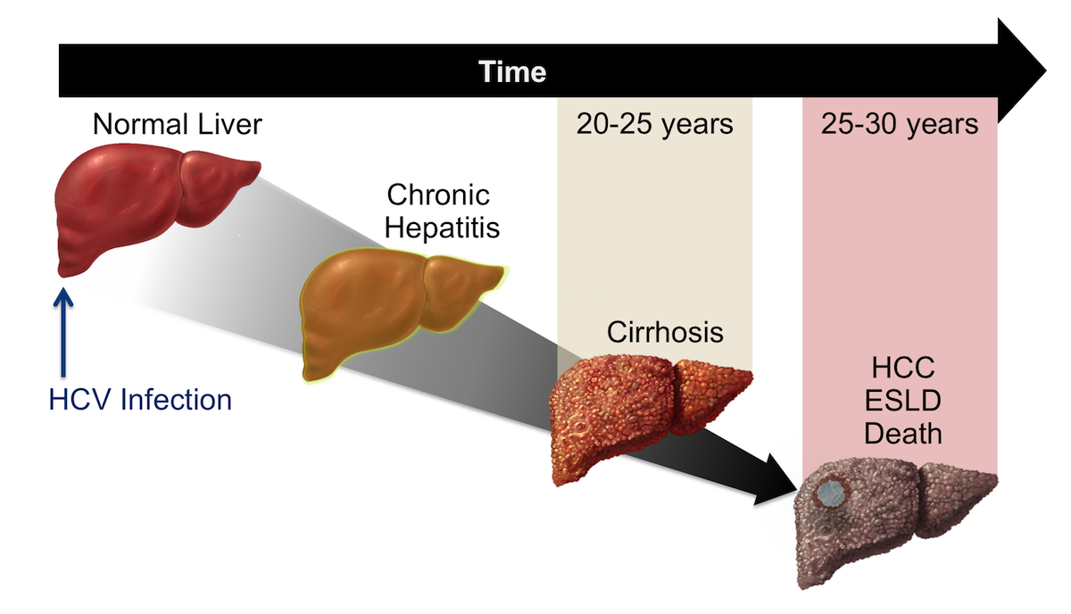

Slide 56
Cirrhosis

Slide 57
Cirrhosis of the liver is an irreversible alteration of hepatic architecture, characterized by diffuse fibrosis and areas of nodular regeneration.
Cirrhosis and its complications is one of the top 10 causes of mortality.
These nodules can be micronodular (<3 mm) or macronodular (>3 mm).
Features of both micronodular and macronodular cirrhosis are frequently present in the same liver.

Slide 58
Etiology and Pathogenesis
The relationship between alcohol abuse and cirrhosis is well established.
Ethanol is a hepatotoxin that leads to the development of fatty liver, alcoholic hepatitis, and ultimately, cirrhosis.
The pathogenesis may differ depending on the underlying causes of the liver disease.
In general, there is ongoing chronic inflammation either due to toxins (alcohol and drugs), infections (hepatitis virus, parasites), autoimmune phenomenon (chronic active hepatitis, primary biliary cirrhosis), or biliary obstruction (common bile duct stone, primary sclerosing cholangitis), and recently well-recognized chronic inflammation caused by nonalcoholic fatty liver disease with the subsequent development of diffuse fibrosis and cirrhosis.

Slide 59
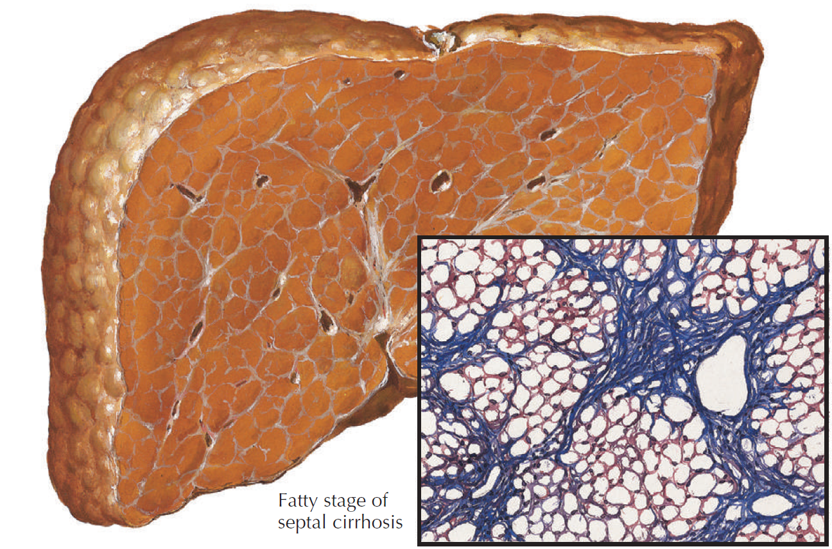

Slide 60
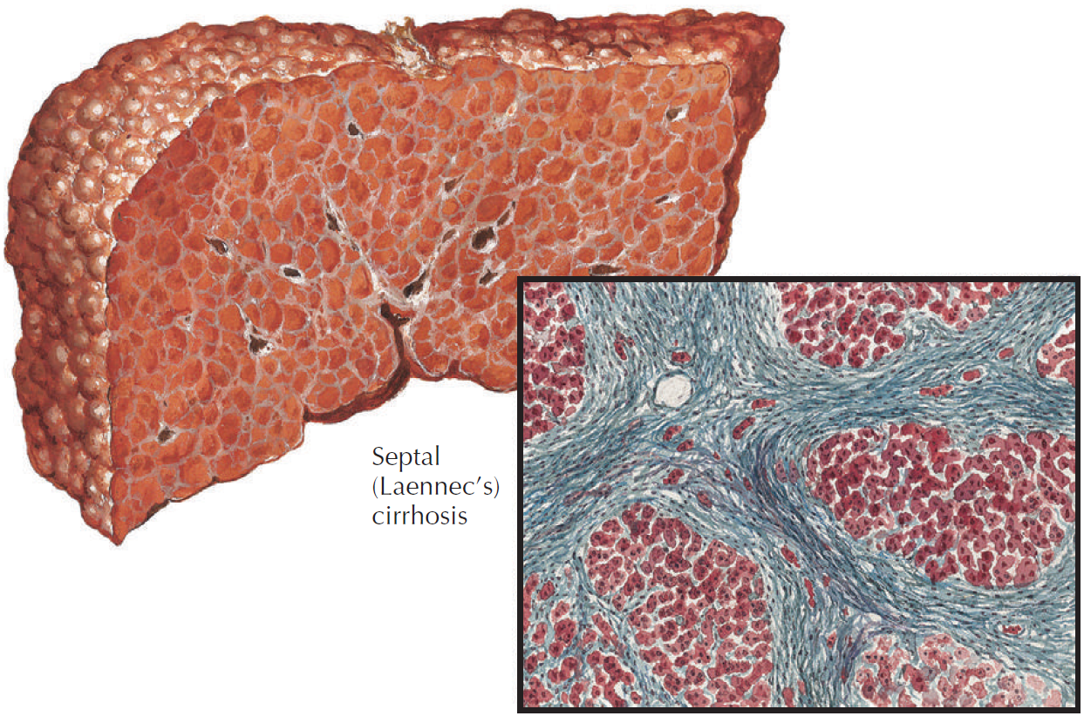

Slide 61
Causes of Cirrhosis
Infections: Hepatitis B, hepatitis C, possibly other viruses, schistosomiasis
Drugs and toxins: Alcohol, methyldopa, methotrexate, isoniazid, amiodarone
Biliary obstruction: Primary and secondary sclerosing cholangitis, cystic fibrosis, biliary atresia, common bile duct stones
Metabolic disorders: Hereditary hemochromatosis, Wilson’s disease, α1-antitrypsin deficiency, cystic fibrosis, glycogen storage disease
Autoimmune diseases: Chronic active hepatitis, primary biliary cirrhosis
Cardiovascular: Chronic right heart failure, Budd-Chiari syndrome, veno-occlusive disease
Miscellaneous: Nonalcoholic fatty liver disease, sarcoidosis, jejunoileal bypass, neonatal hepatitis
Cryptogenic: Unknown cause

Slide 62
Clinical Presentation
Patients may be entirely asymptomatic or may present with nonspecific constitutional symptoms, or symptoms of liver failure, complications of portal hypertension, or both.
Nonspecific symptoms include weakness, lethargy, anorexia, weight loss, abdominal pain, loss of libido, altered sleep-wake pattern, and nausea or vomiting.
Specific symptoms due to hepatic synthetic dysfunction and portal hypertension include jaundice, pruritus, coagulopathy leading to easy bruising, fluid retention with ankle edema, ascites, gastroesophageal variceal bleeding leading to hematemesis or melena, and symptoms of hepatic encephalopathy ranging from mild confusion to coma.

Slide 63
Physical examination
patients may have stigmata of chronic liver disease such as Dupuytren’s contractures, palmar erythema, spider angiomas, parotid enlargement, and bruising.
Palpation of the abdomen may reveal an enlarged or shrunken liver, splenomegaly, ascites, or dilated superficial anterior abdominal wall veins.
Male patients may show signs of feminization (gynecomastia), testicular atrophy, and loss of body hair.
Patients with hepatic encephalopathy may present with a “flapping tremor” or asterixis.

Slide 64
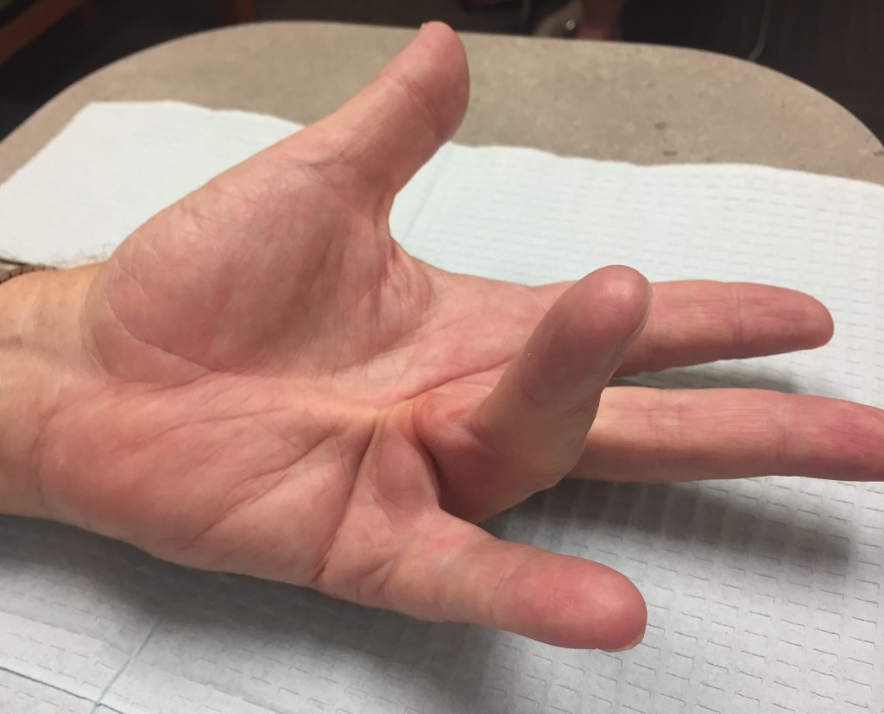
Dupuytren’s contractures

Slide 65
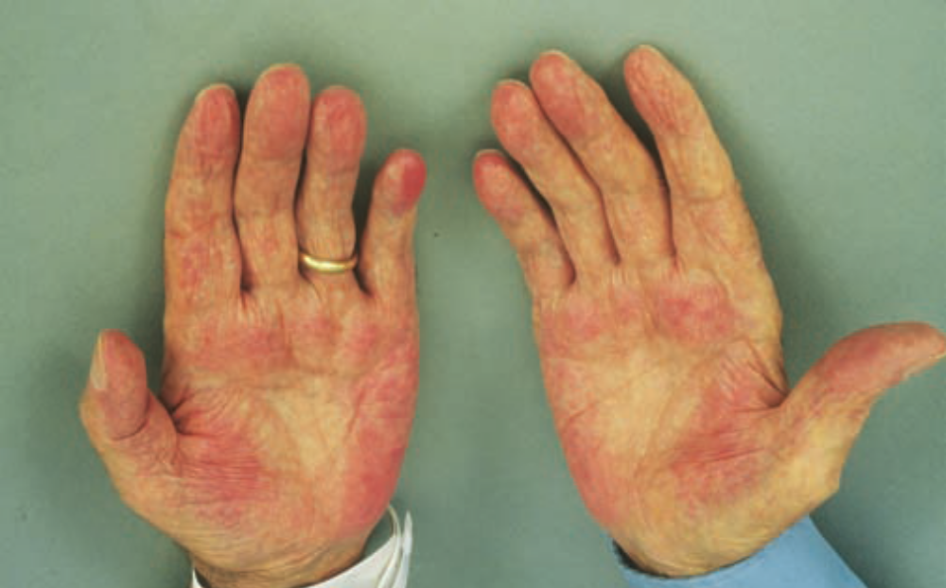
Palmar erythema
This figure shows palmar erythema in a patient with alcoholic cirrhosis.
The erythema is peripheral over the palm with central pallor.

Slide 66
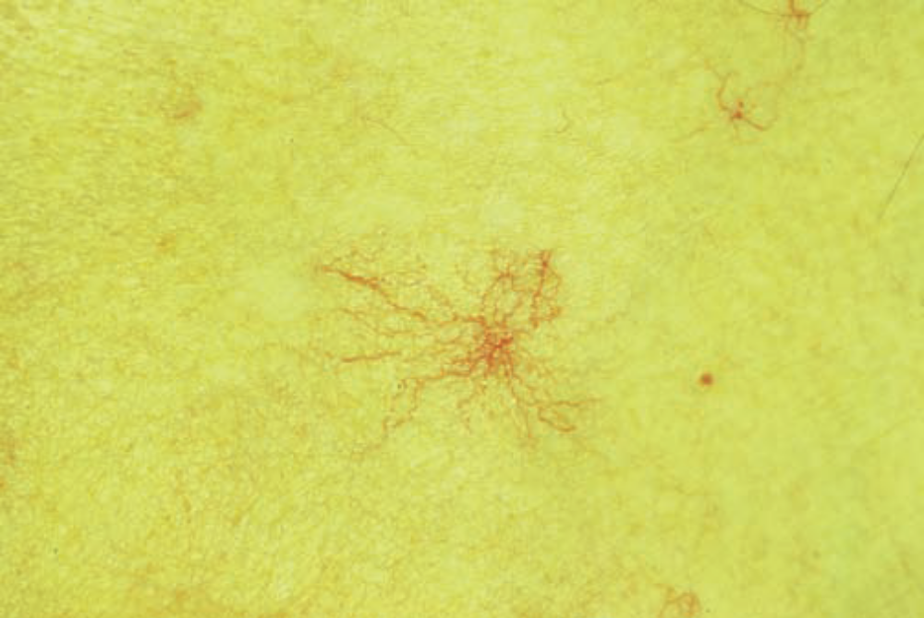
Spider angioma
This figure shows a spider angioma in a patient with hepatitis C cirrhosis.
With release of central compression, the arteriole fills from the center and spreads out peripherally.

Slide 67
Diagnostic
The complete blood cell count may show anemia, leukopenia, or thrombocytopenia.
Hypersplenism causes both leukopenia and thrombocytopenia.
Chronic blood loss and vitamin deficiency can cause anemia.
Prolongation of the prothrombin time occurs secondary to vitamin K deficiency or impaired clotting factor synthesis.
Serum biochemistry often demonstrates an elevated bilirubin level and a low albumin level.
Elevated AST and ALT levels are found in patients with autoimmune hepatitis, viral hepatitis, alcoholic hepatitis, and drug-induced liver injury.
Patients with cholestatic liver disease usually have elevated alkaline phosphatase, γ-glutamyltransferase, and conjugated bilirubin levels.

Slide 68
Diagnostic
Serologic tests are necessary to establish cause: viral serology for hepatitis B (HBsAg), C (anti-HCV Ab), and quantitative DNA and RNA levels, respectively, to define the activity status;
iron studies and HFE gene analysis for hereditary hemochromatosis;
serum and 24-hour urine copper, ceruloplasmin level for Wilson’s disease;
α1-antitrypsin level and genotype for α1-antitrypsin deficiency.
Serum autoantibodies (antinuclear antibody, antismooth muscle antibody, antimitochondrial antibody and anti-liver-kidney microsomal antibody) and quantitative serum immunoglobulins levels may help to diagnose autoimmune liver disease.
Periodic evaluation of tumor markers is indicated to detect complicating primary hepatocellular carcinoma (alpha-fetoprotein, carcinoembryonic antigen, CA 19-9).

Slide 69
Diagnostic
Radiologic studies (ultrasound with Doppler, CT, MRI) provide additional diagnostic information.
Histologic examination of the liver biopsy specimen is often key for diagnosis.
Micronodules, fatty infiltration, and Mallory’s hyaline usually accompany alcoholic cirrhosis.
Primary biliary cirrhosis, primary and secondary sclerosing cholangitis, and autoimmune hepatitis have typical histologic findings.
Liver biopsy is necessary to stage the disease, to help determine the prognosis, and to guide optimum therapy.
The measurement of liver stiffness with transient elastography and its correlation to fibrosis – is a simple and reliable noninvasive method for assessment of liver fibrosis

Slide 70
Management and Therapy
Withdrawal of the causative agent (e.g., alcohol, drugs)
Treatment of the specific underlying cause (e.g., antiviral therapy for viral hepatitis, prednisone or azathioprine for autoimmune hepatitis, phlebotomy for hemochromatosis, d-penicillamine or trientine for Wilson’s disease)
Treatment of underlying risks for NAFLD (obesity, diabetes, hyperlipidemia, drugs)
Treatment of decompensated cirrhosis: ascites, infection, gastrointestinal hemorrhage, hepatic encephalopathy, and hepatorenal syndrome
Orthotopic liver transplantation for decompensated cirrhosis if the patient is a suitable candidate

Slide 71
Ascites
Patients with cirrhosis in whom ascites develops need a diagnostic (10 to 20 mL) abdominal paracentesis.
The factors producing ascites in cirrhosis are a low serum albumin level, hepatic outflow block with overproduction of lymph, and portal venous hypertension.
Ascites can be mild, moderate, or severe on the basis of the amount of fluid in the peritoneal cavity

Slide 72
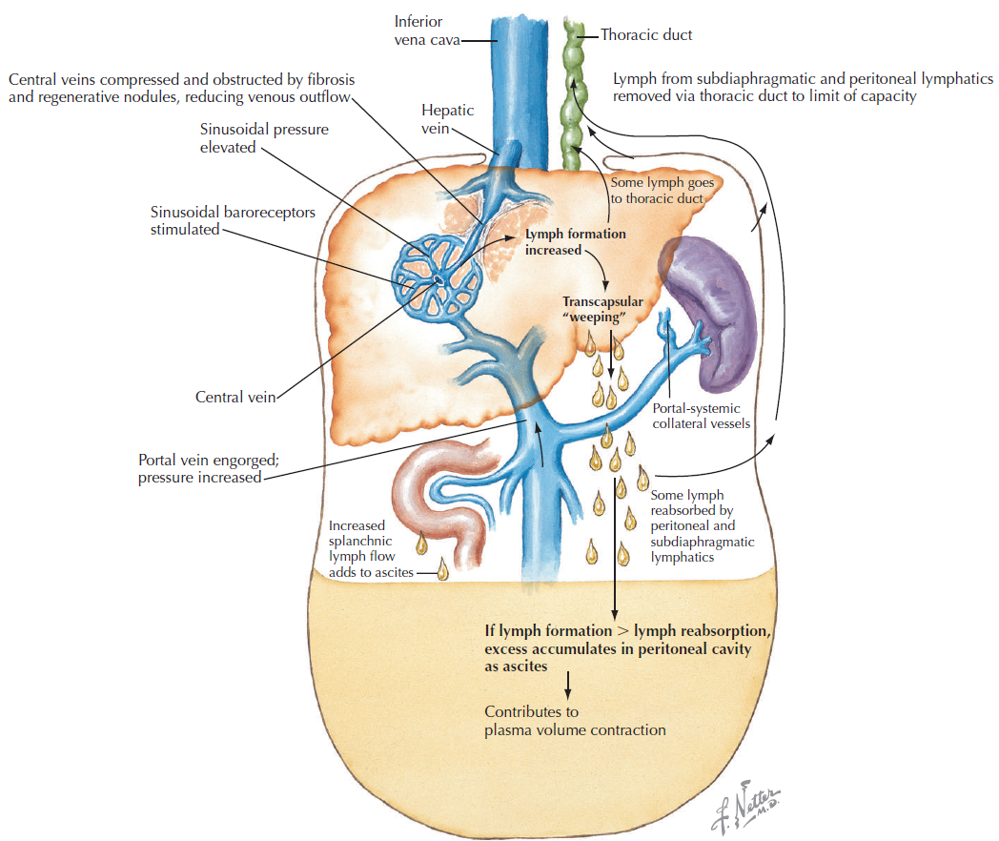
Ascites pathophysiology

Slide 73
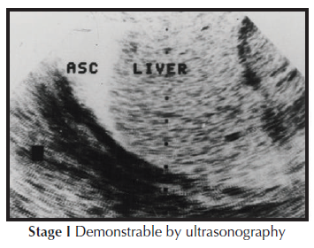
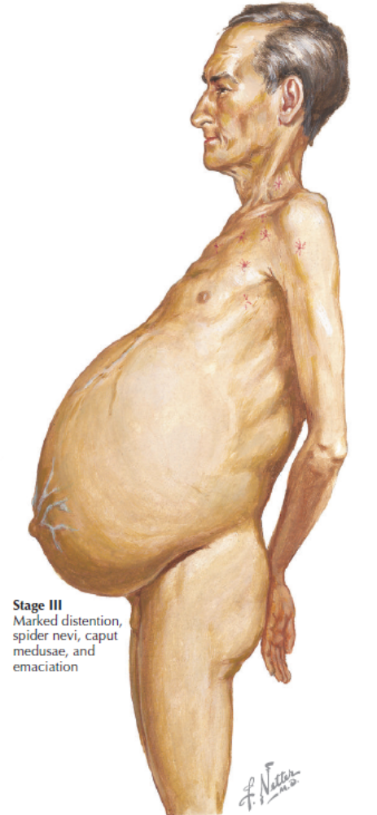
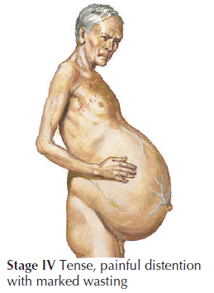
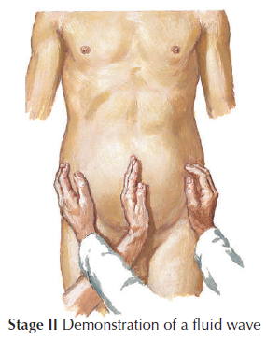
Ascites stages

Slide 74
Ascites - treatment
The initial treatment includes restriction of dietary sodium intake and the use of oral diuretics. Sodium is usually limited to 2 g per day.
Diuretics include spironolactone and furosemide. The maximum spironolactone dose is 400 mg/day, and for furosemide, 160 mg/day. Amiloride, 10 to 20 mg/day, is an alternative to spironolactone if there are side effects such as tender gynecomastia.
Large-volume paracentesis can be used before alternative therapies such as transjugular intrahepatic portosystemic shunt (TIPS) or peritoneovenous shunt.
The development of a newer polytetrafluoroethylene-covered stent may provide better results in shunt dysfunction rates and patient survival.
The TIPS procedure has gained wide popularity and provides a bridge to liver transplantation in patients with advanced cirrhosis.

Slide 75
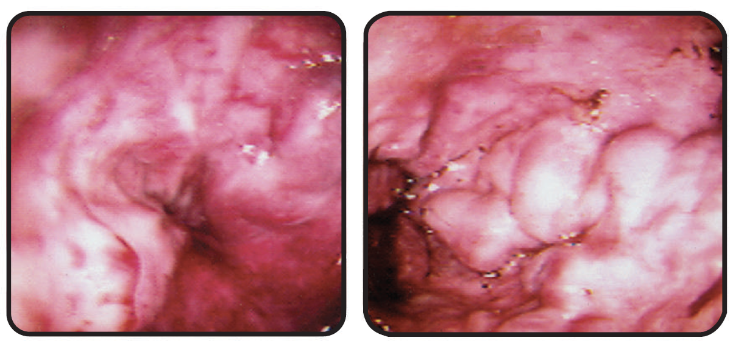
Gastrointestinal Hemorrhage
Gastroesophageal variceal bleeding is the most ominous complication of cirrhosis.
Endoscopic Appearance of Esophageal Varices with Evidence of Recent Hemorrhage

Slide 76
Gastrointestinal Hemorrhage – treatment
Initial management of suspected variceal bleeding requires immediate hospitalization, volume resuscitation, and airway protection for massive bleeding.
If the diagnosis is reasonably certain, pharmacologic therapy with somatostatin or its analogue octreotide can be initiated.
If endoscopy confirms esophageal varices, endoscopic therapy with either variceal ligation or sclerotherapy is indicated.
Options to prevent recurrent variceal bleeding include endoscopic ligation or sclerotherapy, nonselective β-blockers (propranolol, nadolol), surgical shunts, TIPS, and liver transplantation.

Slide 77
Hepatic Encephalopathy
Hepatic encephalopathy represents a constellation of reversible neurologic signs and symptoms accompanying advanced, decompensated liver disease or extensive portosystemic shunting.
The pathogenesis attributable to toxic compounds that are derived from the metabolism of nitrogenous substrates in the gut that bypass the liver through an anatomic and functional shunt.
The four stages of hepatic encephalopathy are based on mental status and neurologic findings:
Stage 1: Mild confusion and incoordination are present.
Stage 2: Asterixis is consistently present and the patient has obvious personality changes.
Stage 3: The patient is somnolent and is disoriented on arousal.
Stage 4: The patient is comatose.

Slide 78
Hepatic Encephalopathy – treatment
Management includes identification and correction of any precipitating factor, restriction of dietary protein to 40 g/day, and administration of lactulose.
Antibiotics to decontaminate the gut, such as neomycin, metronidazole, amoxicillin, and rifaximin, can be added if there is no response to dietary manipulation and lactulose or if there is intolerance to lactulose.
Rifaximin, a nonaminoglycoside antibiotic derived from rifamycin, has gained popularity because it is not absorbed from the gut, thereby eliminating potential toxicities of other antibiotics (renal failure, ototoxicity, and peripheral neuropathy) and has broad-spectrum antibacterial coverage.
Patients with severe refractory hepatic encephalopathy need urgent liver transplantation.

Slide 79
Hepatorenal syndrome
Hepatorenal syndrome is a distinct type of progressive acute renal failure that develops in a patient with cirrhosis in whom all other causes of renal dysfunction have been excluded.
It is a functional type of renal failure.
If the liver disease improves, normal renal function returns.
The pathogenesis of the hepatorenal syndrome is unknown.
Hyponatremia and azotemia are characteristic.
The urinary sodium concentration is less than 10 mEq/L.
The urinary sediment is unremarkable.
Other important chemical findings include a urine-to-plasma creatinine ratio of more than 30 and a urine-to-plasma osmolality ratio of more than 1.

Slide 80
Hepatorenal syndrome – treatment
In the management of hepatorenal syndrome, specific causes for renal failure should be excluded (i.e., acute tubular necrosis, prerenal azotemia from intravascular volume depletion, drug-induced nephrotoxicity, or preexisting chronic renal disease).
Renal replacement therapy should be considered for patients who are potential candidates for liver transplantation.
Experimental forms of therapy include prostaglandin E1, dopamine, terlipressin, peritoneovenous shunt, and TIPS.

Slide 81
Liver transplantation
Liver transplantation is no longer experimental and is considered the standard of care for patients with advanced cirrhosis.
With improved surgical technique and better immunosuppressive drugs, it has become a successful therapy for end-stage liver disease with long-term survival rates approaching 90% and excellent quality of life.
Unfortunately, the gap between the numbers of deceased donors and recipients continues to widen.
Living donor liver transplantation (LDLT) is used by many transplantation centers worldwide.
First used in a child in 1989, LDLT has become a viable alternative for pediatric recipients.
Over the past decade, LDLT has been used successfully in adult recipients with patient and graft survivals similar to those with deceased donor liver transplantation.
The rate-limiting factor is the availability of suitable donors for this procedure.
With appropriate donor and recipient selection, further refinement in surgical technique, and increasing experience, LDLT may give superior results.

Slide 82
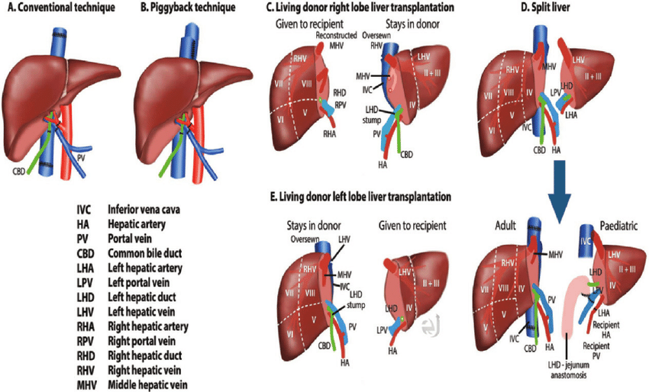
Liver transplantation

