Slide 1
Odessa National Medical University
Department of histology, cytology, embryology and pathological morphology with a course of forensic medicine
Lecture on the topic:
Kidney disease.
PhD in Medicine, Associate Professor of the department
Narbutova Tamara
2023

Slide 2
Diseases of the kidney are characterized
by the injury of basic morphologic components:
glomeruli,
tubules,
interstitium, and
blood vessels.
The clinical manifestations of renal diseases can be grouped into well-defined syndromes.

Slide 3
Acute nephritic syndrome is a glomerular syndrome dominated by the acute inset of usually grossly visible hematuria (red blood cells in urine), mild to moderate proteinuria, and hypertension; it is the classic presentation of acute poststreptococcal glomerulonephritis (GN).
The nephrotic syndrome is characterized by heavy proteinuria, hypoalbuminuria, severe edema, hyperlipidemia, and lipiduria.

Slide 4
Chronic renal failure, characterized by prolonged symptoms and signs of uremia, is the final result of all chronic renal diseases.
Asymptomatic hematuria or proteinuria, or a combination of them, is usually manifestation of glomerular abnormalities.
Acute renal failure is dominated by oliguria or anuria, with recent onset of azotemia. It can result from glomerular injury, interstitial injury, or acute tubular necrosis.

Slide 5
Renal tubular defects are dominated by polyuria, nocturia, and electrilyte disorders. They are the result of either diseases directly affecting tubular structure or defects in specific tubular infection. The latter may be inheridited or acquired.
Urinary tract infection is characterized by bacteriuria and pyuria. The infection may be symptomatic or asymptomatic, and it may affect the kidney or the bladder only.
Nephrolitiasis (renal stone) is manifested by renal colic, hematuria, and recurrent stone formation
Tumors

Slide 6
Glomerular injury is a major cause of renal disease and may be primary and secondary.
Primary glomerular diseases are characterized by primary injury of the glomeruli (acute and chronic glomerulonephritis (GN), lipoid nephrosis, etc.).
In secondary glomerular diseases the kidney is one of many organs and systems damaged by a systemic disease (Systemic lupus erythematous, diabetes mellitus, amyloidosis, etc.)
Pathogenesis of glomerular injury
The consequences of injury at different sites within the glomerulus can be assessed when compared with the normal physiologic role of the main cells involved, i.e. endothelial, mesangial, visceral epithelial, and parietal epithelial cells as well as of the GBM.

Slide 7
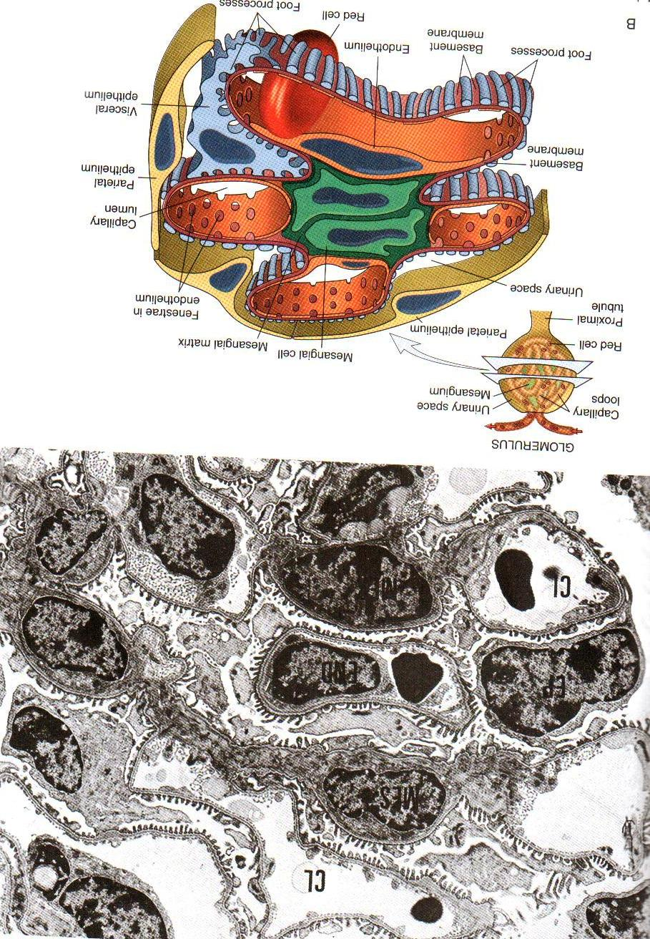
Normal ultrastructure of glomerulus

Slide 8
There are two basic mechanisms of glomerular injury: immune and nonimmune.
Immune mechanisms
A. Antibody-mediated glomerular injury
1. Immune complex disease.
The deposition of Ag-Ab complexes in glomeruli is a major mechanism of glomerular injury, whether they are formed “in situ” with glomerular antigens or are trapped circulating complexes.
Immunologic mechanisms underlying glomerular injury are primarily antibody-mediated (immune-complex disease). More recently there has been evidence to suggest that cell-mediated immune reactions in the form of delayed type hypersensitivity can cause glomerular injury.

Slide 9
Glomerular deposits are formed by one of the following two mechanisms:
Local immune complex deposits. Formation of glomerular deposits of immune complex “in situ”
Circulating immune complex deposits. Circulating immune complexes cause glomerular damage under certain circumstances
Immune complex GN is observed in the following diseases:
  Primary GN, e.g. acute diffuse proliferative GN, membranous GN, membranoproliferative GN, IgA nephropathy and some cases of rapidly progressive GN and focal GN.
  Systemic diseases, e.g. glomerular disease in SLE, malaria, syphilis, hepatitis, Henoch-Schonlein purpura and idiopathic mixed cryoglobulinemia.

Slide 10
2. Anti- GBM disease.
Less than 5% cases of human GN are associated with anti-GBM antibodies. The component of GBM acting as antigen appears to component of collagen IV of the basement membrane.
Anti-GBM disease is classically characterized by homogeneous linear deposits of anti-GBM antibodies (mostly IgG; rarely IgA and IgM) and complement (mainly C3) along the glomerular basement membrane.
Anti-GBM disease is characteristically exemplified by glomerular injury in Goodpasture’s syndrome. About half to two-third of the patients with renal lesions in Goodpasture’s syndrome have pulmonary hemorrhage mediated by cross-reacting autoantibodies against alveolar basement membrane.

Slide 11
3. Alternative pathway disease.
The complement system, in particular C3, contributes to glomerular injury in the majority of forms of GN.
The deposits in alternate pathway of the disease are characteristically electron-dense, glomerular lesions in such cases are referred to as dense-deposit disease.
Alternate pathway disease occurs in most cases of type II membranoproliferative GN, some patients of rapidly progressive GN, acute diffuse proliferative GN, IgA nephropathy and in SLE.

Slide 12
4. Other mechanisms of antibody-mediated injury.
A few autoantibodies have been implicated in some patients of glomerulonephritis:
Anti-neutrophil cytoplasmic antibodies (ANCA). About 40% cases of rapidly progressive GN are deficient in immunoglobulins in glomeruli and are positive for ANCA against neutrophil cytoplasmic antigens in their circulation. ANCA causes endothelial injury by generation of reactive oxygen radicals.
Anti-endothelial cell antibodies (AECA). Autoantibodies against endothelial antigens have been detected in circulation are several inflammatory vasculitis and glomerulonephritis.

Slide 13
B. Cell-mediated Glomerular Injury
Recent evidence suggests that cell-mediated immune reactions in the form of delayed hypersensitivity may be involved in causing glomerular injury, particularly in cases with deficient immunoglobulins.
C. Secondary pathogenetic mechanisms
Secondary pathogenetic mechanisms are a number of mediators of immunologic glomerular injury, such as: neutrophils, mononuclear phagocytes, complement system, platelets, mesangial cells, and coagulation system.

Slide 14
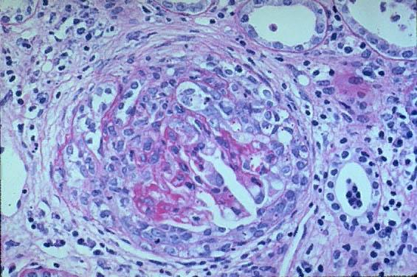
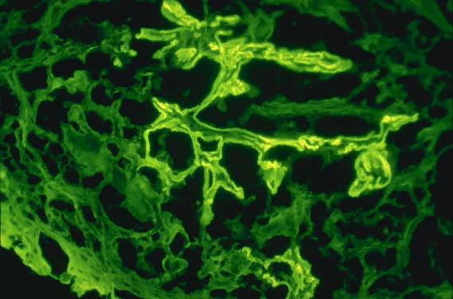
Anti-GBM crescent
Anti-GBM. (Immunofluorescence stain.)

Slide 15
Nonimmune mechanisms
Metabolic glomerular injury, e.g. diabetic nephropathy.
Hemodynamic glomerular injury, e.g. systemic hypertension.
Deposition diseases, e.g. cryoglobulinaemia, amyloidosis.
Infectious diseases, e.g. HBV, HCV, HIV.
Inherited glomerular diseases, e.g. Alport’s syndrome, nail-patella syndrome.

Slide 16
Acute Glomerulonephritis
Anatomically is characterized by inflammatory alterations in the glomeruli and clinically by a complex of findings classically reffered to as the syndrome of acute nephritis.
Nonrenal features, such as: arterial hypertension, hypotrophy of right heart, disproteinemia, edema, hypernitrogenemia and uremia are presence.
It is infectious-allergic or unknown etiology disease with double nonsuppurative glomerulitis.

Slide 17
The nephritic patient usually presents with hematuria, red cell casts in the urine, azotemia, oliguria, and mild to moderate hypertension.
The patient also commonly has proteinuria and edema, but these are not as several those encountered in the nephrotic syndrome.
The acute nephritic syndrome may occur in such multisystem diseases as SLE and polyarteritis nodosa.
Typically, however, it is characteristic of acute proliferative GN and is an important component of crescentic GN.

Slide 18
Principles of glomeluronephritis classification
Glomerulonephritis may be primary or secondary.
According to the etiology it may be bacterial, viral, unclear.
According to the pathogenesis there are 2 types of glomeluronephritis: -immunoassociated and non-immunoassociated.
According to the course GN may be classified into acute, sub-acute, chronic.

Slide 19
Glomerular disease is classified according to the histological pattern of damage seen on renal biopsy; hence knowledge of this aspect of histopathology is needed to understand disease. In morphological classification, topography, character, propagation of pathological process are accounted:
According to topography: intra- and extracapillary GN.
According to character of inflammation: nonsuppurative exudative and proliferative.
According to propagation: diffuse and local

Slide 20
Acute poststreptococcal glomerulonephritis
It usually appears 1 to 4 weeks after streptococcal infection of the pharynx or the skin.
It occurs most frequently in children of 6 to 10 years of age, but adults of any age can be affected.
Duration of disease may 1,5 to 12 monthes.
Gross appearance: Kidney enlarged; cortex broad, pale, without markings; medullary rays congested; glomeruli just visible as grey avascular dots.

Slide 21
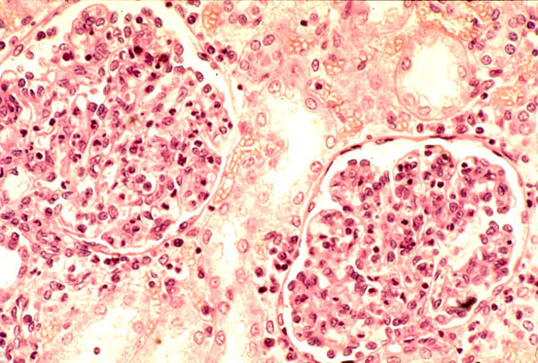
Acute glomerulonephritis. A fairly high power view showing the cellular glomeruli. PMNs can be seen.

Slide 22
Histological type is intracapilary proliferative GN:
Proliferation of endothelial and mesangial cells and, in many cases, epithelial cells.
Diffuse infiltration by leukocytes, neutrophils and monocytes. involving all lobules of all glomeruli.
Combination of proliferation, swelling, and leukocytic infiltration obliterates the capillary lumen.
Special stains can demonstrate small deposites of fibrin within capillary lumina and mesangium.
There may be interstitial edema and inflammation, and the tubes often contain red cell coasts and may show evidence of degeneration.
By immunofluorescence microscopy there are glandular deposits of IgG, IgM, and C3 in the mesangium and along the basement membrane.

Slide 23
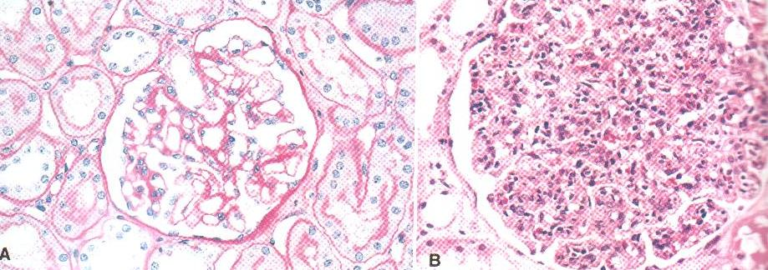
Acute proliferative glomerulonephritis.
A. normal glomerulus. B. glomerular hypercellularity is due to intracapillary leucoytes and proliferation of intrinsic glomerular cells.

Slide 24
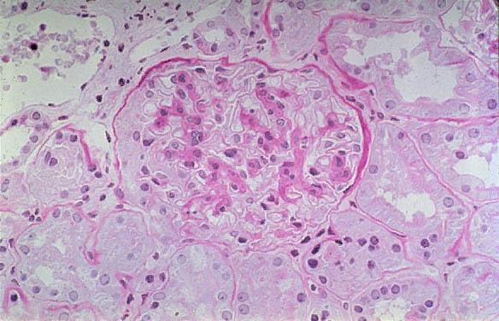
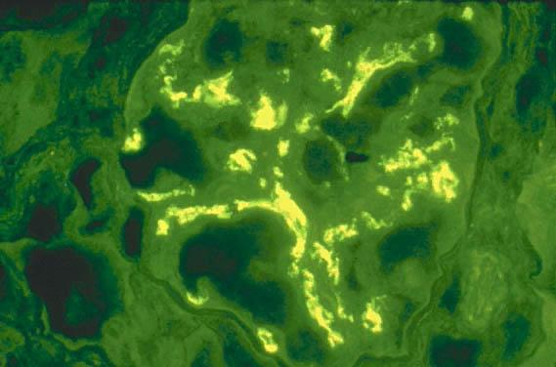

Slide 25
Rapidly progressive (crescentic) glomerulonephritis (RPGN)
It is a syndrome characterized by the accumulation of cells in Bowman’s space in the form of “crescents” accompanied by a rapid, progressive decline in renal function, frequently with severe oliguria or anuria, usually resulting in irreversible renal failure in weeks or months.
Morphology It is extracapillary proliferative GN.
The kidneys are enlarged and pale, often with petechial hemorrhages on the cortical surfaces.
Depending on the underlying cause, the glomeruli may show focal necrosis, diffuse or focal endothelial proliferation.
The syndrome is characterized histologically by the accumulation of cells in Bowman’s space in the form of “crescents”.

Slide 26
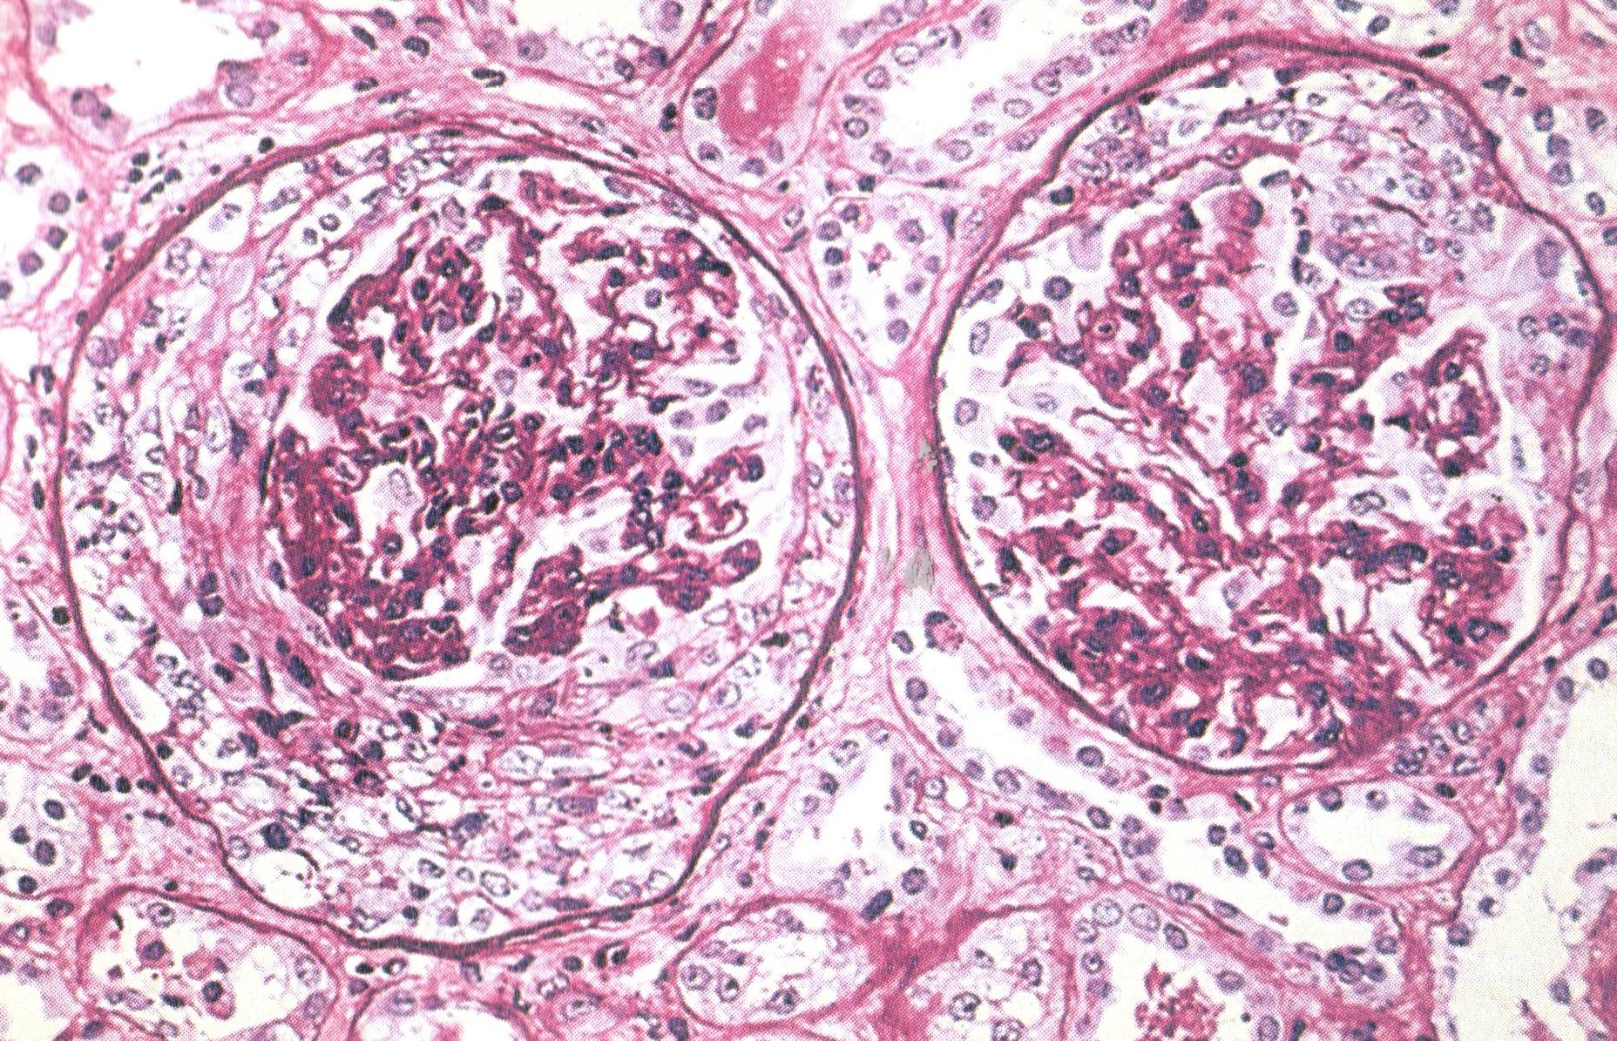
Rapidly progressive (crescentic) glomerulonephritis (RPGN)

Slide 27
Distinctive crescents are formed by proliferation of parietal cells and by migration of monocytes and macrophages into Bowman’s space. Neutrophils and lymphocytes can be present. The crescents eventually obliterate Bowman’s space and compress the glomerular tuft. Fibrin strands are prominent between the cellular layers in the crescents.
In time, most crescents undergo sclerosis.
This syndrome may occur in the course of three broad disease groups:
  Postinfectious rapidly progressive (crescentic) glomerulonephritis, complicating acute GN.
  Systemic diseases (SLE, Goodpasture’s syndrom, polyarteritis nodosa,etc.).
  Idiopathic.

Slide 28
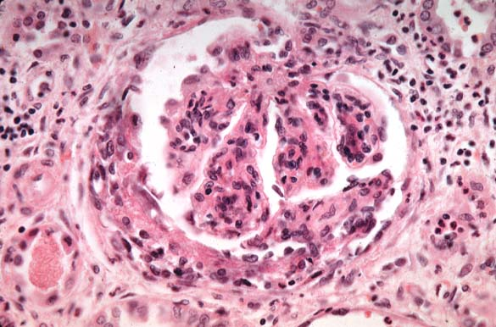
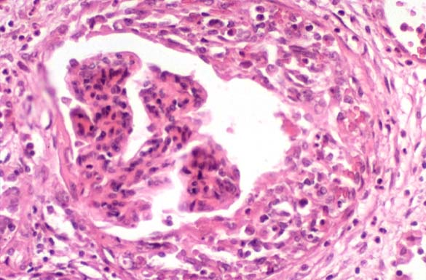

Slide 29
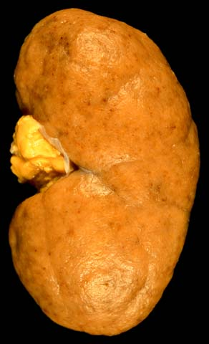
This photo of Type IV lupus nephritis shows the classic "flea-bitten" appearance of the cortical surface in the diffuse proliferative glomerulonephritis

Slide 30
Nephrotic syndrome
Membranous glomerulonephritis (MGN)
It is a major cause of nephrotic syndrome in adults, and characterized by the presence of electron-dense, immonoglobulin-containing deposits along the epithelial side of the basement membrane.
In about 85% of patients, the condition is truly “idiopathic”.
Others changes: protein and fatty droplets in the tubular epithelium and stroma. Foamy macrophages and giant cells form granulomas is association with cholesterol deposits.

Slide 31
MGN may occur in :
Malignant epithelial tumors, particularly carcinoma of the lung and colon and melanoma.
  Systemic lupus erythematosus (SLE).
  Exposure to inorganic salts (gold, mercury).
  Drugs (penicillamine, captopril).
  Infections (chronic hepatitis B, syphilis, schistomiasis, malaria).
  Metabolic disorders (diabetes mellitus, thyroiditis).

Slide 32
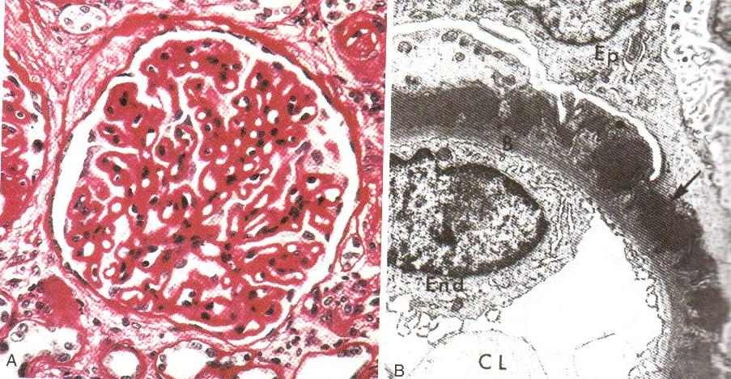
Membranous glomerulonephritis.
A, PAS stain. B, electron micrograph

Slide 33
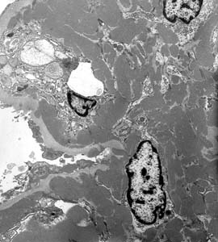
Diffuse proliferative glomerulonephritis with immune complex deposition
is often associated with nephritic syndrome and is associated with a variety of disorders, including infection, SLE, IgA nephropathy, and others. By electron microscopy, endothelial and mesangial cells are swollen with closure of glomerular capillary loops. Here we see numerous electron dense immune-type mesangial deposits. Deposits in this distribution may be characteristic of the condition when associated with SLE or IgA nephropathy.

Slide 34
Membranoproliferative glomerulonephritis (MPGN)
is characterized by alteration in the basement membrane and proliferation of glomerular cells. Because the proliferation is predominant in the mesangium, a frequently used synonym is mesangiocapillary GN.
Patients have hematuria or proteinuria demonstrate a combined nephritic-nephrotic picture.
Primary MPGN is deviled into two major types on the basis of distinct ultrastructural, immunofluorescent, and probably pathogenic findings.

Slide 35
The glomeruli are large and hypercellular.
The glomeruli have a “lobular” appearance.
The GBM is clearly thickened, often focally, most evident in the peripheral capillary loops.
The glomerular capillary wall often shows a “double-contour” or “tram-track” appearance.

Slide 36
Minimal change disease (MCD) (Lipoid nephrosis)
characterized by normal glomeruli on light microscopy but uniform and diffuse effacement of the foot processes of visceral epithelial cells on electronic microscopy.
Etiology is unknown.
Immunofluorescence shows no immune deposits.
The most characteristic feature of this condition is the good response to corticosteroid therapy.
Proteinuria is usually selective and is associated with loss glomerular filtration (negative changes) and a hyperpermeable capillary wall.

Slide 37
Morphology
GBM isn’t changes.
Tubules are dilated; their epithelium is swelling, conteining hyaline and fatty droplets.
Fatty degeneration, necrobiosis, atrophy, desquamation in tubular epithelium take place.
Gross appearances (“big white kidneys”): kidneys enlarged, flabby, yellow color.

Slide 38
Chronic glomerulonephritis (CGN)
CGN is the final stage of GN when sclerosis has eliminated many glomeruli and their associated tubules.
This is often the late result of membranous or membranoproliferative GN,
less commonly postinfectious acute nephritis.
At the final stage, it is difficult to determine the etiology of the pathological lesion.
Morphology
The kidneys are symmetrically contracted and have diffusely granular, cortical surfaces. Pieces of renal tissue adhere to stripped capsule; capsule is adherent and strips with difficult. Weight is 50 gm each. On section, the cortex is thinned and irregular, pelvis dilated and they’re in an increasing peripelvic fat. Such kidneys are called “secondary shrinkage kidneys”.

Slide 39
Histology is depends on the stage of the disease.
In early cases, the glomeruli may still show evidence of the primary disease.
Kidneys from the patients with end-stage disease on long-term dialysis exhibit a variety of so-called “dialysis changes” that are unrelated to the primary disease. Histological feature is nephrosclerosis.
These include arterial intimal thickening caused by accumulation of smooth muscle-like cells and a loose, proteoglycan-rich stroma; calcification, most obvious in glomerular tufts and tubular basement membranes; extensive deposition of calcium oxalate crystals in tubules and interstitium; acquired cystic disease; and increased numbers or renal adenomas and borderline adenocarcinomas.

Slide 40
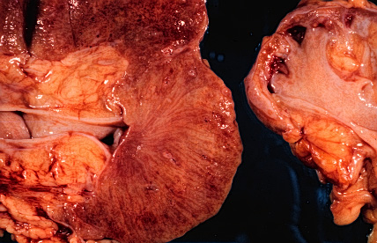
chronic glomerulonephritis

Slide 41
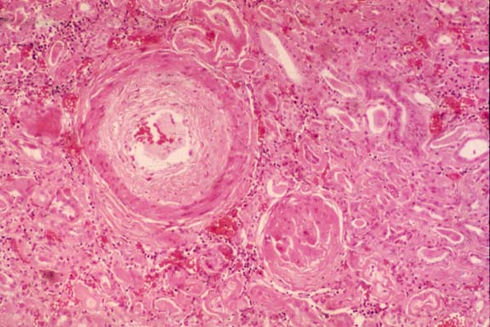
Chronic glomerulonephritis Demonstrates some sclerotic glomeruli and renal vascular changes.

Slide 42
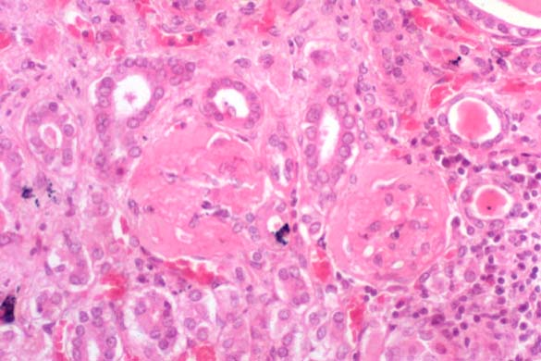
Chronic glomerulonephritis. Completely sclerotic glomeruli. This "end stage" of glomerulonephritis prevents histopathologic determination of the etiology.

Slide 43
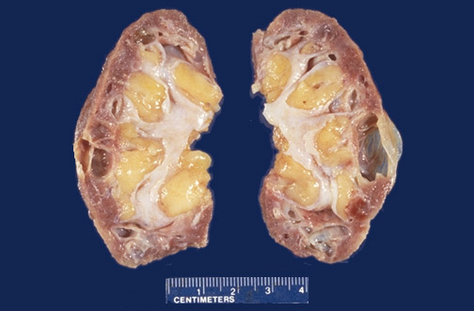
Chronic glomerulonephritis

Slide 44
Patients dying with chronic GN also exhibit pathologic changes outside the kidney that are related to the uremic state and are also present in other forms of chronic renal failure. Often clinically important, these includes:
uremic pericarditis, uremic gastroenteritis, secondary hyperparathyroidism with nephrocalcinosis and renal osteodystrophy, left ventricular hypertrophy due to hypertension, and pulmonary changes of diffuse alveolar damage often ascribed to uremia (uremic pneumonitis).

Slide 45
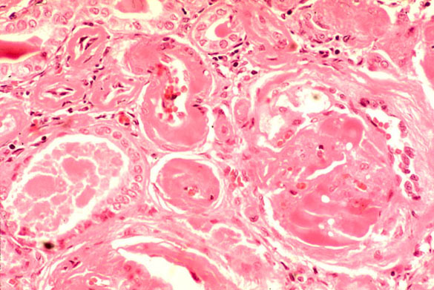
Chronic glomerulonephritis.
Hyalinized arterioles and sclerotic glomeruli.

Slide 46
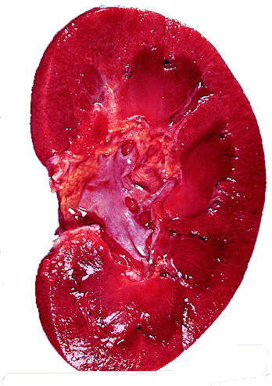
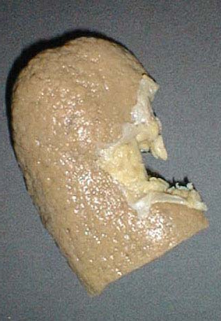
Chronic Glomerulonephritis Note: atrophic and granular

Slide 47
Tubulopathy
Acute renal failure and acute tubular necrosis
Acute renal failure (ARF) is a syndrome associated with acute suppression of renal function, often accompanied by oliguria, and rarely anuria or polyuria. ARF is caused by:
Organic vascular obstruction.
Severe glomerular disease.
Acute tubulointerstitial nephritis.
Massive infection.
Disseminated intravascular renal coagulation.
Urinary obstructions.
Acute tubular necrosis

Slide 48
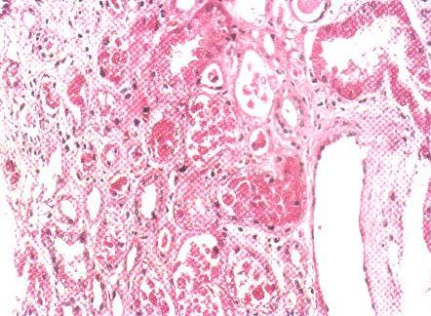
Acute tubular necrosis.

Slide 49
Acute tubular necrosis (ATN)
ATN is characterized by destruction of renal tubular epithelial cells either from ischemia or nephrotoxins.
Ischemic ATN is called tubulorrhectic ATN or shock kidney, occurs due to hypoperfusion of the kidneys resulting in focal damage to the tubules.
Etiopathogenesis. Ischemia may result from following causes:
Shock (post-traumatic, surgical, burns, dehydration, obstetrical and septic). Crush injuries. Non-traumatic rhabdomyolysis
Mismatched blood transfusions, black-water fever (hemoglobinuric nephrosis).

Slide 50
Morphology
Macro: the kidneys are enlarged and swollen. On cut section, the cortex is often widened and pale, while medulla is dark.
Micro:
  Dilatation of the proximal and distal convoluted tubules.
  Focal tubular necrosis at different points along the nephron.
  Flattened epithelium lining the tubules.
  Eosinophilic hyaline casts or pigmented hemoglobin and myoglobin casts in the tubular lumina.
  Disruption of tubular basement membrane (tubulorrhexis).

Slide 51
Nephrotoxic ATN occurs as a result of direct damage to tubular cells by ingestion, injection or inhalation of a number of toxic agents.
The toxic agents causing toxic ATN are:
General poisons such as mercuric chloride, carbon tetrachloride, ethylene glycol, mushrooms and insecticides.
Heavy metals (mercury, lead, arsenic, phosphorus and gold).
Drugs, such as sulfonamides, certain antibiotics (gentamycin, cephalosporin), anaesthetic agents (methoxyflurane, halothane), barbiturates, salicylates.
Radiographic contrast material.

Slide 52
The clinical course of ATN may be divided into stages:
  The initiating stage (shock),
  lasting for about 36 hours,
  is dominated by the inciting medical, surgical, or obstetric event in the ischemic form of ATN.
  Macroscopically, kidneys are diffusely swollen and oedematous. It is characterized by ischemic cortex and congestion of pyramids. Acute renal failure and oliguria, hyperkalemia and fluid overload in patients develop.

Slide 53
  2. The maintenance stage (Oliguric phase, 2-9 days)
  is characterized by sustained decreases in urine output to between 40 to 400 ml per day, with salt and water overload, rising blood urea nitrogen, hyperkaliemia, metabolic acidosis, and other manifestations of uremia dominating this phase. There is blockage of renal tubules by necrotic cells, and a secondary reduction in glomerular blood flow (caused by arteriolar constriction) reduces glomerular filtration. It stage may be fatal.

Slide 54
  3. The recovery stage (Polyuric phase, 10-21 days) is ushered by a steady increase in urine volume that may reach up to 3 liters per day. Regeneration of renal tubular epithelium takes place, with removal of dead material by phagocytic cells, as well as in the form of casts in urine. As tubules open up and glomerular blood flow increases, patients develop polyuria. This is because the regenerated tubular cells are undifferentiated and have not developed the specializations necessary for resorption of electrolytes and water. Replacement of fluid and electrolytes is needed to compensate for excessive loss from urine. Hypokalemia, rather than hyperkalemia, becomes a clinical problem.

Slide 55
Tubulointerstitial Disease
The term tubulointerstitial nephritis is used for inflammatory process that predominantly involves the renal interstitial tissue and is usually accompanied by some degree of tubular damage.
The term interstitial nephritis is reserved for those cases where there is no primary involvement of glomeruli, tubules or blood vessels. A number of bacterial and non-bacterial, acute and chronic conditions may produce tubulointerstitial nephritis.

Slide 56
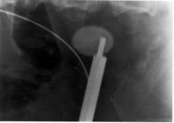
nephrolithiasis

Slide 57
Kidney stones, also called renal calculi, are solid concretions (crystal aggregations) of dissolved minerals in urine; calculi typically form inside the kidneys or bladder. The terms nephrolithiasis and urolithiasis refer to the presence of calculi in the kidneys and urinary tract

Slide 58
Renal calculi can vary in size from as small as grains of sand to as large as a golf ball.
Kidney stones typically leave the body by passage in the urine stream, and many stones are formed and passed without causing symptoms. If stones grow to sufficient size before passage — on the order of at least 2-3 millimeters — they can cause obstruction of the ureter. The resulting obstruction with dilation or stretching of the upper ureter and renal pelvis as well as spasm of muscle, trying to move the stone, can cause severe episodic pain, most commonly felt in the flank, lower abdomen and groin (a condition called renal colic). Renal colic can be associated with nausea and vomiting due to the embryological association of the kidneys with the intestinal tract. Hematuria (bloody urine) is commonly present due to damage to the lining of the urinary tract. Recurrence rates are estimated at about 10% per year. Men are affected approximately 4 times more often than women.

Slide 59
Kidney stones can form when the urine contains too much of certain substances.
These substances can create small crystals that become stones. Kidney stones may not produce symptoms until they begin to move down the ureter, causing pain. The pain is usually severe and often starts in the flank region, then moves down to the groin.
Kidney stones are common. A person who has had kidney stones often gets them again in the future. Kidney stones often occur in premature infants.
Risk factors include renal tubular acidosis and resultant nephrocalcinosis.
Some types of stones tend to run in families. Certain kinds of stones can occur with bowel disease, ileal bypass for obesity, or renal tubule defects

Slide 60
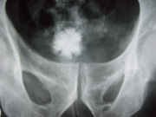
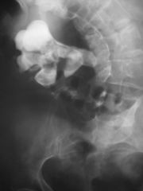
Star shaped bladder urolith
struvite stone

Slide 61
Calcium stones. Calcium stones are the most common comprising about 75% of all urinary calculi. They may be pure stones of calcium oxalate (50%) or calcium phosphate (5%), or mixture of calcium oxalate.
Mixed (Struvite) stones. About 15% of urinary calculi are made of magnesium-ammonium-calcium phosphate, often called struvite. “'Staghorn stone” which is a large, solitary stone that takes the shape of the renal pelvis where it is often formed is an example of struvite stone.
Uric acid stones. Uric acid calculi are radiolucent unlike radio-opaque calcium stones. Uric acid stones are smooth, yellowish-brown, hard and often multiple.
Cystine stones. Cystine stones are small, rounded, smooth and often multiple. They are yellowish and waxy. They are seen in heritable tubular transport defects causing cystinuria.

Slide 62
COMPLICATIONS
Decrease or loss of function in the affected kidney
Kidney damage, scarring
Obstruction of the ureter (acute unilateral obstructive uropathy)
Recurrence of stone
Pyelonephritis
Hydroneprosis
Hemorrhage
Urinary tract infection

Slide 63
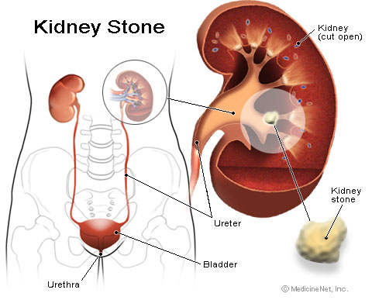

Slide 64
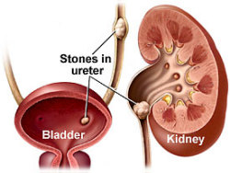
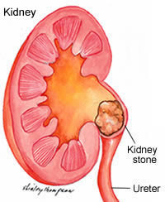
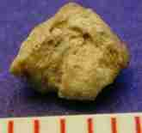

Slide 65
Hydronephrosis
Hydronephrosis is the term used for dilatation of renal pelvis and calyces due to partial or intermittent obstruction to the outflow of urine.
Hydroureter nearly always accompanies hydronephrosis
Hydronephrosis may be unilateral or bilateral.

Slide 66
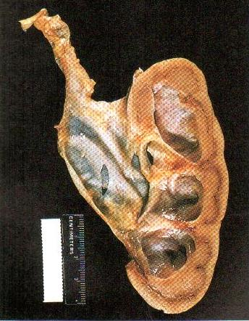

Slide 67
Unilateral hydronephrosis. This occurs due to some form of ureteral obstruction at the level of periureteric junction (PUJ). The causes are:
  Intraluminal, e.g. a calculus in the ureter or renal pelvis.
  Intramural, e.g. congenital PUJ obstruction, atresia of ureter, inflammatory stricture, trauma, neoplasm of ureter or bladder.
  Extramural, e.g. obstruction of upper part of ureter by inferior renal artery or vein, pressure on ureter from outside such as carcinoma cervix, prostrate, rectum, colon or cecum and retroperitoneal fibrosis.

Slide 68
Bilateral hydronephrosis. This is generally the result of some form of urethral obstruction but can occur from the various causes listed above if the lesions involve both sides.
  Congenital, e.g. atresia of the urethral meatus, congenital posterior urethral valve.
  Acquired, e.g. bladder tumor involving ureteric orifices, prostatic enlargement, prostatic carcinoma and prostatitis, bladder neck stenosis, inflammatory or traumatic urethral stricture and phimosis.

Slide 69
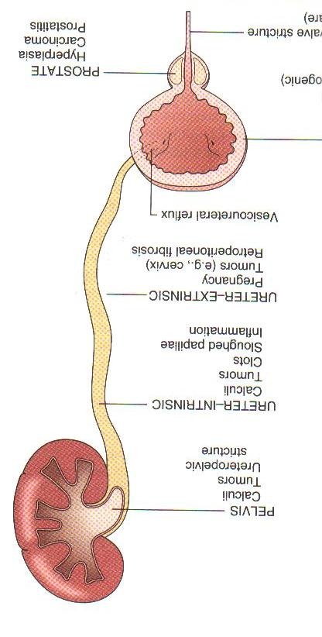

Slide 70
Chronic renal failure
Nephrosclerosis is morphologic basis of chronic renal failure.
Uremia is a syndrome encompassing a group of clinical and biochemical sings derived essentially from the retention of waste products and the failure to control fluid and electrolyte balance.
The prognosis of final stage renal failure has been greatly improved by dialysis, renal transplantation.

Slide 71
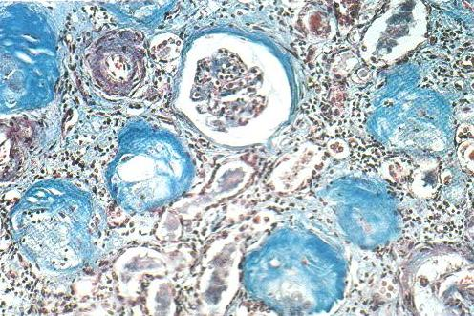
Complete replacement of virtually all glomeruli by connective tissue due to chronic glomerulonephritis. A Masson trichrome staining.

Slide 72
Uremia is final stage of chronic renal failure, which is characterised by
  Hypernitrogenemia.
  Metabolic acidosis (accumulation of sulphates, phosphates, and organic acids).
  Hyperkaliemia, hypercalcemia.
  Anemia.
  Depression of immunological reaction. Infections are common and will in turn affect renal function.
  Arterial hypertension.
  Hemorrhagic syndrome (petechias, hemorrhagic erosions and ulcer in mucosa).
  Fibrinous inflammation:
    Fibrinous pericarditis (“cor vilosum”).
    “Uremic pneumonitis” with pleural exudates.
    Uremic gastritis, enteritis, colitis.
    Edema of lungs.

Slide 73
Pyelonephritis
This is infection within the renal pelvis, usually accompanied by infection within the renal parenchyma. The source of sepsis is often ascending infection from the bladder but haematogenous spread can also occur. The usual organisms are the same as for lower urinary tract infection (e.g. Escherichia coli, Klebsiella, Proteus, Enterococcus). Repeated attacks of acute pyelonephritis can lead to chronic pyelonephritis.

Slide 74
Acute Pyelonephritis
Incidence
Acute pyelonephritis can occur at any age. In neonates it is 1.5 times more common in boys and tends to be associated with abnormalities of the renal tract. Uncircumcised boys tend to have a higher incidence than circumcised boys. Beyond that age girls have a 10-fold higher incidence. In adult life it reflects the incidence of urinary tract infection (UTI) in that it is much more common in young women. Over 65 the incidence in men rises to match that of women.

