Slide 1

ТOPIC 8. STRATEGIC MARKETING IN HEALTHCARE
Marketing strategy in the management system and the process of its development
Strategic marketing planning.
Marketing business planning

Slide 2

STRATEGIC MARKETING IN HEALTHCARE
A strategy is a general concept (action program) of how to achieve the goals (results) of an organization, solve various problems and allocate the limited resources necessary for this.
A strategy is a program for the implementation of management and marketing activities, which can look like graphs, tables, descriptions, etc.
In terms of content, it is a model of actions, a tool for achieving the goals of the organization.
The main task of strategy development is to achieve competitive advantages and profitability of a medical clinic.
There are seven types of strategies, the main one – the general one – reflects the means of accomplishing the tasks set.

Slide 3

STRATEGIC MARKETING IN HEALTHCARE
Methods and approaches of strategic marketing and management:
Comparative analysis – modeling of the future based on knowledge about events in the past.
The normative approach – a direct vision of the future based on real conditions.
Extrapolation – the transfer to the future of the trends in the development of the management object that existed in the past.
Development of scenarios in case of unforeseen circumstances.
The method of expert assessments is based on the opinions of specialists in the relevant industries and their comparison.

Slide 4

STRATEGIC MARKETING IN HEALTHCARE
The result of strategic marketing – a purposeful influence on the object of management, based on the general concept of the organization's views on goals and the choice of methods to achieve them in the future under conditions of uncertainty.
On the basis of obtaining a system of qualitative indicators, three types of forecast are formed:
1) optimistic;
2) realistic;
3) pessimistic.
Successful implementation of the strategic plan involves the use of not only general, but also private management and marketing methods: issuing orders, planning tasks; holding operational meetings; organizational regulation and rationing; economic incentives, etc.

Slide 5
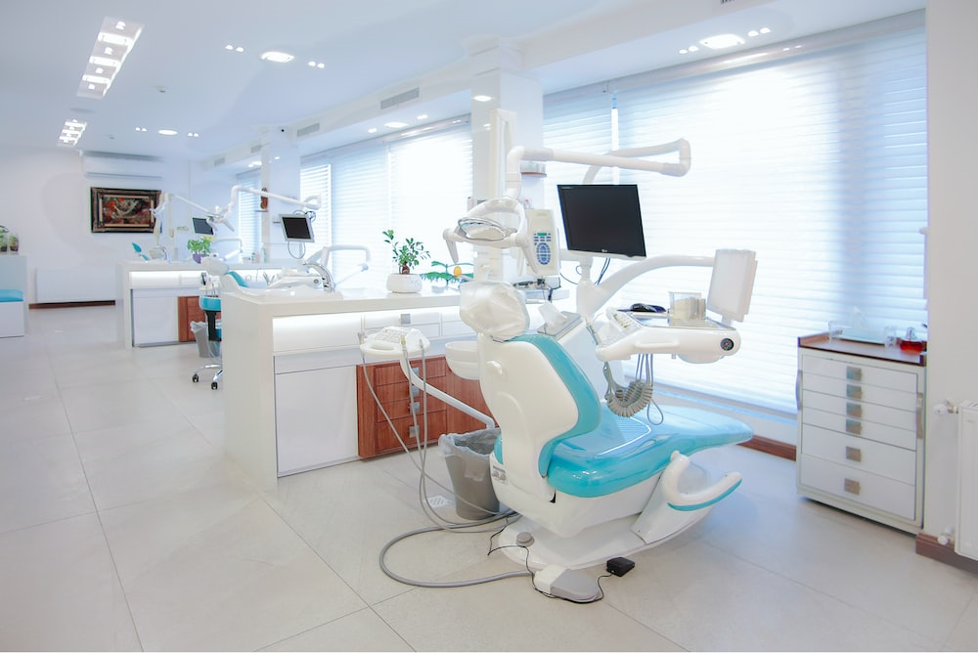
STRATEGIC MARKETING IN HEALTHCARE
The implementation of the strategy of medical clinics is aimed at fulfilling three interrelated tasks:
1. To prioritize of tasks, the relative importance of which corresponded to the strategy that the organization will implement. This concerns the problems of resource use, the formation of organizational etc.
2. To establish a correspondence between the chosen strategy and the internal organizational processes in the medical clinic, in order to orient the organization's activities towards the implementation of the strategy. Compliance is established by the following characteristics: − organization structure; − motivation and incentive system; − norms and rules of conduct; − qualifications of employees and managers, etc.
3. To choose the appropriate strategy leadership style and to approach to the management of the organization.

Slide 6

STRATEGIC MARKETING IN HEALTHCARE
A strategic marketing plan is a business document consisting of a description of the company's real positions in the market for the period covered, defining its market goals and tools to achieve them.
To make a marketing plan, you must first have ready:
a description of the company's services and products,
the target audience,
pricing policy,
analysis of the competitive environment.

Slide 7

STRATEGIC MARKETING IN HEALTHCARE
A marketing plan for a clinic is usually not one document, but several. The minimum "package" for the preparation of a marketing plan should include:
A map of channels for attracting patients with a list of all the tools that you plan to use this year, the expected conversion and responsible persons. In addition, a tactical plan should be created for each channel, recording specific activities and their timing.
2. Budget per year. If the clinic is just opening, it is usually planned to put 15-20% of the profit on marketing expenses. For clinics that have entered the market for a long time with the development of the brand, this percentage is gradually decreasing and amounts to 2.5-10%.

Slide 8

STRATEGIC MARKETING IN HEALTHCARE
3. Sales plan. According to statistics, only 15-20% of businesses make sales plans. However, this is exactly the tool that is an additional motivation, an analytical basis and a basis for understanding your capabilities, as well as a compass during a crisis. The sales plan is based on calculations and specific data. These are well-founded figures that characterize income, profit and other indicators. For the calculation there are special techniques that allow you to make the document as adequate and close to reality as possible.
4. Clinic promotion plan. This is the instrument that will be your voice. It structures your communications by defining:
- what (messages);
- to whom (target audiences);
- where (platforms and events);
- how (tools and budgets) do you talk about your service.

Slide 9

STRATEGIC MARKETING IN HEALTHCARE
Strategic marketing management is the influence on the level, time and nature of demand in such a way as to help an organization achieve goals.
The task of marketing depends on the state of demand, which can be negative, absent, falling, irregular, full-fledged, excessive, irrational.
An integral element of strategic marketing is the business plan of a medical institution or a separate business process, that is, an appropriate feasibility study of the activities and prospects for the development of healthcare.
The purpose of developing a business plan is to organize the medical and economic activities of the organization for the near and distant periods in accordance with the needs of the market and the possibilities of obtaining the necessary resources.

Slide 10

STRATEGIC MARKETING IN HEALTHCARE
The development of a business plan provides the following advantages:
determination of the perspective of a medical institution, a clearer and more specific definition of goals, ways to achieve them, coordination of efforts;
a visual demonstration of the duties and responsibilities of all employees of a medical institution, as well as the functional relationships between them;
analysis and calculation of the necessary indicators of the economic activity of a medical institution.
Types of strategic marketing:
advanced market analysis,
marketing on the basis of anticipating changes,
solving strategic tasks.

Slide 11

STRATEGIC MARKETING IN HEALTHCARE
The Goal is to forecast the future situation and ensure on this basis the survival of the institution in the future, determination of the performance indicators of the dental institution necessary for consistent monitoring.
The main objectives of the business plan:
determining the direction of activity (mission, goals) of a medical institution, target markets and the place of its organization in them;
2) formulation of long-term and short-term goals and objectives;
3) assessment of the material and financial situation of the medical institution, compliance of resources with the set goals.

Slide 12

STRATEGIC MARKETING IN HEALTHCARE
Business planning tasks include:
defining strategies and tactics for achieving long-term and short-term goals of a medical institution;
delegation of authority to employees responsible for the implementation of each strategy;
establishing a list of medical services that will be provided to consumers, assessing the costs of providing medical care;
organization of stimulation and motivation of the work of medical workers;
- definition of marketing activities of a medical institution for market research, advertising, sales promotion, sales, etc.

