Slide 1
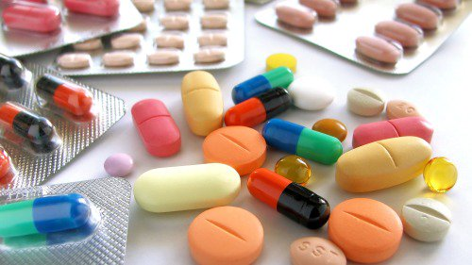
Technology of solid dosage forms
Odesa National Medical University
Faculty of Pharmacy
Department of Pharmaceutical Chemistry and Drug Technology
Docent Zamkova AV.
Odessa 2024

Slide 2
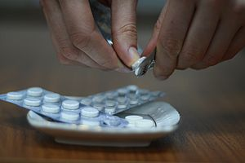
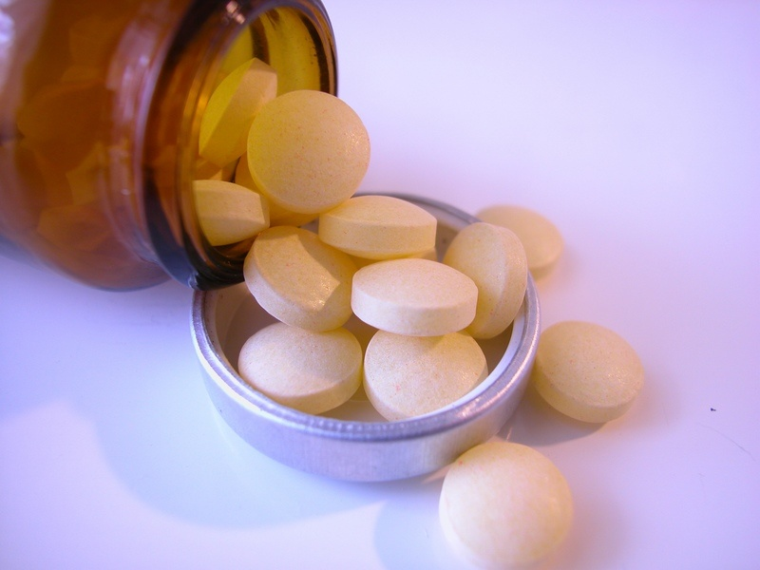
Pills
This is a solid dosage form obtained by pressing powders and granules containing one or more medicinal substances with or without the addition of excipients or obtained by molding special masses.

Slide 3
Among the tablets there are:
the tablets themselves (compressed)
trituration tablets (molded; microtablets)
uncovered, covered
fizzy
gastro-resistant (enteric-soluble)
modified release
for use in the mouth
for preparing a solution or suspension, etc.

Slide 4
В зависимости от дозировки лекарственного вещества выделяют:
Таблетки мите — таблетки с минимальной дозировкой и минимально выраженным действием лекарственного вещества.
Таблетки семи — таблетки со средней дозировкой и средне выраженным действием лекарственного вещества.
Таблетки форте — таблетки с высокой дозировкой и сильно выраженным действием лекарственного вещества.

Slide 5
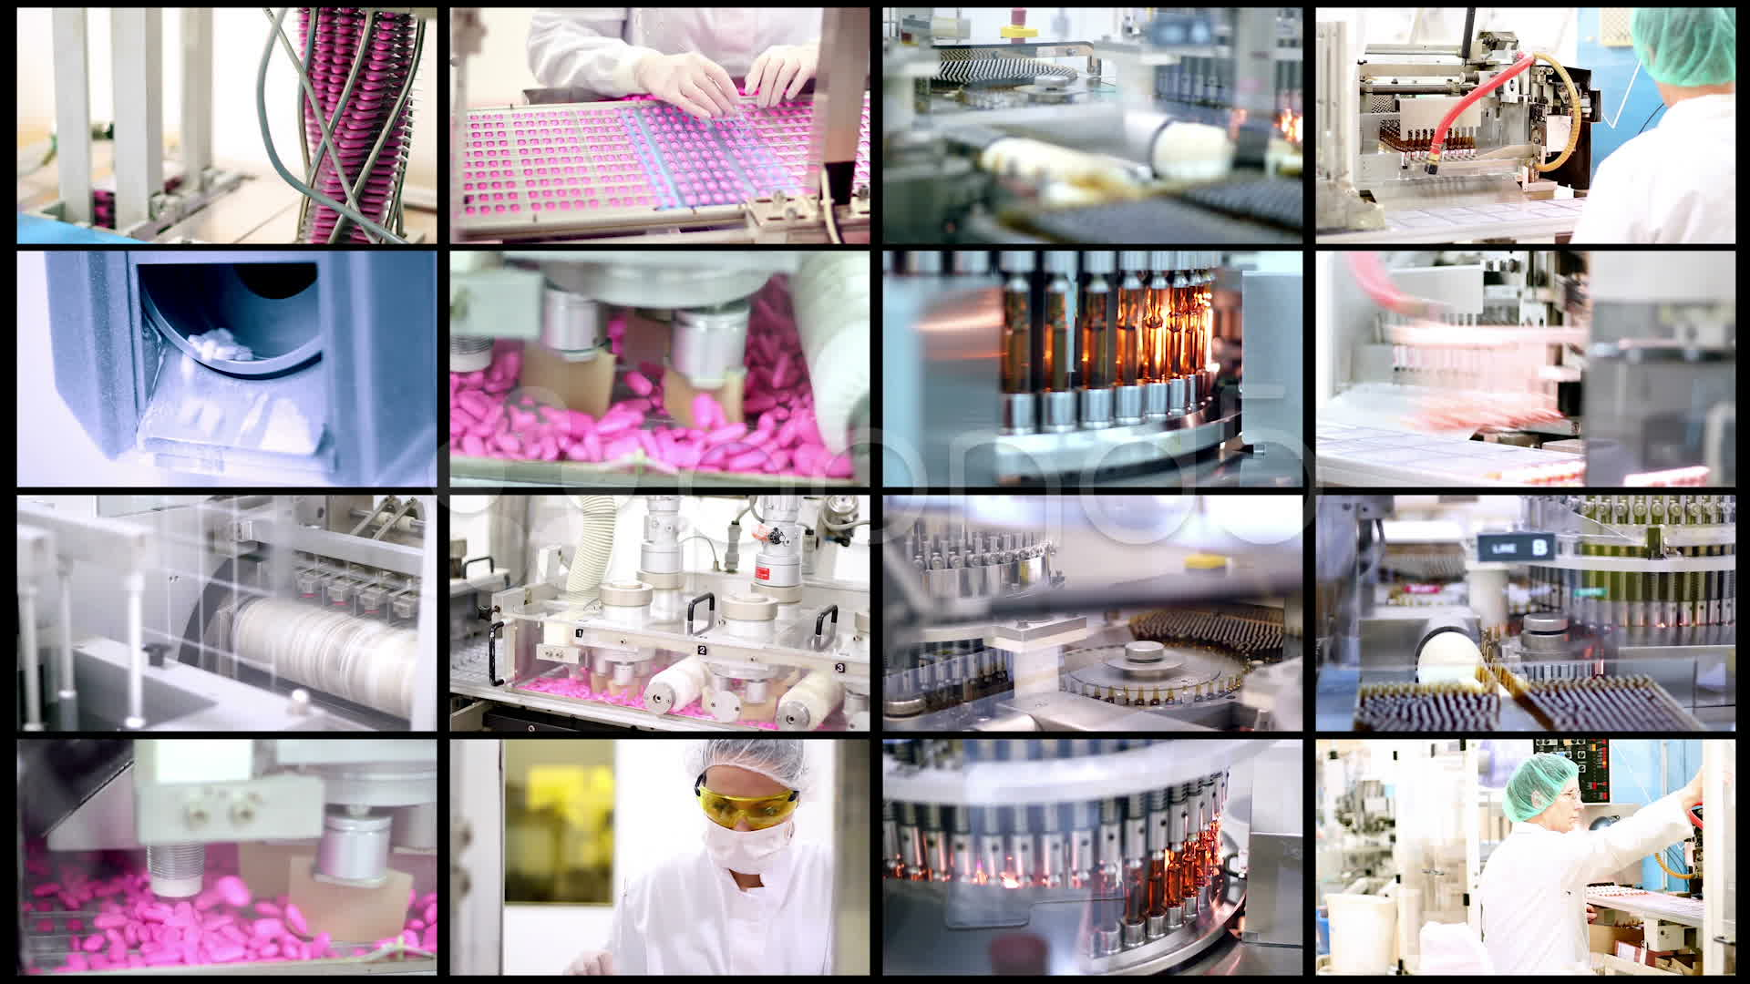
Factory technology for the production of tablets.

Slide 6
Factory technology for the production of tablets includes a number of sequential operations:
the first is weighing (measuring) the components, grinding, sifting;
the second is wet or dry granulation (conversion of powdery substances into coarse sand - (granules) followed by drying;
the third is pressing.

Slide 7
Wet granulatoin
Wet granulation - consists of the following operations:
1) grinding substances into fine powder;
2) moistening the powder with a solution of binding substances;
3) rubbing the resulting mass through a sieve;
4) drying and processing of granulate.

Slide 8
Grinding. This operation is usually carried out in ball mills. The powder is sifted through sieve No. 38.
Hydration. It is recommended to use water, alcohol, sugar syrup, gelatin solution and 5% starch paste as binders. The required amount of binders is determined experimentally for each tablet mass.

Slide 9
Rubbing (actually granulating). Granulation is carried out by rubbing the resulting mass through a 3-5mm sieve (No. 20, 40 and 50). Punching sieves made of stainless steel, brass or bronze are used. The use of woven wire sieves is not allowed to avoid wire scraps getting into the tablet mass.

Slide 10
Drying and processing of granules. The resulting ranulas are scattered in a thin layer on pallets and sometimes dried in air at room temperature, but more often at a temperature of 30 - 40ºC in drying cabinets or drying rooms. The residual moisture in the granules should not exceed 2%.

Slide 11
Dry granulation
In some cases, if the drug substance decomposes in the presence of water, dry granulation is resorted to. To do this, briquettes are pressed from the powder, which are then ground to produce grits. After sifting out the dust, the semolina is tableted.

Slide 12
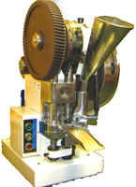
Pressing. (actually tableting). It is the process of forming tablets from granular or powdered material under pressure. In modern pharmaceutical production, tabletting is carried out on special presses - rotary tableting machines (RTM).

Slide 13
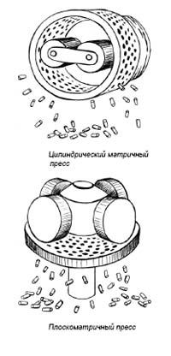
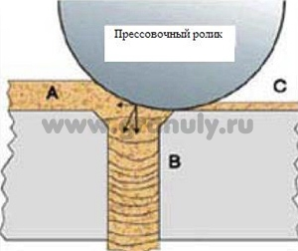

Slide 14
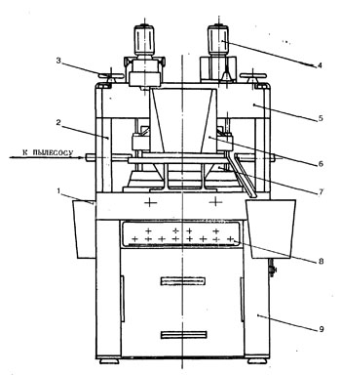
The technological cycle of tableting at RTM consists of a number of sequential operations: dosing of material, pressing (forming a tablet), pushing it out and dropping it. All of the above operations are carried out automatically one after another using appropriate actuators.

Slide 15
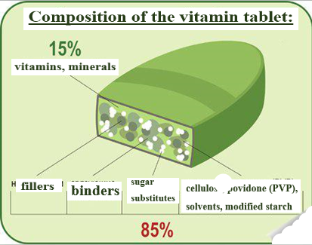
Fillers are substances used to give the tablet a certain weight in cases where the medicinal substance is included in its composition in a small dosage (0.01 - 0.001 g), usually a potent substance. Sucrose, lactose, glucose, sodium chloride, starch, sodium bicarbonate, etc. are used as fillers..

Slide 16
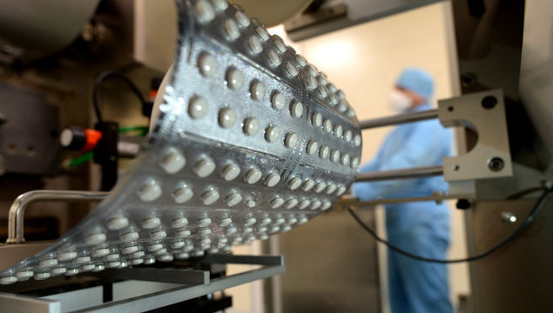
All excipients used in the production of tablets, depending on their purpose, are divided into the following groups: disintegrants, binders, glidants, dyes.

Slide 17
Disintegrants are added to the composition of tablet masses in order to ensure their rapid mechanical destruction in a liquid medium (water or gastric juice), which is necessary for the release and subsequent absorption of the medicinal substance.

Slide 18
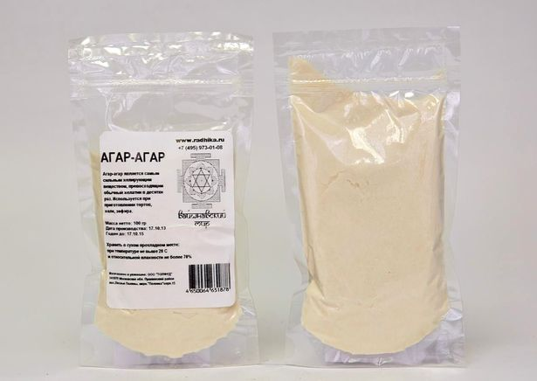
Substances that have the ability to swell in a liquid medium include alginic acid (PS from brown seaweed) and its sodium salt, amylopectin, MC, sodium salt of carboxymethylcellulose, agar-agar (PS from scarlet seaweed), tragacanth, PVP.

Slide 19
Substances that improve wettability include nonionic surfactants - Tweens. Tweens promote the formation of hydrophilic pores in the tablet, through which water or digestive juices penetrate into the tablet. Tween-80 has a pronounced hydrophilicity and added in a small amount (0.2% of the total weight of the tablet) leads to a decrease in disintegration time and acceleration of the absorption of certain medicinal substances.

Slide 20
This same group of disintegrating substances includes starch, the effect of which is caused not so much by the swelling of the grains, but by an increase in the porosity of the tablets and the creation of conditions for the penetration of liquid into them.

Slide 21
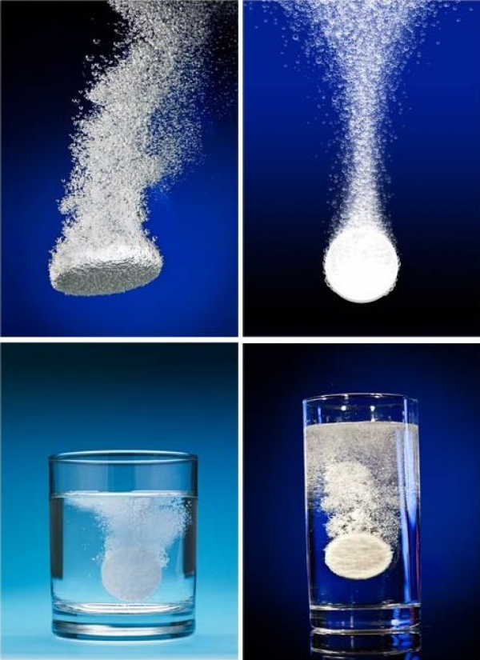
Gas-forming substances: a mixture of citric or tartaric acid with sodium bicarbonate; citric acid with calcium carbonate are used to obtain “effervescent” tablets.
When water or digestive juices penetrate into the mass of a tablet containing a mixture of these substances, a reaction between the components of the mixture occurs, accompanied by the release of CO2. As a result, the tablets undergo mechanical destruction.

Slide 22
Pure solvents (water, ethanol) are used as binders, since they partially dissolve the tablet material; natural gums (acacia, tragacanth), gelatin, sugar (in the form of syrups, concentration 50 - 67%), starch paste, cellulose derivatives, alginic acid and alginates.

Slide 23
Substances that promote gliding. By their nature, sliding substances can be divided into two groups: a) fats and fat-like substances; b) powdery substances.
a) paraffin, hydrogenated vegetable fats and cocoa butter added in amounts up to 2%, calcium and magnesium stearates, pure stearic acid (≤ 1%). b) talc, starch and Tween-80. Talc is added to the granulate no more than 3%, because it is irritating to mucous membranes.

Slide 24
According to their functions, sliding substances are divided into 3 groups: providing sliding, lubricating and preventing sticking. They ensure uniform flow of tablet masses from the hopper into the matrix, which guarantees the accuracy and consistency of the dosage of the medicinal substance. Lubricants facilitate easier ejection of tablets from the matrix, preventing the formation of scratches on their edges. Anti-stick substances prevent the mass from sticking to the walls of punches and dies, as well as the particles sticking together.

Slide 25
Coating of tablets.
The application of coatings serves the following purposes: to give the tablets a beautiful appearance, to increase their mechanical strength, to hide the unpleasant taste and smell, to protect from environmental influences (light, moisture, oxygen), to localize or prolong the action of the drug substance, to protect the mucous membranes of the esophagus and stomach. from the destructive effect of the drug.

Slide 26
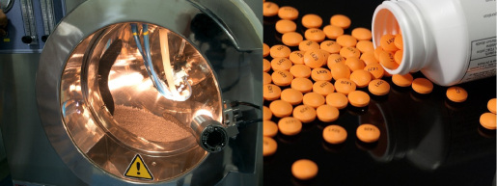
Coatings applied to tablets can be divided into 3 groups:
coated,
film
pressed.

Slide 27
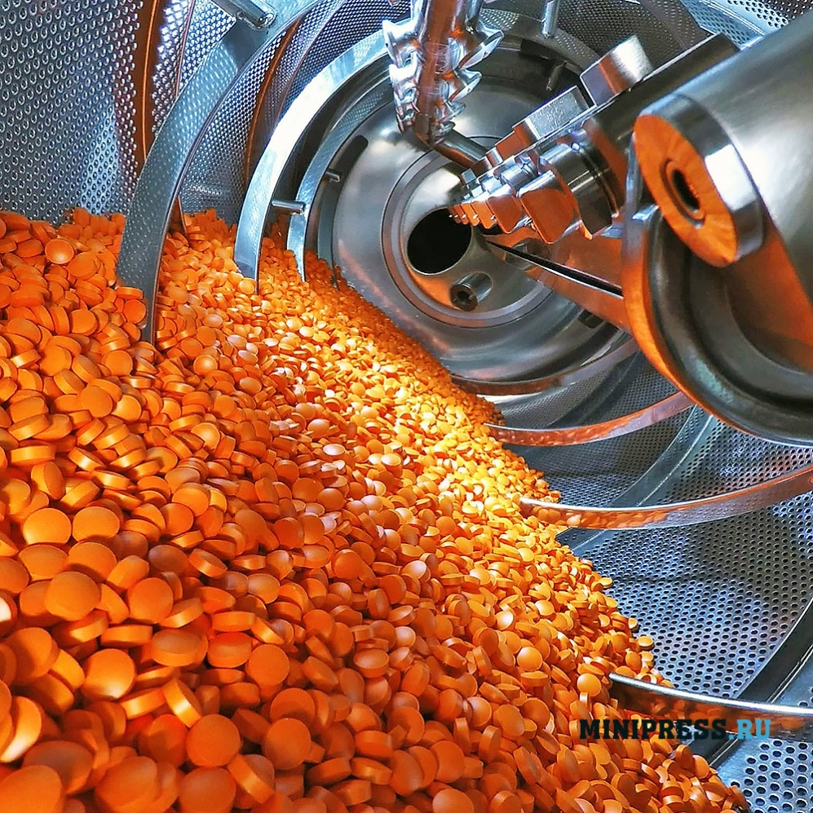
Film coatings.
They are created on tablets by applying a solution of a film-forming substance and then removing the solvent. In this case, a thin (0.05 – 0.2 mm) shell is formed on the surface of the tablets.

Slide 28
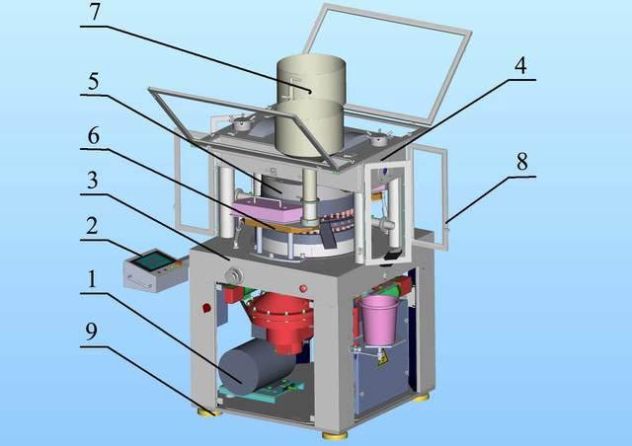
Pressed coatings.
Pressed coatings are dry coatings applied to tablets by pressing on special machines (RTM-41D), which are a combination of two machines: a rotary machine - the usual type for pressing tablets and a special one - for obtaining a pressed coating on them

Slide 29
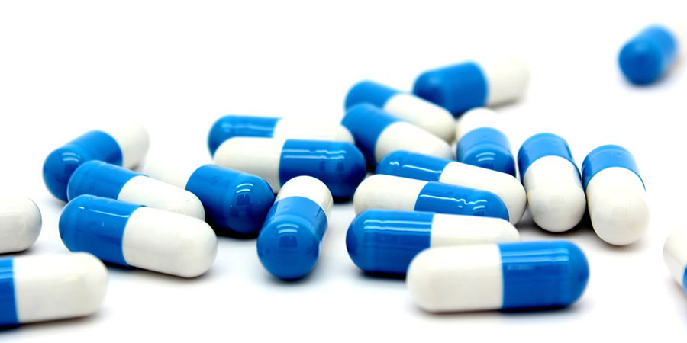
CAPSULES

Slide 30
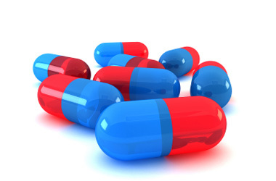
Capsules (capsulae) are a dosage form consisting of a drug enclosed in a shell. As a rule, medications that have an unpleasant taste, odor, or irritating properties to the mucous membrane are released in capsules.

Slide 31
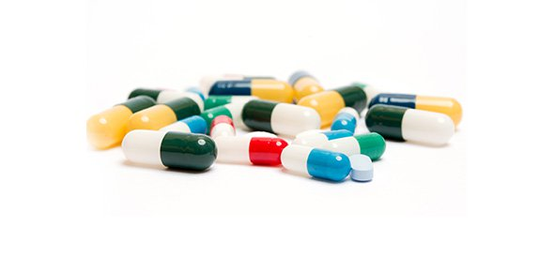
This dosage form has become widespread because the medicinal substances inside the capsules are protected from external influences, are well dosed, easy to swallow, and quickly absorbed from the gastrointestinal tract. In addition, it is very important that the production of capsules in pharmaceutical plants is almost completely automated.

Slide 32
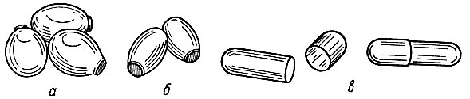
There are two types of capsules: hard with caps and solid soft ones. Soft capsules of ovoid, spherical, cylindrical and other shapes. Their capacity is up to 1.5 ml, rarely more. Liquid and paste-like substances are dosed into them.

Slide 33
Hard capsules are cylindrical in shape and consist of two parts - a body and a cap, which fit into one another. Such hard capsules, depending on capacity, are produced in five sizes: maximum capacity - 1.37 ml; minimum - 0.13 ml. Designed for dosing powdery and granular substances.

Slide 34
