Slide 1
Powders
(PHYSICAL-MECHANICAL AND TECHNOLOGICAL PROPERTIES)
Odesa National Medical University
Faculty of Pharmacy
Department of Pharmaceutical Chemistry and Drug Technology
Docent Zamkova AV.
Odessa 2024

Slide 2
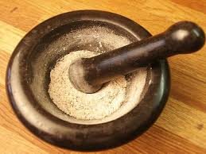
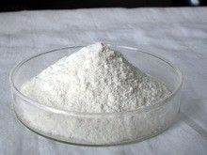
Powder - a solid dosage form for internal and external use, consisting of one or more crushed substances having the property of flowability

Slide 3
"+"
- high pharmacological activity due to high dispersion;
- simplicity of technology in comparison with other solid dosage forms;
- convenience of reception in comparison with tablets for elderly people and children;
- the possibility of manufacturing any composition in the absence of a finished dosage form;
- universality of structure (combinations of substances of various nature and a consistence are possible);
- compactness and stability at storage in comparison with solutions;
- etc.
"-"
irritating effect on the mucous membrane and the gastrointestinal tract;
difficulties with masking the taste and smell;
instability - change in the properties of fine drugs under the influence of light, moisture, oxygen, air, loss of water of crystallization, wetting, sorption of CO2, vapors of odorous substances);
- slow action in comparison with liquid medicinal substances.

Slide 4
Classification
Depending on the composition, powders are divided into simple (Pulveres simplices), which consist of one ingredient and complex (Pulveres compositi), which consist of several ingredients.
Depending on the nature of the dosage, the powders are divided into divided doses (Pulveres divisi) and undivided (Pulveres indivisi).
Depending on the method of application, the powders are for internal and external use.

Slide 5
Powder according to HFC is classified by sieving through a sieve of a certain number:
coarse (not less than 95% of the powder must pass through a sieve number 1400 and not more than 40% of the mass of the powder - through a sieve № 355);
medium-fine (not less than 95% of the powder must pass through a sieve № 355 and not more than 40% of the mass of the powder - through a sieve number 180);
small (not less than 95% of the powder must pass through the sieve number 180 and not more than 40% of the mass of the powder - through the sieve number 125);
very small (not less than 95% of the powder must pass through the sieve number 125 and not more than 40% of the mass of the powder - through the sieve number 90)

Slide 6
The production process of this dosage form consists of the following stages and operations:
production preparation
grinding of raw materials
screening of raw materials
mixing of components
sieving the mixture
quality control
packing, packing, marking

Slide 7
Grinding of raw materials
At the stage of grinding it is important to choose the right grinding machines: take into account the physical and chemical properties of the material, the size of the source material and the final product, the total amount of material to be ground.

Slide 8
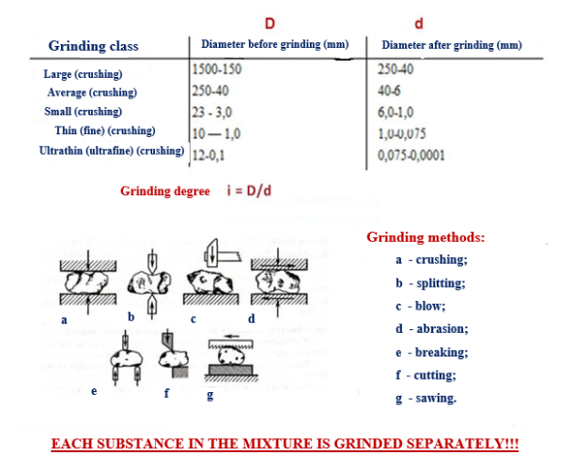
Grinding of each substance in the powder is done SEPARATELY

Slide 9
Grinding machines can be classified on various grounds:
-for the purpose: preliminary and final grinding;
by a way of crushing of material: cut (grass cutters, root cutters), crushes and erases (rolls, runners, a millstone, Excelsior), shock-centrifugal grinders (hammer, cross-cutting, disintegrator, dismembler), shock-erasable (ball and machine) ultrafine grinding (vibro, colloidal and jet mills);
-by the degree of grinding of the material (crushers of large, medium and small crushing, mills of fine and colloidal grinding);
-by the nature of the working tool (machines disk, ball, knife, rotary, etc.).

Slide 10
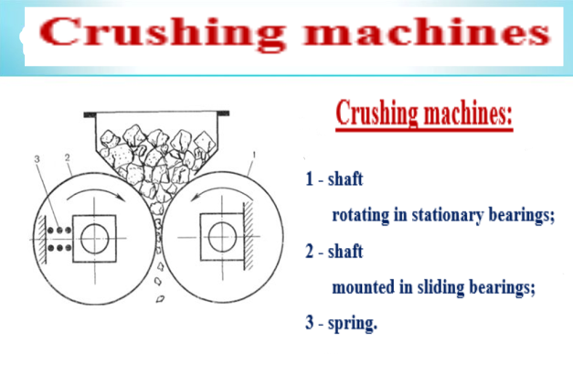
Crushing machines

Slide 11
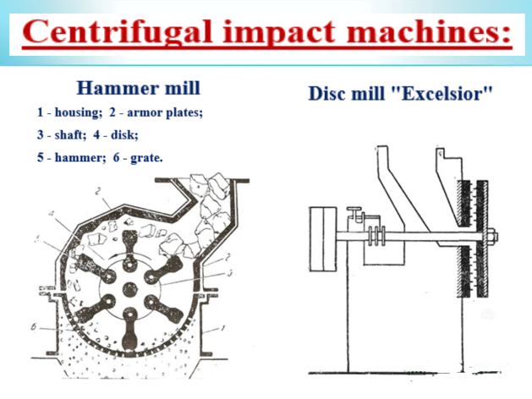
Machines of udoarno-centrifugal action

Slide 12
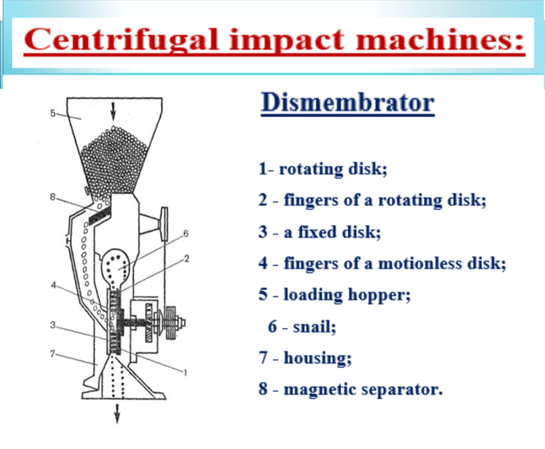
Impact centrifugal machines

Slide 13
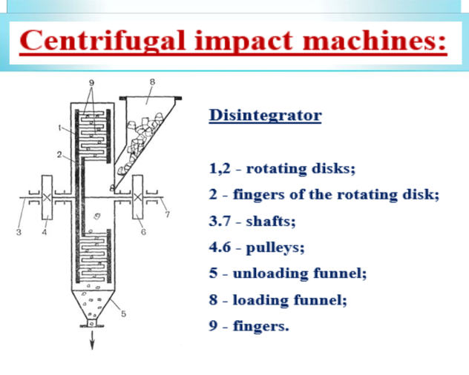
Impact centrifugal machines

Slide 14
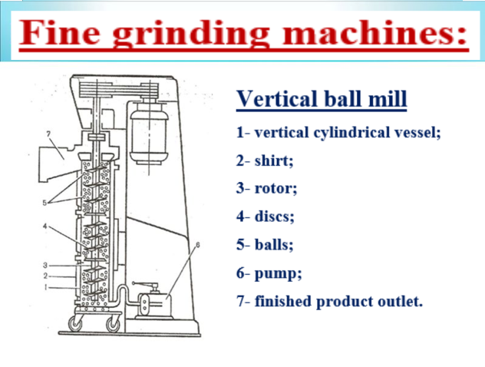
Thin change machines

Slide 15
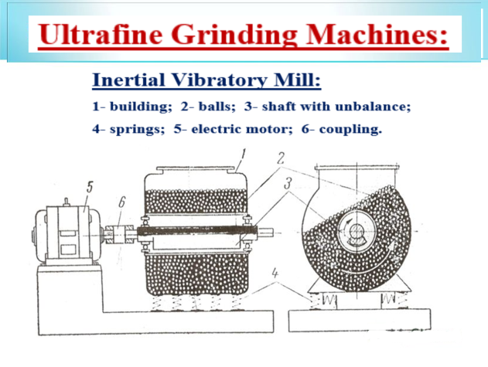
Ultrafine Grinding Machines

Slide 16
Podil particles of powder by size
Falsely as a medical sign and the method of preparation to powders, it is possible to show a greater degree of dispersion.
When the folding powders are removed in the industrial minds, the skin can be used to enter the warehouse of the sum, to adjust the appearance and to pass through the screen.
When the sums are thrown through the openings of the sieves, the particles of larger and larger quantities pass through the sieves before passing. Because of this, there are more light and large parts. As a result, grow into balls of growth. This material is written and asked for it is necessary to know more about it.
The industrial minds have a vicarious effect on the mechanical designs of sieves: wrapped, prickly, vibrated.
For the design of the vibrating device, there are 3 types of vibrating screens in the fallowness of the following: electromagnet, hydration, energy.

Slide 17
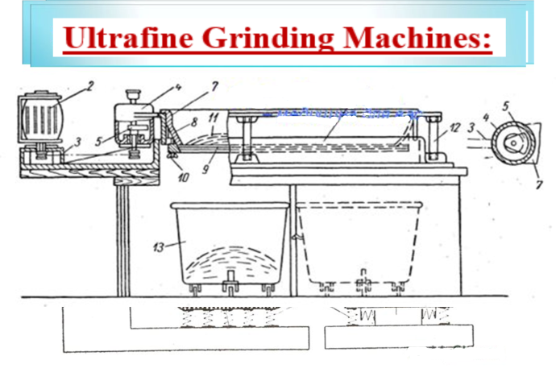
Vibrating sieve

Slide 18
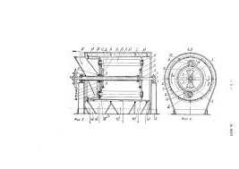
Rotating sieve

Slide 19
Mixing of separate components
Mixing of powders is made in mixers.
Mixers are classified:
- by the nature of the mixing process (convective or diffusion),
- design feature (drum mixers with rotating body and rotating blades),
- method of influencing the mixture (gravitational, centrifugal),
- the nature of the mixing process (periodic or continuous) and other features.

Slide 20
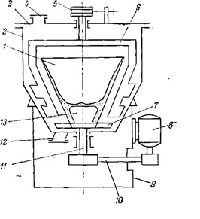
Centrifugal mixer

Slide 21
Packing
Packing of powders is made by means of special batchers: generally screw and vacuum which work on the volume principle.
Volumetric batchers are simple on the device, simple in operation and at a relative error in 23% provide productivity up to 300 doses per minute.
As the dose decreases and the dosing rate increases, the error increases.

Slide 22
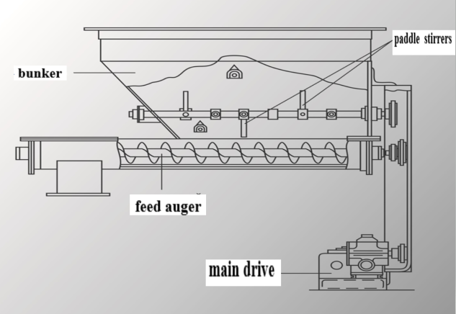
Screw dispenser device

Slide 23
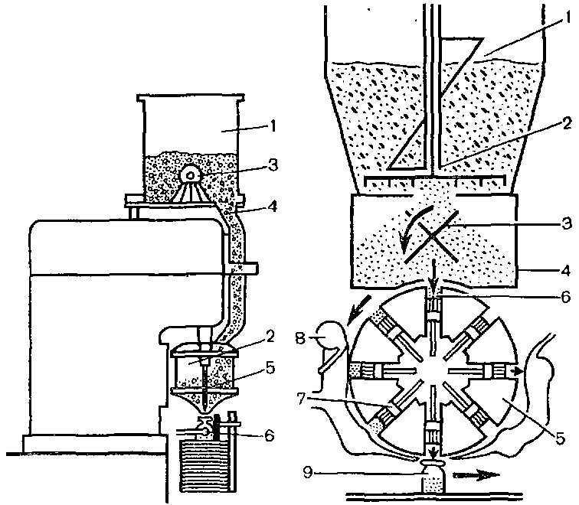
Chamber-vacuum dispenser

