Slide 1
PRODUCTION of plasters and TTS
Odesa National Medical University
Faculty of Pharmacy
Department of Pharmaceutical Chemistry and Drug Technology
Docent Zamkova AV.
Odessa 2024

Slide 2
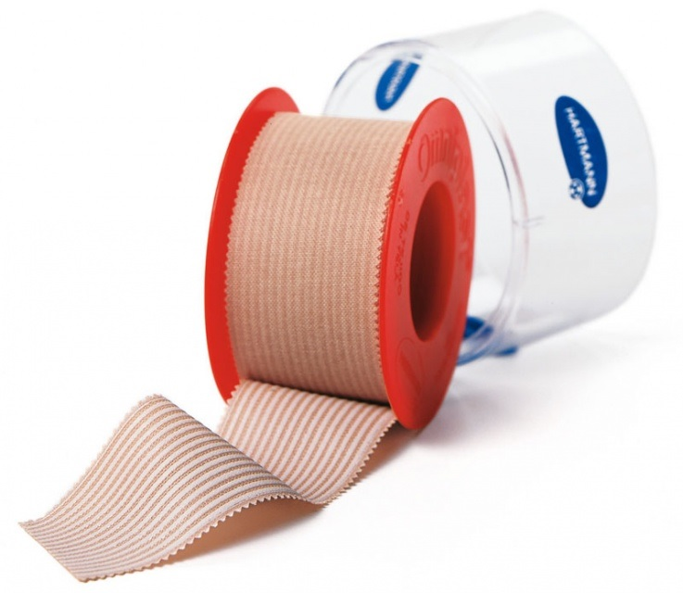
Plaster (Emplastra) - medicinal form for external use, which sticks to the skin, affects the skin, subcutaneous tissues and in some cases has a general effect on the body. This is one of the oldest medicinal forms.

Slide 3
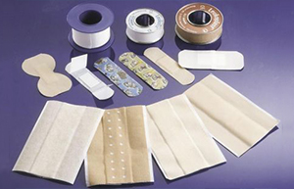
Plasters
Plasters are a medicinal form for external use that has the ability to stick to the skin after softening at body temperature. Patches are easily removed from the skin without leaving a trace. This is one of the ready-made medicinal forms included in all pharmacopoeias of the world. Currently, the nomenclature of plasters and their purpose is extremely diverse.

Slide 4
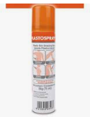
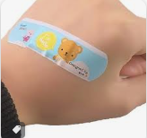
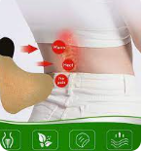
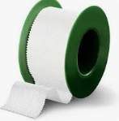
There are several classifications of patches
For dosing:
• dosed;
• undosed.
According to the aggregate state:
• solid (at room temperature they have a dense consistency and soften at body temperature);
• liquid (skin adhesives, leaving an elastic film on the skin).
Preparation:
• plasters in bulk;
• smeared.

Slide 5
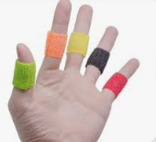
The composition of the plaster mass
The composition of the plaster mass includes medicinal substances and a base. Antibiotics, sulfur, salicylic acid, extracts, tinctures, etc. are used as medicinal substances.
The plaster base may contain natural (rosin) and synthetic resins, wax, paraffin, ceresin, petroleum jelly, lanolin, lead salts of higher fatty acids (lead soap), fats, rubber, nitrocellulose, copolymers of vinylpyrrolidone with vinyl acetate, polymethacrylates and acrylates, volatile solvents ( ether, gasoline, ethanol). They include plasticizers (linetol, vegetable oils, dibutyl phthalate, cetyl alcohol, etc.), antioxidants, fillers, etc.
Depending on the composition of the plaster can be:
- lead (lead-resin and lead-wax);
- resin-wax;
- rubber;
- liquid (skin glues).

Slide 6
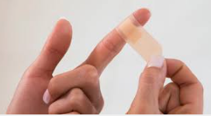
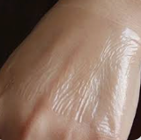
Depending on the medical purpose, plasters are distinguished:
• epidermal: In most cases, they do not contain medicinal substances, they are used as a dressing material, to close the edges of wounds, to hide skin defects, to protect it from harmful external influences;
• endermatic: Contains medicinal substances (keratolytic, depilatory, etc.), used for the treatment of skin diseases at the place of their application;
• diadermal: Contains medicinal substances that penetrate through the skin, affecting deep-lying tissues or general (resorptive) action. A variety of diadermal patches are transdermal patches or transdermal therapeutic systems - TTS (see below).
By composition:
• ordinary (emplastra ordinaria);
lead; lead-resin;
lead-wax;
rubber (collemplastra).

Slide 7
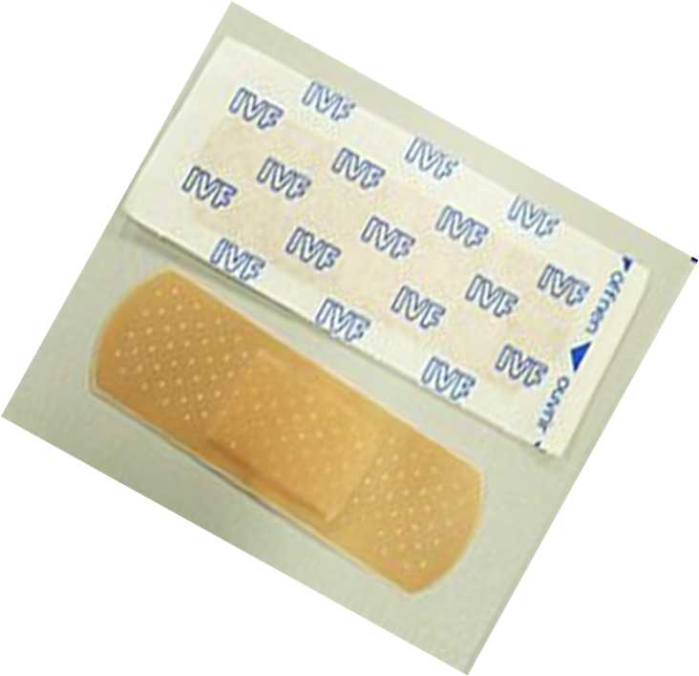
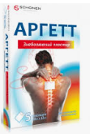
The composition of the plaster mass, depending on the purpose, may include natural or synthetic rubbers approved for medical use, their mixtures, as well as other polymers, fat-like substances, natural oils, fillers, antioxidants and medicinal substances

Slide 8
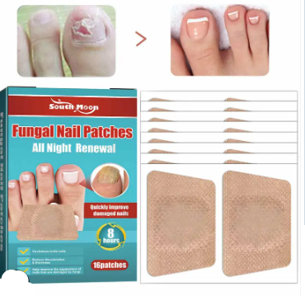
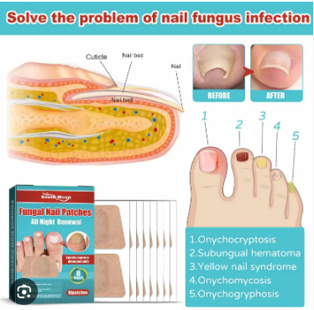
Antifungal patch
The patch is also used to treat fungal nail infections (onychomycosis), thickening of the nail bed (hyperkeratosis), and ingrown toenails or skin (calluses).

Slide 9
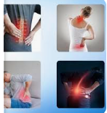
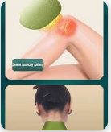
Analgesic patch and anti-inflammatory patch
An example of such means can be plasters based on diclofenac sodium and pepper. T hey are used to treat lesions of soft tissues and joints: b ruises, sprains, inflammation of ligaments and muscles, myositis (muscle pain), neuralgia, sprains and other forms of osteochondrosis.
The patch is glued to the affected area. Before use, the skin should be degreased with hydrogen peroxide (3%). The course of treatment is 5-6 plasters. Such plasters come off in water.
Contraindications: hypersensitivity to the active substance, eczema, open wounds on the skin.

Slide 10
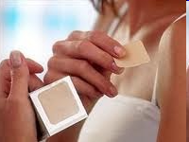
Nicotine patch
A smoking patch is a substitute for cigarettes. Its effect is gradual weaning from nicotine.
In this way, it is possible to avoid stress for the body when quitting smoking. A small dose of nicotine enters the body from the nicotine patch through the skin.
So the smoker does not feel "broken". If a person smoked, for example, 10 cigarettes a day, you should start with 21 mg of nicotine (in a patch) per day for the first month.
Next, reduce the amount of nicotine to 14 mg. The last two weeks of using a smoking patch with a nicotine dose of 7 mg per day are considered the final stage of the therapeutic course.
According to experts, you can get rid of smoking and the negative effects of smoking on the body in about 6 weeks.
Side effects - skin irritation and insomnia.

Slide 11
Contraindication
Contraindication:
increased sensitivity to the drug;
venous and arterial thrombosis, including previously transferred;
severe degree of hypertension;
diabetes mellitus with vascular damage;
migraine;
breast cancer; endometrial cancer; liver adenoma or carcinoma;
age up to 18 years; Menopause fasting;
postpartum period (first 4 weeks);
pregnancy, breastfeeding

Slide 12
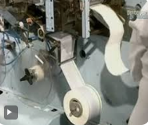
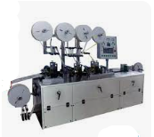
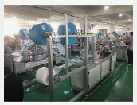
Patch production technology
The composition of the plaster mass determines the
technological scheme of production.
In general, for homogeneous systems, it consists of the
following stages: preparatory, alloying, cleaning, standardization, dosing.
To obtain a heterogeneous plaster mass, the following stages are carried out: preparation of medicinal substances and plaster base, introduction of medicinal substances into the base, homogenization, standardization, dosing by weight or smearing on the substrate.

