Slide 1


Basics of Remuneration in Healthcare
1. Forms and systems of remuneration of medical personnel
2. Motivational mechanisms of medical personnel management

Slide 2

Remuneration is the total compensation received by an employee
● Remuneration is the total amount an employee receives for performing a job
● Remuneration includes not only base salary but all other forms of financial compensation an employee receives
● A company contribution to a retirement plan is deferred compensation, and as such is a component of remuneration
● At the executive level, remuneration may include a combination of salary, stock shares, bonuses, and other financial compensation
● For employees in service jobs, tips are considered part of remuneration

Slide 3
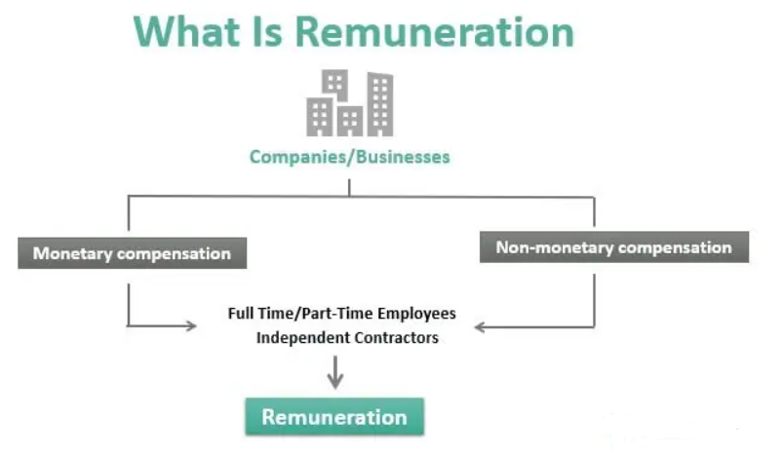
Remuneration refers to the overall monetary and non-monetary compensation that employees or independent contractors receive for providing services to an organization or company.

Slide 4
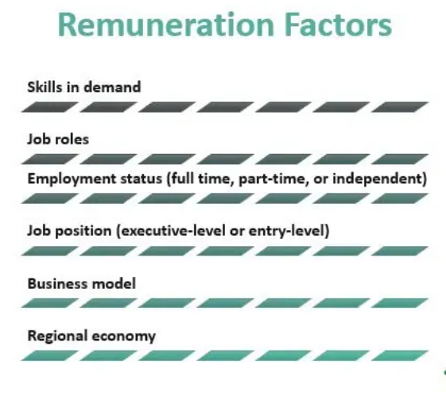
Factors influencing the amount of remuneration

Slide 5

Types of Remuneration
DIRECT i.e., fixed
any sort of compensation that comes as a straightforward financial gain for employees, including salary, allowances for travel and other activities, and bonuses
INDIRECT i.e., variable
a benefit for someone that may be less straightforward. These can include the potential for overtime pay, benefits for retirement, and more flexible schedules for employees

Slide 6
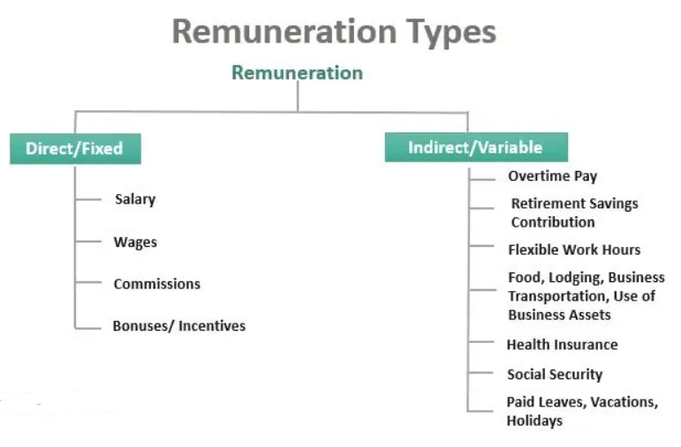
Please enter your title
Click here to add content of the text，Click here to add content of the text，Click here to add text content ，Click here to add content of the text，Click here to add content of the text，Click here to add text content ，
Please enter your title
Click here to add content of the text，Click here to add content of the text，Click here to add text content ，Click here to add content of the text，Click here to add content of the text，Click here to add text content ，

Slide 7
MOTIVATION
motivation
an “individual's degree of willingness to exert and maintain an effort towards organizational goals”
motivation
a process of a deliberate choice of a certain type of behavior by a person under the influence of the external (incentive) and internal (motive) factors
motivation
allows employees to meet their basic needs by means of completing their duties

Slide 8
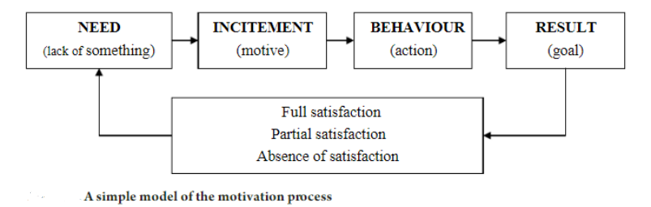
MOTIVATION PROCESS

Slide 9


Stimulation
STIMULATION
STIMULATION
STIMULATION
is the external encouragement to the actions that are rooted in the interest (material; moral, emotional, individual or group)
is the tactics in the motivation mechanism, which meets certain motives of employees (mostly, material) and allows increasing the labor productivity
The motivation process must be supported by the instruments of stimulation (remuneration).

Slide 10
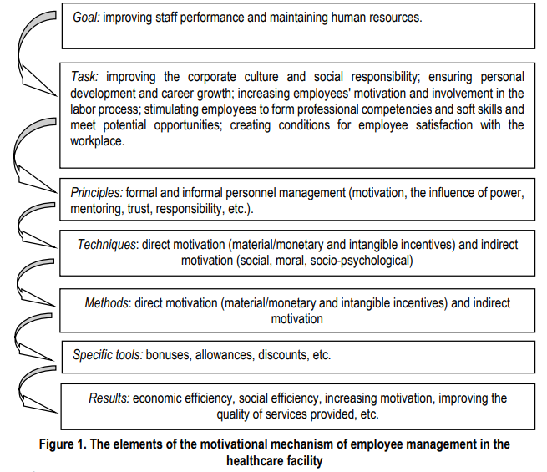
The elements of motivation
04

Slide 11

Seven major themes regarding motivational factors
1. Financial (in terms of salary or allowances)
2. Career development (in regards to the possibility to specialise or be promoted)
3. Continuing education (having the opportunity to take classes and attend seminars)
4. Hospital infrastructure (the physical condition of the health facility, in papers often described as 'work environment')
5. Resource availability (refers to equipment and medical supplies that are necessary for health workers to perform their job)
6. Hospital management (refers to having a positive working relationship with the management with whom the health workers work and with)
7. Personal recognition or appreciation (either from managers, colleagues of the community)

