Slide 1
Basic principles of pricing in healthcare

Slide 2

Definition of pricing
Pricing
A pricing strategy is an approach taken by businesses to decide how much to charge for their goods and services.
The interaction between margin, price, and selling level is given specific consideration while pricing products.

Slide 3
Pricing strategies
Value-based pricing
Price skimming
the practice of setting the price of a product or service at its perceived value to the customer
a pricing strategy in which a firm charges a high initial price and then gradually lowers the price to attract more price-sensitive customers.
Cost-based pricing
Penetration pricing
a pricing method that is based on the cost of production, manufacturing, and distribution of a product.
a marketing strategy used by businesses to attract customers to a new product or service by offering a lower price during its initial offering.
Competitive pricing
Dynamic pricing
a strategy in which competitors’ prices are taken as a basis for determining the prices of products and services.
a pricing strategy that utilizes variable prices instead of fixed ones.

Slide 4
Value Based Pricing
tends to result in very high prices and correspondingly high profits for those companies that can persuade their customers to agree to it.
Principles
Advantages
* It does not take into account the cost of the product or service, nor existing market prices.
* Value based pricing is usually applied to very specialized services.
Increases Profits
Value based pricing results in the highest possible price that you can charge, and so maximizes profits.
Increased Customer Loyalty
Despite the high prices charged, you can achieve extremely high customer loyalty for repeat business and referrals, but only if the service or product provided justifies the high price.
Evaluation of Value Based Pricing
Disadvantages
This method is exceptionally profitable in those niche areas where a company can offer premium services that are highly valued by their customers. Many attorneys and investment bankers have engaged in value based pricing for decades, so it is clearly a viable method. However, it is not applicable in most businesses, where normal competitive pressures make it impossible to use value based pricing.
Only Applies to Niche Markets
The high prices to be expected under this method will only be acceptable to a small number of customers.
Not Scalable
This method tends to work best for smaller organizations that are highly specialized.
Increased Competition
Increased Labor Costs

Slide 5
Cost Based Pricing
setting prices based on the cost of the goods or services being sold. A profit percentage or fixed profit figure is added to the cost of an item, which results in the price at which it will be sold.
Principles
Advantages
* Types: cost-plus pricing, mark-up pricing, break-even cost pricing, target profit pricing
* This method generally uses manufacturing or production costs and distributing and selling costs for setting the price.
* A company always generates profit.
* It is simple to understand and easy to apply.
* It covers all the production and overhead costs.
Cost-Based Pricing vs. Market-Based Pricing
Disadvantages
* It may result in prices to be different from the market rate. Either the price could be much high to discourage buyers or too low to result in a loss.
* It does not encourage business to make efforts to control their cost.
* It may sometime ignore the importance of customers.
* It does not take into account the demand and competition.
A better approach is to adopt market-based pricing, where the firm sets its prices in accordance with the prices being charged by competitors for similar products and services. This form of pricing ensures that a business maximizes its potential profits and also does not price too high, thereby driving away customers

Slide 6
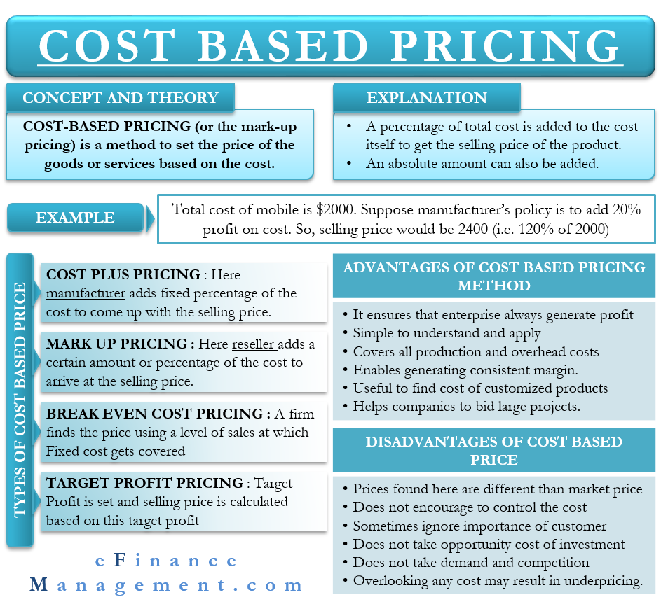

Slide 7
Competition Based Pricing
a strategy in which competitors’ prices are taken as a basis for determining the prices of products and services.
Principles
Advantages
* other name: market based pricing
* Factors such as production costs, product value, and consumer demand are not taken into consideration when setting prices.
* This method is often used in highly competitive markets consisting of businesses that sell similar products.
1. Simplicity
2. Low-risk
3. Moderate Pricing
4. Reduces chances of stakeholder rejection
5. Can be used with other pricing strategies
Evaluation of Competition Based Pricing
Disadvantages
1. Limited flexibility
2. Ignores consumer demand
3. Perception of being ordinary
4. Long-term inefficiency
5. Wrong reference point (It can be the case that the competitor has set ineffective prices, so taking their price as a reference would be the repetition of a mistake)
Using competition-based pricing can be a good idea at the early stages of your business when you haven’t yet attracted enough users to be able to evaluate your pricing model. With the assumption that competitors already have pricing intelligence, using their pricing as a reference can be a low-risk strategy to begin competing in the market.

Slide 8
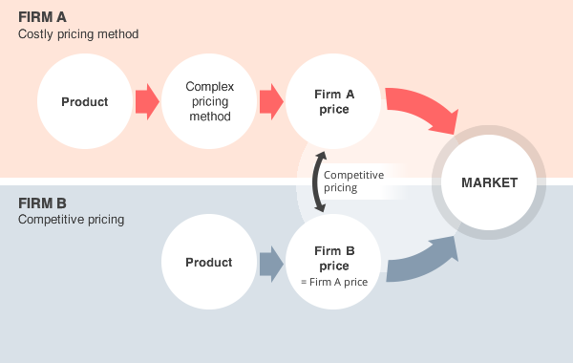

Slide 9
Dynamic Pricing
is a strategy where businesses adjust the prices of their offerings to account for changing demand.
Principles
Advantages
* Dynamic pricing seeks to maximize profit by changing the price at times of peak usage. If the demand for a product or service goes up, so does the price.
* Opposed to static pricing, dynamic pricing helps a business maximize profit by operating at multiple price points.
* Employees get a higher wage during busier times.
* Buisinesses can still sell in downtimes (with dynamic pricing, you can salvage some business in times of low demand. Offering sales and discounts can help you appeal to a broader base of consumers who aren't willing to pay full price.)
Types of Dynamic Pricing
Disadvantages
Time-based Pricing
The time-based pricing occurs when a surge or reduction in demand is linked to a particular time (e.g. Booking airline tickets months in advance, which costs less)
Segmented Pricing
Segmented pricing is a model where you establish two or more prices for the same product.
Peak Pricing
If demand increases during a certain month or season, prices increase.
* Customers might feel cheated and trust you less.
* Overdoing dynamic pricing could make you lose some customers and reduce your returns.

Slide 10
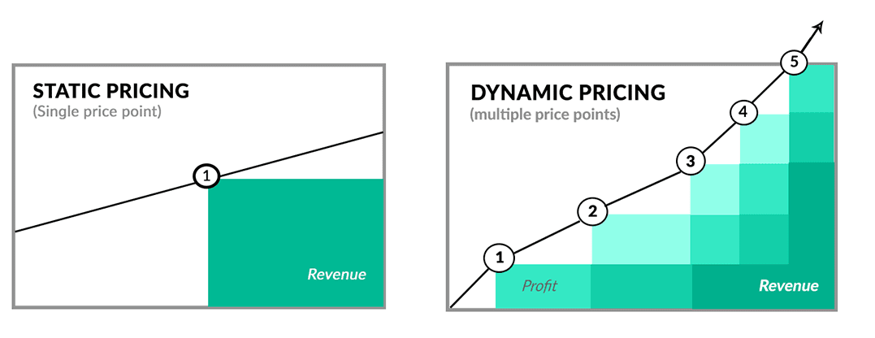
Static pricing vs Dynamic pricing

Slide 11
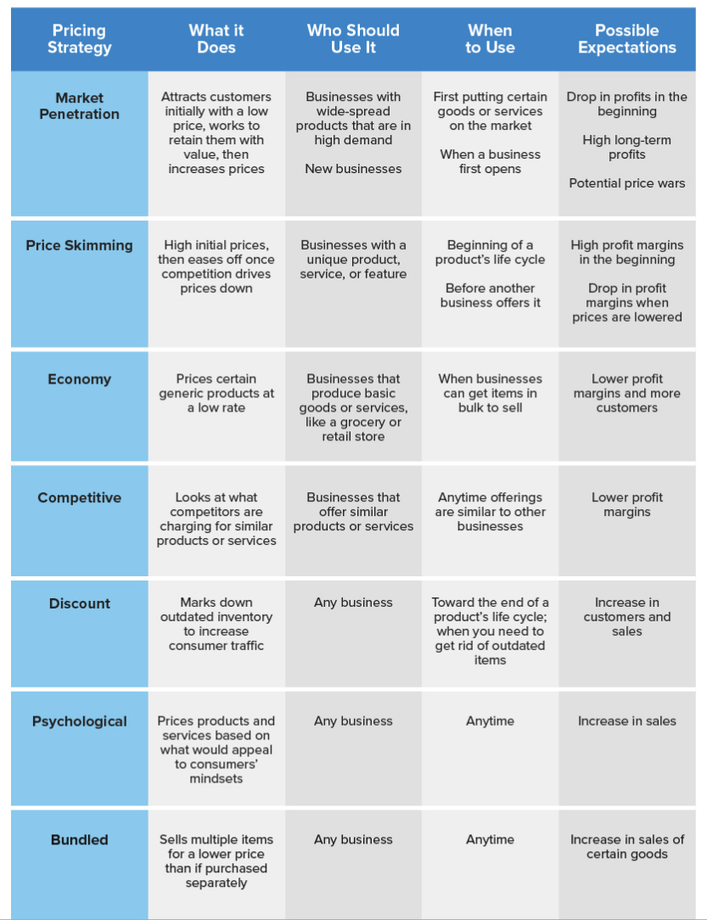
strategic pricing strategic pricing strategic pricing
strategic pricing strategic pricing strategic pricing

Slide 12
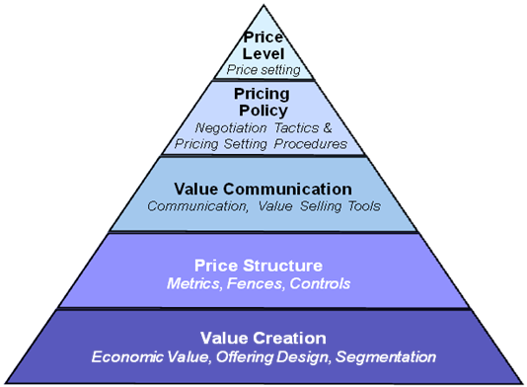
The Pricing Pyramid
A comprehensive pricing strategy is comprised of many layers creating a foundation for price setting that minimises erosion and maximises profits over time. These layers combine to form a strategic pricing pyramid. Value creation forms the foundation of the pyramid.
Tips for Strategic Pricing
- Strategic pricing is a marketing decision, which means it should be informed by dialogue with your customers.
- Keeping a close eye on your competitors is important, but remember they are not the ones purchasing your product, and they may be making mistakes in their own pricing.
- Recognise what your customers value and charge them accordingly rather than going head to head on price with competitors.

Slide 13

Pricing in healthcare: some issues
The price not only ensures that the costs of delivering services are covered. Price adjustments are made to ensure coverage and access, for example, to health care providers in rural and remote areas - WHO
Prices are also adjusted to attain broader health-related goals

Slide 14
WHO:
All payment models have strengths and weaknesses; therefore, the impact of each depends not only on the method chosen but also the price paid.
The price not only ensures that the costs of delivering services are covered, but also provides incentives for health care providers.
Price adjustments are typically made to ensure coverage and access, for example, to health care providers in rural and remote areas; those treating disproportionately high numbers of low-income or high-cost patients to ensure coverage and quality; and for facilities providing medical education.

Slide 15
WHO:
Prices should reflect actual costs and take into consideration broader health system goals and health outcomes.
if prices are set too low
if prices are unaffordable for most people
- this could result in low quality care
- provider selection of healthier patients
- referral of complex cases to another service provider
- providers may try to compensate by increasing volume and (unnecessary) services
- low pricesdo not sufficiently reward health care providers
- informal fees to patients
- high prices in the private sector can undermine UHC objectives by draining resources from the public sector
- services could be underprovided
- it does not contribute to improving population health

Slide 16
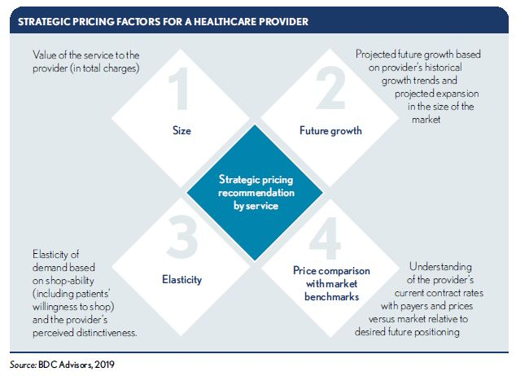
Strategic pricing factors for a healthcare provider

Slide 17

Pricing Strategy: How to find the Ideal Price for a Product

