Slide 1
Basics of healthcare marketing

Slide 2
Marketing
- a management process that involves the assessment of customer wants and needs, and the performance of all activities associated
with the development, pricing, provision, and promotion of product solutions that satisfy those wants and needs.
1. Promotion
2. Selling
3. Product management
4. Pricing
5. Marketing information management
6. Financing
05
7. Distribution

Slide 3
Products: Goods and Services
The term product refers to any offer provided by an entity for purchase
and consumption. A product can be a good (i.e., tangible item), a service
(i.e., an intangible item), or hybrid (i.e., an item with tangible and
intangible characteristics).

Slide 4
Target Marketing
is a marketing strategy that breaks a market into segments and then
concentrates your marketing efforts on one or a few key segments
consisting of the customers whose needs and desires most closely match
the product or service offerings.
01
market segmentation
01
03
targeting
02
product positioning
03

Slide 5

The marketing mix. The Ps
Upon identification of the particular segment or segments to
pursue, marketers formulate the marketing mix for each
customer group that is sought. The marketing mix includes four
interdependent components: product, price, place, and
promotion.

Slide 6
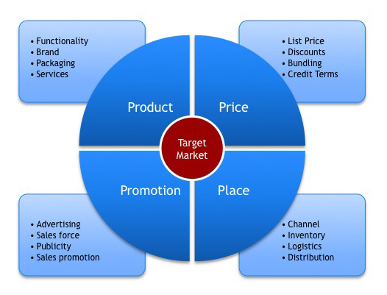
The 4Ps

Slide 7
Inbound marketing vs outbound marketing
Inbound marketing
Outbound marketing
a strategic approach to
creating valuable content
that aligns with the needs
of your target audiences
and inspires long-term
customer relationships
a traditional form of
marketing in which a
company initiates contact with potential customers
(leads)
*what specific needs of a specific potential customers,
*how those needs might be met (Target market),
*how much the customers might be willing to pay
(Pricing analysis),
*who the competitors are (Competition analysis),
*how to design and describe the product or service,
and how the product should be identified (Branding).
advertising and promotions,
sales,
public and media relations,
customer service,
customer satisfaction
Effective inbound marketing often results in much more effective and less difficult outbound marketing

Slide 8
Healthcare marketing
- the process of creating, communicating, and offering healthcare
information. It draws from a variety of fields, including communications,
marketing, healthcare analytics, and patient care. It is a multidisciplinary practice that combines traditional marketing principles and
science-based prevention and health promotion

Slide 9
Objectives:
Patient education
Identifying New Patients
A major objective of many
health-care marketing campaigns is
to educate patients about serious
health conditions
Just as patients must ascertain which health-care facility can best meet their needs, the facilities must determine which patients best fit their mission statement.
Raise Awareness of
Services
Growing the Brand
By raising awareness of a specific
service, such as prenatal care,
occupational rehabilitation or cancer screenings, hospitals help patients
differentiate between facilities and
select those that offer what they need.
When a facility provides the best technology and the best patient experience at the best price for the target market to the customer, patients will recognize the quality in that facility's brand and deliver the most personal form of advertising: word of mouth.

Slide 10

The New Coronavirus
The Six Fundamental Elements
The New Coronavirus
Professional Referral Marketing
1
4
Internal Marketing
Digital Marketing
2
5
External Marketing
Branding
3
6
Public Relations

Slide 11
Healthcare Market Segmentation
Provider Market
hospitals, specialists or other
providers
Payer Market
private and public institutions: health insurance firms,
and State entities
Supplier Market
pharmaceuticals, medical supplies,
devices, etc.

Slide 12
Healthcare Marketing Trends
Reputation management
01
Personalization
02
The Consumerization of Healthcare
03
The growth of telehealth
04
Patient-Evolved SEO
05

Slide 13

The 3 Pillars of Healthcare Marketing Success

