Slide 1


HEALTHCARE MANAGEMENT
for 1st year students
Level of higher education: second (master’s degree)
Field of knowledge: 07 "Management and administration"
Specialty: 073 "Management"

Slide 2

Topic 1. BASICS OF HEALTHCARE MANAGEMENT
1. Basic Principles of Healthcare Management
2. Management in Healthcare Facilities
3. Management of National Healthcare Systems

Slide 3
“Management is quite simply getting things done through people”
Management is a process of planning, decision making, organizing, leading, motivation and controlling the human resources, financial, physical, and information resources of an organization to reach its goals efficiently and effectively.

Slide 4

Health care management
Click here to add content of the text，Click here to add content of the text，Click here to add text content ，C t
encompasses the efforts involved in planning, directing, and coordinating non-clinical activities within health care systems, organizations, and networks.
Please ente

Slide 5
- macro–level:
at the level of public administration (the national level of the legislative and executive branches of government), regional, local, sectoral, departmental levels, that is, at the level of administration of the country's healthcare system;
- micro–level:
at the management level of a separate medical institution (medical institutions, insurance companies, public organizations, health insurance funds).

Slide 6

Key Differences Between Management and Administration
Management is an activity of business at the functional level, whereas Administration is a high-level activity.
Management is a systematic way of managing people and things within the organization. Administration is defined as an act of administering the whole organization by a group of people.
While management focuses on policy implementation, policy formulation is performed by the administration.
Functions of administration include legislation and determination. Conversely, functions of management are executive and governing.
Management focuses on managing people and their work. On the other hand, administration focuses on making the best possible utilization of the organization’s resources.

Slide 7
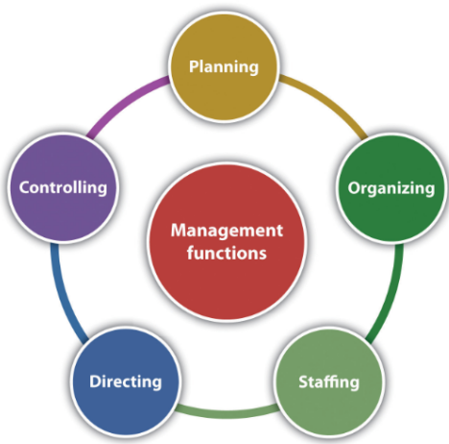
The New Coronavirus
Management Functions
Planning is the process of anticipating future events and conditions and determining courses of action for achieving organizational objectives.
1
Directing is issuing directives, assignments, and instructions; building an effective group of subordinates who are motivated to do what must be done; explaining procedures; issuing orders, etc.
4
Organizing consists of grouping people and assigning activities so that job tasks and the mission can be properly carried out.
2
5
Controlling is the process of evaluating and regulating ongoing activities to ensure that goals are achieved.
3
6
Staffing involves selecting, placing, training, developing, compensating, and evaluating (the performance appraisal) employees

Slide 8
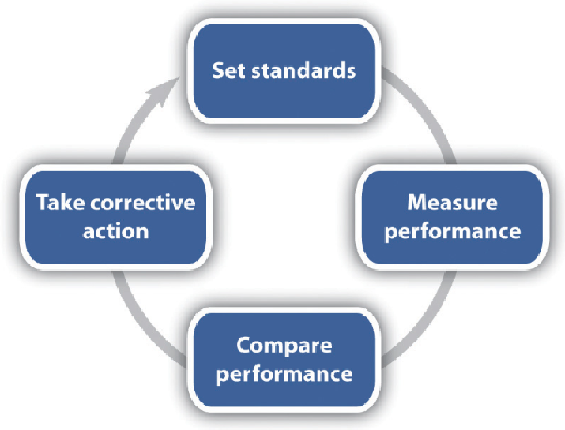
Controlling is the process of evaluating and regulating ongoing activities to ensure that goals are achieved.

Slide 9
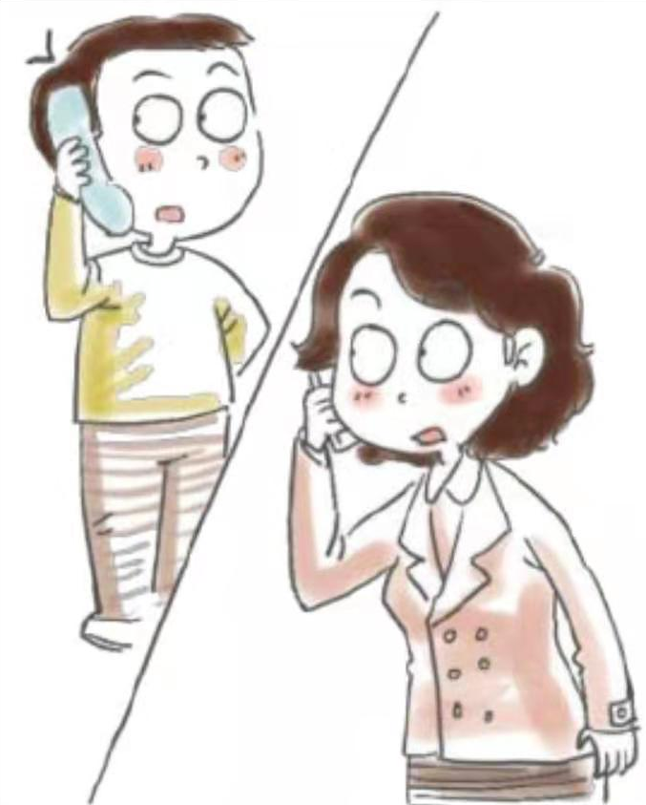
Duties and Responsibilities
The New Coronavirus
Policy and program development
Financial planning
Human resources management
Data documentation
Risk and compliance management

Slide 10






The New Coronavirus
Health care management skills
The New Coronavirus
COMMUNICATION
1
4
STRESS MANAGEMENT
TEAMWORK
2
5
TIME MANAGEMENT
FLEXIBILITY
3
6
DECISION-MAKING

Slide 11
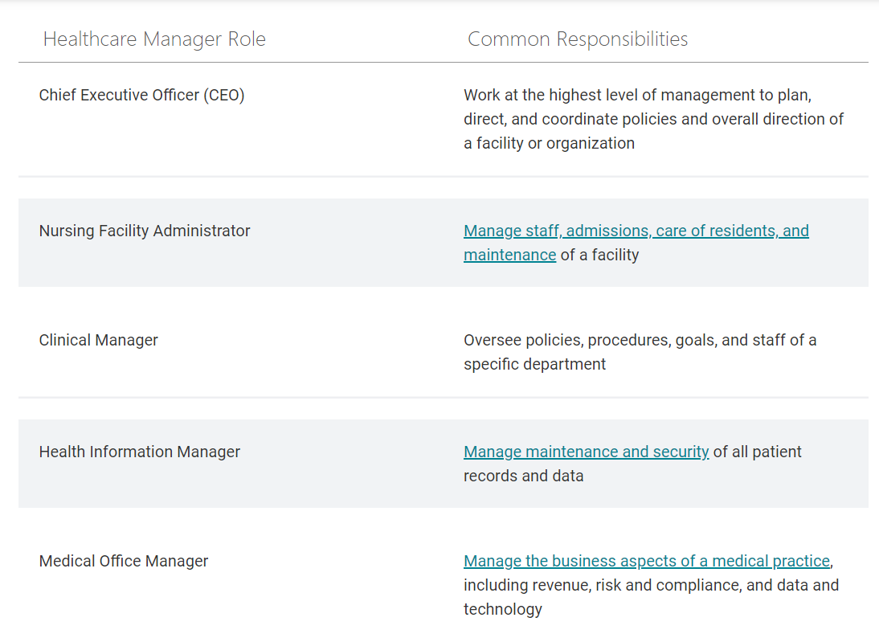
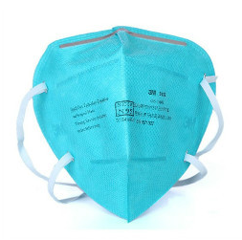
Common Healthcare Manager Roles
The New Coronavirus

Slide 12
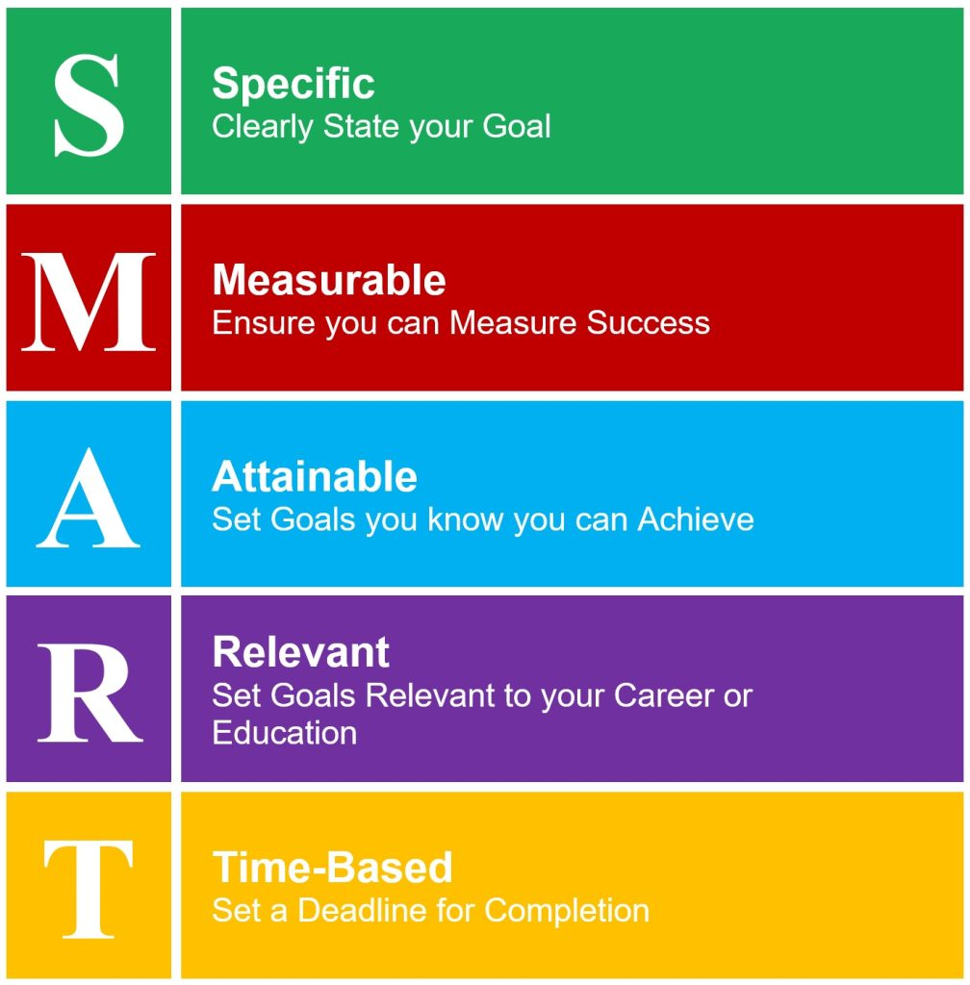
Leadership SMART Goals for New Managers

Slide 13
Facility Management (FM)
“Facility management (FM) is a profession that encompasses multiple disciplines to ensure functionality, comfort, safety and efficiency of the built environment by integrating people, place, process and technology.”
International Facility Management Association

Slide 14

Healthcare facilities management
- the maintenance and administration of a healthcare facility’s development, maintenance, security, and operations. It comprises any structure that delivers healthcare services, such as clinics, long-term institutions, surgical centers, and hospitals, and covers every element of facility upkeep.

Slide 15
The New Coronavirus
Six fundamental duties and responsibilities of healthcare facilities management
The New Coronavirus
Managing Day-To-Day Operations
Construction Project Management
1
4
Ensuring Certification and Compliance
2
5
Ensuring Security
Maintaining a High-Quality Care Environment
3
6
In-House Maintenance

Slide 16

Don’t Be This Kind of Leader or Manager
Some examples of common leadership styles that should be avoided
Post-hoc management
As judge and jury, management is always right and never to blame. This approach ensures security in the leader’s job. This style is a general autocratic leadership style. The first sign of post-hoc management is a vague start to work, typically with unclear and general objectives. If the manager is asked for clarity, they will typically say something like 'you're the expert' or 'this is why we employ you'.
Mushroom management
This manager plants you knee-deep (or worse) in the smelly stuff and keeps you in the dark. Mushroom managers tend to be more concerned about their own careers and images. Anyone who is seen as a threat may be deliberately held back. These managers have their favorites on whom they lavish attention and give the best jobs. Everyone else is swept away and given the unpopular work. Oftentimes, mushroom managers are incompetent and do not know any better.
Micromanagement
Assumes that the subordinate is incapable of doing the job, so close instruction is provided, and everything is checked. Subordinates are often criticized and seldom praised; nothing is ever good enough. It is really the opposite of leadership.
Kipper management
This is the manager who is, like a fish, two-faced because employees can see only one face at a time. To senior managers, this person is typically a model employee who puts business first and himself last. To subordinates, however, the reverse is often the case. The subordinates will work hard to get things done in time, but they are blamed when things go wrong—even if it is not their fault. The kipper will be a friend when things need to get done and then stab the subordinates in the back when glory or reward is to be gained.
Seagull management
This humorous term is used to describe a management style whereby a person flies in, poops on you, and then flies away. When present, such people like to give criticism and direction in equal quantities—with no real understanding of what the job entails. Before anyone can object or ask what the manager really wants, he or she is off to an important meeting. Everyone is actively discouraged from saying anything, and eye contact is avoided.

